Slide 1

The Nuance Neutrino
Monte Carlo:
Present Status and Future Plans
D. Casper
University of California, Irvine

Slide 2


Brief History
Originally developed (ca. 1989) for IMB experiment
Essentially rewritten in 1997-98 for
Super-Kamiokande
  Attempt at more universal interface, extended functionality
  Note: not official Super-K Monte Carlo
First public release (v2) Summer 2002
(hep-ph 0208030)
  Adopted (or plans to adopt) by:
    MiniBooNE
    SNO (atmospheric analysis)
    MINOS (upward-going muons)

Slide 3


Physics Model: Quasi-Elastic
Uses vanilla Smith-Moniz relativistic Fermi gas calculation
  k_{F} = constant
  Fixed potential
Agrees well with e-scattering and K2K FGD data (for leptons)
  Recoil nucleons may have some problems due to hard p > k_{F} cutoff

Slide 4
Physics Model: Resonances
Rein & Seghal (1979) model
  Interference of resonances (and non-resonant background), harmonic oscillator quark model
  Angular distribution of pions (in resonance rest frame) averaged
  Treatment of non-resonant background suspect
  Some evidence of disagreement with K2K near detector data at smallest |Q²| ~ 0

Slide 5
Work in Progress: DIS
Goal: Implement Bodek & Yang ’03 DIS model (using GRV 98 pdf’s)
Standalone B&Y prototype program (including event generation with PYTHIA) now working
  Still needs to be integrated with Nuance
  PYTHIA interface (getting it to generate event with the scaling variables you tell it) has taken 90% of the tiime

Slide 6
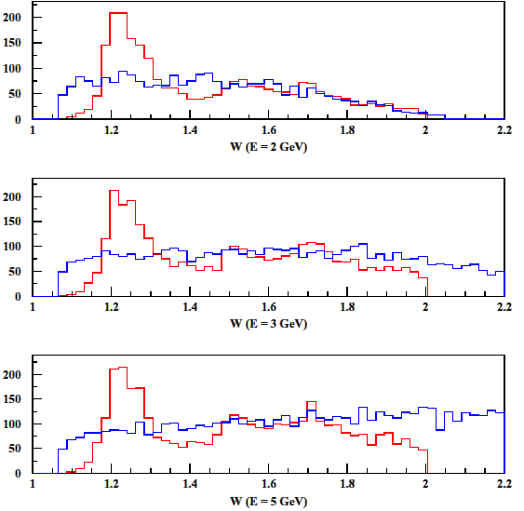
Hadronic Mass Comparison

Slide 7
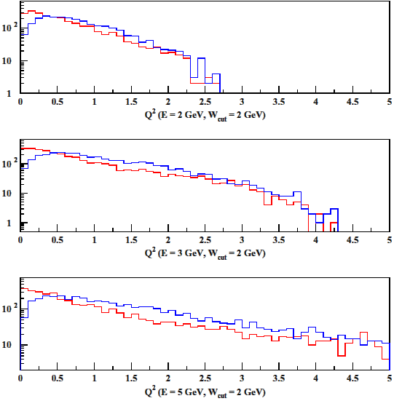
Q² Comparison

Slide 8
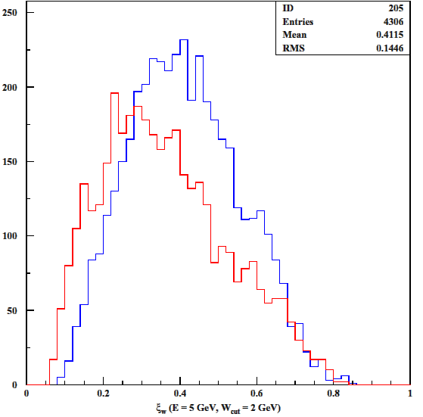
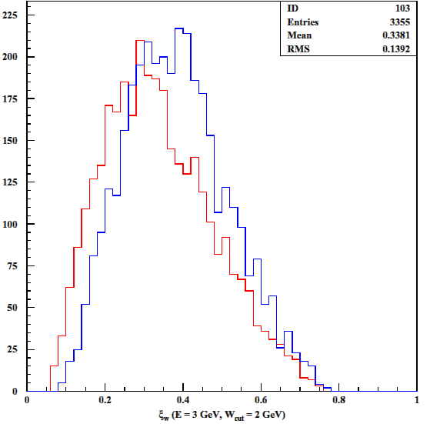
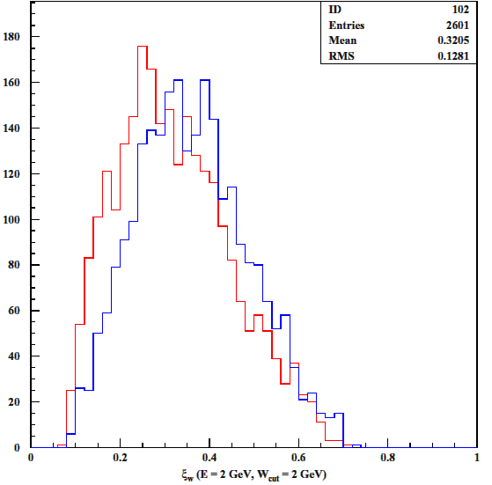
Scaling Variable (ξ_{w})

Slide 9
Work in Progress: Rein ’87 Model
Trying to implement Rein ’87 resonance model in standalone prototype
  Similar to R&S ‘79, main difference is non-resonant background
  Also get pion angular distribution
  See if Q² agrees with Rein 79
So far, unable to get reasonable results
  Still trying to understand calculation – there seem to be contradictory equations
  Wrote to Rein, but response doubtful (retired?)

Slide 10
Other Features and Processes
Many other bells and whistles included
  Coherent and diffractive pion production
    Use Rein-Seghal models
    Little data at low energies, low-A
  Final state interactions in Oxygen nucleus
    Need to add formation zone logic
  Upward-going muons
    A. Habig developing new muon propagation model
  Proton decay, supernovae, 3-neutrino oscillation, etc
    Low priority

Slide 11
Future Plans: Interface
Present interface, while powerful for experts, is poorly documented, clunky and intimidating for new users
  ZEBRA (TZ) based
  Needs a manual desperately
Problem: how to preserve flexibility while making program more accessible?
  KUIP-based (PAW-like) interface?
  Compatibility with GEANT (geometry/materials) would also be desirable

Slide 12
Availability
Posted on the web at:
  http://nuint.ps.uci.edu/nuance
Automated install script
Runs on L/unix or Windows

Slide 13

Next Major Release
A new major release (v3) is planned for the Spring:
  Bodek & Yang 2003 DIS Model, GRV pdf’s
    Improved parton shower/fragmentation; eliiminate LEPTO
    Include EMC effect
  Improved Resonant/DIS connection
    How to accomplish still unclear…
  Rein 87 resonance model
    Pion angular distribution included
    Improved treatment of non-resonant background
    Δ→Nγ channel
  Improved muon propagation for upward mu’s (A. Habig)
  Formation zones (?)
  Clean-up of obsolete code, many minor improvements

Slide 14
Features Still Missing in v3
A user manual
A better interface (KUIP based?)
Cleaner, ZEBRA-free coding
  Would require rewriting in a different language (Fortran 90, C++, ???)
Electron beams
  Getting closer, though
  A high priority for the following release
More general (non-Oxygen) nuclear FSI
  FLUKA would be clear choice, once made public

Slide 15
Comments
From generator point of view, H₂ and D₂ targets are essential
  Modeling of nuclear targets based on free nucleons
From LBL/Proton Decay point of view, O₂ target also seems very worthwhile
  Focus on target materials actually used in real world: O, Ar, Fe, ???
π⁰, K±, proton, and 2-π measurements also vital
  Very limited existing data
  Important backgrounds to current and future experiments

