Slide 1
Overview on Resonant Space Charge Effects in Linacs
I. Hofmann, GSI
Oak Ridge, June 25/26, 2001
Non-equipartitioned Beams
2. Resonance Charts
3. Mismatch
Acknowledgment:
G. Franchetti, GSI, J. Qiang, LANL, R. Ryne, LBL
D. Jeon, ORNL, F. Gerigk, CERN

Slide 2
Types of Resonant Motion
3 kinds:
Emittance growth and halo result
mainly from resonance
other negligible sources (% or less):
intrabeam scattering
conversion of nonlinear field energy
filamentation in nonlinear rf potential
Single particle
resonance with core -> halo
Coherent core resonance with itself -> rms growth
Coherent core resonance with periodic structure
Avoid: σ₀ > 90⁰

Slide 3
Most studies are on isotropic beams
Isotropic cores are stable (non-KV)
Numerous halo studies (2:1 halo extent to 4-5 σ)
Anisotropy brings new features
Core: non-equipartition issue – energy transfer
Halo: halo size and density depend on tune ratios
see: Ikegam in 2D; Fedotov & Gluckstern in 3D,
Qiang, I.H., Ryne (PAC01) – 2:1 halo extent to infinity
We have explored this systematically in 2D to enlarge physics basis for SNS studies

Slide 4
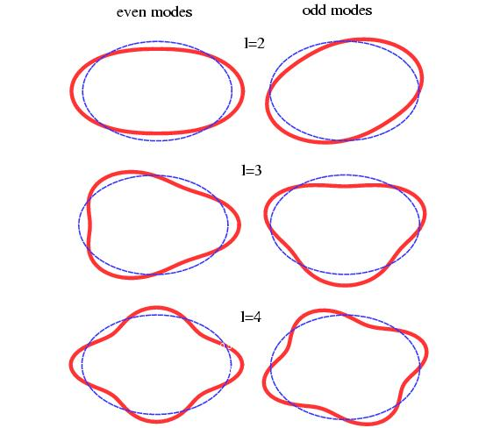
Core eigenmodes are multipole oscillations in density
3D
x
y
z
y infinite
2D
x
z
strong in initial WB
only even modes have r-z symmetry

Slide 5
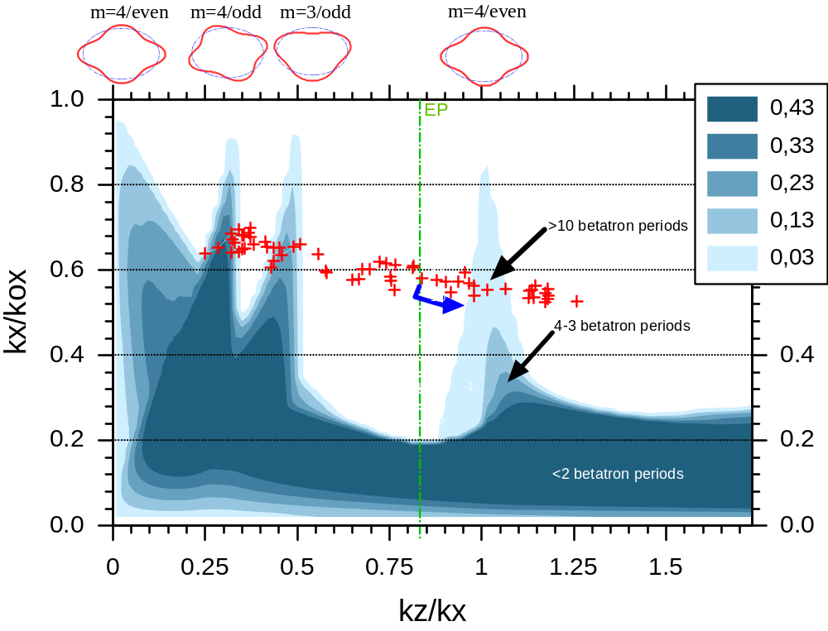
SNS nominal emittance ratio

Slide 6
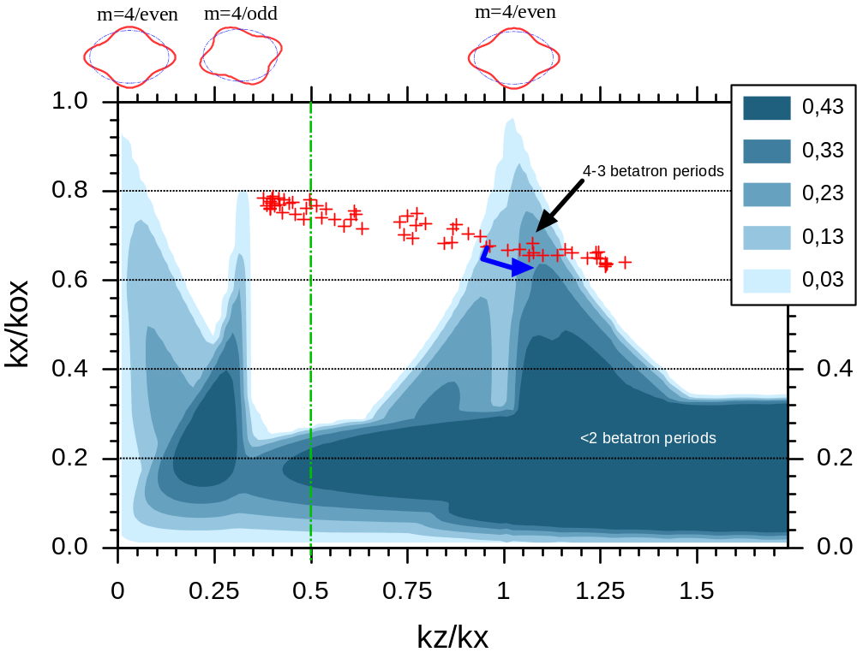
Doubled longitudinal emittance as part of error study

Slide 7
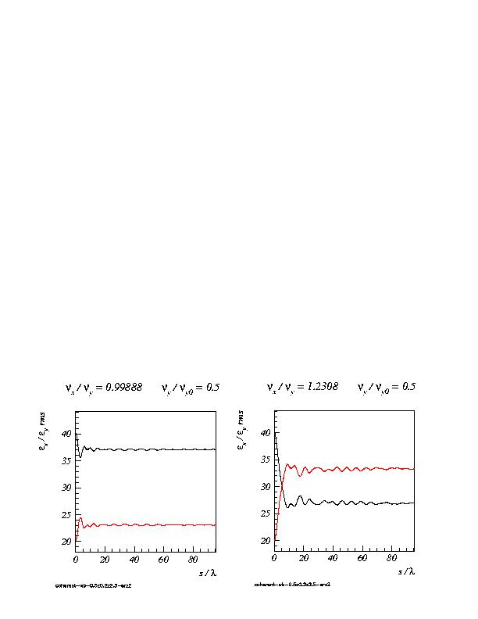
Examples of emittance exchange in 2D
Approach to equipartition depends on where on stopband
in 3D shared by x,y

Slide 8
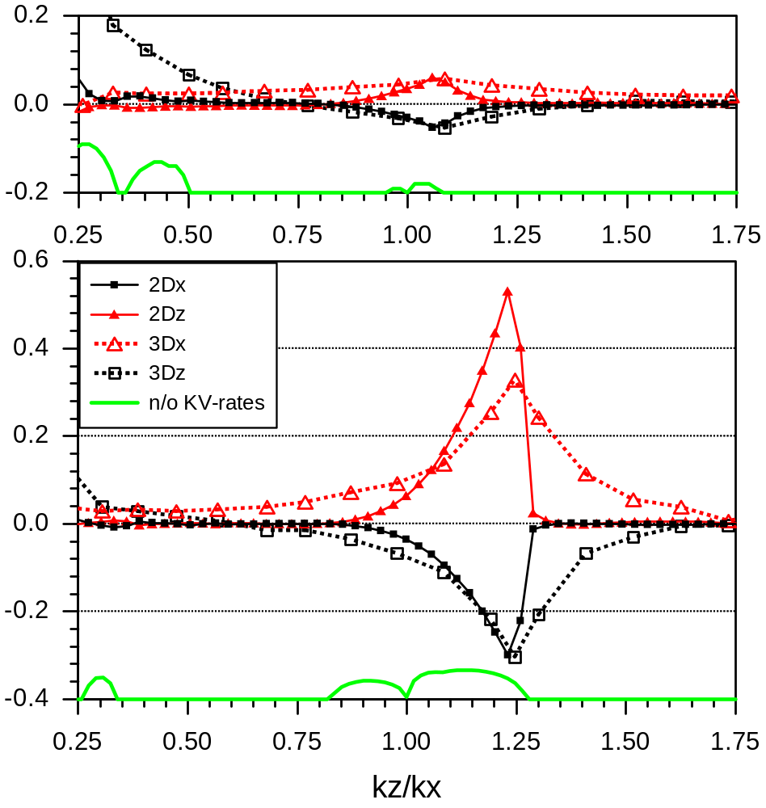
Cuts in 2D/3D and constant focusing
Relative emittance growth

Slide 9
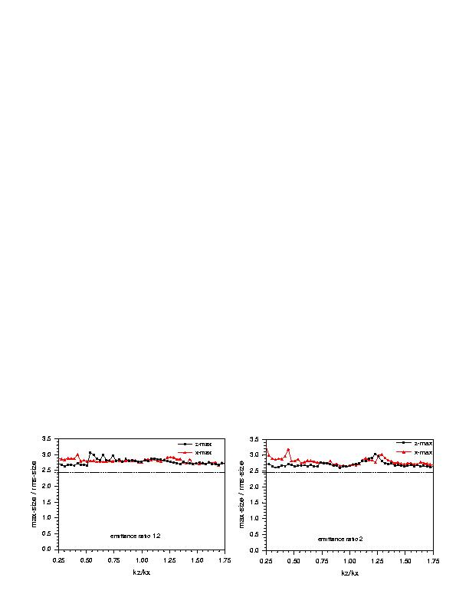
Anisotropy resonance occurs in core – ‘no’ halo
Resulting rms mismatch is negligible,
hence only 20-30% halo found

Slide 10
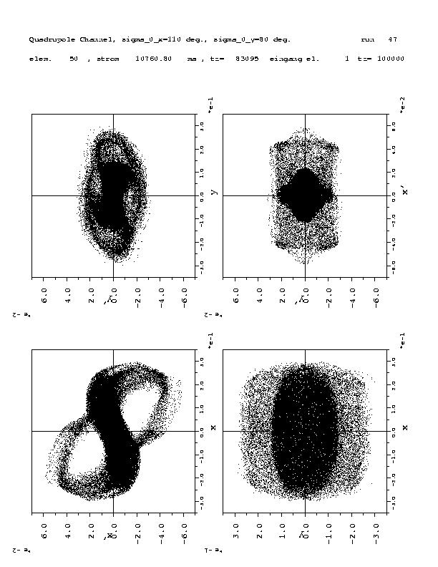
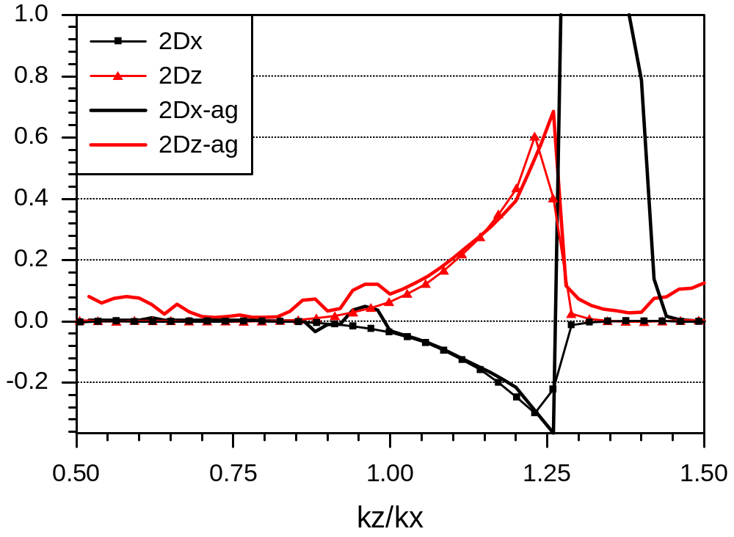
AG –focusing (FODO with σ_{x}=80⁰ kept constant varied zero-current phase advance in z
Envelope instability σ_{z} > 90⁰
y-y‘
x‘-y‘
Relative emittance growth
x-x‘
x-y‘
In x phase space evidence
of structure resonance driven
by periodic focusing

Slide 11
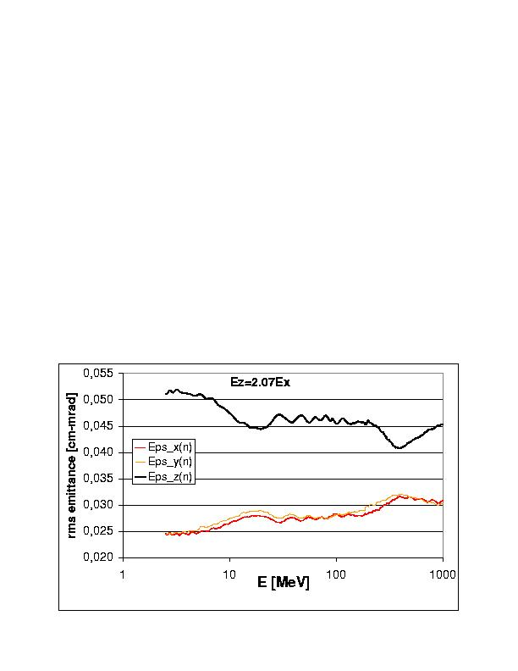
Two crossings found in Parmila simulations for SNS
Two fast crossings may lead to almost maximum exchange (30-40%)
for doubled longitudinal emittance
DTL
SRF

Slide 12
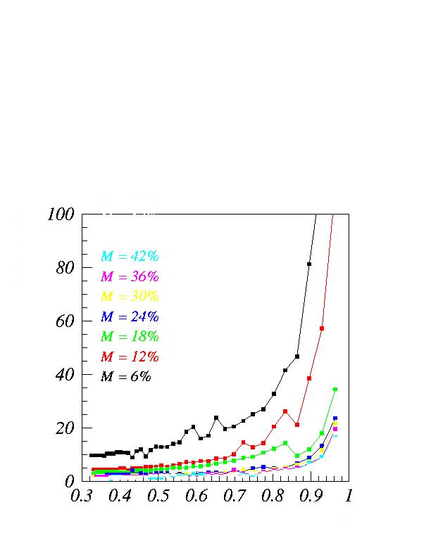
Mismatch: halo build-up time (isotropic beams) for symmetric focusing
betatron periods
k/k₀

Slide 13
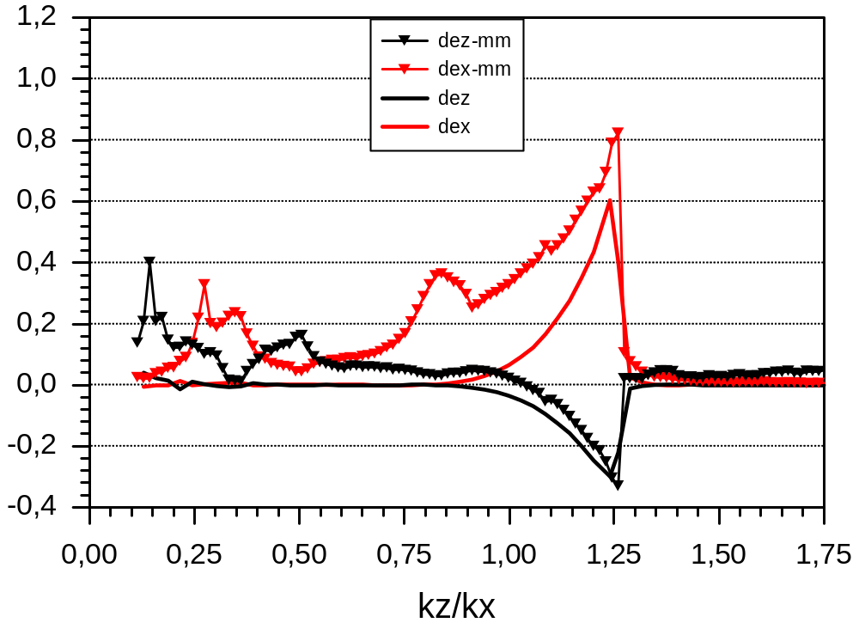
MM effect enhanced by anisotropy example MMz=1.3 / MMx=1.0
doubled initial
longitudinal emittance
in 3D ~ half for x,y
Relative emittance growth

Slide 14
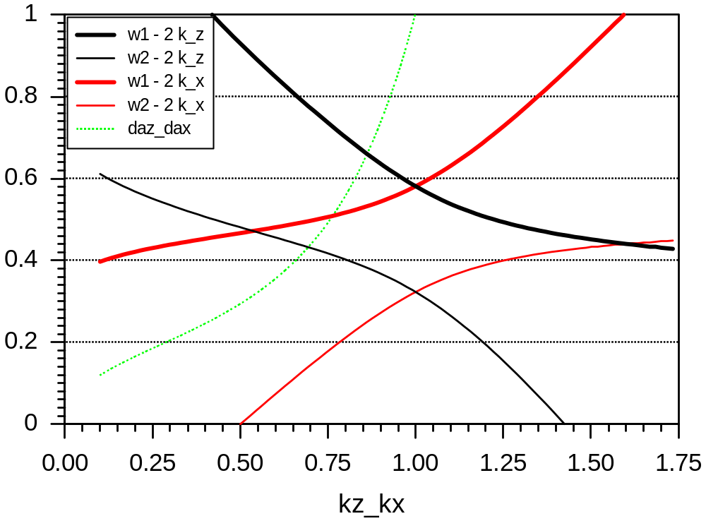
Fixpoints / emittance ratio 1
fix-points at infinity
breathing mode
fix-points
core
quadrupolar mode
fix-points in core

Slide 15
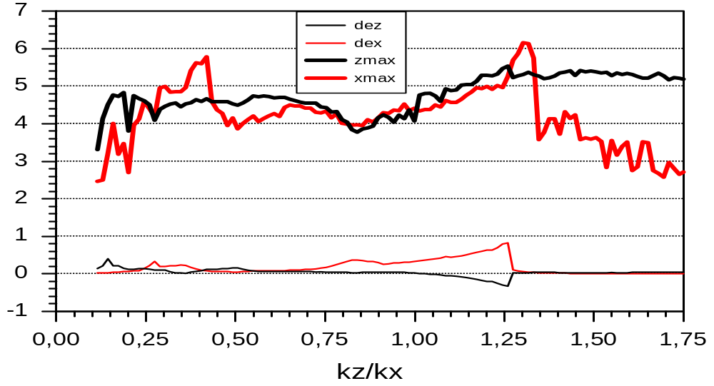
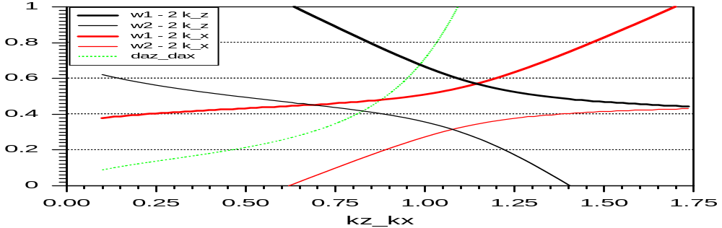
Maximum size

Slide 16
Conclusions
Space charge resonance model now well confirmed by simulation in 2D and 3D – develops unchanged for periodic focusing
Confirmed also in PARMILA simulations for SNS linac: no concern for design emittances (emittance ratio ~ 1) ; 30-40% transverse emittance growth (in x and y) would arise for doubled input longitudinal emittance
Generic 2D mismatch studies have shown that rms and halo growth is a function of the tune ratio due to „floating“ fixpoints for 2:1 resonance; worse for mix of mismatch modes or initial halo (from RFQ)
Next: need to combine initial mismatch with error-driven mismatch and study effect of emittance growth

