Slide 1
Search for SUSY at the Tevatron
Vishnu V. Zutshi
Northern Illinois University
for the
CDF and D∅ Collaborations

Slide 2
Outline
MSSM
Stop search (CDF)
mSUGRA
Single electron channel search (D∅)
RPV
Decays of stop pair (CDF)
di-muon channel, pair & resonant prod. (D∅)
GMSB
Light gravitino search (CDF)
di-photon channel search (D∅)

Slide 3
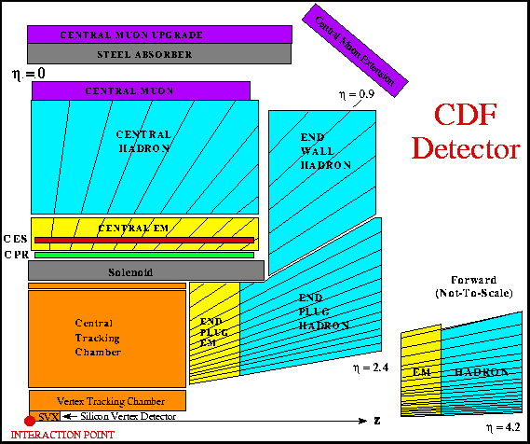
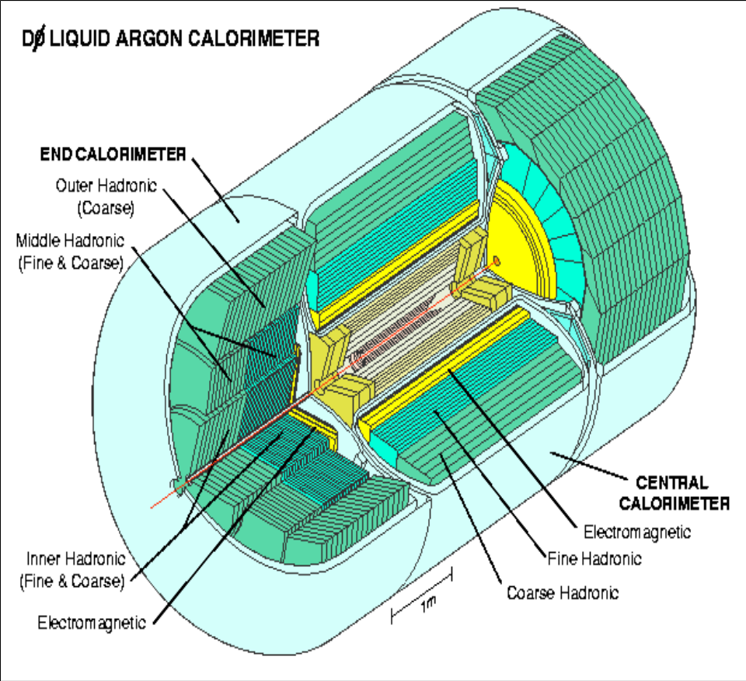
Run1 CDF and D∅ Detectors
DØ

Slide 4
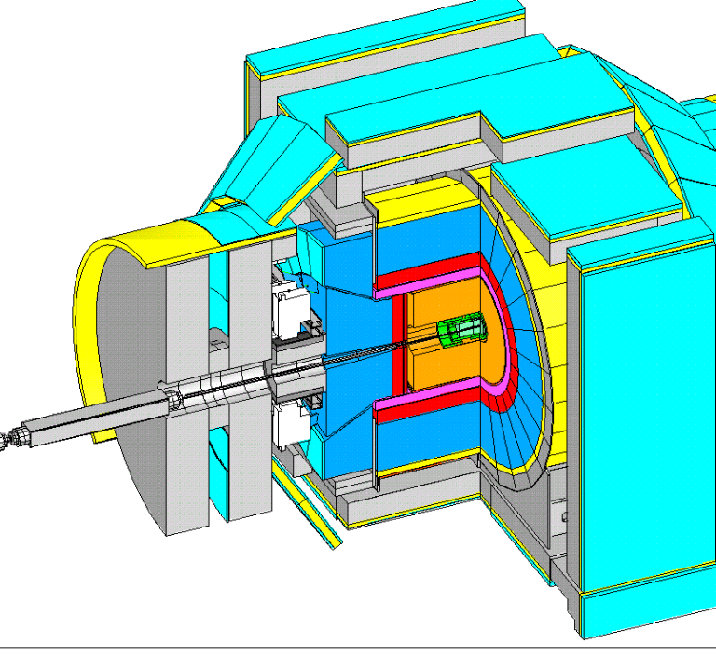
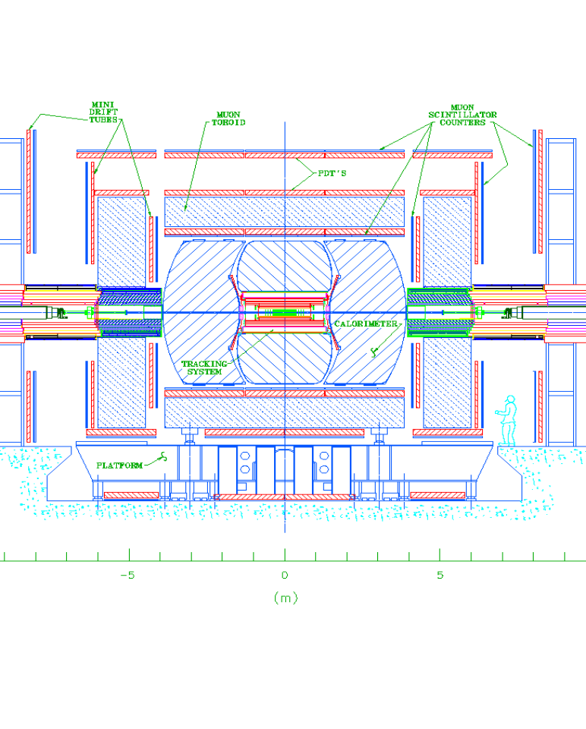
Run 2 CDF and D∅ Detectors
silicon detector, c.o.t., tile plug
and forward calorimeters……
sci-fi central tracker,silicon detector
2T magnet, preshower detectors…..

Slide 5
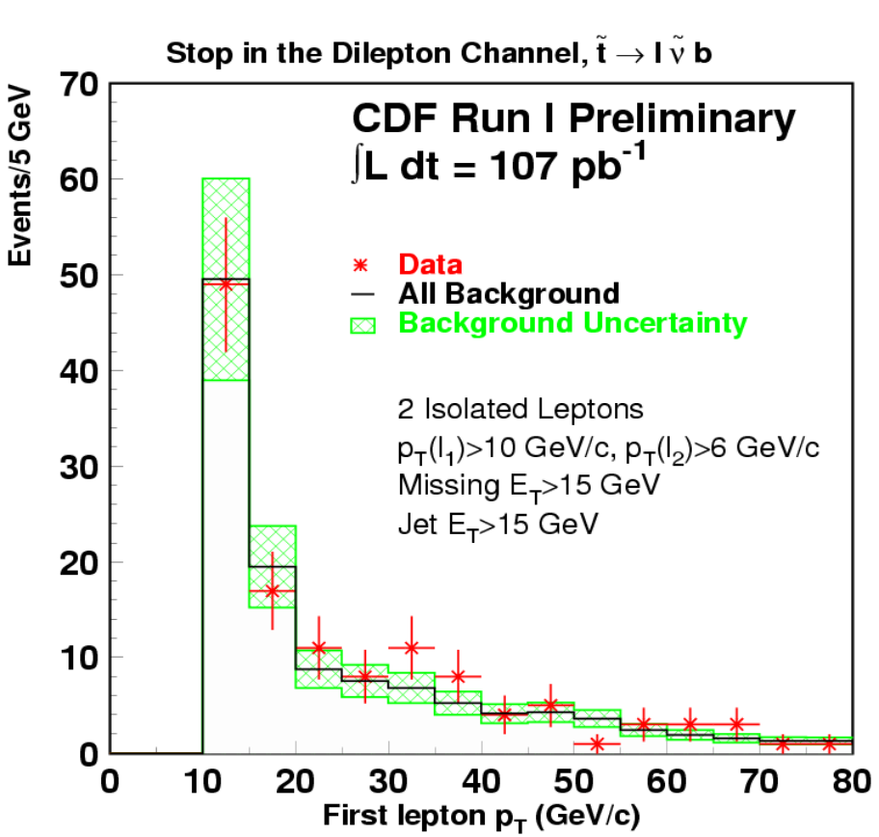
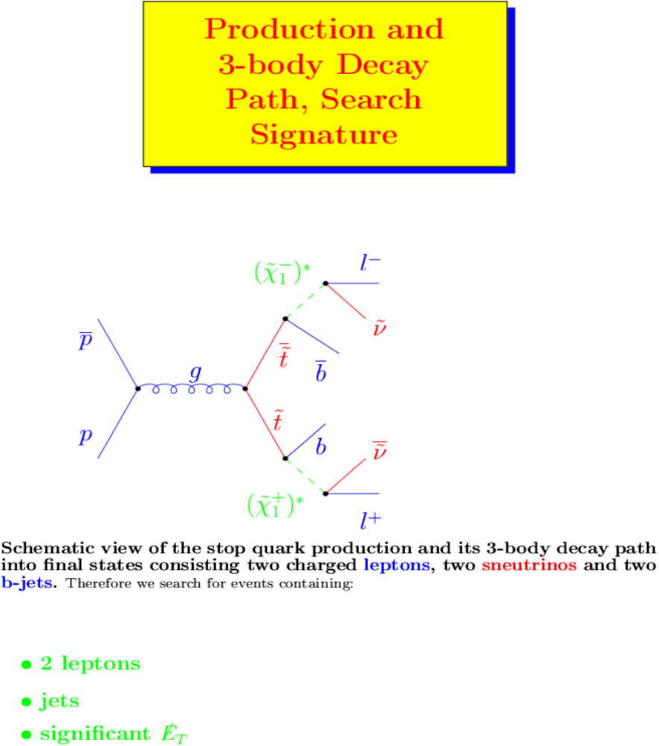
Stop Search
Final state: 2 leptons+jets+ME_{T}
Drell-Yan, heavy quark pair prod.,
QCD fakes, diboson production
Notes:
The charginos are virtual.
Bbar and ccbar also contribute to the bckg.
In addition to the cuts mentioned in the fig. A Met cut of 30 GeV, opening angle cuts between lepton and Met and lepton and jet are applied. A cut on the energy of the dilepton system to cut out top contamination is also applied.
Events observed = 0
Expected = 1.5

Slide 6
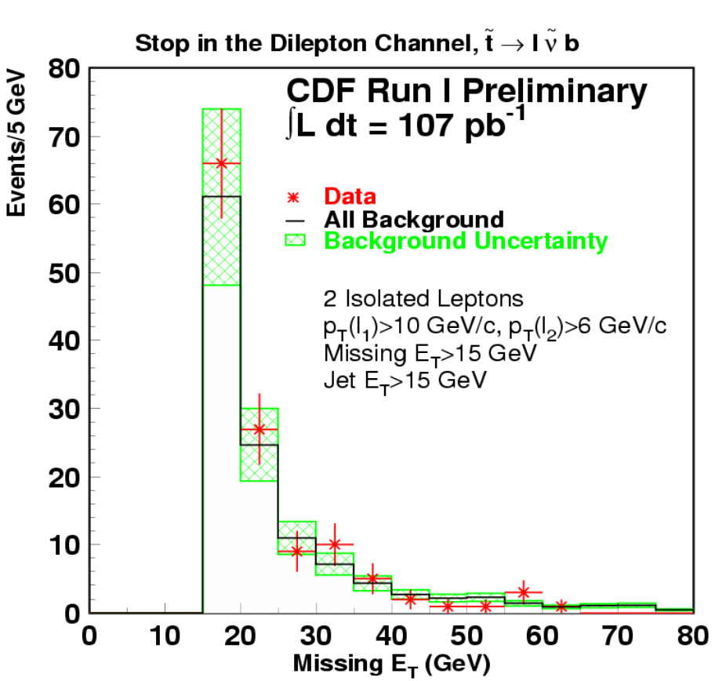
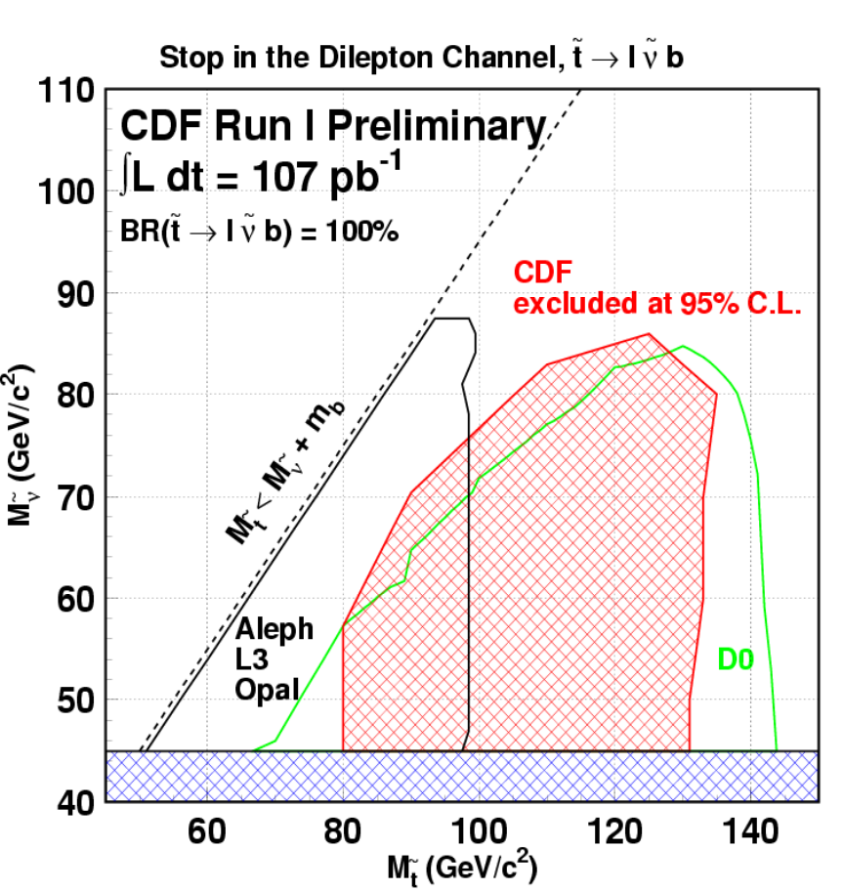
Stop Search (II)

Slide 7
(m)SUGRA models
SUSY breaking is communicated to the physical sector by gravitational interactions
GUT scale parameters + RGE’s → low-scale phenomenology
M₀ = common scalar mass
M_{1/2} = common gaugino mass
A₀ = common trilinear coupling value
tanβ = ratio of the V.E.V. of the two Higgs doublets
sign of μ = Higgsino mass parameter

Slide 8











Single Electron Channel
Bckg: W+jets, qcd multijet,t t
Cuts: E_{t}^{e} >20 GeV,E_{t}^{j} >14 GeV
(≥ 4), no isolated muons,
ME_{T} > 25 GeV
L = 92.7 pb⁻¹
Sensitive to moderate m₀
Complements dilepton and
Jets+ME_{T} channels
Observed events = 72
Expected background = 80 ± 10
DØ
Notes:
Analysis done in mSugra framework with R-parity assumed conserved.
Lightest neutralino is LSP, A0=0 , mu<0 and tanbeta=3.
Search done in m(1/2)-m0 plane.
W+jets 43
Multijet 19
Ttbar 17
WW+jets 2

Slide 9
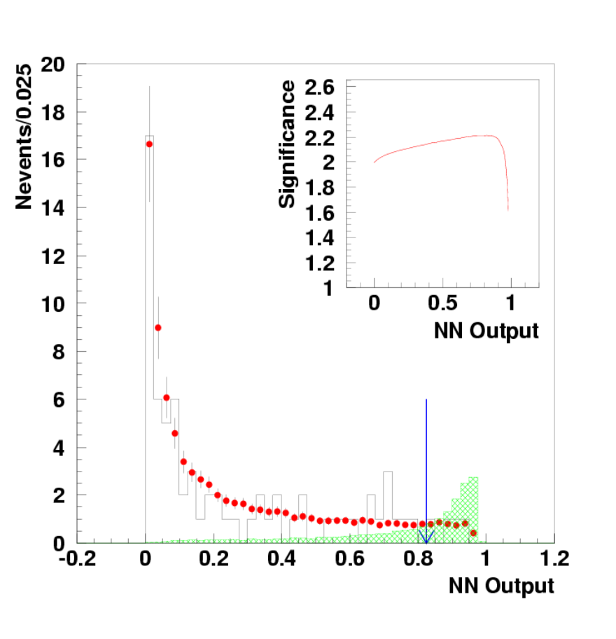
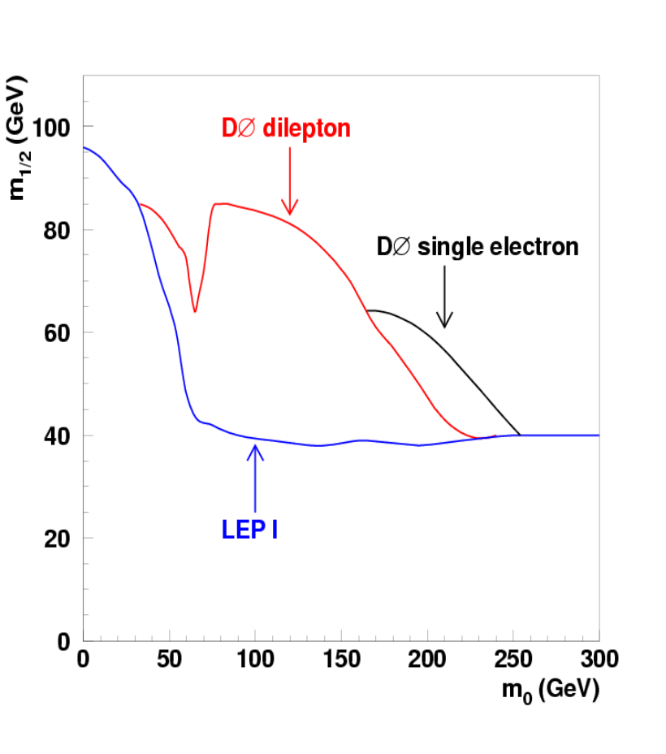
Single Electron Channel
DØ
Notes:
NN variables: Et of 3rd jet, Met, Ht, Mt, delta-phi between Met and the electron (those which showed discrimination between signal and bckg.)
Extends exclusion in the range 170-250 GeV for m0. The limit worsens with rising m0 as the electrons and jets get softer due to the mass difference between the LSP and NLSP decreasing (N2 or C1).
Significance can be defined as the no. of standard deviations required for b to fluctuate to n.
N.B. CDF analysis in jets+met channel provides more stringent limit
PRL 88, 041801 (2002)

Slide 10
R-parity and its violation
Discrete quantum number
R = (-1)^{3B+2S+L} ; is 1 for SM particle,-1 for sparticles
R-parity violation can be introduced by
W_{ΔL=1} = (1/2)λ^{ijk}L_{i}L_{j}ē_{k}+λ' ^{ijk}L_{i}Q_{j}đ_{k}+μ' ^{i}L_{i}H_{u}
W_{ΔB=1} = (1/2)λ'' ^{ijk}ū_{i}đ_{j}đ_{k}
Decay of the LSP
Signatures maybe very different
Single sparticle production possible
Whither dark matter candidate
mSUGRA with RPV
One RPV coupling dominates
If coupling large enough, resonant prod.
Otherwise pair production

Slide 11
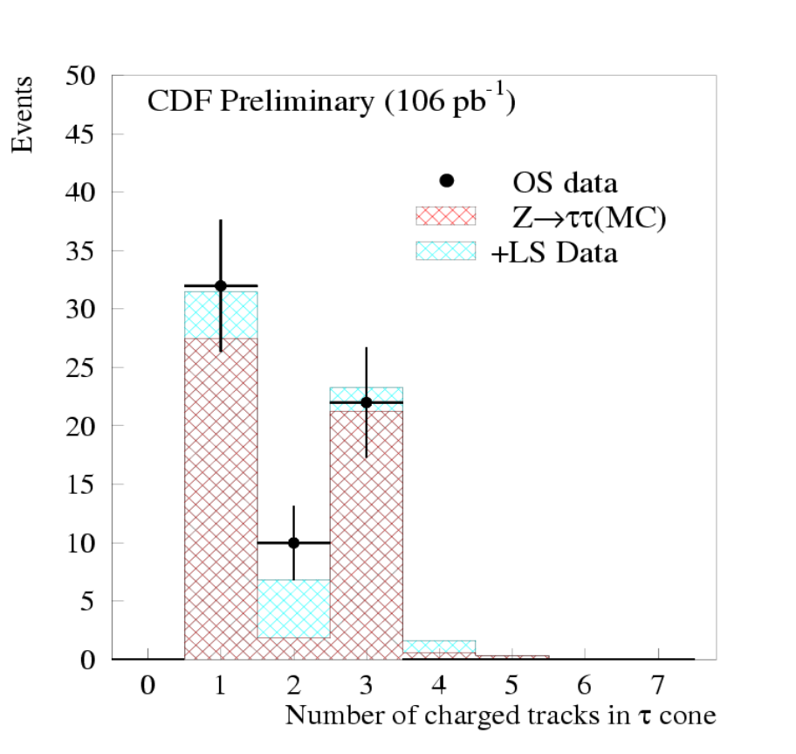
Decays of Stop Pair
Assuming RPV only in 3rd gen.
tt+X = τ_{l} + b + τ_{h} + b + X
Final state: lepton + hadronic τ
+ 2 jets
Bckg: W/Z + jets, multijet, diboson
Cuts: p_{T}^{lepton} >10 GeV,τ_{h} cluster>15,
M_{T}^{(lepton,Met)}<35GeV/c²,H_{T}>70,
≥ 2jets (E_{T} >15 GeV)
L = 106 pb⁻¹

Slide 12
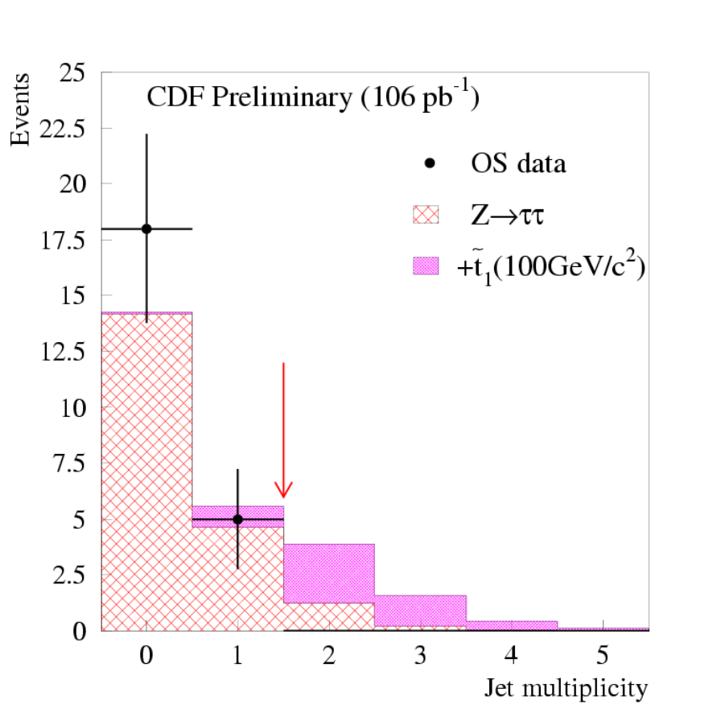
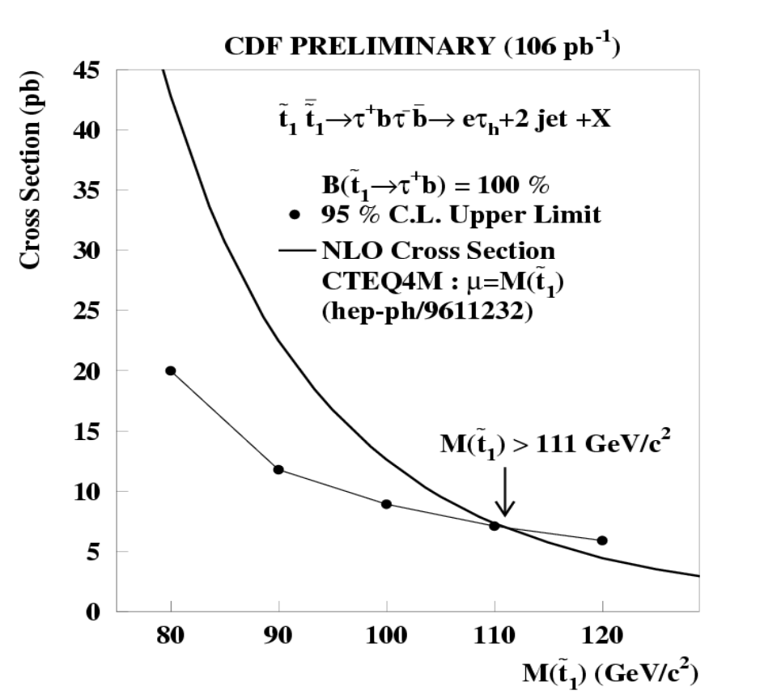
Decays of Stop Pair
CDF
Run IIa proj. ~ m_{t}

Slide 13



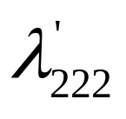


Pair Production: di-muon channel
Final state: 2μ + 4jets
Bckg: Drell-Yan, t t, Z→μμ+jets, Z→ττ→μμ
Cuts: p_{t}^{μ} >15(10) GeV,p_{t}^{jets} >15 GeV,
S_{t} > 150 GeV,M_{μμ} >5 GeV,Acoplanarity>0.03
Run1 L = 77.5 ± 4 pb⁻¹
Events observed = 0
Expected bckg. = 0.18 ± 0.03 ±0.02
DØ

Slide 14
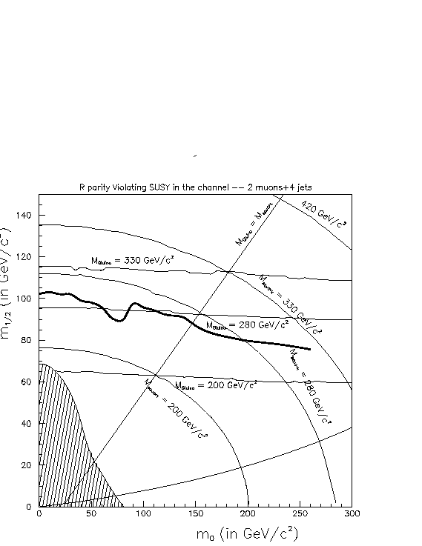
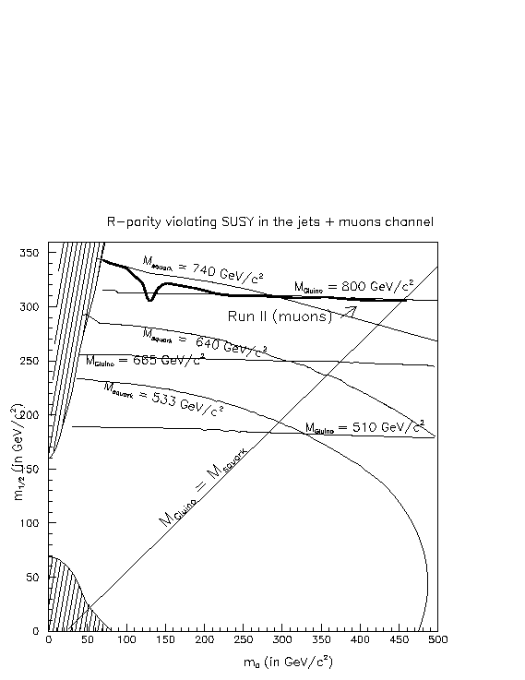
Pair Production: di-muon channel
Run IIa projection
DØ

Slide 15
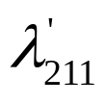
Resonant Production:di-muon channel
~
_
Resonant prod. and decay
of LSP via RPV
Final state: 2μ + 2jets
u
~
χ₁º
μ u d
μ_{L}
_
d
μ
~
_
χ₁º
μ u d
~
l ⁻
d
~
χ₁⁻
ν_{μ}
W ⁻
Bckg: t t, Z+2jets, WW+jets
Cuts: p_{T}^{μ} >20 GeV, p_{T}^{jets} >20 GeV,
S_{T} >50 GeV, ΔR(μ-jet) > 0.5
L = 94 ± 5 pb⁻¹
_
ν_{l}
d
μ⁺
Observed events = 5
Expected bckg = 5.34 ± 0.07
D∅

Slide 16
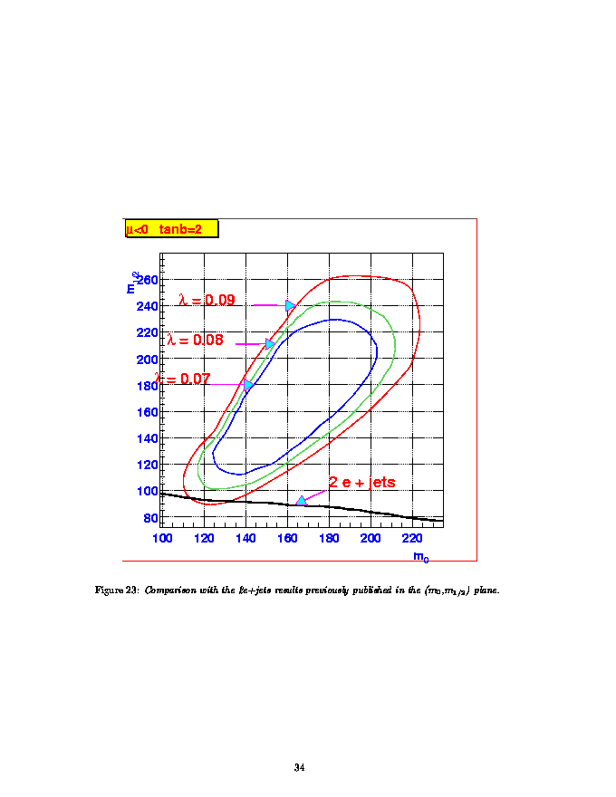
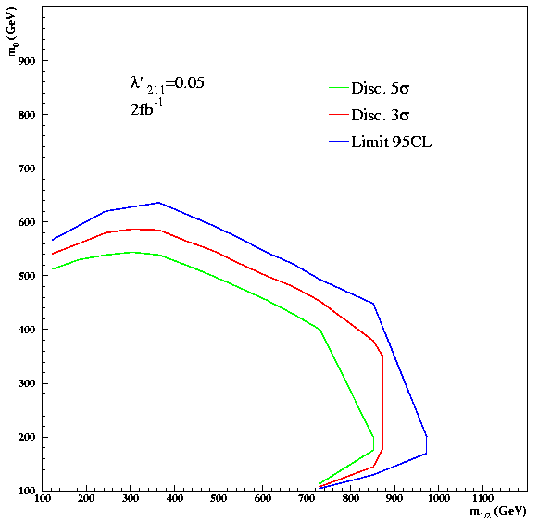
Resonant Production:di-muon channel
Run IIa projection

Slide 17
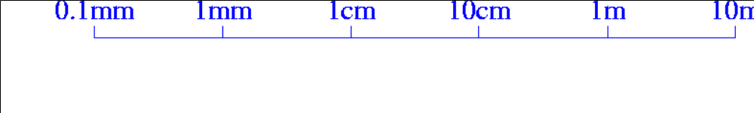



GMSB models
‘Messenger’ sector couples to source of SUSY-breaking and physical sector of MSSM (through gauge interactions)
The identity of the NLSP and its lifetime determine the phenomenology
Photons as
we know
Hot cell
Impact
parameter
SMT
CFT
CAL
Tracks as we know
Kinks
Large dE/dx

Slide 18
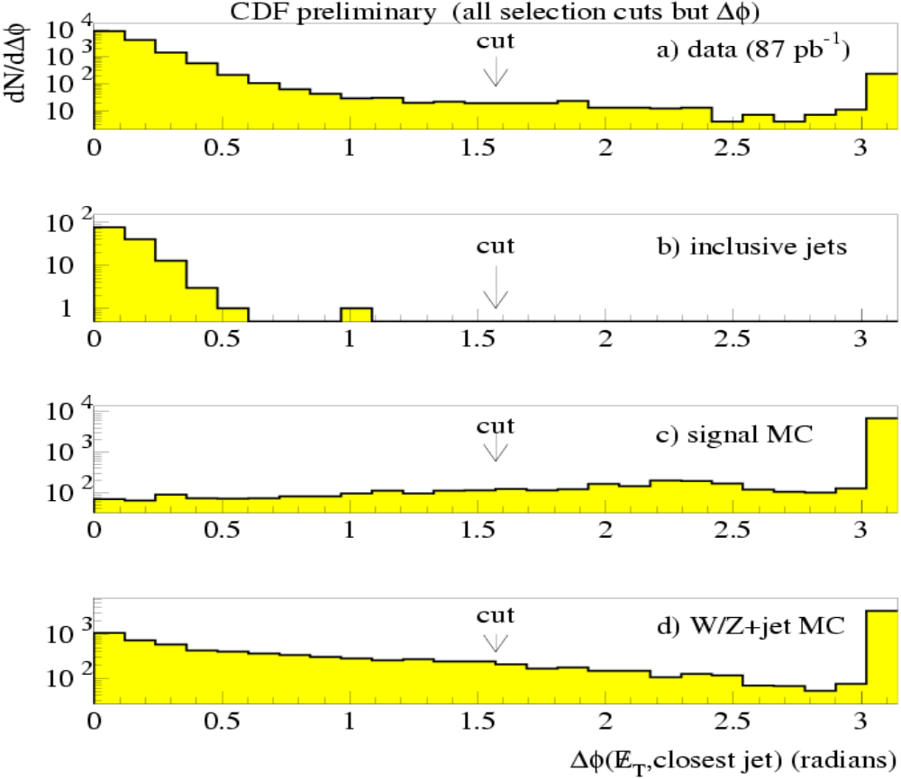
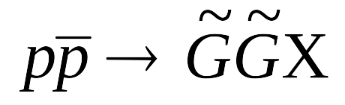
Light Gravitino Search
Final state: ME_{T}+jet
Bckg: mismeasured multi-jets
W/Z + jets, tt, diboson
Cuts: ME_{T} >50 GeV, removal
of events w/ isolated tracks,
Δφ(ME_{T},jet) >90º, E_{t}^{lead-jet} >80
GeV, 0.1 < EMF^{lead-jet} < 0.95
L = 87 pb⁻¹
CDF
Notes:
In SUSY models with GMSB the goldstino (massless, neutral, spin1/2) is introduced.When gravity is added and SUSY is realized locally the gauge particle graviton has a spin3/2 partner, gravitino which acquires mass while the goldstino is absorbed. Production processes at Tevatron:
qqbar→GGg ; qg→GGq; gqbar→GGqbar; gg→GGg or qqbar→Gggamma
The resulting data sample is dominated by mismeasurement of QCD multijet bckg.

Slide 19
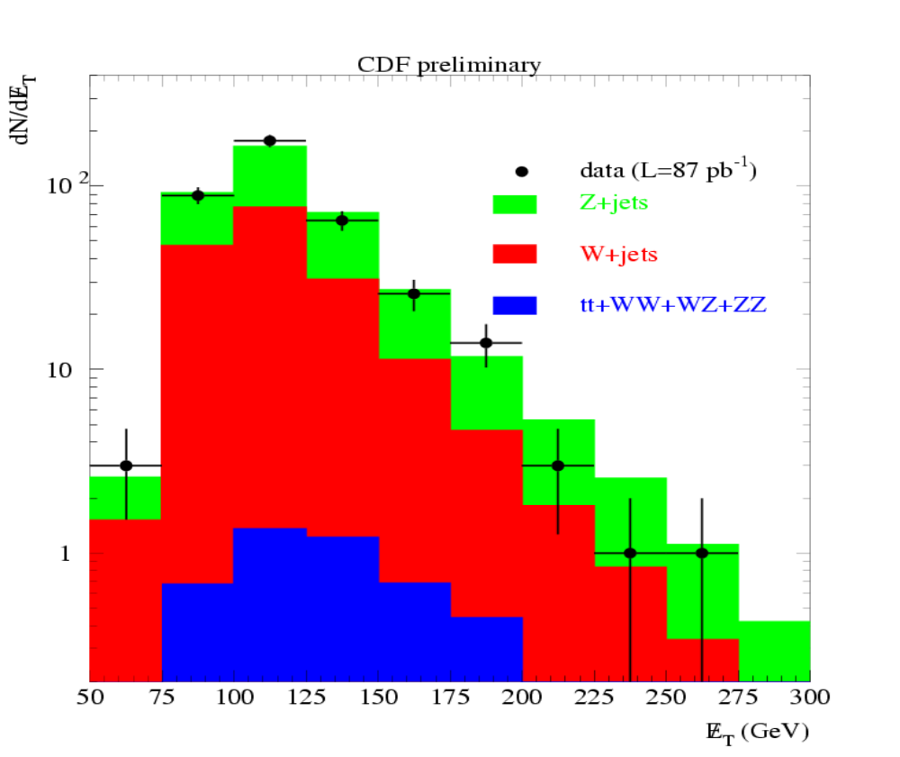
Light Gravitino Search (II)
For ME_{T} >175 GeV:
Events observed = 19
Expected bckg = 21.6
σ(P_{T}^{ĞĞ} >100GeV) < 3.1pb
√F > 217 GeV
m_{Ğ} > 1.1 x 10⁻⁵ eV/c²
CDF
Run IIa proj. ~ 270 GeV
Notes:
For RunIIa the limit will be extended to sqrt(F)>260 GeV.
95% CL upper limit on the cross section is 3.1 pb for the production of
GG+jets events with pT(GG)>100GeV
The production of gravitinos was simulated in Herwig

Slide 20
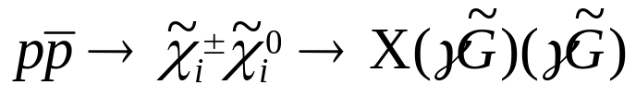
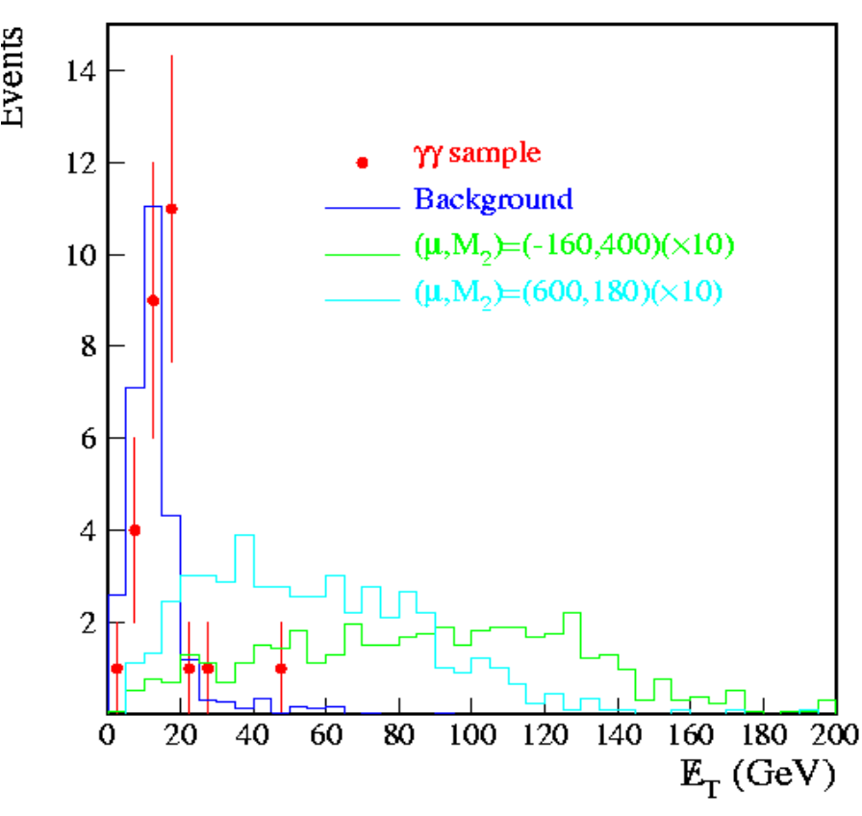
Di-photon Channel
Final state: 2 photons + ME_{T}
Bckg: multijet, direct photons,Wγ,
W+jets, Z→ee
Cuts: E_{T}^{γ1} >20 GeV,E_{T}^{γ2} >12 GeV,
recon. Vertex, ME_{T}>25 GeV
L = 106.3 ± 5.6 pb⁻¹
D∅
Events observed = 2
Expected bckg = 2.3 ± 0.9

Slide 21
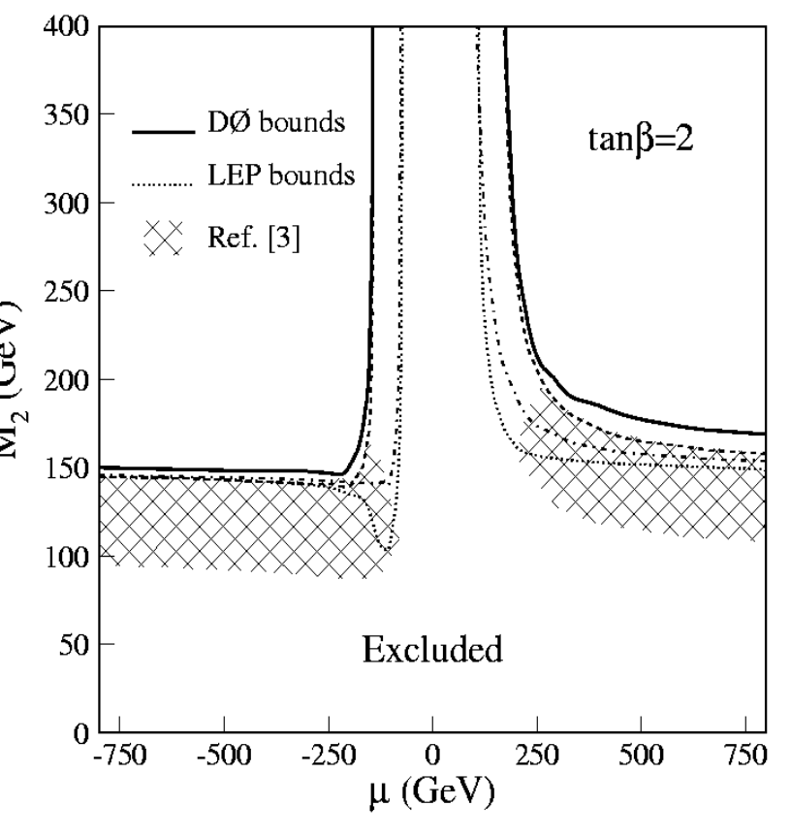
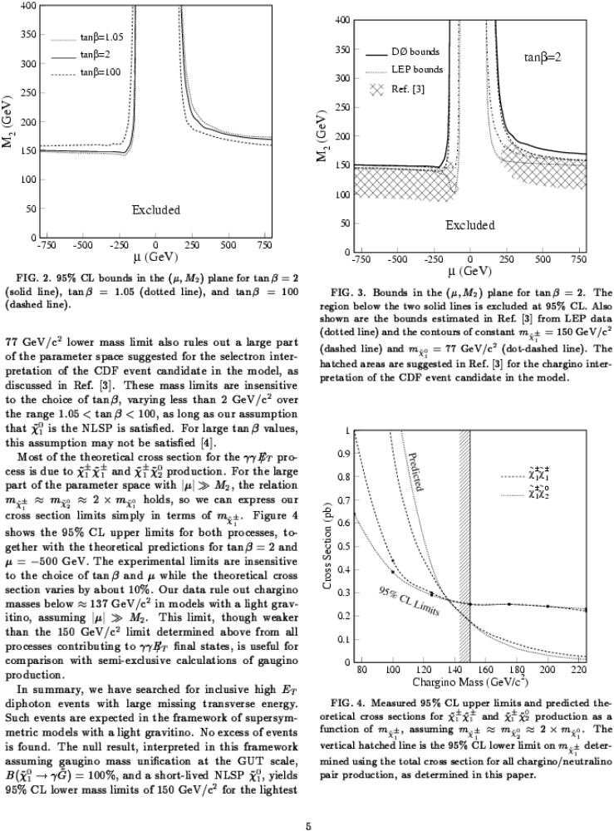
Di-photon Channel (II)
D∅
Run IIa proj. ~ 300 GeV
Notes:
The chargino mass limit will be extended to 300 GeV for RunIIa.

Slide 22
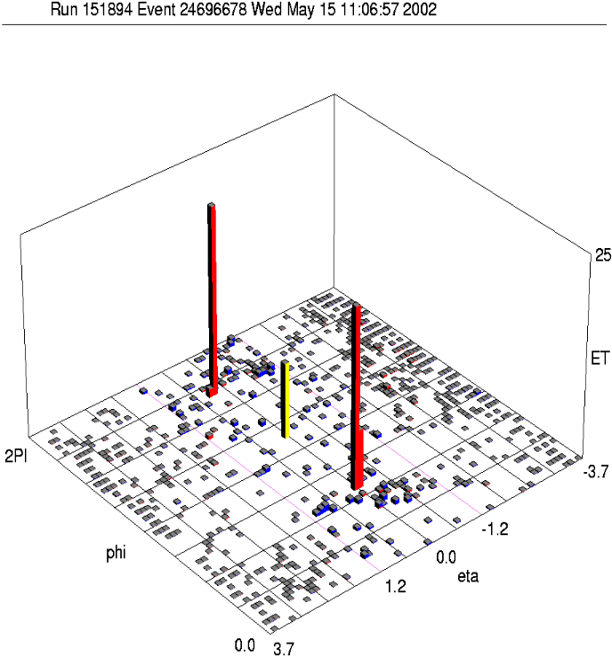
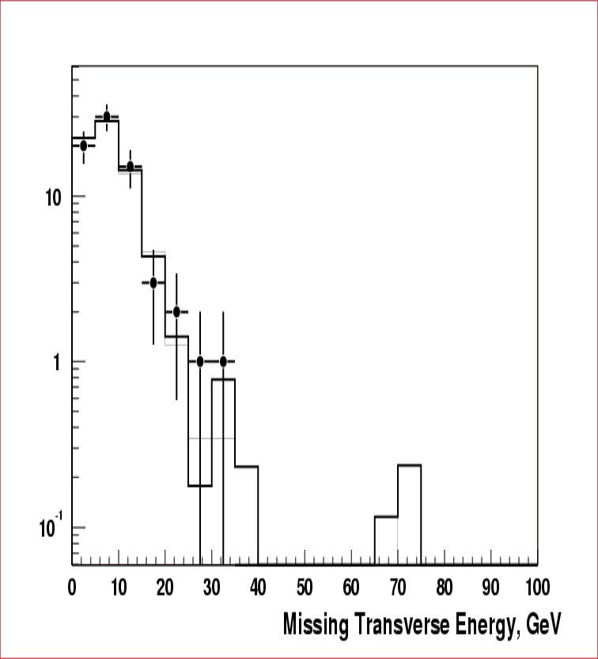
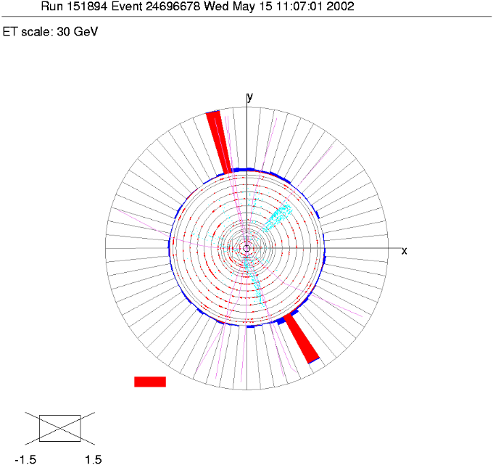
Di-photon Channel (III)
Run II
D∅ Run II
preliminary
ME_{T}

Slide 23
Summary
Comprehensive searches for SUSY have been carried out at the Tevatron exploiting the Run 1 data to the fullest.
A new era is beginning …….

