Slide 1

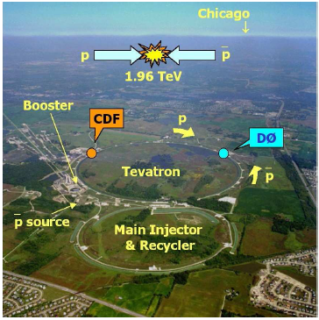
Rare decays of charm & bottom atTevatron
Introduction
Tevatron
CDF & DØ Detector
Rare charm decays
Rare bottom beauty
Summary & Conclusions
Frank Lehner
U Zurich
DIF ’06, Frascati
28 Feb -03 March, 2006

Slide 2
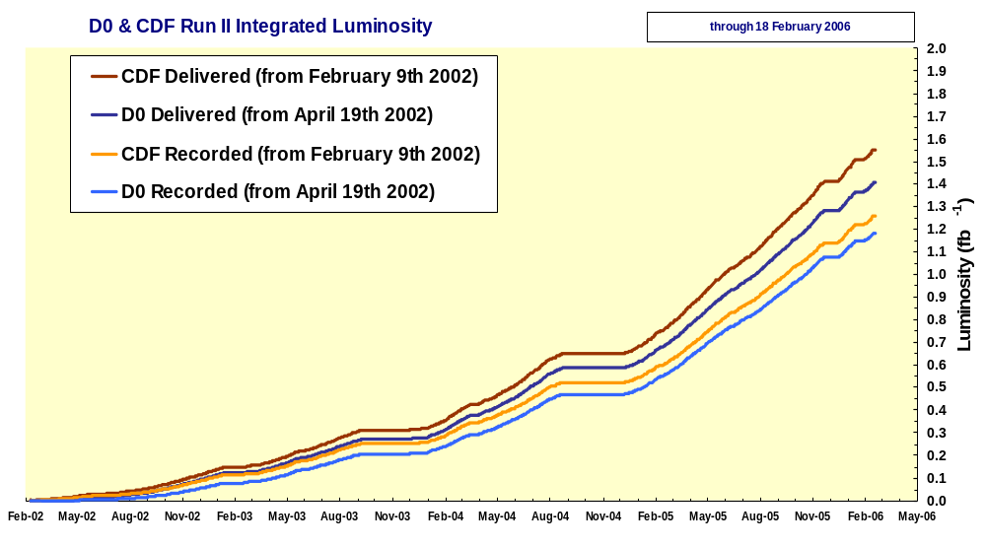
Tevatron performance
excellent performance of Tevatron in 2005 and early 2006
machine delivered more than 1500 pb⁻¹ up to now !!
recorded (DØ/CDF)
  1.2/1.4 fb⁻¹
  record luminosity of 1.7×10³² cm⁻²/s in January 2006
  high data taking efficiency ~85%
current dataset reconstructed and under analysis
  ~1000 pb⁻¹
  compare with ~100 pb⁻¹ Run I

Slide 3
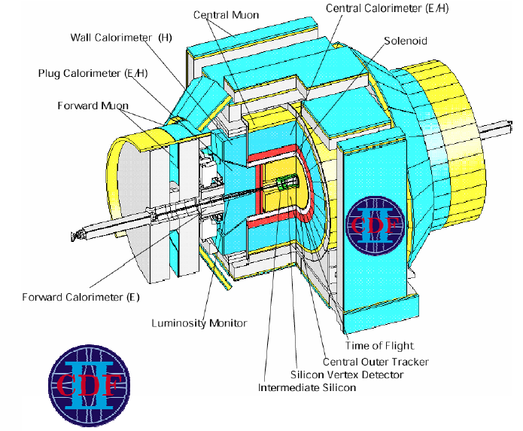
CDF detector
Silicon Tracker SVX
  up to |η|<2.0
  SVX fast r-φ readout for trigger
Drift Chamber
  96 layers in |η|<1
  particle ID with dE/dx
  r-φ readout for trigger
tracking immersed in Solenoid 1.4T
Time of Flight
  →particle ID

Slide 4
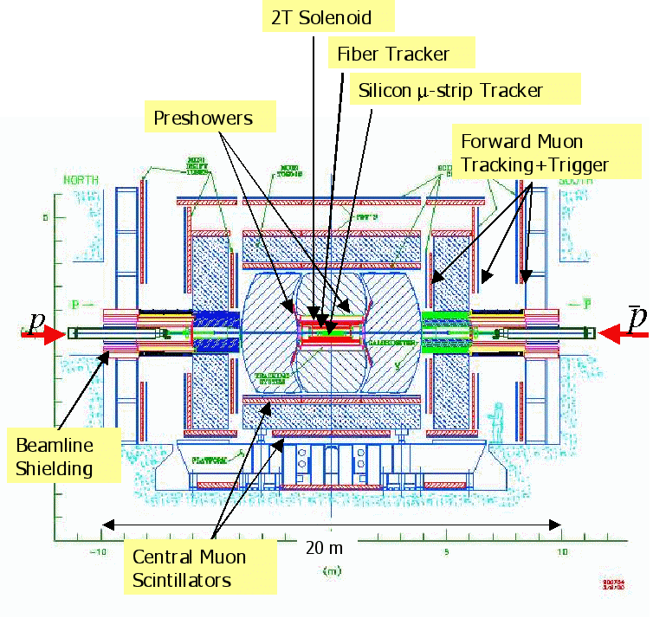
DØ detector
2T Solenoid
hermetic forward & central muon detectors
  excellent coverage |η|<2
Fiber Tracker
  8 double layers
Silicon Detector
  up to |η|<2.5

Slide 5
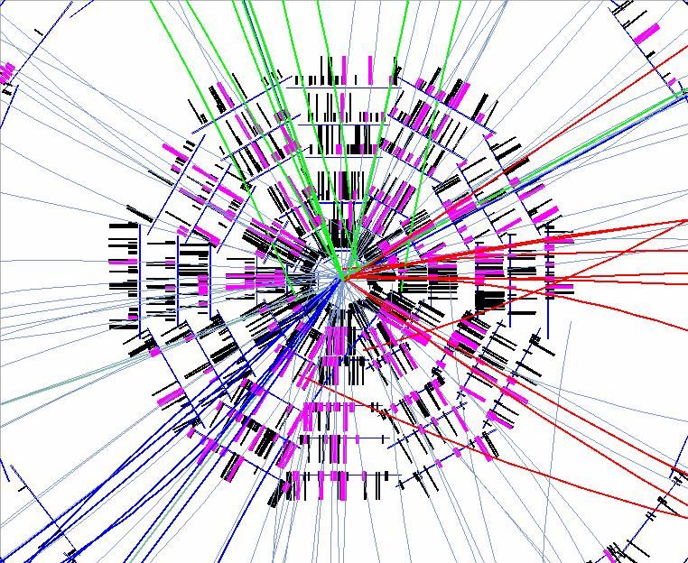
Charm and bottom production at Tevatron
bb cross section orders of magnitude larger than at B-factories ϒ(4S) or Z
all kinds of b hadrons produced:
  B_{d}, B_{s}, B_{c}, B**, Λ_{b}, Ξ_{b}, …
charm cross section even higher, about 80-90% promptly produced
However:
  QCD background overwhelming, b-hadrons hidden in 10³ larger background
  events complicated, efficient trigger and reliable tracking necessary
crucial for bottom and charm physics program:
  good vertexing & tracking
  triggers w/ large bandwidth, strong background rejection
  muon system w/ good coverage
e.g., integrated cross sections
for |y|<1:
σ(D⁰, p_{T} ≥ 5.5 GeV/c)~13 μb
σ(B⁺, p_{T} ≥ 6 GeV/c)~4 μb
Lots going on
in Si detector

Slide 6
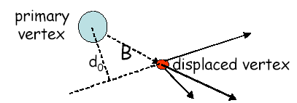
Triggers for bottom & charm physics
“classical” triggers:
  robust and quiet di-muon and single-muon triggers
  working horse for masses, lifetimes, rare decays etc.
  keys to B physics program at DØ
“advanced” triggers using silicon vertex detectors
  exploit long lifetime of heavy quarks
  displaced track + leptons for semileptonic modes
  two-track trigger (CDF) – all hadronic mode
    two oppositely charged tracks with impact parameter
    2-body charmless B decays etc.
    charm physics
Decay length L_{xy}
p_{T}(B)≥5 GeV
L_{xy}≥450 μm

Slide 7
FCNC & new physics
flavor-changing neutral current processes
  in SM forbidden at tree level
  at higher order occur through box- and penguin diagrams
  sensitive to virtual particles in loop, thus can discern new physics
GIM-suppression for down-type quarks relaxed due to large top mass
  observable SM rates lead to tight constraints of new physics
corresponding charm decays are less scrutinized and largely unexplored
  smaller BRs, more suppressed by GIM-mechanism, long-distance effects also dominating
  nevertheless large window to observe new physics beyond SM exists: R_{p}-violating models, little Higgs models w/ up-like vector quark etc.

Slide 8
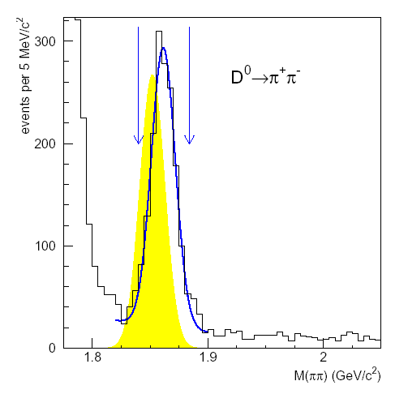
Search for D⁰-> μ⁺ μ⁻
FCNC decay with c->u l⁺ l⁻ quark transition as short distance physics
in SM BR~3×10⁻¹³, but dominated by long-distance two-photon contribution
R_{p}-violating SUSY may enhance BR of this mode considerably
present exp. limit: 1.3×10⁻⁶ @90% C.L. (BaBar)
CDF analysis:
  PRD68 (2003) 091101
  data (65 pb⁻¹) collected with two-track trigger to search for D-> μ⁺ μ⁻
  normalization of search to topological similar D-> ππ, trigger efficiency and acceptance cancel
  mass resolution for two-body decays σ = 10 MeV/c²
CDF
D->πK
D-> ππ almost completely overlap
with the μ⁺ μ⁻ search window,
good understanding of π->μ fake
rate, determined from a sample of
D* tagged D->πK decays.
Misidentification: 1.3±0.1%

Slide 9
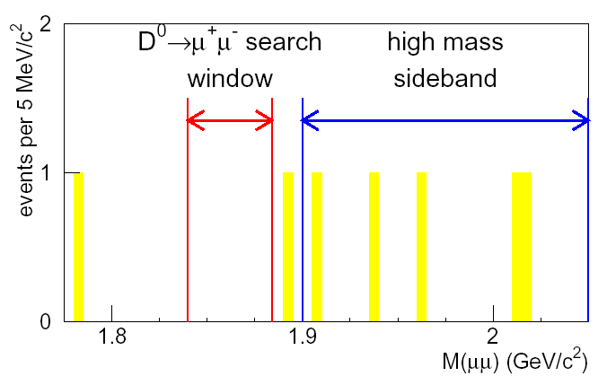
Search for D⁰-> μ⁺ μ⁻
optimization of analysis on discriminating variables keeping the signal box hidden
combinatorial background estimated from high mass sideband: 1.6±0.7
fake background from #D-> ππ events reconstructed in signal window multiplied with misidentification probability π->μ: 0.22 ±0.02
total expected background: 1.8±0.7 events
zero events found -> limit
updated analysis from CDF with much more data coming soon, will also look into ee and eμ channel
CDF
CDF:
BR(D⁰-> μ⁺ μ⁻)<2.5×10⁻⁶ @90% C.L.

Slide 10
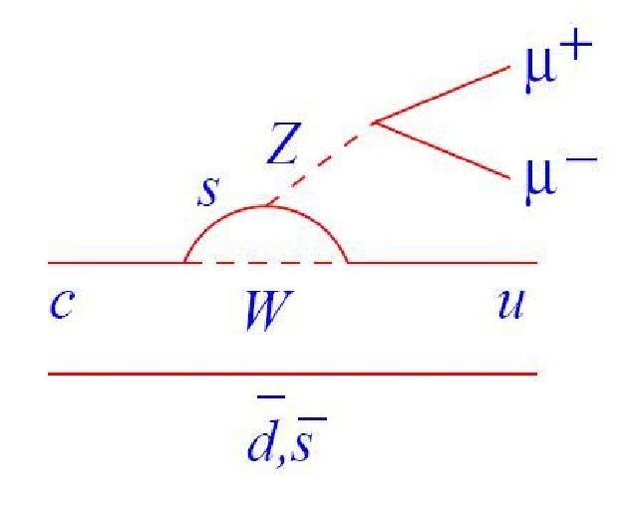
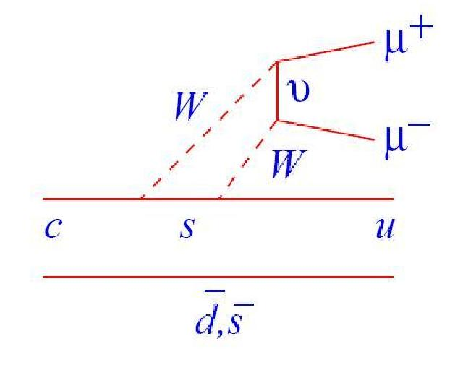
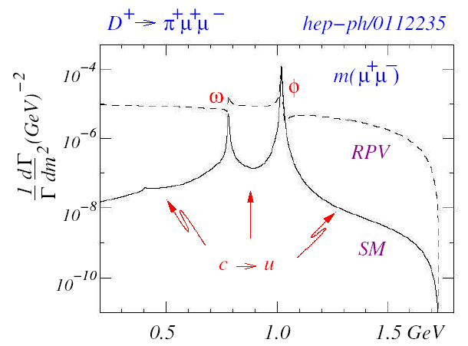
towards D± -> π± μ⁺μ⁻
Penguin
Box
non-resonant D± -> π± μ⁺μ⁻ is a good place to search for new physics in up-type FCNC - enhanced in R_{p}-violating models or little Higgs models (see talk by S. Fajfer)
Strategy at DØ: establish first resonant D_{s}± -> φ π± -> μ⁺μ⁻ π± and search then for D⁺ candidates in the continuum for non-resonant decay
DØ analysis based on ~500 pb⁻¹ of di-muon triggered data, select:
  μ⁺μ⁻ consistent with m(φ)
  combine μ⁺μ⁻ with track p_{t}>0.18 GeV/c in same jet for D_{(s)} candidates with 1.3 < m(μ⁺μ⁻ π± ) <2.5 GeV/c²
  in average 3.3 candidates => apply vertex-χ² criterion to select correct one in 90% of cases (MC)
SM: BR ~10⁻⁸

Slide 11
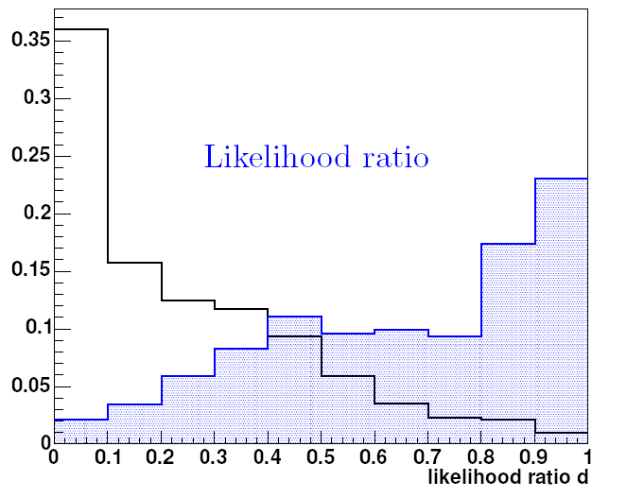
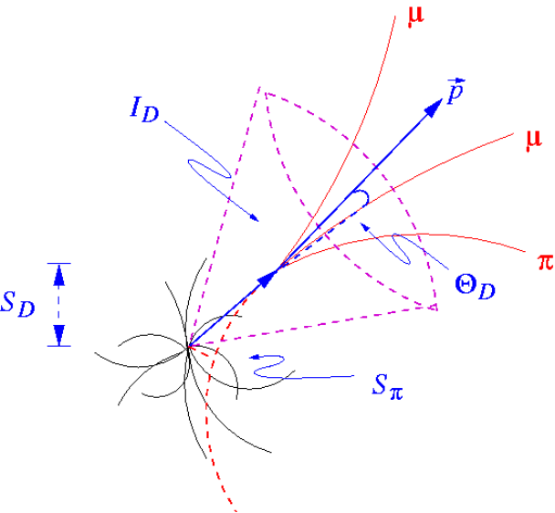
Optimization
DØ
to further minimize background:
construct likelihood ratio for signal (MC) and background (sideband) events based on
  isolation of D candidate I_{D}
  transverse decay length significance S_{D}
  collinearity angle between D momentum and vector between prim. & sec. Vertex θ_{D}
  significance ratio R_{D} = impact parameter of π± / S_{D}
  correlations taken into account
Likelihood cut chosen to maximize ε_{S}/√ε_{B} with background modeled from sidebands

Slide 12
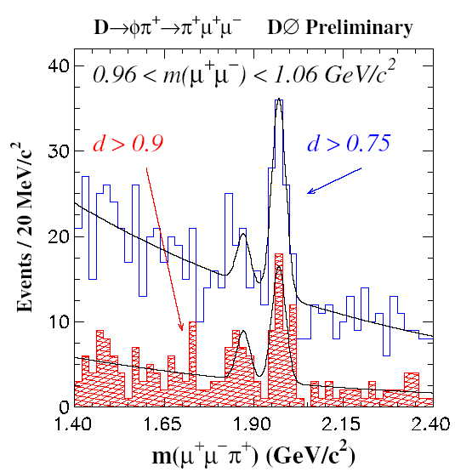
D_{(s)}± -> φ π± -> μ⁺μ⁻ π±
after cuts a signal of 51 D_{s} resonant decay candidates with expected background of 18 are observed
  excess with (>7σ) significance
first observation of resonant decay D_{s}± -> φ π± -> μ⁺μ⁻ π± as benchmark
the number of (resonant) D⁺ -> φ π± -> μ⁺μ⁻ π± is determined in fit with parameters fixed in looser selection
fit yields 13±5 D± events (significance: 2.7σ), set either limit or calculate BR
accomplished first major step in FCNC three-body charm decay program
analysis will be updated with more statistics soon (~1fb⁻¹)
as future goal: search for excess in non-resonant continuum region
+0.08+0.06
Br(D± →φπ± →μ⁺μ⁻ π±) <3.14x10⁻⁶ (90% C.L)
Br(D± →φπ± →μ⁺μ⁻ π±) = (1.70 )x10⁻⁶
-0.73 -0.82

Slide 13
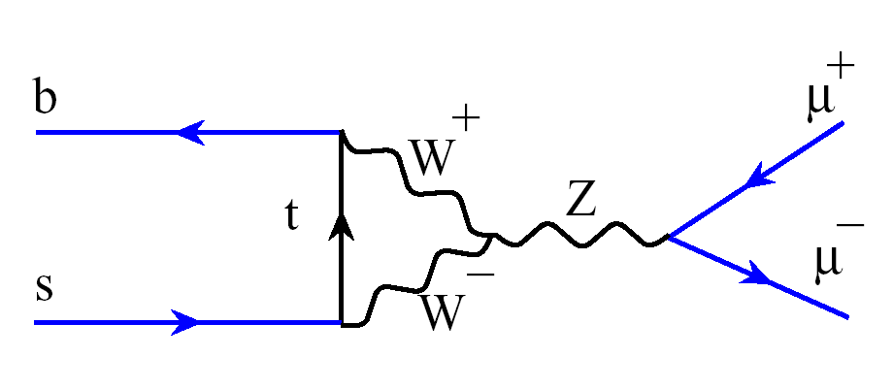
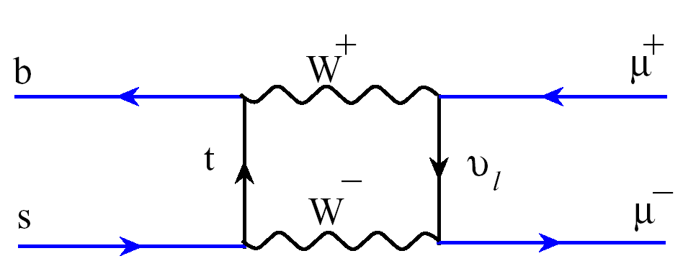
Purely leptonic B decay
B->l⁺ l⁻ decay is helicity suppressed FCNC
SM: BR(B_{s}->μ⁺μ⁻) ~ 3.4×10⁻⁹
depends only on one SM operator in effective Hamiltonian, hadronic uncertainties small
B_{d} relative to B_{s} suppressed by |V_{td}/V_{ts}|² ~ 0.04 if no additional sources of flavor violation
reaching SM sensitivity: present limit for B_{s} -> μ⁺μ⁻ comes closest to SM value
Current published limits:
SM expectations:
C.L. 90% | Br(B_{d}→l⁺l⁻) | Br(B_{s}→l⁺l⁻)
l = e | < 6.1 ·10⁻⁸ | < 5.4 ·10⁻⁵
l=μ | < 8.3 ·10⁻⁸ | <1.5 x 10⁻⁷
l=τ | < 2.5% | < 5.0%
 | Br(B_{d}→l⁺l⁻) | Br(B_{s}→l⁺l⁻)
l = e | 3.4 × 10⁻¹⁵ | 8.0 × 10⁻¹⁴
l=μ | 1.0 × 10⁻¹⁰ | 3.4 × 10⁻⁹
l=τ | 3.1 × 10⁻⁸ | 7.4 × 10⁻⁷

Slide 14
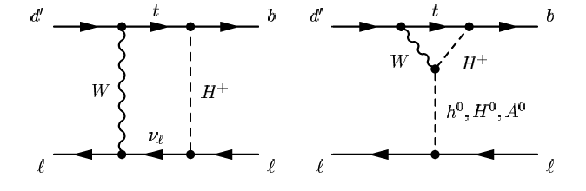
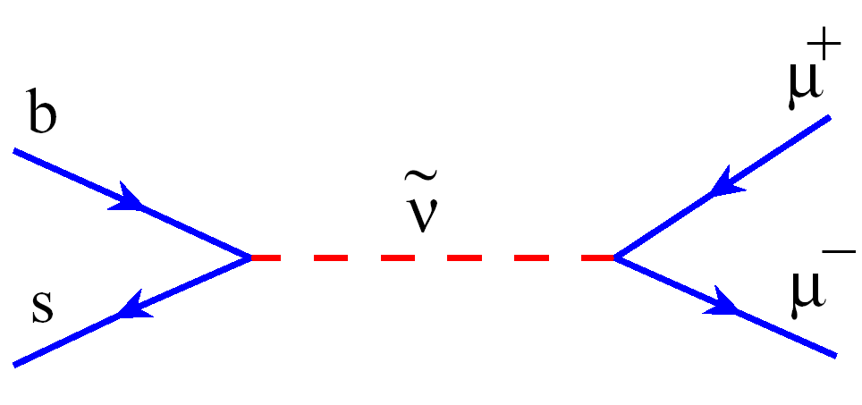
Purely leptonic B decay
excellent probe for many new physics models
particularly sensitive to models w/ extended Higgs sector
  BR grows ~tan⁶β in MSSM
  2HDM models ~ tan⁴β
  mSUGRA: BR enhancement correlated with shift of (g-2)_{μ}
also, testing ground for
  minimal SO(10) GUT models
  R_{p} violating models, contributions at tree level
  (neutralino) dark matter …
Two-Higgs Doublet models:
R_{p} violating:

Slide 15
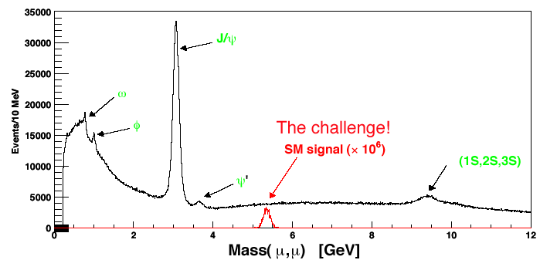
Experimental search
CDF:
  364 pb⁻¹ di-muon triggered data
  two separate search channels
    central/central muons
    central/forward muons
  extract B_{s} and B_{d} limit
DØ:
  240 pb⁻¹ (update 300 pb⁻¹) di-muon triggered data
both experiments:
  blind analysis to avoid experimenter’s bias
  side bands for background determination
  use B⁺ -> J/ψ K⁺ as normalization mode
    J/ψ -> μ⁺μ⁻ cancels μ⁺μ⁻ selection efficiencies
DØ
blinded signal region:
DØ: 5.160 < m_{μμ} < 5.520 GeV/c²;
±2σ wide, σ=90 MeV
CDF: 5.169 < m_{μμ} < 5.469 GeV/c²;
covering B_{d} and B_{s}; σ=25 MeV

Slide 16
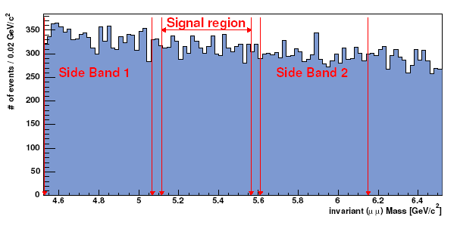
Pre-selection
Pre-selection DØ:
  4.5 < m_{μμ} < 7.0 GeV/c²
  muon quality cuts
  p_{T}(μ)>2.5 GeV/c
  |η(μ)| < 2
  p_{T}(B_{s} cand.)>5.0 GeV/c
  good vertex
Pre-Selection CDF:
  4.669 < m_{μμ} < 5.969 GeV/c²
  muon quality cuts
  p_{T}(μ)>2.0 (2.2) GeV/c CMU (CMX)
  p_{T}(B_{s} cand.)>4.0 GeV/c
  |η(B_{s})| < 1
  good vertex
  3D displacement L_{3D} between primary
  and secondary vertex
  σ(L_{3D})<150 μm
  proper decay length 0 < λ < 0.3 cm
e.g. DØ: about 38k events after
pre-selection
Potential sources of background:
continuum μμ Drell-Yan
sequential semi-leptonic b->c->s decays
double semi-leptonic bb-> μμX
b/c->μx+fake
fake + fake

Slide 17
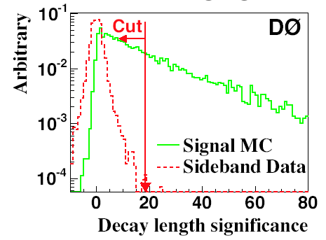
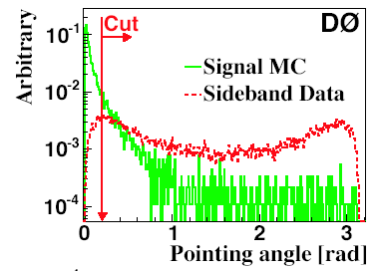
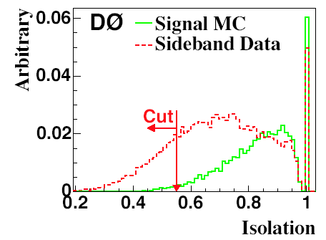
Optimization I
DØ:
optimize cuts on three discriminating variables
  angle between μ⁺μ⁻ and decay length vector (pointing consistency)
  transverse decay length significance (B_{s} has lifetime): L_{xy}/σ(L_{xy})
  isolation in cone around B_{s} candidate
use signal MC and 1/3 of (sideband) data for optimization
random grid search
maximize ε/(1.+√B)
total efficiency w.r.t 38k pre-selection criteria: 38.6%

Slide 18
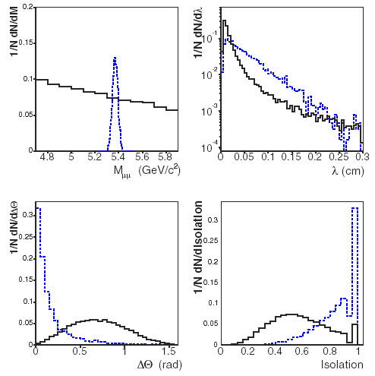
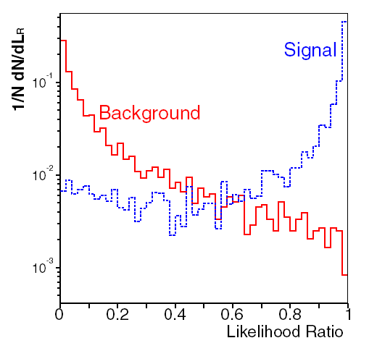
Optimization II
CDF: discriminating variables
  pointing angle between μ⁺μ⁻ and decay length vector
  isolation in cone around B_{s} candidate
  proper decay length probability p(λ) = exp(- λ/ λ_{Bs})
  construct likelihood ratio to optimize on “expected upper limit”

Slide 19
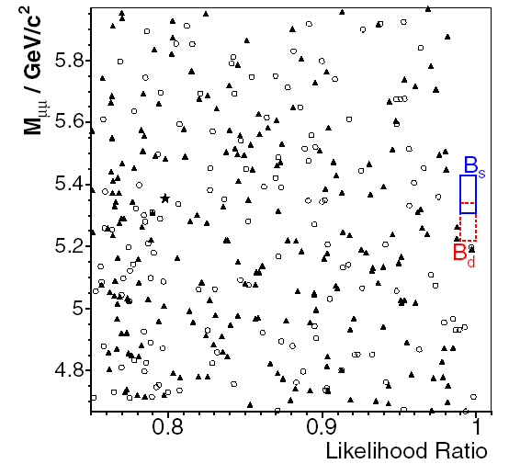
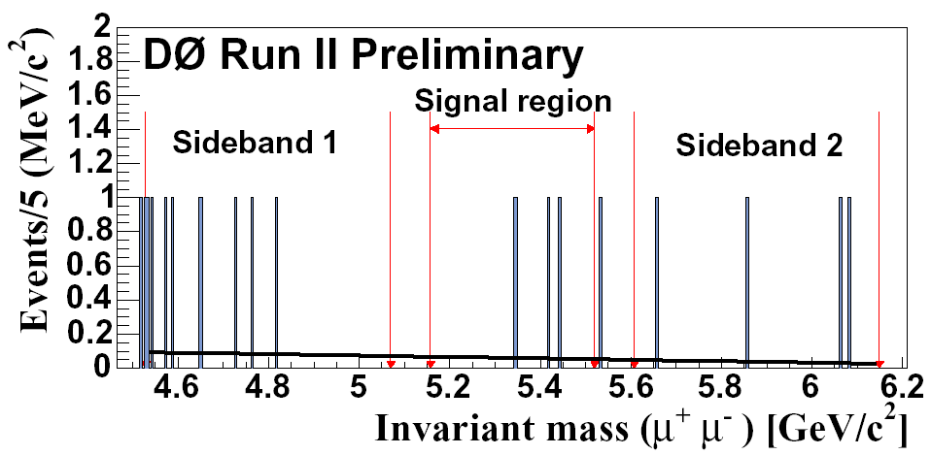
Unblinding the signal region
CDF:
  central/central: observe 0, expect 0.81 ± 0.12
  Central/forward: observe 0, expect 0.66 ± 0.13
DØ:
  observe 4, expect 4.3 ± 1.2
CDF

Slide 20
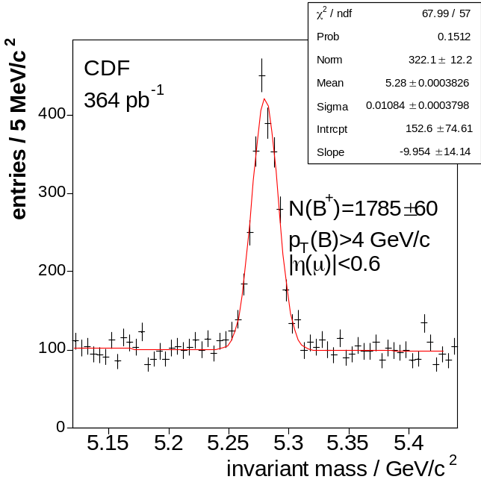
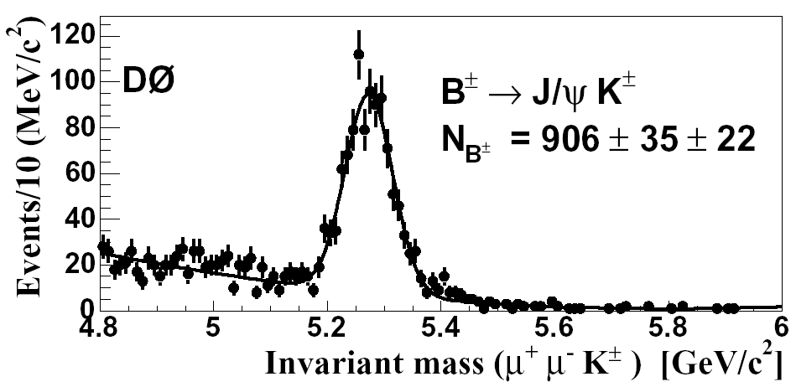
Normalization
relative normalization is done to B⁺ -> J/ψ K⁺
advantages:
  μ⁺μ⁻ selection efficiency same
  high statistics
  BR well known
disadvantages:
  fragmentation b->B_{u} vs. b-> B_{s}
DØ: apply same values of discriminating cuts on this mode
CDF: no likelihood cut on this mode

Slide 21
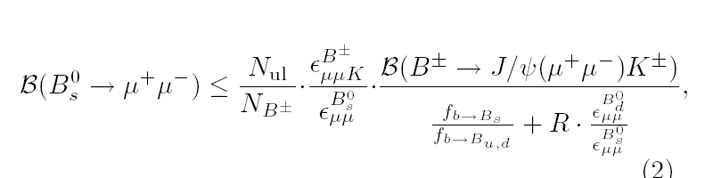
Master equation
R = BR(B_{d})/BR(B_{s}) is small due to |V_{td}/V_{ts}|^2
ε_{B}+ /ε_{Bs} relative efficiency of normalization to signal channel
ε_{Bd} /ε_{Bs} relative efficiency for B_{d}-> μ⁺ μ⁻ versus B_{s}-> μ⁺ μ⁻ events in B_{s} search channel (for CDF~0, for DØ ~0.95)
f_{s}/f_{u} fragmentation ratio (in case of B_{s} limit) - use world average with 15% uncertainty

Slide 22
The present (individual) limits
DØ mass resolution is not sufficient to separate B_{s} from B_{d}. Assume no B_{d} contribution (conservative)
CDF sets separate limits on B_{s} & B_{d} channels
all limits below are 95% C.L. Bayesian incl. sys. error, DØ also quotes FC limit
CDF B_{s}->μμ | 176 pb⁻¹ | 7.5×10⁻⁷ | Published
DØ B_{s}->μμ | 240 pb⁻¹ | 5.1×10⁻⁷ | Published
DØ B_{s}->μμ | 300 pb⁻¹ | 4.0×10⁻⁷ | Prelim.
CDF B_{s}->μμ | 364 pb⁻¹ | 2.0×10⁻⁷ | Published
CDF B_{d}->μμ | 364 pb⁻¹ | 4.9×10⁻⁸ | Published
B_{d} limit x2 better
than published Babar
limit w/ 111 fb⁻¹
updates on limits/sensitivities expected soon

Slide 23
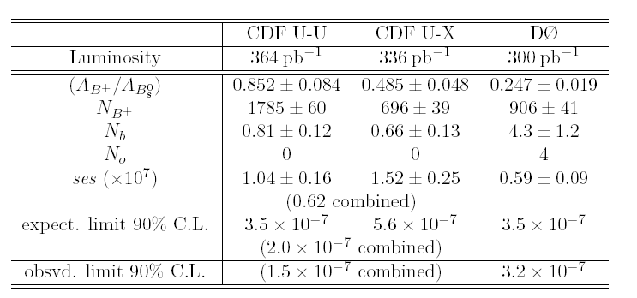
Tevatron limit combination I
fragmentation ratio b->B_{s}/b->B_{u,d}
  standard PDG value as default
  Tevatron only fragmentation (from CDF) improves limit by 15%
uncorrelated uncertainties:
  uncertainty on eff. ratio
  uncertainty on background
correlated uncertainties:
  BR of B± -> J/ψ(->μμ) K±
  fragmentation ratio b->B_{s}/b->B_{u},_{d}
quote also an average expected upper limit and single event sensitivity
hep-ex/0508058
DØ has larger acceptance due
to better η coverage,
CDF has greater sensitivity due to
lower background expectations

Slide 24
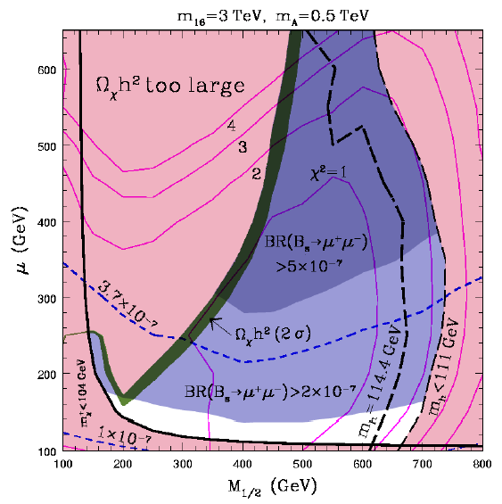
Combination II
Example: SO(10) symmetry breaking model
combined CDF & DØ limit:
BR(B_{s}-> μ⁺ μ⁻ ) < 1.2 (1.5) × 10⁻⁷ @ 90% (95%) C.L.
world-best limit, only factor 35 away from SM
important to constrain models of new physics at tanβ
e.g. mSO(10) model is severely constraint
R. Dermisek et al.
hep-ph/0507233
Contours of constant Br(B_{s}→μ⁺μ⁻)

Slide 25
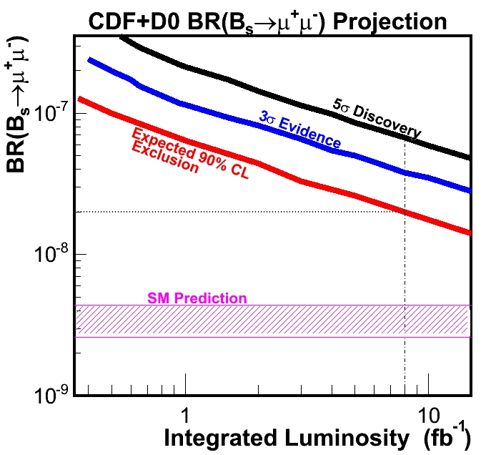
Future Prospects for B_{s}-> μ⁺μ⁻
assuming unchanged analysis techniques and reconstruction and trigger efficiencies are unaffected with increasing luminosity
for 8fb⁻¹/experiment an exclusion at 90%C.L. down to 2×10⁻⁸ is possible
both experiments pursue further improvements in their analysis

Slide 26
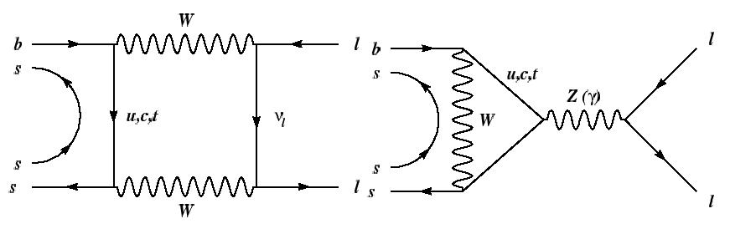
Search for B_{s} -> μ⁺μ⁻φ
long-term goal: investigate b -> s l⁺ l⁻ FCNC transitions in B_{s} meson
exclusive decay: B_{s} -> μ⁺μ⁻φ
SM prediction:
  short distance BR: ~1.6×10⁻⁶
  about 30% uncertainty due to B->φ form factor
2HDM: enhancement possible, depending on parameters for tanβ and M_{H+}
presently only one published limit
  CDF Run I: 6.7×10⁻⁵ @ 95% C.L.

Slide 27
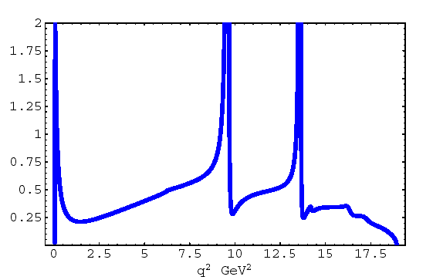
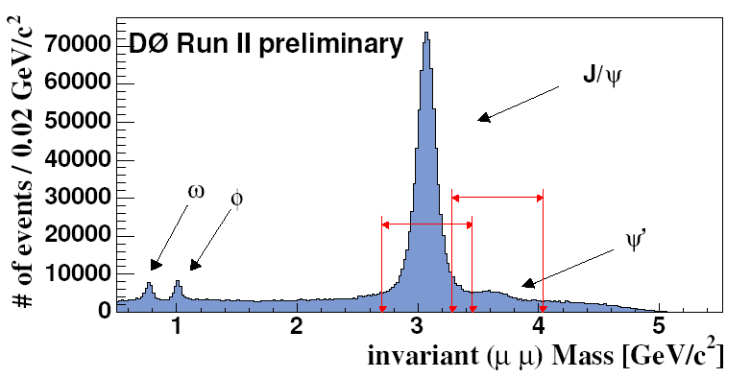
Search for B_{s} -> μ⁺μ⁻φ
Dilepton mass spectrum
in b -> s l l decay
DØ: 300 pb⁻¹ of dimuon data
normalize to resonant decay B_{s} -> J/ψ φ
cut on mass region 0.5 < M(μμ) < 4.4 GeV/c² excluding J/ψ & ψ’
two good muons, p_{t} > 2.5 GeV/c
two additional oppositely charged tracks p_{t}>0.5 GeV/c for φ
φ candidate in mass range 1.008 < M(φ) < 1.032 GeV/c²
good vertex
p_{t}(B_{s} cand.) > 5 GeV/c
non-resonant decay: cut out J/ψ and ψ’
J/ψ
ψ’

Slide 28
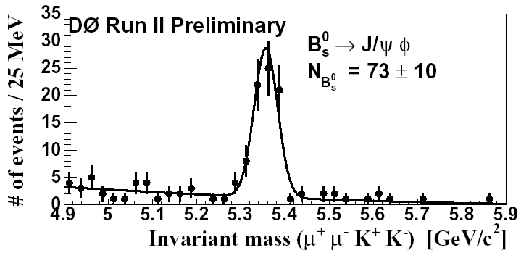
Search for B_{s} -> μ⁺μ⁻φ
blind analysis: optimization with following variables in random grid search
  pointing angle
  decay length significance
  Isolation
background modeled from sidebands
use resonant decay B_{s} -> J/ψ φ with same cuts as normalization
gaussian fit with quadratic background: 73 ± 10 B_{s}-> J/ψ φ resonant decays

Slide 29
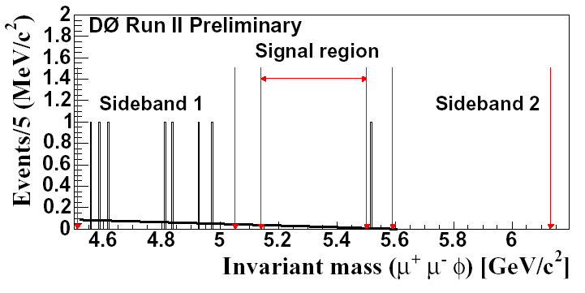
Limit on B_{s} -> μ⁺μ⁻φ
expected background from sidebands: 1.6 ± 0.4 events
observe zero events in signal region
  BR(B_{s} -> φ μ⁺μ⁻)/BR(B_{s} -> J/ψ φ) < 4.4 × 10⁻³ @ 95% C.L.
  Using central value for BR(B_{s} -> J/ψ φ) = 9.3×10⁻⁴ PDG2004:
  BR(B_{s} -> φ μ⁺μ⁻) < 4.1×10⁻⁶ @ 95% C.L.
x10
improvement
w.r.t previous limit

Slide 30
Conclusions
Tevatron is also a charm & bottom production factory for probing new physics in rare charm and bottom decays
CDF limit on D-> μ⁺ μ⁻ decay already competitive with only 65 pb⁻¹, improved limit will come soon…
first DØ observation of benchmark channel D_{s}± -> φ π± -> μ⁺μ⁻ π± as first step towards a charm rare FCNC decay program
CDF & DØ provide world best limits on purely leptonic decays B_{d,s} -> μ⁺μ⁻, limit important to constrain new physics
with more statistics to come enhance exclusion power/discovery potential for new physics
improved DØ limit on exclusive B_{s} -> μ⁺μ⁻φ decay shown, about 2x above SM
Tevatron is doubling statistics every year - stay tuned for many more exciting results on charm & bottom

Slide 31
SPARE

Slide 32
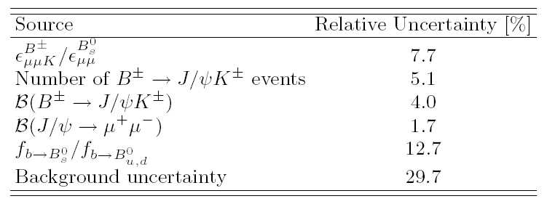
Systematic uncertainties
systematics for DØ (CDF very similar)
efficiency ratio determined from MC with checks in data on trigger/tracking etc.
large uncertainty due to fragmentation ratio
background uncertainty from interpolating fit

Slide 33
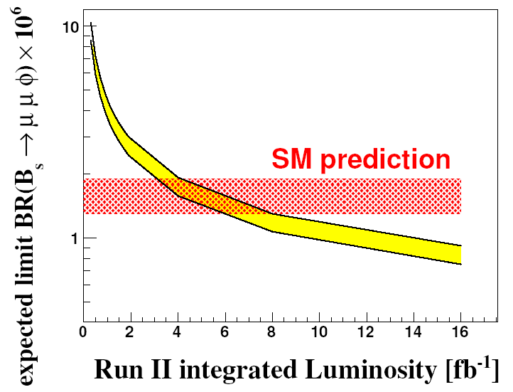
expected limit B_{s} -> μ⁺μ⁻φ
expected limit at 95% C.L. for B_{s} -> μ⁺μ⁻φ

Slide 34
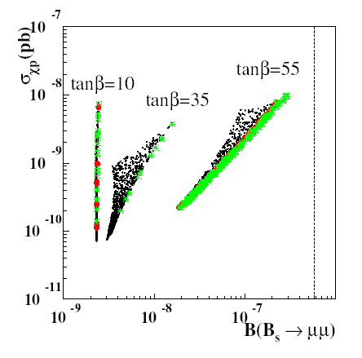
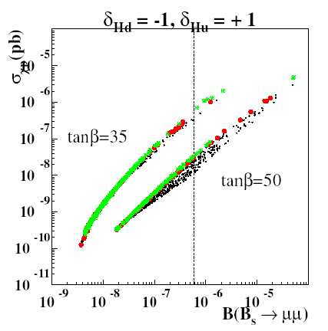
Constraining dark matter
mSUGRA model: strong correlation between BR(B_{s}->μ⁺μ⁻) with neutralino dark matter cross section especially for large tanβ
constrain neutralino cross section with less than, within and greater than 2σ of WMAP relic density
universal
Higgs mass
parameters
non-universal Higgs mass
Parameters, δH_{u}=1, δH_{d}=-1
S. Baek et al., JHEP 0502 (2005) 067

