Slide 1
BIG/Tune/Scraper
BNL SNS Status/Handoff Meeting
Peter Cameron
March 26-27, 2003

Slide 2
Outline
Summary and Conclusions
March 2003 FDR, ASAC and DOE Review updates
Status by system
Budget
Schedule
Summary and Conclusions

Slide 3
Summary and Conclusions
Guidance from all sources (DAC, DOE, ASAC, ORNL,…) has been to prioritize, reduce scope as needed to support critical systems
This guidance has been followed in practice
  Vacuum hardware is on schedule
  DAQ is on hold
This guidance has not yet been reflected in the budget
We have presented here a reduced budget and schedule that
  Retains almost all of the original functionality (BTF), and adds some new (scraper)
  Makes ~$200K available for higher priority diagnostics

Slide 4
Review updates
March 2003 FDR
  no comments beyond ‘prioritize’!
ASAC March 03
  Include resonant quadrupole pickup
DOE May 03
  Reduced set of Diagnostics for initial commissioning
  End Game plan - funding for BIG pulser and incoherent tune kicker amplifiers moved to FY05 (or beyond?)
DOE November 03
  Focus on BLM, BCM, BPM, VFM (no mention of wires)
Writing is on the wall for these systems - cut frills, maximize effectiveness with available resources

Slide 5
Beam-in-Gap
Status - full speed ahead on vacuum hardware, pulser and DAQ on hold
Kicker module
  went to the shops in October
  design modification to reduce number of flanges and feedthus - continuous 4.5m stripline
  first article custom EIA HV feedthru is in testing
Not a requirement for CD-4
Pulser is problematic - tough engineering problem
Alternative approach available for measurement (but not cleaning)
  mistime extraction kicker (as done at PSR), look at beam on scraper

Slide 6
Coherent Tune
Status - shared hardware with BIG (full speed ahead on vacuum hardware, pulser and DAQ on hold)
Alternatives
  measure tune of injected 400MHz bunches with Ring BPMs - in the baseline
  Provide a less expensive pulser, sufficient for tune (previous recommendation of DAC)
    single kick from 3KV Belke switches would deliver ~ 1cm oscillation
    these switches are standard fare at RHIC - Artus
    estimate ~$30K for switches and control
    no polarity reversal/collision avoidance
    advocated by ORNL Diagnostics - Mike Plum’s presentation

Slide 7
Incoherent Tune
Status
  full speed ahead on vacuum hardware (dipole and quadrupole pickups and kickers, and damper kickers), motion control, and resonant networks for dipole and quadrupole pickups
  kicker amplifiers and DAQ on hold
Alternatives
  tune of injected 400MHz bunch - problematic, but in baseline
  give up BTF, just look at spectra from pickups
    sensitive resonant pickups have proven extremely valuable in other machines
    gated acquisition with averaging
  Look at spectra with DSAs (already purchased)
    flexibility of DSAs is useful in early system development
    this was evolution of systems at RHIC
    BTF in machine studies mode can be accomplished with DSAs

Slide 8
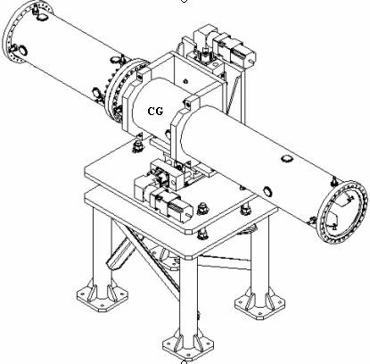
Tune Pickups
dipole
quadrupole

Slide 9
Scrapers
full speed ahead on vacuum hardware and motion control
  job was in the shops in October, pulled back to extend motion range and add feedthrus for emission current
two options for DAQ
  first choice is emission current - by ORNL, more of what is already provided for HEBT scrapers (more BW needed for gap measurement?)
  fallback is photomultipliers/gated MCPs
    PMT adequate for halo
    gated device needed for gap measurements

Slide 10

Budget
Reduced Incoherent tune
  Labor (hdware assy, res networks, motion ,…) ~$25K
  Materials (resonant networks, motion control,…) ~$25K
Reduced BIG/Coherent tune/Scrapers
  Labor (hdware assy, pulsers, motion, DAQ…) ~$40K
  Materials (pulsers, motion control, DAQ…) ~$40K
This frees up ~$200K, provides all Diagnostic capability except BTF (gap cleaning is not a Diagnostic)

Slide 11
Schedule
All Vacuum hardware (including scrapers) complete by July 04
Motion control interleaved with Dave Gassner’s many other responsibilities, to be accomplished in FY05
Belke pulser and control to be delivered in FY05
LabVIEW software to control DSAs - FY05
Scraper DAQ to be accomplished at ORNL convenience

Slide 12
Summary and Conclusions
Guidance from all sources (DAC, DOE, ASAC, ORNL,…) has been to prioritize, reduce scope as needed to support critical systems
This guidance has been followed in practice
  Vacuum hardware is on schedule
  DAQ is on hold
This guidance has not yet been reflected in the budget
We have presented here a reduced budget and schedule that
  Retains almost all of the original functionality (BTF), and adds some new (scraper)
  Makes ~$200K available for higher priority diagnostics

