Slide 1
Status of the LAPP
LHC AC Dipole Task
Ryoichi Miyamoto
University of Texas at Austin
2/27/2008 FNAL LARP Meeting
Collaborators
BNL: M. Bai, R. Calaga, W. Fischer, P. Oddo
FNAL: A. Jansson, M. Syphers
UT Austin: S. Kopp, R. Miyamoto
CERN: J. Serrano, H. Schmickler

Slide 2
Overview of FY08
System development
  Circuit design (CERN).
  Test to stack multiple (Crown or Labgrupen) audio amplifiers (FNAL, CERN).
  Work on tunability of the resonant circuit (maybe as an upgrad) (BNL).
Further development of measurement schemes
  On-line applications for linear optics measurements (BNL).
  Test linear and nonlinear optics measurements (FNAL).
After FY08
  The task completes this year?
  Hire a postdoc to work on on-line applications? (NSF approved the proposal but fonds are up in air).
  TBT analysis (or even optics measurement) task?

Slide 3
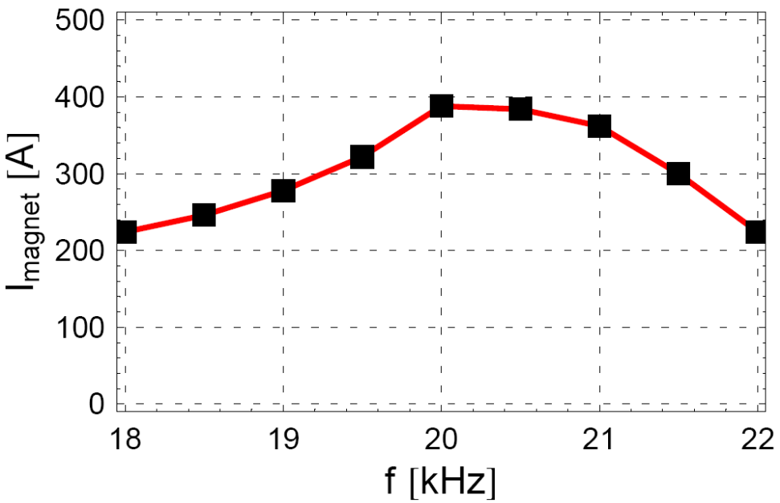
Tevatron AC Dipole System
8 μF
Magnet + Cable:
8 μH & 90 mΩ
+
Audio Amp
20 kHz & 8 kW
−
7.5 μF
|Z| ~ 8 Ω
Transformer
Balanced → Unbalanced
Adjust impedance
~1.8 mm oscillation (1 TeV)
±0.04 in tune

Slide 4
AC Dipoles for the Tevatron, RHIC, and LHC
Machine | RHIC | Tevatron | LHC
E [GeV] | 250 | 980 | 7000
σ [mm] | 0.75 | 0.5 | 0.3
|ν_{d} - ν| | ≥ 0.01 | ≥ 0.01 | ≥ 0.01
β_{arc}, β_{acd} [m] | 45, 11 | 80, 47 | 180, 260
(Bl)_{acd} for 4σ [Gm] | 140 (105) | 140 (115) | 200
f_{rev} [kHz] | 78 | 48 | 11
ν, 1-ν | 0.69, 0.31 | 0.58, 0.42 | 0.3, 0.7
f_{acd} [kHz] | 55 | 20.5 | 3, 8, 14, 19
LHC AC dipoles will be the Tevatron style.

Slide 5
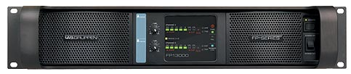
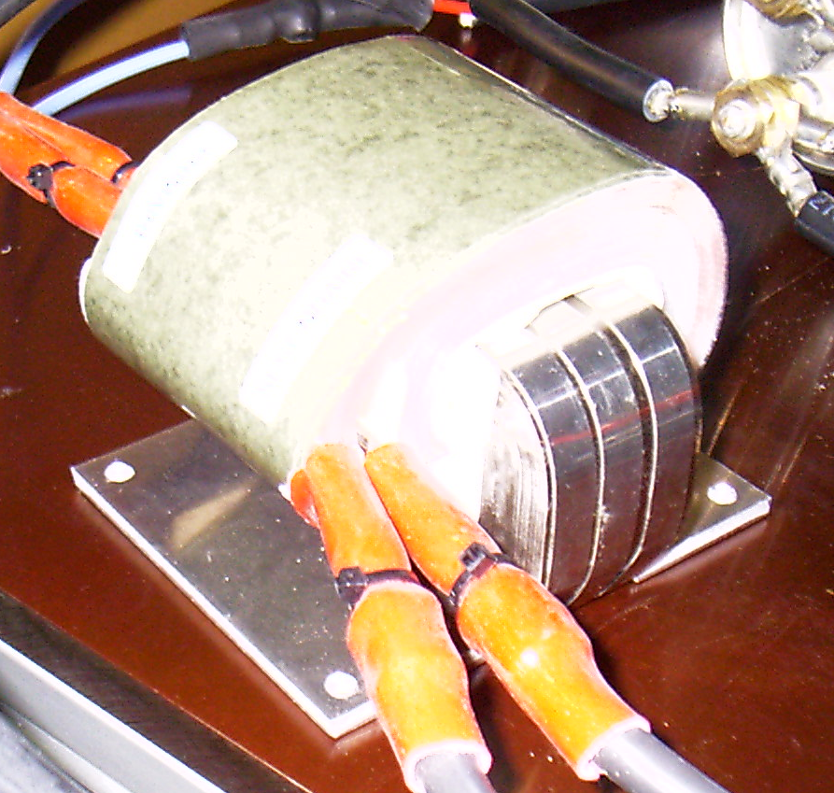
Status of Work at CERN
CERN has decided to adopt the FNAL solution
  4 pingers (MKQs)
  Lab-Gruppen FP13000
  Spec: 1800 A in MKQ for 4σ @ 7 TeV
Tests using new two amplifiers and 4:1 transformers
  1500A current achieved (2128A should be possible).
  The 4σ (1800A) goal seems in reach.
Peter Oddo (BNL) has been working
with Javier Serrano to implement
CERN system.

Slide 6
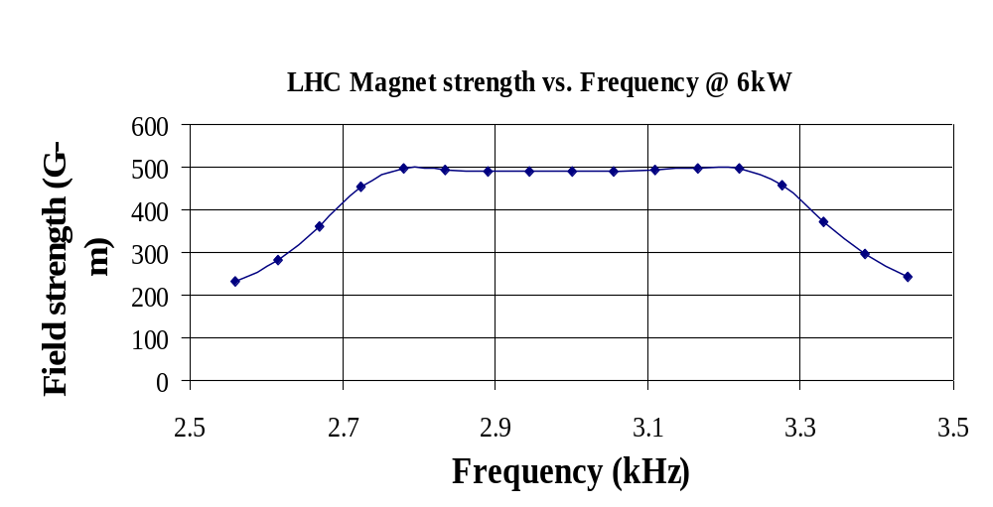
Goal: Tunability of Resonant Circuit (BNL)
Peter Oddo (BNL) is developing continuous tuning technique using single switched capacitor with MOSFT at BNL
Tunes resonant frequency by varying parallel capacitor
C changes because of variable duty cycle of the switch
Simulations suggest Df ~ 400 Hz

Slide 7
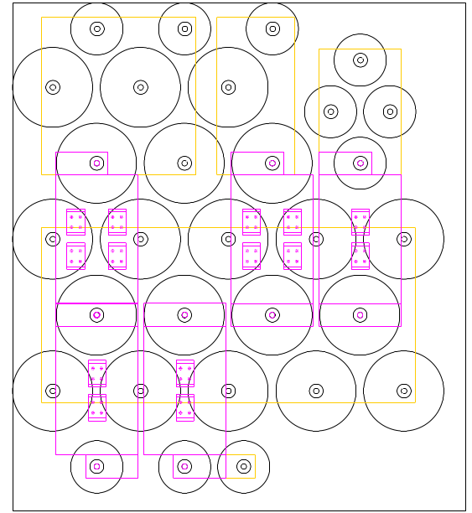
Intermediate Solution: Capacitor Bank
5-bit binary-weighted capacitor-bank
  0.255-0.345 (±15%) tune range
    2.867-3.880kHz
  0.002-0.005 tune steps
    22-54 Hz
Static MOSFET switching
  Can be replaced with mechanical switches or straps
Conservative design
  Can withstand CW operation
Peter and Mei have been working with Javier Serrano this Fall to implement this solution
Capacitor
Bit4
Bit3
Bit2
Bit0
Bit1
GND Plate
MOSFET Module
Coil/Drive Plate

Slide 8
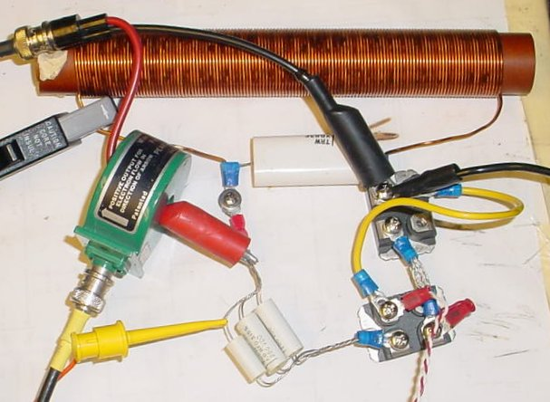
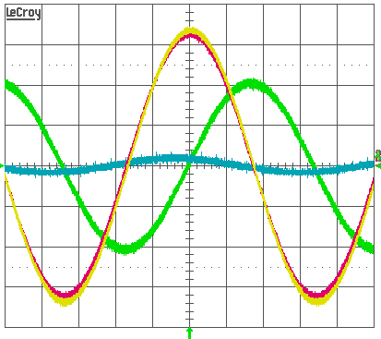
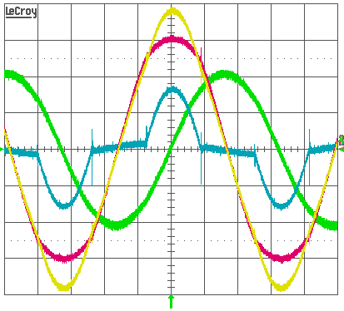
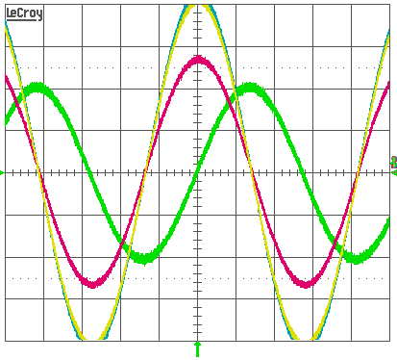
Low-power Switched-capacitor Results
7.33-9.04kHz (±10%) range
  Basic Topology, 0.56W, Q=15-19
Coil current fairly constant ~2.2A_{pk}
  3rd harmonic –33dBc
Consistent with simulation
Always on
7.33kHz
Switching
8.67kHz
Always off
9.04kHz
Coil current
Switch voltage
Coil voltage
Drive current

Slide 9
Initial Conclusions on Switched Cap’s
Maximum Q limited by existing MOSFET technology
  MOSFETs evaluated have a dissipation factor of 0.45-1% (or Q 100-220)
The need for many paralleled MOSFETs favor using a binary weighted capacitor-bank and modulating the LSB
  Modulating a smaller capacitance will also reduce distortion
  Modulation is not necessary for the LHC (low-Q)

Slide 10
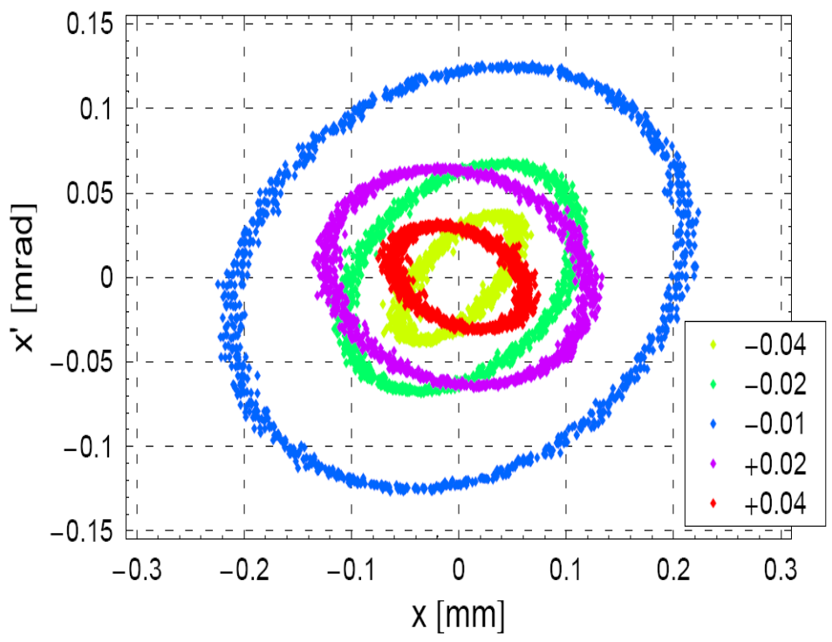
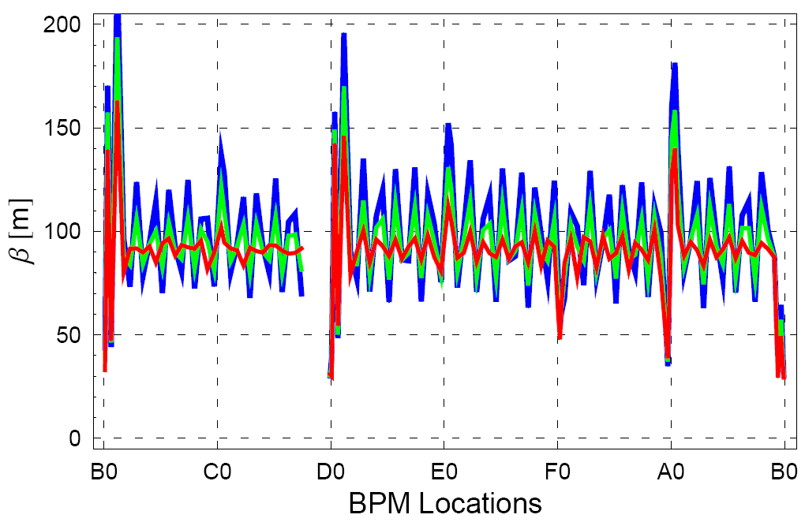
A New Linear Optics Measurement Scheme
(FNLA, Submitted to PRST-AB.)
true β
δ = -0.01
δ = -0.02
Driven motion ≠ Free Betatron Motion

Slide 11
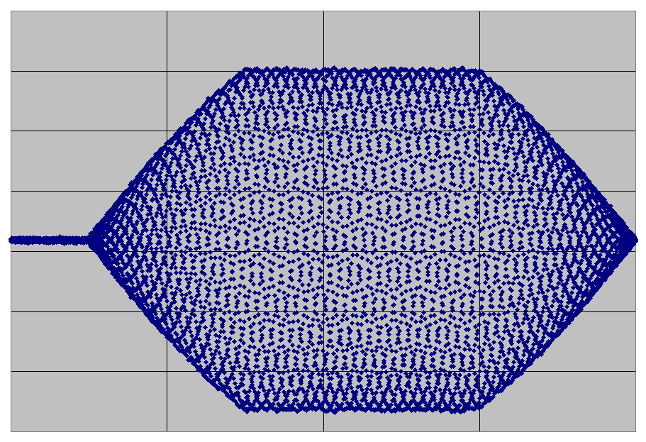
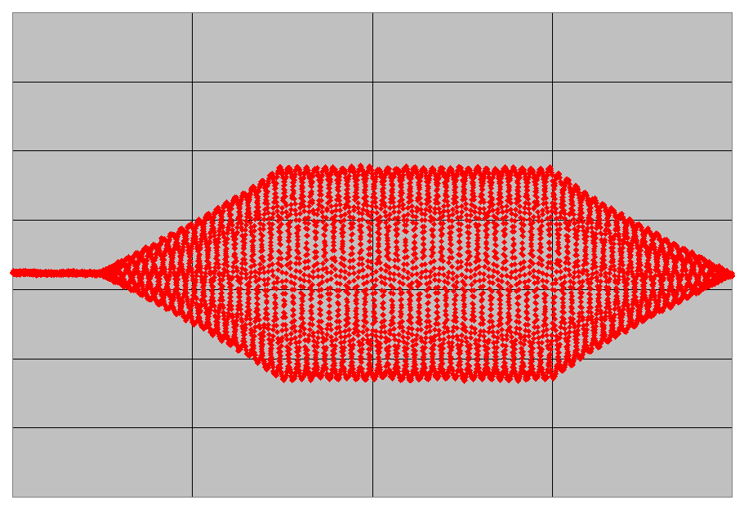
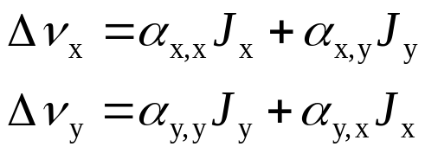
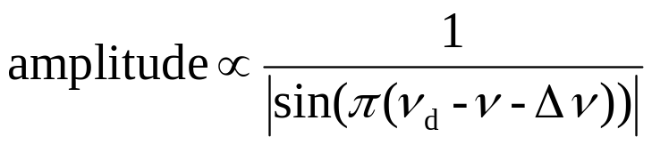
Detuning Measurement (FNAL)
y [mm]
8
6
4
2
0
-2
-4
-6
0
2000
4000
6000
8000
0
2000
4000
6000
8000
number of revs
number of revs
 | α_{y,y} [mm⁻¹ mrad⁻¹]
“Estimate” | 0.0207
Measurement | 0.020

Slide 12
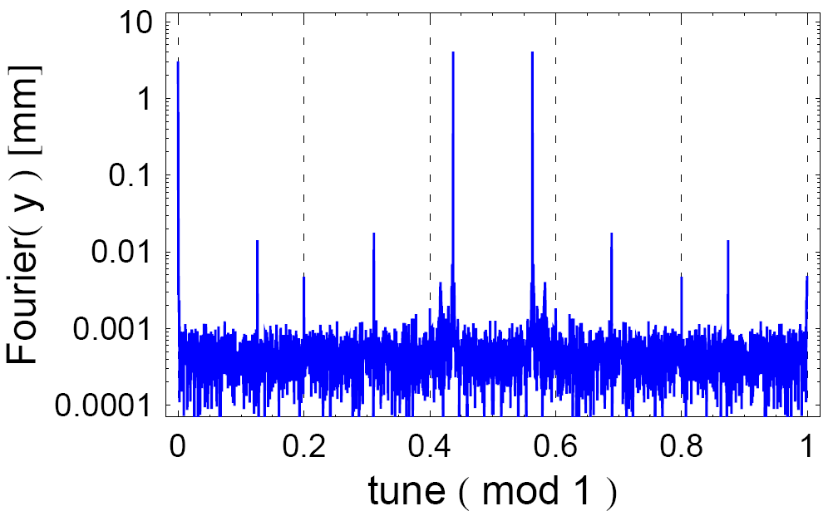
Driving Term Measurements Based on the Spectrum of TBT Data (FNAL)
ν_{d}
ν_{d}
closed orbit
3ν_{d}
3ν_{d}
2ν_{d}
2ν_{d}
ν
ν

Slide 13
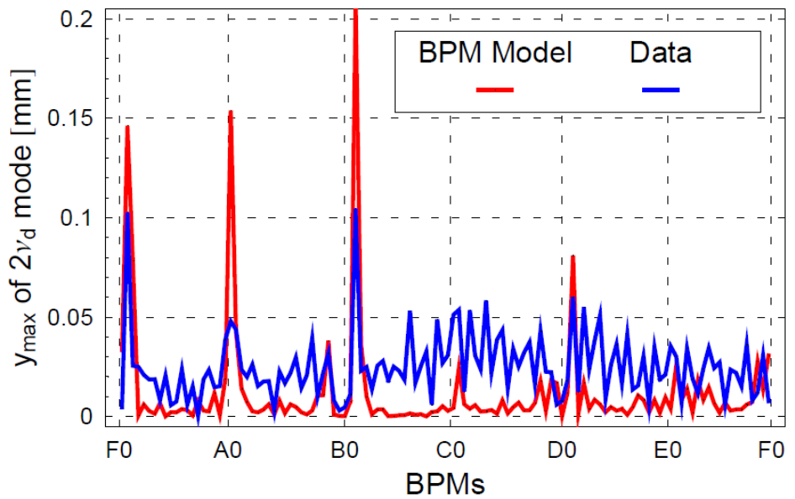
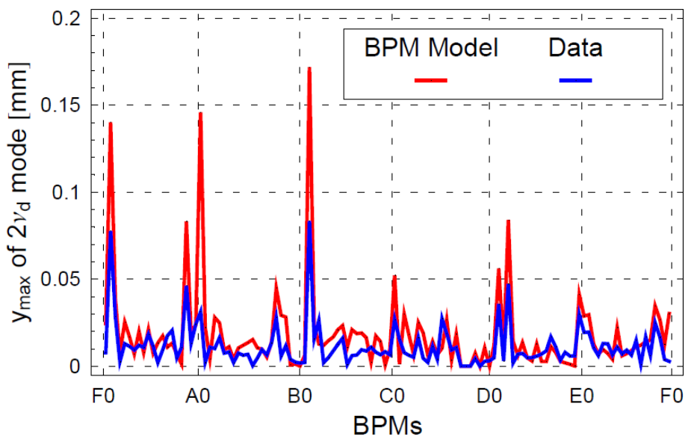
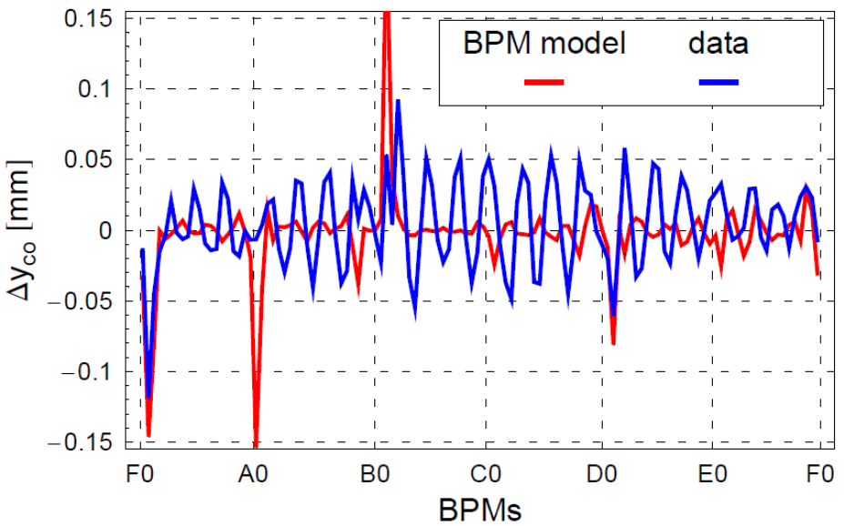
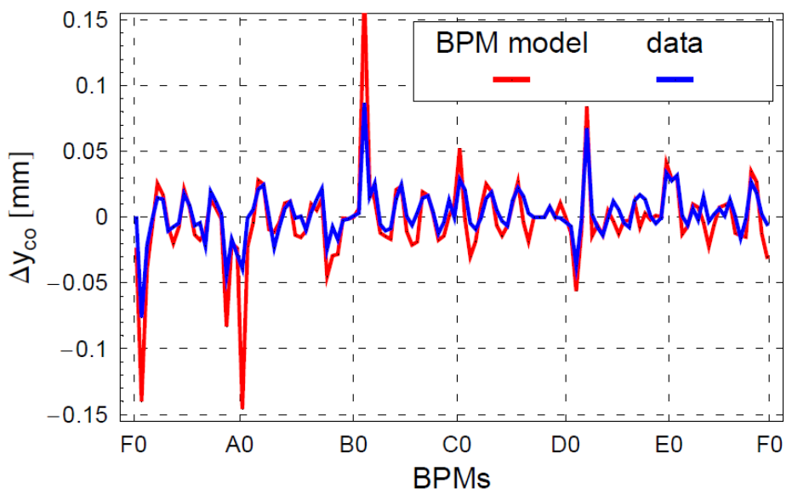
Driving Term Measurements Based on the Spectrum of TBT Data 2 (FNAL)

