Slide 1


Ferromagnetic Resonance study of Cobalt Nanowires for
Magnetic Storage
By Kevin Jagdipsingh
Dr. John Flowers (MEC)
Dr. Steve Greenbaum (Hunter College)
Abstract
The X-Band Bridge Bruker EMX spectrometer was used in the experiment to obtain the various characteristics of cobalt nanowires, such as the gyro magnetic ratio and the resonant magnetic field at various angles. It was discovered that the resonance frequency of the cobalt samples is angular dependent and peaks at around 90 degrees.

Slide 2
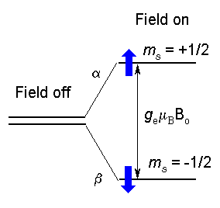

Abstract
Electron Paramagnetic Resonance Spectroscopy is a technique that is used to obtain specific physical and chemical characteristics from a sample. It is usually used as an supplementary method to other forms of spectroscopy. It works by detecting unpaired electrons in samples in a magnetic field. Ferromagnetic resonance (FMR) is a special case of EPR, in which the individual electron spins are strongly interacting, as in the case of ferromagnetic materials. The X-Band Bridge Bruker EMX spectrometer was used in the experiment to obtain the various characteristics of cobalt nanowires, such as the gyro magnetic ratio and the resonant magnetic field. It was discovered that the resonance frequency of the cobalt samples is angular dependent and peaks at around 85 degrees.

Slide 3
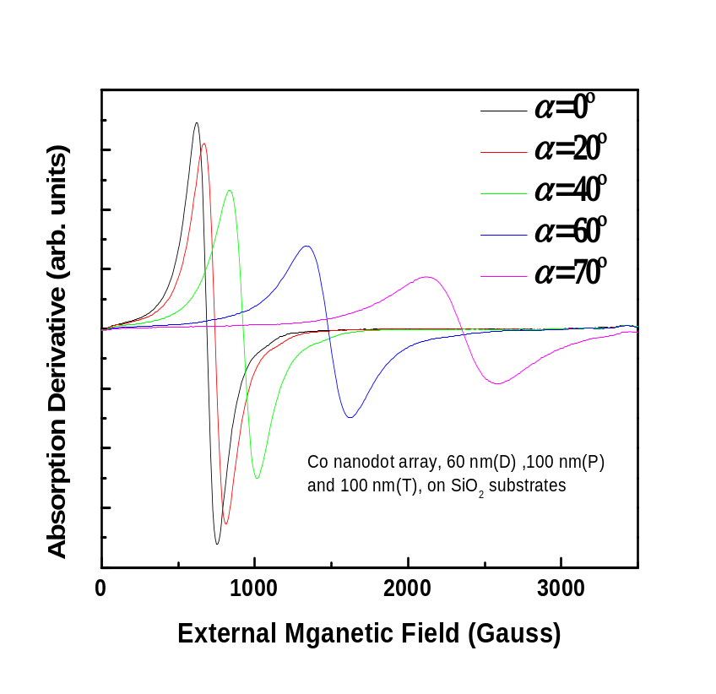
Results/Discussion
The cobalt wafers were found to be highly anisotropic. As the angular degree measure was increased, the signal both decreased in it’s intensity and increased in it’s field width.
It was also found that the sample had magnetic resonance above 8800 Gauss but due to the limitations of the magnetic field produced by the magnet, it was unable to be measured.

Slide 4
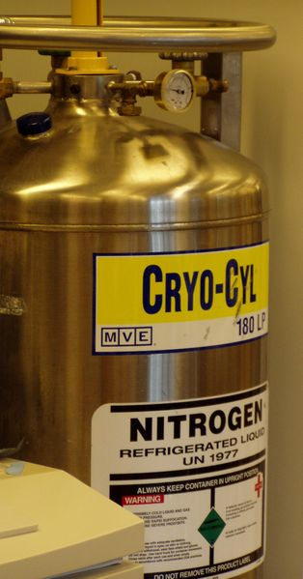
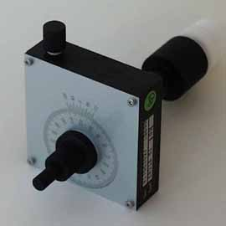
Conclusion/Future Research
It was found that the cobalt samples were highly anisotropic as predicted. This is due to the ferromagnetic electron environment of the cobalt wafers.
Possible follow up research could include a repeat of the experiment using a two degree intervals on the goniometer to test the reproducibility of the experiment. Also, the cobalt sample can be tested with liquid nitrogen to see the effects of low temperature on the magnetic resonance. Another experiment would be to try orienting the wafer a different way inside of the cavity in order to see the magnetic properties of the sides not tested.

Slide 5
Acknowledgements
I thank Dr. Flowers for helping me trough the methods and techniques of using the EPR spectrometer, Dr. Greenbaum for his useful dialogue and recommendations for research, and the other members of the lab for helping me along with my research and keeping me on task.

