Slide 1
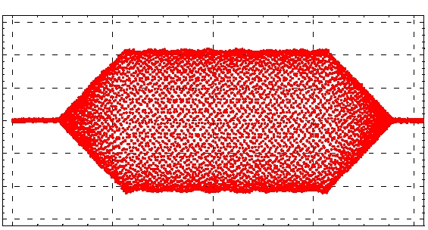
AC Dipole Report
M. Bai,¹ R. Calaga,¹ W. Fischer,¹ A. Jansson,²
S. Kopp,^{3†} R. Miyamoto,^{3§} P. Oddo,¹ M. Syphers²
¹Brookhaven National Laboratory
²Fermi National Accelerator Laboratory
³University of Texas at Austin
§PhD student
†Caution: particle physicist!

Slide 2
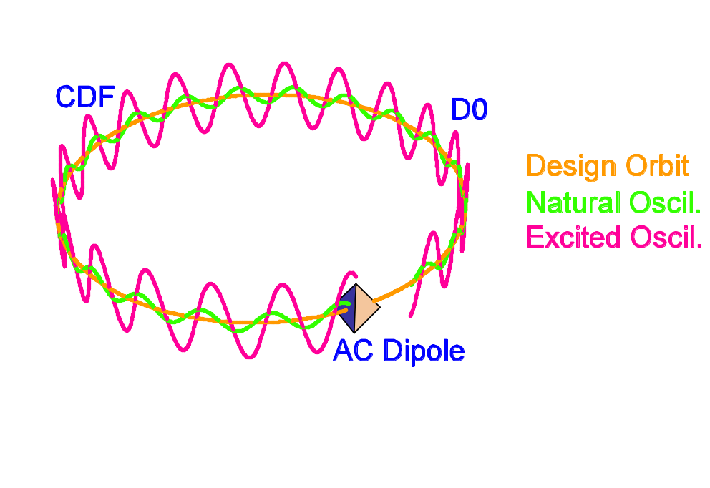
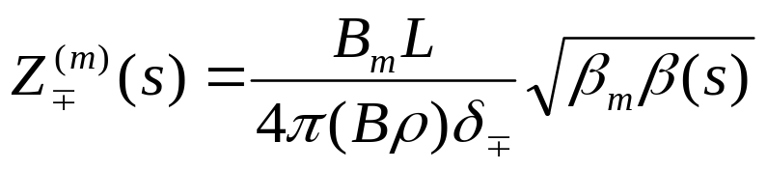
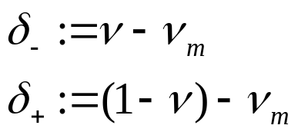
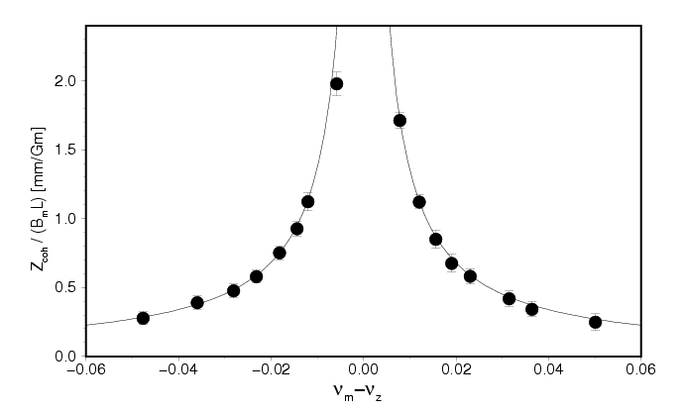
Simple View of AC Dipole:
Near-resonant excitation
IP1
IP2
AC Dipole
IP3
IP4
Long lasting large coherent oscillation with ε preserved
Data from AGS
unstable if ν_{m}=ν_{z}

Slide 3
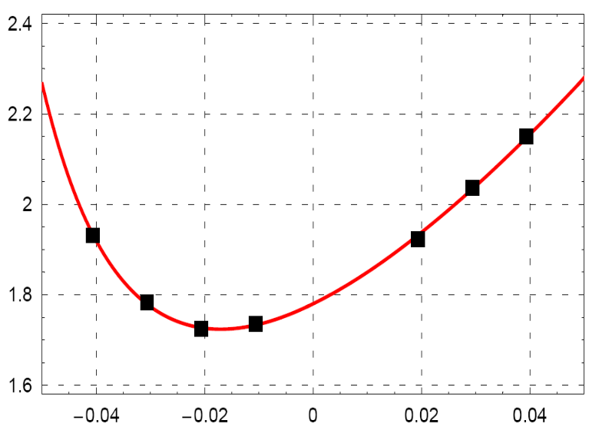
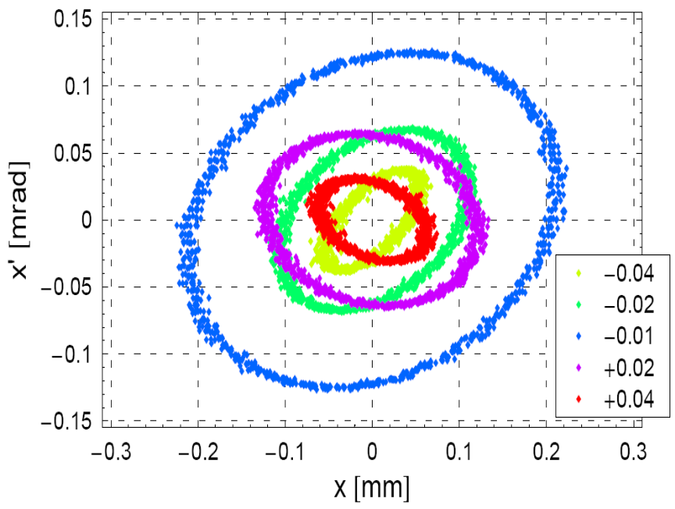
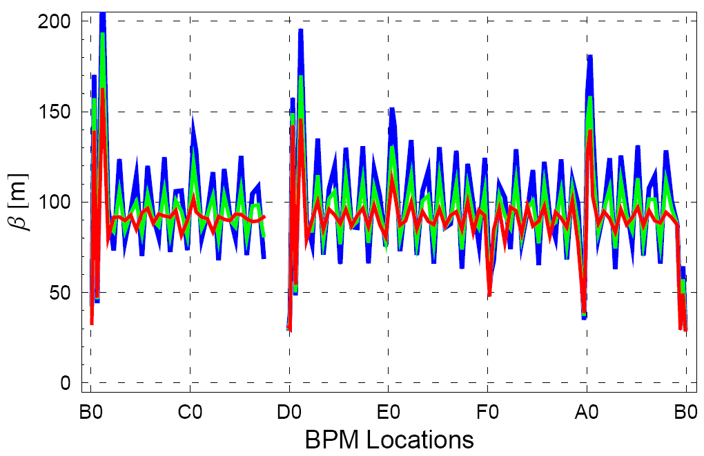
More Complicated View:
Driven Oscillation ≠ Free Oscillation!!
Phase Space @ an IP
Measured β from Fits
β_{d} [m]
True β
ν_{d} - ν
ν_{d} - ν
true β
δ = -0.01
δ = -0.02
R. Miyamoto et al,
Submitted to PRST-AB (also
arXiv:0709.4192)

Slide 4
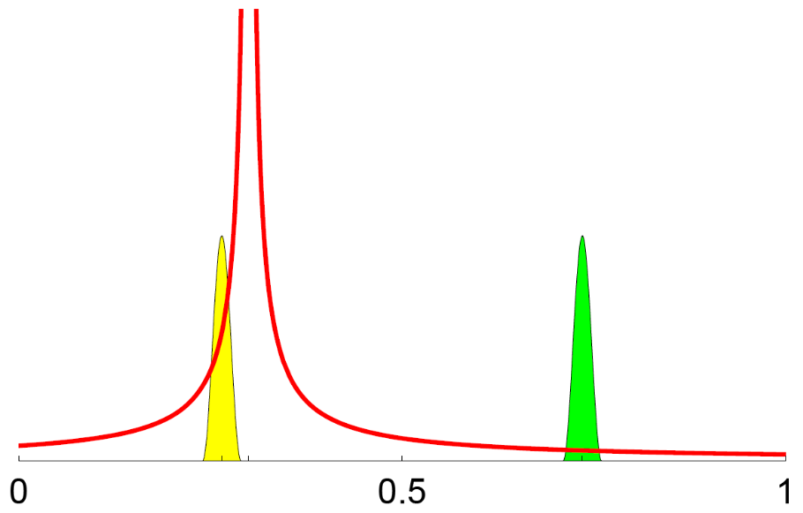
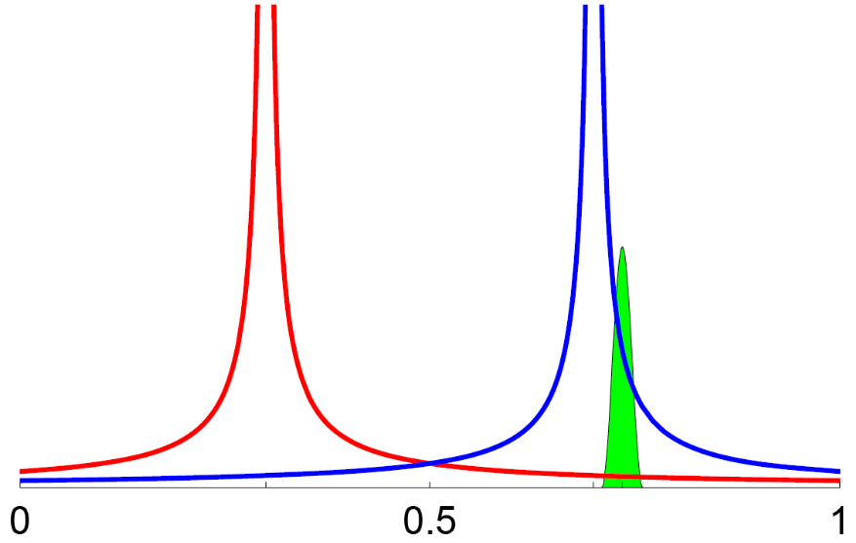
Two Driving Terms of an AC Dipole
1−ν
ν
ν
ν_{ac dipole}
ν_{ac dipole}
1−ν_{ac dipole}
Amplitude of the Driven Motion vs. Machine Tune
(For the AC Dipole)
Amplitude of the Driven Motion vs. Machine Tune
(For the Beam)
R. Miyamoto et al, Submitted to PRST-AB (arXiv:0709.4192)

Slide 5
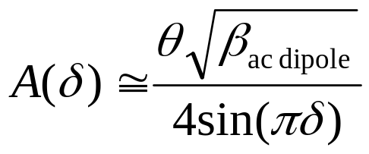
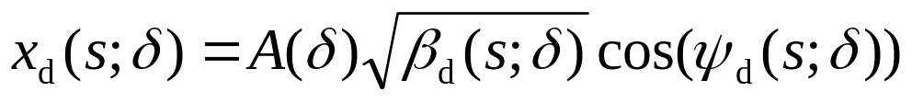
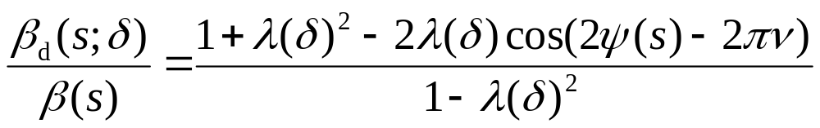
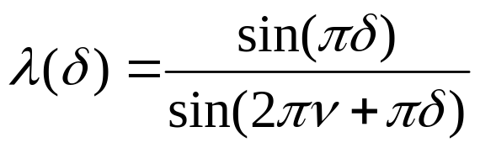
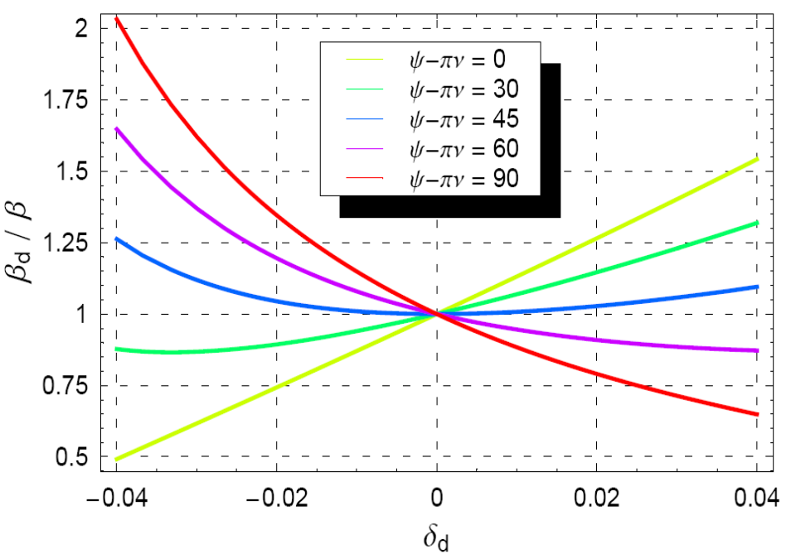
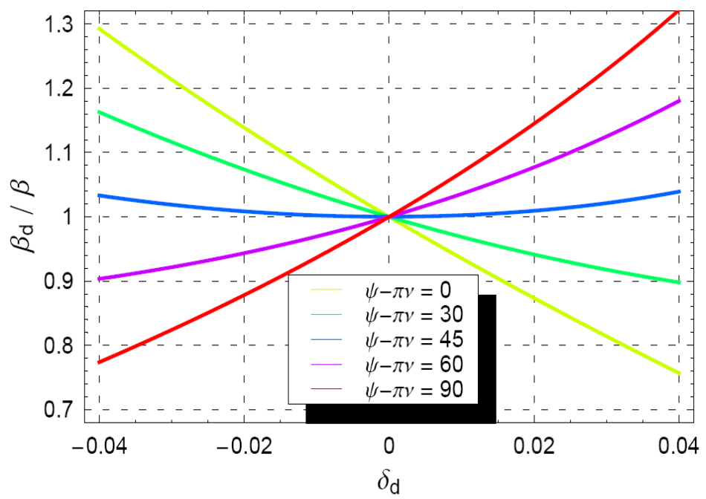
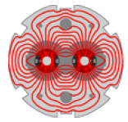
Analytic Expression of the Driven Motion
(AC Dipole introduces something that looks like a “quad error”)
ν = .58 (Tevatron)
ν = .30 (RHIC, LHC)
S. Kopp (U.Texas) – LARP Collaboration 10/17/07

Slide 6
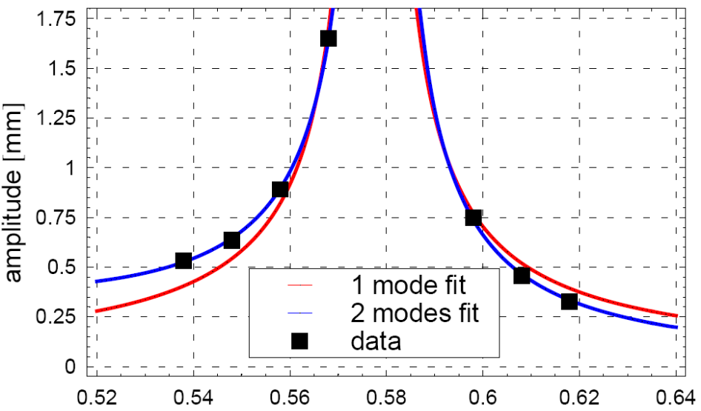
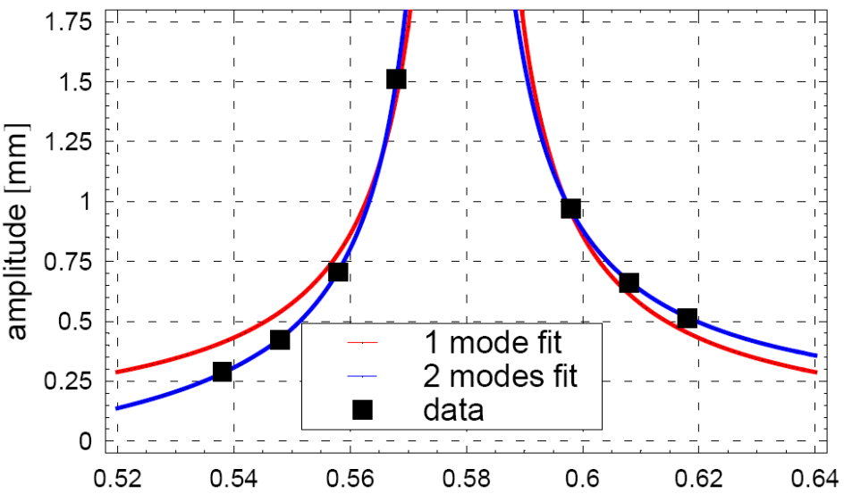
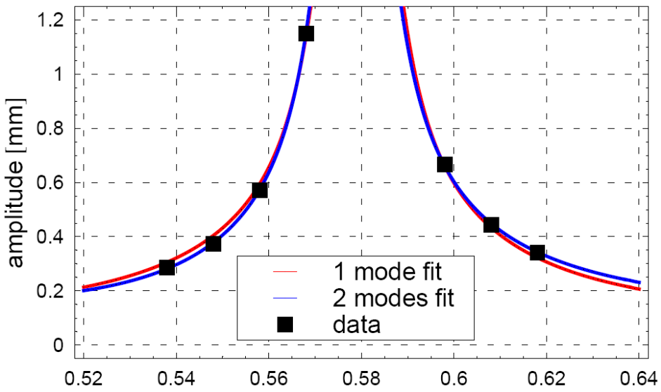
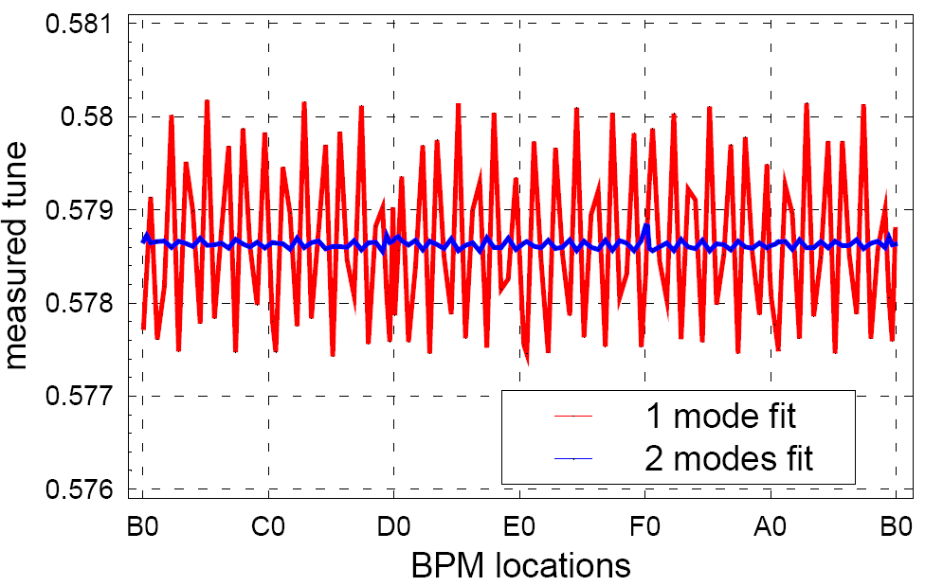
Amplitude vs. Driving Tune
driving tune
driving tune
Measured tune from fits
driving tune

Slide 7
Launching Activities at CERN
Mei Bai visited CERN and worked with Rogelio Tomas, Rama Calaga and Frank Schmidt on the AC dipole applications
She has developed a new fitting code which incorporates Ryoichi’s ‘two mode’ analysis.
Glenn from CERN is developing a JAVA application for LHC optics correction.
In a meeting with Rogelio, Frank, Rama, Yiton Yan from SLAC, Akio Morita from KEK they discussed wanting to see this tested in RHIC during the coming run.

Slide 8
High lights from CERN visit (Mei)
Rogelio organized an meeting with us, Rama, Frank Schmidt, Javier, Yiton from SLAC, Akio Morita from KEK and a few others to discuss the applications of LHC ac dipoles
  Linear optics measurement and gradient correction
  Dynamic aperture measurement
  Non-linear resonance driving term measurement
Meeting Summary: Rogelio
  A collection of techniques and software applications are being prepared to measure and correct the LHC optics on-line.
  Experiments are being performed in RHIC and SPS to assess these techniques
  Realistic simulations of LHC optics measurement and correction are also being performed with satisfactory results, so far. The AC dipole could play a key role in the measurement.
  Two points have to be clarified concerning the AC dipole: the discrepancy that Mei is observing between model and experiment and the safety issues for the LHC AC dipole.
  Yiton Yan offered his collaboration in the implementation of the MIA analysis for the LHC, with the advantage of obtaining a virtual machine that would reprocuce the observations. A perfect communication between the optics measurement on-line application and the on-line model application is being established.

Slide 9
High lights from the CERN visit
discussed with Yiton Yan on what we need to do to modify his MIA for the ac dipole optics measurements.
Analyze the dedicated ac dipole optics data with artificial quadrupole error during the RHIC 2007 Au run. Both Mei’s and Rama’s code can identify the artifical gradient error correctly. Rama also compared this with his optics measurements with one-turn kicker.
  Ed comment from Sacha: it seems to be well-established that we can properly observe a quad error that has been artificially inserted. But this is not a “blind analysis”. What evidence can we provide that the AC Dipole would really diagnose (and lead to correction) an effect on-line?

Slide 10
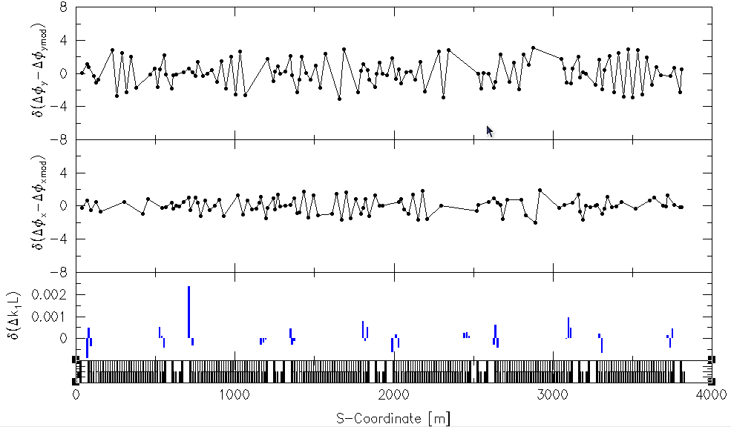
RHIC ac dipole optics data – 2007
(Mei’s analysis)

Slide 11
Parameters of RHIC, TeV, and LHC
machine(GeV) | RHIC(250) | Tev (150) | Tev (980) | LHC(7000)
f_{rev} [kHz] | 78 | 47.7 | 47.7 | 11
ν, 1-ν | 0.71 | 0.58, 0.42 | 0.58, 0.42 | 0.3, 0.7
f_{m} [kHz] | 55 | 20 | 20 | 3, 8,14,19
(Bρ) [Tm] | 833.9 | 500 | 3,300 | 23,000
δ | ≥ 0.01 | ≥ 0.01 | ≥ 0.01 | ≥ 0.01
β (β_{m}) [m] | 45(11) | 80 (47) | 80 (47) | 180**
σ [mm] | 0.75 | 1.3 | 0.5 | 0.3
B_{m}L [Gm] (4σ) | 142 | 50 | 140 | 190
I_{FNAL} [A] | 284 | 100 | 450 | 610
** Serano’s talk @ LTC gives β_{m}=258m at location of MKQ kicker

Slide 12

“Musical Dipoles”
Desired excitation f in audio band
  Use commercially-available, cheap amplifiers
Parallel resonant circuit
  Match impedance of the amplifer
  Maximizes current in the magnet
Use pinger magnet
  Iron core ⇒ good field
  Large R_{magnet} ⇒ low Q
Downstairs
+
6 μF
Magnet + Cable:
8 μH & 0.1 Ω
Audio Amp
20 kHz, 8 kW
−
8 μF
A. Jansson
1:1 Transformer
Balanced → Unbalanced

Slide 13
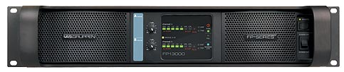
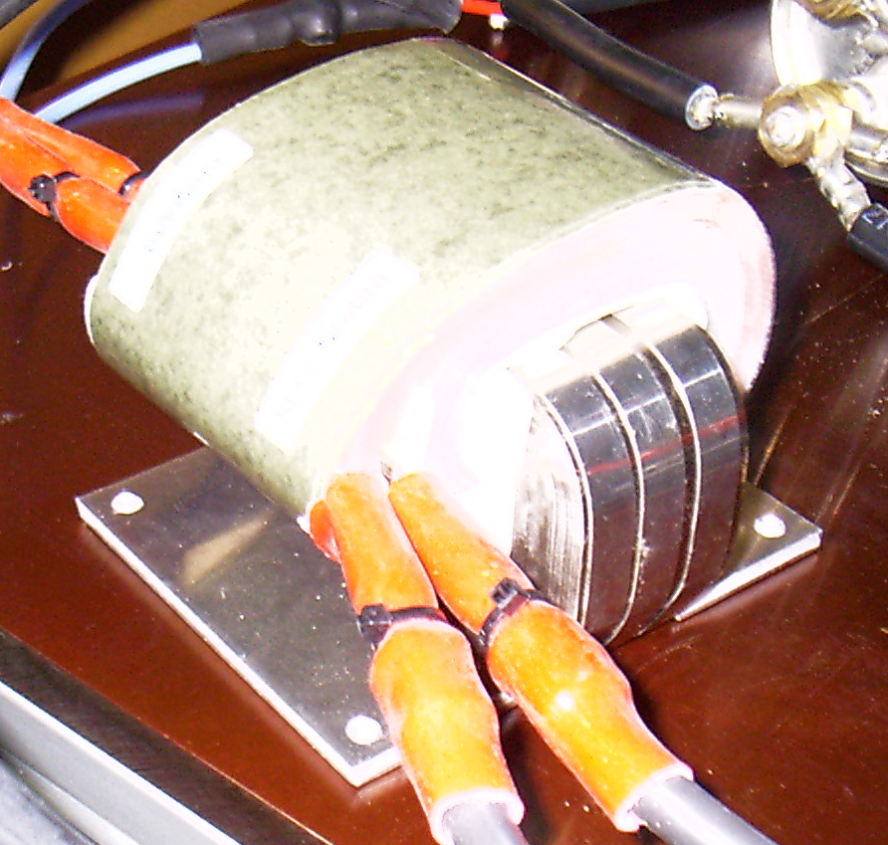
Current Status of Work at CERN
As I reported last year, CERN has decided to adopt the FNAL solution of audio amps driving a pinger
  Spec: 1800 A in MKQ for 7σ @ 7 TeV.
  4 pingers (MKQs)
  Lab-Gruppen Class-H amp
Testing started using new 2 Lab.Gruppen FP13000 amps and 4:1 transformers
  1500A_{pk} magnet current achieved
  2128A_{pk} should be possible at resonance with an adequate AC-supply
  The 7σ (1800A_{pk}) goal seems in reach
Peter Oddo has been working with Javier Serrano to implement CERN system (great to have CERN presence!)

Slide 14
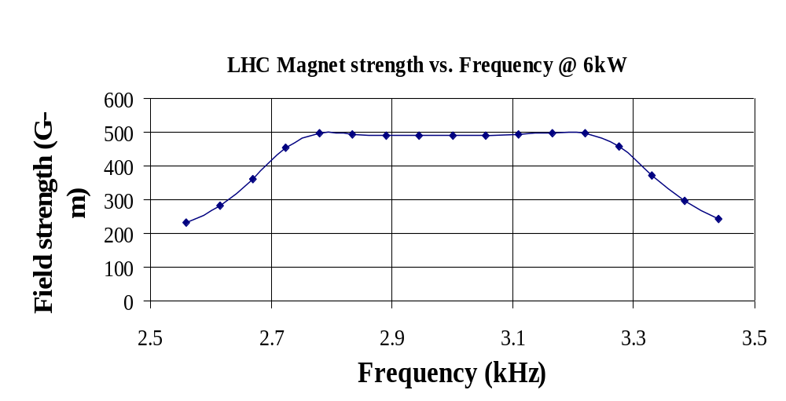
Goal: Tunability of Resonant Circuit
Peter Oddo (BNL) is developing continuous tuning technique using single switched capacitor with MOSFT at BNL
Tunes resonant frequency by varying parallel capacitor
C changes because of variable duty cycle of the switch
Simulations suggest Δf ~ 400 Hz

Slide 15
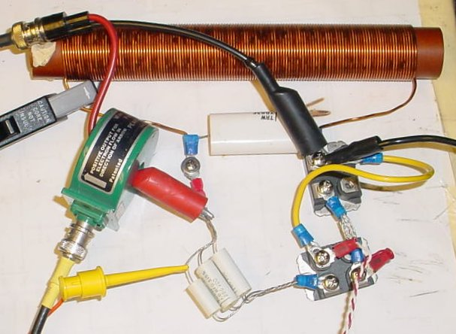
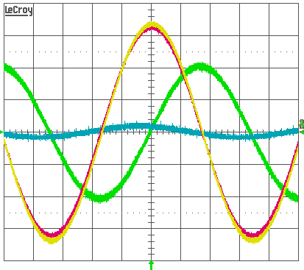
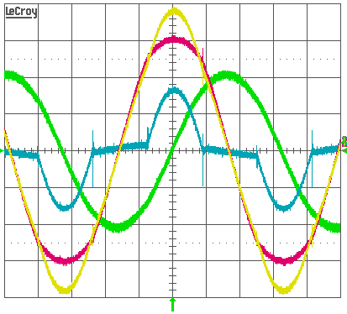
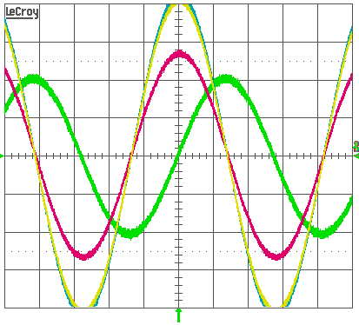
Low-power Switched-capacitor Results
7.33-9.04kHz (±10%) range
  Basic Topology, 0.56W, Q=15-19
Coil current fairly constant ~2.2A_{pk}
  3rd harmonic –33dBc
Consistent with simulation
Always on
7.33kHz
Switching
8.67kHz
Always off
9.04kHz
Coil current
Switch voltage
Coil voltage
Drive current

Slide 16
Initial Conclusions on Switched Cap’s
Maximum Q limited by existing MOSFET technology
  MOSFETs evaluated have a dissipation factor of 0.45-1% (or Q 100-220)
The need for many paralleled MOSFETs favor using a binary weighted capacitor-bank and modulating the LSB
  Modulating a smaller capacitance will also reduce distortion
  Modulation is not necessary for the LHC (low-Q)

Slide 17
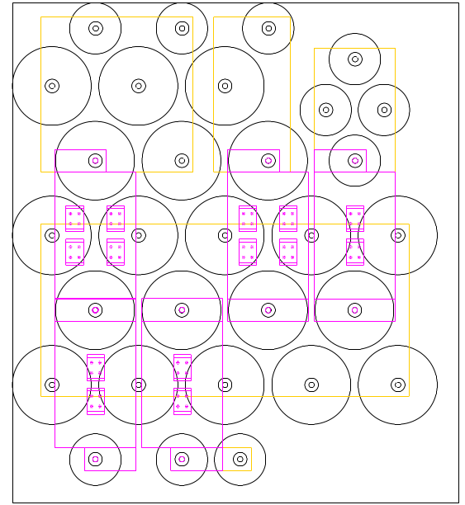
Intermediate Solution for Selective Tunability of LHC AC-Dipole
5-bit binary-weighted capacitor-bank
  0.255-0.345 (±15%) tune range
    2.867-3.880kHz
  0.002-0.005 tune steps
    22-54 Hz
Static MOSFET switching
  Can be replaced with mechanical switches or straps
Conservative design
  Can withstand CW operation
Peter and Mei have been working with Javier Serrano this Fall to implement this solution
Capacitor
Bit4
Bit3
Bit2
Bit0
Bit1
GND Plate
MOSFET Module
Coil/Drive Plate

Slide 18
In the Coming FY08 Year
Can already point to this as a LARP success?
$80k allocated to this task for FY07
  We promised a conceptual plan by Dec. 2007
  Largely, this done for PAC07 (arXiv:0709.2753)
We’ve asked for similar $80k this year
There are still issues for consideration
  Demonstrate 1800 Amp magnet current for 7σ at 7TeV
  Completion of continuous tuning capacitor circuit
  Completion of “in-out” selective capacitor switching
  On-line diagnostic tools, analysis (if not the software, at least the demonstrated analysis)
  Great to have a presence at CERN!
  Study issues of machine protection, possible interferences with damper (other?) systems (not clear this is a LARP task, however).
I view this task as being completed after FY08 (move to commissioning work, doesn’t need separate task).

