Slide 1
Some Thoughts on Schottky for LHC
Peter Cameron - BNL

Slide 2
Thoughts
The need
What you can measure
Examples from RHIC
Lessons learned at RHIC
Day One at LHC
Advocates are essential

Slide 3
The Need
The accelerator is expensive, instrumentation is comparatively cheap
All of the information (except position, coherent tune,…?) regarding the beam is available in Schottky spectrum
Schottky is always there, no emittance growth
RHIC experience has shown value of multiple and/or fallback measurements

Slide 4
What You can Measure
Synchrotron frequency – cavity phasing,…
Momentum spread
Incoherent tune – the one you really care about
Linear Chromaticity
Non-linear chromaticity – lineshape
Non-linear tune spread – two ways
  Betatron sum width relative to revolution line
  Central line width
Transverse emittance
Coupling,…..

Slide 5
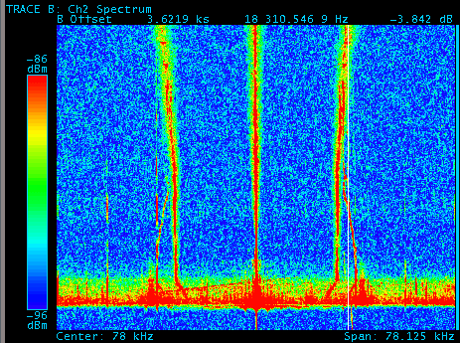
LF Schottky on the Ramp
Injection
Transition

Slide 6
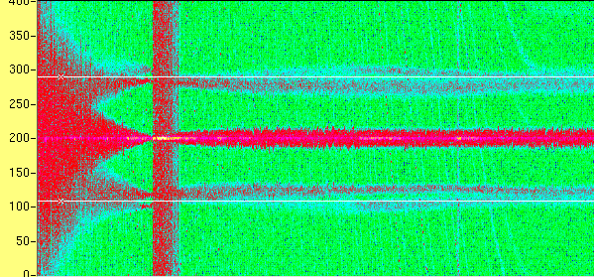
HF Schottky Tune up the Ramp
inj
transition
store

Slide 7
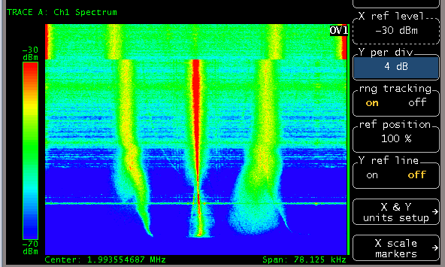
Down Ramp Chromaticity

Slide 8
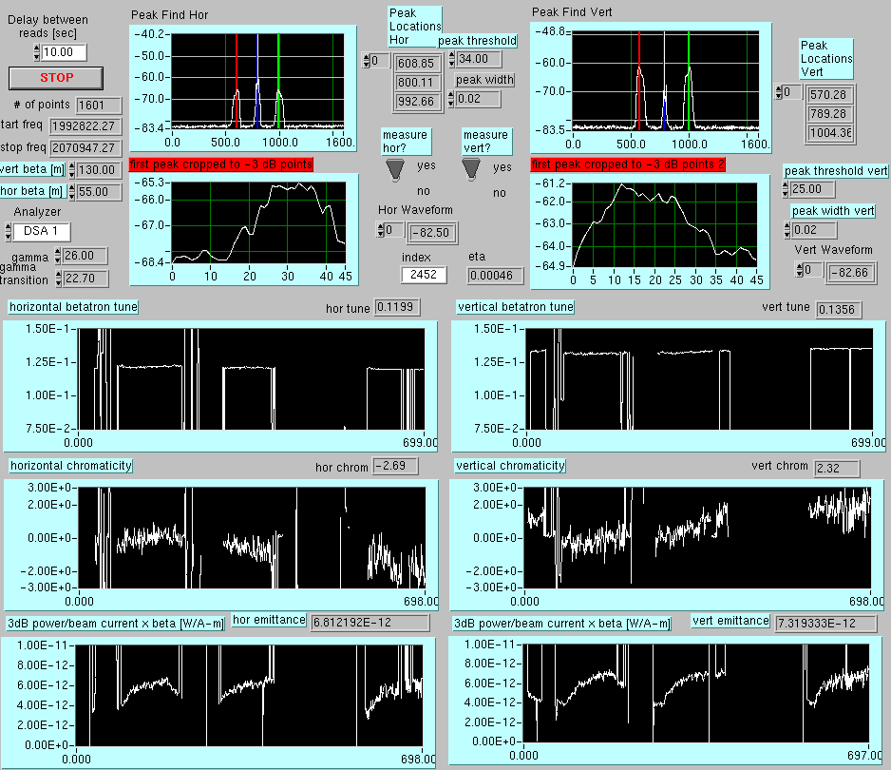
HF Schottky with Polarized Protons

Slide 9
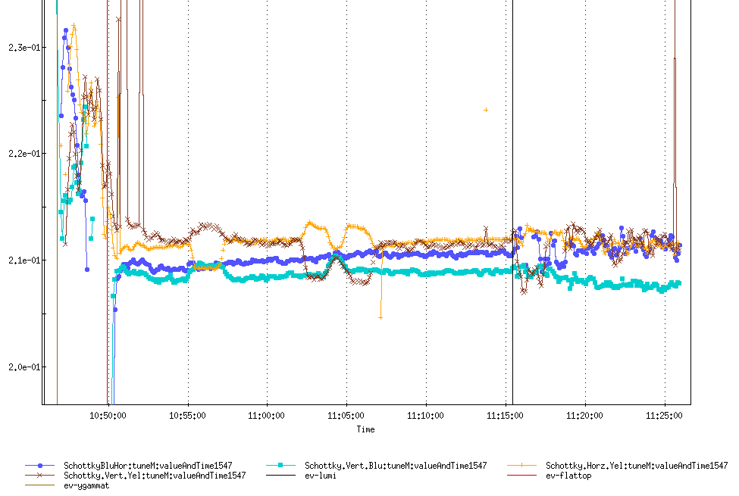
HF Schottky at Store - RHIC 2001
transition
Flat top
200MHz on

Slide 10
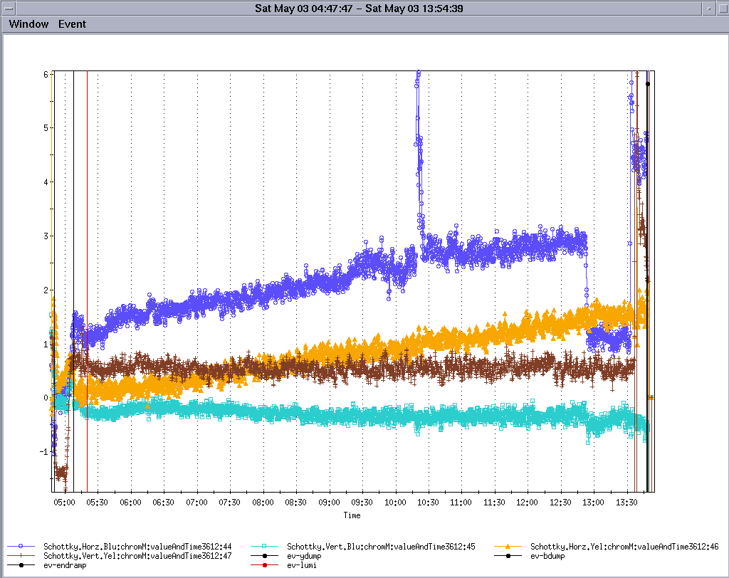
Chromaticity during Store (protons)
200MHz RF on

Slide 11
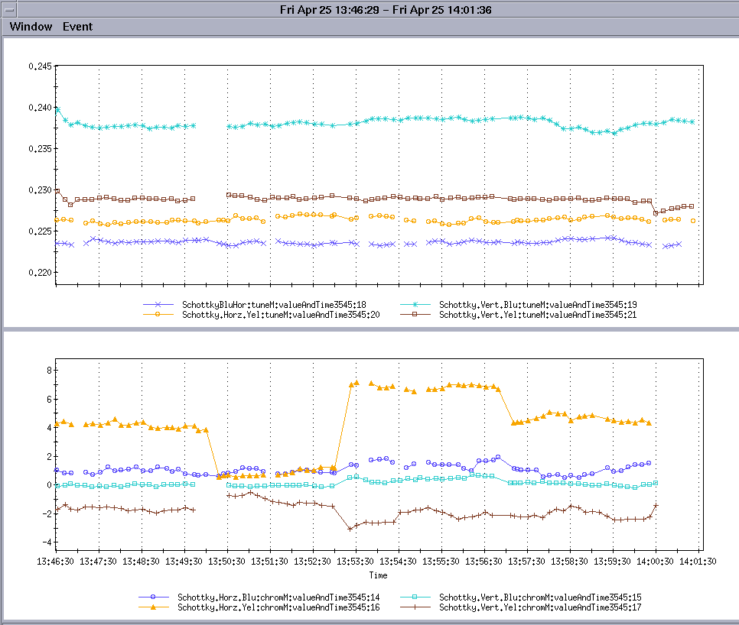
Fit Dependence of Chromaticity
tunes
4th order
4th order
2nd order
6th order

Slide 12
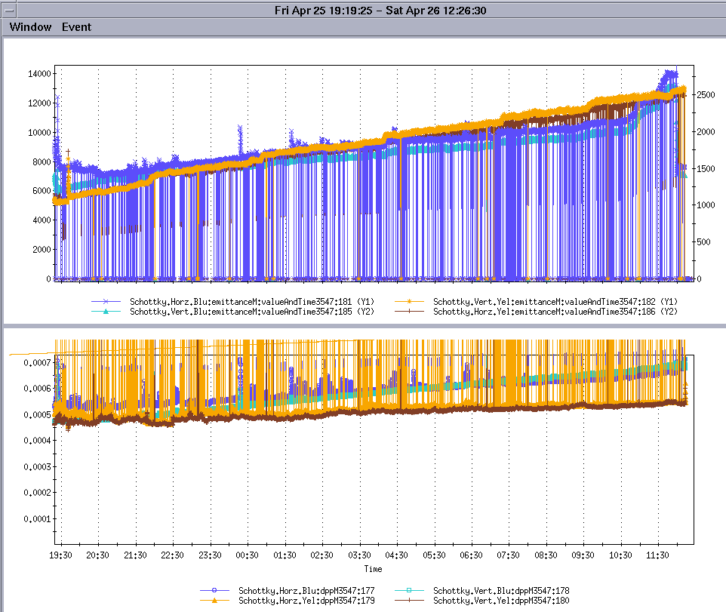
Emittance and deltap/p thru store
Emittance jumps at pol measurement
Deltap/p growth greater in blue than yellow

Slide 13
Schottky Lessons Learned
Dynamic range problem - Saturation of transverse mode due to revolution line – motion control is essential
Sensitivity to beam loss – wall currents blind the pickup
Mixers – beam synchronous LOs are essential
Software – Sophisticated algorithms essential to extract sophisticated data, requires considerable experience with beam to get this right
Platform
  DSAs are a pain due to data output rate limitations
  In terms of sophistication, it is hard to beat a DSA with DSPs
  RHIC experience – first DSAs, then DSPs, then back to DSAs

Slide 14
Day One at LHC
Traveling wave pickup appears advantageous
  Scaling of S/N
    Transverse impedance? 10dB difference
      Resonant cavity ~ 10 MΩ/m
      TW pickup ~ 1 MΩ/m (Caspers’ estimate)
    Equivalent Q? 23dB difference
      Resonant cavity ~ 5000
      TW pickup ~ 30
Comparative Design Study is essential – reference Goldberg’s RHIC study
  Clear estimates of what can be measured day one with TW pickup
Follow on Resonant cavity? This should be evaluated in design study
Essential to have pickups in place, and DSA DAQ at the least

Slide 15
Advocates are essential
Need two types (at least in RHIC environment)
  Instrumentation Specialist
  Accelerator Physicist
Both need to be on board early, and need to have Schottky as a high priority thru development and commissioning

