Slide 1
Recent ψ(2S) and J/ψ results from CLEO
PANIC05, Santa Fe, NM
Oct 24 - 28, 2005
GuangShun Huang
Purdue University
(Representing the CLEO collaboration)
    Ψ(2S) → XJ/ψ
    J/ψ → l⁺ l⁻
    Ψ(2S) → baryon pair
    Ψ(2S) → multi-body hadrons
    Ψ(2S) → K_{S}K_{L}

Slide 2
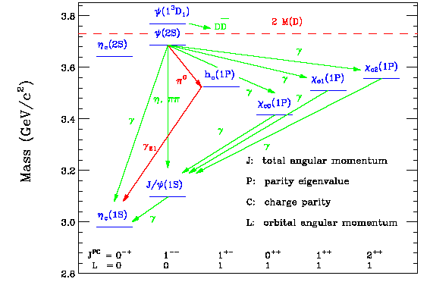
Charmonium

Slide 3
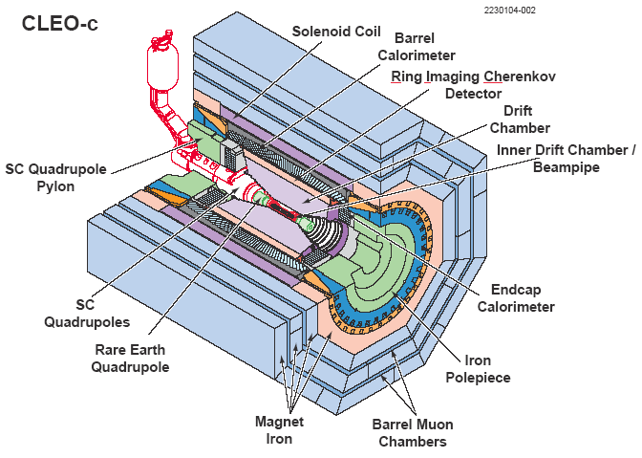
CLEO-c detector
B=1 Tesla
0.6% p @ 1GeV/c
2.2% Eγ @ 1 GeV
5% Eγ @100 MeV
Track 93% of 4π
RICH 80% of 4π
Data sets:
Ψ(2S) (3686) 5.63pb⁻¹
Cont. (3670) 20.70pb⁻¹

Slide 4
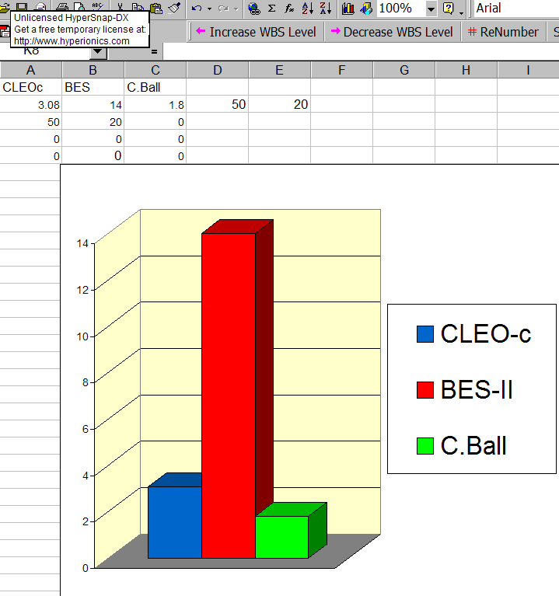
CLEO vs other experiments
Ψ(2S) in millions of resonance decays
Detector | Magnetic field | σ_{p} /p resolution at p=1 GeV
CLEO-c | 1.0T | 0.5%
BES-II | 0.4T | 2.4%
C.Ball | 0 | --
Detector | Calorimeter crystals | σ_{Eγ} resolution at Eγ=100 MeV | Number of inner segments (crystals) | Inner radius (cm)
CLEO-c | CsI(Tl) | 4.8 MeV | 7800 | 100
C.Ball | NaI(Tl) | 4.8 MeV | 672 | 25
BES-II | Sampling | 70 MeV
CLEO-c Ψ(2S) data sample is not the biggest in the world, but the detector is excellent (both tracking and γ detection),
and we also have a large continuum data sample.

Slide 5
ψ(2S)→X J/ψ(1S)
Hadronic transitions (X=ππ,η,π⁰):
  BR(ψ(2S)→XJ/ψ(1S)) needed in phenomenological models;
  BR(ψ(2S)→ π⁺π⁻ J/ψ(1S)) often used as normalization;
  BR(ψ(2S)→ π⁰ J/ψ(1S)) / BR(ψ(2S)→ η J/ψ(1S)) is sensitive to
  m_{u}-m_{d} (isospin violation)
  Previous ratio of BR(ψ(2S)→ π⁰π⁰ J/ψ(1S)) / BR(ψ(2S)→ π⁺π⁻ J/ψ(1S)) at odds with isospin symmetry (beyond amount of expected violation)
Photon cascades ψ(2S)→ γχ_{cJ}(1P) → γγJ/ψ(1S):
  Serves as determination of BR(χ_{cJ} (1P) → γJ/ψ(1S))
Inclusively measured BR(ψ(2S)→X J/ψ(1S)):
  Σ_{i} BR(ψ(2S)→X_{i} J/ψ(1S)) = BR(ψ(2S)→X J/ψ(1S))_{inclusive}
  a powerful check on validity of the measurements
  Test if “12% rule” satisfied with inclusive decays

Slide 6
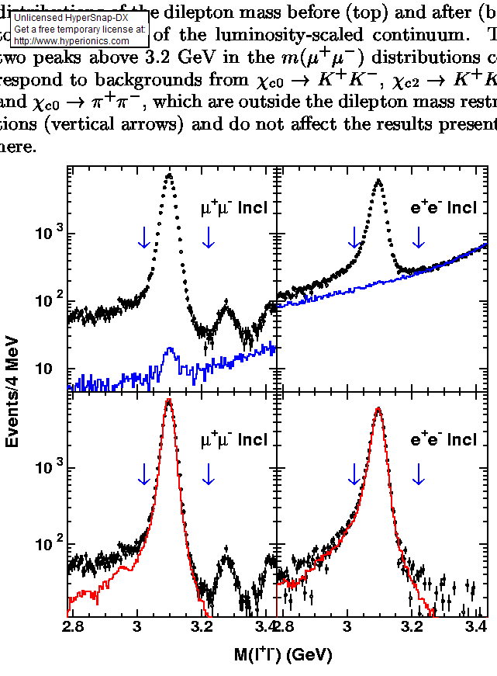
Inclusive BR(ψ(2S)→X J/ψ(1S))
ψ(2S)
data
Inclusive
dilepton pairs:
  Electrons and muons identified with loose E/p cuts
cut
cut
J/ψ
ψ(2S)
BW tail
scaled continuum
ψ(2S)
continuum
subtracted
χ_{c0,2} → Κ⁺Κ⁻
π⁺π⁻
MC

Slide 7
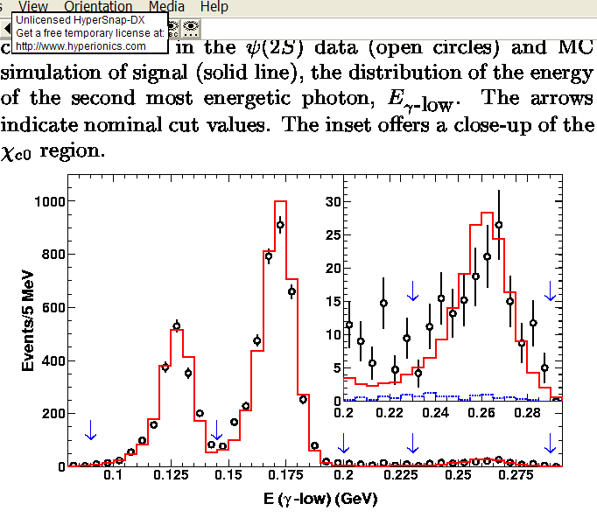
Exclusive
BR(ψ(2S)→ γχ_{cJ}(1P)→ γγJ/ψ(1S))
χ_{c1}
χ_{c0}
Fully reconstructed events
η → γγ,π⁰ → γγ suppressed by 250<p(J/ψ)<500MeV, which corresponds to 227<m(γγ)<522MeV:
  Other experiments used direct cuts on m(γγ) (they really didn’t have a choice)
  In CLEO-c resolution of m(γγ) calculated via p(J/ψ →⁺⁻) is actually better than calculated via γγ
χ_{c2}

Slide 8
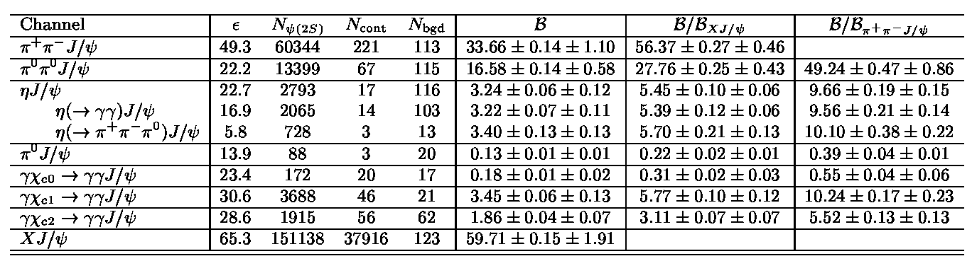
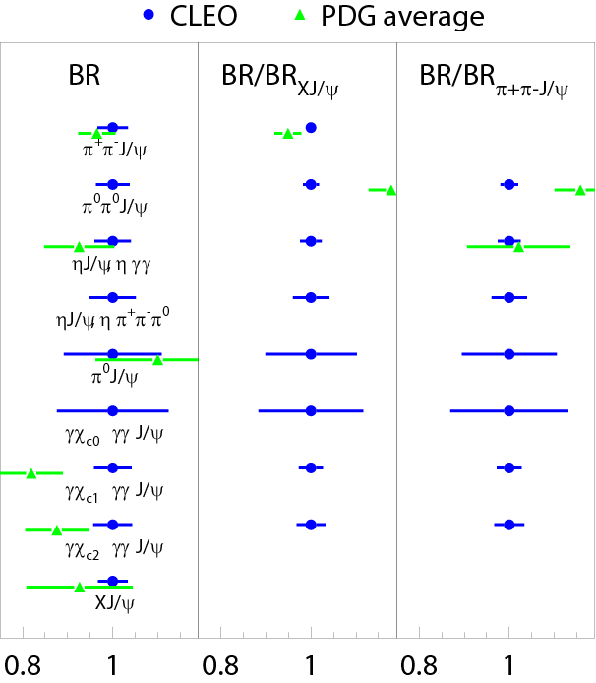
Ψ(2S) → XJ/ψ Results
Best measurements in all modes
Isospin symmetry restored in π⁰π⁰ / π⁺π⁻
Significantly higher BR(χ_{cJ} (1P) → γJ/ψ(1S))
Phys.Rev.Lett94,232002(2005)
All PDG values are scaled by CLEO central values

Slide 9
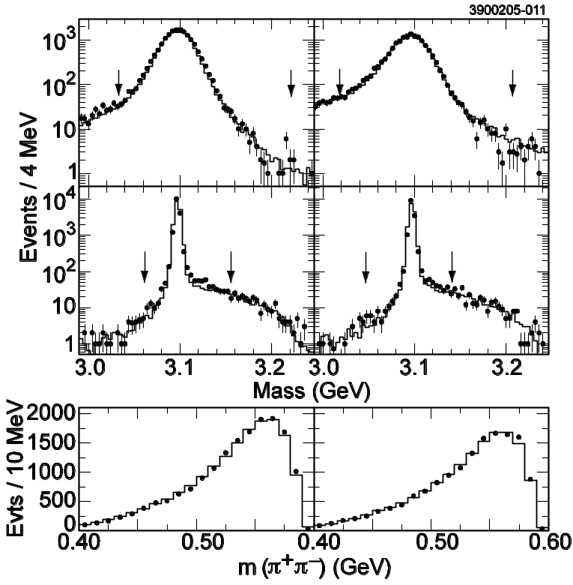
B(J/ψ→l⁺l⁻) from Ψ(2S) → π⁺π⁻J/ψ
Used in determination of Γ_{tot}(J/ψ) and Γ_{ee}(J/ψ) from σ(e⁺e⁻→ J/ψ→hadrons)
Sensitive to the wave function at the origin: used to test potential models
In this analysis we use
Ψ(2S) → π⁺π⁻J/ψ and measure N(J/ψ→l⁺l⁻) & N(J/ψ→X) (determined from the inclusive π⁺π⁻ recoil mass distribution).
μ⁺μ⁻
e⁺e⁻
M(l⁺l⁻)
M_{recoil}
M_{ππ}
π⁺π⁻J/ψ (J/ψ → l⁺l⁻)
solid line: MC, points: data

Slide 10
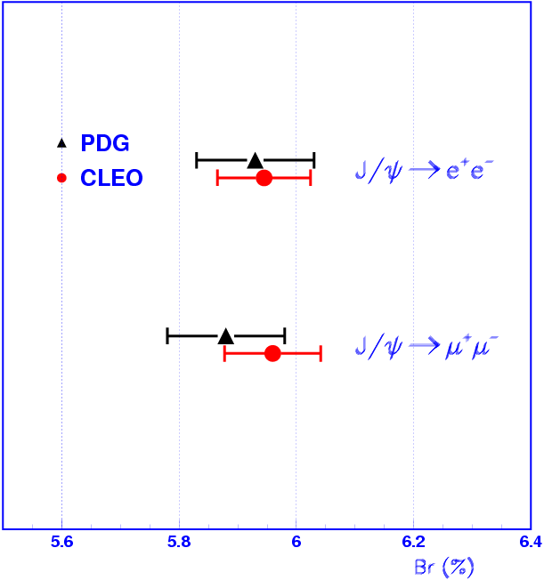
Results for J/ψ → e⁺e⁻ and μ⁺μ⁻
PRD 71, 111103(R) (2005)
B(J/ψ→e⁺e⁻) = (5.945±0.067±0.042)%, rel. 1.3%
B(J/ψ→μ⁺μ⁻) = (5.960±0.065±0.050)%, rel. 1.4%
B(J/ψ→l⁺l⁻) = (5.953±0.056±0.042)%
B(J/ψ→e⁺e⁻)/B(J/ψ→μ⁺μ⁻) = (99.7±1.2±0.6)%
PDG
B(J/ψ→e⁺e⁻) = (5.93±0.10)%, rel. 1.7%
B(J/ψ→μ⁺μ⁻) = (5.88±0.10)%, rel. 1.7%

Slide 11
Ψ(2S) to light hadrons
The branching fraction for ψ(2S) decaying to light hadrons can be computed as the difference between unity and the branching fraction sum of all exclusive direct transitions measured in this work (and previous CLEO results).
That is: 1 − (ΣB[ψ(2S)→J/ψ+h]
− (ψ(2S)→ γ χ_{cJ} and ψ(2S)→ γη_{c})
− dilepton branching fractions
This yields
B[ψ(2S)→light hadrons] = (16.9±2.6)%.
To be compared with that of the J/ψ,
B(J/ψ→light hadrons) = (86.8±0.4)%,
yielding a ratio of
(19.4±3.0)%
which is ~ 2.2σ above
B[ψ(2S)→l⁺l⁻]/B(J/ψ→l⁺l⁻) = (12.7±0.5)%.

Slide 12
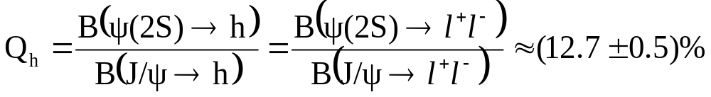
Hadronic decays of the ψ(2S)
ψ(2S): the “12% rule”?
For the charmonium system (cc annihilation),
decay rate ∼ |Ψ(0)|²,
Information on resonant vs. non-resonant in multi-body final states.
Hints for S-D mixing between ψ(2S) and ψ(3770).
PID with combined RICH-dE/dx information;
Scale continuum data for non-resonant subtraction;
Use scaled energy and/or resonant mass to isolate signal.
_
PDG04

Slide 13
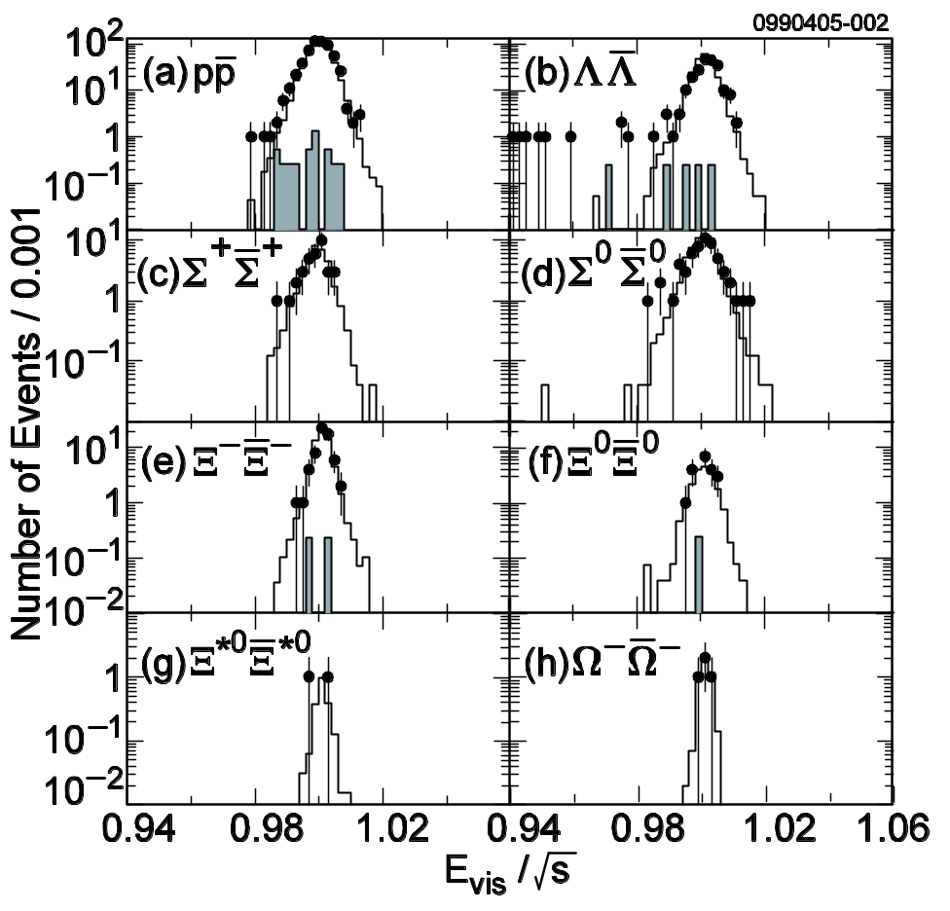
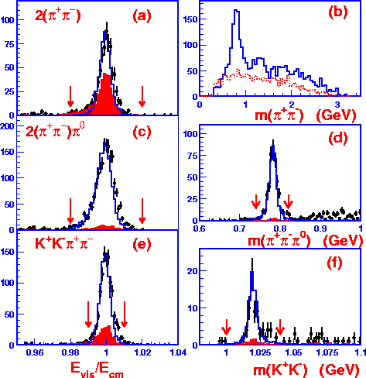
Hadronic decays of the ψ(2S)
Scaled energy for baryon anti-baryon
Scaled energy and resonant production in multi-particle hadronic decays

Slide 14
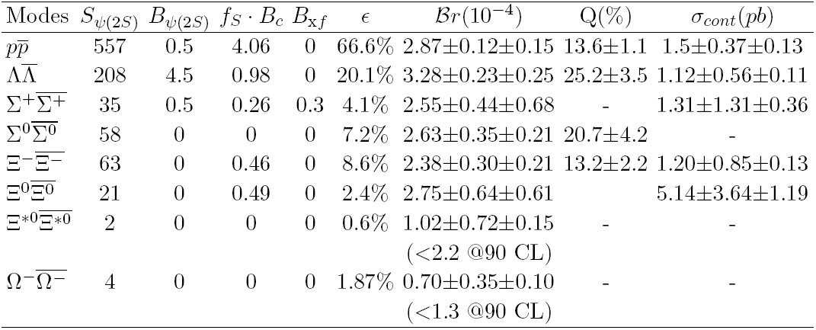
Results for Ψ(2S) → baryon anti-baryon
2 first observations
Phys. Rev. D 72, 051108(R) (2005)
N_{S} = S_{ψ(2S)} - B_{ψ(2S)} - B_{cf} - f • B_{c} , Br=N_{s}/(ε N_{ψ(2S)})
S=0
-1
-2
J=3/2
First observation
To be compared with ( 12.7 ± 0.5 )%

Slide 15
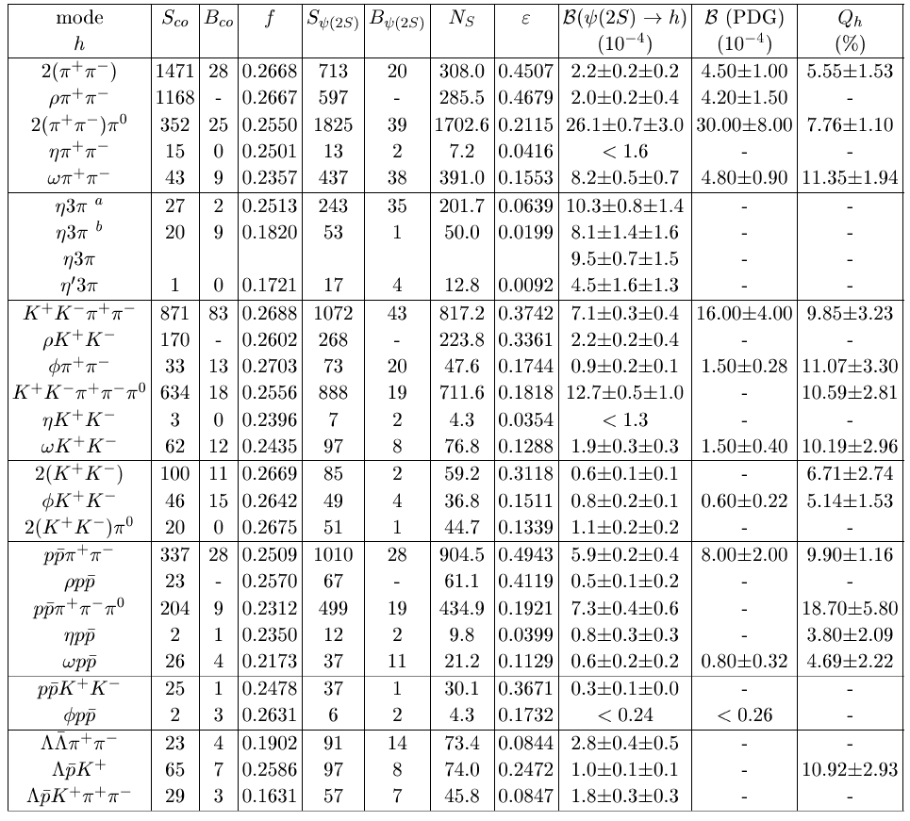
Results for Ψ(2S) → multi-body
13 first observations
Phys. Rev. Lett 95, 062001 (2005)
12.7 ± 0.5 ?

Slide 16
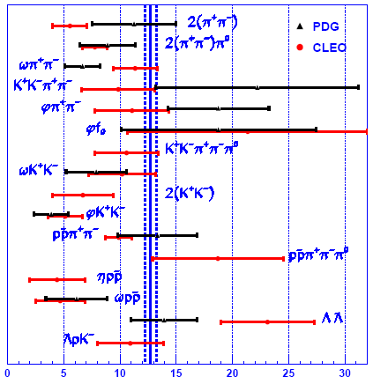
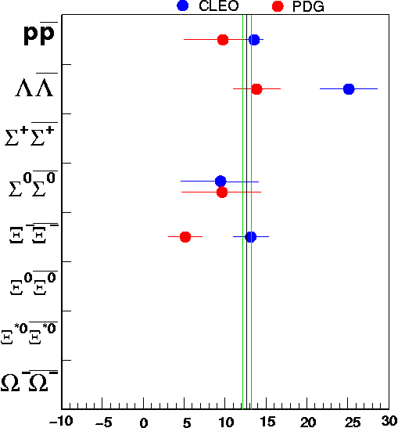
The 12% rule: Q_{h}= B(ψ(2S)→h)/B(J/ψ→h)≈12%
Q_{h}(%)
Q_{h}(%)
Reasonable agreement with the rule, in contrast to VP modes and π⁺π⁻π⁰.

Slide 17
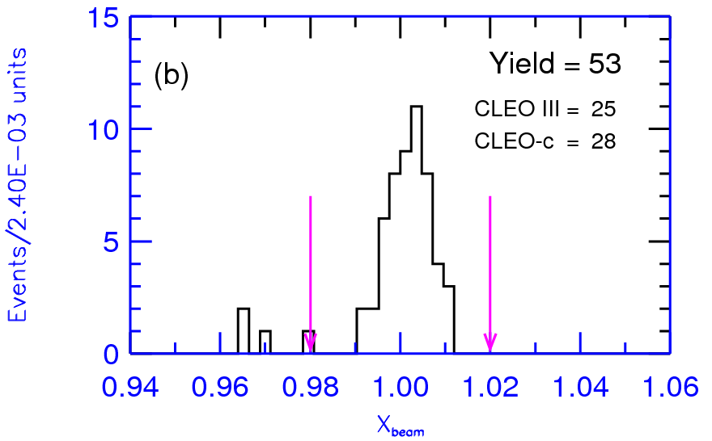
Measurement of B (Ψ(2S) → K_{S}K_{L})
Reconstruct K_{S}→π⁺πˉ
DO NOT reconstruct K_{L}
Allow possible K_{L} signature
Veto π⁰; veto γ outside K_{L} cone
Scaled energy of K_{S}:
X_{beam}= E_{Ks} / E_{beam}
0.98 < X_{beam} <1.02
B(Ψ’→ K_{S} K_{L}) = (5.84 ± 0.80 ± 0.43)×10⁻⁵ !!!CLEO PRELIMINARY!!!
B(Ψ’→ K_{S} K_{L}) = (5.24 ± 0.47 ± 0.48)×10⁻⁵ BES [PRL.92:052001,2004]

Slide 18
Summary
CLEO-c has made a variety of measurements of charmonium transitions: Ψ(2S) → XJ/ψ, J/ψ→l⁺ l⁻, Ψ(2S)→baryon pair, Ψ(2S)→multi-body hadrons and Ψ(2S) → K_{S}K_{L}.
The results presented are part of a continuing detailed systematic analysis of charmonium decays by the CLEO collaboration. Most of the results are either first observations or of higher precision than previous measurements.
CLEO-c plans to continue running for the next few years in the charm region both for the bound states and for open charm meson production.

Slide 19
Backup slides

Slide 20
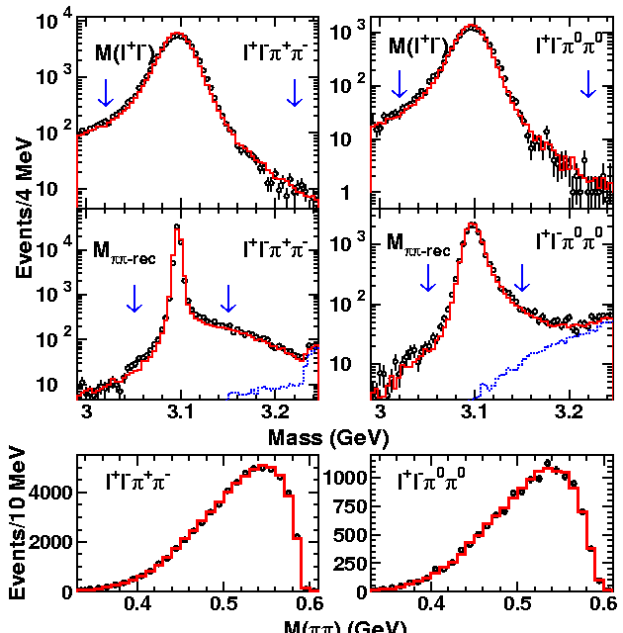
Exclusive BR(ψ(2S)→ππ J/ψ(1S))
Fully reconstructed events:
  Energy-momentum conservation
  Dilepton mass and dipion-recoil mass consistent with J/ψ
η → π⁺π⁻π⁰
η → π⁰π⁰π⁰

Slide 21
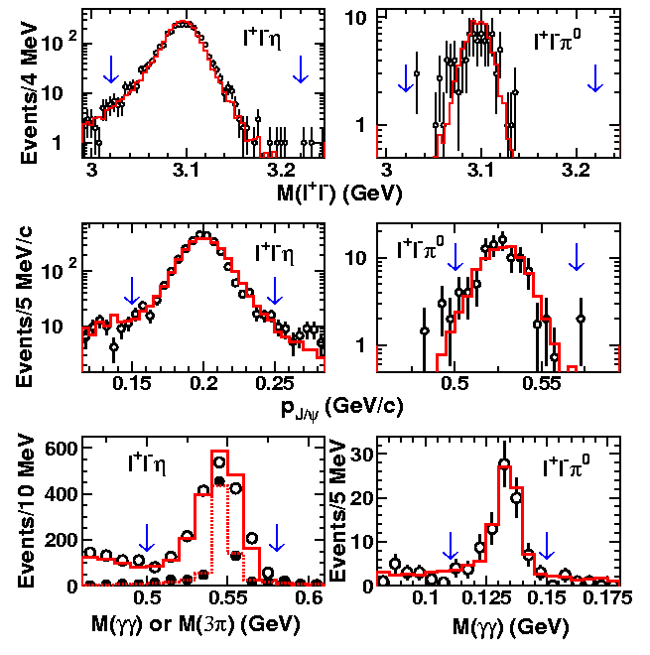
Exclusive BR(ψ(2S)→η,π⁰ J/ψ(1S))
Fully reconstructed events
η → γγ and π⁺π⁻π⁰
π⁰ → γγ
η → γγ + π⁺π⁻π⁰

Slide 22
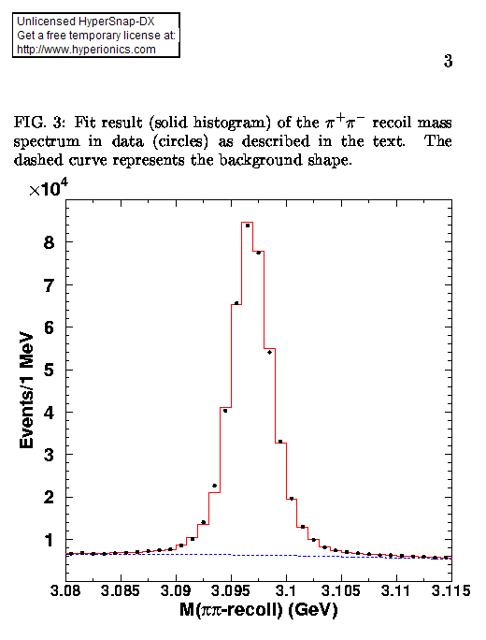
N_{π+π- J/ψ, J/ψ→X} : Fitting Recoil Mass Spectrum
π⁺π⁻(J/ψ→X):
  p_{T}>150 MeV/c, |cosθ|<0.83, m(π⁺π⁻)=400-600 MeV
  Fit M(π⁺π⁻-recoil) for N_{X}
M(π⁺π⁻-recoil) uses only the pions, hence ~independent of what the J/ψ does.
Efficiency is obtained by weighting a set of basis modes to produce J/ψ→X mix.

