Slide 1
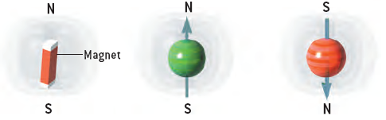
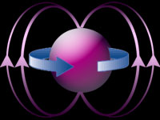
or how to measure a single electron spin
Ivar Martin
Single Spin Magnetic Resonance and Related
Phenomena in Si Field Effect Transistors
April 2006,
Los Alamos
This work is supported by the DOE and NSF

Slide 2
Collaborators
D. Mozyrsky (T-4)
M. Hastings (T-13)
A. Shnirman (Karlsruhe)
Experiment: H.W. Jiang’s group at UCLA
REFS: Phys. Rev. Lett. 90, 018301 (2003) - ESR - theoretical scheme
Phys. Rev. Lett. 91, 078301 (2003) - experiment (B-dep)
Nature 430, 435 (2004) - experiment (1 spin ESR)
Phys. Rev. B 71, 165115 (2005) - Kondo + lattice
cond-mat/0312503 - Fermi-edge + lattice
Phys. Rev. B 73, 035104 (2006) - polaronic molecular switch

Slide 3
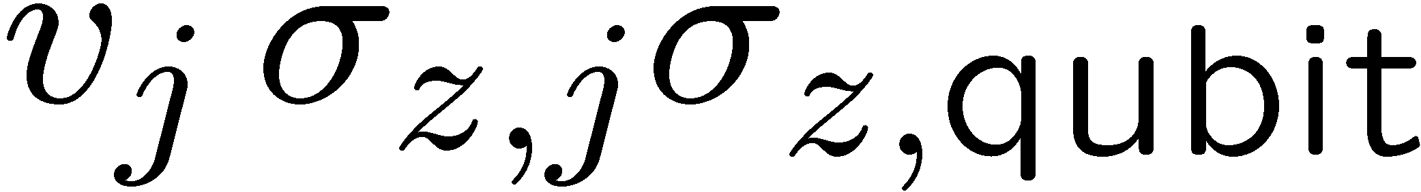
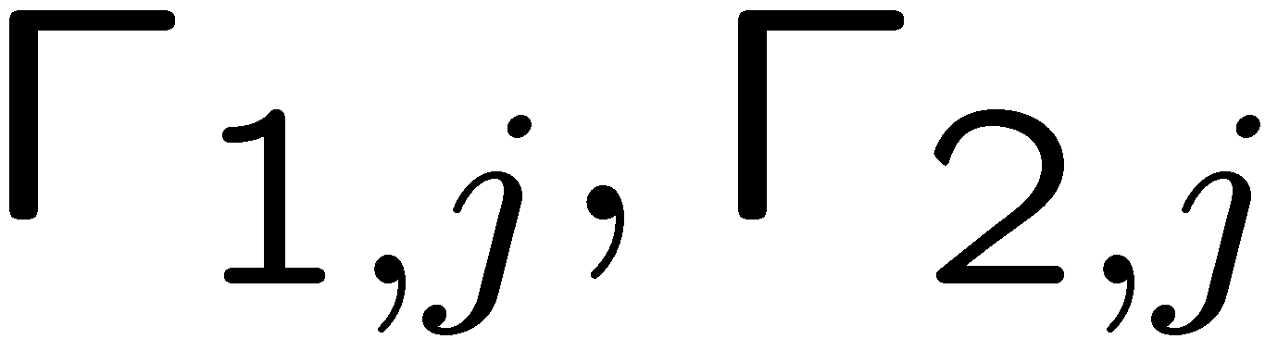
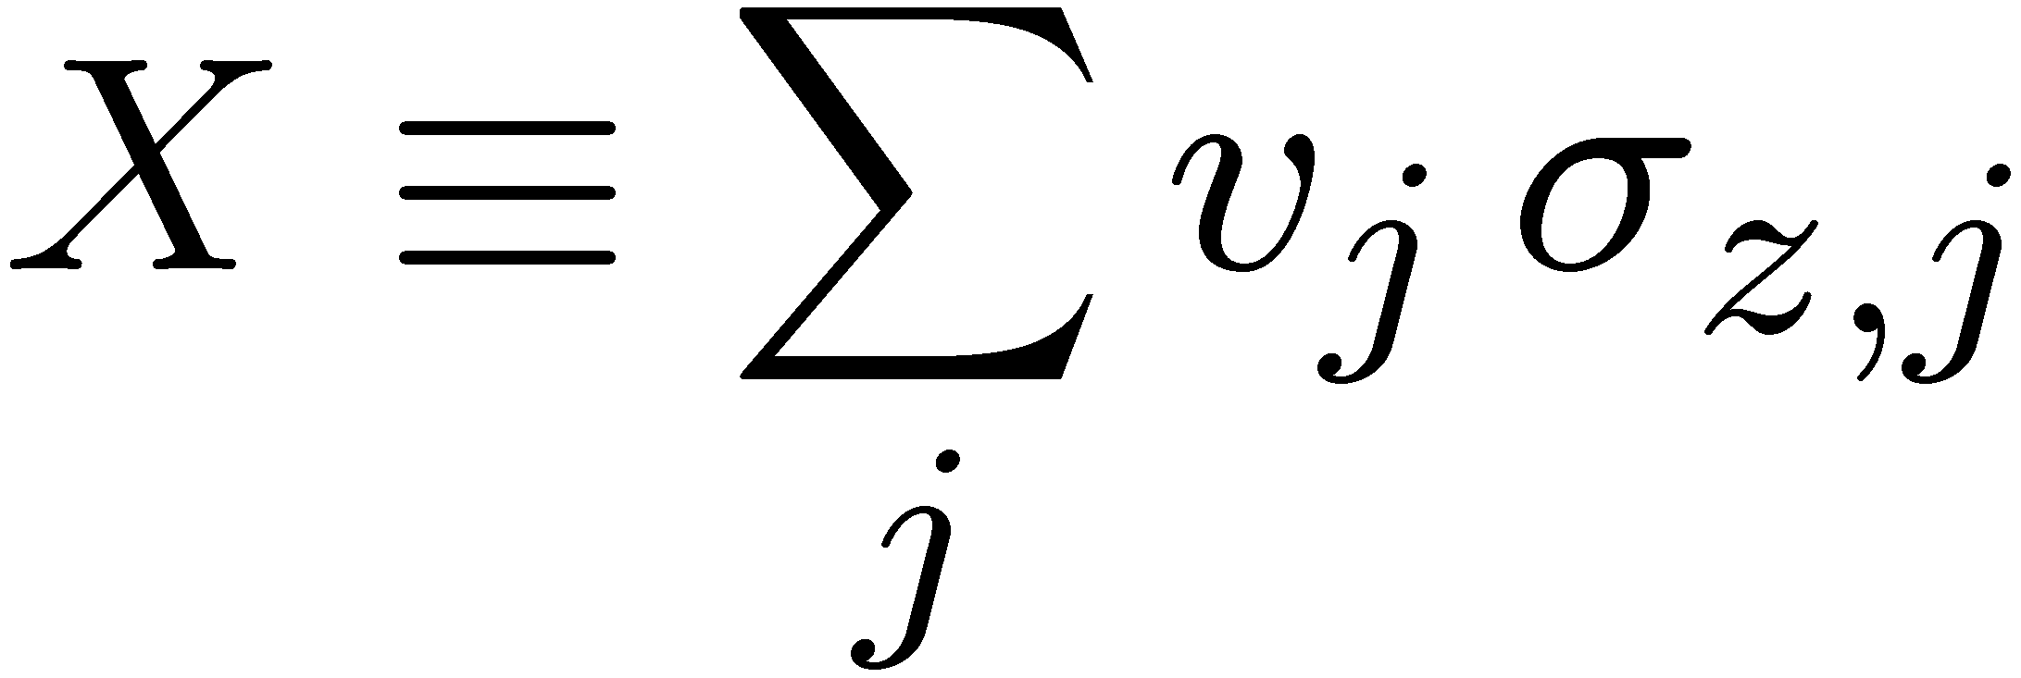
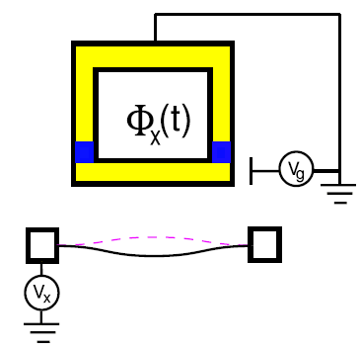
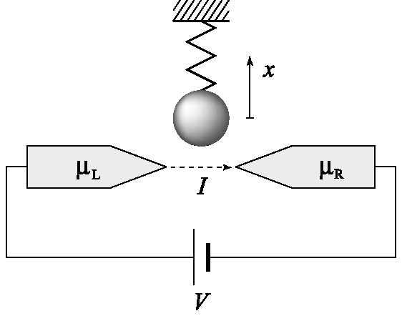
T-11 context
(Balatsky, Bulaevskii, Martin, Ortiz, Smith)
Physics of quantum computing
  Qubit-meter interaction
  Modeling environment influence
Nano-electromechanical systems
  Sensitive measurement (quantum limited)
  Ground-state cooling
  Quantum-classical crossover
Inelastic noise spectroscopy
  ESR-STM
  DNA sequencing by STM
Spintronics
Local probes
qubit
TLS
bath

Slide 4
Outline
Introduction: Single Spin Magnetic Resonance
Random Telegraph Noise in Field Effect Transistors
A scheme for Electron Spin Resonance: Theory
A scheme for Electron Spin Resonance: Experiment
Single Spin Detection
Inconsistency between expected and observed tunneling rates: Polaronic slowdown
Low temperature magnetic anomalies: Possible Kondo Effect
Summary and Open problems

Slide 5
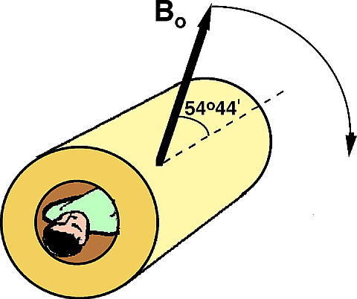
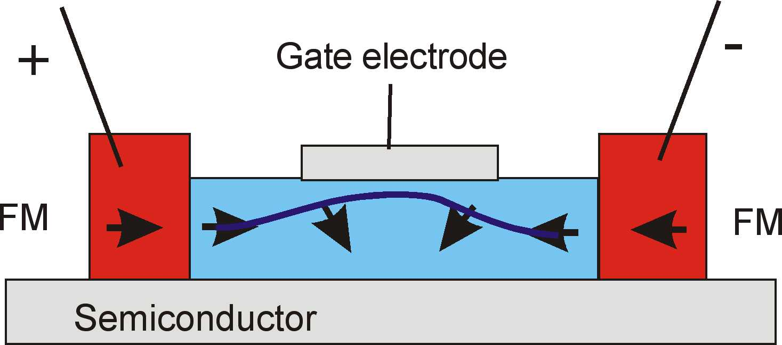
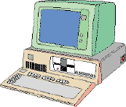
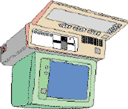
Applications of Spin measurement
Magnetic Resonance Imaging
(MRI)
Spin – Effect Devices (Spin Transistors)
> 10¹⁰ spins
> 10³ spins
Quantum Computing
+
1 spin

Slide 6
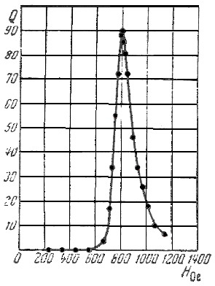
Electron Spin Resonance
B₀
If ω₁ = ω₀
spin rotates
with Rabi
frequency ~ B₁
Ћω₀ = gμ_{B}B₀
B₁cos(ω₁t)
Experiment
V_{EMF}
B₀
Rabi , Zacharias, Millman, Kusch (1939)
V₁cos(ω₁t)

Slide 7
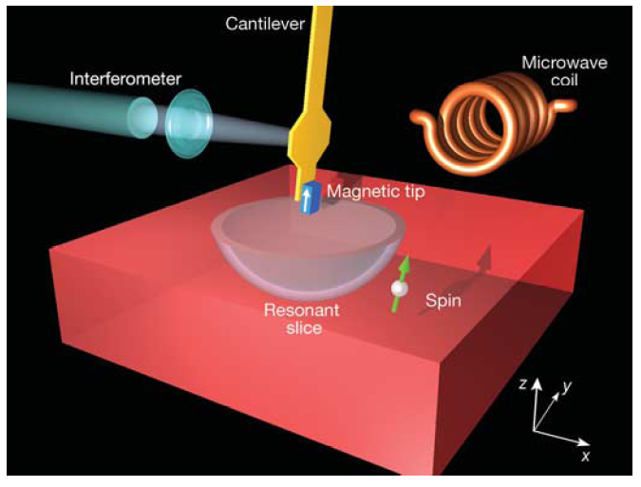
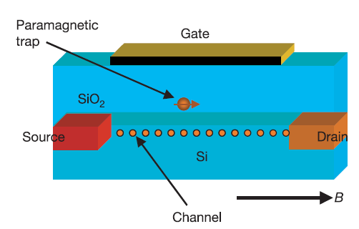
Single Spin Resonance: MRFM and Paramagnetic Traps in FETs
Magnetic Resonance Force
Microscopy (MRFM)
Electron Spin Resonance in a
Field Effect Transistor (FET)
Rugar, Budakian, Mamin & Chui,
Nature 430, 329 (2004)
Xiao, Martin, Yablonovitch & Jiang,
Nature 430, 435 (2004)

Slide 8
Traps in Field Effect Transistors and Random Telegraph Signals
Field Effect Transistor (FET)
empty trap (positive)
higher resistance
I_{e}
+
I > 0
or
-e
filled trap (neutral)
lower resistance
V_{g}>0
I_{f}
+
RTS – random switching
I_{f}
I_{e}
t

Slide 9
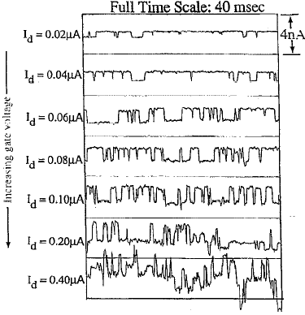
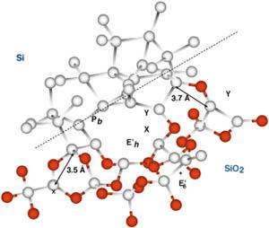
Random Telegraph Signal (RTS) – experiment
Defects at Si - SiO₂
interface
source-drain current

Slide 10
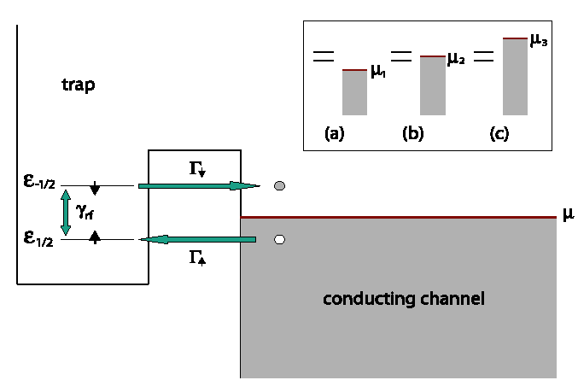

A Setup for Electron Spin Resonance(ESR)
At T = 0, B₁ =0:
trap is filled if ε_{1/2} < μ
trap is empty if ε_{1/2} > μ
trap
No RTS
Β₁
At T = 0 and resonant B₁(t):
trap can be filled if ε_{-1/2} < μ
e⁻ is promotedε_{1/2} -> ε_{-1/2}
e⁻ can escape if ε_{1/2} > μ
Electron Spin Resonance
-induced RTS!
B₁cos(ω_{rf}t)
The trap occupation number is modified by resonant B₁(t)

Slide 11
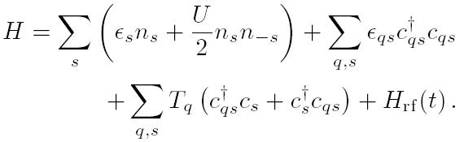

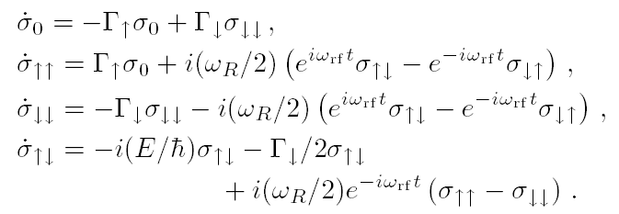


Quantum rate equations for ESR-RTS
I. Martin, D. Mozyrsky & H.-W.Jiang, Phys. Rev. Lett. 90, 018301 (2003)
h.c.
– rotating wave approx
equations of motion
for trap density matrix
Average FET channel resistivity:

Slide 12










Resonance in average resistance
0
Application of resonant rf B₁(t) modifies the average channel resistivity by changing the RTS statistics
In presence of dephasing 1/T₂’ >> Γ:
peak width:
peak height:
ρ_{e}
ρ_{f}
t

Slide 13
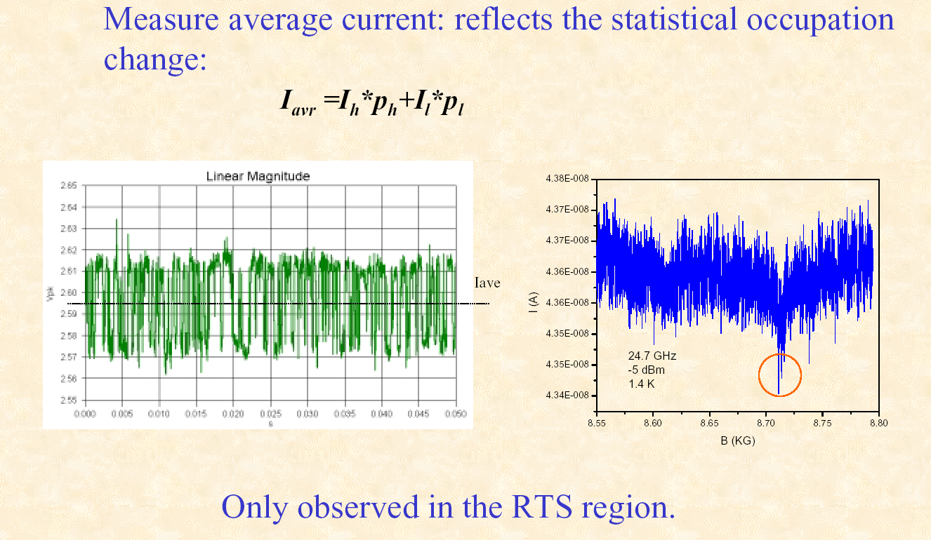
ESR-RTS Experiment –average current
(M. Xiao et al., Nature 430, 435, 2004)
g = 2.02

Slide 14


Traps for Quantum Computing A Readout Scheme
B
B
1.
2.
or
|Ψ> = 0
|Ψ> = α|0> + β|1>
3.
RTS
|β|²
or
B
|α|²
|Ψ> = |0> or |1>
Notes:
The scheme is based on a possibility to shift relative positions of energy levels and therefore is realizable in systems with electrostatic gates, such as quantum dots, FET, etc.

Slide 15
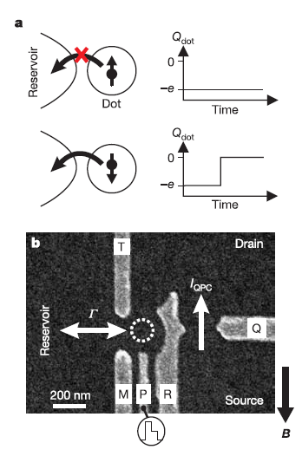
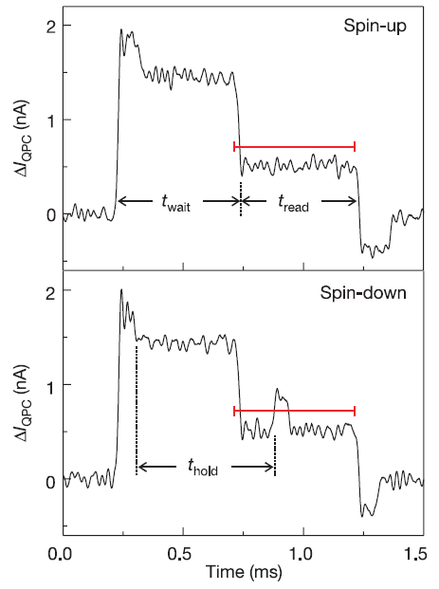
Single Spin Measurement in Quantum Dots
Elzerman et al., Nature 431, 430 (2004)
Demonstrated Spin Measurement Efficiency ~ 65%

Slide 16
The Readout Scheme: Experimental Facts
The scheme works in quantum dots with 65% efficiency
REF: J.M. Elzerman etal., Nature 430, 431(2004).
So far in FET traps the scheme does not work – no RTS signal
WHY? => spin is always in its ground state.
WHY? => fast spin relaxation => WHY?
Maybe because of the exchange interaction with electrons
in the conduction channel ?!
Need to look at the microscopic structure of traps!

Slide 17
Outline
Introduction: Single Spin Magnetic Resonance
Random Telegraph Noise in Field Effect Transistors
A scheme for Electron Spin Resonance: Theory
A scheme for Electron Spin Resonance: Experiment
Single spin Detection
Inconsistency between expected and observed tunneling rates: Polaronic slowdown
Low temperature magnetic anomalies: Possible Kondo Effect
Summary and Open problems

Slide 18
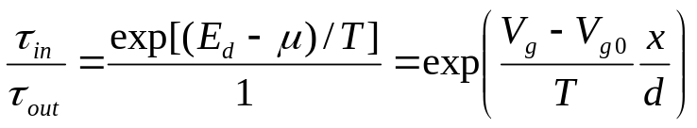
Determination of Defect’s Position. Surprise…
Experimentalists can measure the location of the trap (x) with respect to the conduction channel.
One finds x~1-3 Å.
Defect position determination:
Metal
d
Ins.
x
V_{g}
2DEG
Semi.
V_{sd}
I_{sd}
Estimate for tunneling time yields ~ (ps – ns)
Observed ~ (ms – s) ???

Slide 19
Polaronic Slowdown
SiO₂ is a polar crystal ⇒ strong coupling to optical phonons
Empty Trap
Trap with an extra electron
+ e⁻
SiO₂
2DEG
SiO₂
2DEG

Slide 20
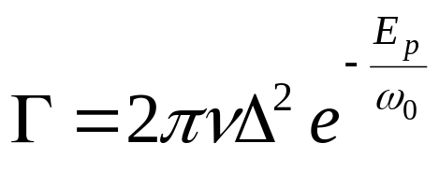


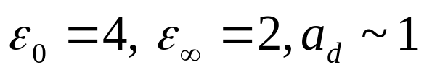
Estimate for Si Field Effect Transistor
Mozyrsky, Martin, Shnirman cond-mat/0312503
Assuming Fröhlich electron-phonon coupling
For SiO₂ Å
→ E_{p} ≈ 1.2 eV
For bulk optical phonons in SiO₂: ω₀^{bulk} ≈ 60 meV
exp (-E_{p} /ω₀) ~ exp(-20) ~ 10⁻⁸
Qualitative agreement with observed rates !
Strong electron-phonon interaction is responsible
for long tunneling time in Si FET

Slide 21
Outline
Introduction: Single Spin Magnetic Resonance
Random Telegraph Noise in Field Effect Transistors
A scheme for Electron Spin Resonance: Theory
A scheme for Electron Spin Resonance: Experiment
Single Spin Detection
Inconsistency between expected and observed tunneling rates: Polaronic slowdown
Low temperature magnetic anomalies: Possible Kondo Effect
Summary and Open problems

Slide 22
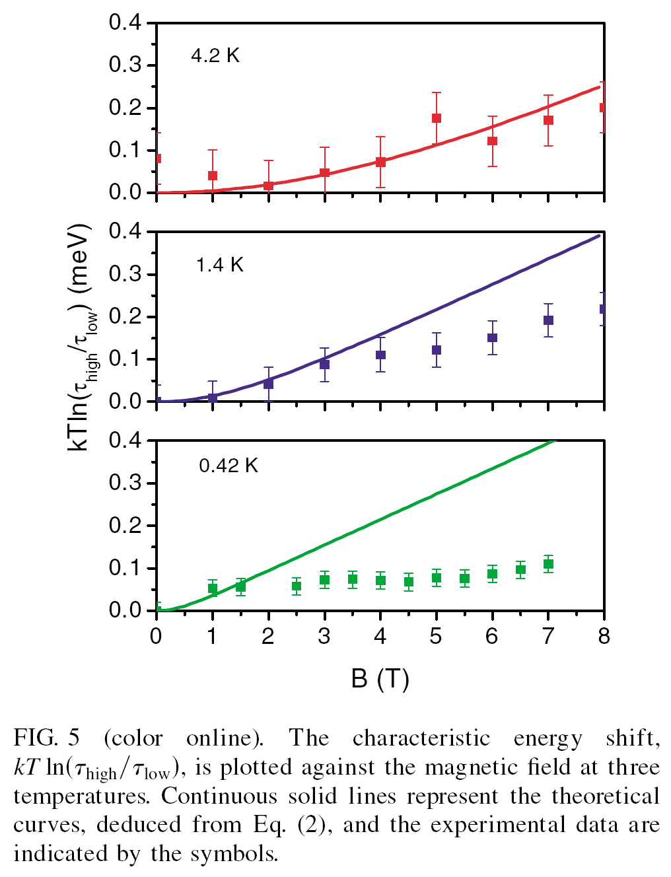
Magnetic field dependence at low temperatures. Surprise II
Xiao et al., Phys. Rev. Lett. 91, 078301 (2003)
gμ_{B}B
μ
B
trap
channel
k_{B}T ln(τ_{empty}/τ_{full})
For a paramagnetic spin
(τ_{empty}/τ_{full}) ≈ exp(gμ_{B}B / k_{B}T)
No agreement between simple model
and experiment at low T!
Kondo effect?
(Tesla)
Solid lines: theoretical fits for a
paramagnetic trap
Bullets: experimental data

Slide 23
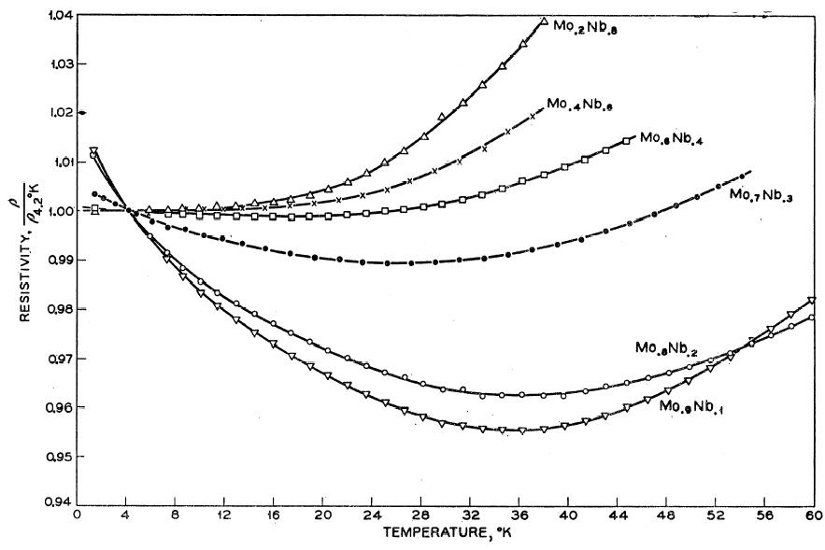
Kondo Effect
Resistivity of metals doped with magnetic impurities
Magnetic impurity in a metal
ρ
E₀+U
Virtual
2-particle state
μ
μ
E₀
T
From: Sarachik, etal, Phys. Rev. 135 (1964)
A localized impurity spin is screened by spins of conduction electrons
At low energy scale (below T_{K}) the magnetic impurity creates a strong
resonance at Fermi surface => scattering => resistivity

Slide 24
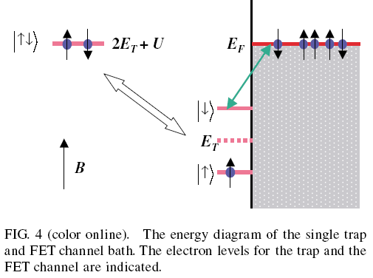
Kondo?
T_{K} ~ exp[-O(1) U/Γ ]
For Γ ~ 1 s⁻¹ => T_{K} → 0
However, Γ is small only effectively – due to
strong electron-lattice coupling! The “bare”
hybridization (“bare” Γ₀) may be strong!
Large bare Γ₀ relevant for Kondo if U > ω₀ → finite T_{K}

Slide 25
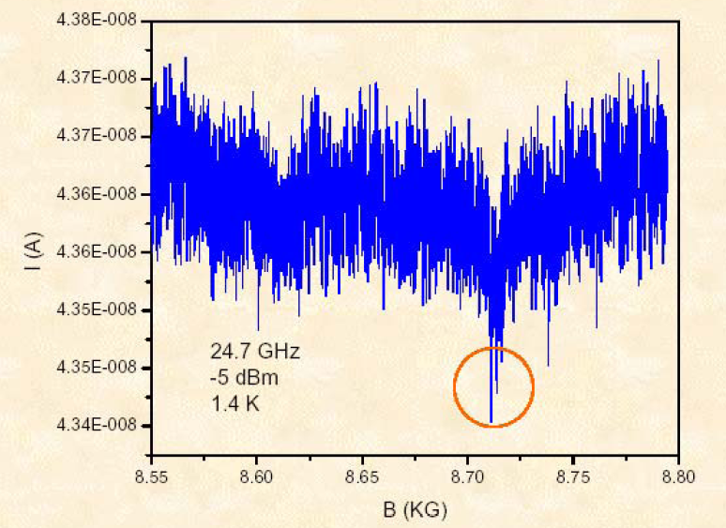
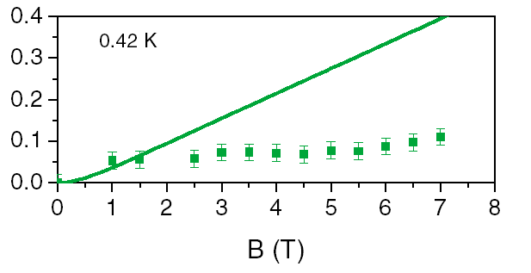
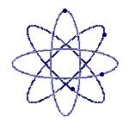
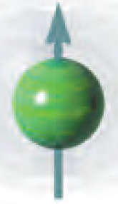
Summary and Perspectives
Single electron spin resonance in FET
Tunneling slowdown (due to strong electron-lattice coupling)
Kondo Effect in FET traps
What’s next?
A single nuclear spin?...

