Slide 1
LLRF & SCRF Instrumentation
Brian Chase
March 15 , 2005

Slide 2
Outline
RF Control System (LLRF) Requirements
Options for Implementation
Cryomodule/warm cavity Instrumentation
Costs
Conclusions

Slide 3
LLRF Functionality
Provide a phase-stable RF reference subsystem signal to correctly phase each cavity
Maintain cavity field stability within ±0.5% amplitude and ±0.5° phase
Resonance control of both warm and cold cavities
  the cavity's resonant frequency shifts due to RF heating, beam loading, microphonics, Lorentz force detuning, cryogen pressure changes, and variations in klystron high voltage.
Maintain control during beam loading transients
Handle state control and exceptions
Provide diagnostics
Provide and respond to interlocks

Slide 4
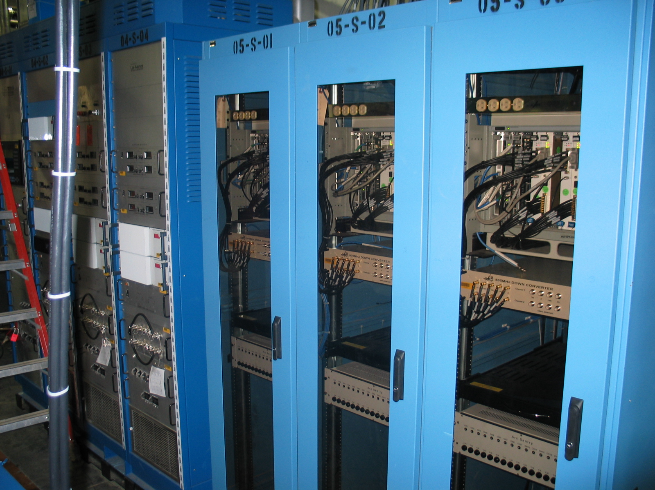
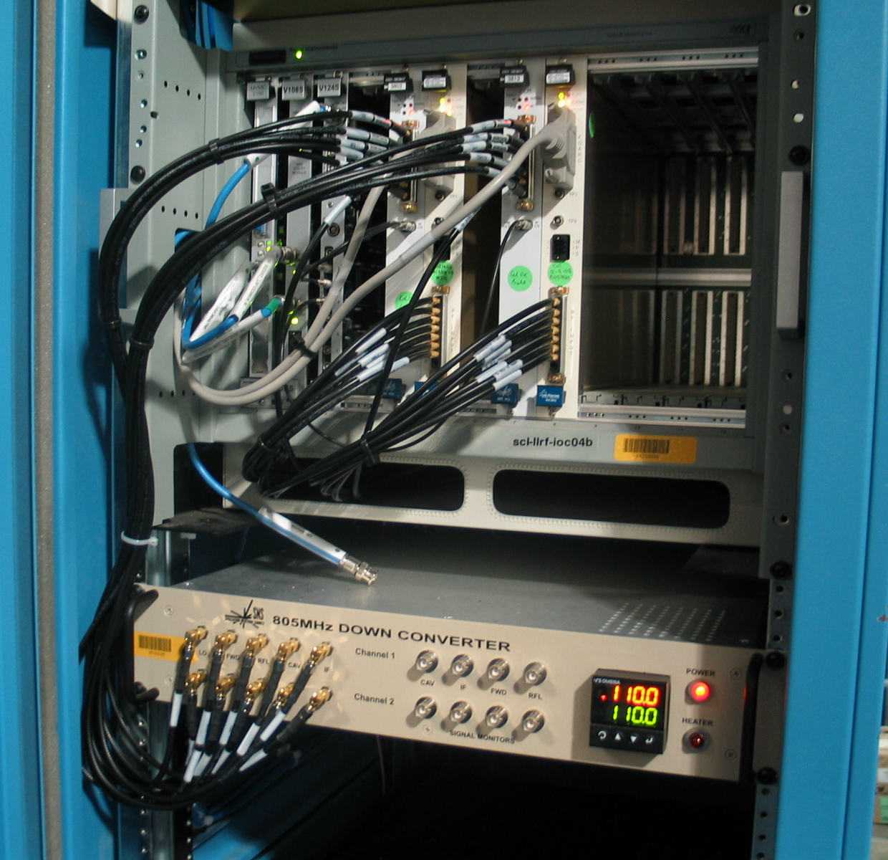
SNS LLRF
Each VXI crate and downconversion chassis serves two SCL RF systems. Full system tests this summer.

Slide 5
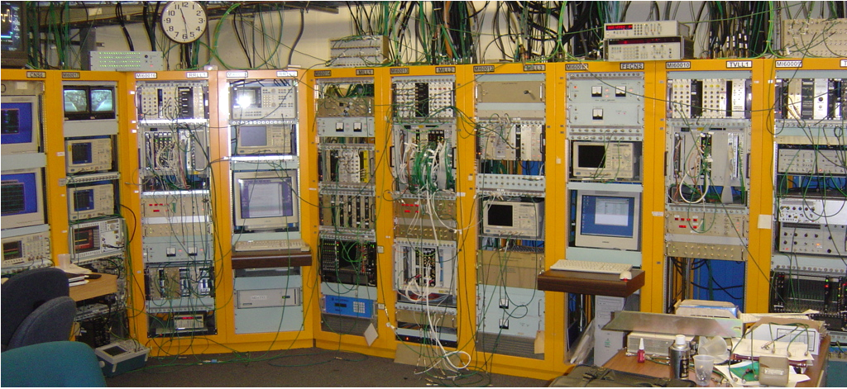
FNAL LLRF
MI-60 Control Room for the Main Injector, Recycler and Tev

Slide 6
LLRF Comparison
 | Fermilab | DESY | SNS
FE OS | VxWorks | Solaris | VxWorks
ContrSys | ACNET | DOOCS | EPICS
Platform | VXI | VME | VXI
DSP | AD SHARC | TI | none
FPGA | Altera | Xilinx | ??

Slide 7
The Plan
Get a test system from DESY up and running at AO
Test fast phase shifters at A0. A single cavity test will be instructive
Multiple cavity tests at SMTF
Evaluate SNS and new DESY modules as they become available
Parallel design of RF phase reference system
Finalize design with collaborators and or vendors

Slide 8
The Good News
Control of SRF is a mature science/art
  More than a decade of well documented experience
Digital radio technology is driven by the telecom market and is developing at a rapid rate. It is now good enough
  Getting faster, smaller, lower power, cheaper
FPGA technology is driven by everything. It is now good enough
  Getting faster, smaller, lower power, cheaper
ILC is a driving force for LLRF collaboration
  SMTF and the Proton Driver may be an interesting test bed for the ILC in addition to the XFEL

Slide 9
More Good News?
The Proton Driver will not be a boring LLRF project!
The fast phase shifters are new technology and are central to the success of this accelerator
  Small signal BW is low
  Slew rate is slow 1 deg/us
  Single cavity simulations look promising
The loaded Q is much higher than SNS
  We are counting on the Piezo tuners to work

Slide 10
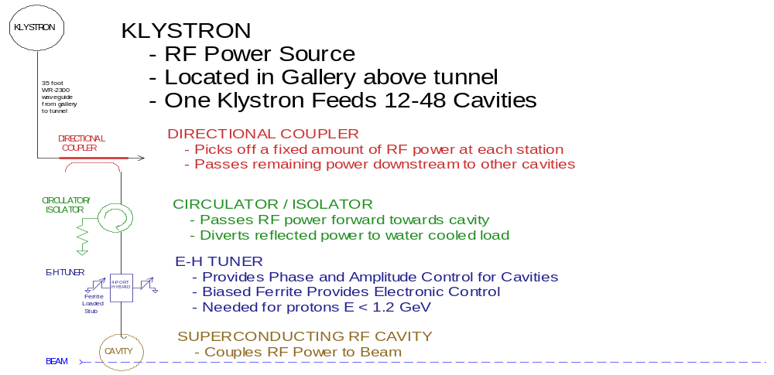

Slide 11
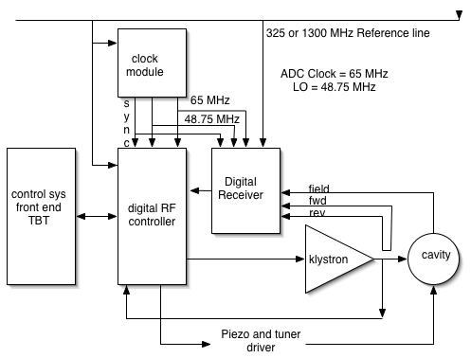
A Possible Structure

Slide 12
Frequency Agile Phase Reference System
Lorentz detuning of the cavities takes reactive power to correct. This causes higher voltage and current in the power coupler and takes real power from the klystron that just ends up in the circulator load. Piezo tuners work to correct this but the Tesla cavities have only a 500 Hz range. With a 3ms pulse, the cavities could detune by 2 kHz.
If cavities track together, there is no need to stay at a fixed frequency for the linac. So, program the reference line to track the mean trajectory of the natural cavity frequency. Spoke Resonators will not track as they detune much less.
2 kHz of dF will only cause 1.4 deg phase change along the length of the Linac. This can be programmed out.

Slide 13
LLRF Rack Space
Number of LLRF/klystron systems 13{33}
Max number of cavities/klystron 48
Support for 36 cavities 2 crates (3 for 48)
19 crates for linac 13 racks
Piezo controllers;
  1 rack for 36 cavities
  26 racks for Linac

Slide 14
R&D Efforts and Risks
Development of new LLRF hardware and software
Testing at SMTF with reference line
Single klystron driving multiple SRF cavities; field control with fast phase shifters
Single klystron driving multiple cavities (warm and cold) in Linac front end
  Different Qs controlled with one klystron feedback loop
  Different cavity types will have different beam loading
  Warm cavities have power dependent resonant frequencies. These will vary between individual cavities and cavity types. Warm cavity types will have different initial frequencies
  SRF cavities cannot be regulated without beam loading

Slide 15
Instrumentation = Cables
Over 16,000 cables in 31 waveguide chases!
Over 10,000 3/8 heliax
Average runs of 150 ft
Most of these signals are << 1MHz BW
  R&D to use twisted pair where possible; direct or down converted
  Use 7916A RG6/U where possible $0.10/ft Quad Shielded. Comes in 10 cable snakes (rad hard?)
  Explore tunnel electronics (rad hard) to fiber

Slide 16
Instrumentation Processing
Single rack per wave guide chase
  Common crates (VME)
BPMs 290 @$2k
HOM 1000 @ $200
Spark detectors 2500 @$25
Lots of other stuff 5000 @$25
$~3M
Lots of processing - To do this right(save $$)
  Coordinated effort between subsystems
  Competing design teams through prototype stage

Slide 17
LLRF Hardware Costs
LLRF
  Base cost per klystron
    2 VXI crates, 2 Slot0 controllers,Timing card, RF Control Module, rack, etc. $30k
  Cost per cavity
    1/2 Cavity Module, $2k
Resonance Control
  $2k/cavity for Piezo actuators and control or other tuner control
Reference and reference line
  Reference oscillators $70k
  Reference line $100k
Total ~ 13 * 30k + 453 * 4k + 170k ~ $2.5M

Slide 18
CONCLUSIONS
The PD RF Control System is technically feasible
  Many years of experience at FNAL with digital LLRF and some SRF
  Many years of well documented experience with SRF at other labs. SNS and DESY are willing to help!
Costs have a reasonable bracket
The Risks are Low for most of the Linac
R&D is required for the Linac front end @ SMTF
We have a working prototype from DESY in our lab (MTF)
Instrumentation; been done before - cost reduction

