Slide 1


Searches for New Physics in the Top Quark Samples at CDF
15th International Conference on Supersymmetry and the Unification of Fundamental Interactions
Parallel session: “ALTERNATIVES”
Susana Cabrera
IFIC ( CSIC - University of Valencia )
On behalf of the
CDF Collaboration

Slide 2
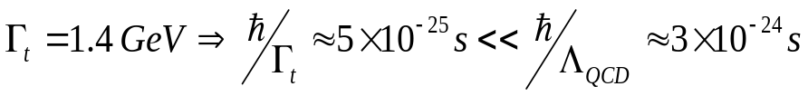
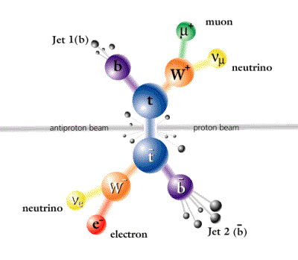
MOTIVATION
Top is MASSIVE M_{TOP} = 170.9 ± 1.8 GeV/c² (TEWG hep-ex/0703034)
Decays before hadronization
  →Spin information transferred to decay products
  Special role in EWSB?
  →Top Yukawa coupling to Higgs is “natural” (~1)
  →M_{top} together with M_{W} constrains M _{Higgs}
  New physics in the top quark samples ?
Searches in the production:
σ_{tt} , σ(gg→tt)/σ(qq→tt)
Z´→tt
t´→Wb
Searches in the decay:
Top charge.
FCNC t→Zq
W helicity

Slide 3
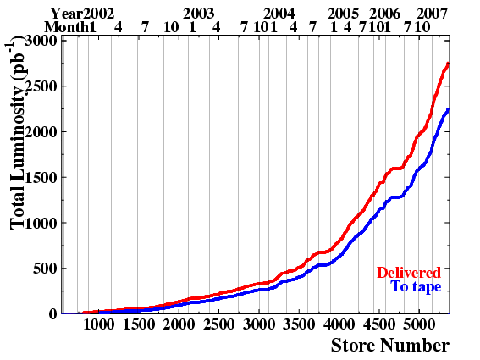
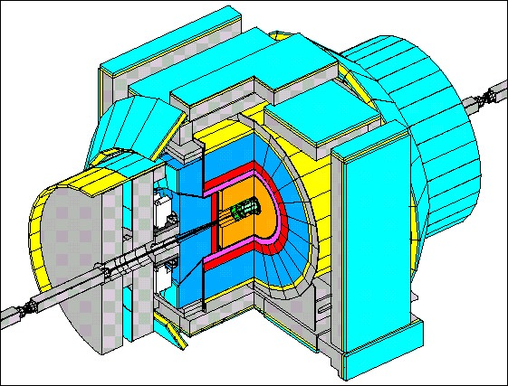
THE EXPERIMENTAL SETUP
The CDF II detector:
  Excellent tracking system:
    Drift chamber: Central Outer Tracker.
    Inner silicon detector: → essencial for b-tagging and vertexing.
  EM and HAD calorimeters.
  MUON systems.
TEVATRON RUN II:
  Proton-Antiproton Synchrotron
  √s = 1.96 TeV
  Aim for 6-8 fb⁻¹ by 2009.
Searches for new physics in ~1 fb⁻¹ top quark samples
Delivered 3106.5
Recorded 2551.8
Eff = 82 %
TOP PHYSICS require a good understanding of the entire detector

Slide 4
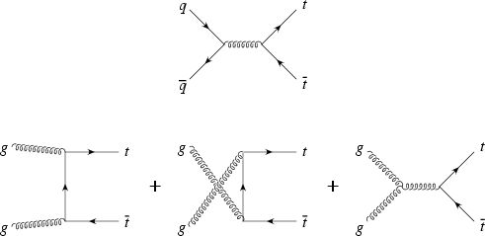
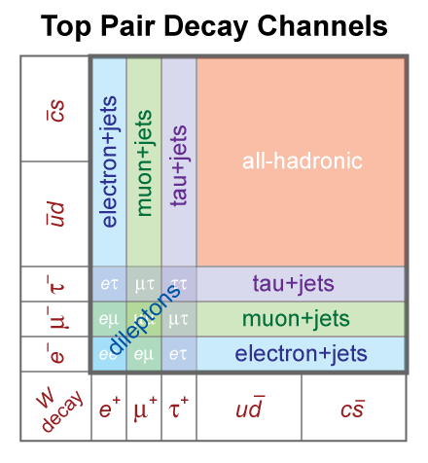
TOP QUARK PRODUCTION & DECAY
Produce in pairs via strong interaction
At √s=1.96 (14) TeV:
85 (10) ±5% qq
15 (90) ±5% gg
Decay via electroweak interaction ~100% BR( t→W⁺b)
tt → W(→lν)bW(→lν)b (e+µ: 5%)
low background, low yield
→ DILEPTON SAMPLE
tt → W(→lν)bW(→qq)b (e+µ:35%)
background moderate, medium yield
→ LEPTON PLUS JETS SAMPLE
tt → W(→qq)bW(→qq)b all hadronic ( 45% )
high background, high yield

Slide 5
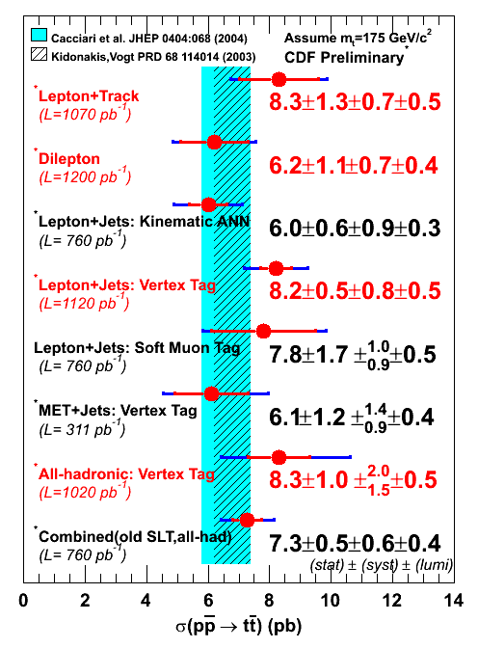
σ(pp-bar→tt-bar) MEASUREMENTS
  σ_{tt} measured in ALL final states:
    Independent top quark samples with different non-SM sensitivities.
σ_{tt} (CDF) ≅ 7.3 ± 0.9 pb
Cacciari et al. JHEP 0404:068 (2004)
Kidonakis & Vogt PRD 68 114014 (2003)
σ_{tt} (NLO-THEO) ≅ 6.7± 0.8 pb
(M_{TOP}=175GeV/c²)
12% ACCURACY: THEORY & EXPERIMENT

Slide 6
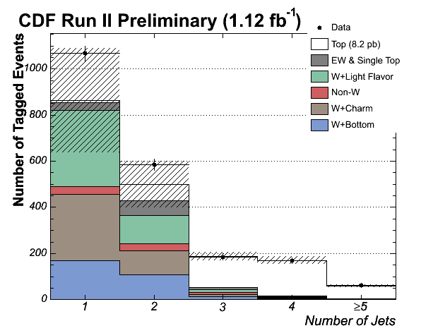
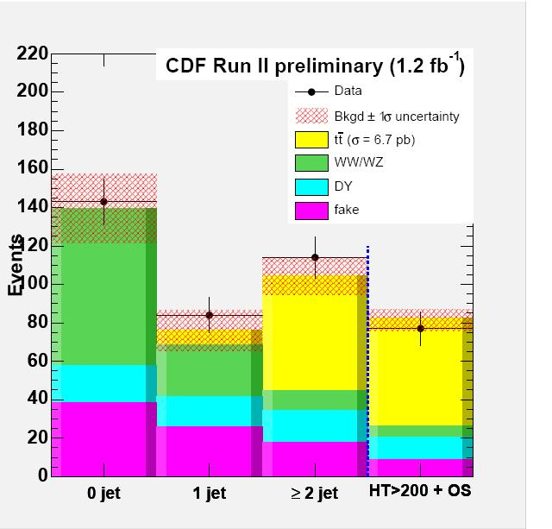
THE ~1 fb⁻¹ TOP QUARK SAMPLES
DILEPTON SAMPLE
L+JETS
SAMPLE
CONTROL
SIGNAL
CONTROL
SIGNAL
1 high P _{T} lepton (e,µ ) P_{T}> 20 GeV/c
≥4 high E _{T} jets.
High Missing E _{T}
B-tagging with secondary vertex.
2 high P _{T} leptons (e,µ ) P_{T}> 20 GeV/c
2 high E _{T} jets.
High Missing E _{T}
 | 4 jets | ≥5 jets
Total Backgr. | 16.7 ± 5.9 | 4.7 ± 1.7
tt-bar (σ=6.7pb) | 153.5 ± 15.6 | 53.6 ± 5.5
Total SM | 170 ± 17 | 58 ± 6
DATA | 169 | 62
Total Backgr. | 25.6±5.5
tt-bar (σ=6.7pb) | 55.9±4.3
Total SM | 81.5±8.9
DATA | 77
Notes:
An interesting and promising technique, not yet analized the full dataset.

Slide 7
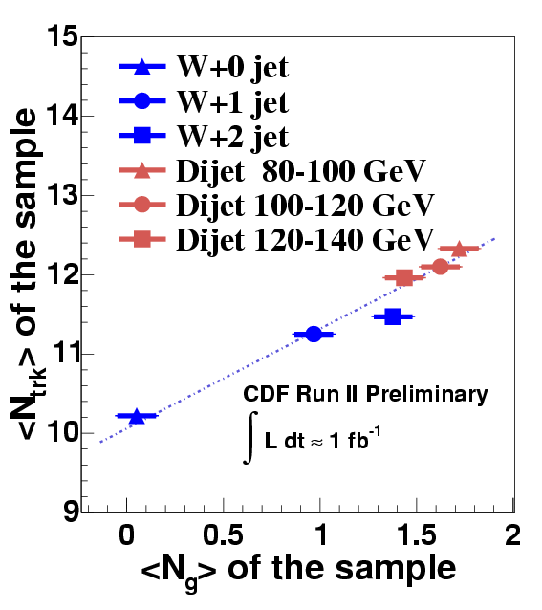
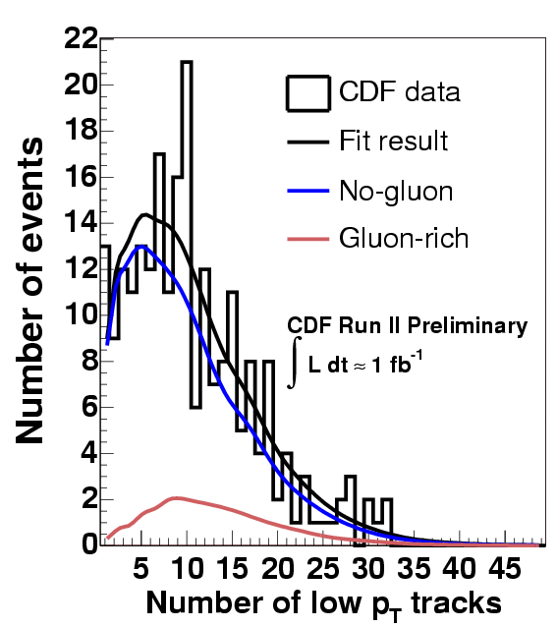
σ(gg→tt)/σ(pp →tt): <N_{TRK}> VS <N_{gluon}>
Sensitive to new top production & decay mechanisms simultaneously.
G.L Kane and S. Mrenna Phys. Rev. Lett.77: 3502-3505 (1996)
Top quark from gluino decays and top quark decays to stops
PRINCIPLE: gg→tt tends to have more underlying event activity w.r.t qq→tt
Calibrate <N_{TRK}> (low P_{T} tracks) vs. <N_{g}> correlation with W+jets and dijet data.
Fit W+jets (b-tagged) data to <N_{TRK}> templates: gluon-rich (DIJET 80-100 GeV )
no-gluon (W+0 jets)

Slide 8
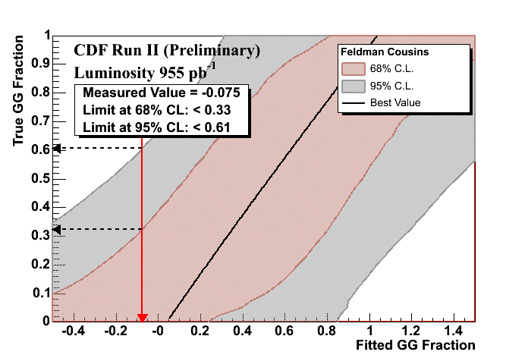
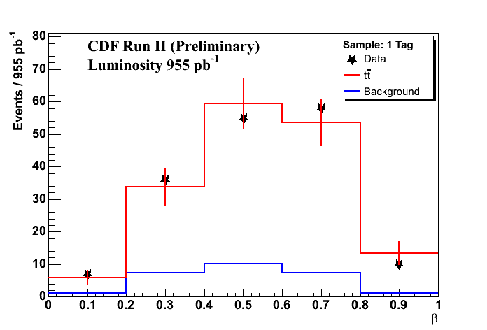
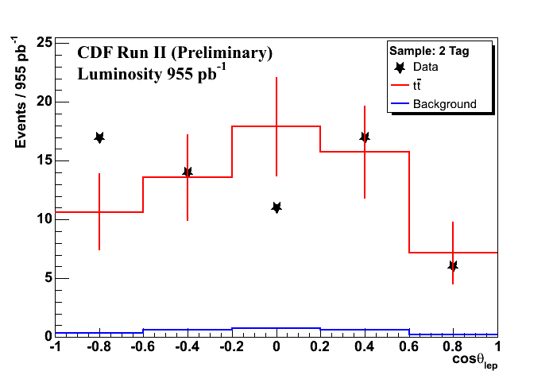
σ(gg→tt)/σ(pp →tt):neural network
PRINCIPLE: gg (qq-bar) tt-bar events tend to be produced with unlike (like) spin.
Use NN with 8 input variables:
  2 in the tt-bar reference frame: β and angle top quark-incoming parton.
    kinematic information from the production.
  6 angles between decay products in the “off-diagonal” bases
    spin correlation information from the decay.
Fit data to templates built from the NN output shapes.

Slide 9
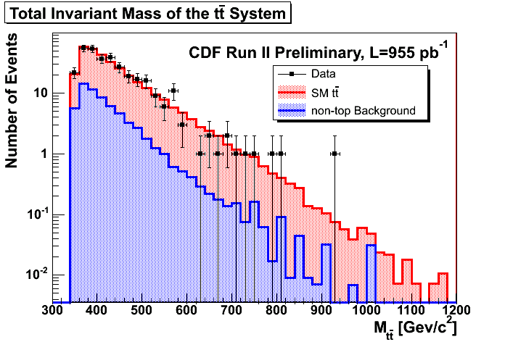
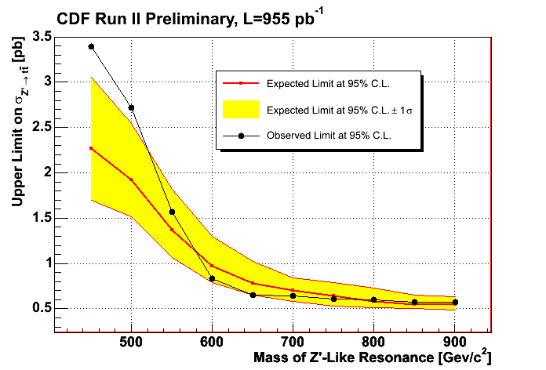
Search for resonant top pair production
Sensitive to new resonant t-tbar production mechanisms:
  Extended Gauge Theories
    ( A. Leike, Phys. Rep. 317, 143, 1999. hep-ph/9805494 )
  KK states of the gluon , Z
    ( J. Rosner, CERN-TH/96-169, 1996, B. Lillie, hep-ph/0701166)
  Topcolor
    (C. Hill, S. Park, PRD49, 4454, 1994 )
Search for narrow width Z’ (1.2% of the mass ) with same coupling as Z0
  no resonant interference with the s channel gluon production.
Reconstruct Mtt-bar with kinematic fitter.
Binned likelihood fit of data to 3 templates:
  SM tt-bar, Z’→tt-bar,non tt-bar
  Range of Z' masses (450-900 GeV/c²)
95%CL: σ(Z´→tt-bar)< 0.7 pb⁻¹
for M_{Z´} > 700 GeV/c²

Slide 10
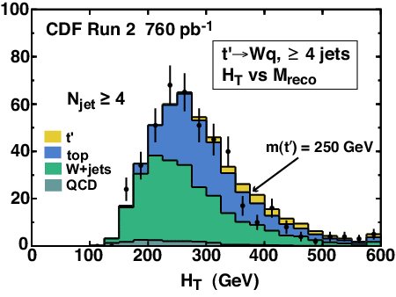
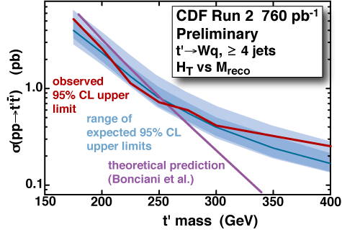
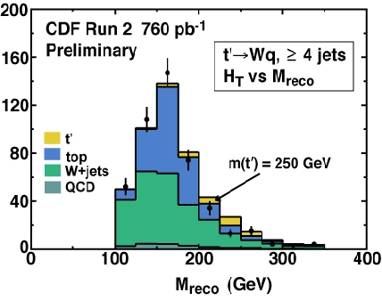

Search for a Heavy Top t´→Wb
Hypothesis: t´ is pair-produced strongly, heavier than SM top quark, decay to Wb.
  2HD models and N=2 SUSY models can accomodate a heavier 4th fermion generation with m _{Z/2} < m_{f} < m_{Higgs} (hep-ph/0102144,hep-ph/0111028)
  Other models: “Beautiful mirrows” (hep-ph/0109097)
Data fitted to templates (t´, top, background) with 2D binned likelihood (H_{T} and M_{RECO})

Slide 11
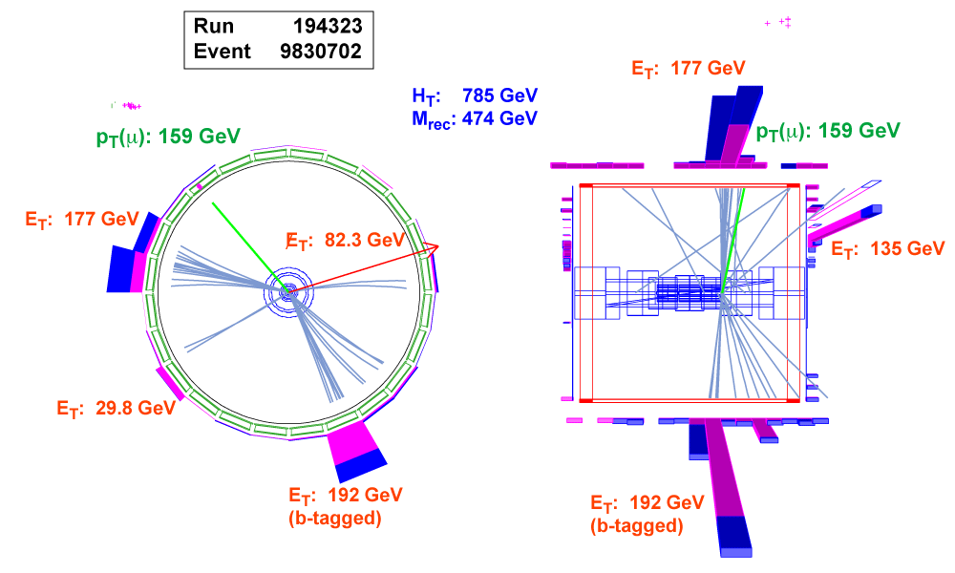
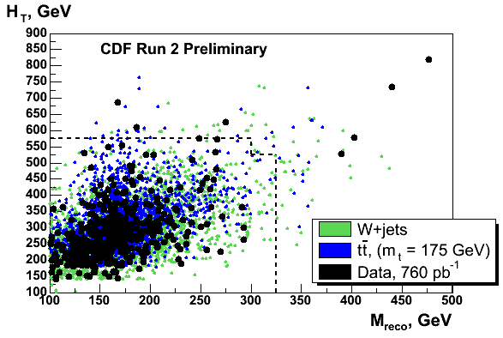
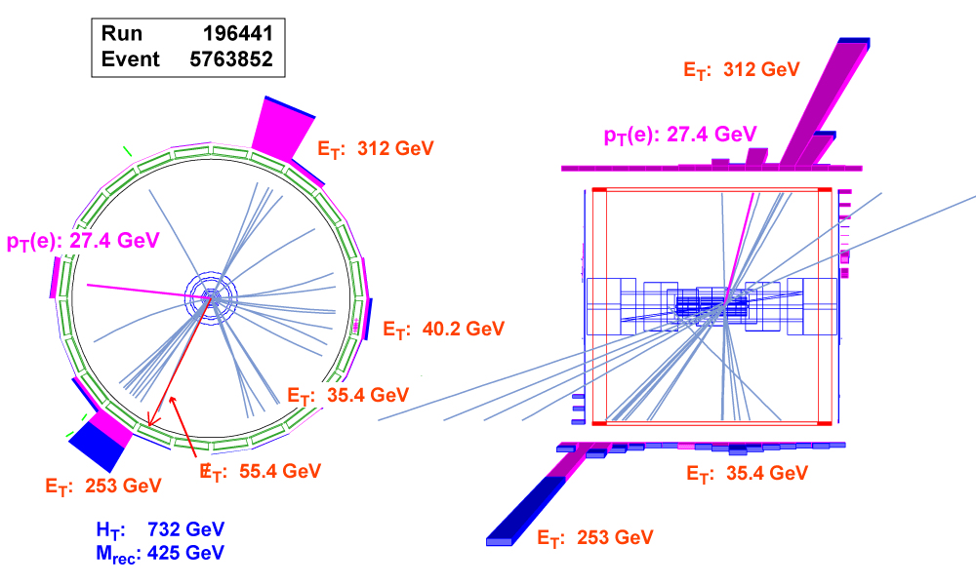
Event Displays: high H_{T} high M_{REC} candidates

Slide 12
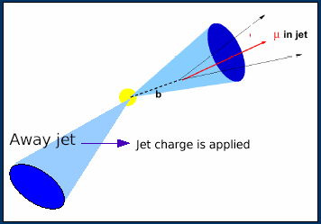
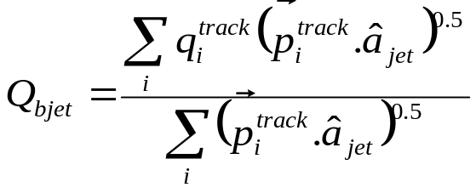
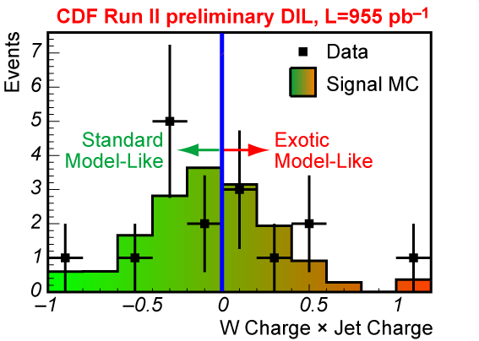
Top quark charge: +2/3 or -4/3 ?
Hypothesis: Top quark charge = -4e/3
  New exotic quark part of a fourth generation. D.Chang et al. PRD 59, 09153(99)
A challenging experimental method:
  Jet Charge algorithm:
    Calibration with dijet data bb-bar enriched
    “Purity”:= probability of correctly pairing Wb and getting the correct flavor of b-jet
  Counting experiment:
    62 Standard Model-like (SM)
    48 Exotic Model-like (XM)
  Likelihood versus f+= Fraction of pairs with charge 2e/3 in data.
  Result:
Consistent with charge 2e/3 hypothesis
  Exclude charge -4e/3 hypothesis at 81% confidence

Slide 13
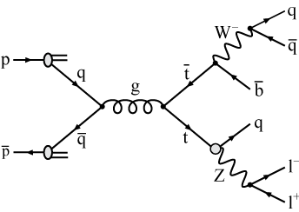
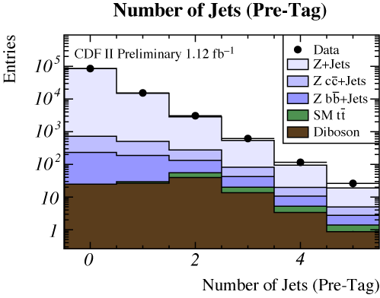
Search for the FCNC decay t→Zq
SM: Top quark FCNC highly suppressed (GIM mechanism and CKM suppression)
Beyond SM scenarios enhance top FCN decays providing observable BR´s
J. A. Aguilar-Saavedra Acta Phys. Polon. B35 (2004) 2695-2710, hep-ph/0409342
Blind search in tt → Zq Wb
  Z → e⁺e–,µ⁺µ– (clean signature)
  4 jets (larger BR of hadronic W → qq’)
  Two separate signal regions: zero b-tags – one
  or more b-tag
Backgrounds: from data-driven and MC methods
  Dominant background: Z+Jets production
  Smaller backgrounds: tt and diboson (WZ, ZZ)
Model | SM | Q=2/3 quark singlets | 2HDM | MSSM | RPV-SUSY
BR(t→qZ) | ~10⁻¹⁴ | ~ 10⁻⁴ | ~ 10⁻⁷ | ~ 10⁻⁶ | ~ 10⁻⁵

Slide 14
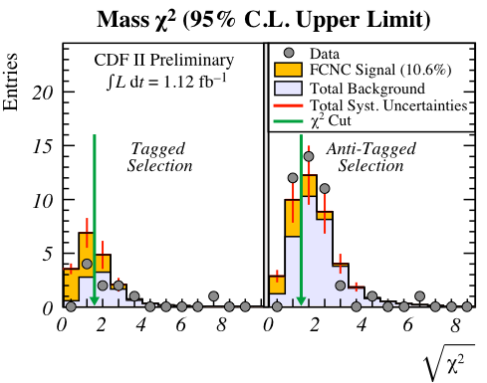
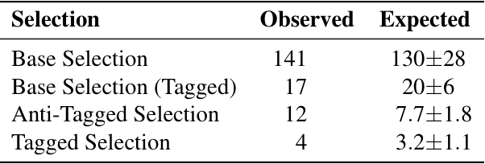
Search for the FCNC decay t→Zq (Cont´)
Optimize event selection for best expected limit
  Strongest discriminator: Mass χ² : reconstructed W, SM Top and NON-SM FCNC Top masses
Unblinding after optimization: observed numbers events consistent with background
New world´s best limit: improves previous limit by 25% (13.7% from non-observation of e⁺e– → tq at LEP,L3)

Slide 15
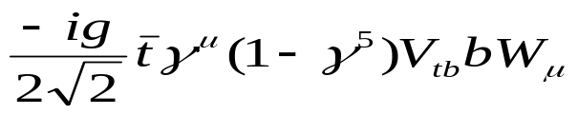
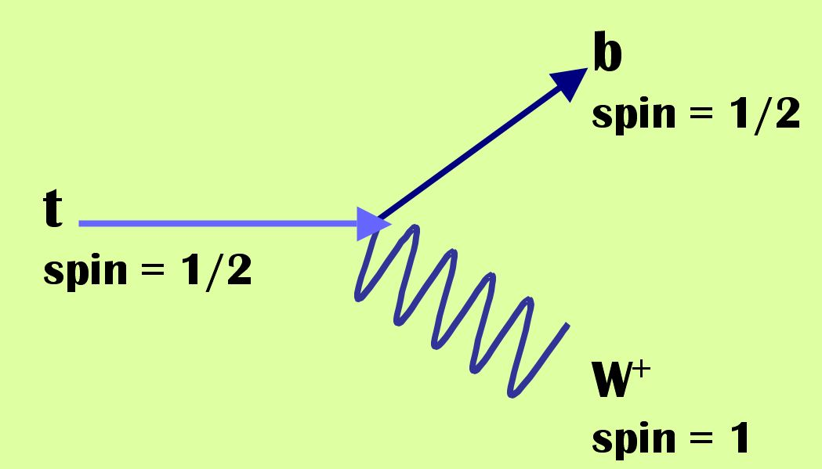
W Helicity in Top Quark Decays
SM: Top quark decays via weak interaction to spin-1 W⁺ boson and spin-1/2 b quark
→ V-A coupling like all other fermions:
V+A is Suppressed
in the SM
W₀ longitudinal fraction F₀ = 0.7
W₋ left-handed fraction F₋ = 0.3
W₊ right-handed fraction F₊ = 0.0
0
+1/2
-1/2
+1/2
W
b
+1/2
+1
t
W
t
W
b
W
t
W
b
+1/2
+1
-1/2
In general, t-W-b coupling can have form-factors of type: V-A (standard model), V+A and Magnetic-moment G.L. Kane, G.A. Ladinsky, C.P. Yuan Phys. Rev. D 45, 124 (1992)
.
The presence of V+A could signal new physics: Left-right symmetric models? Mirror fermions? Beg, Mohapatra et al. Phys.Rev.Lett.38:1252, 1977
Triantaphyllou: J.Phys.G26:99,2000
Tait,Yuan, He et al.:Phys.Rev.D62:011702,2000, Phys.Rev.D65:053002,2002

Slide 16
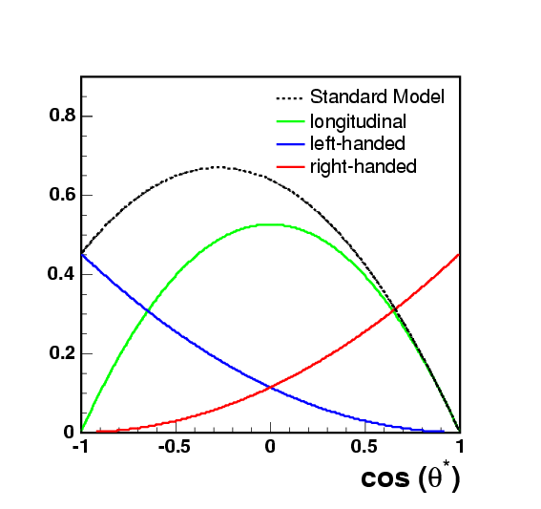
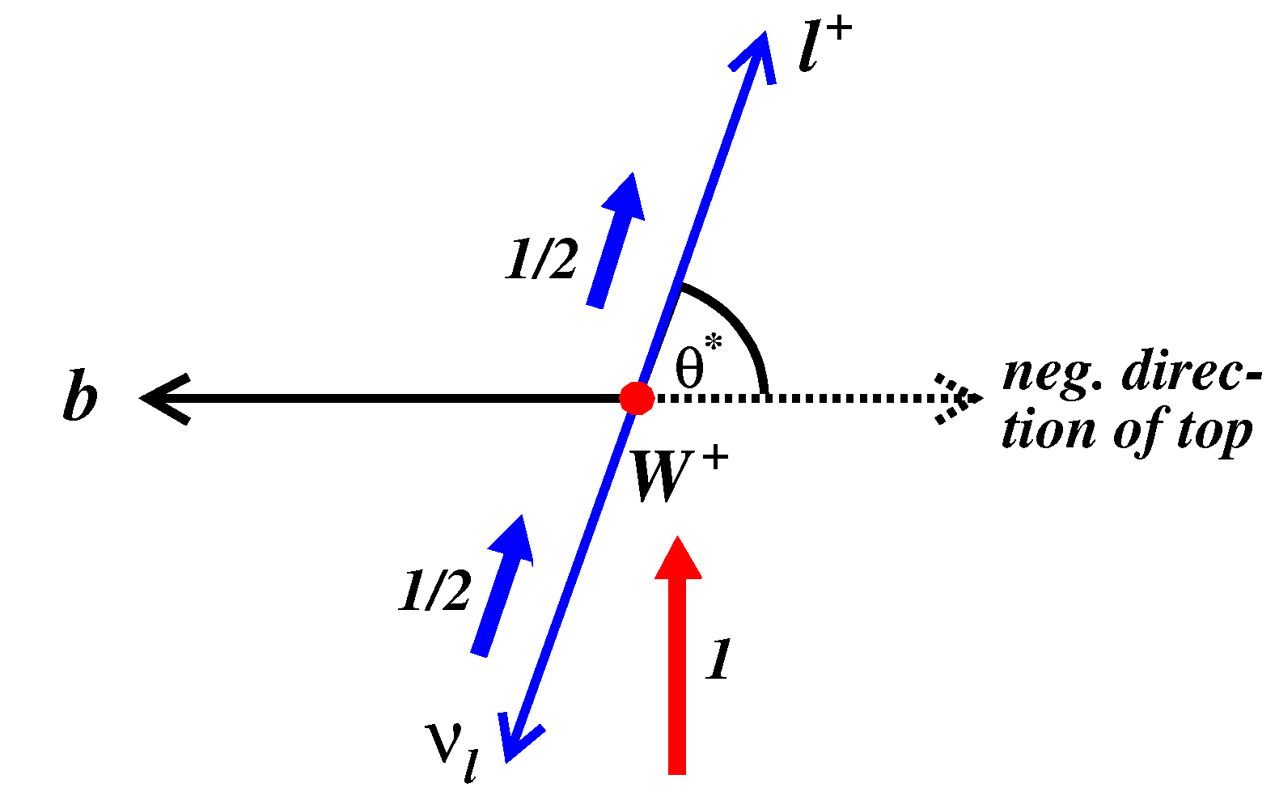
W-helicity: cosθ*method
~(1 - cos θ *)²
~(1 - cos² θ)
~(1 + cos θ *)²
  L+JETS sample with N_{JETS}≥4 and ≥ 1 btag.
  tt-bar kinematics fully reconstructed.
  Extract cosθ* by boosting lepton and top into W rest frame.
  Two methods to extract F₀ and F₊ (next two slides)
  3 set of results:
    1-Parameter-fit: F₀ fixed to 0.7 → Test possible V+A contribution in weak interactions
    1-Parameter-fit: F₊ fixed to 0. → Test possible anomalous couplings ( non zero-magnetic moment couplings )
    2-Parameter-fit ➔ MODEL INDEPENDENT

Slide 17
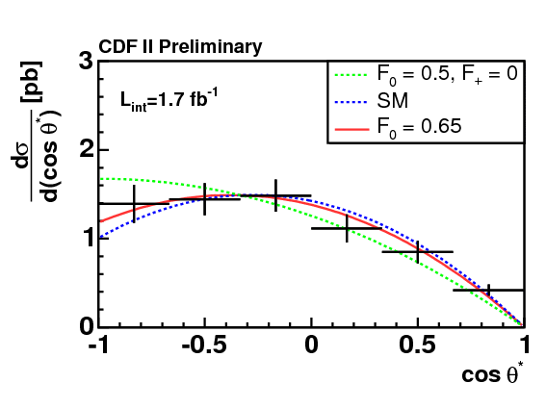
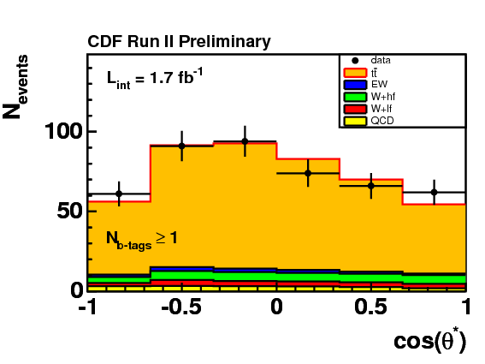
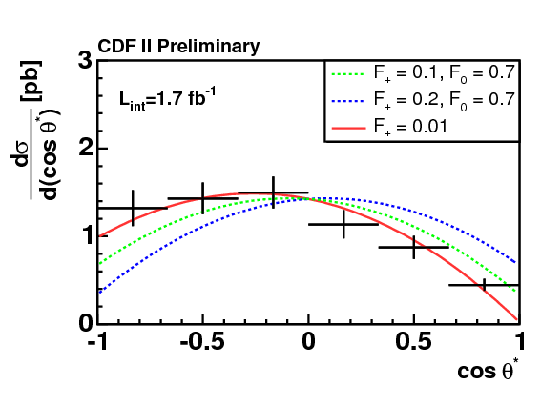
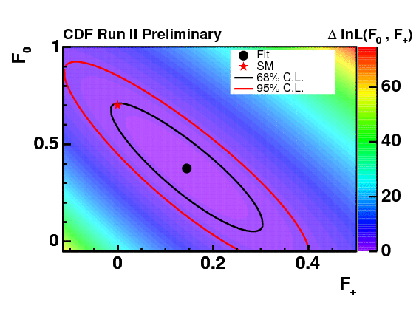
W-helicity: cosθ*method (I) 1.73 fb⁻¹
FIRST METHOD TO EXTRACT F₀ AND F₊
Binned likelihood.fitter:
  Fits data to signal and background templates.
  Signal Templates: from theoretical principles
corrected for detector efficiency and resolution
Unfolding of measured
distribution:
Background substraction of data.
Correct for acceptance and resolution effects: f(F₀,F₊)
F₀=0.38 ± 0.22_{stat} ± 0.07_{syst} and F₊=0.15 ± 0.10_{stat} ± 0.04_{syst}
F₀=0.65 ± 0.10_{stat} ± 0.06_{syst} with F₊=0
F₊=-0.01± 0. 05_{stat} ± 0.03_{syst} with F₀=0.7 f₊< 0.12 @95% CL

Slide 18
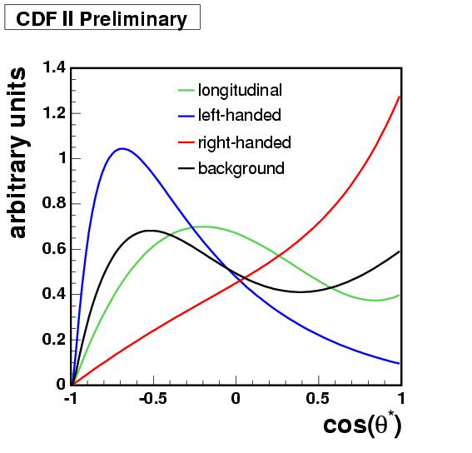
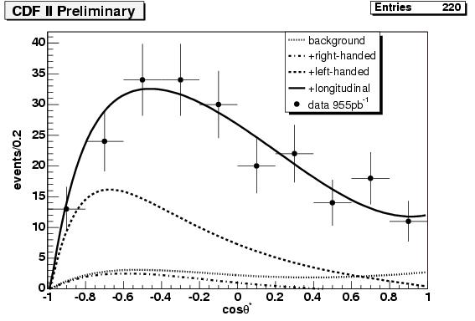
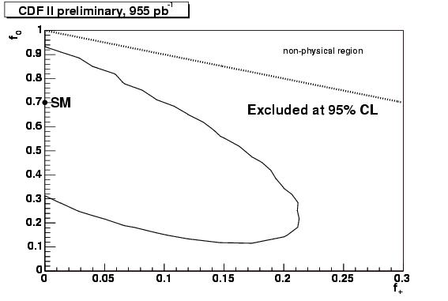
W-helicity: cosθ*method (II) 1 fb⁻¹
SECOND METHOD TO EXTRACT F₀ AND F₊
Unbinned likelihood fitter.
Fits data to signal and MC shapes:
  3rd order polinomial times exponent parameterizations from templates.
F₀=0.74 ± 0.25_{stat} ± 0.06_{syst} and F₊=-0.06 ± 0.10_{stat} ± 0.03_{syst}
F₀=0.61 ± 0.12_{stat} ± 0.06_{syst} with F₊=0
F₊=-0.06± 0. 06_{stat} ± 0.03_{syst} with F₀=0.7 f₊< 0.11 @95% CL

Slide 19
CONCLUSIONS AND PROSPECTS
The CDF top quark samples with L = 1.1 – 1.2 fb⁻¹ have been reestablished:
  Top pair production cross section has been measured and found in good agreement with QCD-NLO predictions.
A lot of challenging and creative “ALTERNATIVE” searches have been performed on the CDF top quark samples in order to find NEW PHYSICS.
  New production mechanisms: resonances, t´, etc
  New decay mechanisms: FCNC t→Zq
  Search for deviations in SM values of measured top properties: charge, W helicity.
  For the time being are very statistical limitted, but the methodology is in place.
  2fb⁻¹ analyses coming by the end of summer.
  NO EVIDENCE OF NEW PHYSICS IN THE 1 fb⁻¹ CDF TOP QUARK SAMPLES
All the ongoing CDF analysis techniques described can be applied to search for new physics in the TEVATRON PHASE OF THE LHC (early LHC data 0.1-1 fb⁻¹)
  Background methods for total rates and shapes.
  Determination of systematic uncertainties.
  Statistical machinery to extract limits.

Slide 20
Backup slides.

Slide 21
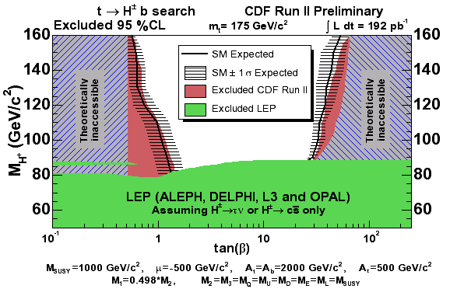
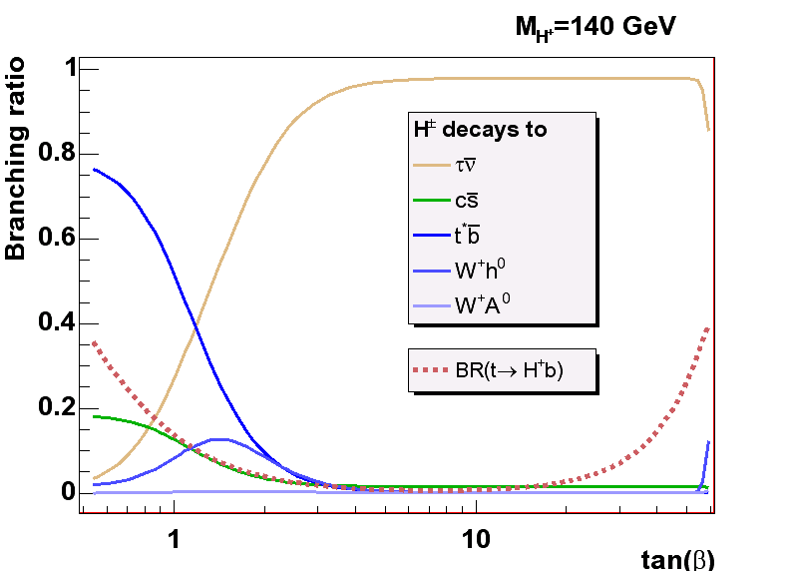
Charged Higgs from Top quark decays
Branching ratio for t→H⁺b significant (>10%) for small and large tanβ
H⁺ decays differently than W^{+:}
  H⁺→τ⁺υ_{τ} enhanced if high tanβ:
    Excess of taus
  H⁺→t*b→W⁺bb for high m(H⁺) if low tanβ:
    Mimics SM signature but observe more b-tags
  H⁺→cs: defect all channels.
Compare number of observed events in 4 ttbar final states:
dilepton, eτ_{h} + μτ_{h,}
lepton+jets with single b-tag, and lepton+jets with double b-tags
(Phys. Rev. Lett 96,042003)
Limits on BR(t->H⁺b)

Slide 22
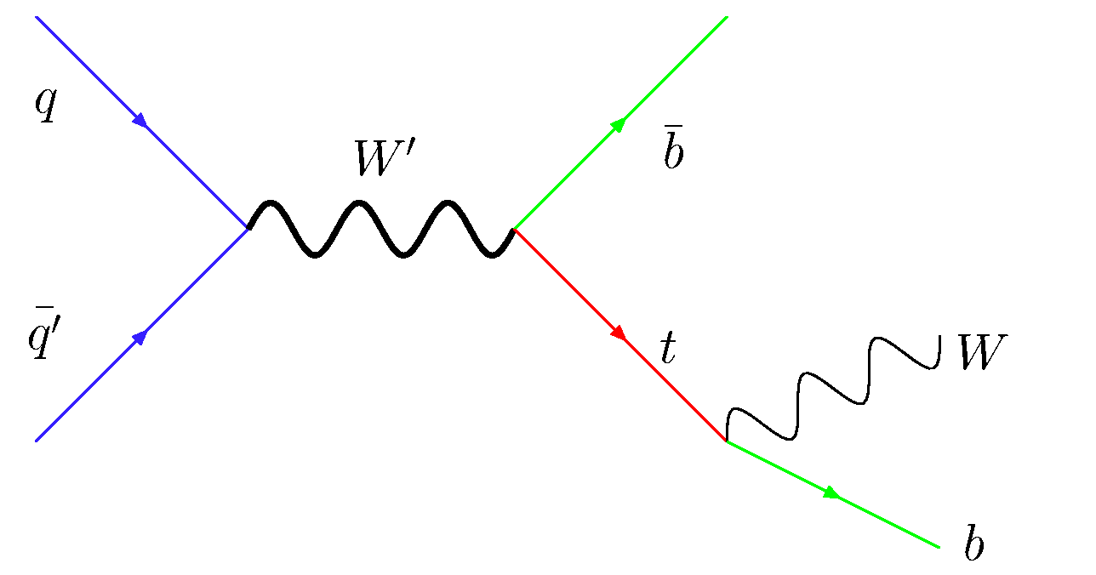

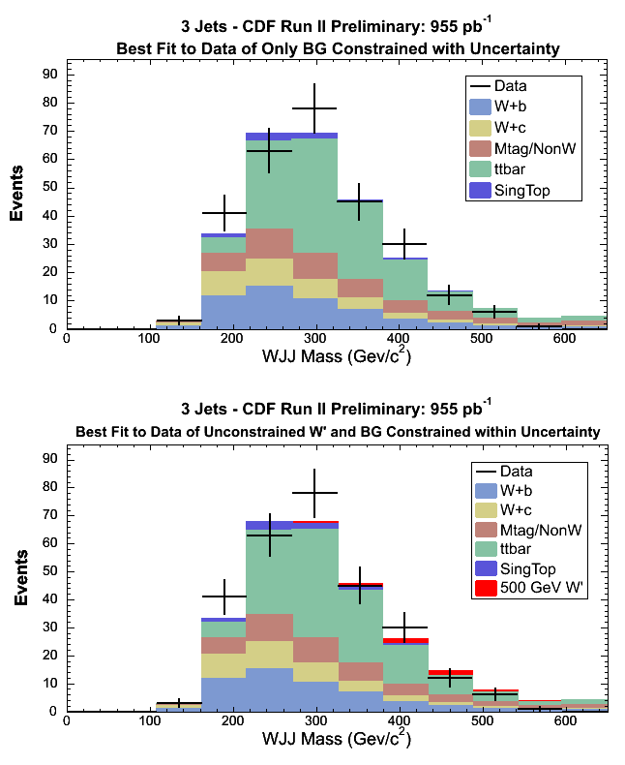
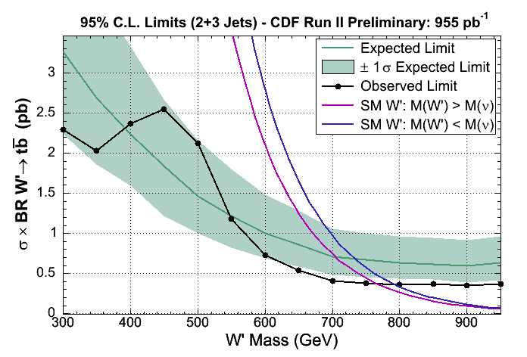
W´-like resonances in the tb-bar decay channel.
Beyond SM models predict massive W-like bosons describing resonant tb production:
  Extra dimensions, PL B538, 406 (2002)
  Top Color PL B385,304 (1996)
Single Top analysis methods applied to search for a narrow peak in M_{WJJ}
Set limits on W’ production and it’s coupling to fermion.

Slide 23
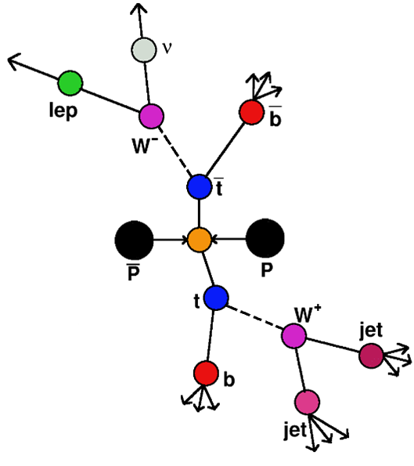
A COMMON TOOL: THE “TOP MASS” KINEMATIC FITTER
24: 0 btags
12: 1 b-tag
4: 2 b-tags
e,μ
jet 1
jet 2
jet 3
jet 4 ( b tag )
missing Et
lepton
b-jet
χ²
b-jet
b ( top )
neutrino ( W )
lepton ( W )
b ( top )
q₁ ( W )
q₂ ( W )
jet
jet
Reconstruction of kinematics:
  Constrain jet-jet mass to W mass.
  Constrain lepton-neutrino mass to W mass
  Constrain b-lepton-neutrino and b-jet-jet to Top masses.
  Top mass equal to anti-top mass
  Lowest χ2 gives correct combination in 70% of the cases
.
Notes:
Top mass unconstained.
Lowes chi-2 combination: best combination.
Find the correct assignment between reconstructed objects and partons.

