Slide 1

Light Vehicle Rollover
Background on NHTSA’s Activities in this Area

Slide 2
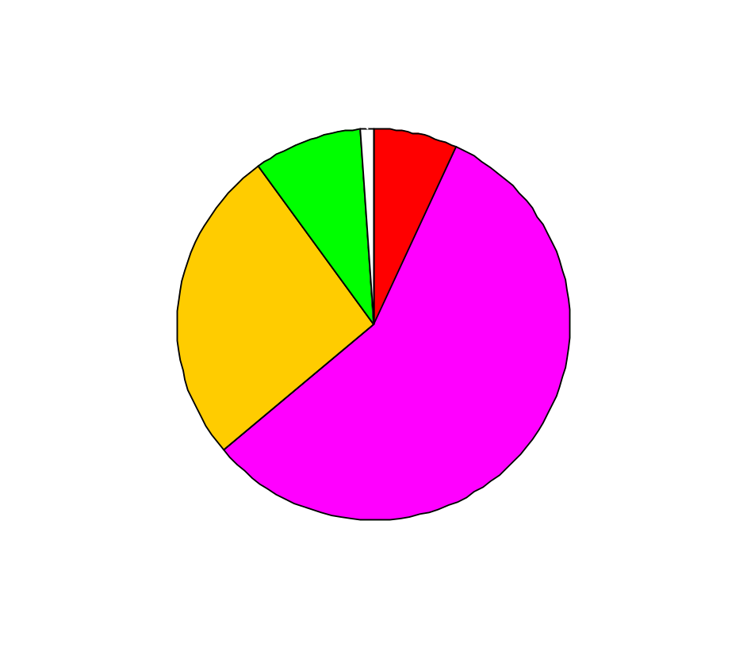
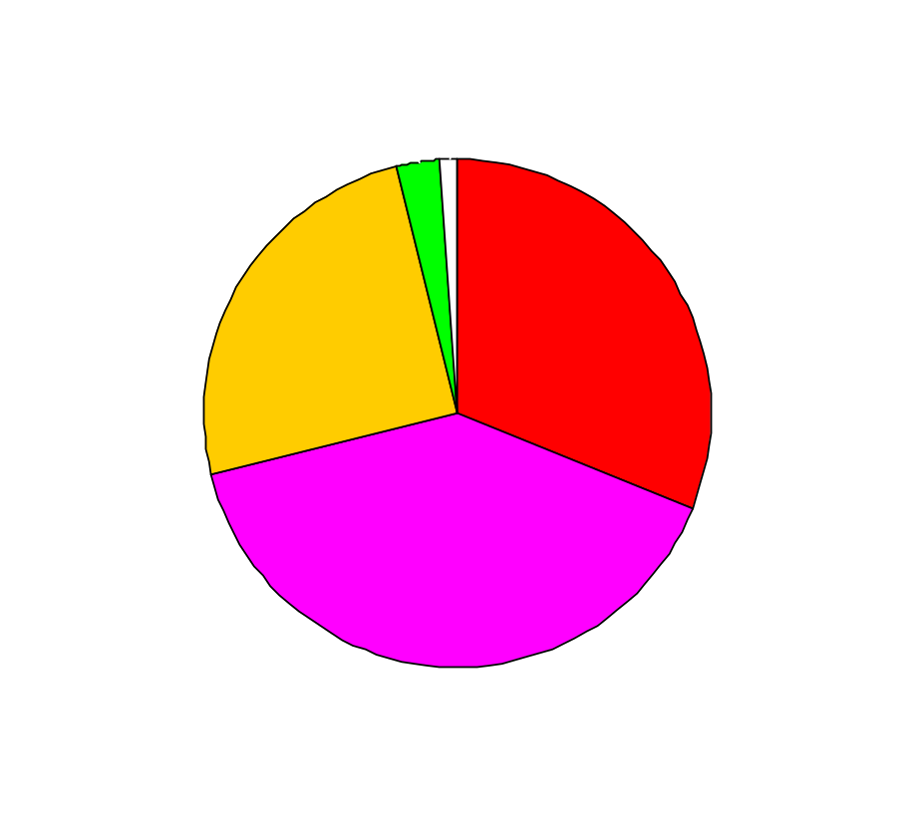

Light Vehicle Tow-away Crashes
1995-1999 NASS-CDS
3.4 million crashes per year
Light Vehicle Occupant Fatalities
1999 FARS
31,921 total occupants killed

Slide 3
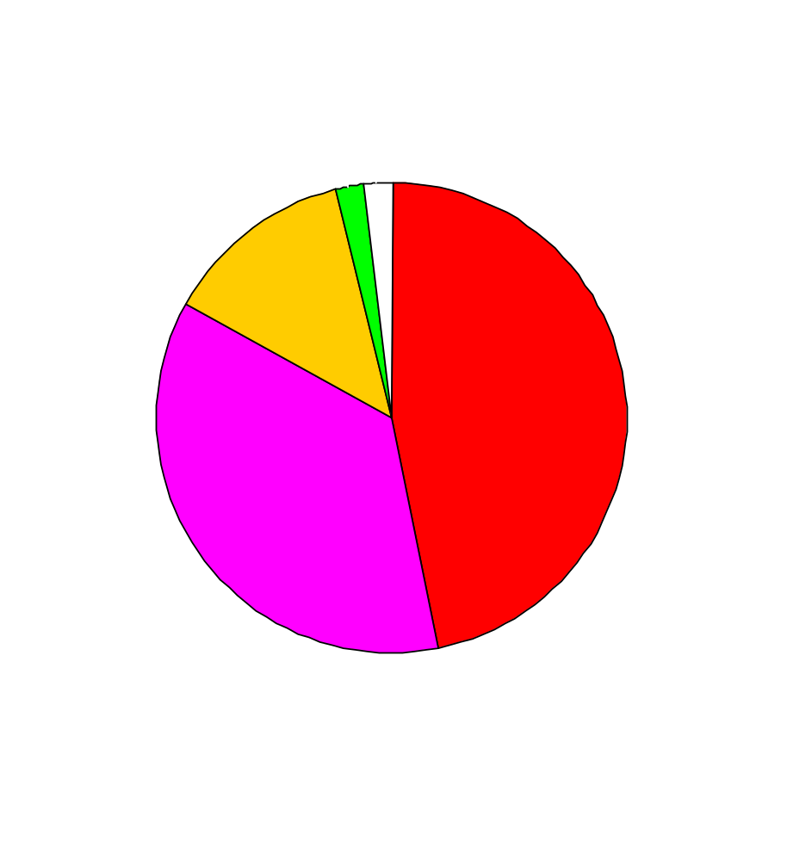


Occupant Fatalities
1999 FARS
Cars
LTVs

Slide 4





Occupant Fatalities
1999 FARS
SUVs
Cars
Vans
Pickups

Slide 5
Chronology of NHTSA Rollover Actions - Page 1
1973: Advance Notice of Proposed Rulemaking on Minimum Standard for Rollover Resistance
1978: Terminate action because of the difficulty in getting tip-up and lack of repeatability
1986: Rep. Wirth petitions for minimum standard based on Static Stability Factor (SSF)
1987: NHTSA denies Wirth petition because of difficulties measuring SSF and because SSF, while correlated to rollover risk if there is a crash, does not predict likelihood of crash
1992: NHTSA issues ANPRM for minimum standard for rollover resistance based on vehicle metrics

Slide 6
The First NHTSA Rollover Rulemaking Action
1973 ANPRM for safety standard “that would specify minimum performance requirements for rollover resistance”
Focus was on safety standard for the next 20 years
  Goal is to set a level that eliminates unreasonable risk to safety
  Challenge is to make it meaningful for cars and light trucks

Slide 7
The First NHTSA Rollover Rulemaking Action (Cont’d)
Agency’s early-70’s work was focused on rollovers on flat road surfaces, with hard driving maneuvers to induce rollover
After years of work, we concluded
  Difficult to get wheel lift with even these maneuvers
  Even more difficult to repeat wheel lift response
Could not use these maneuvers for standard

Slide 8
The Second NHTSA Rollover Rulemaking Action
NHTSA’s early work was with dynamic tests, but found too much variability
Mr. Wirth asked agency to use vehicle physical characteristics (SSF) as a surrogate measure of rollover propensity
From mid-80’s to mid-90’s, NHTSA analyzed different vehicle metrics as a potential means to address rollover
Three widely accepted metrics

Slide 9
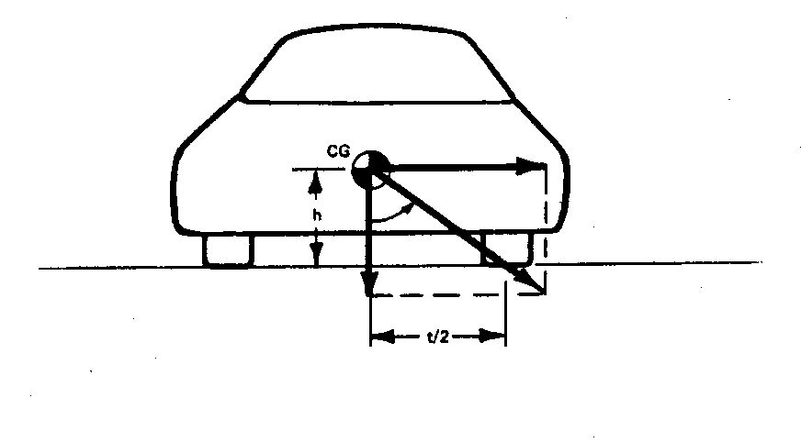
Static Stability Factor (SSF)
T/2h
First order estimate of steady state lateral acceleration when rollover begins.

Slide 10
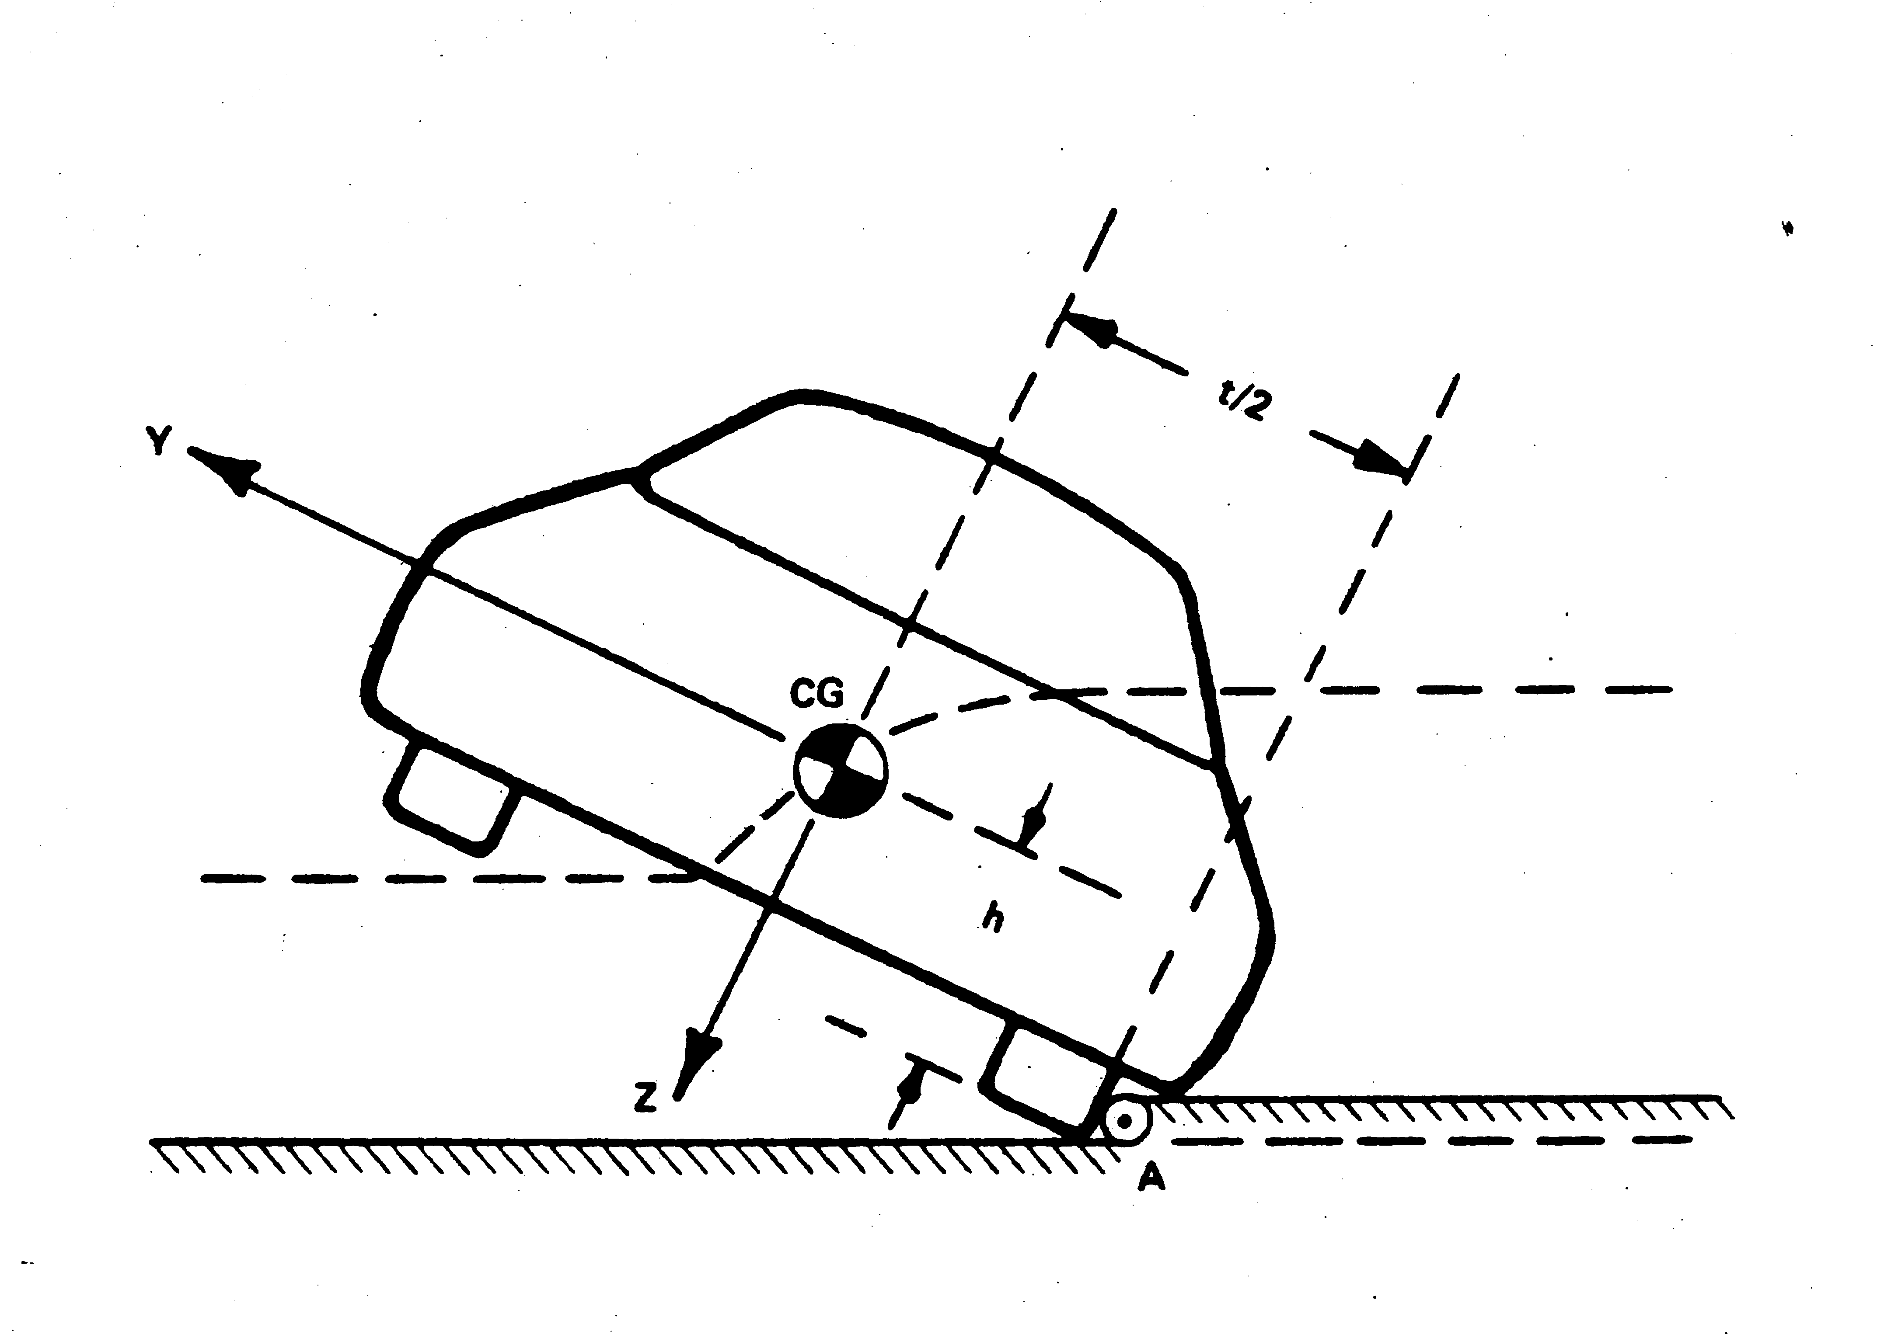
Critical Sliding Velocity (CSV)
Theoretical lowest speed at which sliding sideways into a curb causes rollover.
Vehicle Motion

Slide 11
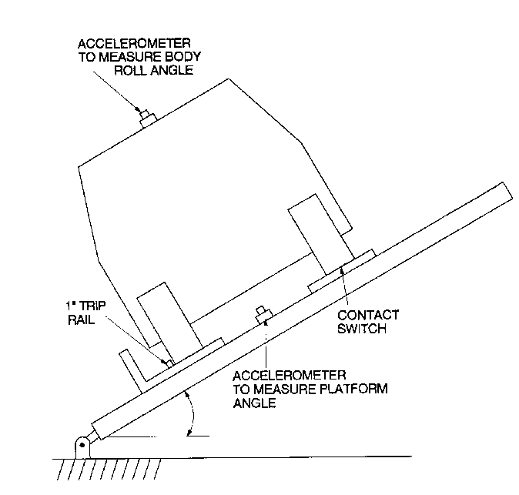
Tilt Table Angle (TTA)
Minimum table angle at which a vehicle on the table will tip over.

Slide 12
The Second NHTSA Rollover Rulemaking Action (Cont’d)
After evaluating a standard requiring a minimum SSF, NHTSA concluded:
  Requested minimum would essentially make all vehicles cars - NOT NHTSA’s mission
  SSF was too simple -correlated to rollover given a crash, but could not predict likelihood of being in a crash
  Difficult to repeatably measure center-of-gravity height

Slide 13
The Third NHTSA Rollover Rulemaking Action
In 1992, NHTSA began a rulemaking with the goal of using a vehicle metric other than SSF to establish a minimum performance standard
Hoped this would:
  Establish a base level of rollover resistance
  Use greater ease and repeatability of metrics
  Find a metric better than SSF

Slide 14
Chronology of NHTSA Rollover Actions - Page 2
1994: NHTSA terminates rulemaking on minimum standard, but proposes consumer information based on vehicle metric
1994: Congress suspends rollover rulemaking until National Academy of Sciences (NAS) study of consumer information
1996: NAS study published
1996: NHTSA begins new study of feasibility of dynamic rollover
1999: NHTSA publishes report of its testing results

Slide 15
Safety Standard vs. Consumer Information
In 1994, we terminated rulemaking on a vehicle standard - benefits were too low to justify costs of redesigning most light trucks
Because of the difficulties of the standard, NHTSA suggested providing consumer information, instead of a standard
This would give the public helpful information about what they are buying without restricting their ability to buy small SUVs and pickups

Slide 16
Recent NHTSA Testing of Dynamic Maneuvers
In 1997, NHTSA set out to see if it was now possible to develop a practicable, repeatable and appropriate emergency handling test
Chose best procedures from existing literature and selected some for further analysis
After analysis, did further testing with three maneuvers

Slide 17
J-Turn Maneuver
brake pulse (if applicable)
steering pulse
hold steering & throttle
accelerate to target test speed
start

Slide 18
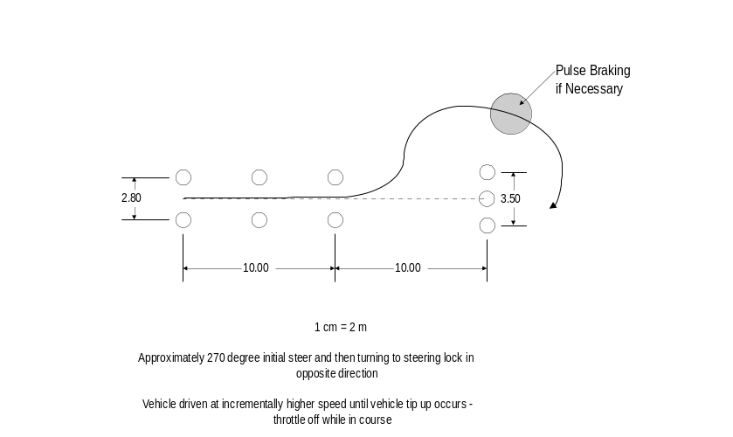
Toyota Fishhook Maneuver

Slide 19
Resonant Steer Maneuver
Step 1 Measure resonant steering frequency:
Start: 0.2 Hz
Start: 0.2 Hz
End: 1.5 Hz
End: 1.5 Hz
increasing steering frequency
Vehicle Path
Vehicle Path
Step 2 Drive test vehicle at resonant steering frequency:
constant steering frequency
Vehicle Path

Slide 20
Conclusions on Dynamic Testing vs Metrics
These dynamic tests give reasonable results that correspond to real-world performance
But dynamic tests are not better than metrics at predicting rollover involvement.
Extra expense of dynamic testing is substantial.
Several practical problems remain with vehicle testing:
  Use of human driver leads to safety concerns and mandates use of outriggers.
  Outriggers affect handling.
  Tire debeading may mask true limit behavior

Slide 21
Why Choose SSF as the Metric for Consumer Information?
None of the three metrics was the clear winner statistically.
SSF is the only metric that will do no harm.
SSF has broad industry acceptance as “first order” design consideration.
SSF is least complex, intuitively related to rollover.

Slide 22
Rollover Actions in the Past 12 Months
June 2000: NHTSA proposes rollover consumer information using SSF
October 2000: Congress mandates NAS study of NHTSA’s proposed SSF rollover information program
November 2000: Congress requires NHTSA to provide consumer information on performance in dynamic rollover testing as of November 2002
January 2001: NHTSA issues first rollover ratings based on SSF

