Slide 1
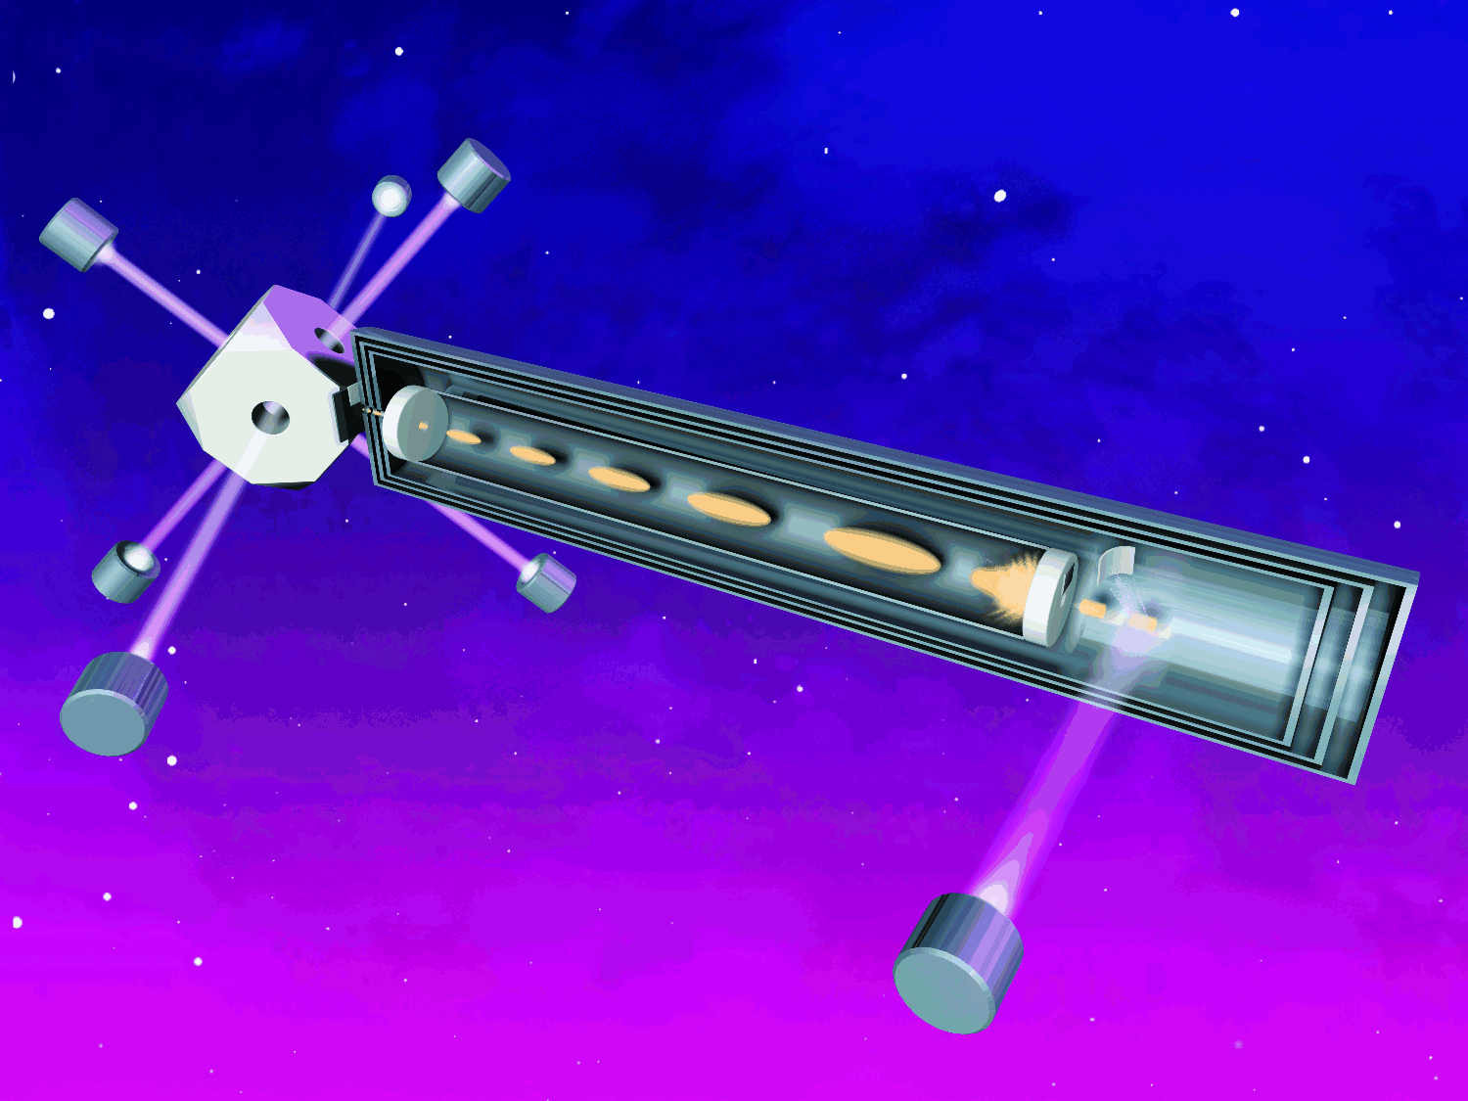
PARCS, Artist’s Rendition

Slide 2



RACE Concept

Slide 3
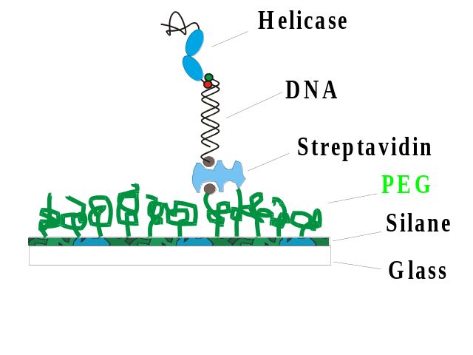
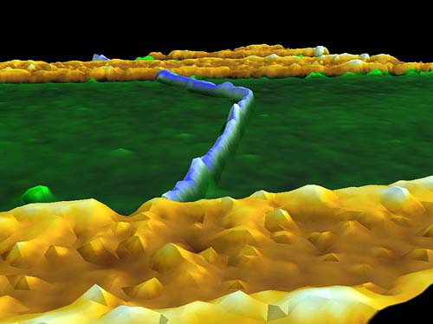
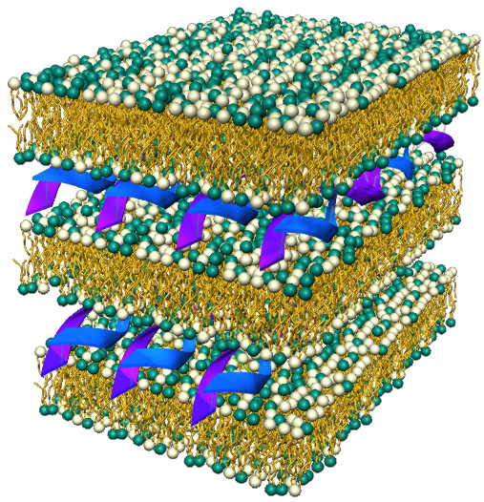
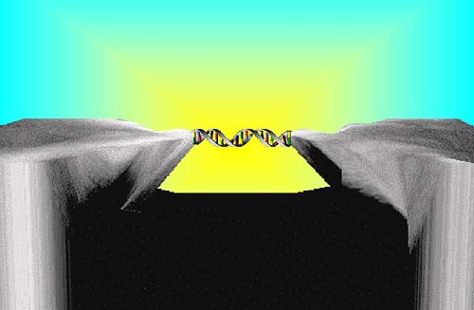
Biological Physics Pictures
nanotube kinks change conduction properties Nature, 18 November 1999
Fluorescent Resonant Energy Transfer technique used by Steven Chu (Nobel Prize ‘97) allows studies of dynamics of individual molecules
DNA shown to be a semiconductor. DNA electronics now feasible Nature, 10 February 2000
Perfect alignment of DNA-membrane complex can serve as nano-fabrication template (Applied Physics Letters, 5 October 1998)

