Slide 1


Search for Physics Beyond the
Standard Model in tt Production
-
Kinematics of tt events
Jet multiplicity
Search for V+A, H⁺,
Resonances, rare decays…
Run1 results
Petra Merkel
Fermilab
For the CDF Collaboration
EPS 2003
Aachen
-
Run2 prospects

Slide 2
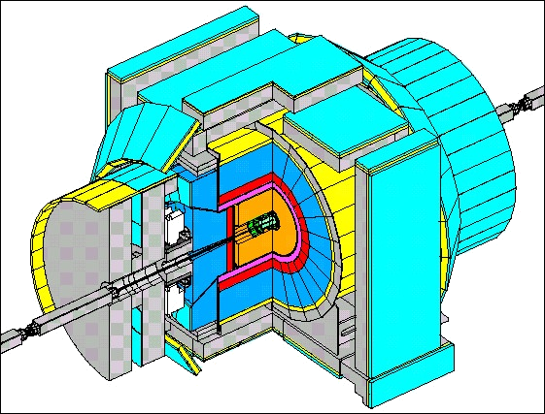
The New CDF Detector
Fully digital DAQ (132ns)
Pipelined trigger (drift chamber tracks @ L1, silicon tracks @ L2)
7-8 silicon layers
722k channels
rφ, rz views
z₀^{max}=45, η^{max}=2
1.3<R<30cm
TOF (100ps@150cm)
μ coverage
extended to
η=1.5
Tile/fiber endcap
calorimeter
(faster, no gap)
96 layer drift chamber
30k channels
σ(1/p_{T}) ~ 0.1%/GeV
σ(hit) ~ 150μm

Slide 3
Top Physics
l⁺,q
Exciting possibilities
Third generation, high mass…
➔ Special role in EW symmetry breaking?
W helicity
Production cross section
Production kinematics
Resonant production
Spin correlations
-
-
b
W⁻
ν,q’
-
t
-
p
p
l⁻,q
X
t
W⁺
BSM?
(SUSY,
technicolor,
...)
Top mass
Top Pt
-
-
b
ν,q’
Decay modes
Branching ratios
|V_{tb}|
Rare/non-SM decays
Notes:
Analysis of production and decay kinematics
Resonant production
W helicity
Spin correlations
Single top production
V_{tb}
Rare and forbidden decays
M_{t} with ∼3 GeV/c² precision

Slide 4
Kinematics of Top Events
It is important to compare various distributions of the reconstructed top quark and especially of the tt system, with SM predictions. Discrepancies could indicate new physics.
A list of some of the distinctive features that were seen in the RunI dataset (no significant effects observed yet):
  increase of measured M_{t} w/ jet multiplicity?
  slight excess of W+2jet events where 1 jet is tagged by 2nd-vertex AND soft-lepton-tag (Phys.Rev.D65 (2002) 052007)
  2/9 di-lepton evts have unexpectedly large E_{t}+E_{t}(l₁)+E_{t}(l₂) (compare Hall and Barnett, hep-ph/9609313)
  measured M(tt) seems to deviate a little from expected distribution
  measured P_{t}(tt) seems a bit harder than expected (but difficult measurement)
  measured rapidity of tt system has different shape than expected
-

Slide 5
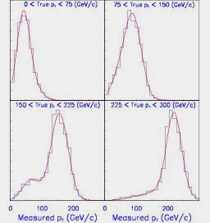










P_{t}(top)
Phys.Rev.Lett. 87, 102001 (2001)
Measure P_{t} of hadronically decaying top in l+jets tt channel
Constrain M_{top}=175 GeV, perform kinematic fit
In 106 pb-1: 61 evts found
BG estimate: 31.9+-4.6 evts
Use unsmearing procedure and unbinned likelihood fit to extract true P_{t}(top)
0-75 GeV
75-150 GeV
150-225 GeV
225-300 GeV
CDF Run I
True p_{T} Bin | Parameter | Measurement | SM Expectation
 | R₁ |  | 0.41
 | R₂ |  | 0.43
 | R₃ |  | 0.13
 | R₄ |  | 0.025
 | R₁+R₂ |  | 0.84
Upper limit:
R₄(225<P_{t}<425GeV/c)<0.16 @ 95% C.L.

Slide 6
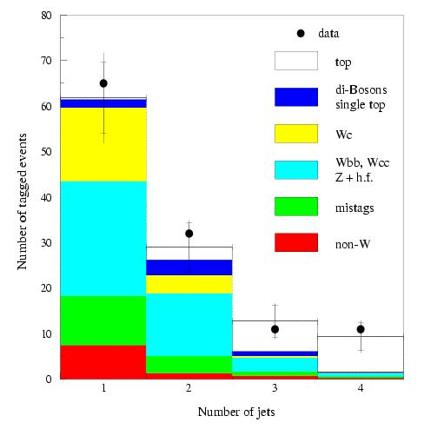
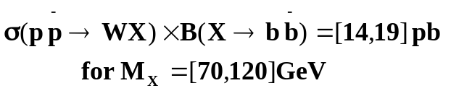
Search for Higgs in W+2jets Events
-
-
Most of the signal expected in W+2jets bin; use other bins to check BG calculation
1 or 2 b-tags required: 2nd-vertex and soft-lepton-tags
W+3jets bin in reasonably good agreement; small excess in W+2jets bin
increase sensitivity of search, look for resonant mass peak in Mjj
No resonance seen in CDFI data
Use binned max-likelihood fit, constraining QCD and tt contributions, to extract N_{WX}
Use SM Higgs production (pp→WH⁰) as a model to extract upper limit
statistically compatible w/ no signal (SM Higgs)
~2 orders of magnitude away from sensitivity to SM Higgs
Search for pp→W+X→lν+bb in 109pb⁻¹
RunI W+jets
-
-

Slide 7
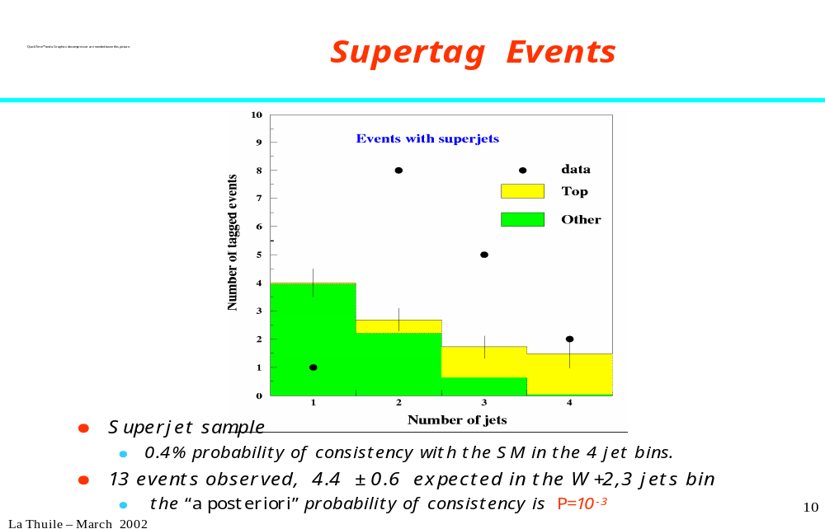
Heavy Flavor Content
Phys.Rev.D65, 052007 (2002)
tt signal region: 3,4 jet bins
We also looked for additional heavy flavor
“Superjets”: 2nd-vertex-tag AND soft-lepton-tag
statistics limited: 14 evts observed, 4.4±0.6 expected in W+2,3 jets bin (while good agreement when integrating over all Njet bins)
many checks performed in order to understand this slight excess
either statistical fluctuation OR mis-undertsanding of detector OR new physics…
Need more data from RunII to re-evaluate this analysis
RunI superjets
0.4% probability of consistency w/ SM in the 4 jet bins
“a posteriori” probability of consistency in 2jet bin is P=10⁻³

Slide 8
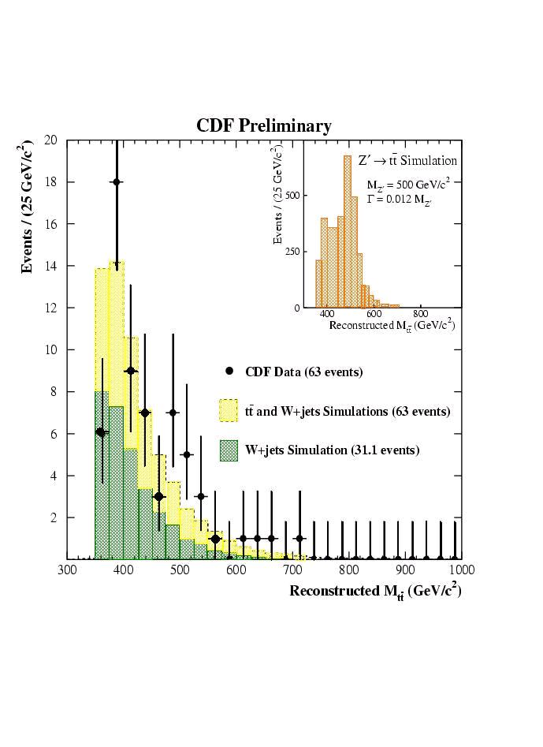
Search for tt Resonances
-
Phys.Rev.Lett. 85, 2062 (2000)
Model independent search for narrow vector particle X→tt in l+jets sample
CDFI found no evidence for a tt resonance
Establish upper limits on σ*B for narrow resonances
Use limits to constrain a model of topcolor assisted technicolor (Z’→tt)
-
-
Expected sensitivity for RunII:
δ(σ*B)~90 fb
-
Exclude a narrow, leptophobic
X boson with m_{X} < 560 GeV/c²
Notes:
Use Bayesian statistics to derive posterior probability distns by fitting mttbar from data weighted to sum of 3 sources.
Write Nx=A*L*Sx*B, can define Sx*B at 95% CL.
No statistically significant excess is found.
Large value of Mtop suggests the introduction of new strong dynamics into SM
Leptophobic Z’ results in large sigma(tt)

Slide 9
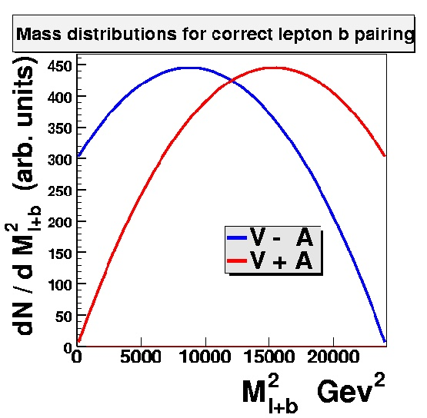
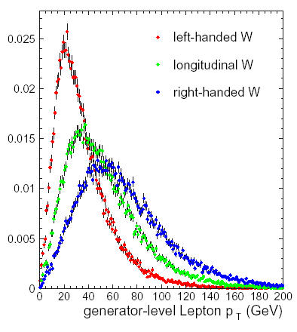

Search for V+A
Phys.Rev.Lett. 84, 216 (2000)
Verify that this is the top quark of the SM…
Use invariant mass of lepton and b quark (frame independent): M²_{lb} = ½ (M²_{t} – M²_{W})(1 + cosΨ*_{l})
RunI
Fit for fraction of right-handed (V+A) component: f_{V+A}
SM V-A predicts W helicity:
F₀ = 70% longitudinal
F₋ = 30% left-handed
[V+A: 70% long., 30% r.-h.]
Use Pt of lepton:
ν
Fit for F₀, then fit for F₊ while fixing F₀
RunII measurement already more sensitive than in RunI!
b
t
RunI & RunII
W
l
Notes:
Analysis makes use of the asymmetry in the lepton’s decay angle b/w left-handed and r-handed W’s from top decay.
For left-handed W’s, the lepton tends to be produced in the direction of the b due to the spin being opposite its momentum.
For right-handed W’s, the lepton is opposite the b because the spin is in the direction of its momentum.
This results in an asymmetry in the Mass distribution between V-A theory (70% longitudinal, 30% left-handed)
And V+A theory (70% longitudinal, 30% right handed). This can be used to discriminate b/w them.

Slide 10
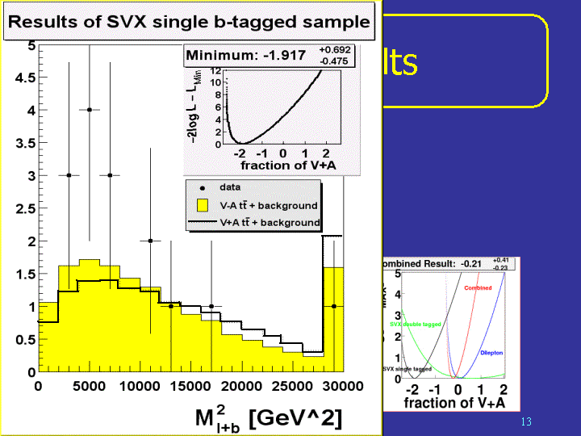
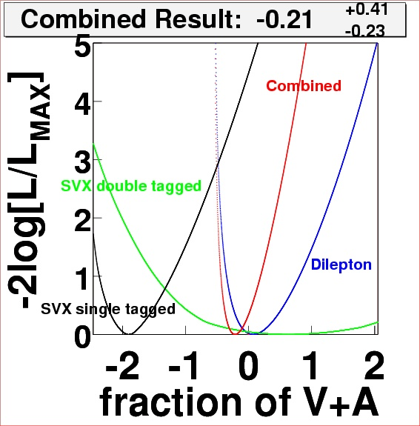
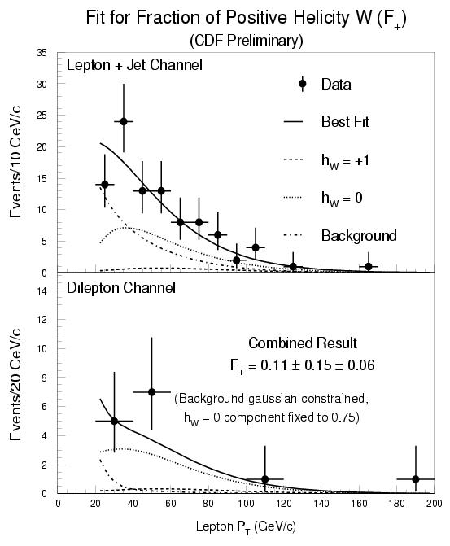
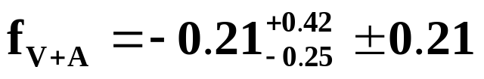

V+A Results
Using M²_{l+b}
Using P_{t}(l)
-
Expected sensitivity for RunII:
δΒ(t→W₀)=5.5% ; δΒ(t→W₊)=2.7%
CDF I preliminary
CDFI Result (109pb⁻¹):
(Using tt dilepton, and lepton+jets
events with 1 and 2 SVX b-tagged jets)
f_{V+A}= -0.21 ^{+0.42}_{-0.25} ± 0.21
CDFI Result (106pb⁻¹):
F₀ =
F₊<0.28 @ 95% C.L.
Notes:
The result is the combined result of all three samples, and comes from a binned likelihood fit based on poisson fluctuating background, V-A, and V+A templates to get the best agreement with the data.
The dominant source of systematic uncertainty is due to the uncertainties in the top mass. Although correlations with
The jet energy scale uncertainty make this effect smaller and tend to cancel out the JES systematic somewhat.
The plot is just for the SVX single tagged sample (not the other two samples or the combined). There are 15 events in that sample, or 15 Mlb’s. The combined measurement uses 53 Mlb’s from all 3 samples.

Slide 11
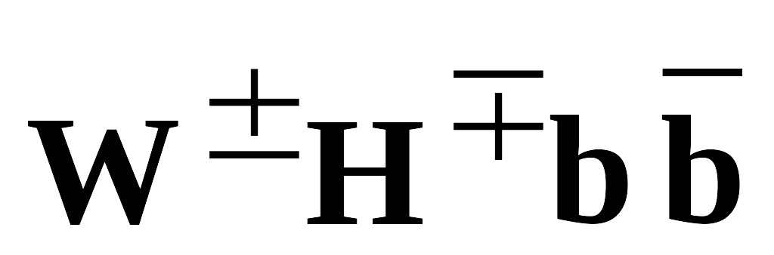
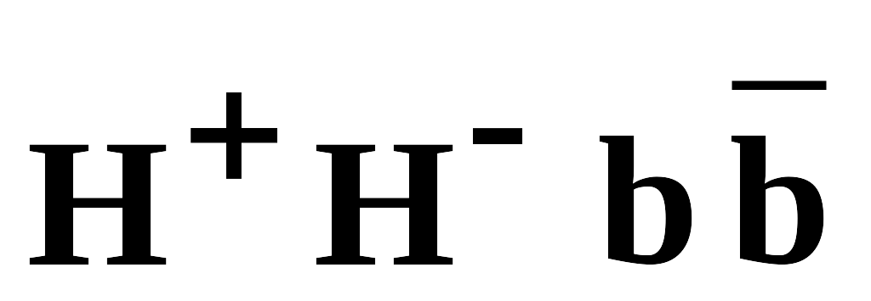
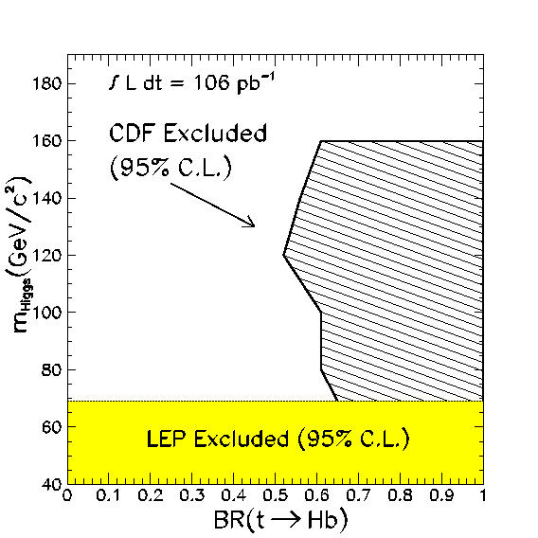
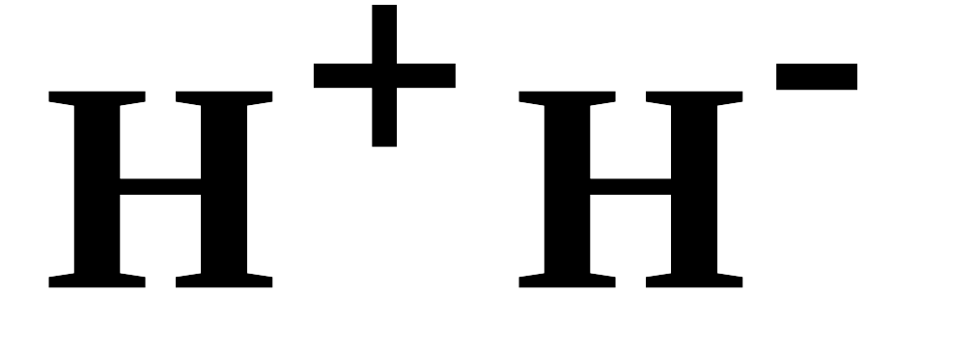
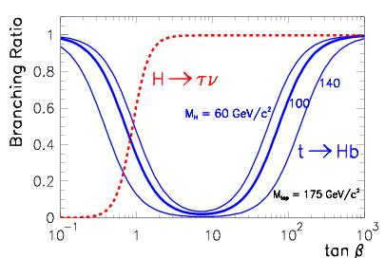
Search for H⁺:
Phys.Rev.D62, 012004 (2000)
2-Higgs-doublet model, MSSM:
t→H⁺b competes with SM t→W⁺b, if m_{H}<(m_{top}-m_{b})
➔tt production/decay provides source of Higgs (strong interaction) :
➔Direct Higgs pair production (weak interaction) :
In MSSM (for large tanβ): dominant decay mode
Predict excess of top events with tau leptons!
Direct search for signature of τ lepton in t decays → upper limit on B(t→H⁺b)
Signature:
In 106pb⁻¹ 4 candidates found
Expect: 4.0+-0.6 from SM (BG+top)
-
l+τ+E_{t}+2jets+X
/
For B(H⁺→τν)=100%
Expected sensitivity for RunII:
δ(Β(t→Wb)/Β(t→Xb))=9%
H⁺→τν
Very
interesting
channel
for RunII
CDF RunI

Slide 12
Search for FCNC Decays
Phys.Rev.Lett. 80, 2525 (1998)
Unusual decays of the top quark might provide insight into the mechanism of EW symmetry breaking
CDF RunI
Rare decays: t→qγ, t→qZ
Look for tt events w/ t→qγ and the other t→Wb(→lνb or →qqb)
  <1 evt expected from SM BG sources
  1 evt found in 110pb⁻¹: P_{t}(μ)=72GeV, E_{t}(γ)=88GeV, E_{t}=24GeV, 3 jets
  Also kinematically consistent w/ t→W⁺b & t→W⁻bγ, but E_{t}(γ) exceptionally large!
  B(t→c+γ) + B(t→u+γ) < 3.2% @ 95% C.L.
Look for tt events w/ t→qZ(→qee or →qμμ) and the other t→Wb(→qqb)
  Less sensitive because B(Z→leptons) small
  1.2 evts expected from SM BG sources
  1 evt found in 110pb⁻¹: Z→μμ + 4 jets
  Kinematics fit better the Z+multijet hypothesis than FCNC decay
  ➔ B(t→c+Z) + B(t→u+Z) < 33% @ 95% C.L.
-
/
-
-
-

Slide 13
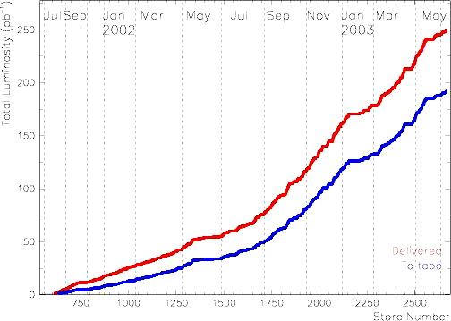
Tevatron Performance
-
pp collisions at √s=1.96 TeV
Stable data-taking since June ‘02 shutdown ~ 200 pb⁻¹ on tape
~ 5-8 pb⁻¹/wk @ > 90% efficiency
Record instantaneous luminosity after January shutdown ~4.7-10³¹cm⁻²s⁻¹
250
200
150
100
50
0
Jan
2002
Jan
2003
Delivered
Integrated luminosity [pb⁻¹]
To Tape
Most of the RunII results so far used 72 pb⁻¹ (March ‘02 – January ‘03)
New results from ~120 pb⁻¹ expected soon!

Slide 14
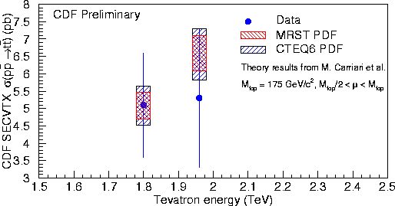
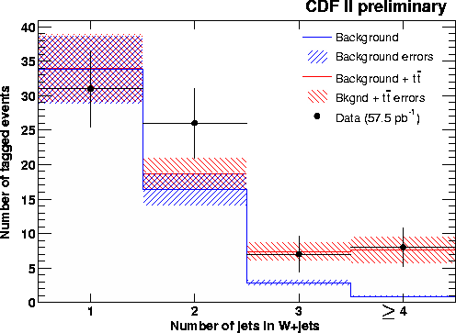
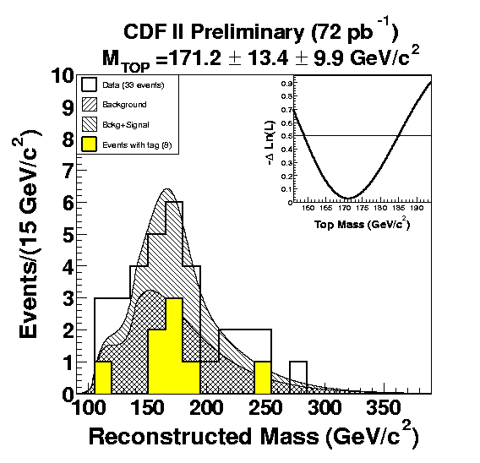
Top in RunII
First cross section and M_{top} measurements using 72pb⁻¹
New results from ~125pb⁻¹ expected soon
Expected sensitivity for RunII:
δ(σ_{tt})=7%
Some searches are already on the way, like single top and V+A
Expected sensitivity for RunII:
δ(Μ_{t})=2−3 GeV

Slide 15
Summary & Outlook
Many interesting and promising tests for new physics in the top sector
Cross-section of CDF RunI results presented
Standard top measurements established in RunII
Some searches in tt events already started
Measurement | Estim.uncertainty | Tests
M_{t} | 2-3 GeV/c² | Indirect M_{H}
σ_{tt} | 7% | QCD couplings
σ_{ll}/σ_{l+j} | 12% | Non-SM decays
B(t→Wb)/B(t→WX) | 2.8% | “
B(t→Wb)/B(t→Xb) | 9% | “
B(t→W_{long}) | 5.5% | Non-SM couplings
B(t→W_{V+A}) | 2.7% | “
σ*B(Z’→tt) | ~90 fb | exotics
-
-

Slide 16
BACKUP SLIDES:

Slide 17
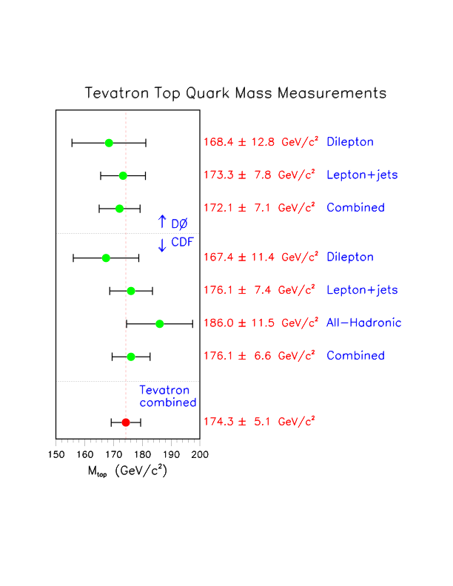
Mtop versus # of jets
Notes:
It has been suggested there is a hint of increase of the top mass with number of jets; values agree within errors

Slide 18
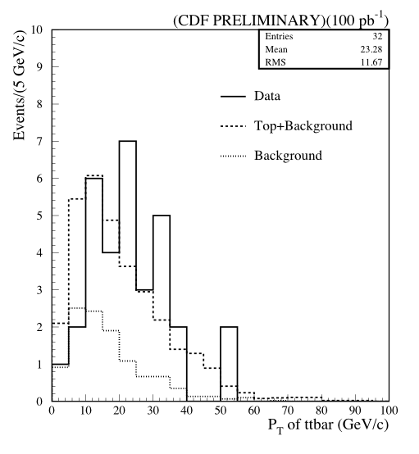

Pt(ttbar)

Slide 19
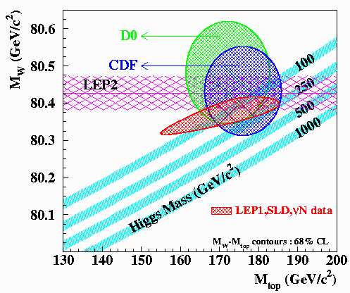
EWSB
Precision measurements of top and W masses constrain the mass of the Standard Model Higgs
M_{w} : CDF ⊕ D∅
  σ_{M} ~ 30 MeV (2 fb⁻¹)
  σ_{M} ~ 20 MeV (10 fb⁻¹)
M_{t} : CDF or D∅
  σ_{M} < 4 GeV (2 fb⁻¹)
  σ_{M} < 2 GeV (10 fb⁻¹)
DØ / CDF
Run 2a
Prediction
With only 2 fb⁻¹ we may find a contradiction with
the Standard Model Higgs direct search limit

Slide 20
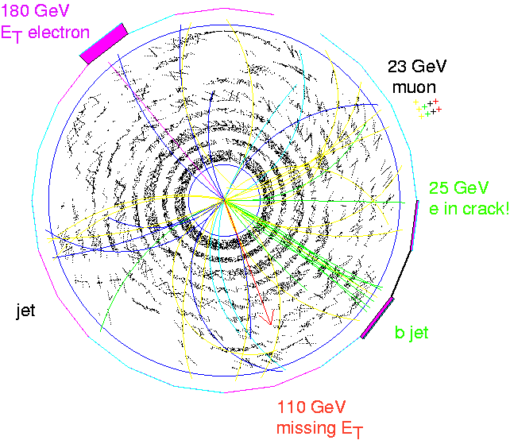
Anomalies in the Top Quark Sample?
CDF Run 1 Trilepton Event
found in dilepton sample
electron in crack called jet
180 GeV E_{T} electron!
110 GeV missing E_{T} !

Slide 21
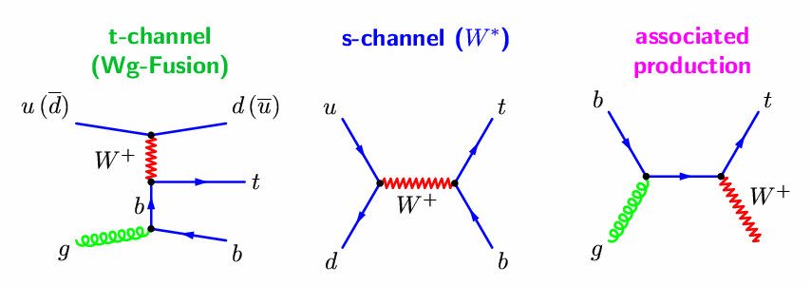
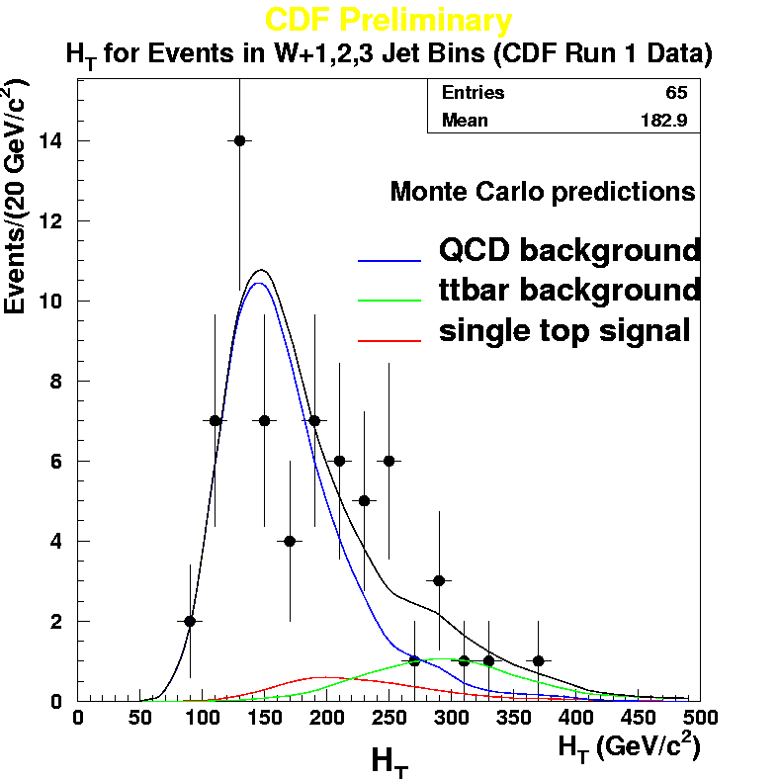
Search for Single top
Probe the electroweak Wtb vertex
Phys.Rev.D65, 091102 (2002)
Search for anomalous couplings - large production rates or anomalous angular distributions
Background to Higgs
1.98 ± 0.13 pb
Steltzer, et al. ‘98
0.88 ± 0.05 pb
Smith/Willenbrock ‘96
<0.1 pb
Tait ‘99
CDF I has performed searches for s and t channels separately in RunI
CDF I has also searched for combined process:
σ(t) < 14 pb at 95% C.L.
If SM is correct, observation in RunIIa
Expect about 100-150 events in 2 fb⁻¹
Measure |V_{tb}| with 10-15% precision
Notes:
Single top processes are harder to observe than tt production: final states containing fewer jets suffer from higher
background, and a priori no sensitivity expected in Run 1 data unless new physics processes enhance production rate.

Slide 22
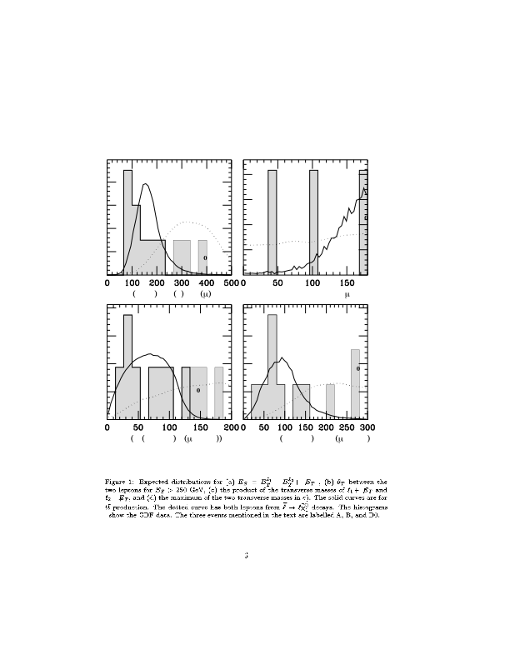
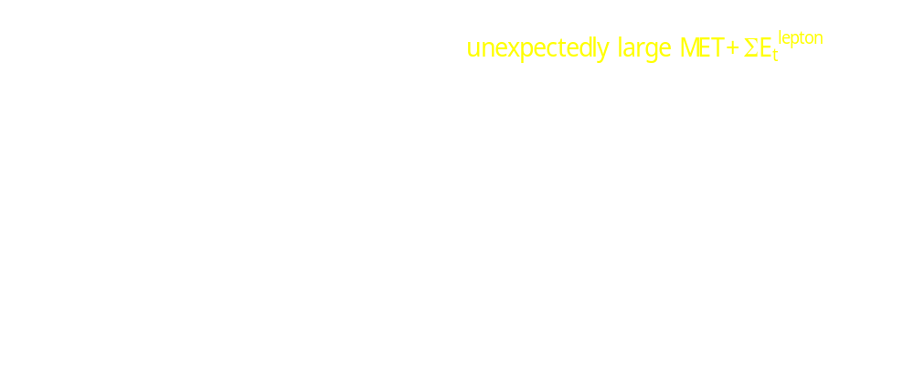
Kinematics in Dilepton Events
hep-ph/9609313
CDFI
CDFI
D0
-
tt or decay
of SUSY
quarks
with masses
around
300 GeV?
ME_{t}+E_{t}(l₁)+E_{t}(l₂) [GeV]
θ_{l} [deg]
sqrt(M_{T1}*M_{T2}) [GeV]
max(M_{T1},M_{T2}) [GeV]

