Slide 1
WW scattering
Dec. 17 LBL ATLAS analysis meeting
Motivation
Theoretical Introduction
Review of MC analyses

Slide 2
Why?
It is an electroweak measurement using well known SM particles, not a search.
A well defined problem, can extensively study with simulation before data without worrying about choosing some phase space point or other.
A model independent probe of mass and EW symmetry breaking, independent of Higgs, SUSY, extra-D, etc.
Remains an interesting measurement even if a Higgs particle is observed or SUSY particles are discovered.
But note this is NOT a quick result. Needs luminosity of order 100fb⁻¹ (>~3 years)

Slide 3
A cynic’s view of the Higgs mechanism
Problem: EW Lagrangian with simple mass terms is not gauge invariant. Bad m²A^{μ}A_{μ}
Solution 1: Add a gauge invariant part that contains multiple terms, one of which is the desired simple mass term. The other terms are required for gauge invariance but not observable at low E
  The new physics question then is, what are the other terms?- we already know that W,Z have mass, that’s not really new physics (the Higgs mechanism claims the other terms are fundamental scalar fields and couplings, solution 1.1)
Solution 2: Forget local gauge invariance, the EW SM is just a low E effective theory and none of the terms are valid in some limit (non-perturbative at some point)
  The new physics questions then is, when does perturbation theory break down- dynamics become strong?

Slide 4
EW precision fits
Low mass Higgs favored, but there are assumptions:
  Same mass mechanism for W,Z and fermions
  No additional new particles in loop corrections of EW parameters
With added complexity many options are possible
  No Higgs
  Higgs present but not responsible for EW symmetry breaking
  More complex sector producing Higgs-like degrees of freedom
No obligatory reason yet for a more complicated theory (except for Higgs self interaction maybe…), but no reason to rule out either- only data will tell.

Slide 5
Can we forget Higgs and study phenomenologically the W,Z mass?
Yes
If W,Z bosons were massless they would be just like the photon and have 2 polarization states (both transverse to the propagation direction)
Longitudinal polarization is impossible without mass, so one can guess that by studying W_{L} and Z_{L} we can learn something about mass.
Recall that in the Higgs mechanism the W,Z acquire longitudinal polarization (third degree of freedom) by eating 3 Goldstone Higgs bosons.
There is actually a formal Equivalence Theorem, that equates W_{L},Z_{L} processes, to those of scalar Goldstone bosons.
Even more interestingly, we already know very well a system of 3 (almost) Goldstone bosons: π⁺π⁻π⁰.
So W_{L}⁺ W_{L}⁻ Z_{L}⁰ can be viewed as a reincarnation of π⁺π⁻π⁰.

Slide 6
Review of Pion Scattering
Cannot calculate low E pion scatering in QCD
But there are low energy theorems that actually predate QCD
Knowledge from pion scattering helped uncover the underlying QCD physics
Analogy is that knowledge of W_{L},Z_{L} scattering will help uncover the underlying physics.
What do we see in 2->2 pion scatering?
  Can look at π⁺π⁻, π⁺π⁺,π⁺π⁰, π⁰π⁰
    All different, but related by isospin.
    Rich resonant structure as unitarity bound is approached
Exactly the same can happen in EW Goldstone boson scattering
  But, if resonance(es) are light (below WW mass) this can be the good old light Higgs, with no structure in real WW, WZ final states
    This is a crucial prediction of the Higgs mechanism.
    Finding a light scalar particle does NOT prove the Higgs mechanism. It’s finding a light scalar PLUS the absence of structure in WW, WZ at higher mass!
  W⁺W⁻, W⁺W⁺, WZ final states are complementary (remember isospin). As one x-section falls the others rise => there is no “blind spot”.
(But pions are really composite.
  Can the “Higgs” be composite? => Technicolor)

Slide 7
The scattering process
Signal
Backgrounds
q
W,Z
W,Z
q
jets
W,Z
q
W,Z,γ∗,g
q
(plus others, like ttbar)
Hard, forward jets
No primary hadronic interaction => clean event (in principle)
High Pt central jets
Hadronic interaction => messy event

Slide 8
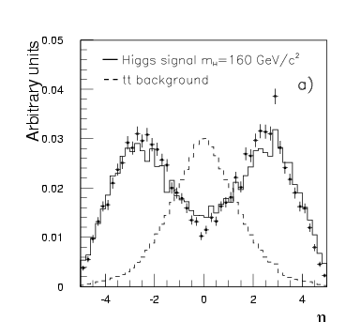

Forward jets from Davide’s Talk
H→WW →2l 2ν

Slide 9
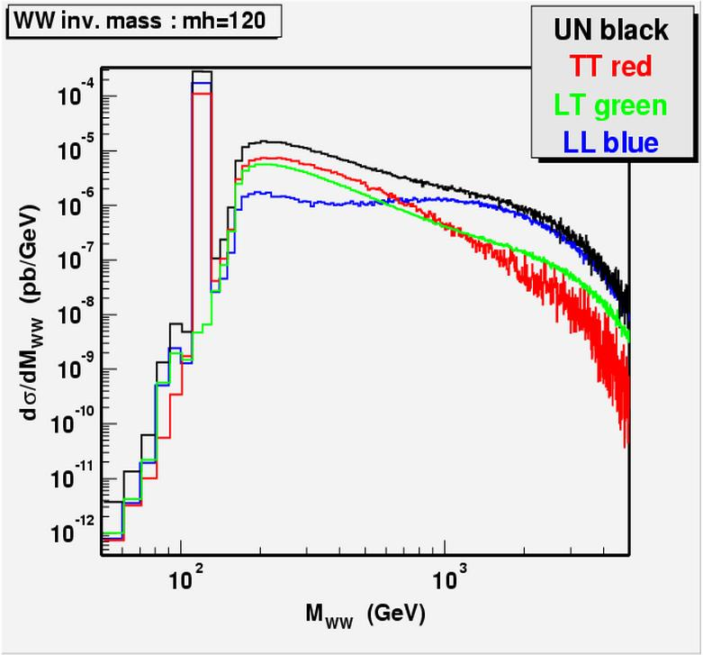
What to look for?
Forward jets and clean central detector are a must
Central all leptonic final states
  WZ -> l⁺l⁻ lν
  W⁺W⁺ -> l⁺ l⁺νν
Central Semileptonic
  WW or WZ -> lνjj
  ZZ of WZ -> lljj
Some things get a little murky here
  Everyone seems to drop the L subscript at this point
  Are the W’s polarized?
  Do the kinematics of 2->2 scattering select longitudinal states only?
  Does an admixture of transverse states simply add a known background (and do we know what that admixture is?)
From CMS

Slide 10
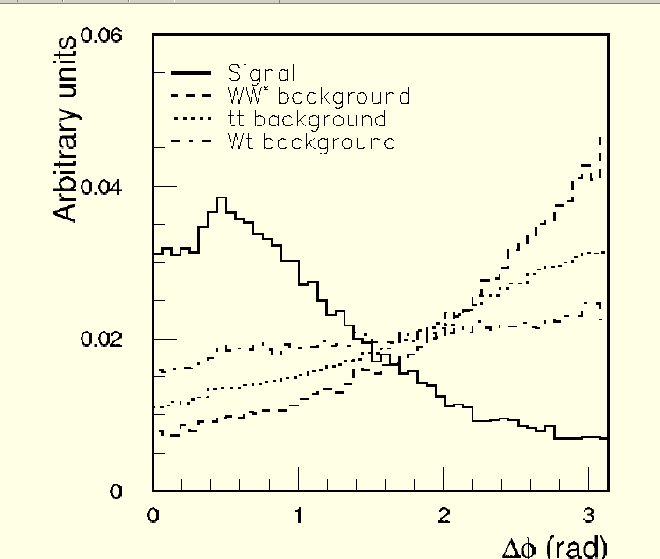
What about W⁺W⁻ -> l⁺ l⁻ νν?
This is favored mode for H->WW because the spin 0 H decay has very different kinematics from background
from Ian’s talk
But for non-resonant WW the backgrounds are not well separated

Slide 11
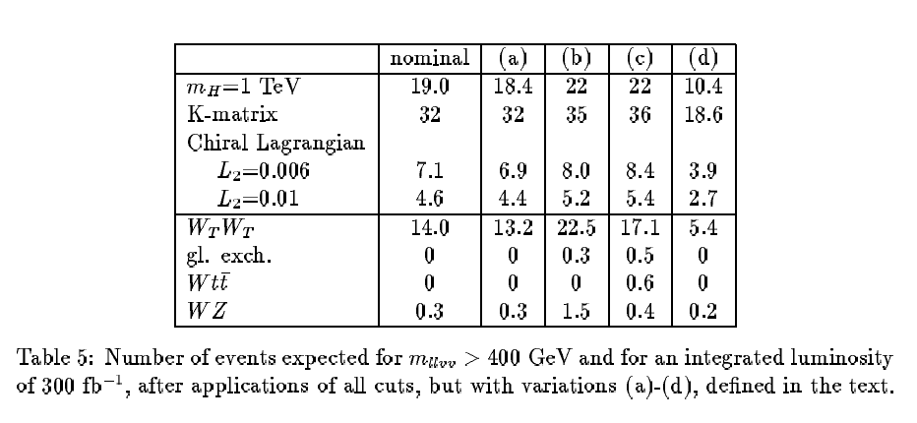
W⁺W⁺->l⁺ l⁺νν (ATLAS)
Luminosity requirement given by statistics needed to exclude non-resonant strong WW scattering (K-matrix)
Complementarity with WZ
Pixel B-layer is pretty dead here

Slide 12
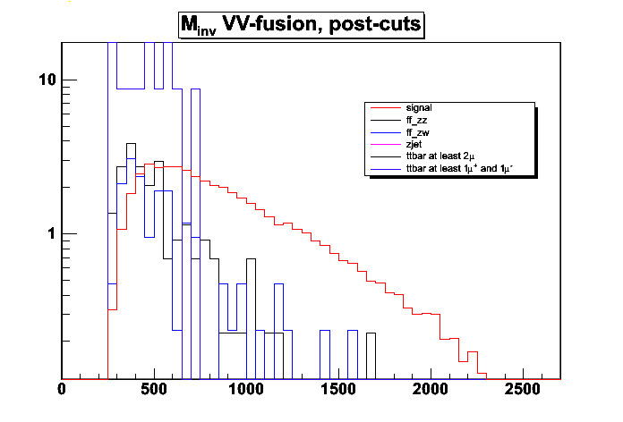
ZZ + WZ -> l⁺l⁻ jj
(CMS)
This is missing the WW channel, which has higher rate
But the background separation is pretty clean
Any resonances would be easy to see (good Minv resolution
M_{inv} [GeV]
100 fb⁻¹
S/√B
0-1 TeV: 1.03+0.87= 1.90
1-2 TeV: 5.70+3.76= 9.46
2-6 TeV: ∞
S/√B+S
0-1 TeV: 1.84
1-2 TeV: 4.72
2-6 TeV: 2.01

Slide 13
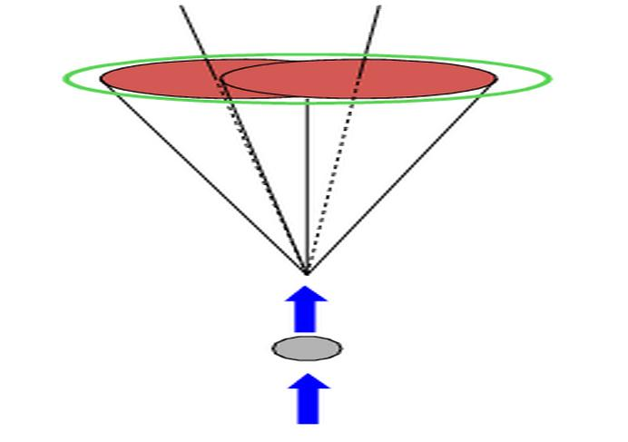
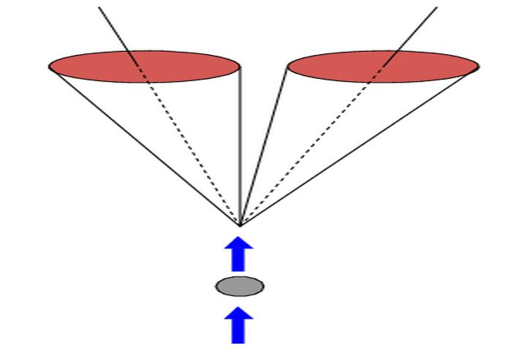
Di-jet reconstruction (CMS)
I) well separated
jets
II) Merged Jets
Reconstruct
as one cluser
M_{CL}= (∑|E_{CELL}|)² ⁻ (∑E_{CELL})²
What algorithm to choose? ...... depends on M_{WW}
M_{H}, GeV 2Jets (R=0.5) 1Jet (R=0.7)
500 61% 27%
1000 23% 75%

Slide 14
Conclusion
A low or intermediate mass peak discovery during initial running would not be the end of the story
High energy behavior has to be known to get the full picture => full luminosity results remain interesting.
Some studies in both ATLAS and CMS give a feel for luminosity range required in different channels
  Use of fast simulation
  Ultimate reach combining all modes not fully evaluated
    should also consider combined ATLAS/CMS result
    Can ultimately get by with <100pb⁻¹?

