Slide 1
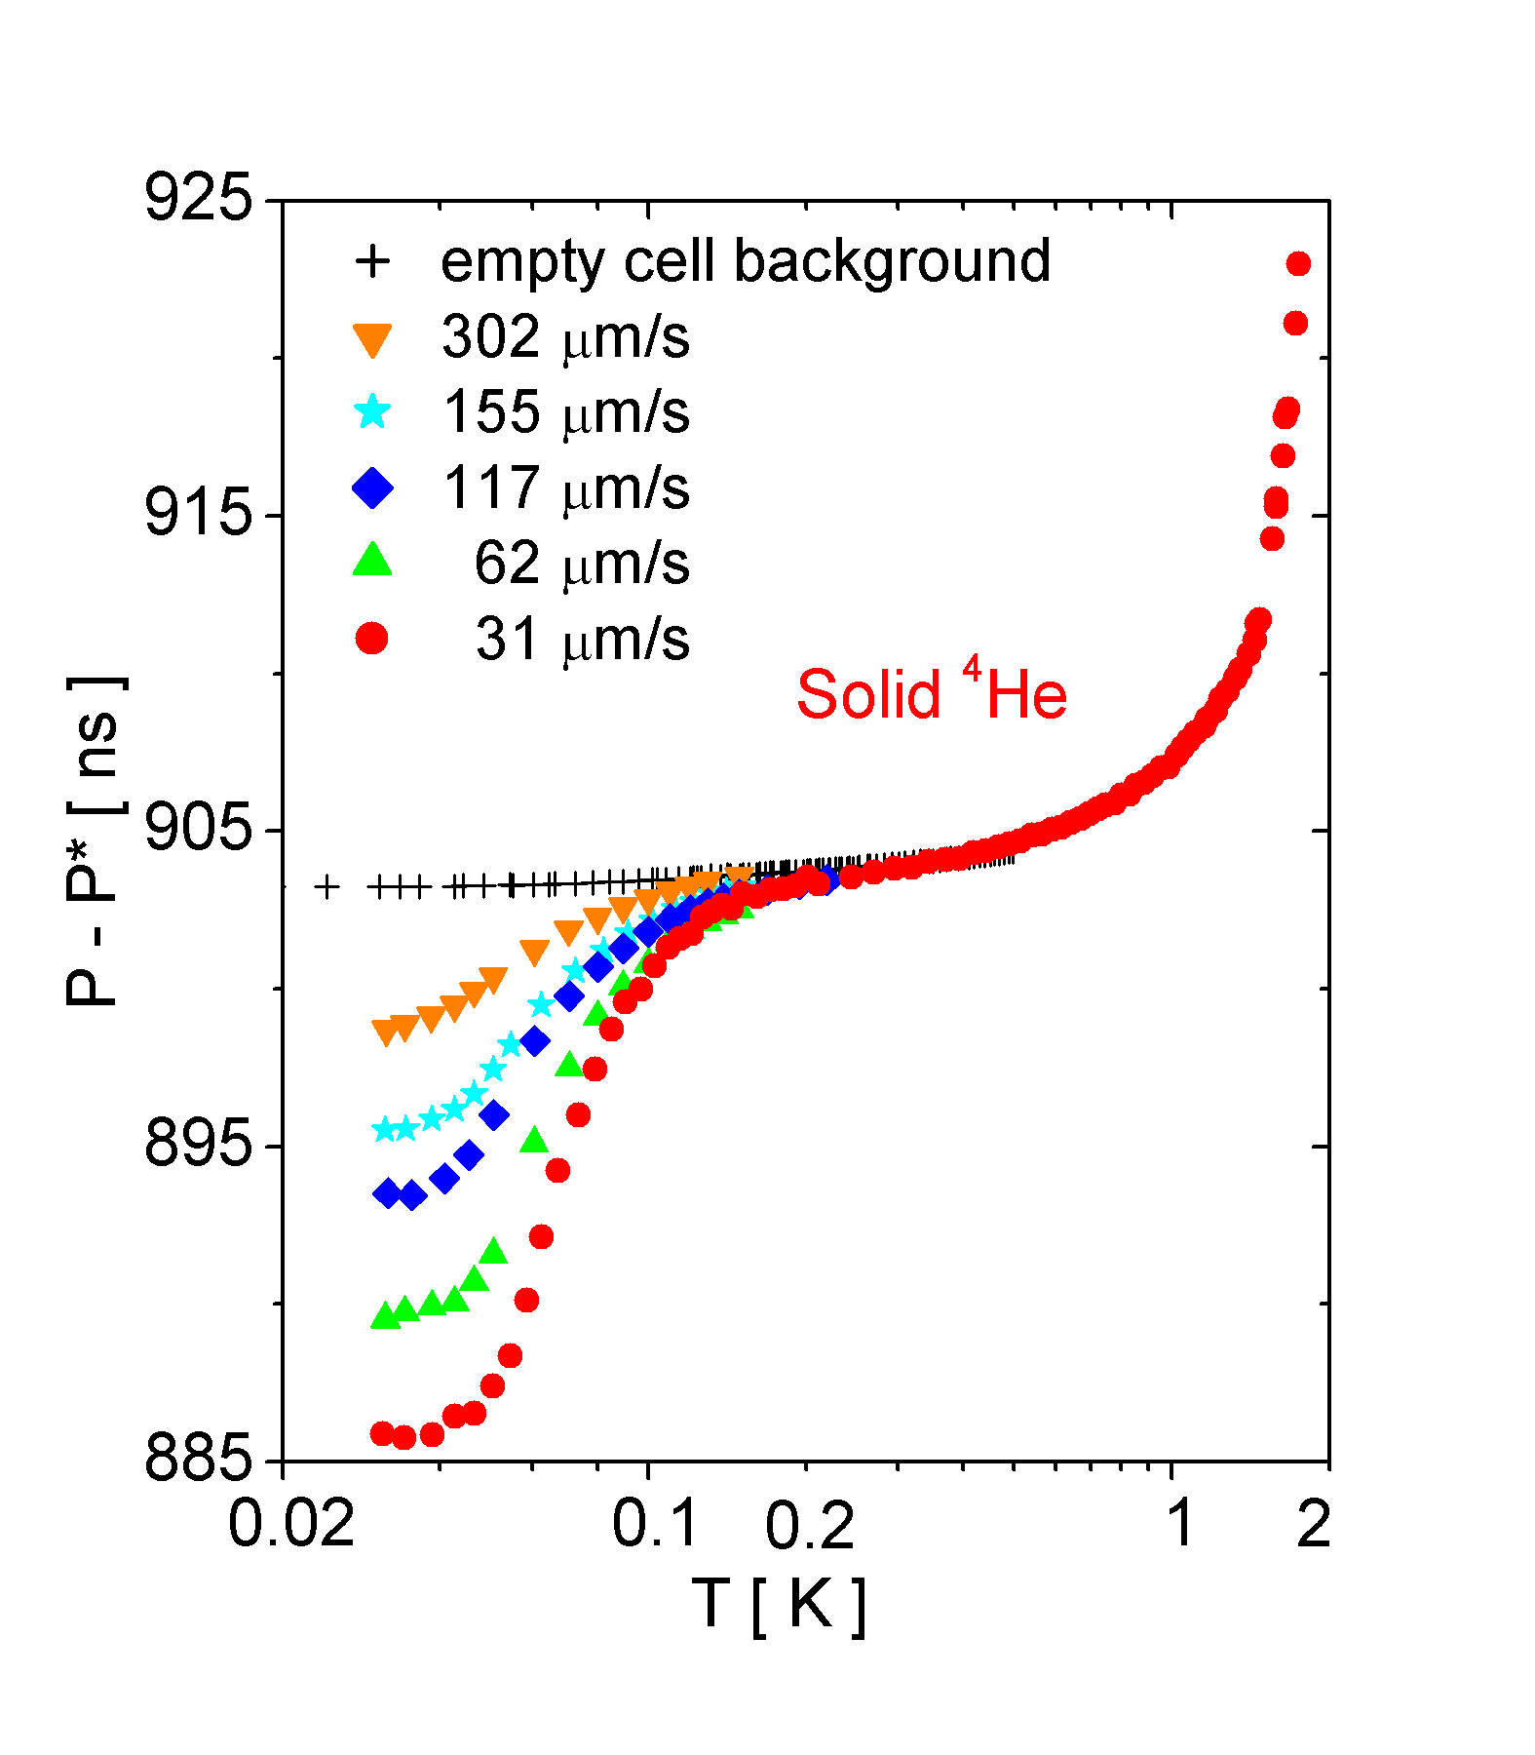
Quantum Fluids in One and Two Dimensions
Moses H. W. Chan, Penn State University
DMR 0207071
Torsion Rod
We carried out a torsional oscillator study of solid ⁴He at 62 bars confined in Vycor glass and find evidence of onset of supersolid phase.
We found an abrupt drop in the resonant period of oscillator below a certain critical temperature. The most likely interpretation of the drop is the entry into the supersolid phase. If confirmed, our results showed that all three states of matter, gas, liquid and solid can undergo the Bose-Einstein condensation transition.
Submitted to Nature
Torsion Bob Containing
Vycor Disk
Drive
Detection

Slide 2
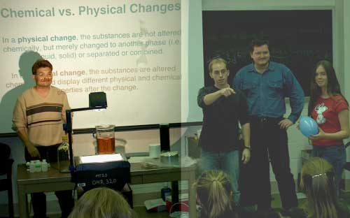
Quantum Fluids in One and Two Dimensions
Moses H. W. Chan, Penn State University, DMR-0207071
Broader Impact:
Students and Post-doc supported by this and the predecessors of this grant in the last 5 years include Jongsoo Yoon, graduate student, currently an Assistant Professor at University of Virginia; Mitsunori Hieda, post-doc, currently an Assistant Professor at Nagoya University; Gabor Csathy, graduate student, currently a post-doc at Princeton University; Stephen Jordan, REU student, currently a graduate student at MIT.
Outreach:
Graduate students, Eunseong Kim and Anthony Clark and Post-doc Andriy Ganshyn supported fully or partially on this grant participate in outreach activities sponsored by the Penn State MRSEC, Center for Nanoscale Science.
Presentation using liquid nitrogen to liquefy air for a visiting class from Mount Nittany Middle School.

