Slide 1
Optical properties of the output of a high-gain, self-amplified free-electron laser
Yuelin Li¹, Sam Krinsky², John Lewellen¹, Vadim Sajaev¹
¹Advanced Photon Source, Argonne National Laboratory
²Brookhaven National Laboratory

Slide 2
Acknowledgements
K.-J. Kim, S. V. Milton, K. Harkay, O. Makarov, R. Dejus (ANL)
Z. Huang (SLAC)
Work supported by the U. S. Department of Energy, Office of Basic Energy Sciences,

Slide 3
Layout
SASE and SASE experiments
The LEUTL system and the FROG experiment
The system
Statistics in the time domain
Statistics in the frequency domain
Correlation between the two domains
Near term plan
Conclusion
Acknowledgement

Slide 4
Layout
SASE and SASE experiments
The LEUTL system and the FROG experiment
The system
Statistics in the time domain
Statistics in the frequency domain
Correlation between the two domains
Near term plan
Conclusion
Acknowledgement

Slide 5
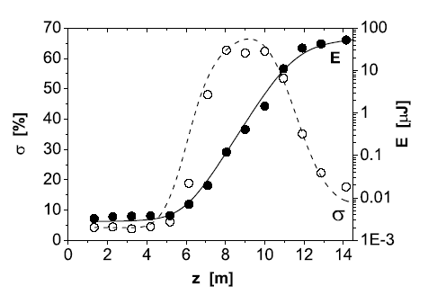
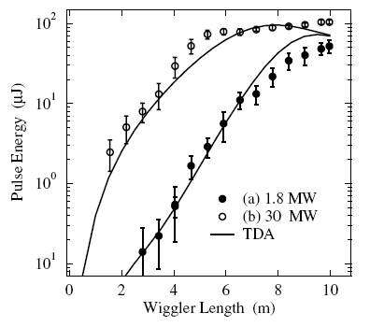
SASE FELs
Demonstrated, existing, and future projects
LEUTL @ APS
TTF @ DESY
HGHG, VISA & DUV @ BNL
Ayvazyan et al, PRL 88 104802 (2002)
LCLS @ SLAC
TESLA @ DESY
BATES @ MIT
4GLS @ Rutherford
……………
Yu et al, PRL 91, 074801 (2003)

Slide 6
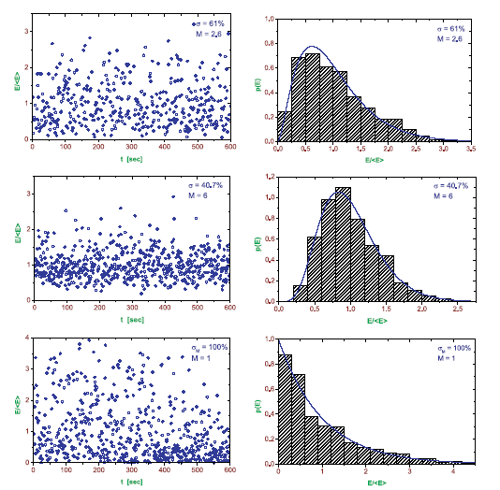
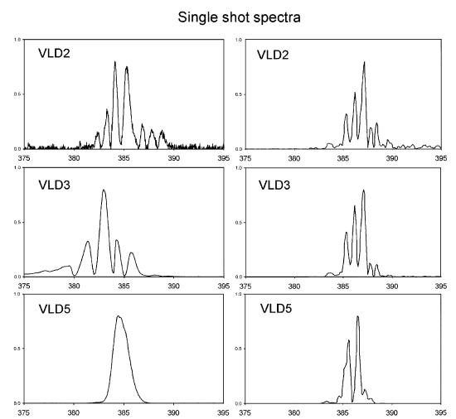
Some results on optical properties of SASE FEL
Time Integrated Results:
DESY: energy statistics
LEUTL: spectra

Slide 7
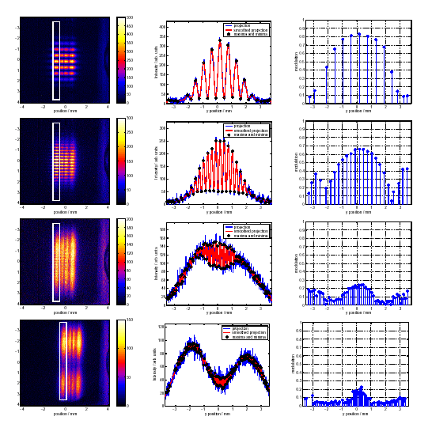
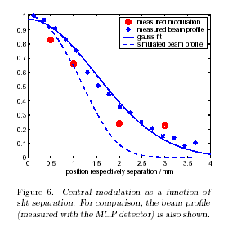
DESY: Spatial coherence
Any information about the temporal structure?
Ischebeck, NIM 507, 175 (2003).

Slide 8
Layout
SASE and SASE experiments
The LEUTL system and the time-resolved experiment
The system
Statistics in the time domain
Statistics in the frequency domain
Correlation between the two domains
Near term plan
Conclusion
Acknowledgement

Slide 9
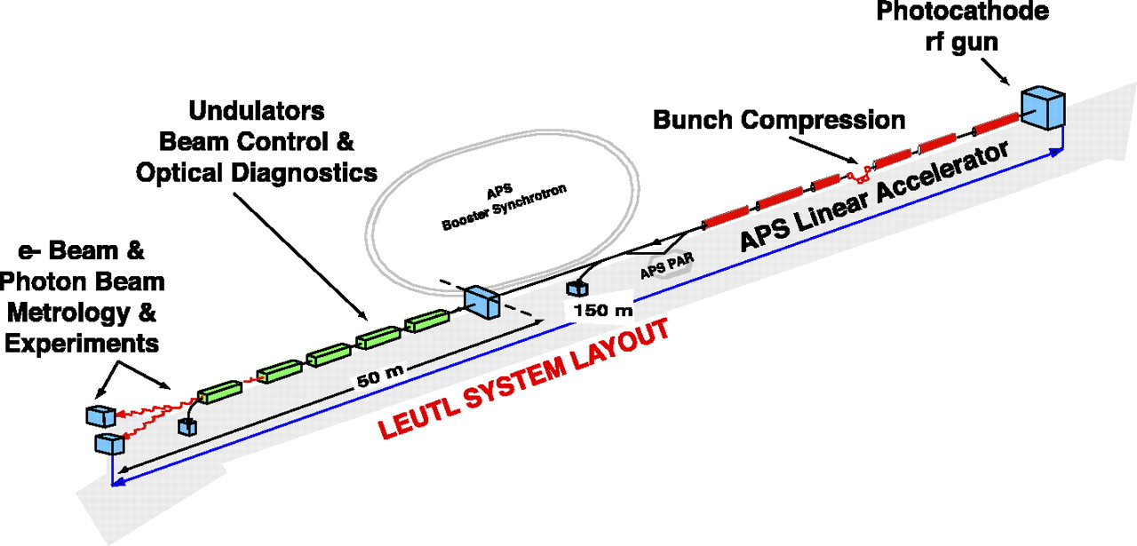
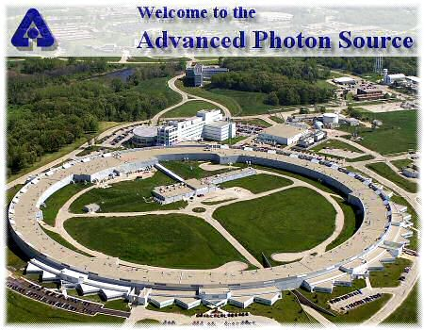
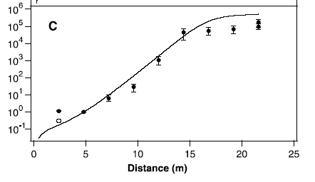
The low-energy undulator test line FEL: future ALFF
6 Hz, 0.5 ps, 50 μJ @ 120-530 nm
Milton et al., Science 292, 2037 (2001)

Slide 10
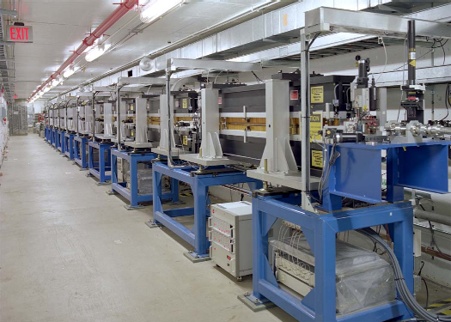
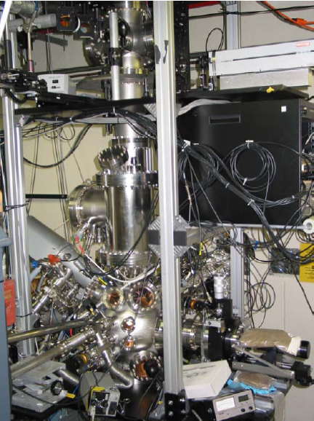
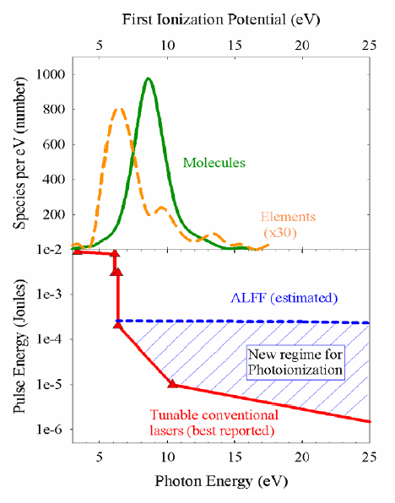
The facility and application experiment
FEL undulator hall
Single Photon Ionization or Resonant Ionization at Threshold

Slide 11
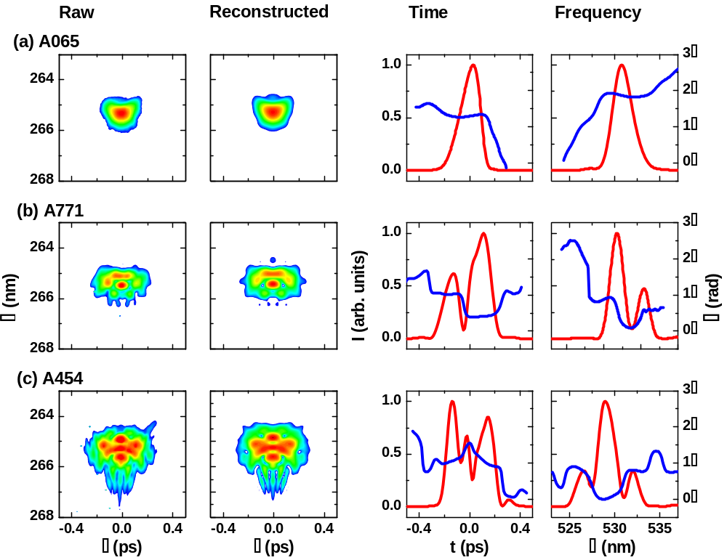


The FROG experiment at 530 nm

Slide 12
Layout
SASE and SASE experiments
The LEUTL system and the FROG experiment
The system
Statistics in the time domain
Statistics in the frequency domain
Correlation between the two domains
Near term plan
Conclusion
Acknowledgement

Slide 13
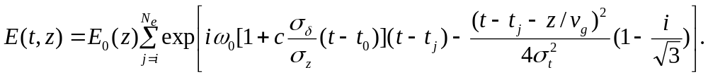
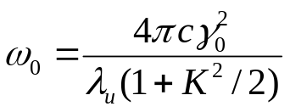
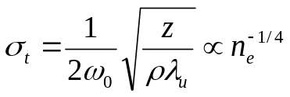
Temporal structure: Analysis
The field of a SASE FEL (by solving Green’s function) is
[S. Krinsky and Z. Huang, Phys. Rev. ST Accel. Beams 6, 050702 (2003).]
ω₀resonant frequency
σ_{t} coherence length
σ_{δ}/σ_{z} electron beam energy chirp
Summing of random phasors:
Chaotic light
Goodman, Statistical Optics, (John Wiley & Sons, New York, 1985), p. 35.
S. Krinsky, PRSTAB 6, 050701 (2003).

Slide 14
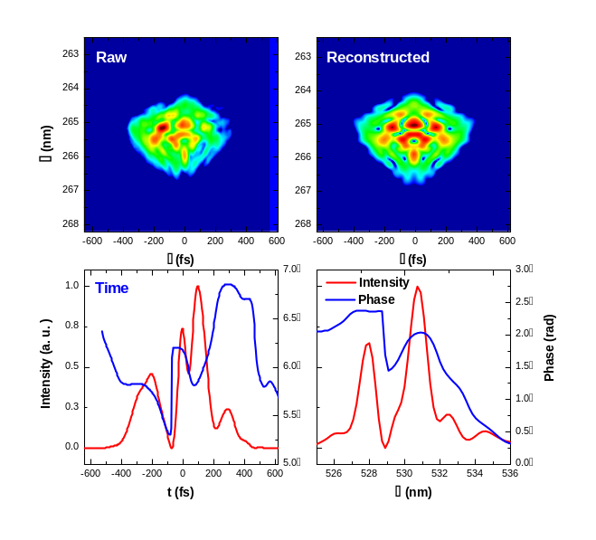
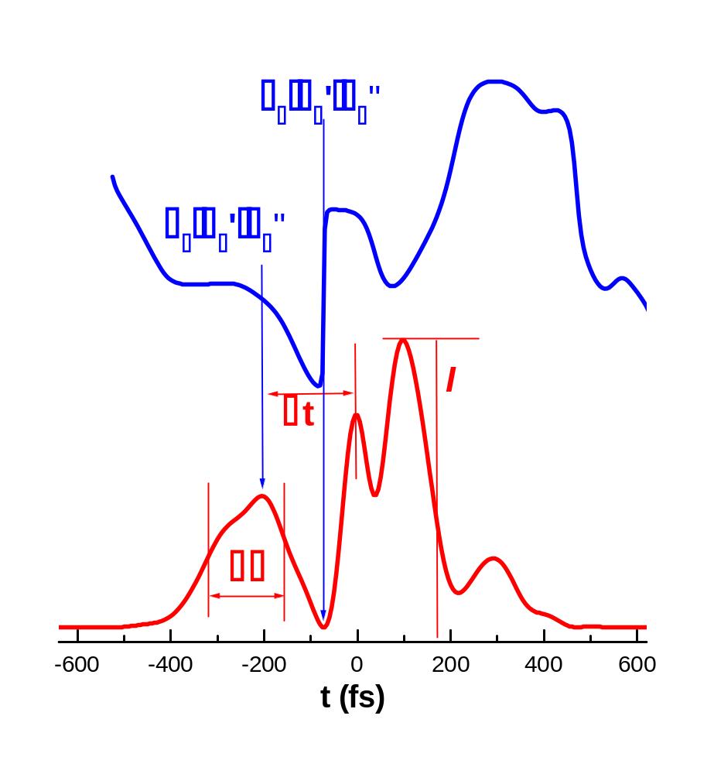
Interest in temporal structure
Experimental data
Simulation
Analytical theory

Slide 15
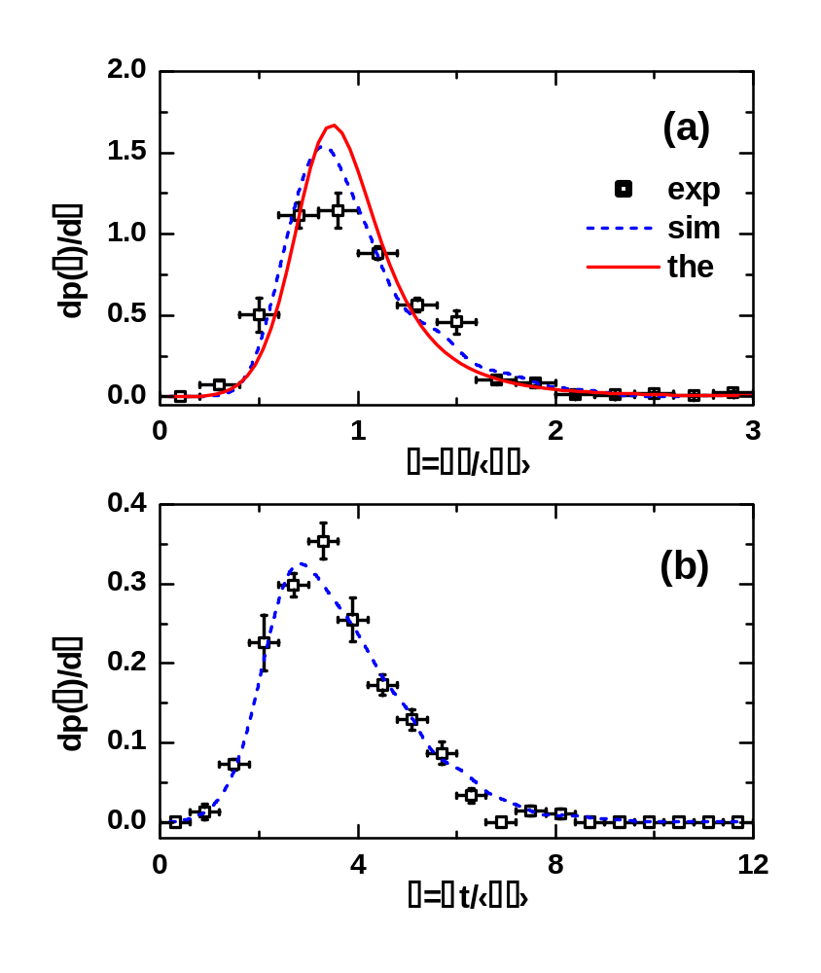
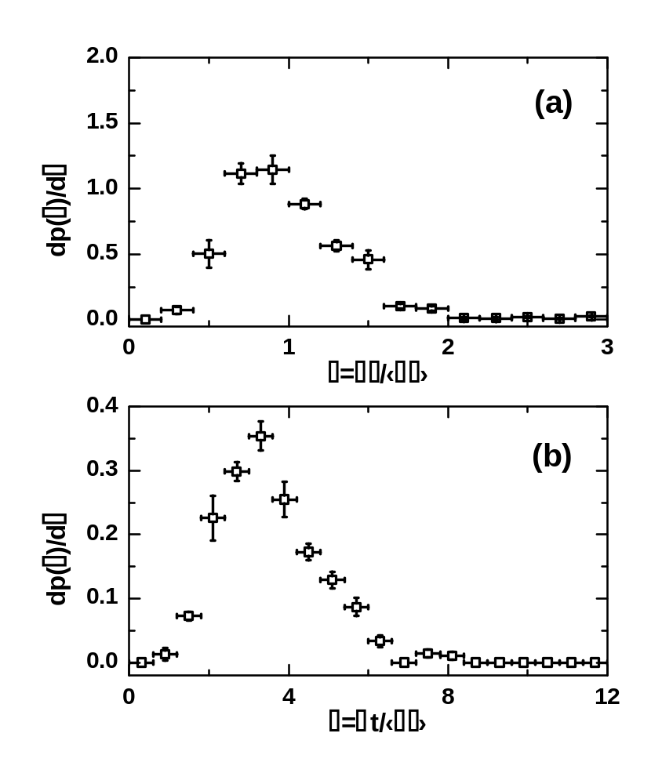
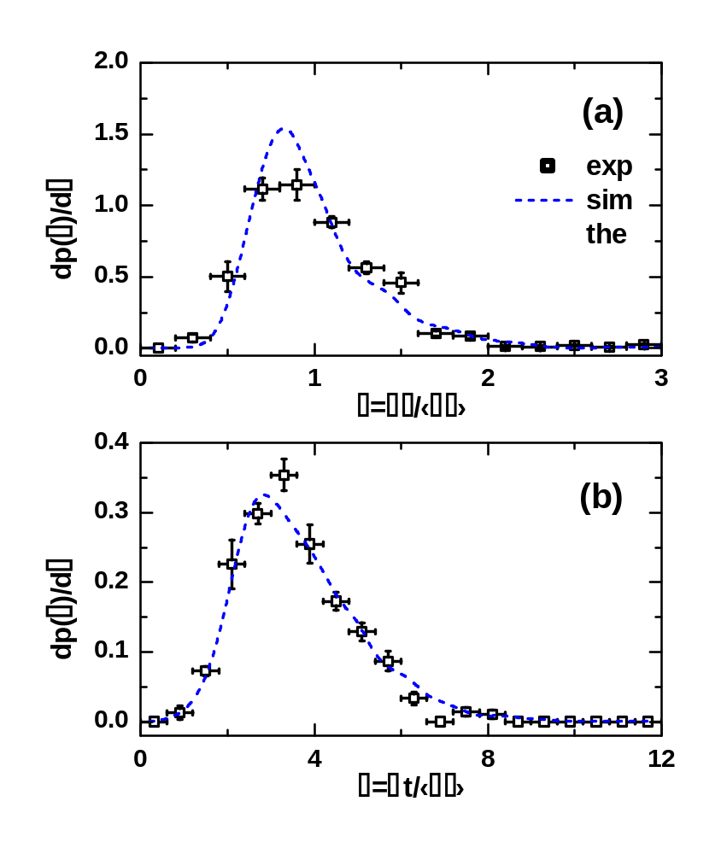
Temporal structure: spike width and spacing
Follow statistics for chaotic light exactly.
⟨Δτ⟩ = 52 fs
Li et al., PRL 91 243602 (2003).

Slide 16
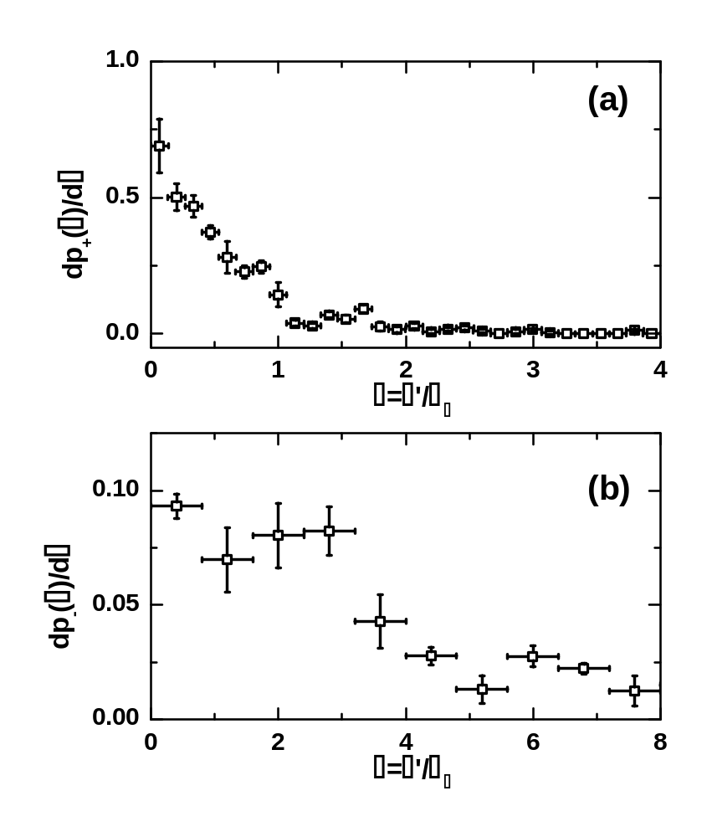
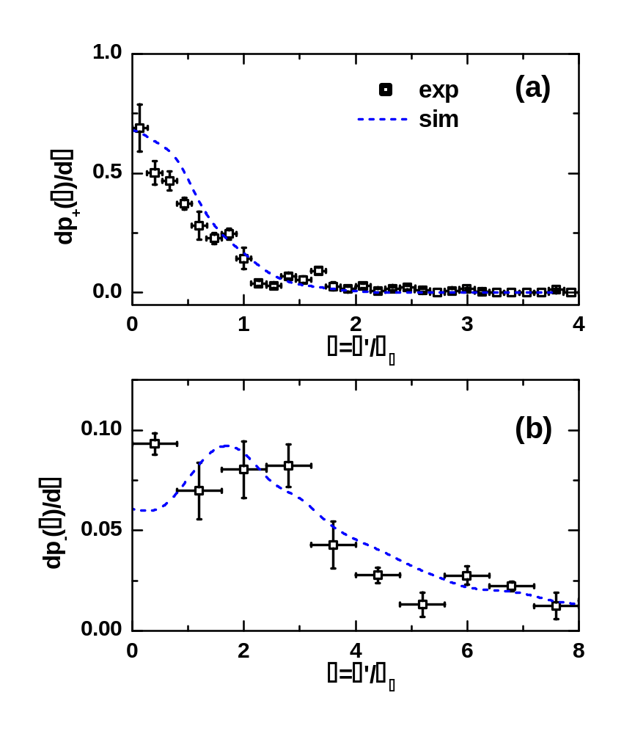
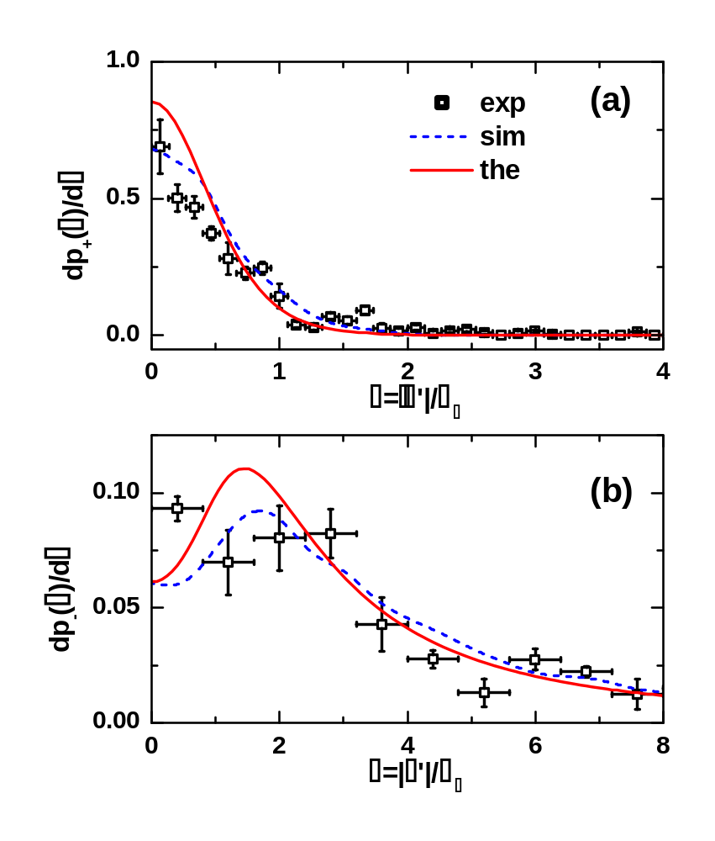
Derivative of phase (frequency)
Each intensity spike is a coherence mode.
σ_{ω}=0.0094 rad/fs
Li et al., PRL 91 243602 (2003).

Slide 17
Layout
SASE and SASE experiments
The LEUTL system and the FROG experiment
The system
Statistics in the time domain
Statistics in the frequency domain
Correlation between the two domains
Near term plan
Conclusion
Acknowledgement

Slide 18
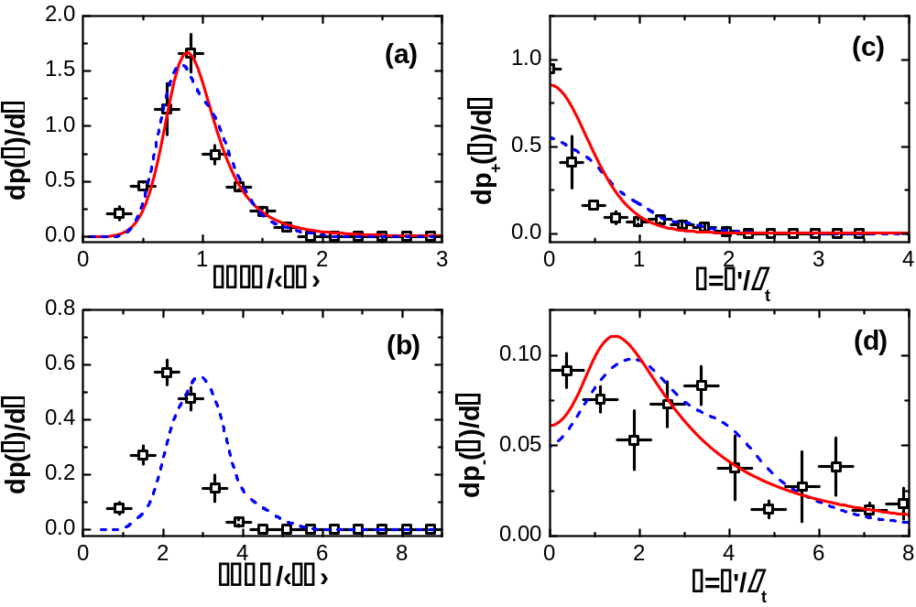
Frequency domain statistics
The frequency domain follows the same statistical behavior
Intensity spikes are coherence modes in the frequency domain

Slide 19
Layout
SASE and SASE experiments
The LEUTL system and the FROG experiment
The system
Statistics in the time domain
Statistics in the frequency domain
Correlation between the two domains
Near term plan
Conclusion
Acknowledgement

Slide 20
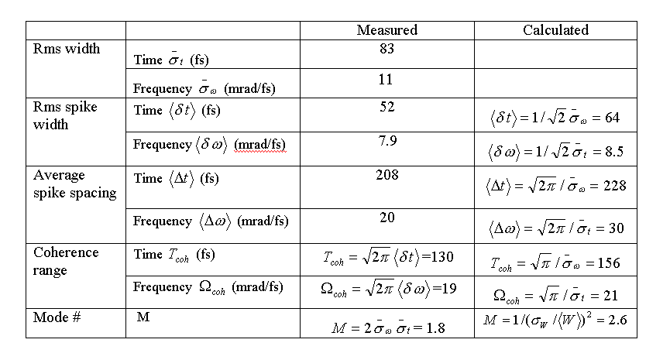
Correlation between the time and frequency domains
The two domains should have about the same number of intensity spikes

Slide 21
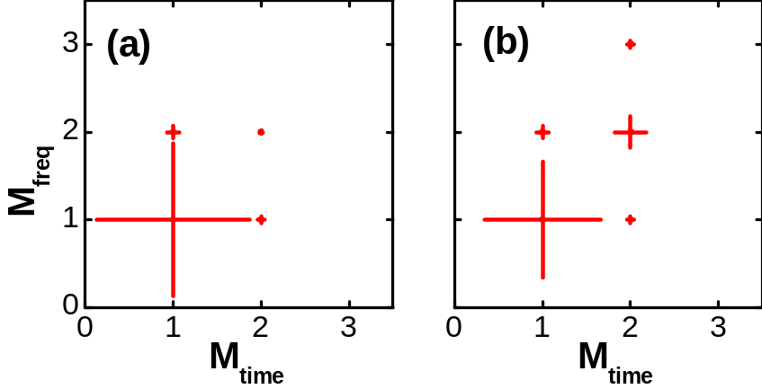
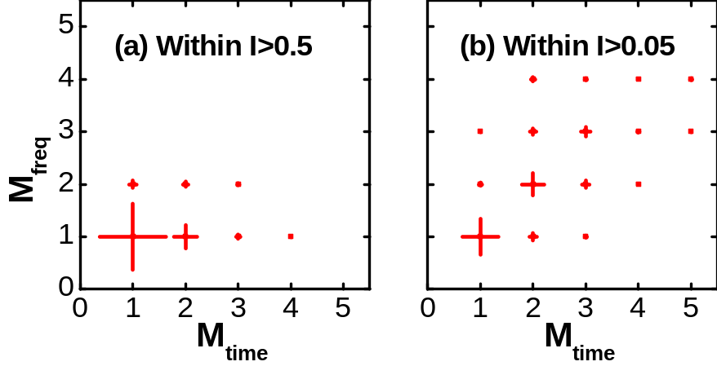
Number of spikes in the two domains
Experiment B
Experiment A

Slide 22
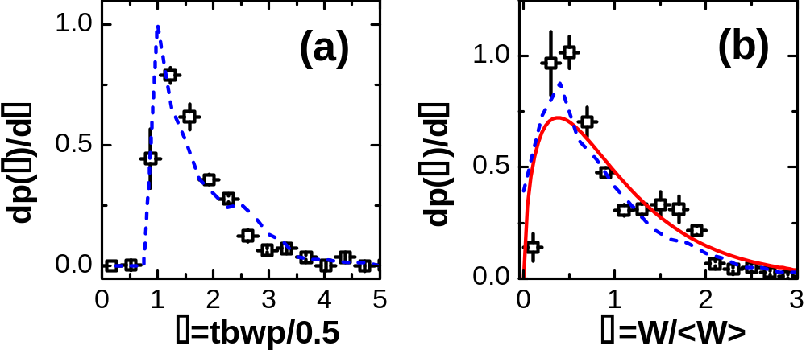
Time-bandwidth product…….
Number of modes=(W/σ_{W})² =<tbwp>/0.5

Slide 23
Conclusion
SASE FEL output is chaotic: fully coherent transversely (to be measured), but only partially coherent longitudinally
Time and frequency domain statistics determined.
Explicitly determined the correlation between the two domains.
Also the first time a chaotic light source is fully characterized.

Slide 24
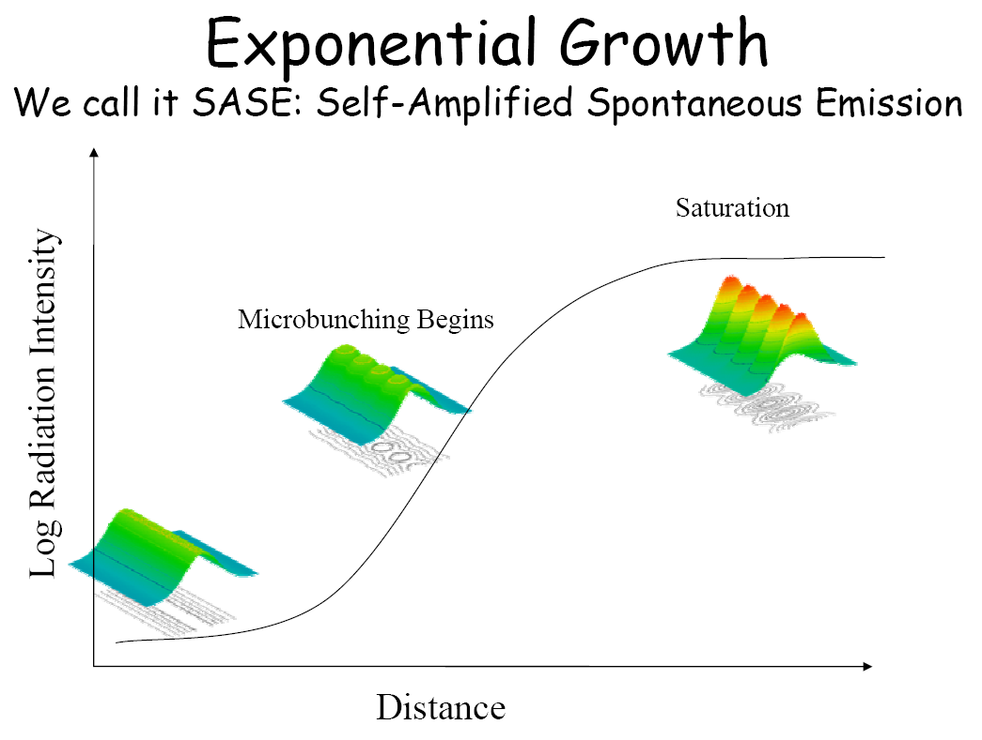
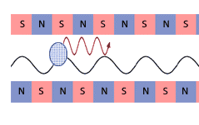
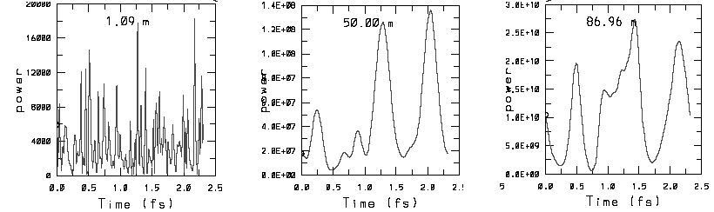
Self Amplified free electron laser
Grow from noise
Microbunching->amplification
Slippage->coherence buildup
Continuously tunable
X-ray capability

Slide 25
Layout
SASE and SASE experiments
The LEUTL system and the FROG experiment
The system
Statistics in the time domain
Statistics in the frequency domain
Correlation between the two domains
Near term plan
Conclusion
Acknowledgement

Slide 26
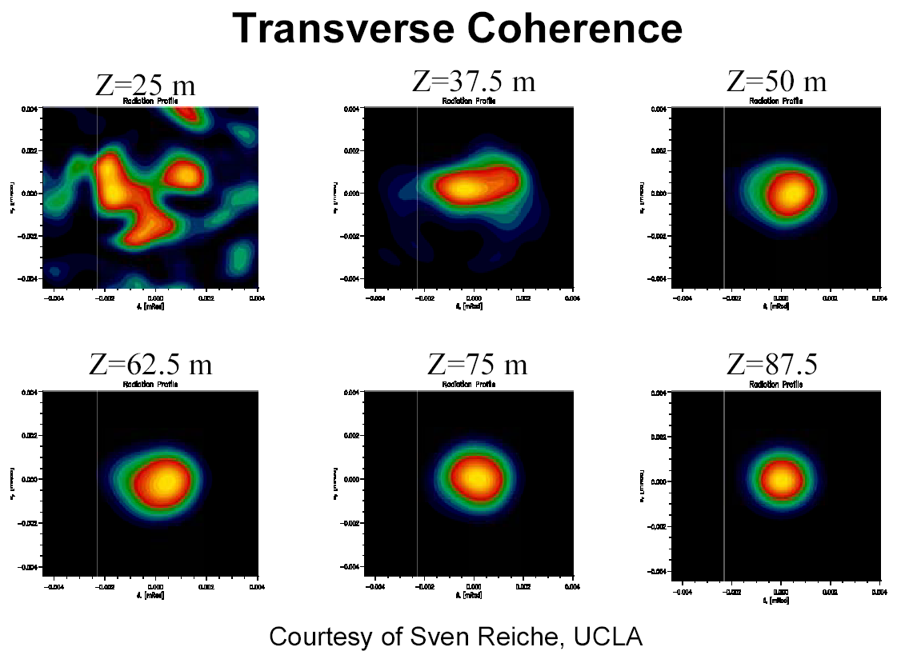
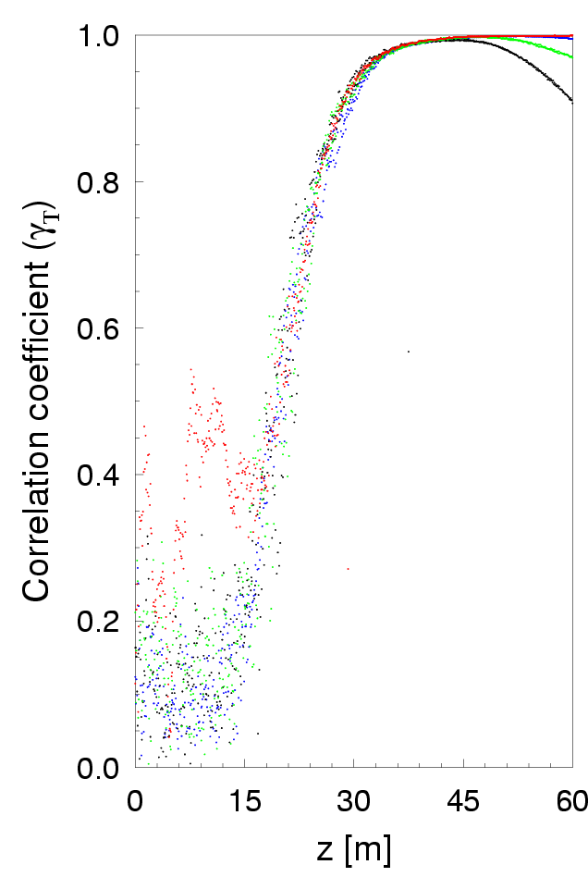
Future experiment: growth of spatial coherence
And the coherence grows along the undulators
Courtesy of V. Kumar

Slide 27
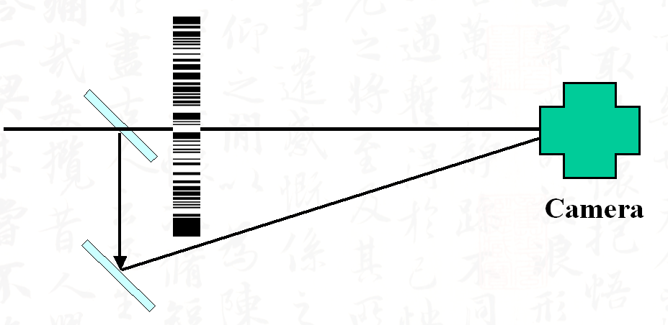
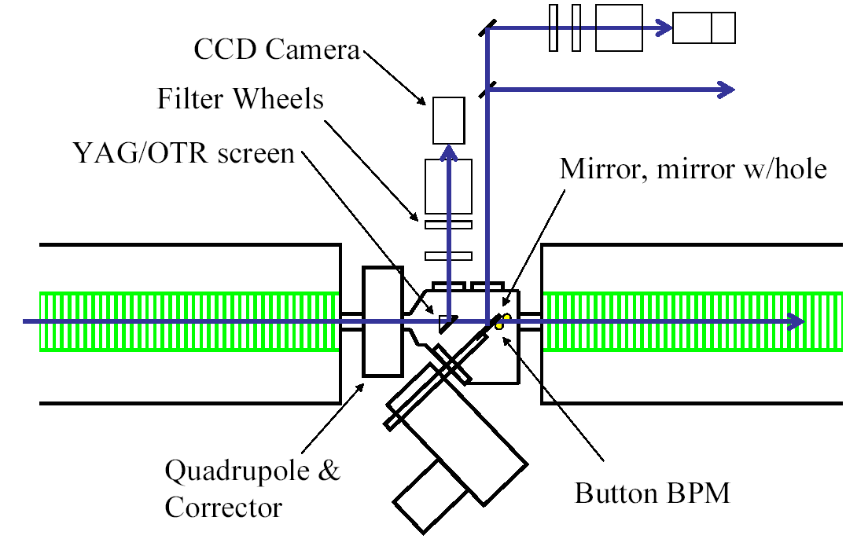
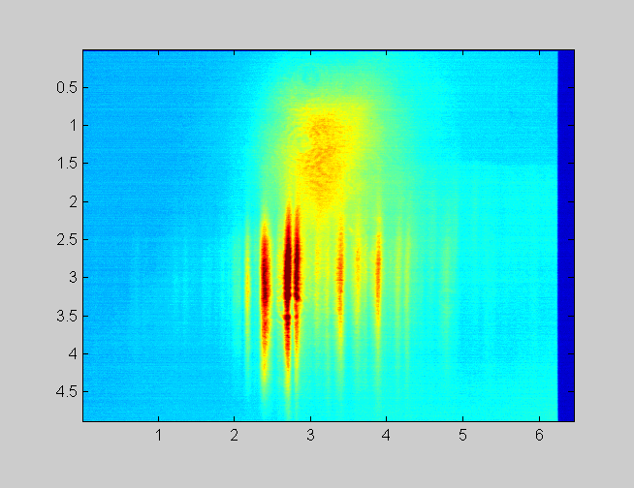
Future experiment: growth of spatial coherence
Ischebeck, NIM 507, 175 (2003).
Our Plan

Slide 28
Layout
SASE and SASE experiments
The LEUTL system and the FROG experiment
The system
Statistics in the time domain
Statistics in the frequency domain
Correlation between the two domains
Near term plan
Conclusion
Acknowledgement

