Slide 1
3D AFE
Marek Gasior, CERN
Overview and Status at RHIC
presented by Al DellaPenna, BNL

Slide 2
Outline
The classical approach
Direct Diode Detection (3D)
RHIC Installation
The ‘Beam Noise problem’
Dropouts, saturation,…
        Instabilities
Conclusions

Slide 3
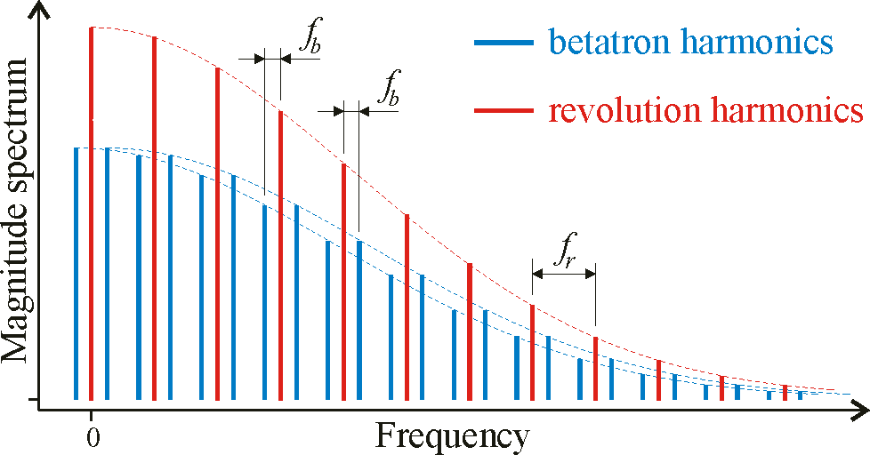
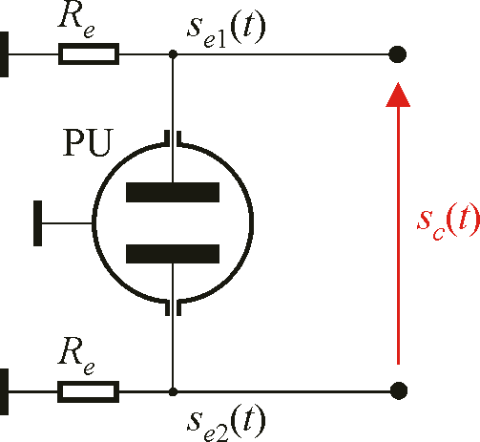
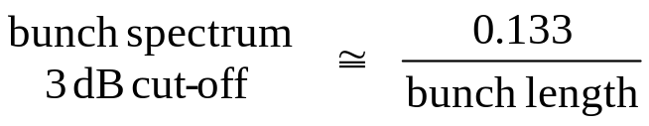
Classical Approach – “one betatron harmonic filtering”
one sigma

Slide 4
Classical Approach 2 – “one betatron harmonic filtering”
The LHC bunch length (4σ) is about 1 ns - corresponding bunch spectrum cut-off is about 500 MHz (during RHIC Run 6, 3dB point was ~60MHz)
With one bunch in LHC the revolution spectral lines are spaced by 11 kHz, so there are some 50,000 of these and some 100,000 betatron lines
When using the classical “one betatron harmonic filtering” method, one observes only 0.00001 (-100 dB) of the spectral content
This results in very small signals, requiring low noise amplifiers and mixers, which have small dynamic ranges; they can be easily saturated by a huge revolution content
Resonant PU = larger signals. Does not work for single bunches (bunches do not pass through the PU often enough to maintain the resonance)

Slide 5
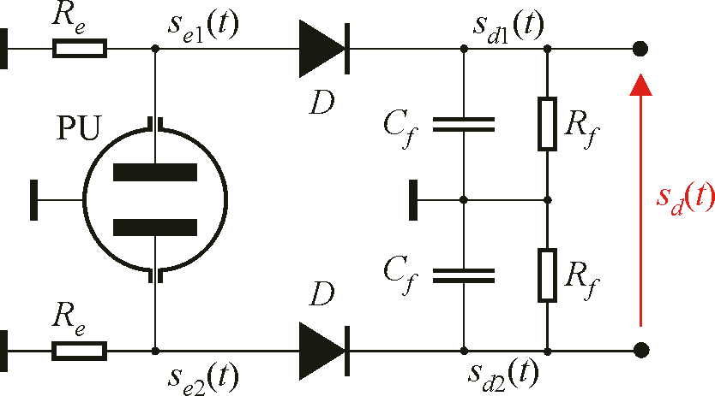
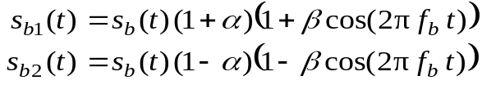
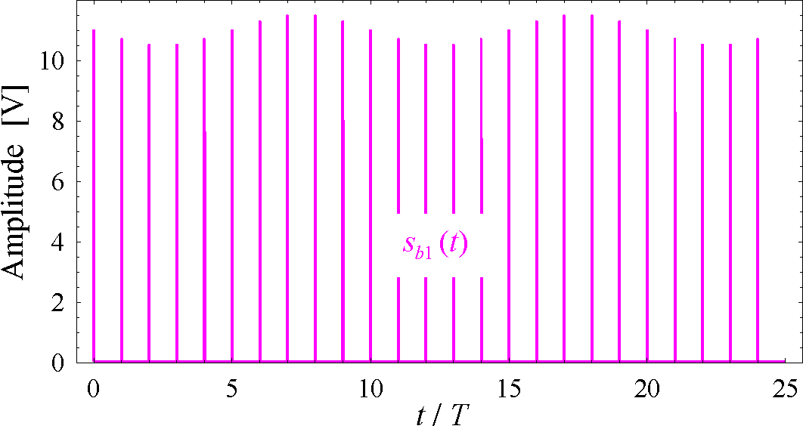
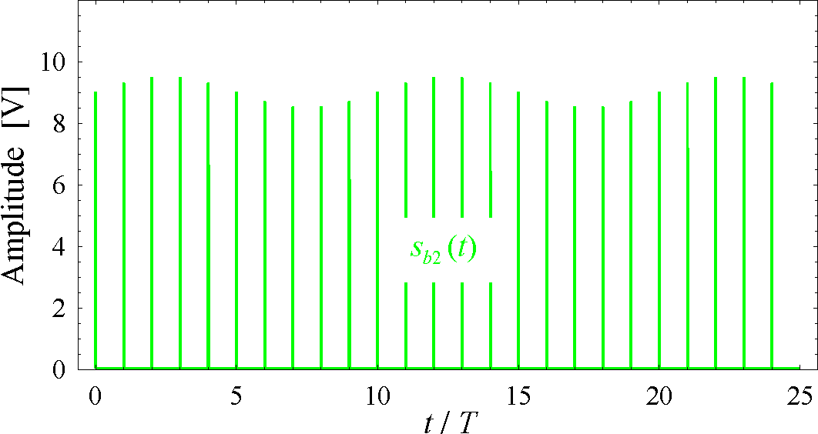
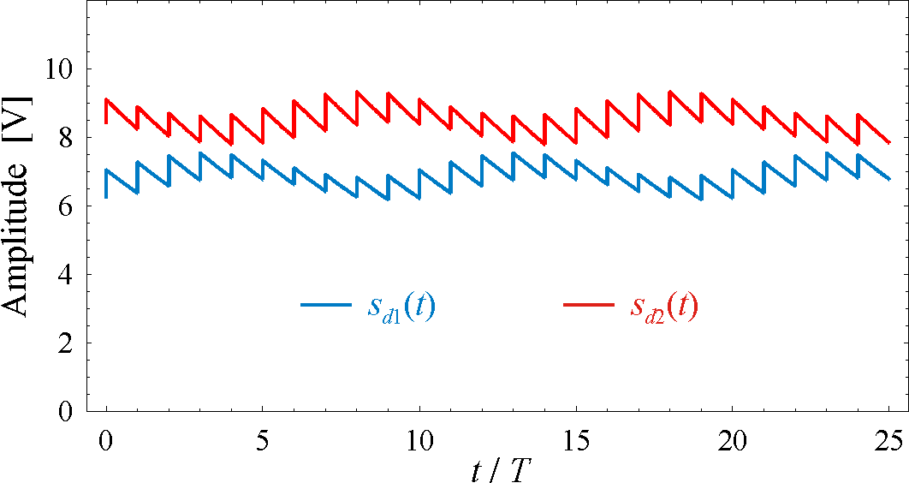
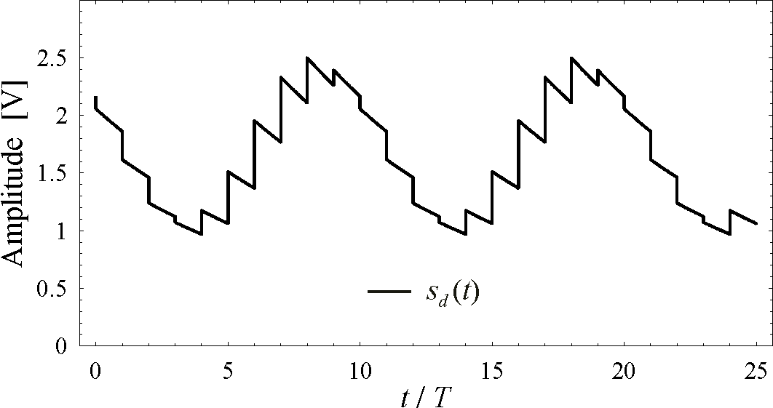
Direct Diode Detection – the Principle
Sb
Sb1
beam relative offset α = 0.1
betatron oscillation relative amplitude β = 0.05
simulated tune value q = 0.1
filter time constant τ = 10T (T = revolution period)
storage capacitor C_{f} = C_{pu} (PU electrode capacitance)
Sb
Sb2
Electrode 1
signal
Electrode 2
signal
Signals
of both peak
detectors
Detector signal
difference

Slide 6
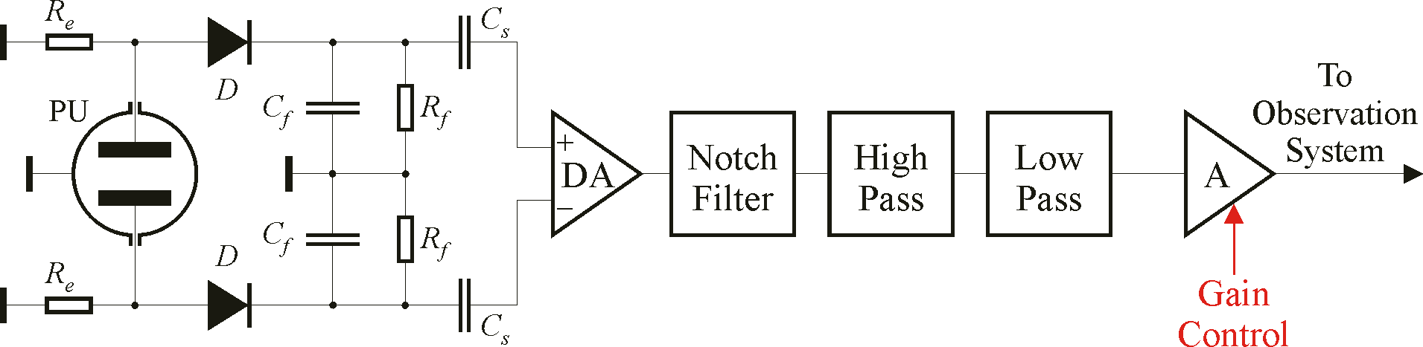
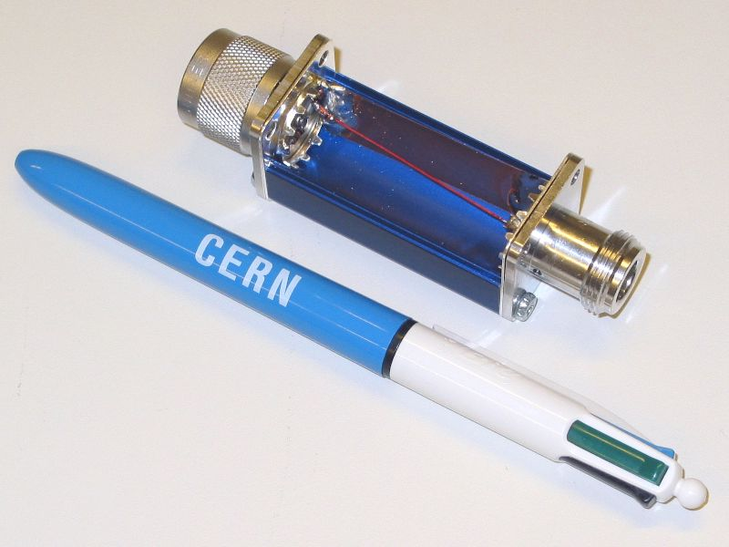
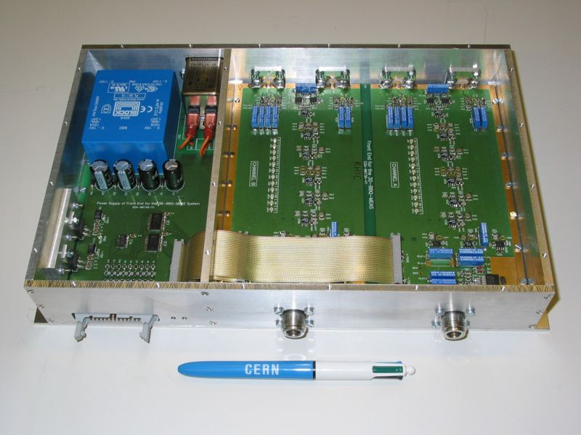
3D AFE Block Diagram and Construction
Detector box (for one PU electrode)
Analog front-end box (2 channels)

Slide 7
One component of the AFE is the active filter chain section:
The active filtering chain removes the revolution line.
The data comes in differentially (instrumentation amplifier) – initial rev line supression
Following the differential amplifier it goes through a Notch filter to remove the revolution line, followed by 6th order LP, 2nd order HP and two more 6th order LP’s.
The AFE also allows for ~100db total of gain through its control pins. A portion of the total gain is fixed, and the remaining gain is variable in steps.
This control section allows the user the ability to remotely control gain and time constant parameters. This control is thru a 26pin ribbon connector.

Slide 8
3D AFE ‘beam noise’
Various signatures
  dropouts, saturation, noise due to ‘microinstabilities’,…
Possible sources
  instabilities (weak – not noticed by anything except 3D AFE)
  diodes driven ‘zener’
  beam loss – direct on electrode??
  high frequencies – the well known longitudinal ‘hot spots’
  mains harmonics (covered in RHIC Run 6 presentation), quadrupole cryostat vibrations,…

Slide 9
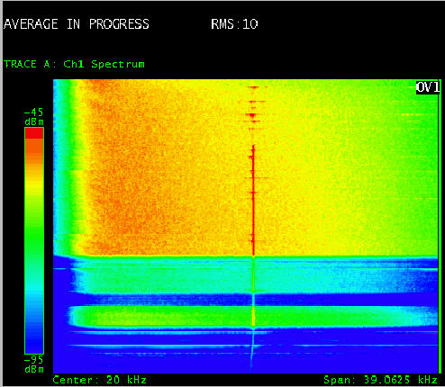
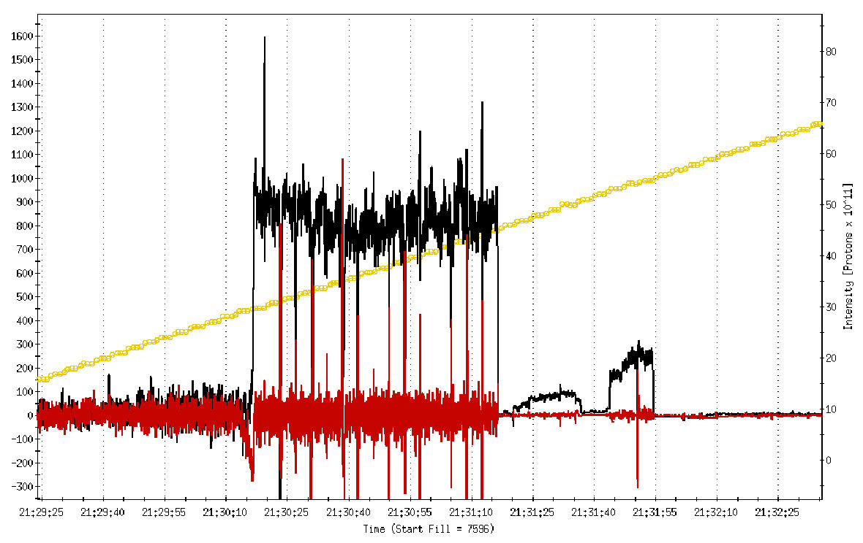
YH Dropouts during filling
beam current
3D AFE output goes away completely!
10¹¹, 1σ = 1ns, 1m stripline gives ~40V peak
3 minutes

Slide 10
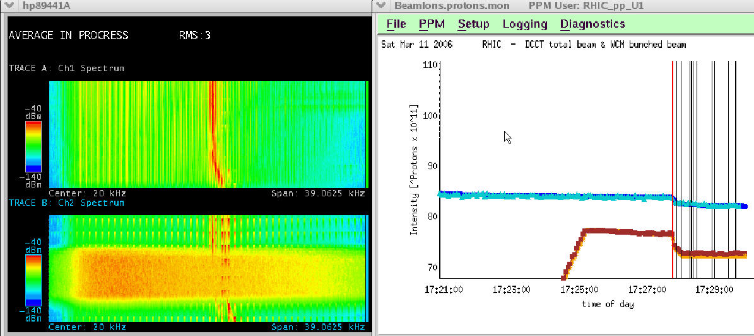
BV Saturation – why vert only?
mains harmonics as ramping supply turns off, horizontal only (understood)
BH
39KHz span
~10 sec
Here?
BV
blue vert IPM firing at 1 sec interval

Slide 11
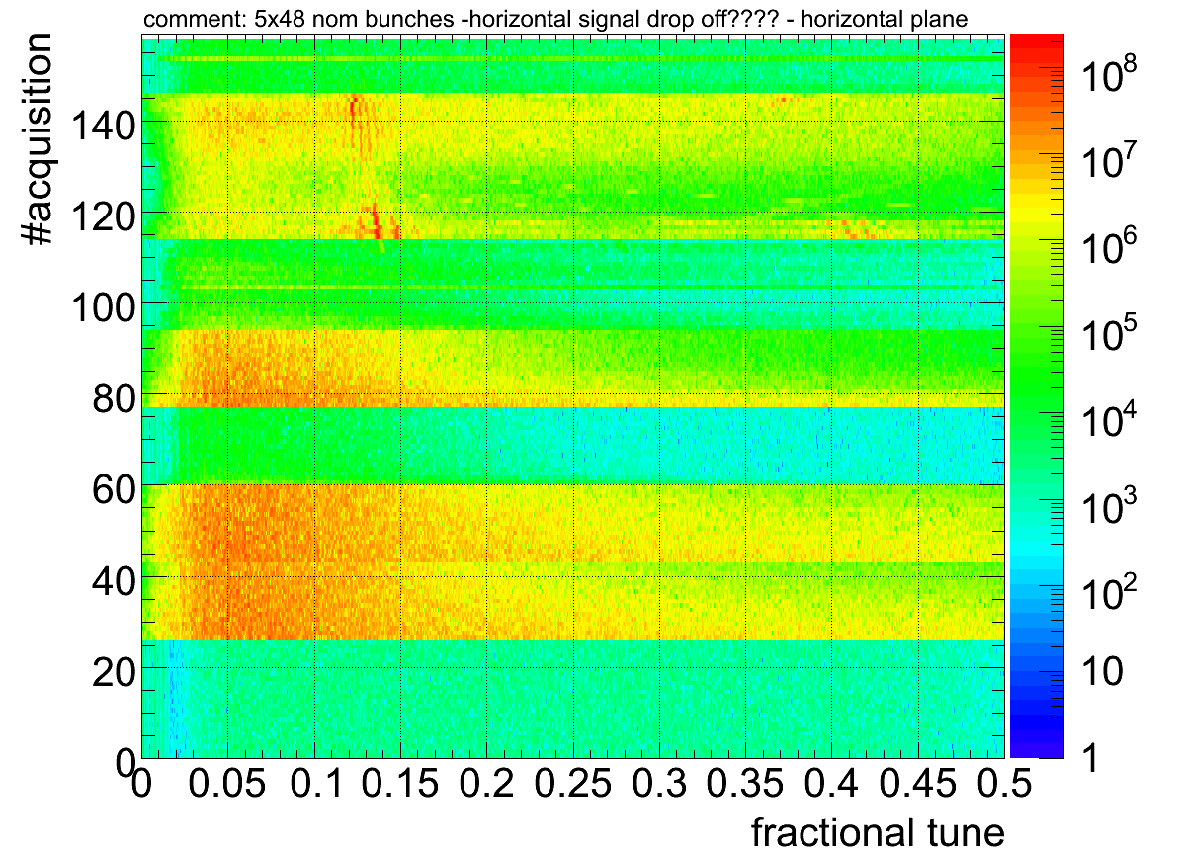
SPS drop outs
Drop outs
Possible High intensity driving the Diode front end into the Zener regime and discharging the capacitor ???? Else???

Slide 12
“ZENER MODE”
The signal coming from the PU is a doublet , so a positive and negative signal is observed. The diode is setup in the forward bias condition which allows the positive part to pass thru while blocking the negative part. However, if the negative portion is large enough to overcome the reverse breakdown of the diode(“ZENER MODE)” then the diode will conduct. In RHIC we have 50ohm terminations on our PU’s, this will short the charge on the Capacitor. The diodes chosen in the AFE have ~ 50V breakdown threshold.
Possible solutions
  Attenuation: adding a resistor to prevent the “zener mode” of the diode.
  Putting a low-pass filter in front of the diode to limit the band width.

Slide 13
3D AFE out of tunnel
We pulled the AFE’s out of the tunnel when we thought they were damaged due to radiation. It was determined , after testing the AFE’s they were still functioning.
From the pickups we had ~100m of ¼” heliax cable before the diodes.
Shorter time constants seem to help the situation
Experimented with filtering and attenuation before the diodes, typically had 50MHz LP followed by 6dB pad for the rest of the run, 1 turn time constant
saturation and dropout problems did not recur
but performance was still erratic at times - chromaticity

Slide 14
Chromaticity – what we learned from 250GeV
Weak sensitivity to chrom with 245MHz PLL
  linewidth is dominated by Nηdp/p
Much stronger sensitivity with BBQ
  phase slope changes - affects overall loop gain
Chromaticity too large
  loop gain becomes too small, can’t track fast tune changes
Chromaticity too small
  3D AFE is peak detector, sensitive to ‘micro-instabilities’
  BBQ becomes unstable, repeatedly loses and regains lock
Acceptable range for BBQ is only a few units

Slide 15
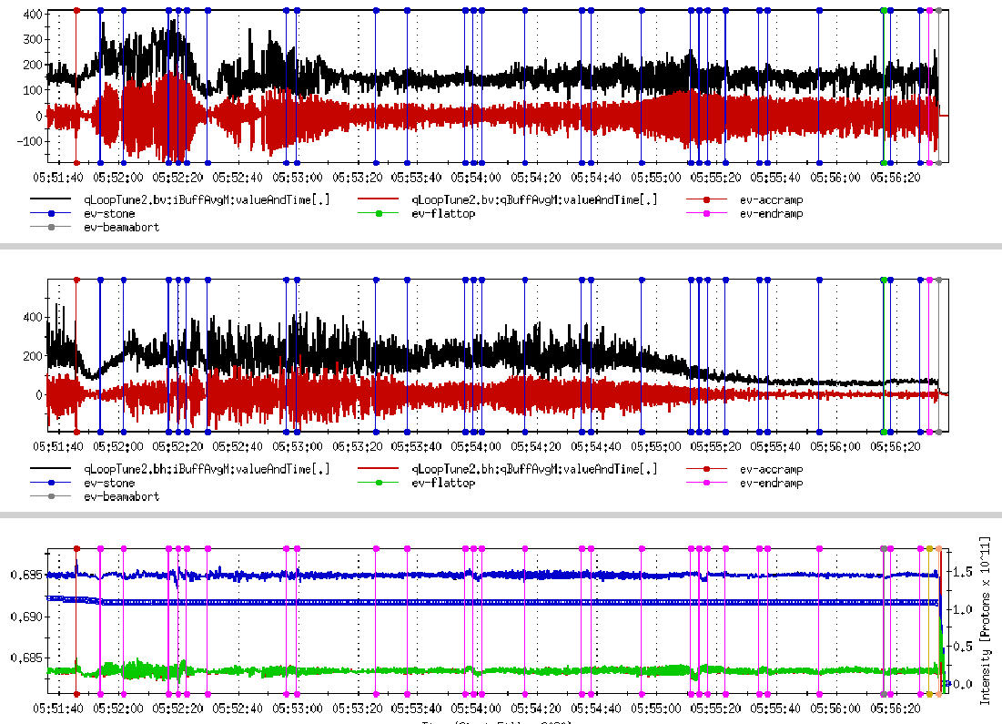
Blue Ring 250GeV ramp
small ξ
vert
I and Q
horiz
I and Q
tunes
and
beam
current
kicker feedback loop on
large ξ

Slide 16
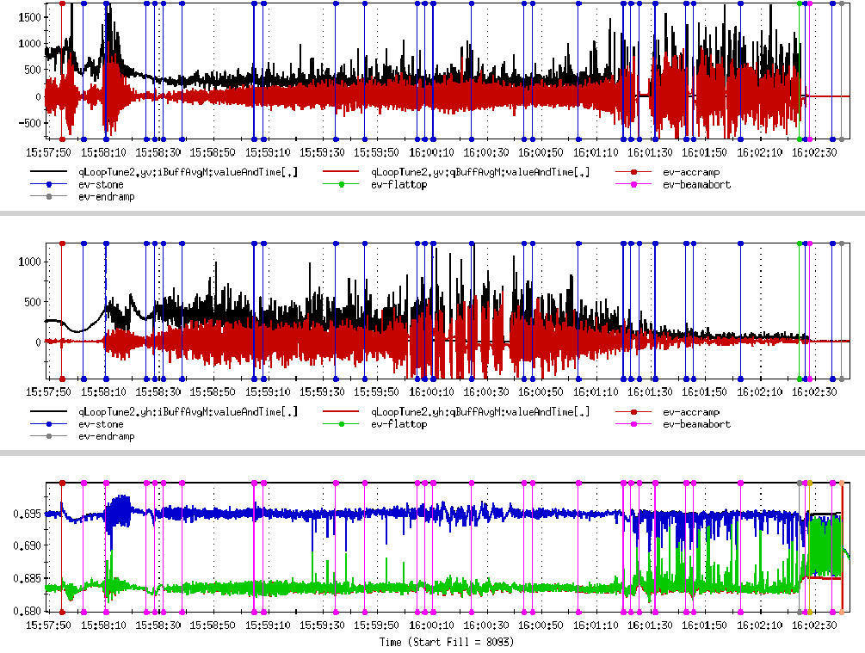
Yellow Ring 250GeV ramp
small ξ
vert
I and Q
horiz
I and Q
tunes
kicker feedback loop on
small ξ
large ξ
manual loop gain adjustments

Slide 17
Conclusions
The AFE , has been running at RHIC for two years.
Extremely sensitive peak detector, great rejection of revolution component. (active filter section)
Large variable gain selection.
Seemed to work well in or out of tunnel.(more flexible for modifications, out of tunnel)
Drop Outs : Zener Mode : Intensity dependant , LP filter to limit the bandwidth is one possible solution.
Sensitive to Chromaticity at high intensity (RHIC 250GeV).
- Large :can’t drive the beam
- Small: unstable
Using a resonant pickup as a solution to the instabilities problem when LHC goes to high intensities???

