Slide 1
Radioactive Ion Beam Development at the HRIBF
Dan Stracener
S & T Review
November 22-23, 2004

Slide 2
Outline
Highlights of Recent Accomplishments
  Laser Ion Source
  Photodetachment to purify ⁵⁶Ni beams
  Comparison of UC yields
  New target preparation techniques (‘paint’)
HRIBF RIB Capabilities
  Test Facilities (off-line and on-line)
  Radioactive Ion Beam Intensities
ISOL Development Plans
  New beams (^{25,26}Al, ³⁰P, ^{33,34}Cl, ¹¹C)
  Efforts to improve beam quality (intensity and purity)
  High power target development with the HPTL to achieve higher production rates in the target

Slide 3
Laser Ion Source Experiments (8/31/04 – 9/23/04)
Laser ion source set up and operated at HRIBF in collaboration with a group from Mainz (Klaus Wendt and students)
Three-step ionization of Sn, Ge, and Ni obtained
Last ionization step:
  autoionization state for Sn and Ge
No surface ionized Sn, Ge, and Ni ions observed
  hot-cavity temperatures ~ 1700-2000 C
Overall LIS efficiencies:
  20% for Sn (compared to 10% achieved at ISOLDE)
  3% for Ge and Ni
Laser resonant ionization of Ga was observed
  small signals on top of a large surface ion background

Slide 4
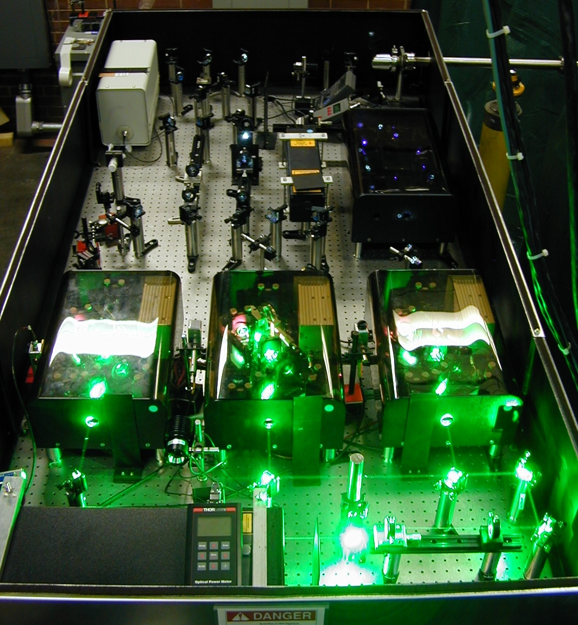
Laser setup for the initial test at the HRIBF
Laser beam into the hot
cavity through the
mass-analysis magnet
Ti:sapphire lasers
(supplied by the
Mainz group)
Nd:YAG Pump laser
(60 W, 10 kHZ, 532 nm)

Slide 5
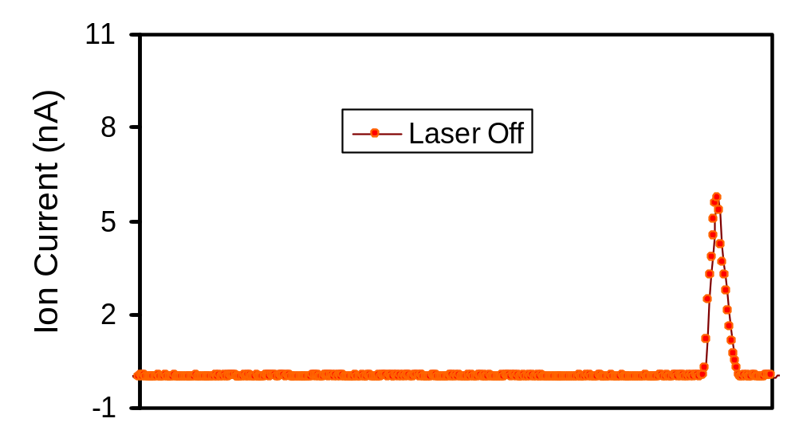
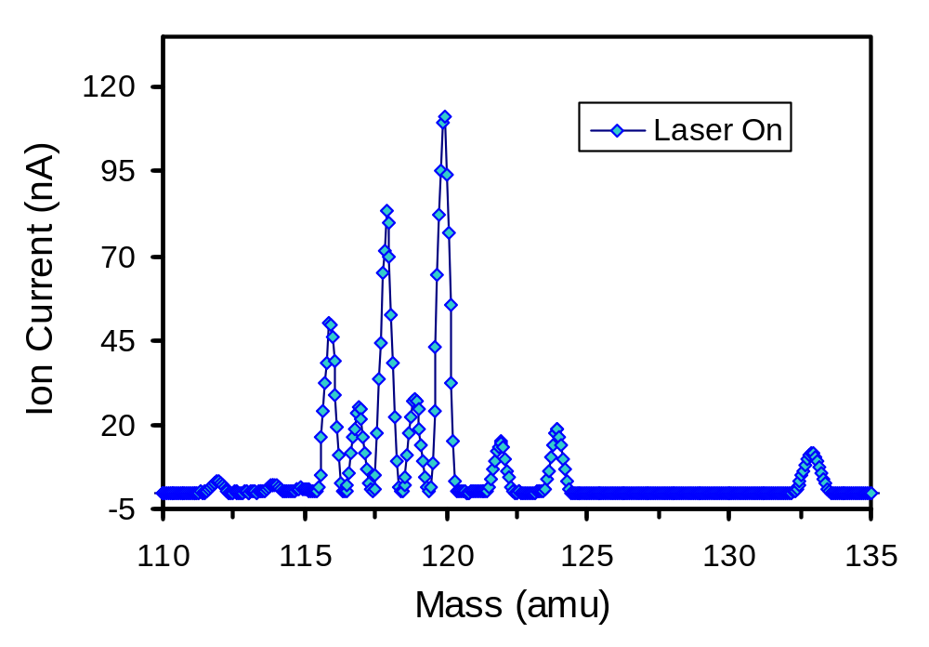
Sn Ionization Scheme
Cs
AI
59375,9 cm⁻¹
59231,8 cm⁻¹
IP
823,5 nm / 12143,29 cm⁻¹
47235,2 cm⁻¹
120
811,4 nm / 12324,37 cm⁻¹
118
34914,2 cm⁻¹
116
124
286,3317 nm /
3 x 11638,06 cm⁻¹
122
Cs
112
114
3427,7 cm⁻¹
1691,8 cm⁻¹
0 cm⁻¹

Slide 6
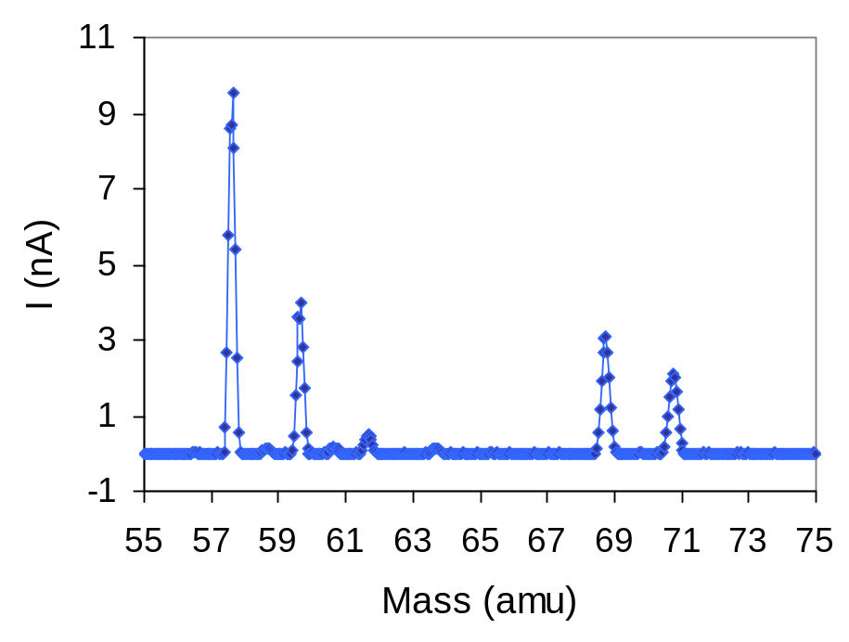
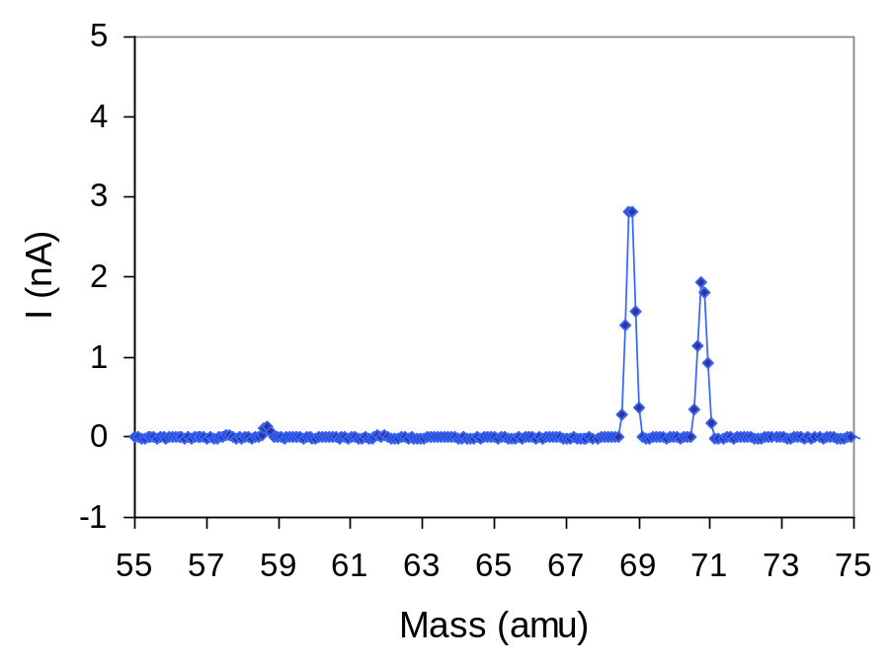
Ni Ionization Scheme
58
Ni
Laser On
60
69Ga
71Ga
IP, 61579 cm⁻¹
62
64
808.7900 nm / 12364.15 cm⁻¹
³F, 49313.851 cm⁻¹, J=3
786.5936 nm / 12713.04 cm⁻¹
Laser Off
69Ga
¹D, 36600.805 cm⁻¹, J=2
71Ga
59
279.9474 nm
274.7553 nm
1713.080 cm⁻¹, J=1
³D
879.813 cm⁻¹, J=2
204.786 cm⁻¹, J=3

Slide 7
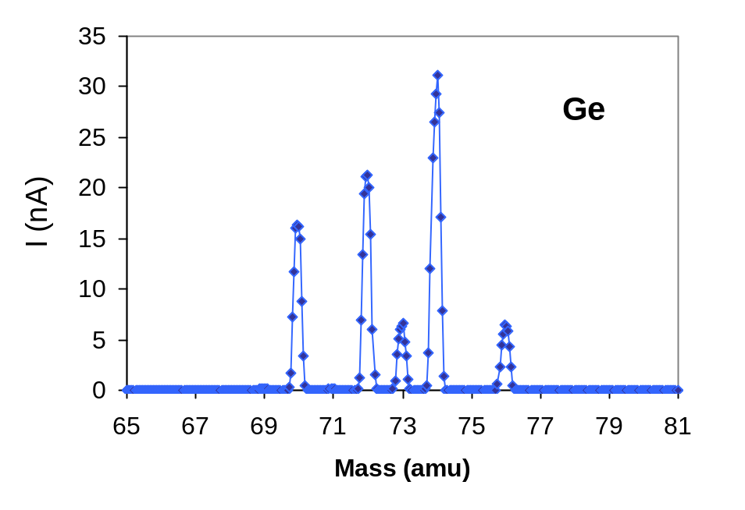
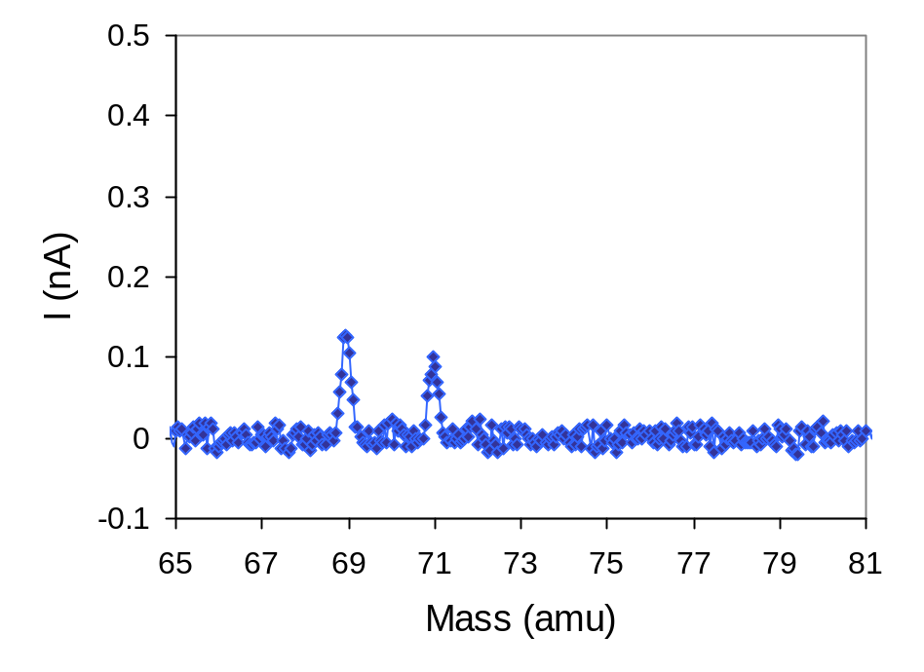
Ge Ionization Scheme
74
Laser On
72
70
59375,9 cm⁻¹
AI
59231,8 cm⁻¹
IP
76
823,5 nm / 12143,29 cm⁻¹
47235,2 cm⁻¹
811,4 nm / 12324,37 cm⁻¹
Laser Off
34914,2 cm⁻¹
69Ga
71Ga
286,3317 nm /
3 x 11638,06 cm⁻¹
3427,7 cm⁻¹
1691,8 cm⁻¹
0 cm⁻¹

Slide 8
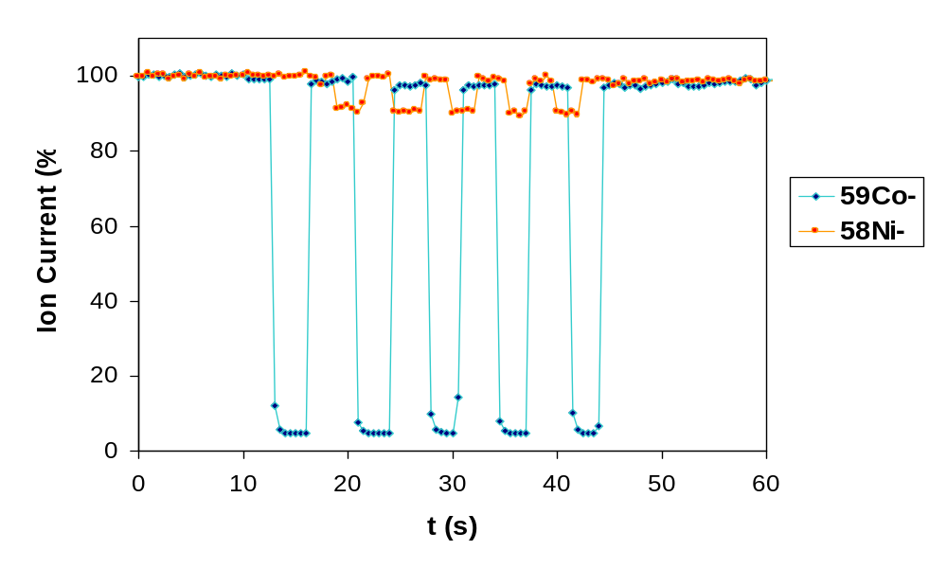
Laser-induced Photodetachment of Niˉ and Coˉ in a He-filled RFQ Ion Cooler
Laser off
Laser on
Neutralization:
Coˉ: ~95%
Ni ˉ: ~10%
Laser on
Laser: Nd:YAG, 5 W, CW, 1064 nm
About 50% of laser beam passed through the RFQ (40 cm long)
The energy of the negative ions was reduced from 5 keV to <50 eV in the cooler
Laser interaction time in the RFQ cooler is on the order of 1 ms

Slide 9
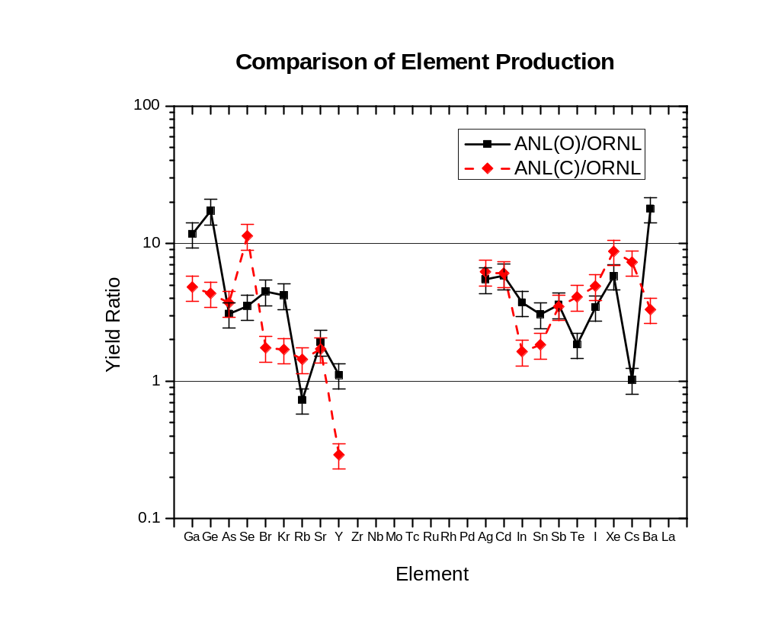
RIB yields from different UC targets
Three UC target geometries tested
UC-coated RVC
  low-density, highly porous carbon matrix (standard for HRIBF)
  density is 0.6 g/cm³ to 1.2 g/cm³
UC pressed pellets (ANL-O)
  UOx powder mixed with C powder and converted at high temperature to UC (manufactured at ANL)
  density is 2.5 g/cm³
UC pressed pellets (ANL-C)
  UC powder (manufactured at ANL)
  density is 6 g/cm³
The pressed powder pellets
  Are significantly cheaper to produce
  Need to be tested at high power

Slide 10
New Target Fabrication Technique
New ‘paint’ technique to produce thin layer of target material on porous support matrix
  make a very fine powder (~ 1 μm dia.) of the target material
  suspend this fine powder in a liquid binder
  coat the support matrix with the paint using vacuum infiltration to draw the suspension into the internal surfaces
  dispersant is needed to prevent formation of aggregates and to allow penetration of ‘paint’ into the more dense matrices
  heat the target to about 850 C to drive off the binder, leaving a thin coating of the target material on the fibers
  has been used to make several targets (e.g. CeS, SiC, BN, HfC, ...)
CeS has performed well
SiC has been tested with mixed results
  the most recent test shows that the SiC powder was not tightly bound to the matrix
  solution: sinter at high temperatures in an Argon atmosphere

Slide 11
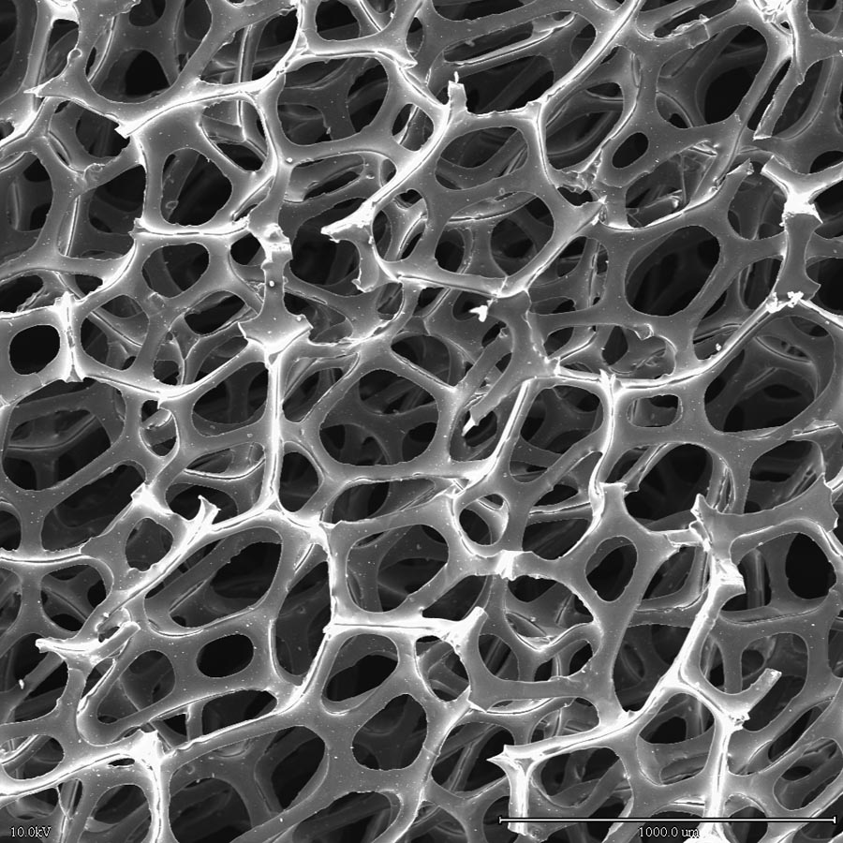
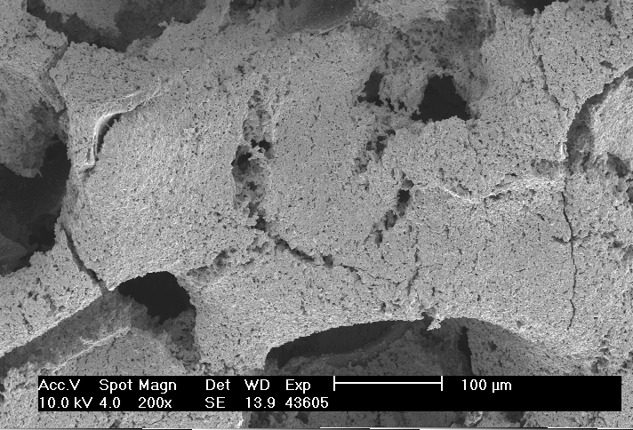
UC targets using the ‘paint’ technique
un-coated carbon matrix
UC coating on a 6xRVC matrix
UC is uniformly distributed and tightly bound to the matrix
On-line tests needed to compare release efficiencies to data from our standard UC/RVC targets (chemical deposition technique)
Future targets will be made using higher density RVC matrices to increase the surface-to-volume ratio and thus increase the U density

Slide 12
RIB Development and Testing Facilities
Ion Source Test Facility I (ISTF-1)
  characterize ion sources (efficiency, longevity, emittance, energy spread, effusion)
  some target tests (e.g. effusion through matrix)
  ion cooler for negative ions (gas-filled RFQ)
Ion Source Test Facility II (ISTF-2)
  laser ion source
  ECR ion source
On-Line Test Facility (OLTF)
  low intensity tests of target and ion source performance
  compatible with the RIB Injector and results are scaleable
Facility for preparing target/ion source modules for the RIB Injector (assembly and quality assurance)
High Power Target Laboratory (HPTL)
  available in 2005 for target tests with high power beams from ORIC

Slide 13
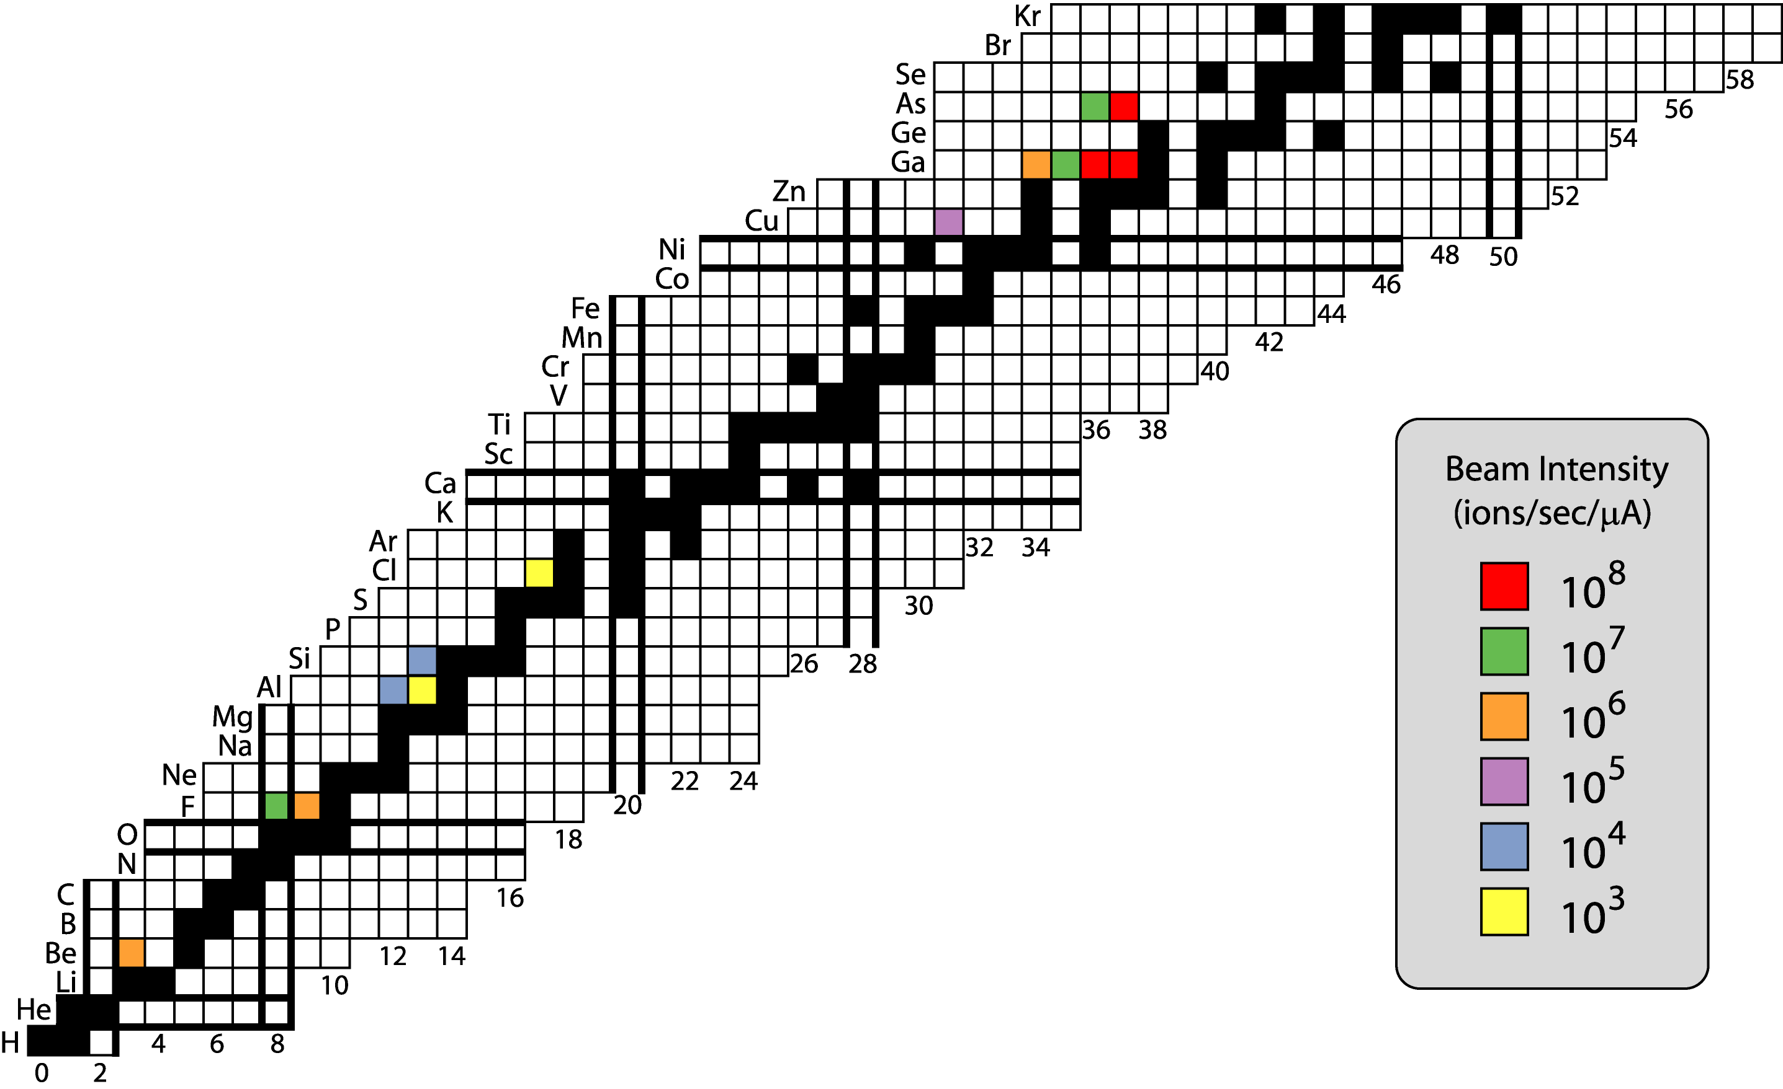
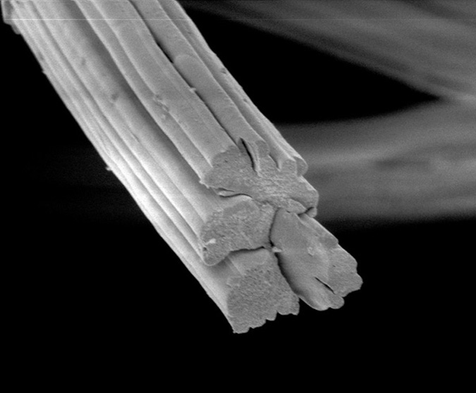
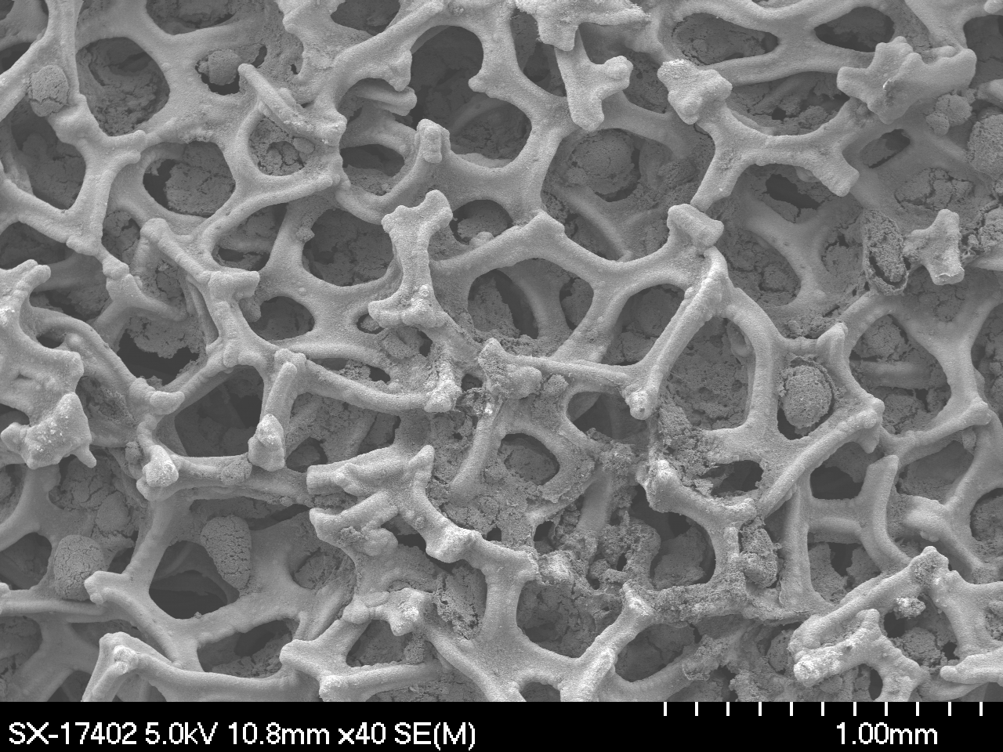
Proton-rich Radioactive Ion Beams
Seven different targets used
Three different ion sources
14 radioactive beams
HfO₂ for ^{17,18}F beams
2μm
CeS on RVC matrix for ³⁴Cl
Notes:
F from hafnium oxide targets
Al from SiC target
Cu from a molten nickel target
As and Ga from a molten germanium target (hope to produce Se from this target using He-induced reactions)

Slide 14
Accelerated Proton-rich
Radioactive Ion Beams
RIB | Energy Range | Highest Intensity | ORIC Current | Purity
 | (MeV) | (pps on target) | (μA on target) | (%)
⁷Be | 4 - 27 | 4.0 x 10⁶ | n/a | 100
¹⁷F | 10-170 | 1.0 x 10⁷ | 3 | 100
¹⁸F | 10-108 | 6.0 x 10⁵ | 1.5 | 100
⁶⁷Ga | 160 | 2.5 x 10⁵ | 5 | > 90
⁶⁹As | 160 | 2.0 x 10⁶ | 5 | ~ 10
⁷⁰As* | 140 | 2.0 x 10³ | 0.01 | < 10⁻⁶
* This beam was used for commissioning of the RIB Injector

Slide 15
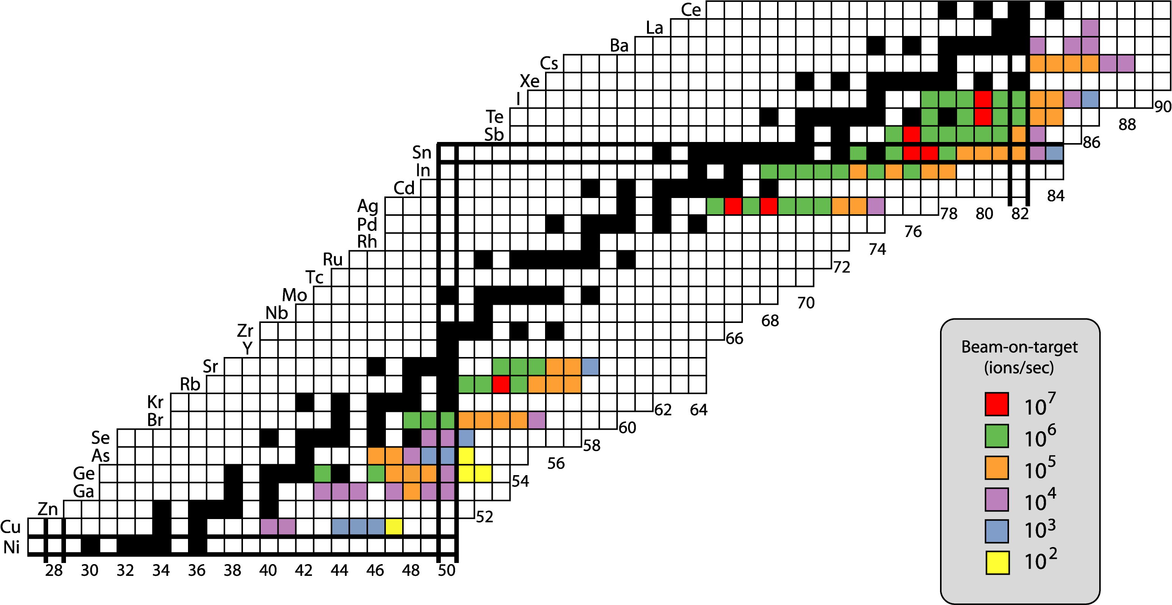
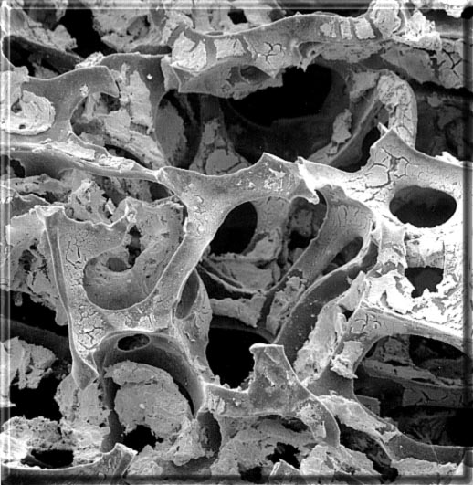
Available Neutron-rich Radioactive Ion Beams
(over 110 beams with intensities ≥10³ ions/sec)
E/A = 3 MeV/amu

Slide 16
Accelerated n-rich RIBs (A<100 amu)
RIB | Energy Range (MeV) | Highest Intensity (pps) | Purity (%)
⁷⁶Cu | 220 | 15 | 0.3
⁷⁷Cu | 220 | 1.6 | 0.03
⁷⁸Cu | 220 | 0.15 | 0.003
⁷⁹Cu | 220 | 0.006 | 0.00012
⁷⁸Ge | 175 | 1.5 x 10⁶ | 67
⁸⁰Ge | 179 | 1.8 x 10⁶ | 95
⁸²Ge | 183 - 327 | 1.8 x 10⁴ | 22
⁸³Ge | 220 - 327 | 1500 | 43
⁸⁴Ge | 220 - 327 | 95 | 12
⁸⁵Ge | 220 | 1.3 | 18
⁸⁶Ge | 220 | 0.006 | 0.8
⁸²Se | 380 | 4.7 x 10⁵ | 78
⁸³Se | 327 | 1.7 x 10⁵ | 95
⁸⁴Se | 327 - 380 | 1.1 x 10⁴ | 10
⁹²Sr | 450 | 500 | 72

Slide 17
Accelerated n-rich RIBs (A>100 amu)
RIB | Energy Range (MeV) | Highest Intensity (pps) | Purity (%)
¹¹⁷Ag | 460 | 1.2 x 10⁶ | 95
¹¹⁸Ag | 236 – 455 | 1.7 x 10⁶ | 90
¹²⁶Sn | 378 | 1.0 x 10⁷ | 50
¹²⁸Sn | 384 | 3.0 x 10⁶ | > 99
¹³⁰Sn | 391 – 550 | 5.0 x 10⁵ | > 99
¹³¹Sn | 550 | 2.5 x 10⁵ | > 99
¹³²Sn | 316 | 8.6 x 10⁵ | 96
¹³²Sn | 453 – 620 | 1.5 x 10⁵ | 96
¹³³Sn | 316 | 1.7 x 10⁴ | 33
¹³⁴Sn | 316 – 560 | 2.8 x 10³ | 38
¹³⁶Sn | 400 | 3 | 0.2
¹²⁹Sb | 400 | 2.9 x 10⁷ | 49
¹³²Te | 350 – 396 | 3.0 x 10⁷ | 87
¹³⁴Te | 396 – 565 | 2.4 x 10⁶ | 95
¹³⁶Te | 396 – 470 | 5.0 x 10⁵ | 80

Slide 18
Summary of Planned RIB Development
Proton-rich beams
  ^{25,26}Al – proton scattering and transfer rates to better understand the γ-ray astronomy observations of ²⁶Al
  ^{33,34}Cl – reaction rates that are important for nova nucleosynthesis
  ³⁰P – proton scattering and transfer rates to understand the large sulphur enhancements seen in novae
  ¹¹C – resonant scattering to investigate the low-lying states in ¹²N
  ⁵⁶Ni – nuclear structure in the ¹⁰⁰Sn region; also proton capture is an important reaction in the rp process
  ¹⁷F – higher intensities needed to measure the proton capture rates to better understand ¹⁸F production in novae
Neutron-rich beams
  increase intensity by developing more robust targets and utilizing beam rastering techniques
  increase beam purity by exploiting the differences in chemical behavior
Develop ion sources with higher efficiency and higher selectivity

Slide 19
New Radioactive Beams
²⁵Al, ²⁶Al
  Measured yields from three SiC targets (fiber, powder, and SiC coating on RVC matrix)
  From measured yields, we expect about 10⁴ ions/sec on target
  Need to determine limit of production beam power
  Plan to investigate release rates from metal silicide targets (e.g. W₅Si₃) which have faster diffusion rates for aluminum
³³Cl, ³⁴Cl
  Measured yields using a thin layer of CeS on a RVC matrix
  Expect about 10⁴ ions/sec of ³⁴Cl
  Need to investigate use of a negative ion source and determine the power handling capabilities of this target
¹¹C
  Need to develop both the target and the ion source
  Off-line tests to determine suitability of material (possibly BN/RVC)
  On-line test to measure release rate
  Plan to use LaB₆ surface to make CNˉ (surface ionization)
⁵⁶Ni & ¹⁷F
  efforts are underway to improve the quality (intensity and purity) of these beams

Slide 20
Enhancing Beam Purity
Selective ionization techniques
  surface ionization sources (depends on the temperature and work function of the surface)
    LaB₆ at 1100° C ionizes halogens with efficiencies up to 25%
    hot cavity of Ta or W at ~2000° C can ionize alkaline elements with nearly 100% efficiency
  laser ion source (useful for many elements)
Molecular formation, transport, and ionization
  fluorides, chlorides, oxides, sulfides (e.g. SnS⁺ and GeS⁺)
  aluminum for halogens (e.g. AlF⁺, AlCl⁺)
  CO⁺, SeCO⁺, GaCl⁺, InCl⁺, SrF⁺, fluorides of refractory metals
Selective photo-detachment of contaminants
  Niˉ/Coˉ, Clˉ/Sˉ, Fˉ/Oˉ

Slide 21
Goals of R&D at the HPTL
To design and test targets that can withstand higher power densities
Develop target/beam overlap schemes to increase RIB production rates in the target
  Increase the production beam current while maintaining the same power density
  Larger target volumes
  Beam rastering or defocusing
Implement and test new ion source designs in a realistic high-radiation environment
Develop targets that may be useful for RIA

Slide 22
Ion Sources to be used at the HPTL
The target station and the RIB analysis beam line are designed to be flexible enough to accommodate a variety of ion sources
  Electron-Beam Plasma ion source (EBPIS)
  Kinetic Ejection Negative ion source (KENIS)
  Laser ion source (LIS)
  Positive surface ionization sources (hot Ta or W tubular ionizer)
  Negative surface ionization sources (e.g. LaB₆ ionizer)
  Cs-sputter type ion sources (multi-sample, batch-mode)
  Close-coupled designs (e.g. FEBIAD ion source – GSI design)
  Electron Cyclotron Resonance (ECR) ion sources
  Ion guide (cooler) techniques

Slide 23
Initial Tests at the HPTL (after commissioning)
We need to significantly enhance the quality (intensity and purity) of the available proton-rich radioactive beams at the HRIBF.
New Materials tests
  SiC and metal silicides (e.g. Zr₅Si_{3,} Ta₅Si_{3,} Nb₅Si₃) for ^{25,26}Al beams
  CeS for ^{33,34}Cl and ^{29,30}P beams
New target geometries
  Thin liquid Ge for ⁶⁹As and p-rich Se beams
  Thin solids for use with ^{3,4}He production beams
Effect of rastering the production beam
  Increase intensity of ^{17,18}F beams from HfO₂ (production beam presently limited to 3 μA due to target damage)
  Important measurements to be made include ¹⁷F(p,γ)¹⁸Ne, ¹⁸F(p,α)¹⁵O
  ¹⁷F Beam-on-target is 1 x 10⁷ pps – need about a factor of ten improvement

Slide 24
A Possible Thin Target Geometry
Target thickness
is 0.08 cm
Actual geometry used for liquid Ge target for As beams
(1.2 cm dia. x 0.6 cm thick)

