Slide 1


Shot-noise-limited polarimetry for precision measurement of spin precession
Rene Jacome
Eric Bahr
Valentin Dutertre
Srikanth Guttikonda
Khoa Nguyen
Derek Kimball
Funded by

Slide 2
Need to measure precession frequency of a
sample of atoms as precisely as possible...
Magnetic field exerts torque
on atomic spins:
τ = μ × B
B
Causes atoms to precess
at Larmor frequency:
μ, F
Ω_{L} = g_{F} μ_{B} B
τ

Slide 3
Use light resonant with atomic transition
to probe the angular momentum of atoms:
nucleus
+
-
electron
Angular momentum can be transferred
between light and atoms.
E
light
Polarization of light is related to
photons’ angular momentum distribution.

Slide 4
Average angular momentum of room temperature sample
of atoms averages to zero.
light
Exchange of angular momentum of light with atoms does
not change light polarization...

Slide 5
However, optical pumping transfers photon angular momentum
to atoms: angular momentum of atoms becomes nonrandom.

Slide 6
Magnetic field creates torque on atomic spins,
changes angular momentum distribution.
Magnetic field
Exchange of angular momentum from atoms to light
changes light polarization!

Slide 7
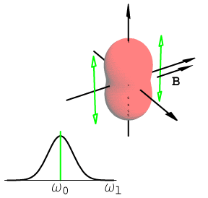
Light polarization oscillates at Larmor frequency:
When light/atom interaction is modulated synchronously
with Larmor precession, we observe a resonance in the
amplitude of light polarization rotation.

Slide 8
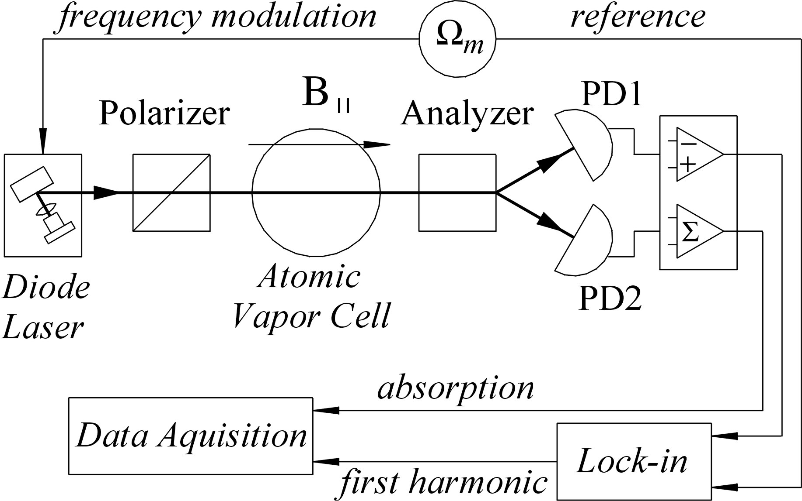
Nonlinear Magneto-optical Rotation with Frequency-Modulated Light
Experimental Setup:

Slide 9
Nonlinear Magneto-optical Rotation with Frequency-Modulated Light
Experimental Setup:

Slide 10
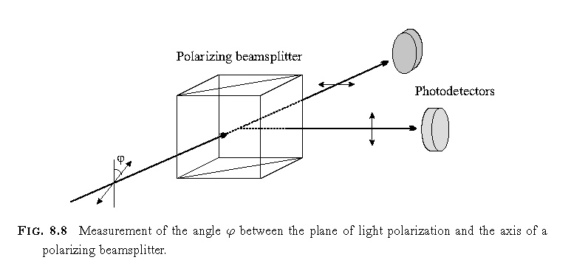
Shot-noise limit
Photodiode 1
Photodiode 2
Quantum fluctuations of light field cause noise in
the measurement of the angle of rotation of light
polarization.

Slide 11
Shot-noise limit
Number of
photons
Output light
polarization
Photons in
PD1
Photons in
PD2
10
10
45
45
4
6
10
45
7
3
10
45
5
5
10
45
6
4
10
45
3
7

Slide 12
Signal to noise ratio
Signal α to Number of photons
Noise α to (Number of photons)^{1/2}
Signal
= (Number of photons)^{1/2}
Noise

Slide 13
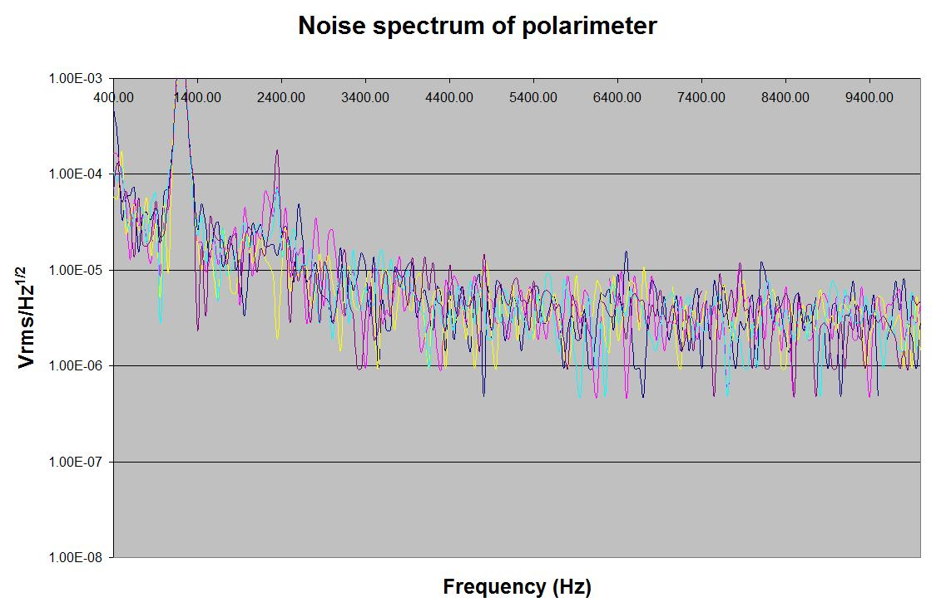

Slide 14
