Slide 1

PumpPlugTM a vacuum earplug patent pending
Martin L. Lenhardt, Au.D., Ph.D.
Professor of Biomedical Engineering and Emergency Medicine
Virginia Commonwealth University, Richmond VA 23298-0168
and
Virginia Advanced Shipbuilding and Carrier Integration Center
Northrop Grumman Newport News
lenhardt@hsc.vcu.edu

Slide 2
PumpPlugTM a vacuum earplug patent pending
Creates a negative pressure (-2 kPa) in the ear canal.
Increases attenuation 20 dB (< 1kHz) by: securing the fit, distending the eardrum laterally, increasing its impedance lowering its transmission and shifting canal resonant frequency.

Slide 3
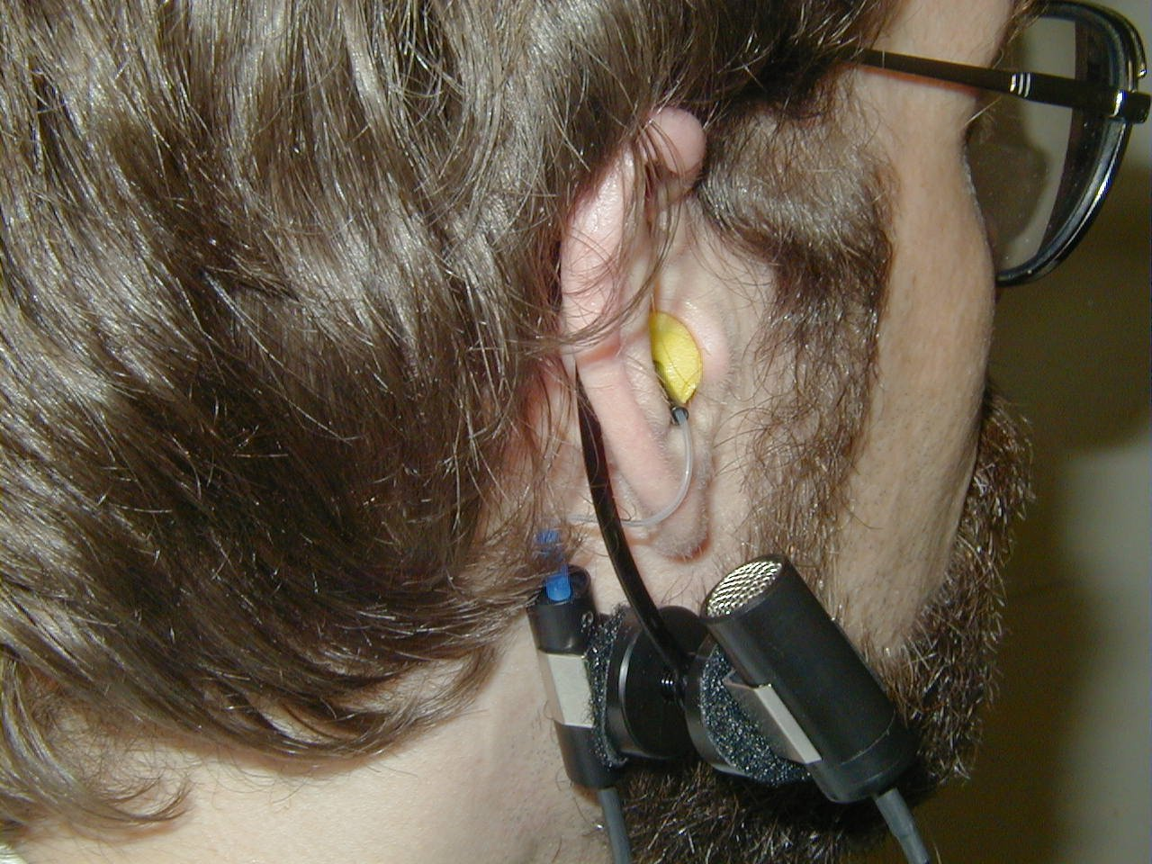
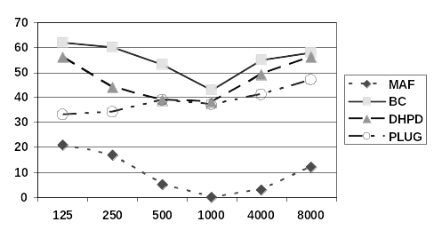
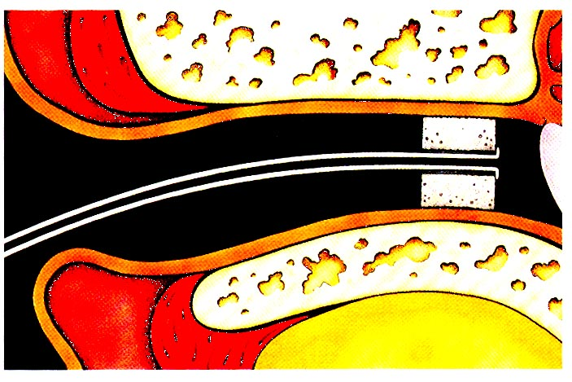
Pump PlugTM
passive ear protection
dB
Hz
        -2kPa canal pressure increases the efficiency of earplugs for frequencies < 1 kHz by about 20 dB.

