Slide 1

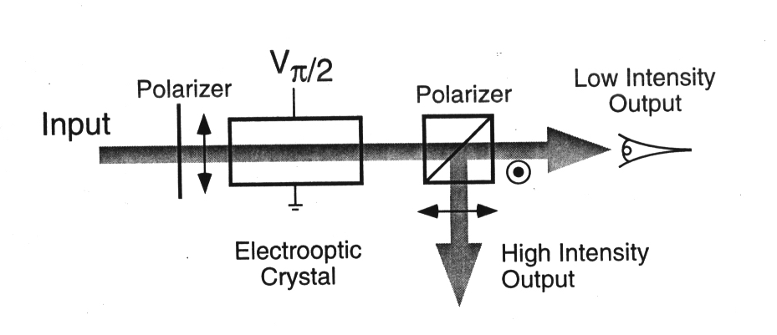
Small
Business
Innovation
Research
Novel Photorefractive Material ZnTe:V
for Optical Processing
Brimrose Corporation of America
Baltimore, Maryland
INNOVATION
A new photorefractive material, ZnTe, that is optical
limiting with real time holographic properties in the
wavelength range of 0.63 to 1.6 µm
ACCOMPLISHMENTS
Successfully demonstrated electro-optic power limiting (EOPL) and dynamic holography for wavelength of 0.63 to 1.6 µm
Improved crystal growth techniques for related materials
COMMERCIALIZATION
As result of this SBIR received follow-on funding of almost $1M from DoD for applications of ZnTe: $830K Air Force Phase I and II SBIR; $99K ARPA Phase I SBIR; and $66K for Air Force “White Paper” contract
Used ZnTe in a novel photo-emf signal processor. Received $830K Army Phase I and II SBIR contracts for this spin-off
Applied self-restraint in commercialization of an optical limiter because of the sensitive nature of DoD applications
Components of Electro-Optic Power Limiter
GOVERNMENT/SCIENCE APPLICATIONS
A NASA sponsored research project with MetroLaser in Irvine, California used this material to demonstrate resonant holographic interferometric spectroscopy
Air Force has expressed interest in continuing to fund further development of material for EOPL applications
Company in England is interested in using this material for terahertz technology
Received inquiries from France and Israel with regard to photorefractive and optical limiting materials
Glenn Research Center
Materials
3-058
1991 Phase II, NAS3-26983, 10/00
NASA Contact – Walter Duval
Company Contact – Sudhir Trivedi

