Slide 1

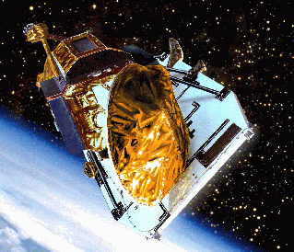
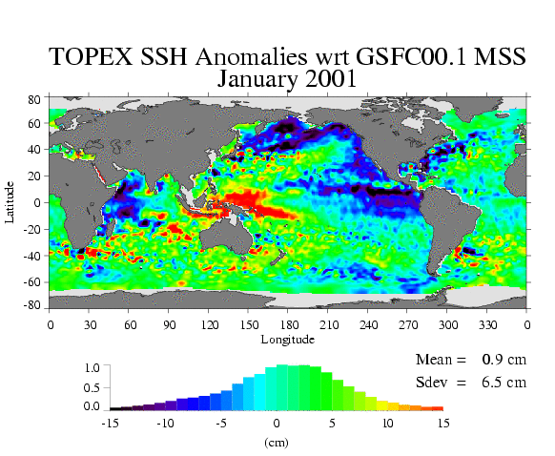
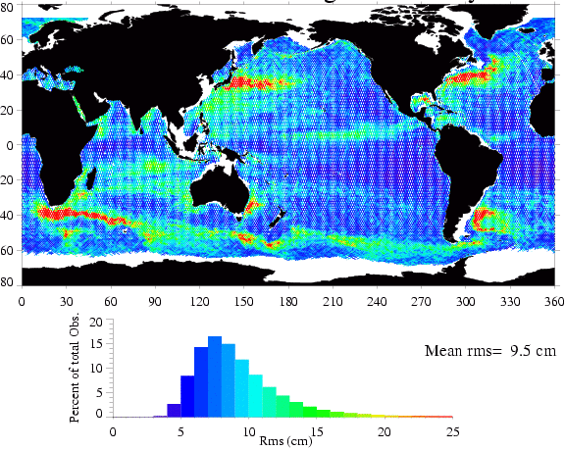
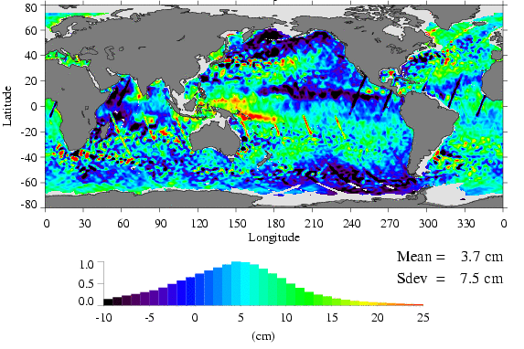
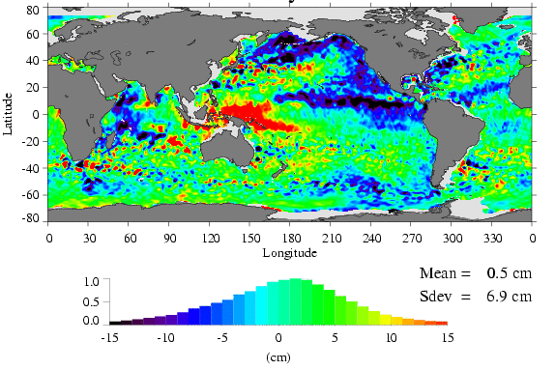
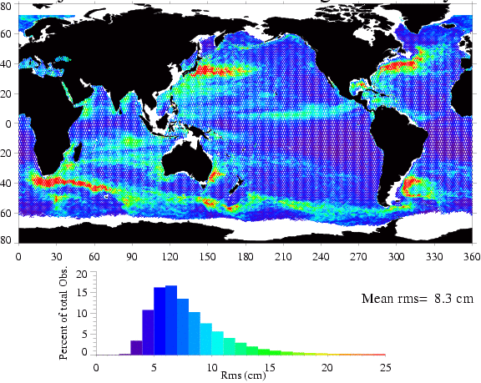
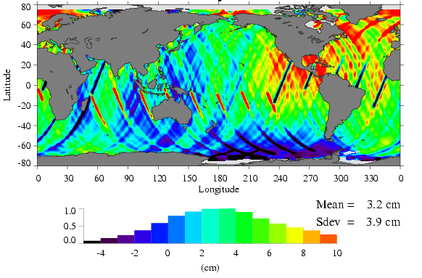
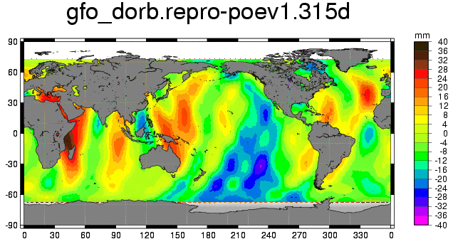
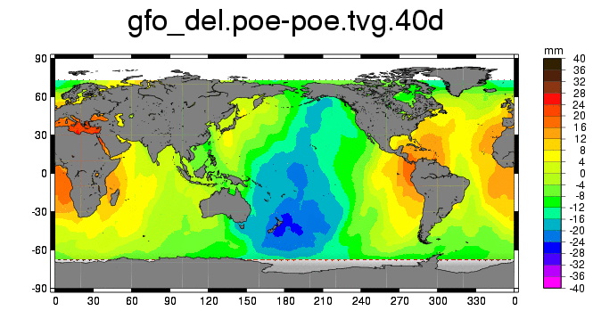
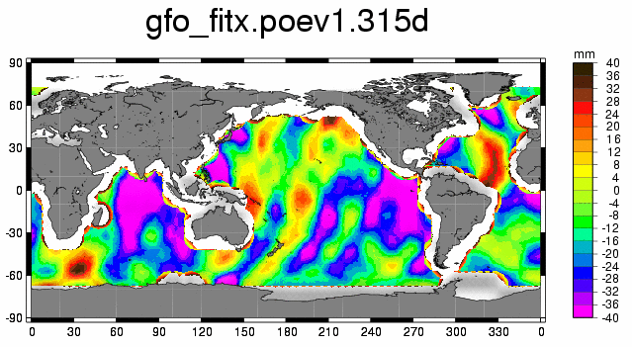
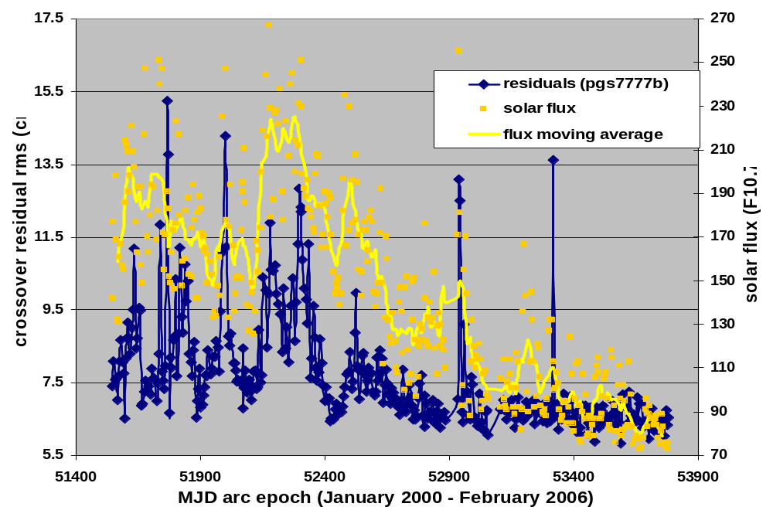
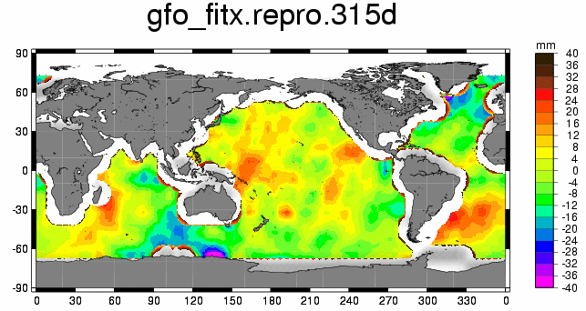
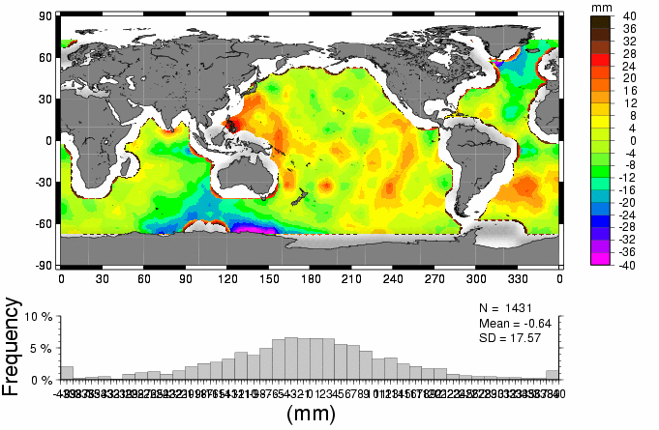
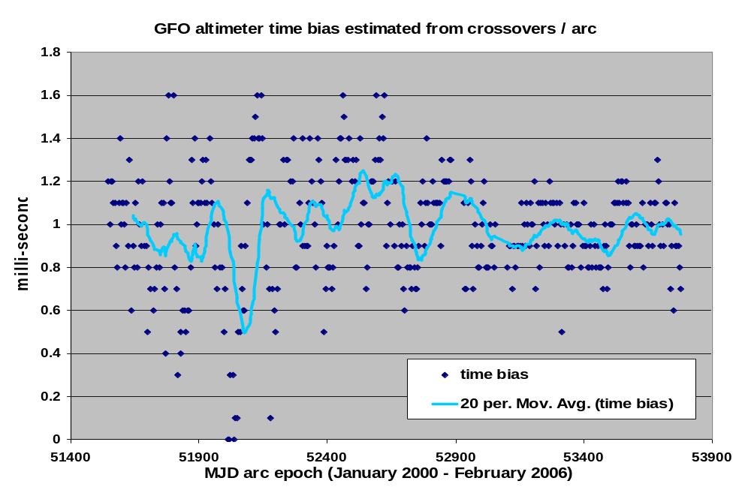
Evaluation of the Geosat Follow-On Precise Orbit Ephemeris
Nikita P. Zelensky, Brian D. Beckley, Douglas S. Chinn
SGT Inc, Greenbelt, MD 20770
Frank G. Lemoine, David D. Rowlands
Space Geodesy Branch, NASA / GSFC,
Greenbelt, MD 20771
John L. Lillibridge
Laboratory for Satellite Altimetry, NOAA, Silver Spring, MD 20910
ABSTRACT
4-5 cm GDR (pgs7727) orbit error relative to TOPEX
The GEOSAT Follow-On spacecraft (GFO), launched in 1998, began continuous radar altimeter coverage of the oceans in 2000. After an extensive series of calibration campaigns in 1999 and 2000, the spacecraft was finally accepted by the US Navy on November 29, 2000. By providing high quality altimeter data, GFO can supplement Jason, TOPEX/POSEIDON(T/P), and Envisat, providing a different synoptic sampling of the oceans with its 17-day ground track repeat cycle. Altimeter crossover analysis suggests GFO is capable of POSEIDON class altimetry, with orbit error the largest contributor to the GFO altimeter error budget. Satellite laser ranging (SLR) data, especially in combination with altimeter crossover data, offer the only means of determining high-quality precise orbits. SLR tracking is also augmented by Doppler (Tranet style) beacons. These data were used to tune the gravity field and macromodel (3D representation of the spacecraft geometry and surface properties). Beginning with January 2000 GSFC has produced a 6 year span of the Precision Orbit Ephemeris (POE) intended for use on the GFO GDR. The GFO orbits are currently produced with pgs7777b, a model based on CHAMP, GFO, and other satellite data. The pgs7777b had shown significant improvement in POD performance over all previous gravity fields. Recent tests suggest even further orbit improvement using the Grace-derived GGM02C static gravity field. Other possible improvements are evaluated such as using new ocean and earth tide models that conform to IERS2003 stands, a new Grace-derived time-varying gravity field, and forward modeling of atmosphere gravity. Orbit accuracy is evaluated using GFO tracking data and altimeter crossover and collinear sea surface height residuals, and analysis of coefficients used to adjust GFO data into the TOPEX frame
2-years of T/P-GFO altimeter crossover data are used to adjust GFO to the T/P frame removing GFO instrumental and orbit effects
4-5 cm GFO orbit error relative to TOPEX inferred from the improvement in the mean rms of the Adjusted GFO SSH variability
TOPEX SSH anomaly wrt GSFC MSS
January 2001
GFO Sea Surface Height Variability
GFO SSH anomaly wrt GSFC MSS
January 2001
GFO SSH anomaly wrt GSFC MSS adjusted using TP-GFO crossovers
January 2001
Adjusted GFO Sea Surface Height Variability
GFO Correction (mostly orbit error)
January 2001
New POD models offer significant improvement to GFO GDR orbits
GFO Orbit Modeling Development (red is new)
The table and three figures below illustrate progressive orbit improvement with each new set of POD models. Significant improvement is achieved beyond GGM02C using time-varying gravity models developed at GSFC. The average altimeter crossover residuals maps (figures A1– A3) indicate anti-correlated gravity orbit error. Notice the reduction in this error as we move from the pgs7727 to the tvg orbits.
The mean orbit difference (Figures B1 and B2) indicate geographically correlated error in the orbits It is believed most of the error is in the pgs7727 orbits (Fig. B1), and then in the pgs7777b orbits (Fig. B2)
Orbit | pgs7727 (2001) | pgs7777b (2004) | ggm02c (2005) | tvg (2006)
Gravity (static) | PGS7727 (70x70) | PGS7777b (110x110) | GGM02C (120x120) | GGM02C (120x120)
Gravity (time-variable) | C20dot, C21dot, S21dot | same | same | C20dot, C21dot, S21dot + 20x20 annual terms from GSFC GRACE solutions
Atmospheric gravity | Not applied | not applied | not applied | NCEP, 50x50 @6 hrs
Ocean Tides | Ray99 (T/P) + PGS7727 resonant | Ray99 (T/P) + PGS7777b resonant | same | (T/P-derived) GOT00.2 (20x20)
Solid Earth Tides | k₂= 0.300; k₃=0.093 + special handling for FCN. | same | same | IERS2003
Albedo/IR | Knocke & Ries, 1988 | same | same | same
Atmospheric drag | MSIS86 | same | same | same
surface force macromodel | tuned 8-panel model | re- tuned 8-panel model | same | same
Data | SLR + Altimeter Crossovers + Doppler | same | same | same
Parameterization and arc span | Cd/8 hrs + opr along+cross track/day; 6-day arc | same | same | same
SLR stations | ITRF2000 with ocean loading | same | same | same
Doppler stations | adjusted to the SLR CSR95L02 frame | same | same | same
LRA offset | tuned with 2-months SLR tracking data | same | same | same
precession | IAU1976 | same | same | IAU2000
nutation | IAU1980+corrections | same | same | IAU2000
B1. pgs7777b – pgs7727 radial orbit mean
rms=14 mm
Orbit Performance Summary (June 24 ’05 – August 4 ’05)
Orbit
RMS residuals
SLR
(cm)
Crossovers
(cm)
B2. pgs7777b - tvg radial orbit mean
pgs7727
5.317
7.576
rms=11 mm
pgs7777b
4.127
7.440
ggm02c
4.047
7.472
tvg
4.001
7.421
A1. pgs7727 crossover residuals mean
September 2002 – August 2003
Altimeter crossover residuals/arc and altimeter time biases estimated/arc spanning 6-years of the GFO Mission are shown below. The first plot shows orbit error in the early years of the Mission was dominated by atmosphere drag. The 2nd plot shows how the timing biases have stabilized over time to one millisecond.
rms=31 mm
A2. pgs7777b crossover residuals mean
September 2002 – August 2003
Gravity Model Summary
rms=19 mm
Gravity model | projected radial orbit error (mm)
JGM-3 (1995) Update to JGM-2 with TOPEX/GPS, Stella and other satellite data | 49.8
EGM96 (1996) Model with new-satellite tracking data, altimetry, and surface gravity | 26.2
PGS7727 (2001) computed from post-EGM96 pgs7609g using GFO SLR, Doppler, GFO and TOPEX-GFO altimeter crossover data | 13.2
PGS7777b (2003) computed from pgs7727 using 87 days of Champ data and tracking data from GFO (SLR/Crossovers), TOPEX (SLR/DORIS), Jason (GPS), Envisat (SLR/DORIS), and other SLR data | 10.0
GGM02C (2004) GRACE-based combination model | 4.0 (Ries 2006)
A3. tvg crossover residuals mean
September 2002 – August 2003
rms=17 mm

