Slide 1
Mitigation of Aero-Optical Effects and Subsonic Cavity Noise
using Fluidic Actuators
Jacob George
Post Doc, Caltech/OSU
Collaborators: Mo Samimy and Walter Lempert (Ohio State University
James Trolinger (Metrolaser, Irvine)
Sponsor: US AirForce

Slide 2
Outline
Research Motivation
Experimental Apparatus and Technique
Results (with and without flow control)
Conclusions

Slide 3
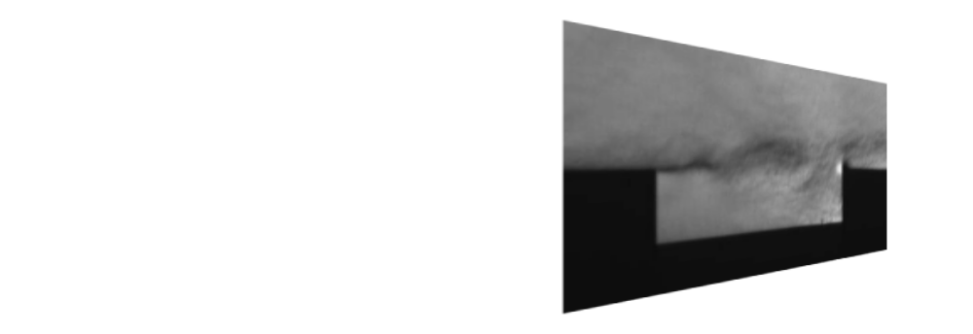
Research Motivation
Aberrated Wavefront
Planar Wavefront
The passage of an optical wavefront through a turbulent and varying index of refraction flow field causes wavefront aberration.
These aero-optical effects limit the performance of laser based and guided systems.
The goal is to understand the connection between the flow field and the optical degradation
The basis of flow control is to either reduce the degradation as much as possible or to transform the flow into a more predictable state enabling the use of adaptive optics to remove the degradation
To employ flow control to suppress cavity tones since they cause structural damage and fatigue
Flow structure and wavefront distortions are analyzed with and without control

Slide 4
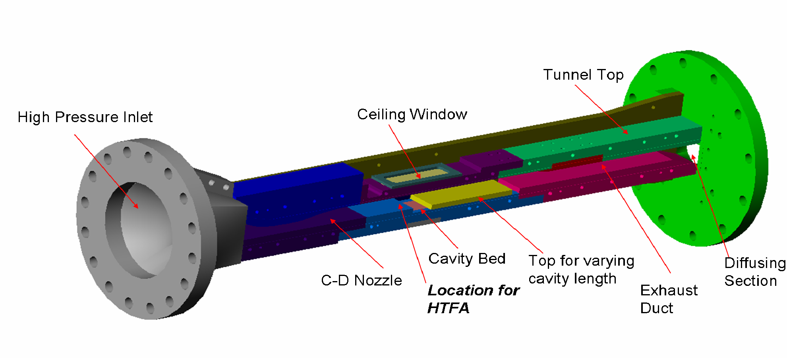
Experimental Apparatus and Technique
Aero-Optics Wind Tunnel
Test section area : 3” (span) by 1.5” (height)
Cavity Dimensions: Span (3”), Depth (0.5”), Length variable from 2” to 3”
Test section side-walls, ceiling and cavity bed have Fused Silica windows for easy optical access
Ports on cavity bed for dynamic pressure measurement
Flow diagnostics using Schlieren imaging and PIV
Flow measurements in conjunction with wavefront interferograms using (includes interferograms, Strehl ratio, etc.)

Slide 5
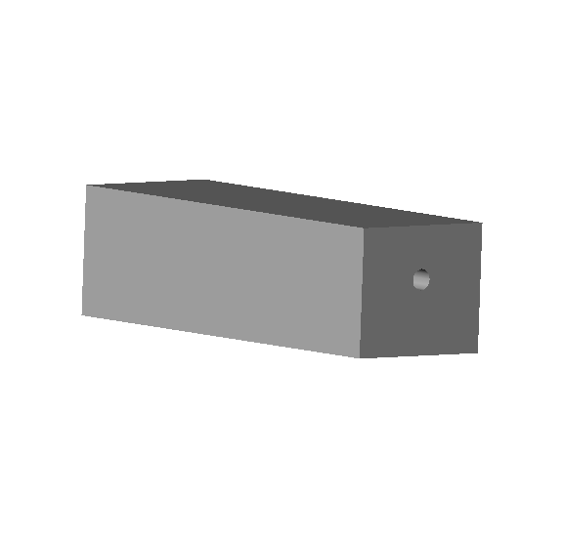
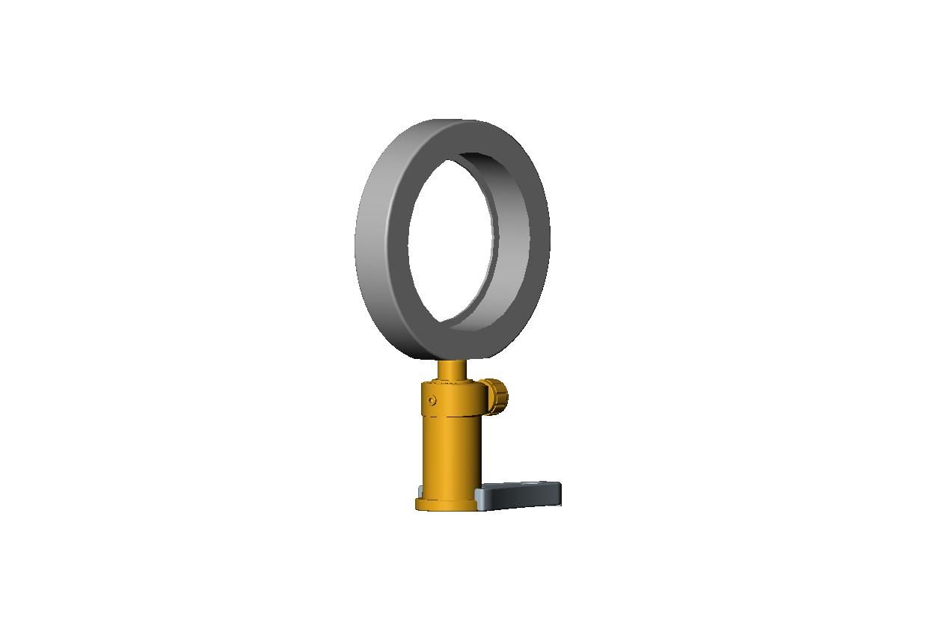
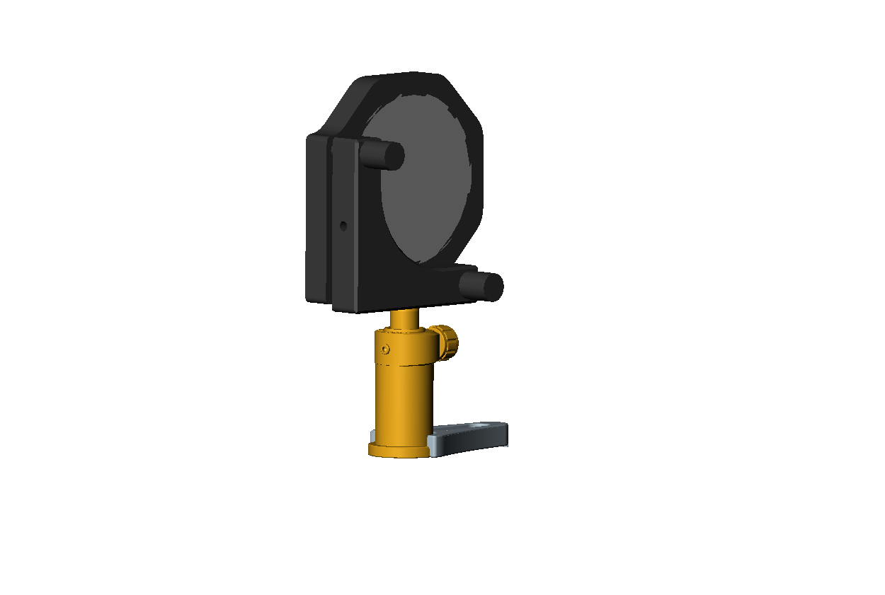
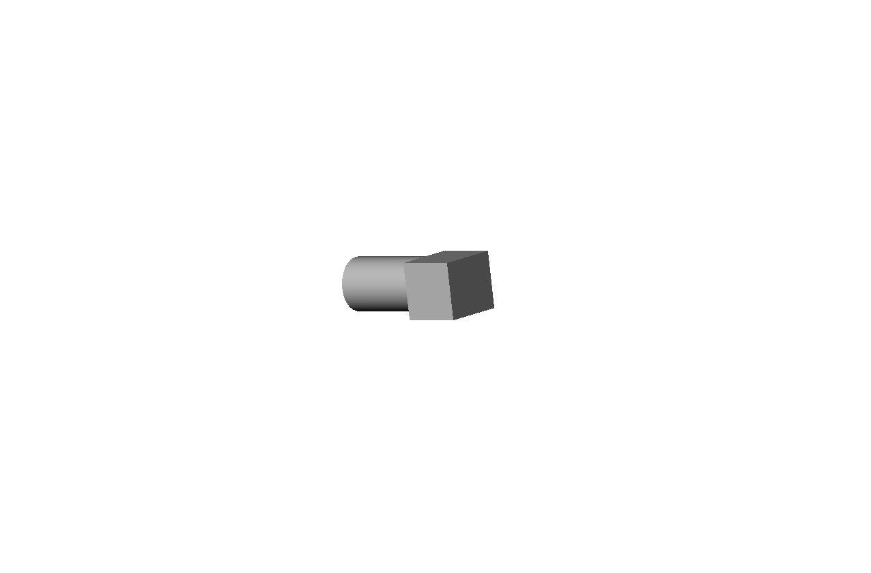
Simultaneous Flow and Wavefront Measurements in Mach 0.7 Cavity Flow
Laser sheet for PIV
Laser beam from
PhaseCam
Region common to
PhaseCam and PIV Camera
Wavefront sensor
(PhaseCam)
PhaseCam
lens
Cavity TE
Flow,
M = 0.7
PIV Camera
HTFA
Cavity LE
Kulite pressure
transducers,
0.5” apart
PhaseCam mirror
Simultaneous measurements of flow and wavefronts are made using pressure transducers, Particle Image Velocimetry (PIV) and a wavefront sensor that utilizes the principle of phase shifting intereferometry

Slide 6
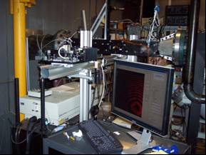

Slide 7
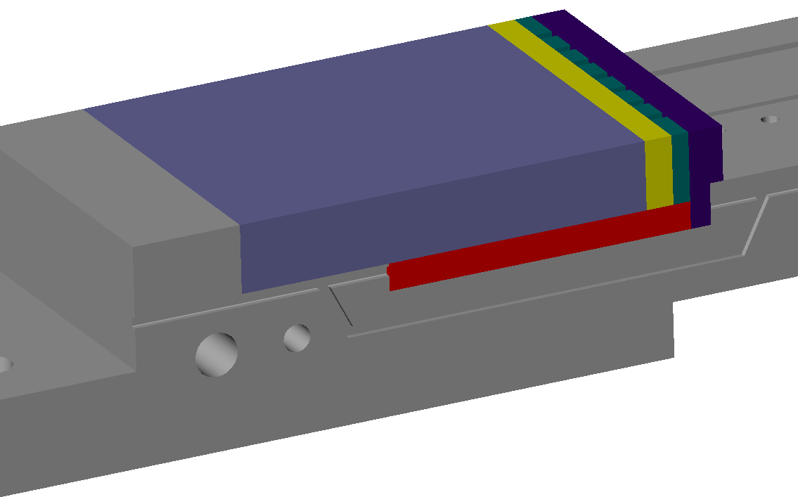
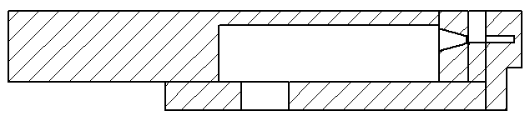
Flow Control implementation using Hartmann Tube Fluidic Actuator (HTFA)
Resonator Tube
Cavity LE
Nozzles
Cavity LE
Plenum
Exit for the pulsating jet
Plenum
Air Inlet
Spacer
Nozzles
Resonator
tube
Spacer
Sectional View
Perspective View
Two HTFA assemblies were used – one that delivers medium frequence forcing and other that delivers high frequency forcing.

Slide 8
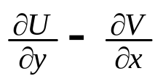
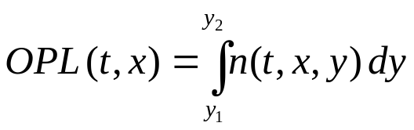








Definitions and Measured quantities
Pressure Field: Sound pressure level in dB
Flow Field: Streamwise velocity (U) in m/s
Vorticity (Ω) in 1/s, Ω =
Wavefront: RMS Wavefront variance in wavelengths
Optical Path Length (OPL):
In practice: Optical Path Difference (OPD):
Strehl’s ratio, =
Where, is max. light irradiance for aberrated system, and
is max. light irradiance without aberrations
and
is the RMS wavefront variance

Slide 9
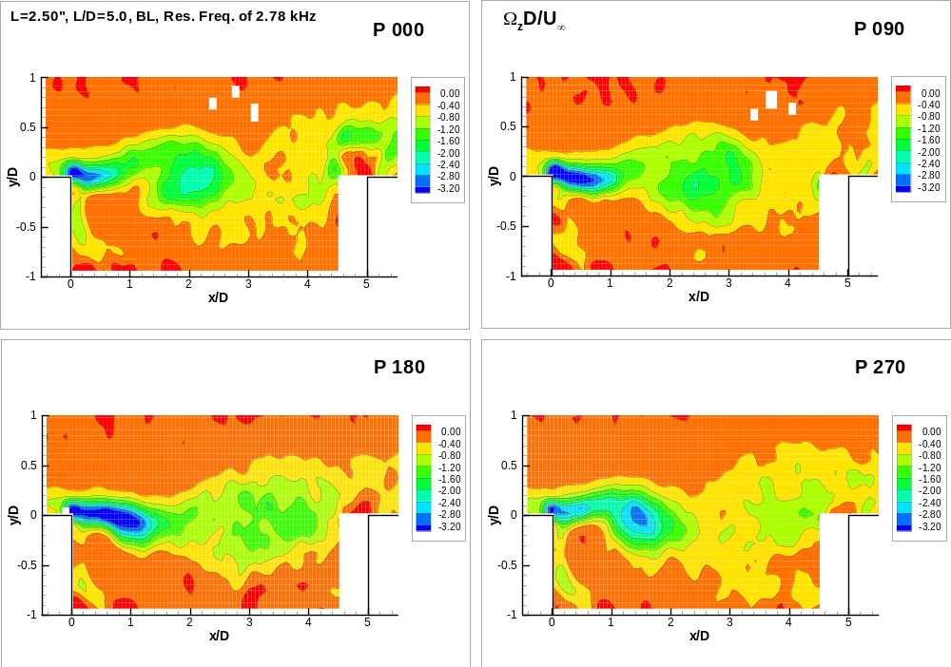
Results
Vorticity contour of roll-up of vortices during one cycle

Slide 10
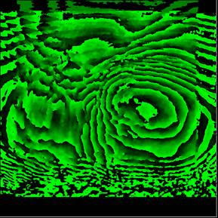
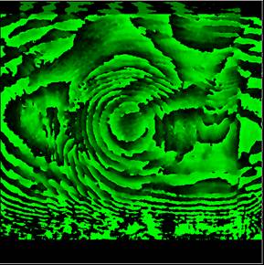
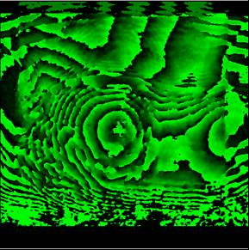
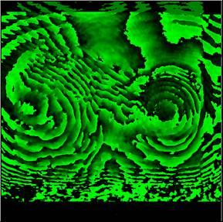
Results
Interferograms of roll-up of vortices during one cycle
0 deg
90 deg
180 deg
270 deg

Slide 11
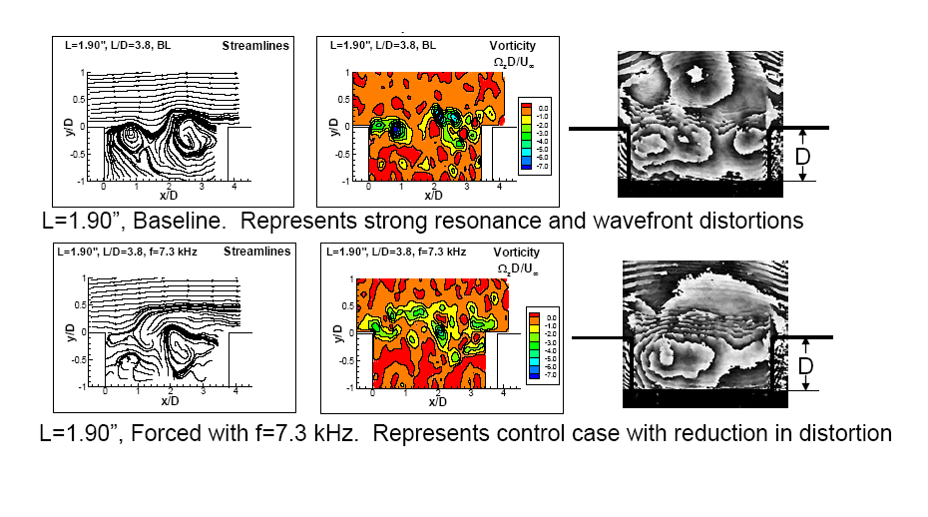
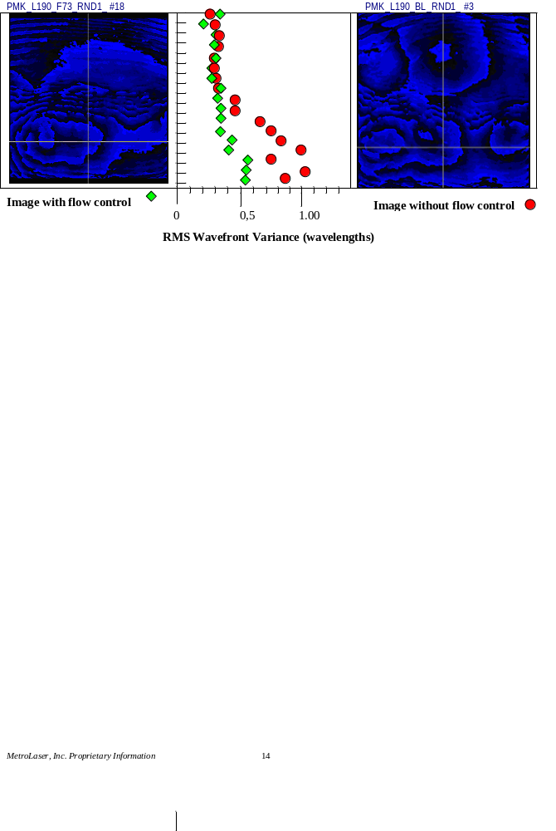
Results

Slide 12

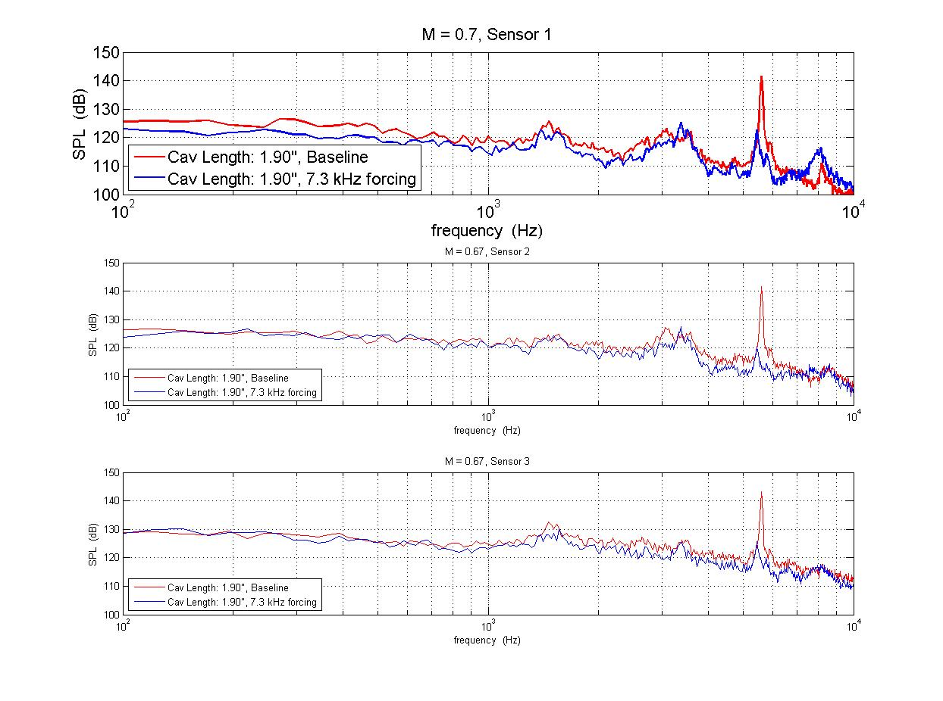
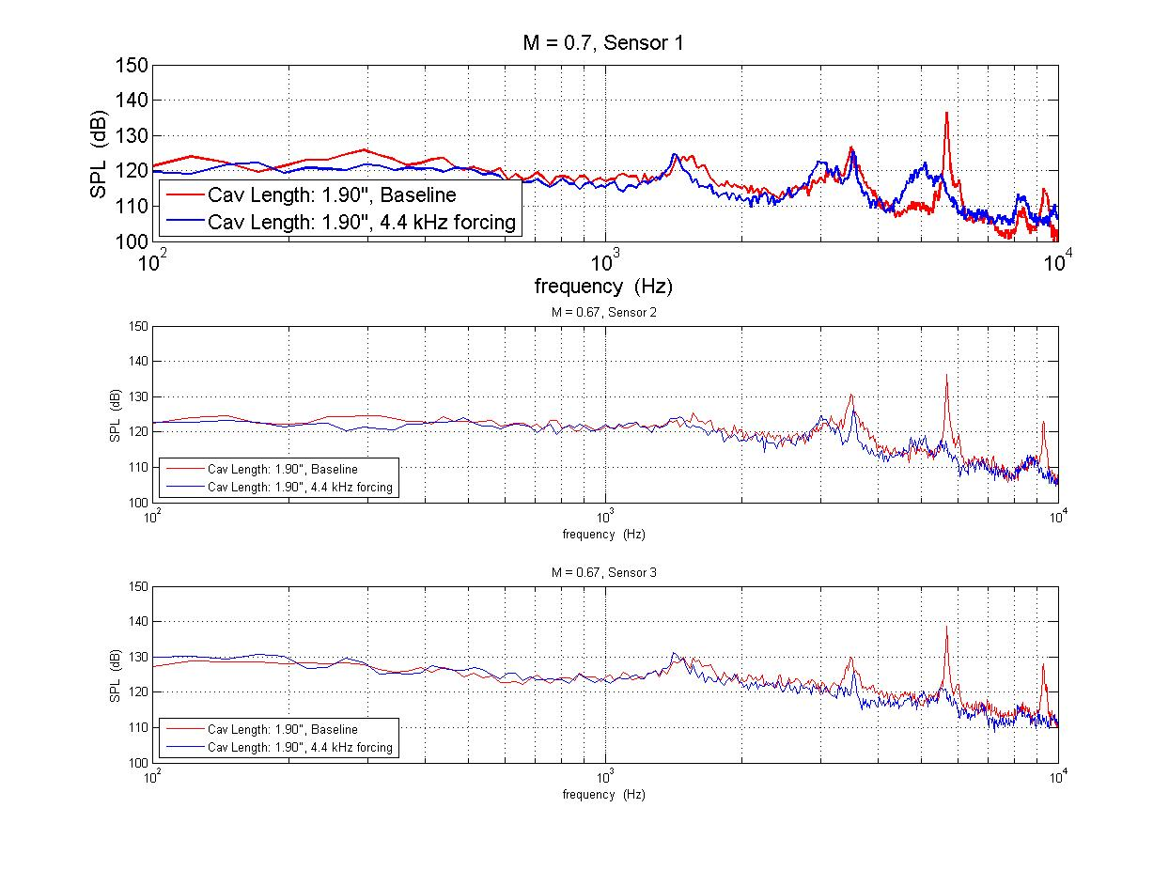
Wall Pressure Spectra - Effects of Flow Control
Mode: 5.59 kHz
Forcing leads to 18 dB
peak suppression
Strong Resonance Mode (L=1.90”): Baseline and Flow Control
Mode: 5.69 kHz
Forcing leads to 14 dB
peak suppression
Moderately Strong Resonance Mode (L=1.90”): Baseline and Flow Control

Slide 13
Conclusions
The ability to simultaneously measure flow structure and the resultant wavefront distortion has been achieved which is in itself a state of the art
Observations show a distinct correlation between the large scale structures and wavefront distortions
The effects of different forcing cases on various cavity resonant modes in high subsonic flows yields significantly less wavefront distortions.
The Hartmann Tube Fluidic Actuators have been shown to be successful in obtaining significant reduction in the cavity resonant tones
Efforts are ongoing towards further quantifying the relationship between the flow structure and the wavefront distortions

