Slide 1
CS 267 Applications of Parallel Computers
Lecture 10:
Sources of Parallelism and Locality
(Part 2)
David H. Bailey
based on previous lecture notes by Jim Demmel and Dave Culler
http://www.nersc.gov/~dhbailey/cs267

Slide 2
Recap of last lecture
Simulation models
A model problem: sharks and fish
Discrete event systems
Particle systems
Lumped systems - ordinary differential equations (ODEs)

Slide 3
Outline
Continuation of (ODEs)
Partial Differential Equations (PDEs)

Slide 4
Ordinary Differential Equations
ODEs

Slide 5
Solving ODEs
Explicit methods to compute solution(t)
  Example: Euler’s method.
  Simple algorithm: sparse matrix vector multiply.
  May need to take very small time steps, especially if system is stiff (i.e. can change rapidly).
Implicit methods to compute solution(t)
  Example: Backward Euler’s Method.
  Larger timesteps, especially for stiff problems.
  More difficult algorithm: solve a sparse linear system.
Computing modes of vibration
  Finding eigenvalues and eigenvectors.
  Example: do resonant modes of building match earthquakes?
All these reduce to sparse matrix problems
  Explicit: sparse matrix-vector multiplication.
  Implicit: solve a sparse linear system
    direct solvers (Gaussian elimination).
    iterative solvers (use sparse matrix-vector multiplication).
  Eigenvalue/vector algorithms may also be explicit or implicit.

Slide 6
Solving ODEs - Details
Assume ODE is x’(t) = f(x) = A*x, where A is a sparse matrix
  Try to compute x(i*dt) = x[i] at i=0,1,2,…
  Approximate x’(i*dt) by (x[i+1] - x[i] )/dt
Euler’s method:
  Approximate x’(t)=A*x by (x[i+1] - x[i] )/dt = A*x[i] and solve for x[i+1].
  x[i+1] = (I+dt*A)*x[i], i.e. sparse matrix-vector multiplication.
Backward Euler’s method:
  Approximate x’(t)=A*x by (x[i+1] - x[i] )/dt = A*x[i+1] and solve for x[i+1].
  (I - dt*A)*x[i+1] = x[i], i.e. we need to solve a sparse linear system of equations.
Modes of vibration
  Seek solution of x’’(t) = A*x of form x(t) = sin(f*t)*x0, where x0 is a constant vector.
  Plug in to get -f *x0 = A*x0, so that -f is an eigenvalue and x0 is an eigenvector of A.
  Solution schemes reduce either to sparse-matrix multiplication, or solving sparse linear systems.
2
2

Slide 7
Parallelism in Sparse Matrix-vector multiplication
y = A*x, where A is sparse and n x n
Questions
  which processors store
    y[i], x[i], and A[i,j]
  which processors compute
    y[i] = sum (from 1 to n) A[i,j] * x[j]
    = (row i of A) * x … a sparse dot product
Partitioning
  Partition index set {1,…,n} = N1 u N2 u … u Np.
  For all i in Nk, Processor k stores y[i], x[i], and row i of A
  For all i in Nk, Processor k computes y[i] = (row i of A) * x
    “owner computes” rule: Processor k compute the y[i]s it owns.
Goals of partitioning
  balance load (how is load measured?).
  balance storage (how much does each processor store?).
  minimize communication (how much is communicated?).

Slide 8
Graph Partitioning and Sparse Matrices
Relationship between matrix and graph
1 2 3 4 5 6
1 1 1 1
2 1 1 1 1
3 1 1 1
4 1 1 1 1
5 1 1 1 1
6 1 1 1 1
3
2
4
1
6
5
A “good” partition of the graph has
  equal (weighted) number of nodes in each part (load and storage balance).
  minimum number of edges crossing between (minimize communication).
Can reorder the rows/columns of the matrix by putting all the nodes in one partition together.

Slide 9
More on Matrix Reordering via Graph Partitioning
“Ideal” matrix structure for parallelism: (nearly) block diagonal
  p (number of processors) blocks.
  few non-zeros outside these blocks, since these require communication.
P0
P1
P2
P3
P4
=
*

Slide 10
What about implicit methods and eigenproblems?
Direct methods (Gaussian elimination)
  Called LU Decomposition, because we factor A = L*U.
  Future lectures will consider both dense and sparse cases.
  More complicated than sparse-matrix vector multiplication.
Iterative solvers
  Will discuss several of these in future.
    Jacobi, Successive overrelaxiation (SOR) , Conjugate Gradients (CG), Multigrid,...
  Most have sparse-matrix-vector multiplication in kernel.
Eigenproblems
  Future lectures will discuss dense and sparse cases.
  Also depend on sparse-matrix-vector multiplication, direct methods.
Graph partitioning
  Algorithms will be discussed in future lectures.

Slide 11
Partial Differential Equations
PDEs

Slide 12
Continuous Variables, Continuous Parameters
Examples of such systems include
Heat flow: Temperature(position, time)
Diffusion: Concentration(position, time)
Electrostatic or Gravitational Potential: Potential(position)
Fluid flow: Velocity,Pressure,Density(position,time)
Quantum mechanics: Wave-function(position,time)
Elasticity: Stress,Strain(position,time)

Slide 13
Example: Deriving the Heat Equation
0
x-h
x
x+h
1
Consider a simple problem
A bar of uniform material, insulated except at ends
Let u(x,t) be the temperature at position x at time t
Heat travels from x-h to x+h at rate proportional to:
d u(x,t) (u(x-h,t)-u(x,t))/h - (u(x,t)- u(x+h,t))/h
dt h
= C *
As h 0, we get the heat equation:
d u(x,t) d² u(x,t)
dt dx²
= C *

Slide 14
Explicit Solution of the Heat Equation
For simplicity, assume C=1
Discretize both time and position
Use finite differences with u[j,i] as the heat at
  time t= i*dt (i = 0,1,2,…) and position x = j*h (j=0,1,…,N=1/h)
  initial conditions on u[j,0]
  boundary conditions on u[0,i] and u[N,i]
At each timestep i = 0,1,2,...
This corresponds to
  matrix vector multiply (what is matrix?)
  nearest neighbors on grid
t=5
t=4
t=3
t=2
t=1
t=0
For j=0 to N
u[j,i+1]= z*u[j-1,i]+ (1-2*z)*u[j,i]+ z*u[j+1,i]
where z = dt/h²
u[0,0] u[1,0] u[2,0] u[3,0] u[4,0] u[5,0]

Slide 15
Parallelism in Explicit Method for PDEs
Partitioning the space (x) into p largest chunks
  good load balance (assuming large number of points relative to p)
  minimized communication (only p chunks)
Generalizes to
  multiple dimensions.
  arbitrary graphs (= sparse matrices).
Problem with explicit approach
  numerical instability.
  solution blows up eventually if z = dt/h > .5
  need to make the time steps very small when h is small: dt < .5*h
2
2

Slide 16
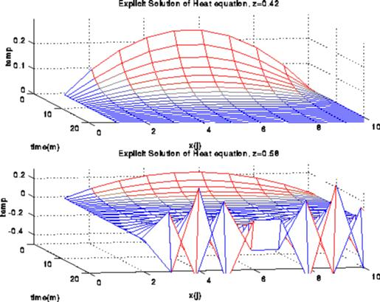
Instability in solving the heat equation explicitly

Slide 17
Implicit Solution
As with many (stiff) ODEs, we need to use an implicit method.
This turns into solving the following equation:
Here I is the identity matrix and T is:
I.e., essentially solving Poisson’s equation in 1D
(I + (z/2)*T) * u[:,i+1]= (I - (z/2)*T) *u[:,i]
2 -1
-1 2 -1
-1 2 -1
-1 2 -1
-1 2
Graph and “stencil”
T =
-1
2
-1

Slide 18
2D Implicit Method
Similar to the 1D case, but the matrix T is now
Multiplying by this matrix (as in the explicit case) is simply nearest neighbor computation on 2D grid.
To solve this system, there are several techniques.
Graph and “stencil”
4 -1 -1
-1 4 -1 -1
-1 4 -1
-1 4 -1 -1
-1 -1 4 -1 -1
-1 -1 4 -1
-1 4 -1
-1 -1 4 -1
-1 -1 4
-1
-1
4
-1
T =
-1

Slide 19
Algorithms for 2D Poisson Equation with N unknowns
Algorithm Serial PRAM Memory #Procs
Dense LU N³ N N² N²
Band LU N² N N^{3/2} N
Jacobi N² N N N
Explicit Inv. N log N N N
Conj.Grad. N ^{3/2} N ^{1/2} *log N N N
RB SOR N ^{3/2} N ^{1/2} N N
Sparse LU N ^{3/2} N ^{1/2} N*log N N
FFT N*log N log N N N
Multigrid N log² N N N
Lower bound N log N N
PRAM is an idealized parallel model with zero cost communication
(see next slide for explanation)
2
2
2

Slide 20
Short explanations of algorithms on previous slide
Sorted in two orders (roughly):
  from slowest to fastest on sequential machines.
  from most general (works on any matrix) to most specialized (works on matrices “like” T).
Dense LU: Gaussian elimination; works on any N-by-N matrix.
Band LU: Exploits the fact that T is nonzero only on sqrt(N) diagonals nearest main diagonal.
Jacobi: Essentially does matrix-vector multiply by T in inner loop of iterative algorithm.
Explicit Inverse: Assume we want to solve many systems with T, so we can precompute and store inv(T) “for free”, and just multiply by it (but still expensive).
Conjugate Gradient: Uses matrix-vector multiplication, like Jacobi, but exploits mathematical properties of T that Jacobi does not.
Red-Black SOR (successive over-relaxation): Variation of Jacobi that exploits yet different mathematical properties of T. Used in multigrid schemes.
LU: Gaussian elimination exploiting particular zero structure of T.
FFT (fast Fourier transform): Works only on matrices very like T.
Multigrid: Also works on matrices like T, that come from elliptic PDEs.
Lower Bound: Serial (time to print answer); parallel (time to combine N inputs).
Details in class notes and www.cs.berkeley.edu/~demmel/ma221.

Slide 21
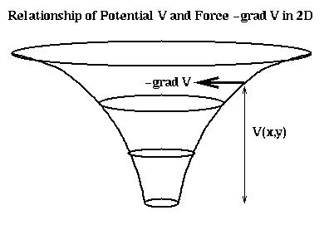
Relation of Poisson’s Equation to Gravity, Electrostatics
Force on particle at (x,y,z) due to particle at 0 is
-(x,y,z)/r^3, where r = sqrt(x +y +z )
Force is also gradient of potential V = -1/r
= -(d/dx V, d/dy V, d/dz V) = -grad V
V satisfies Poisson’s equation (try it!)
2
2
2

Slide 22
Comments on practical meshes
Regular 1D, 2D, 3D meshes
  Important as building blocks for more complicated meshes.
Practical meshes are often irregular
  Composite meshes, consisting of multiple “bent” regular meshes joined at edges.
  Unstructured meshes, with arbitrary mesh points and connectivity.
  Adaptive meshes, which change resolution during solution process to put computational effort where needed.

Slide 23
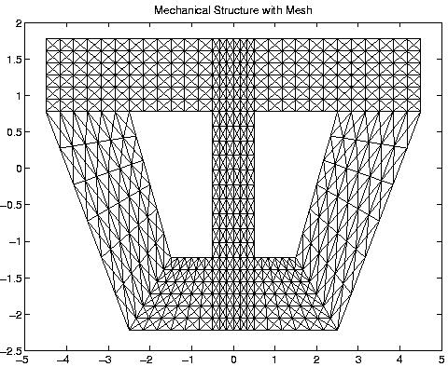
Composite mesh from a mechanical structure

Slide 24
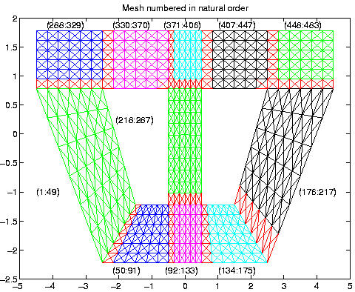
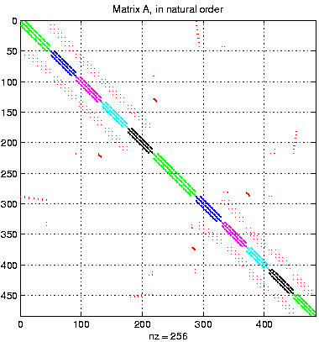
Converting the mesh to a matrix

Slide 25
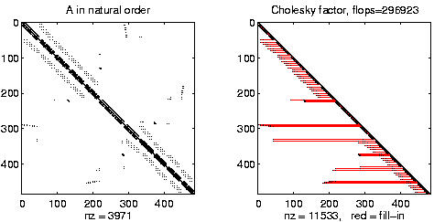
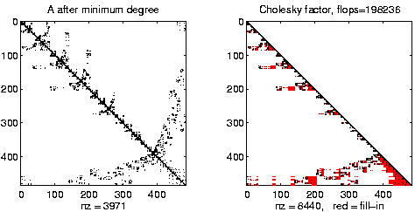
Effects of Ordering Rows and Columns on Gaussian Elimination

Slide 26
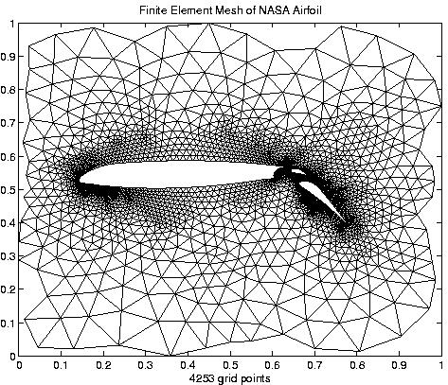
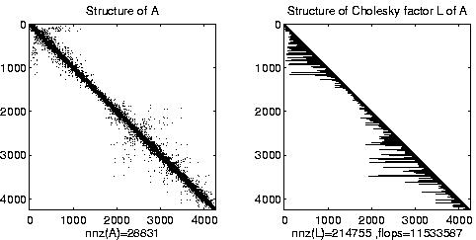
Irregular mesh: NASA Airfoil in 2D (direct solution)

Slide 27
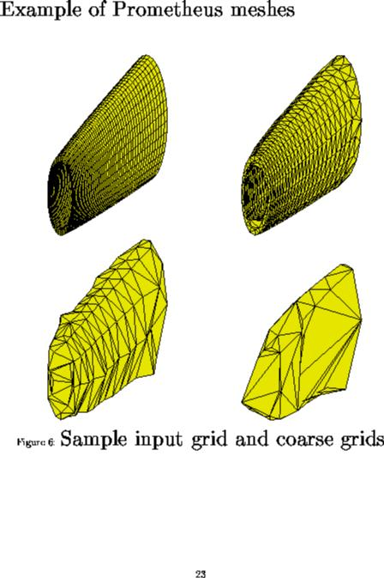
Irregular mesh: Tapered Tube (multigrid)

Slide 28
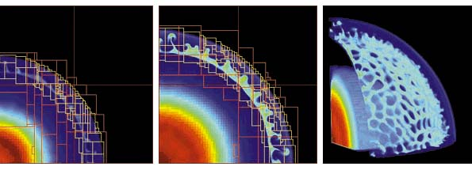
Adaptive Mesh Refinement (AMR)
Adaptive mesh around an explosion.
John Bell and Phil Colella at LBL/NERSC.
Goal of Titanium is to make these algorithms easier to implement
  in parallel.

Slide 29
Challenges of irregular meshes (and a few solutions)
How to generate them in the first place:
  Triangle, a 2D mesh partitioner by Jonathan Shewchuk.
How to partition them:
  ParMetis, a parallel graph partitioner.
How to design iterative solvers:
  PETSc, a Portable Extensible Toolkit for Scientific Computing.
  Prometheus, a multigrid solver for finite element problems on irregular meshes.
  Titanium, a language to implement Adaptive Mesh Refinement.
How to design direct solvers:
  SuperLU, parallel sparse Gaussian elimination.
These are challenges to do sequentially, the more so in parallel.

