Slide 1
Fastened Joint Analysis and Test Correlation of the MLA Beam Expander
Craig L. Stevens
Craig.Stevens@nasa.gov
Mechanical Systems Analysis & Simulation Branch
NASA Goddard Space Flight Center
Greenbelt, Maryland
FEMCI Workshop Presentation
May 6, 2004

Slide 2
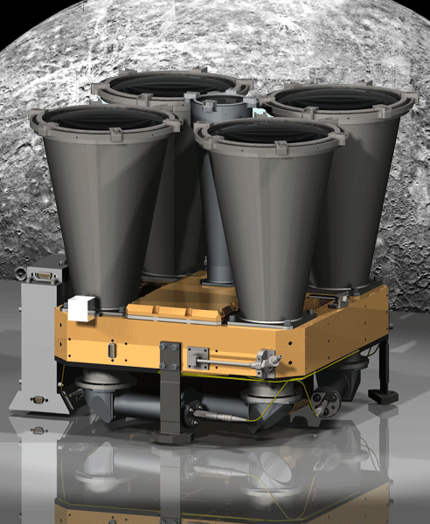
Overview
Introduction
Problem Description
Pre-Test Analysis
Test Results
Model Correlation
Conclusions

Slide 3
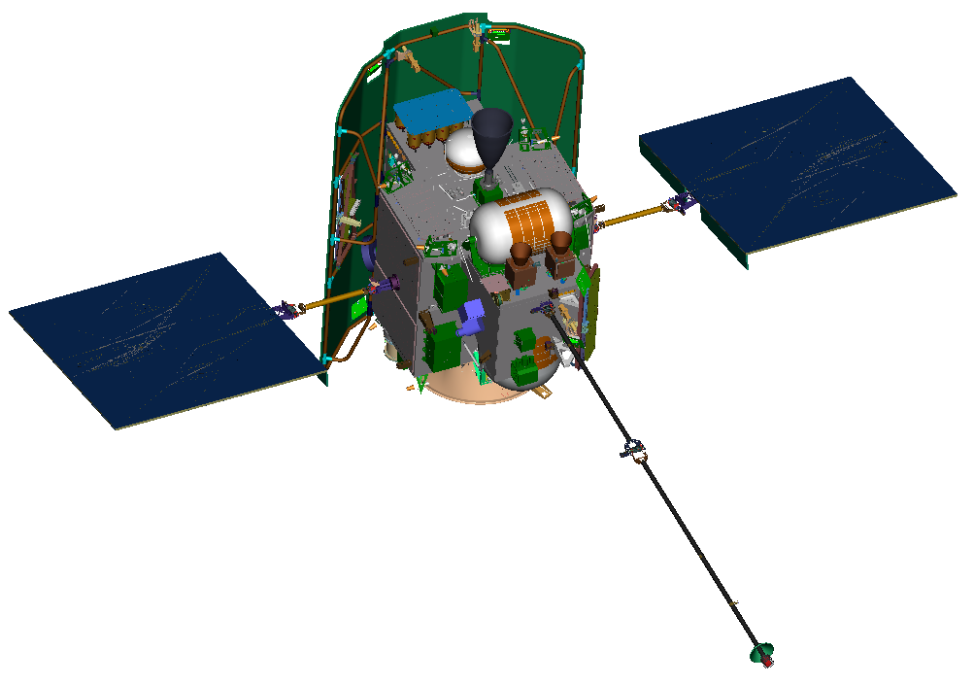
Introduction
Mercury Laser Altimeter (MLA) on Mercury Surface, Space Environment, Geochemistry, and Ranging (MESSENGER) spacecraft
MLA produces accurate measurements of topography and measures Mercury's wobble (due to the planet's libration)
MESSENGER Objectives:
  Determine the structure of Mercury’s mantle and crust
  Investigate Mercury's polar caps
  Determine the state of Mercury’s core (fluid or solid?)
MESSENGER developed by Johns Hopkins University Applied Physics Laboratory (APL)
MLA developed by NASA Goddard Space Flight Center (Delivered to APL June 2003)
Launch
  August 2004
  Delta II 2925H-9-5

Slide 4
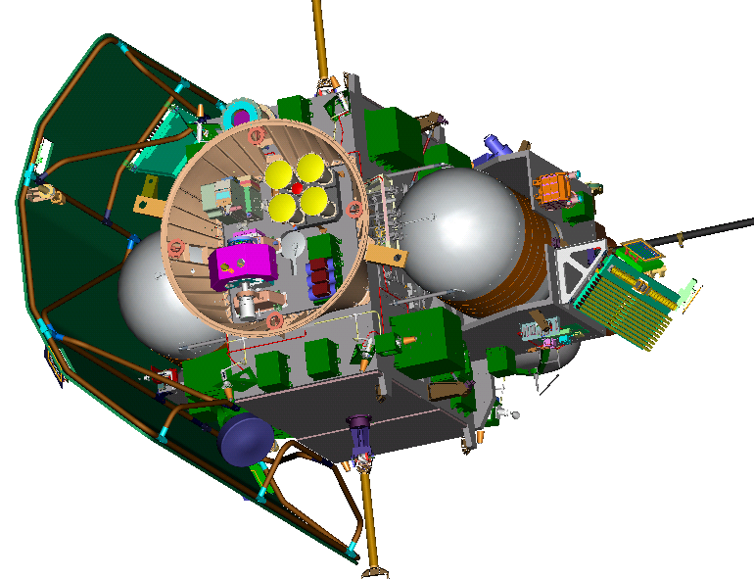
MESSENGER Configuration
Introduction
MLA
Gamma-Ray Spectrometer
Plasma Spectrometer
Neutron Spectrometer
Energetic Particles Spectrometer
Atmospheric and Surface Spectrometer
Dual Imager on Pivot Platform
X-Ray Spectrometer

Slide 5
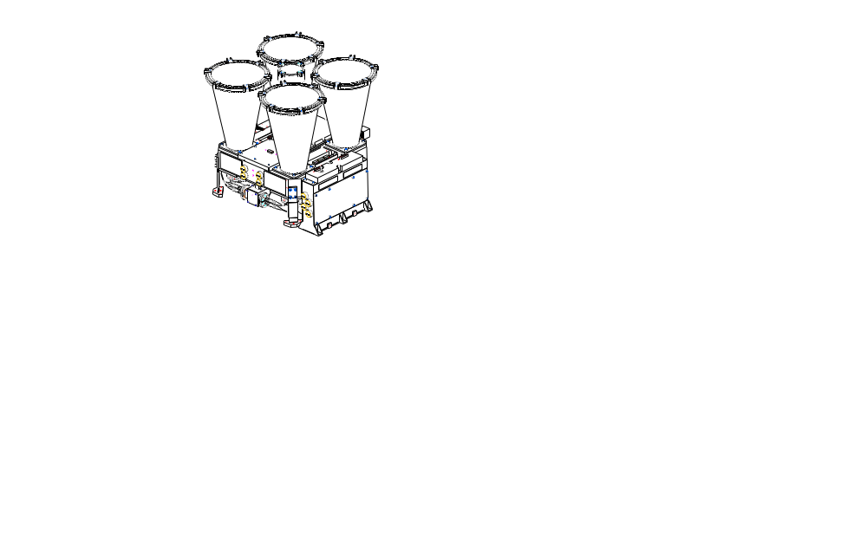
Introduction
MLA Configuration
Z
Receiver tubes [4] (Be)
Laser beam expander (Be)
Laser bench (Be)
Main housing (Be)
Mounting flexures [3] (Ti)
Aft optics (Be)
Power Converter Assy. Housing (Mg)
Y
X

Slide 6
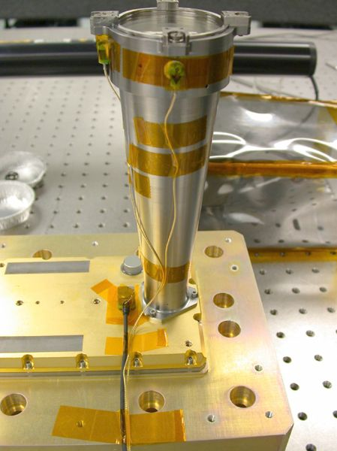
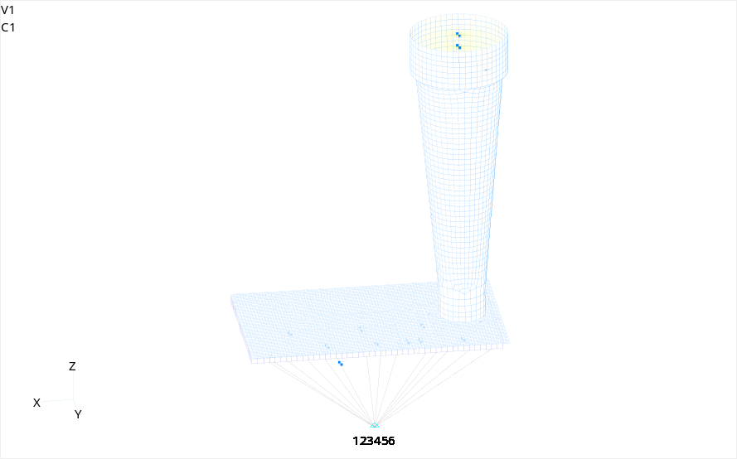
Problem Description
Flight laser bench with attached beam expander
Three point mount: #2-56 fasteners
Beam expander: mass ~0.4 lbm, height ~6.5”
MLA laser workmanship level vibration test/analysis
Low level: 0.04 G2/Hz, 6.8 GRMS
Task:
Pre Test Analysis: Predict natural frequencies and loads
Correlate FEM with test data
Investigate test anomalies and determine cause
FEM:
  CQUAD4 model
  Fixed Base
80002
80001
80003

Slide 7
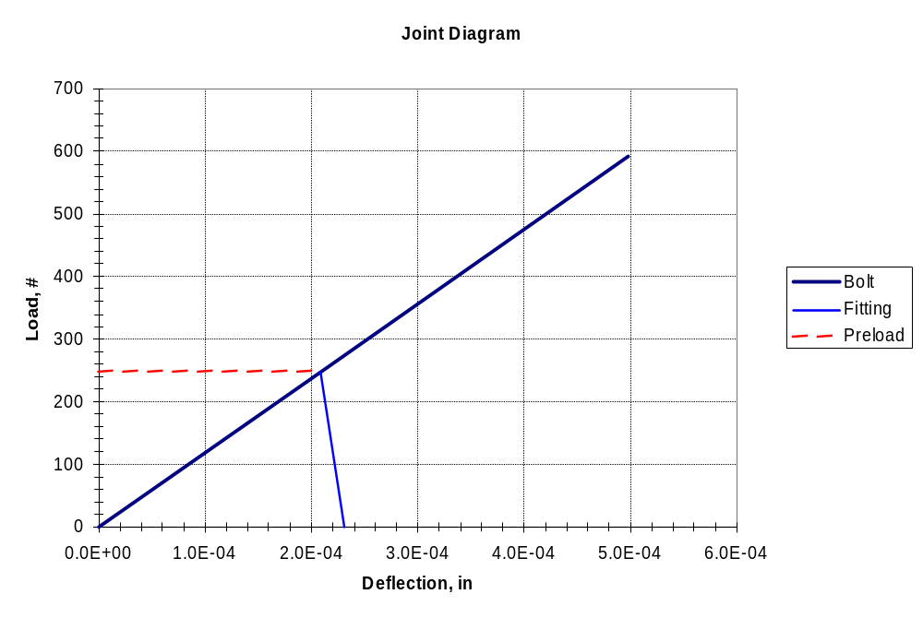
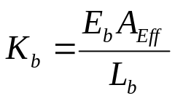
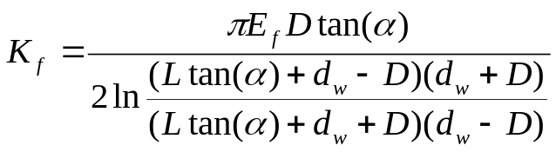
Pre-Test Analysis
Initial joint stiffness estimated using tension joint theory
Bolt:
Fitting:
where,
E_{b} = Bolt Young’s modulus
A_{eff} = Bolt effective area
L_{b} = Grip
E_{f} = Fitting Young’s modulus
D = Bolt diameter
L = Clamped fitting thickness
d_{w} = Washer diameter
α = Apex angle (assume 30º)
Bolt carries 10% of applied load
K_{b}= 1.2E+6 #/in
Preload = 250#
K_{f}=1.1E+7#/in
d_{w}
0.1” thick flange
L
L_{b}
0.5” thick bench
#2-56 Fastener
D

Slide 8
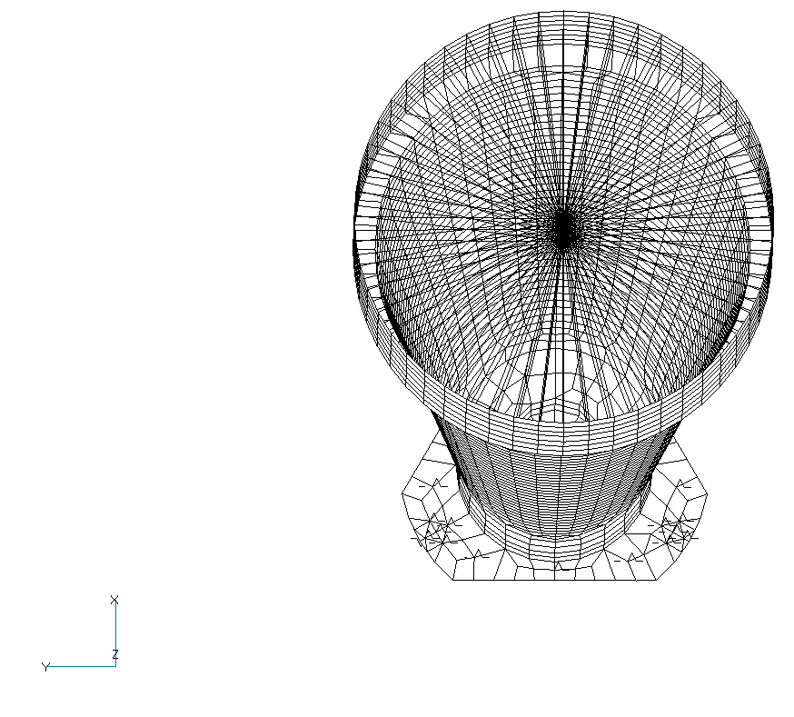
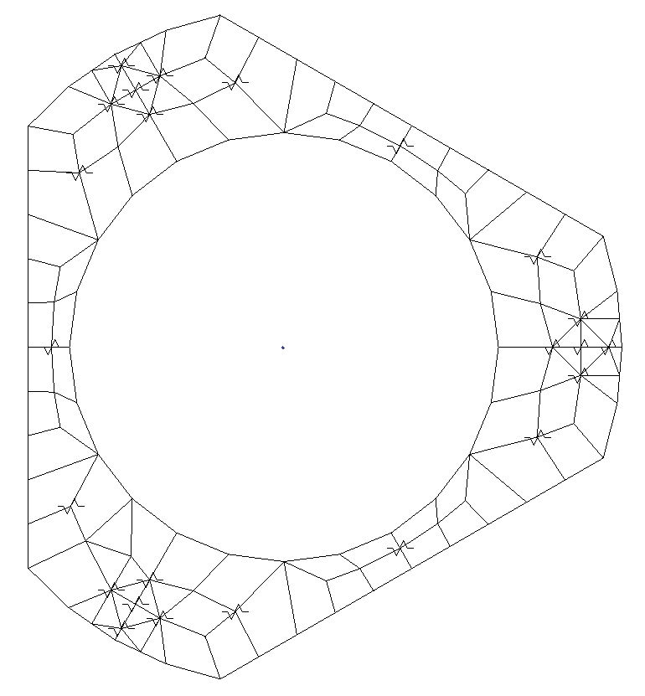
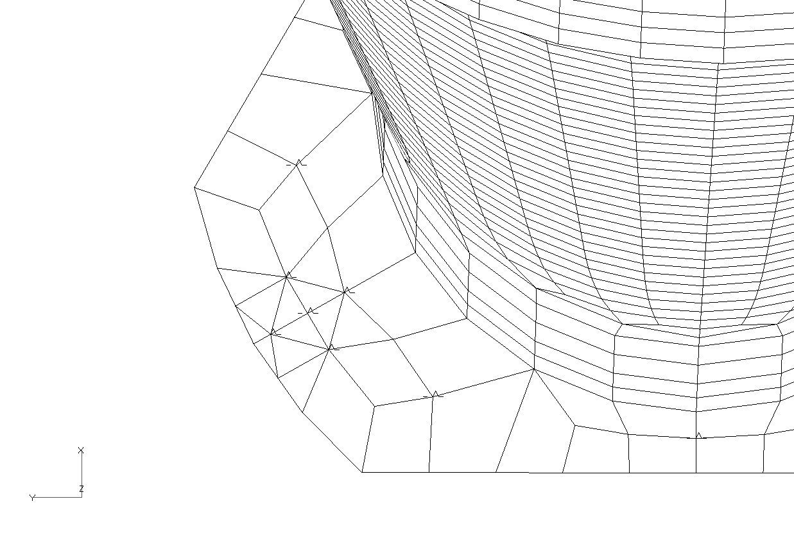
Pre-Test Analysis
Use Springs (CELAS) to model joint stiffness:
Fitting stiffness = K_{f}/4 (9)
Bolt stiffness = K_{b} (3)
Normal constraints (center flange) = K_{NC} (3)
Normal constraints (near bolt) = K_{NCb} (6)
Normal constraint locations chosen based on aluminum engineering model test data
Value of K_{NC} and K_{NCb} chosen based on aluminum engineering model test data and fitting stiffness
  Same order of magnitude as fitting stiffness
  1E+7 #/in
X and Y shear forces reacted through bolts using RBE2
2
Y
X
1
3

Slide 9
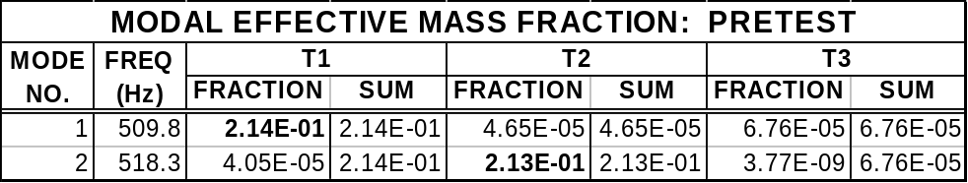
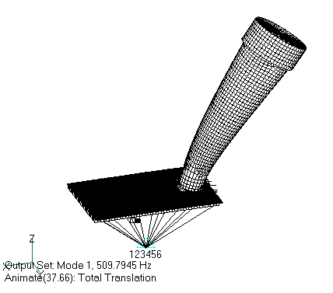
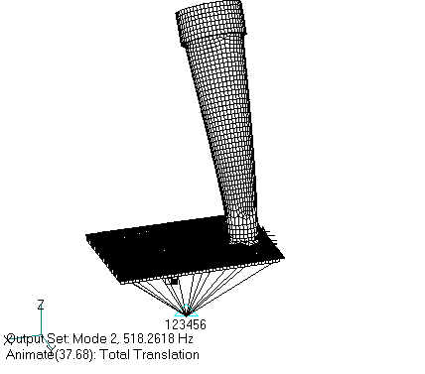
Pre-Test Analysis
Normal modes analysis:

Slide 10
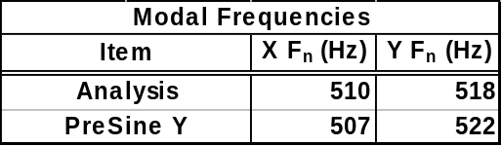
Test Results
Z-axis:
Test performed with no issues (no major modes)
Y-Axis:
Sine Signature Y
10²
Y-Axis Pre Sine FRF
Y-Axis Pre Sine FRF
10²
10¹
10¹
10⁰
H₁₂(f)
H₂₂(f)
10⁰
10⁻¹
10⁻²
10⁻¹
10⁻³
200
400
600
800
1000
1200
1400
1600
1800
2000
10⁻²
200
400
600
800
1000
1200
1400
1600
1800
2000
Frequency, Hz
Frequency, Hz

Slide 11
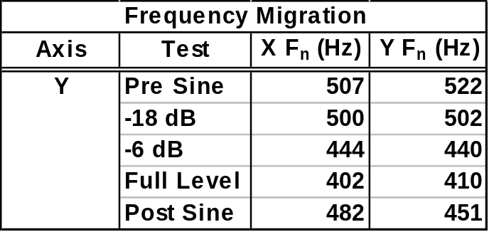
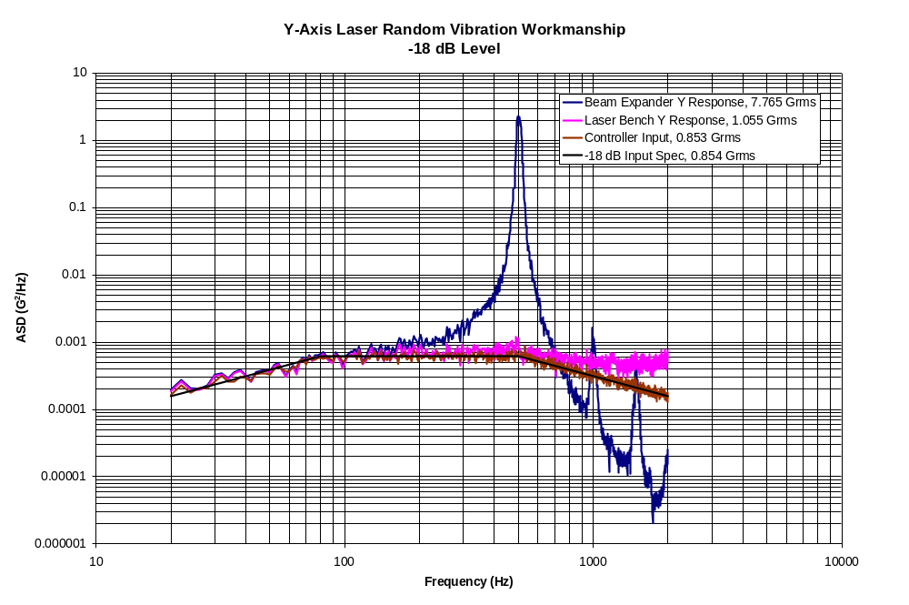
Test Results
Y-axis (cont’):
Frequency shift as random vibration levels increased:
Harmonics observed in random beam expander responses
  Integer multiples of resonant frequency
  Indicates nonlinear response
  Not present in sine runs

Slide 12
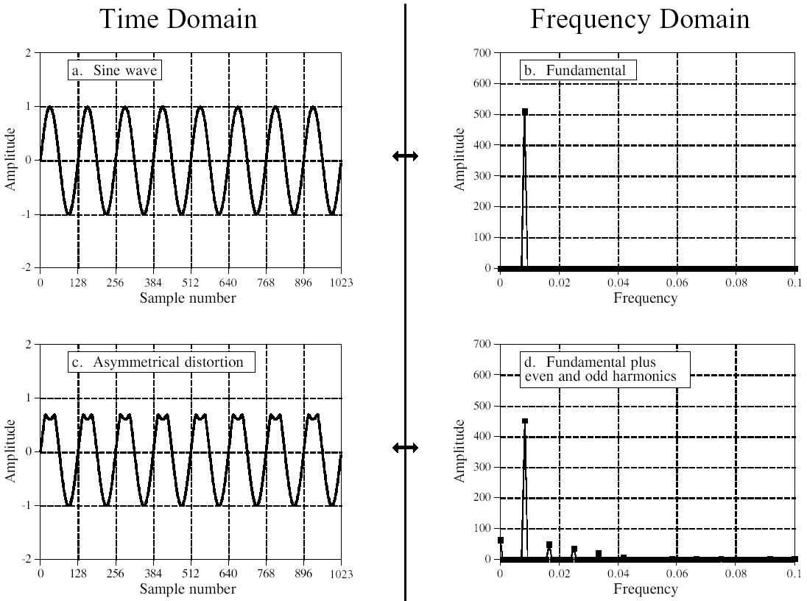
Test Results
Why do harmonics of resonant frequency exist?:
Asymmetrical distortion of sine wave
Several reasons:
Contact
Boundary Condition

Slide 13
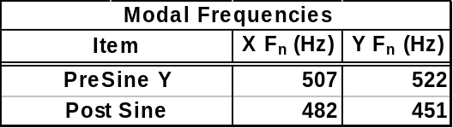
Test Results
Frequency shifts observed in pre and post sine sweeps
Modal frequencies drop over 10%
X and Y modes switch order
Y-Axis Sine FRF
Y-Axis Sine FRF
10²
10²
Pre Sine Y
Pre Sine Y
Post Sine Y
Post Sine Y
10¹
10¹
10⁰
H₁₂(f)
H₂₂(f)
10⁰
10⁻¹
10⁻²
10⁻¹
10⁻³
10⁻⁴
200
400
600
800
1000
1200
1400
1600
1800
2000
10⁻²
200
400
600
800
1000
1200
1400
1600
1800
2000
Frequency, Hz
Frequency, Hz

Slide 14
Model Correlation
Use MSC NASTRAN Solution 200 to correlate model and investigate frequency shift
Assume linear modes and mode shapes
Vary CELAS stiffnesses to investigate preload loss
Key cards:
  MODTRAK: Performs cross orthagonality check to ensure proper modes meet constraints
  DEQATN: Create Least squares objective function formulation
For Post Sine Y correlation:
W₁ = 1.0
W₂ = 1.0
f_{n2act} = 451 Hz (Y Mode)
f_{n1act} = 482 Hz (X Mode)
2
Y
X
1
3

Slide 15
Model Correlation
Results:
$ UPDATED DESIGN MODEL DATA ENTRIES
$
DESVAR * 1NCS 7.72887313E+05 1.00000000E+04+D 1V
*D 1V 1.00000000E+10
DESVAR * 2KB1 1.19993400E+06 1.00000000E+04+D 2V
*D 2V 1.00000000E+10
DESVAR * 3KF1 9.05991600E+05 1.00000000E+04+D 3V
*D 3V 1.00000000E+10
DESVAR * 4KB2 1.19993800E+06 1.00000000E+04+D 4V
*D 4V 1.00000000E+10
DESVAR * 5KF2 3.37498700E+06 1.00000000E+04+D 5V
*D 5V 1.00000000E+10
DESVAR * 6KB3 1.19594200E+06 1.00000000E+04+D 6V
*D 6V 1.00000000E+10
DESVAR * 7KF3 1.45899362E+05 1.00000000E+04+D 7V
*D 7V 1.00000000E+10
DESVAR * 8NCB1 8.14678800E+06 1.00000000E+04+D 8V
*D 8V 1.00000000E+10
DESVAR * 9NCB2 4.54948100E+06 1.00000000E+04+D 9V
*D 9V 1.00000000E+10
DESVAR * 10NCB3 1.00000000E+04 1.00000000E+04+D 10V
*D 10V 1.00000000E+10
$ MODE TRACKING HAS BEEN PERFORMED SUCCESSFULLY WITH SOME CHANGE IN THE MODE ORDER.
$ ALL THE DRESP1 ENTRIES ASSOCIATED WITH MODE TRACKING ARE WRITTEN HERE FOR CONVENIENCE.
$
DRESP1 101FN1 FREQ 2
DRESP1 102FN2 FREQ 1

Slide 16
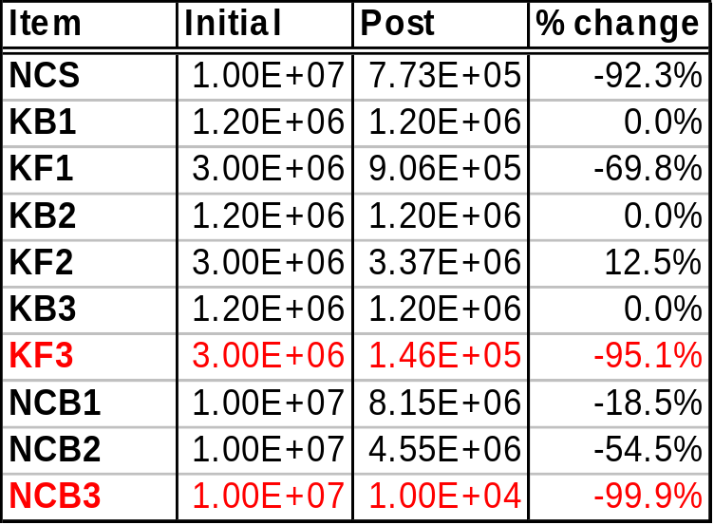
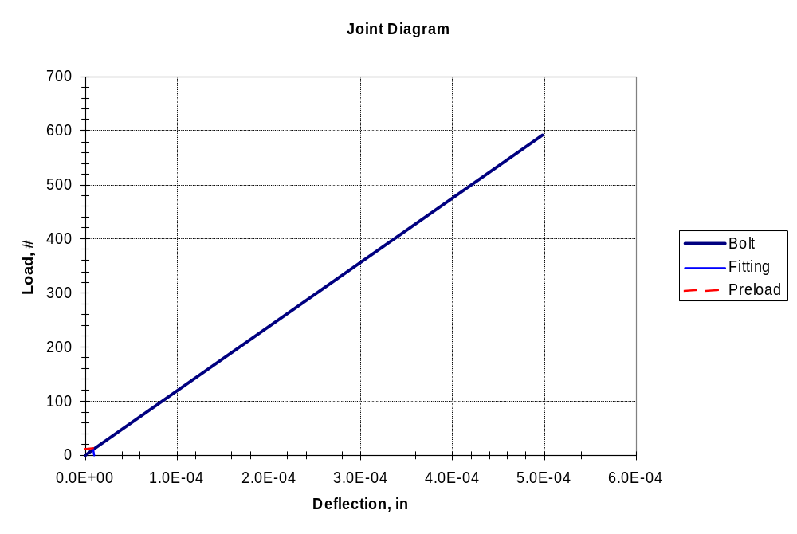
Model Correlation
2
Results (Cont’):
Over 90 % stiffness loss in fastener 3 (or 2)
Preload ~0
Results from post test investigation verified no structural failure and no other significant source for frequency shift
Y
X
1
3

Slide 17
Conclusions
Presence of harmonics in broadband responses indicative of nonlinearities in test data
Optimizer is quick and efficient method to correlate modes and mode shapes of models
Over 90% stiffness loss in fastener 2 or 3
Results indicate preload loss is the probable cause of frequency shift
References
Joseph Shigley. Mechanical Engineering Design. Fifth Edition. McGraw-Hill, Inc. New York. 1989
Thomas Sarafin. Design and Analysis of Fastened Joints for Aerospace Engineers. Course Notes. Instar Engineering and Consulting, Inc. 2001.
John H. Bickford. Handbook of Bolts and Bolted Joints. Marcel Dekker, Inc. New York
Ryan Simmons. MLA Laser Subassembly Workmanship Vibration Post-Test Report. NASA GSFC, Greenbelt, Maryland, 2003. MLA-RPT-000127
Steven W. Smith. The Scientist and Engineer’s Guide to Digital Signal Processing, 2nd Edition. California Technical Publishing, San Diego, California, 1999.
Scott Gordon. Private Correspondence. NASA GSFC, Greenbelt, Maryland.
Daniel Kaufman. Private Correspondence. NASA GSFC, Greenbelt, Maryland.

