Slide 1
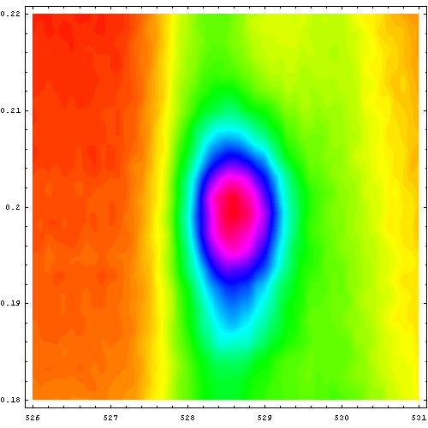
Crystallization of holes in the spin ladder of Sr₁₄Cu₂₄O₄₁
Peter Abbamonte
Brookhaven National Laboratory / SUNY Stony Brook
Collaborators:
Andrivo Rusydi, Brookhaven and U. Groningen
Girsh Blumberg, Bell Laboratories
Adrian Gozar, U. Illinois and Bell Labs
Paul Evans, University of Wisconsin
Theo Siegrist, Bell Laboratories
Luc Venema, U. Groningen
Hiroshi Eisaki, AIST, Tsukuba, Japan
Eric Isaacs, Argonne National Laboratory
George Sawatzky, University of British Columbia
Acknowledgements to:
Ian Affleck, Brad Marston, Maurice Rice, Alexei Tsvelik, John Tranquada, Young-June Kim, John Grazul, Shu Cheung
Funding: DOE, NSF, NWO (Dutch Science Foundation)
(to appear in Nov. 4 issue of Nature)

Slide 2
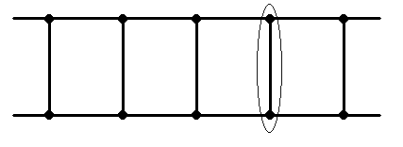
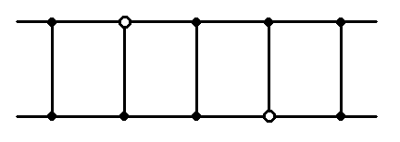
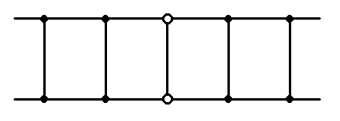
Spin ladders
E. Dagotto, J. Riera, and D. Scalapino, Phys. Rev. B, 45, 5744 (1992)
E. Dagotto and T. M. Rice, Science, 271, 618 (1996)
t||, J||
Spin liquid (exponential decay in correlation)
Singlets across the rungs
t, J
J >> J||
Doped hole breaks a singlet (costs ~J)
Holes bind into pairs
Superconductivity without phonons,
Δ ~ d_{x2-y2} [M. Sigrist, PRB, 49, 12058 (1994)]

Slide 3
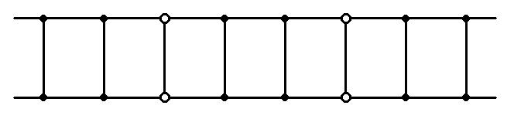
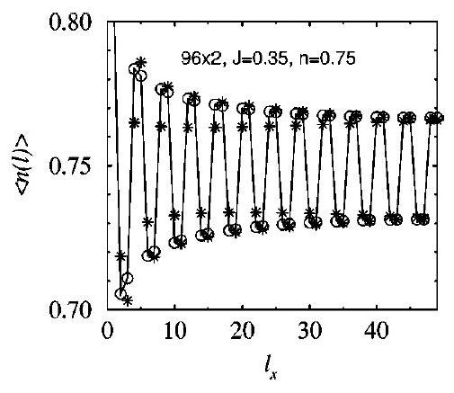
Spin ladders
E. Dagotto, J. Riera, and D. Scalapino, Phys. Rev. B, 45, 5744 (1992)
S. White, I. Affleck, and D. Scalapino, Phys. Rev. B, 65, 165122 (2002)
S. Carr, A. Tsvelik, Phys. Rev. B, 65, 195121 (2002)
Superconductivity not automatic – models also reveal a “charge density wave”
x rational ⇒ holes “crystallize” into a CDW
x irrational ⇒ power law correlations 1/|n-n′|^{K+ρ}. Friedel oscillations easily induced.
Reminiscent of ordered stripes vs. SC in perovskite cuprates
Not high T_{c}, but worthy of study in its own right

Slide 4
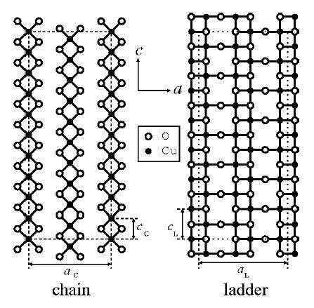
Sr_{14-x}Ca_{x}Cu₂₄O₄₁
incommensurate and internally strained
Sr²⁺ , O^{2–} ⇒ Cu^{2.25+} isoelectronic to perovskite cuprates
6 holes / formula unit
ladder has larger electronegativity: 5.2 holes on chain, 0.8 holes on ladder ¹
δ_{chain} = 0.52 , δ_{ladder} = 0.057
CuO₂ Cu₂O₃
¹Osafune, PRL, 78, 1980 (1997); Nücker, PRB, 62, 14384 (2000)

Slide 5
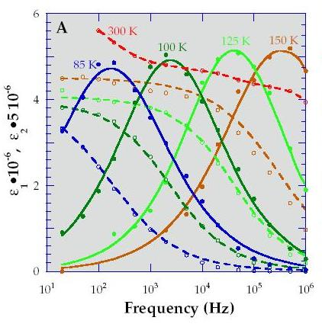
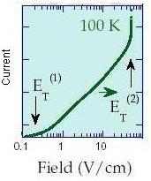
Sr_{14-x}Ca_{x}Cu₂₄O₄₁
x = 13.6 ⇒ superconductivity T_{c} = 12 K at P = 3 GPa ²
x = 0 ⇒ insulating with a CDW ³
m* ~ 50 (10³ – 10⁴ more typical) ⁴
Exhibits characteristics of both phases predicted by Dagotto (1992)
²Uehara, J. Phys. Soc. Jap., 65, 2764 (1996)
³Blumberg, Science, 297, 584 (2002); Gorshunov, PRB, 66, 60508 (2002)
⁴Vuletić, PRL, 90, 257002 (2003)

Slide 6
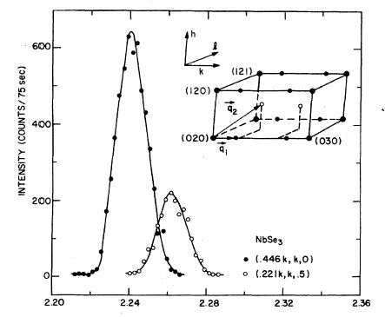
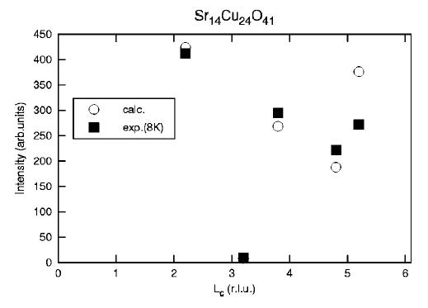
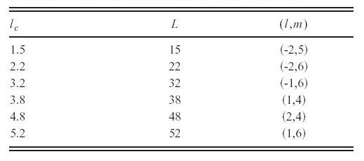
Study with x-ray scattering?
R. M. Fleming, D. E. Moncton, and D. B. McWhan, Phys. Rev. B, 18, 5560 (1978)
modulation wavelength (commensurate?)
coherence length
form factor (sinusoidal?)
Δ(T) (mean field or no?)
NbSe₃
S. van Smaalen, PRB, 67, 26101 (2003)
T. Fukuda, PRB, 66, 12104 (2002)
[refinement of study by D. E. Cox, PRB, 57, 10750 (1998)]
Conclusion: no obvious evidence for a structural CDW in Sr₁₄Cu₂₄O₄₁

Slide 7
Two types of CDWs
Wigner crystal
[E. Wigner, Phys. Rev., 46, 1002 (1934)]
Peierls CDW
Examples
Mechanism
Effective mass
Charge modulation
Cross section
Bottom line
NbSe₃, K_{0.3}MoO₃
H_{ep}
~ 10³ – 10⁴
~ Z = 10¹ – 10²
~ Z² ~ 10² – 10⁴
Easy to measure
⁴He surface, 2DEG, (Mott state!)
Coulomb
???
~ 10⁻² (White et. al.)
~ 10⁻⁴
Hard to measure
Scattering from Wigner crystal nominally weaker by ~ 10⁻⁷
CDW predicted by Dagotto et. al. is Wigner, not Peierls (viz. “hole crystal”)
Could a hole crystal be responsible for the transport properties of Sr₁₄Cu₂₄O₄₁?

Slide 8
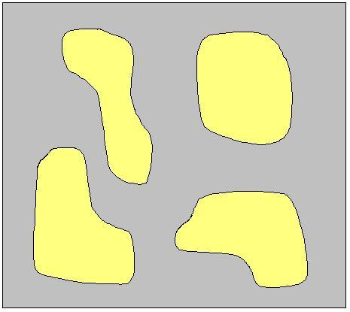
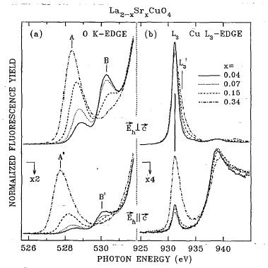

Resonant soft x-ray scattering
P. Abbamonte, L. Venema, A. Rusydi, G. A. Sawatzky, G. Logvenov, and I. Bozovic, Science, 297, 581 (2002)
χ₁
χ₁
χ₂
μ (cm⁻¹)
χ₁
χ₁
C. T. Chen, et. al., PRL, 66, 104 (1991)
I_{normal} ~ | ρ(q) |²
I_{RSXS} ~ | ρ(q) + α n(q) |² n_{i} = Σ_{σ} c†_{iσ} c_{iσ} – 1 α ~ 10²

Slide 9
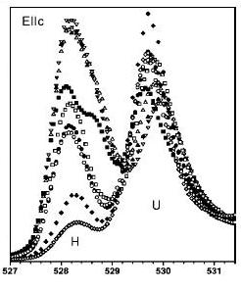
Edge structure in Sr₁₄Cu₂₄O₄₁
chain ladder
UHB
N. Nücker, et. al., PRB, 62, 14384 (2000)

Slide 10
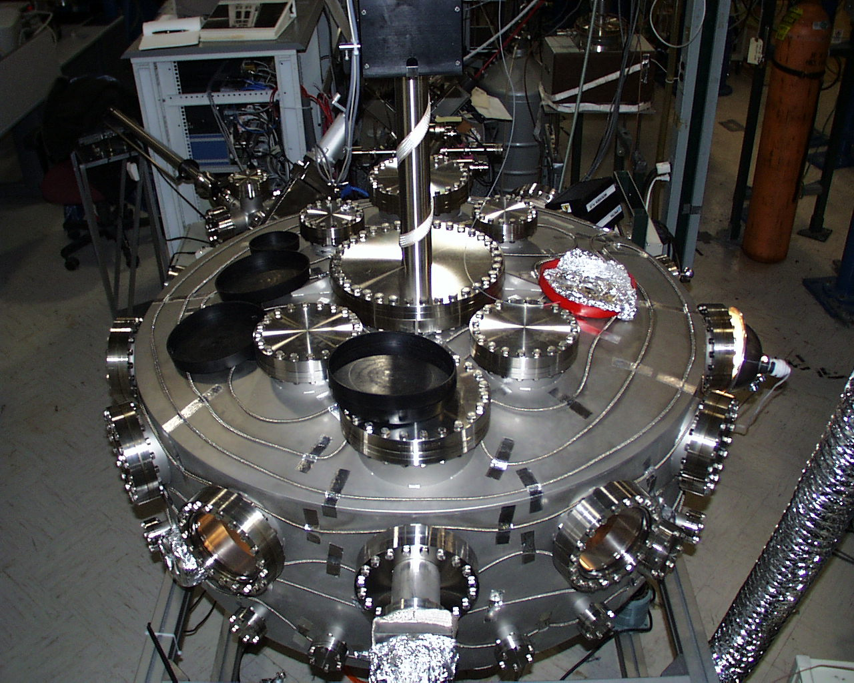
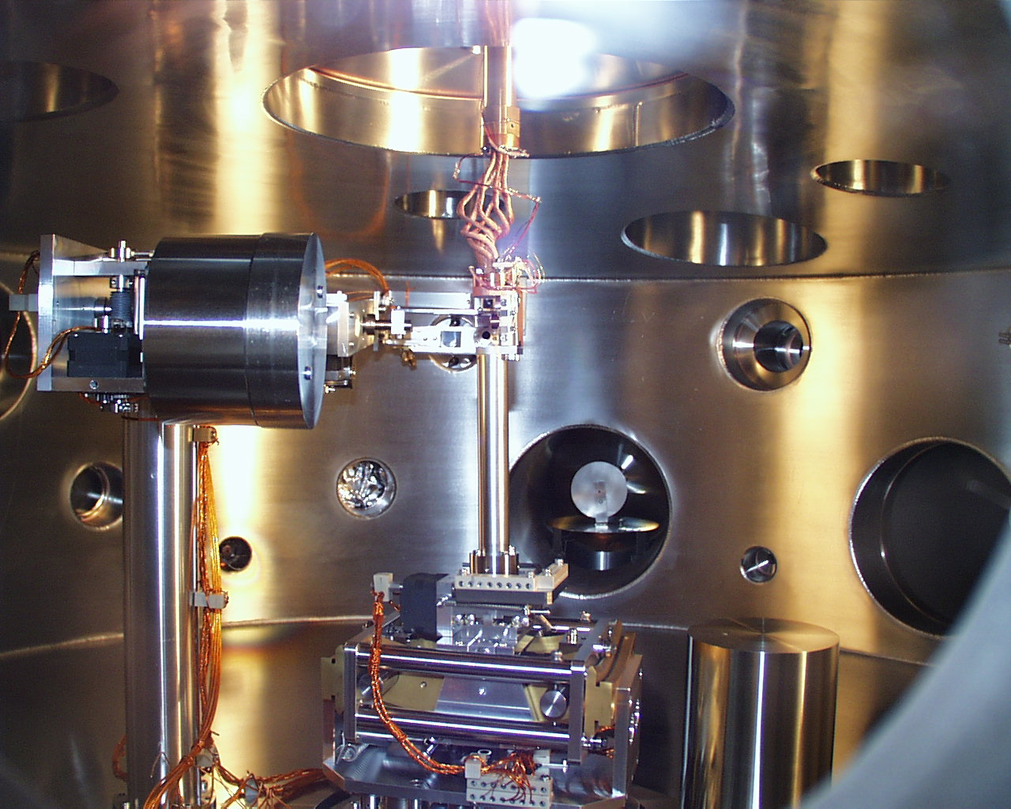
X-ray scattering in vacuum
1.2 m vacuum chamber
4 circle geometry
Multilayer fluorescence rejection
Channeltron / Au·CsI cathode
He flow cryostat
5 Tesla magnet (vertical field)
Base pressure = 5 × 10⁻¹⁰ mbar
National Synchrotron Light Source, X1B

Slide 11
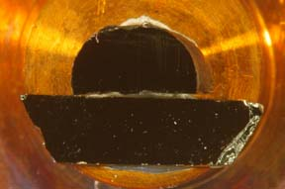
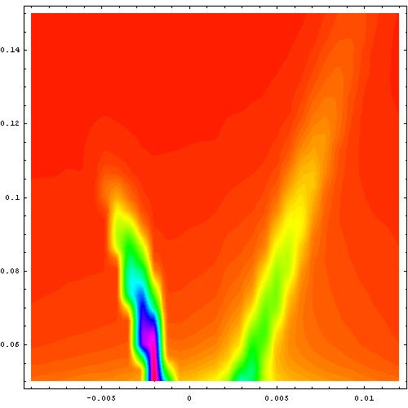
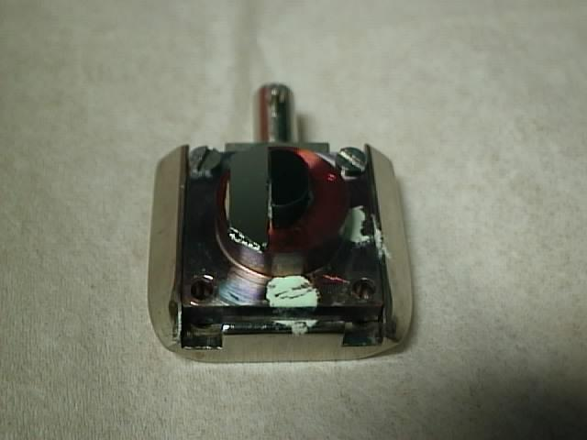
Sample prep. for low energy scattering – the surface is everything
Traveling solvent floating zone technique*
Polish with dry, diamond film, 30 μm ⇒ 10 μm ⇒ … 0.1 μm
Anneal at 120 °C in O₂ for ~1 day
No bragg peaks! ⇒ Orient with Ge(111) reference sample and use surface reflection
Surface roughness
L (r.l.u.)
H (r.l.u.)
* T. Osafune, N. Motoyama, H. Eisaki, S. Uchida, PRL, 78, 1980 (1997)

Slide 12
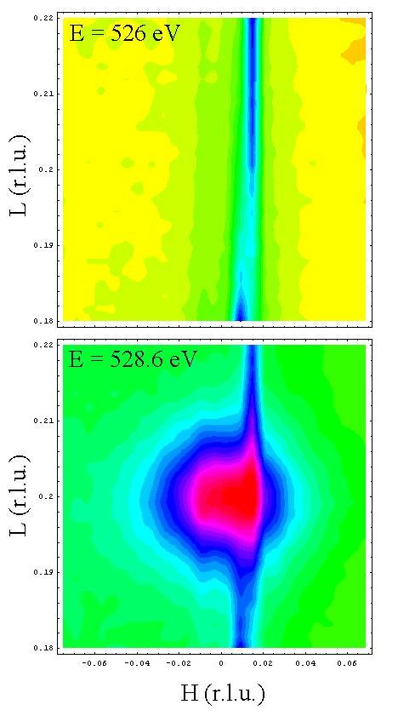
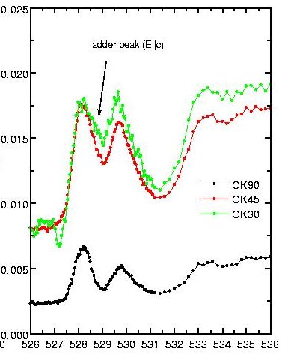
Valence modulation in Sr₁₄Cu₂₄O₄₁
T=28K
Total fluorescence yield
(relative units)
T=28K
Photon Energy (eV)
L = 0.200 ± 0.009 r. l. u. ⇒ λ = 5.00 ± 0.24 c_{L}.
Does not index to 27.3 Å unit cell.
ξ_{c} = 255 Å, ξ_{a} = 274 Å
No measurable off-resonant signal ⇒ purely electronic phenomenon

Slide 13
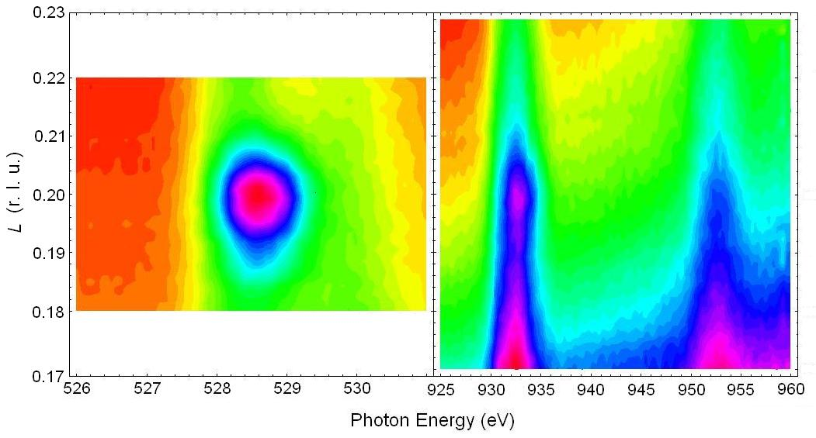
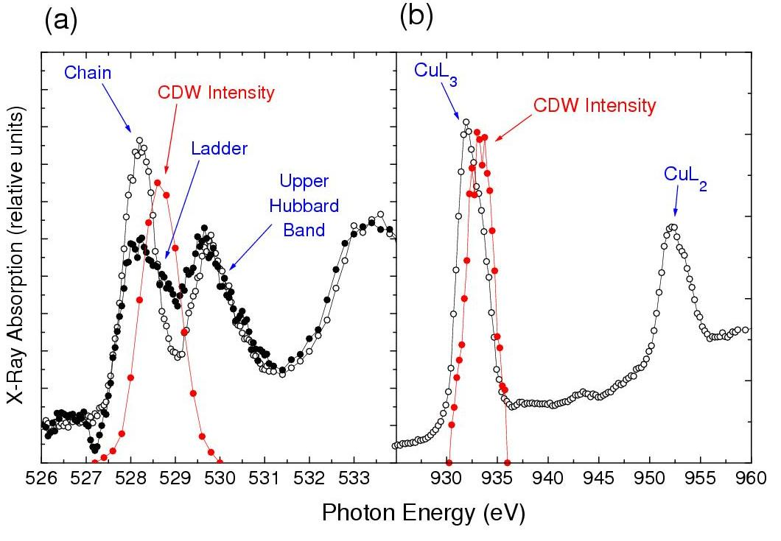
Resonance properties
T=28K
Disappears of O_{K} prepeak –cannot be structural
Visible at CuL_{2,3} – still at L=0.2
Coherent, bulk phenomenon
No harmonic at L=0.4 – sinusoidal
Resonates only with ladder feature
Resonates at CuL₃′, not L₃ (just electrostatic)
Simplest explanation: hole crystal in the ladder, as predicted by Dagotto et. al.

Slide 14
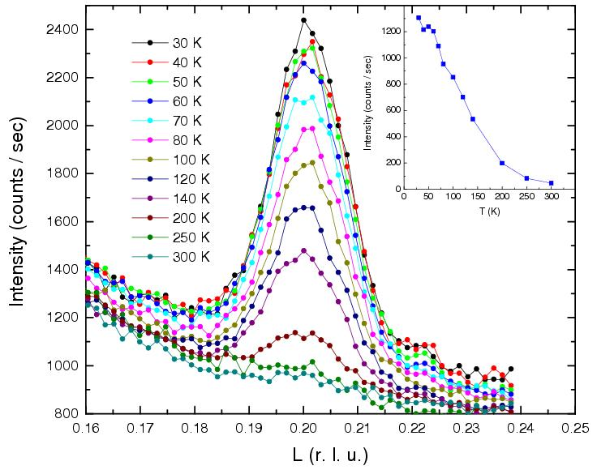
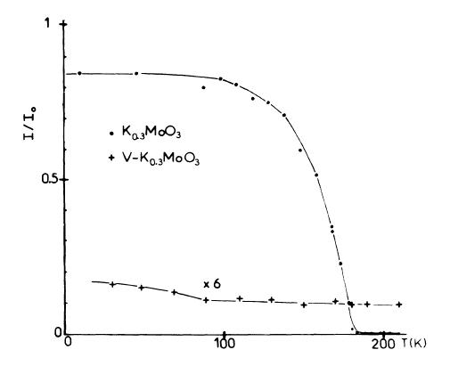
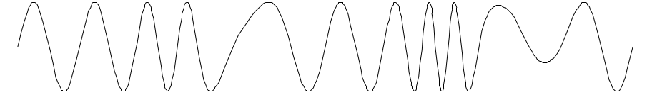
Temperature dependence
Δ(T) non–MFT (crossover)
Agrees with Vuletić et. al. [PRL, 90 257002, (2003)]
ξ_{c} is T–independent
Simplest explanation: phase fluctuations from impurities
S. Girault, A. H. Moudden, J. P. Pouget, J. M. Goddard, PRB, 38, 7980 (1988)

Slide 15
Does the wavelength λ = 5.00 c_{L} make sense?
0.8 holes in 7 rungs ⇒ δ = 0.8 / 14 = 0.057
Spin gap ⇒ bosonic pairs
Expected λ = 1/δ = 17.54 c_{L} – what is going on?
Possible explanations:
Hole density from Nücker et. al. incorrect
Umklapp strong enough to draw extra charge from chains (Marston & Troyer)
3rd harmonic stabilized instead of 1st
Coherent across ~ 50 neighboring ladders. Two-dimensional?

Slide 16
Summary
We see a standing wave in the hole density in Sr₁₄Cu₂₄O₄₁
commensurate / resonates with ladder ⇒ originates in ladder
no (measurable) lattice distortion ⇒ Driven by many-body interactions
No visible harmonics ⇒ sinusoidal (weak-coupling c.f. White et. al.)
Δ(T) and ξ_{c}(T) ⇒ impurities (sample inhomogeneity)
Confirmation of Dagotto, Riera, Scalapino (1992)
of hole crystallization in doped spin ladders.
Conclusions
Explains observed CDW in transport with no Peierls distortion
Explains low effective mass estimated by Vuletić et. al.
Low-dimensional precursor to stripe phases in high T_{c} superconductors
Supports picture that superconductivity in copper-oxides occurs in close
proximity (in the RG sense) to charge order

