Slide 1


Robert D. Falgout and Panayot Vassilevski
Center for Applied Scientific Computing
Lawrence Livermore National Laboratory
Germany
June, 2003
On Generalizing the AMG Framework

Slide 2
Outline
AMG / AMGe framework background
New Measures and Convergence Theory
Building Interpolation
Compatible Relaxation
Examples
Conclusions and future directions

Slide 3
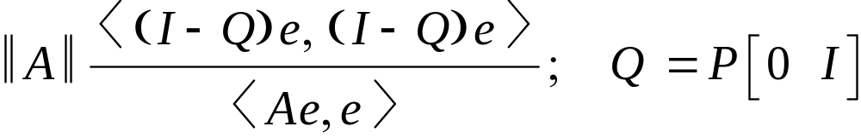
AMG / AMGe Framework
AMGe heuristic is based on multigrid theory: interpolation must reproduce a mode up to the same accuracy as the size of the associated eigenvalue
Bound a measure (weak approximation property):
Localize the measure to build AMGe components
Several variants developed: E-Free, Spectral
Based on pointwise relaxation
Assumes coarse grid is a subset of fine grid

Slide 4
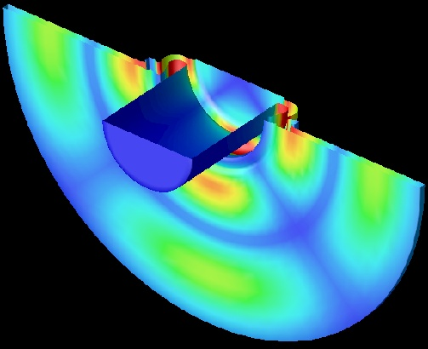
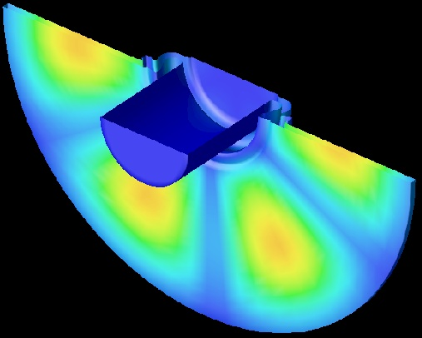
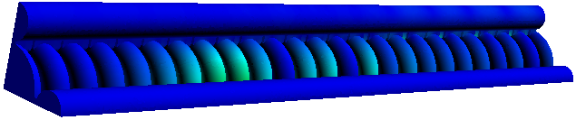
We are generalizing our AMG framework to address new problem classes
Maxwell and Helmholtz problems have huge near null spaces and require more than pointwise smoothing to achieve optimality in multigrid
Our new theory allows for any type of smoother, and also works for a variety of coarsening approaches (e.g., vertex-based, cell-based, agglomeration)
Paper submitted
Model of a section of the Next Linear Collider structure
Resonant frequencies in a Helmholtz Application

Slide 5

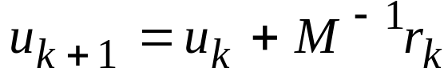
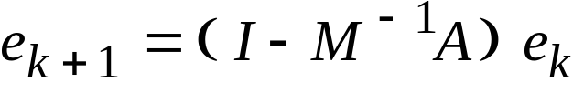
Preliminaries…
Consider solving the linear system
Consider smoothers of the form
where we assume that (M+M^{T}− A) is SPD (necessary & sufficient condition for convergence)
Note: M may be symmetric or nonsymmetric
Smoother error propagation

Slide 6
Preliminaries continued…
Let P : ℜ^{nc} → ℜ^{n} be interpolation (prolongation)
Let R : ℜ^{n} → ℜ^{nc} be some “restriction” operator
  Note that R is not the MG restriction operator
  The form of R will be important later
Define Q : ℜ^{n} → ℜ^{n} to be a projection onto range(P); hence Q=PR such that RP=I

Slide 7
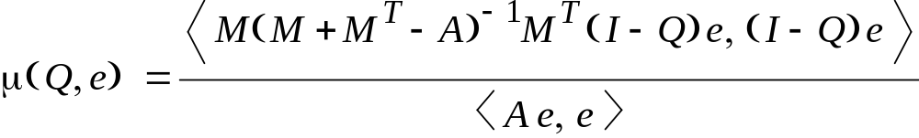
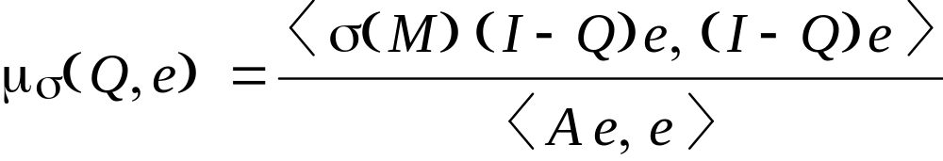
Two new measures
First measure:
Second measure: Define σ(M) ≡ ½(M+M^{T}) , then
Measure μ_{σ} is the analogue to the AMGe measure

Slide 8

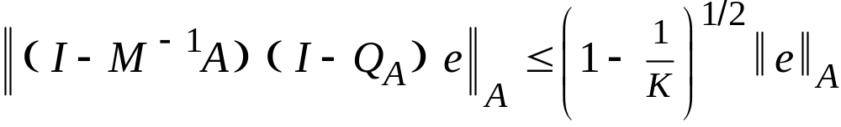
First measure and MG convergence
Theorem: Assume that the following holds for some constant K:
Then, 2-level MG converges uniformly:
Here, Q_{A} = P(P^{T}AP)⁻¹P^{T}A is the A-orthogonal projector onto range(P)
As in AMGe, we could try to directly localize this new measure to help us build AMG algorithms
But, we will take a different approach

Slide 9
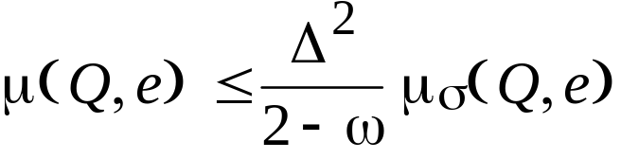
Second measure and MG convergence
Bounding μ_{σ} also implies uniform convergence…
Lemma: Assume that (M+M^{T}− A) is SPD. Then,
where Δ ≥ 1 measures the deviation of M from σ(M)
and where 0 < ω ≡ λ_{max}(σ(M)⁻¹A) < 2 .
Must insure “good” constants
  in particular, ω « 2

Slide 10
General notions of C-pts & F-pts
Recall the projection Q=PR, with RP=I
We now fix R so that it does not depend on P
  Defines the coarse-grid variables, u_{c} = Ru
  Recall that R=[ 0, I ] (P^{T}=[ W^{T}, I ]^{T}) for AMGe; i.e., the coarse-grid variables were a subset of the fine grid
  C-pt analogue
Define S : ℜ^{ns} → ℜ^{n} s.t. n_{s}= n− n_{c} and RS = 0
  Think of range(S) as the “smoother space”, i.e., the space on which the smoother must be effective
  Note that S is not unique
  F-pt analogue
S and R^{T} define an orthogonal decomposition of ℜ^{n}; any vector e can be written as e = Se_{s}+ R^{T}e_{c}

Slide 11
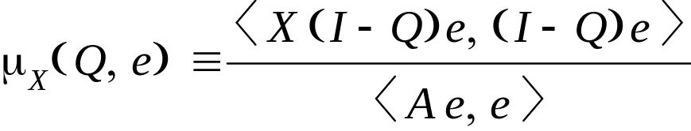
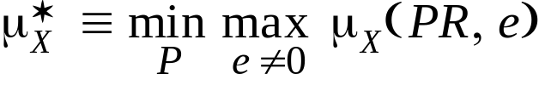
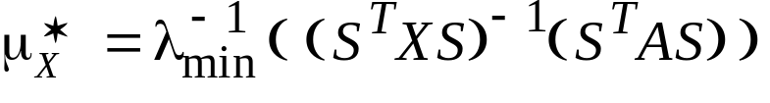
The Min-max Problem
Consider the following base measure, where X is any SPD matrix:
Theorem: Define
The arg min satisfies S^{T}AP* = 0 and the minimum is
We will call P* the optimal interpolation operator

Slide 12
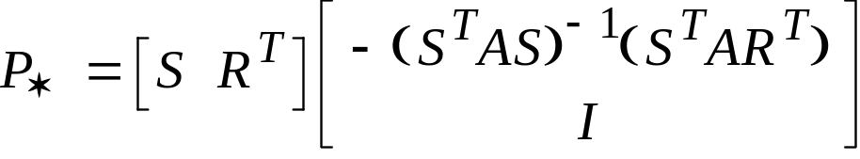
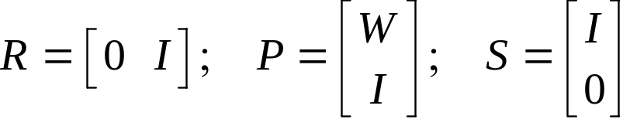
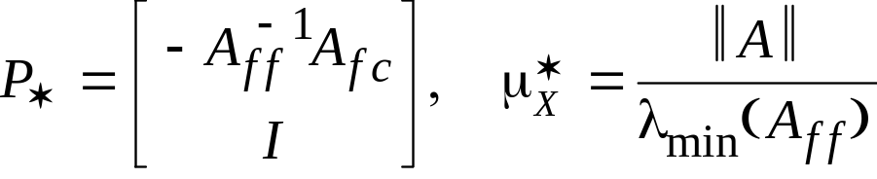
The Min-max Problem… and AMGe
The optimal interpolation has the general form:
For AMGe, the coarse-grid variables are a subset of the fine grid:
Hence,

Slide 13
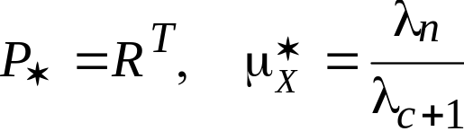
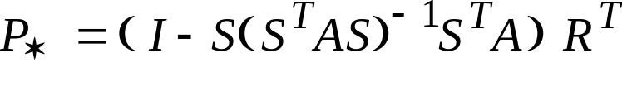
The Min-max Problem… Spectral AMGe and Smoothed Aggregation (SA)
For Spectral AMGe and SA, the coarse-grid variables are coefficients of basis functions:
where the p_{i} are orthonormal eigenvectors of A with eigenvalues λ₁ ≤ … ≤ λ_{n} . Hence,
The optimal interpolation can also be viewed as a “smoothed” tentative prolongator

Slide 14

The new theory separates construction of coarse-grid correction into two parts
The following measures the ability of a given coarse grid Ω_{c} to represent algebraically smooth error:
Theorem: (1) Assume that μ* ≤ K for some constant K.
(2) Assume that any one of the following holds for η ≥ 1:
Then, μ(PR, e) ≤ ηK, ∀e.
(1) insures coarse grid quality – use CR
(2) insures interpolation quality – necessary condition that does not depend on relaxation!

Slide 15
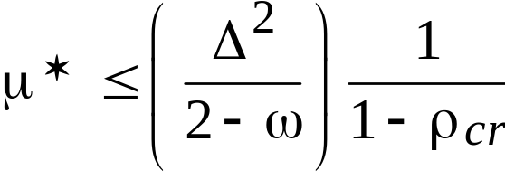
CR is an efficient method for measuring the quality of the set of coarse variables
CR (Brandt, 2000) is a modified relaxation scheme that keeps the coarse-level variables, Ru, invariant
We have defined several variants of CR, and shown that fast converging CR implies a good coarse grid:
Hence, CR can be used as a tool to efficiently measure the quality of a coarse grid!
General idea: If CR is slow to converge, either increase the size of the coarse grid or modify relaxation
F-relaxation is a specific instance of CR

Slide 16

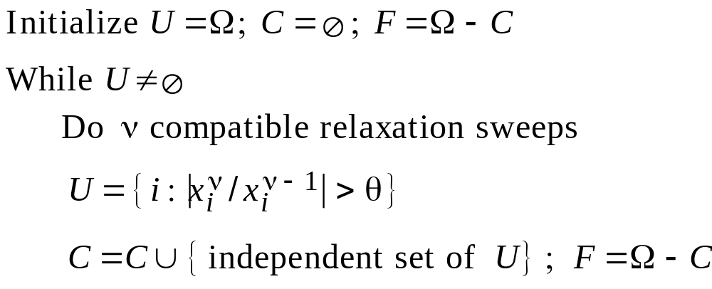
We can use CR to choose the coarse grid
To check convergence of CR, relax on the equation
and monitor pointwise convergence to 0
CR coarsening algorithm:
Notes:
Add graphics here.

Slide 17
Using CR to choose the coarse grid
Initialize U-pts
Do CR and redefine U-pts as points slow to converge
Select new C-pts as indep. set over U

Slide 18
Using CR to choose the coarse grid
Initialize U-pts
Do CR and redefine U-pts as points slow to converge
Select new C-pts as indep. set over U

Slide 19
Using CR to choose the coarse grid
Initialize U-pts
Do CR and redefine U-pts as points slow to converge
Select new C-pts as indep. set over U

Slide 20
Using CR to choose the coarse grid
Initialize U-pts
Do CR and redefine U-pts as points slow to converge
Select new C-pts as indep. set over U

Slide 21
Using CR to choose the coarse grid
Initialize U-pts
Do CR and redefine U-pts as points slow to converge
Select new C-pts as indep. set over U

Slide 22
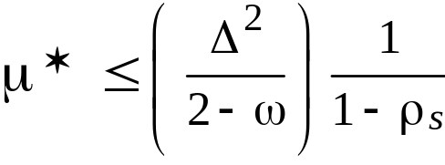
CR based on matrix splittings
Theorem: Assume that (M+M^{T}− A) is SPD. Then,
where Δ and ω are as before, and ρ_{s} = ║(I − M_{s}⁻¹A_{s})║_{As}.
Fast converging CR implies good coarse grid
If relaxation is based on a splitting A = M − N, then M is explicitly available, and CR is probably feasible

Slide 23
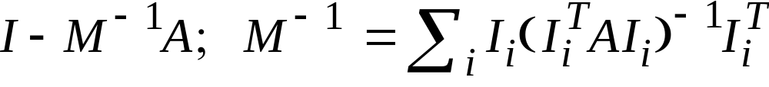
CR based on additive subspace methods
Consider the following additive method:
where I_{i} : ℜ^{ni} → ℜ^{n} and ℜ^{n} = ∪_{i} range(I_{i}).
Define full rank normalized operators S_{i} and R_{i}^{T} s.t. range(S_{i}) = range(I_{i}^{T}S) and range(R_{i}^{T}) = range(I_{i}^{T}R^{T})
The I_{i} must be chosen so that R_{i} S_{i}=0
Then an additive CR is given by
Same theoretical result as before, but with Δ = 1

Slide 24
Compatible Additive Schwarz is natural when R=[ 0, I ]
Just remove coarse-grid points from subdomains
It is clear that R_{i} S_{i}=0 for any choice of I_{i}
Additive Schwarz
CR Additive Schwarz

Slide 25
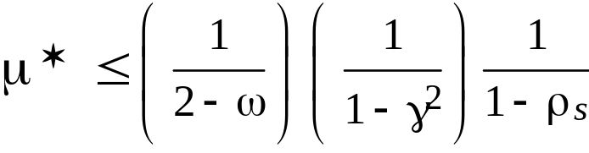
More general form of CR
Here, S must be normalized so that S^{T}S = I
This variant of CR is always computable
Theoretical result currently requires SPD smoother, M, and involves an additional constant:
where γ∈[0,1) satisfies

Slide 26
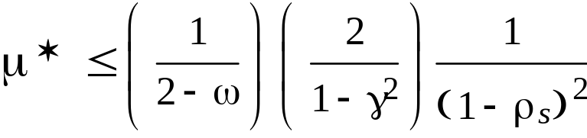
Another general form of CR (due to Brandt and Livne)
As before, S must be normalized so that S^{T}S = I
This variant of CR is also always computable
Theoretical result is similar, but weaker:

Slide 27
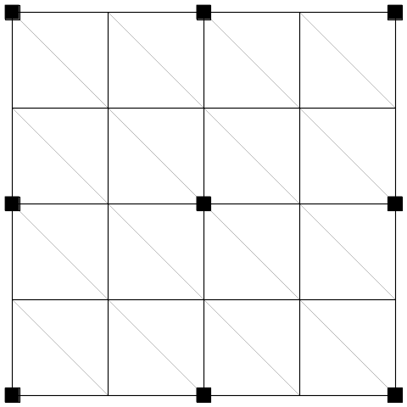

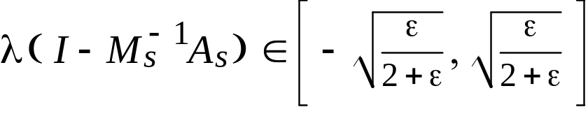
Anisotropic Diffusion Example
Dirichlet BC’s and ε∈(0,1]
Piecewise linear elts on triangles
Standard coarsening, i.e., S = [ I, 0 ]^{T}
The spectrum of the CR iteration matrix satisfies
Linear interpolation satisfies, with η = 2,

Slide 28

Anisotropic Diffusion Example – leveraging previous work
Consider the AMGe measure
It is easy to show that η ≥ ║A║ / ε
As mentioned earlier, this implies
But the AMGe method produces linear interpolation; it is just unable to judge its quality in this setting (i.e., when using line relaxation)

Slide 29
Conclusions and Future Directions
We have developed a more general theoretical framework for AMG methods
  Allows for any type of smoother
  Allows for a variety of coarsening approaches (e.g., vertex-based, cell-based, agglomeration)
The theory separates construction of coarse-grid correction into two parts:
  Insuring the quality of the coarse grid via CR
  Insuring the quality of interpolation for the given coarse grid (leverages earlier work)
We have defined several variants of CR
Will explore further the use of CR in practice
Choosing / modifying smoothers automatically?

Slide 30
This work was performed under the auspices of the U.S. Department of Energy by Lawrence Livermore National Laboratory under contract no. W-7405-Eng-48.
UCRL-PRES-150807

