Slide 1
Transport Simulation of Precessing Spin
Distribution across Semiconductor
Heterojunctions
Paul von Allmen
Motorola Labs, Solid State Research Center, Tempe, AZ
Gerhard Klimeck
Jet Propulsion Lab, California Institute of Technology, Pasadena, CA

Slide 2
Nanoelectronics & Spintronics
Why? What? How?
Objective
Low power and high speed electronics
High sensitivity detectors
Approach
Small(er) devices
Utilize quantum effects
Problems
Small coherence times / lengths
Low temperature operation
Size control / quality control
Quantum quantities
Electron charge
Electron state (in a small system / artificial atom)
Electron Spin
Related length scales
Few nanometers
e²/2C >> k_{B}T
Few nanometers
ΔE = E_{n+1}-E_{n} >> k_{B}T
Many micrometers
(expect radiation hardness)
Spin-injection / creation
Magnetic materials
Optical injection

Slide 3
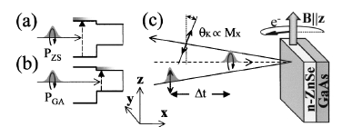
Experimental Setup
Pump beam:
Probe beam:
Pump-probe time delay Δt:
I. Malajovich, J.M. Kikkawa, D. Awschalom, J.J. Berry and N. Samarth, PRL 84, 1015 (2000)
Notes:
TRKR in the two-color configuration measures the magnetization in the epilayer
The Kerr effect is that the polarization plane of linearly polarized light rotates by an angle proportional to the magnetic field (or magnetization)
The circularly polarized pump beam produces a spin polarized distribution with spin oriented parallel to the propagation of the pump beam
Faraday effect rotation of linearly light - angle of rotation propotional to B
Works also on reflection
X is growth direction
Faraday effect is a resonance effect - need to be resonant with the band-edge - off resonant in the GaAs

Slide 4
TIME RESOLVED KERR ROTATION
Pump beam:
energy E_{g}(GaAs) < E_{p} < E_{g}(ZnSe)
circular polarization generates spin polarized electrons in CB
Probe beam:
energy E_{probe} ≈ E_{g}(ZnSe)
linear polarization - resonant Faraday effect measures ZnSe magnetization
Pump-probe time delay Δt:
spin dynamics
I. Malajovich, J.M. Kikkawa, D. Awschalom, J.J. Berry and N. Samarth, PRL 84, 1015 (2000)
Notes:
TRKR in the two-color configuration measures the magnetization in the epilayer
The Kerr effect is that the polarization plane of linearly polarized light rotates by an angle proportional to the magnetic field (or magnetization)
The circularly polarized pump beam produces a spin polarized distribution with spin oriented parallel to the propagation of the pump beam
Faraday effect rotation of linearly light - angle of rotation propotional to B
Works also on reflection
X is growth direction
Faraday effect is a resonance effect - need to be resonant with the band-edge - off resonant in the GaAs

Slide 5
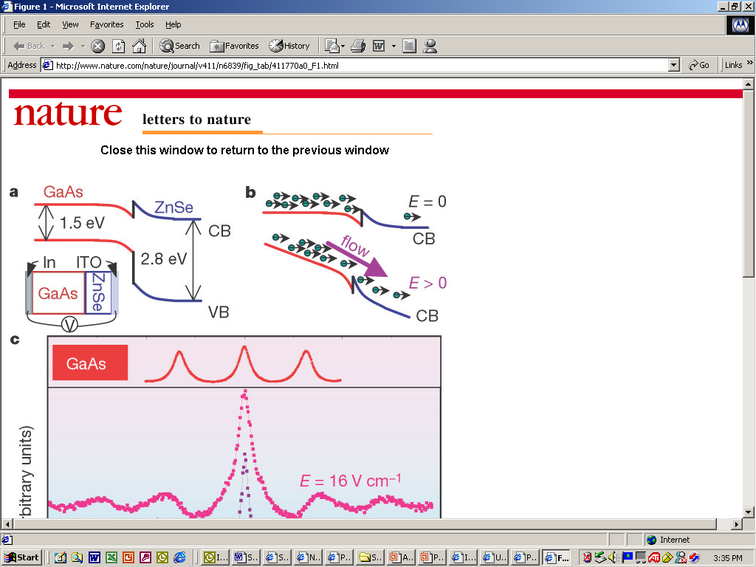
SPIN Transport Across an Interface
Problem Statement
GaAs
ZnSe
Inject spin polarized
Electrons in GaAs and
measure spin population
and precession in ZnSe
Zero Bias:
Transmitted spins precess
ZnSe-like
x (μm)
0
0.1
GaAs
ZnSe
With Bias:
Transmitted spins precess
GaAs-like
x (μm)
0
0.1
I. Malajovich, J.M. Kikkawa, D. Awschalom, J.J. Berry and N. Samarth, PRL 84, 1015 (2000)
Notes:
Transmission coefficient at interface decreases exponentially with time which allows for the accumulation process.
Origin of transmission coefficient decay is attributed to energy relaxation of non-equilibrium energy distribution generated by pump above GaAs CB
This slide is the qualitative explanation

Slide 6
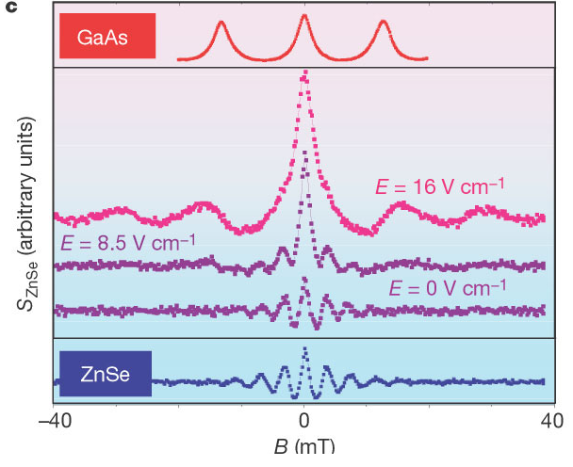
ELECTRIC FIELD DEPENDENT
SPIN DYNAMICS
Larmor frequency:
Landé factors:
Spin dynamics:
zero bias: ZnSe-like
non-zero bias: GaAs-like
I. Malajovich, J.J. Berry, N. Samarth and D.D. Awschalom, Nature 411, 770 (2001)
Notes:
The band offset at the GaAs/ZnSe critically depend on growth conditions and is poorly understood
As electric field increases the spin dynamics evolves from ZnSe-like to GaAs-like

Slide 7
Why is Landé factor GaAs-like at E>0?
Within the effective mass approximation the Landé factor is a local material property :
The Landé factor describes how the band energies vary with B
in the material where the electron is located
Expect precession at ZnSe Larmor frequency as soon as the electron enters ZnSe.
However, at non-zero bias experiments show that the GaAs spin parameters determine the spin dynamics in the ZnSe epilayer.
The apparent contradiction is lifted by examining the interplay of the transport and precession dynamics.
Notes:
Experimental data seems to suggest that spin precession is not entirely a local property. Is there an unexpected “proximity effect”
The goal of this paper is to understand this data without violating locality properties of material properties within effective mass approximation
We will show that data can be explained by interplay of transport and spin dynamics

Slide 8
SPIN DIFFUSION MODEL
Continuity equation for spin accumulation
Space dependent material parameters:
spin relaxation time τ, Landé factor g and diffusion coefficient D
Numerical method:
finite difference in space, Crank-Nicholson in time
Reflection at interface:
diffusion coefficient at one grid point reduced by a time dependent
transmission factor
τ_{d} is the accumulation lifetime
M.D. Stiles and A. Zangwill, preprint (2002)
Notes:
Simplest model is to describe spin polarized cloud with spin accumulation, which obeys a conservation equation plus loss term plus precession term
1-D solution … standard
reflection at interface cannot be described explicitly because we have no explicit propagation of electrons
one approach would be to use Monte Carlo to solve diffusion, where reflection at interface can be introduced explicitly
we choose an ad hoc numerical device which is to set the diffusion coefficient to a smaller value at one grid point. This results in a discontinuity in the spin density, which is the same result as reflection would cause
m is spin density / accumulation (spin density - spin at equilibrium)

Slide 9
SPIN DIFFUSION MODEL
Continuity equation for spin accumulation
Look at 3 cases:
no external magnetic field - no spin precession
  1) no electric field -> spin diffusion / presence
With external magnetic fields - > spin precession
  2) No electric field: ZnSe like precession
  3) With electric field: GaAs-like precession
Notes:
Simplest model is to describe spin polarized cloud with spin accumulation, which obeys a conservation equation plus loss term plus precession term
1-D solution … standard
reflection at interface cannot be described explicitly because we have no explicit propagation of electrons
one approach would be to use Monte Carlo to solve diffusion, where reflection at interface can be introduced explicitly
we choose an ad hoc numerical device which is to set the diffusion coefficient to a smaller value at one grid point. This results in a discontinuity in the spin density, which is the same result as reflection would cause
m is spin density / accumulation (spin density - spin at equilibrium)

Slide 10
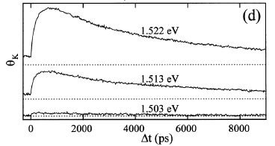
SPIN TRANSFER AT ZERO BIAS
AND ZERO MAGNETIC FIELD
Simulation
Experiment
Simulations:
- Accumulation lifetime τ_{d} is finite
- Fraction transferred is within experimental range 5-10%
- Large times: exponential decay with lifetime τ_{ZS}
- Larger μ(GaAs) induces larger transfer
Notes:
Transmission coefficient at interface decreases exponentially with lifetime Tau(d)
Blue exponential on simulation plot is fit at large t. Gives spin relaxation time for ZnSe
Difference between the two blue curves gives time behavior of residual spin. It describes dynamics of spin accumulation,
The epilayer magnetization is the integral of m over the epilayer
The initial spin polarization distribution (m) is given by optical intensity profile of pump beam. Dynamics during pumping is neglected (100fs long pulse)

Slide 11
ZERO-BIAS SPIN DYNAMICS
GaAs
ZnSe
x (μm)
0
0.1
Barrier at heterojunction establishes two separate spin-precessing
populations in GaAs and ZnSe.
Therefore, TRKR measures the precession frequency in ZnSe
Notes:
Transmission coefficient at interface decreases exponentially with time which allows for the accumulation process.
Origin of transmission coefficient decay is attributed to energy relaxation of non-equilibrium energy distribution generated by pump above GaAs CB
This slide is the qualitative explanation

Slide 12
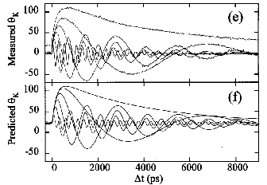
SPIN PRECESSION – NO BIAS
τ_{d}=2e-10 s
D(GaAs)=0.1 cm²/s
D(ZnSe)=2 cm²/s
Simulation
Experiment
Simulations:
- Accumulation lifetime τ_{d} is finite
- Spin dynamics according ZnSe parameters
- Spin coherence decreases as magnetic field increases
- Phase shift increases as magnetic field increases
Notes:
Simulations reproduce all of the major features of experimental data.
Difficult to be quantitative because we don’t have access to experimental data first hand.

Slide 13
NON-ZERO BIAS SPIN DYNAMICS
GaAs
ZnSe
x (μm)
0
0.1
Transit time through epilayer (diffusion):
Dephasing in ZnSe epilayer:
Therefore, TRKR measures the precession frequency in GaAs
Notes:
The main condition for this to work is that at non-zero bias the barrier disappears and the transmission coefficient is always equal to one
The phase shift due to a different Lande factor in the ZnSe is very small
This slide is the qualitative explanation

Slide 14
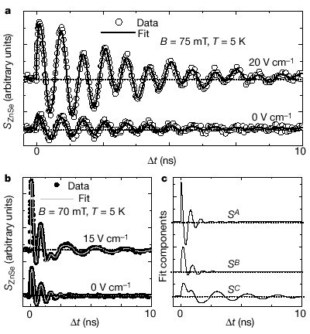
SPIN PRECESSION – BIASED
Experiment
Simulation
Simulations:
- Accumulation lifetime τ_{d} is infinite, transmission coefficient T=1
- Spin dynamics according GaAs parameters
Notes:
- At non-zero bias the spin dynamics is GaAs-like … it works!!!

Slide 15
SPIN Transport Across an Interface
Conclusion
GaAs
ZnSe
Spin density diffusion model reproduces experimental data for biased and unbiased samples.
2. Switch from ZnSe-like to GaAs-like spin dynamics is explained by fast transit times through ZnSe epilayer and barrier at interface.
x (μm)
0
0.1
GaAs
ZnSe
x (μm)
0
0.1
Inject spins
in GaAs
Measure spins
in ZnSe
Notes:
Transmission coefficient at interface decreases exponentially with time which allows for the accumulation process.
Origin of transmission coefficient decay is attributed to energy relaxation of non-equilibrium energy distribution generated by pump above GaAs CB
This slide is the qualitative explanation

