Slide 1

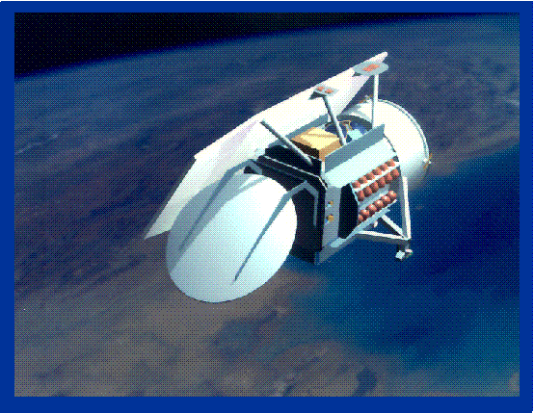
Towards the GEOSAT Follow-On Precise Orbit Determination Goals of High Accuracy and Near-Real-Time Processing
Frank G. Lemoine
Planetary Geodynamics Laboratory
NASA GSFC, Greenbelt, Maryland USA
Nikita P. Zelensky, Douglas S. Chinn,
Brian D. Beckley
SGT Inc.,
Greenbelt, Maryland USA
John L. Lillibridge
Laboratory for Satellite Altimetry, NOAA
Silver Spring, Maryland USA
AIAA Paper 2006-6402
AIAA/AAS Astrodynamics Conference, Keystone, Colorado
August 21-24, 2006

Slide 2
Outline
Introduction
Data
Description of GFO POD System
Gravity Modelling Improvements
Macromodel
Medium precision orbit (MOE) results
Precise orbit (POE) results.
VIII. Summary

Slide 3
GEOSAT-FOLLOW-ON (GFO-1)
Manufactured by: Ball Aerospace for the US Navy.
Launched: February 10, 1998.
Declared Operational: Nov. 29, 2000.
Orbit:
Altitude: 784 km
Eccentricity: 0.0008
Inclination: 108.04°
Arg. of perigee: 90.5° (frozen orbit)
Repeat Period: 244 revs in 17 days.
Payload:
Radar Altimeter
Water Vapour Radiometer
SLR Retroreflector
Doppler Beacon
GPS antenna (not operational)
NAVSOC: Operates s/c.
NASA: Coordinates SLR tracking with ILRS. Computes daily medium precision and precise orbits.
NOAA: Distributes altimeter data (IGDR and GDR)

Slide 4
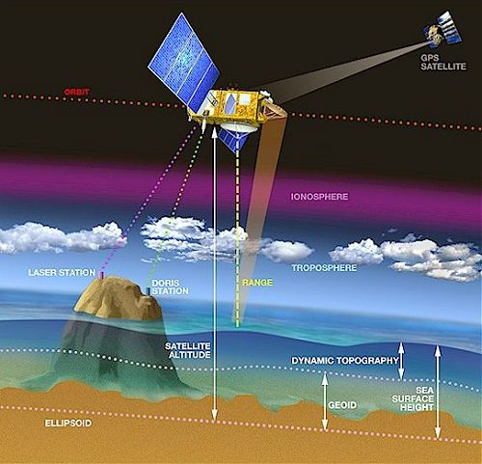
Altimeter Measurement Schematic

Slide 5
GFO Orbit Determination Challenge
=>> Altimeter range measurement accuracy depends on orbit quality.
=>> In light of the failure of GPS on GFO, can the other GFO tracking systems (SLR, Doppler, Altimeter) deliver sufficient data to meet POD requirements, especially since GFO altitude (784 km) is more challenging than Topex/Poseidon altitude (1336 km)?
=>> Can SLR+Doppler data be use to compute operational orbits (latency of < 24 hrs)?
=>> How do we measure orbit accuracy?

Slide 6
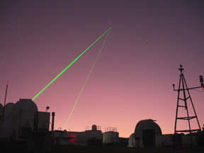
Satellite Laser Ranging
Up to 40 stations worldwide operate under the aegis of the International Laser Ranging Service (ILRS)
URL: http://ilrs.gsfc.nasa.gov/
The best stations deliver ranging accuracy of a few mm.
Greenbelt, Maryland, USA
Mt. Stromlo, Canberra, Australia

Slide 7
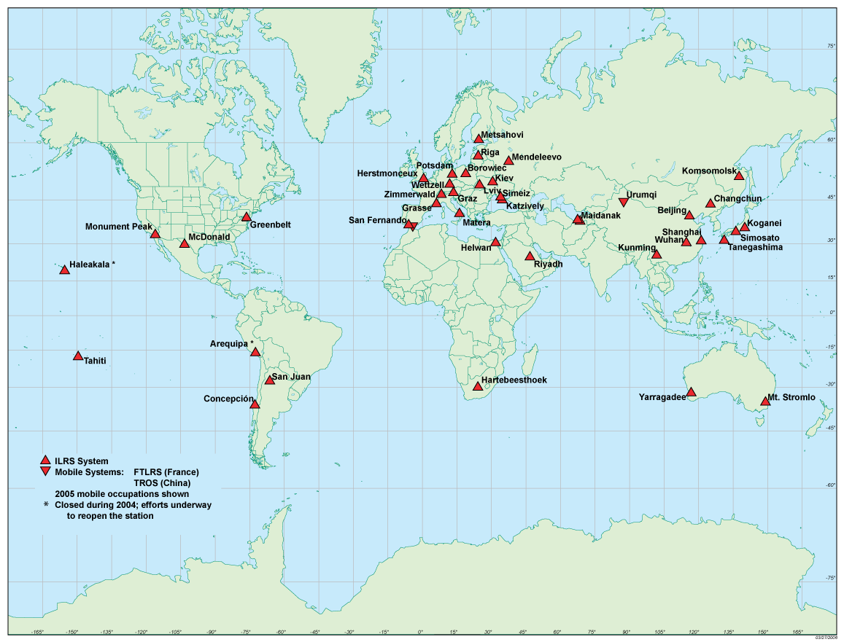
ILRS NETWORK in 2005

Slide 8
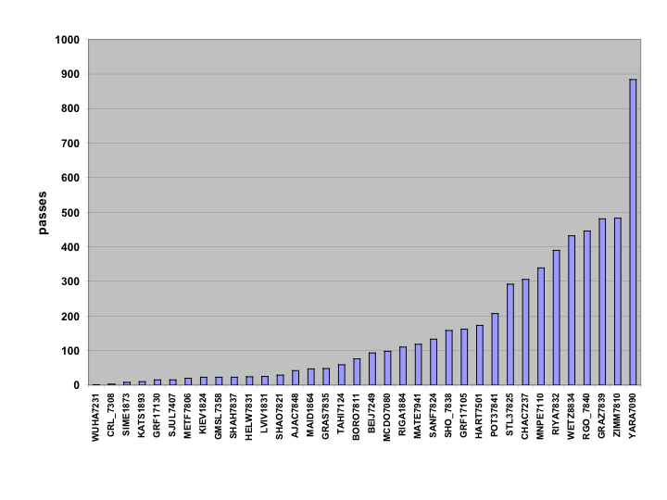
Number of SLR Passes for GFO, January 2005 to March 2006
Stations (36 total) | percent passes
Yarragadee (YARA) | 15 %
NASA (MNPE, GRF1, MCDO) (no HOLL7210) | 11 %
Other | 74 %

Slide 9
SLR Tracking History: January 2005 - March 2006

Slide 10
Doppler and Altimeter Data
Doppler Data: Three stations: Guam, Point Mugu, California; Maine. Dual-frequency 150/400 Mhz. Noise 1.5 - 2.0 cm/s.
Altimeter Data: Use data from NOAA IGDR (Intermediate Geophysical Data Record). Form altimeter crossovers.
Altimeter Range Modelling for the GFO IGDR
Ocean Tide | GOT00.2 (Topex derived tide model)
Earth Tide | Cartwright & Eden (updated)
Dry Troposphere | NCEP
Wet Troposphere | GFO WVR or NCEP
Ionosphere | IRI95
Inverse barometer | ƒ (dry troposphere)
EM bias | 3.8% SWH

Slide 11
GFO Altimeter Crossover Modelling
Sea Surface Variability (TP+ERS)
Editing Criteria
Bathymetry:
(Reject depth < 500 m)
Sea surface variability: (Reject > 20 cm)
Max Residual:
  (Reject > 20 cm)
Example of Crossover
Data Distribution

Slide 12
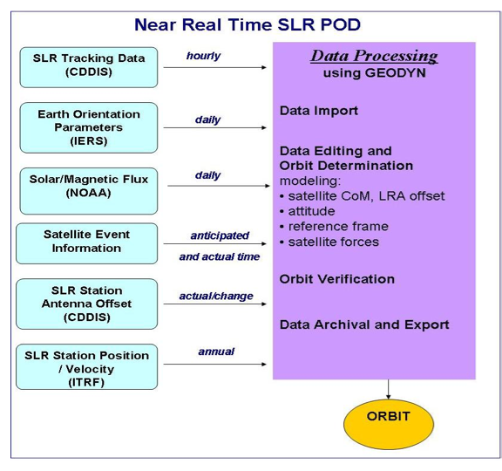
GFO Precision Orbit Determination System

Slide 13
Typical Processing Scenario
=>Import SLR Data and Doppler data by early afternoon
(local time, or 17:00-18:00 UT).
(SLR data delivered hourly to ILRS data centers)
=>Import IGDR altimetry data from NOAA
(Lag of 48 hrs in data delivery).
Import updated Earth orientation parameter info (IERS) and solar flux/geomagnetic index info (NOAA/NGDC)
Process data with GEODYN Orbit Processor and Geodetic Parameter Estimation Program. Medium precision orbits (MOE’s) have five day sliding window.
By COB, or 21:00 to 23:00 UT, deliver MOE orbit to users at NOAA and the US Navy.
=>Send new ephemeris predict based on daily MOE orbit to SLR stations.
Precise orbits have a latency of ~3 weeks.
(6-day arcs with 1-day overlaps).
=> Maneuvers introduce complications!!

Slide 14
GFO Processing Standards
POE Generation | 1st: PGS7727 (2001) | 2nd: PGS7777b (2004) | New: GGM02C (2006)
Gravity | PGS7727 (70x70) | PGS7777b (110x110) | GGM02C (120x120)
Time-variable Gravity | C20dot, C21dot S21dot | Same +zonal annuals | 20x20 annuals from GRACE
Ocean Tides | Ray99 + pgs7727 resonant | Ray99 + pgs7777b resonant | GOT00.2 (20x20)
Solid Earth tides | k₂, k₃, + FCN | Same | IERS2003
Albedo/IR | Knocke/Ries, 1988 | Same | Same
Drag | MSIS86 | Same | Same
Parameterization | C_{d}/ 8hrs, opr along+cross/day | Same | Same
SLR coordinates | ITRF2000 | ITRF2000 | ITRF2000
Doppler coordinates | Tuned with CSR95L02 | Same | Same
LRA offset | Estimated with CSR95L02 | Same | Same

Slide 15
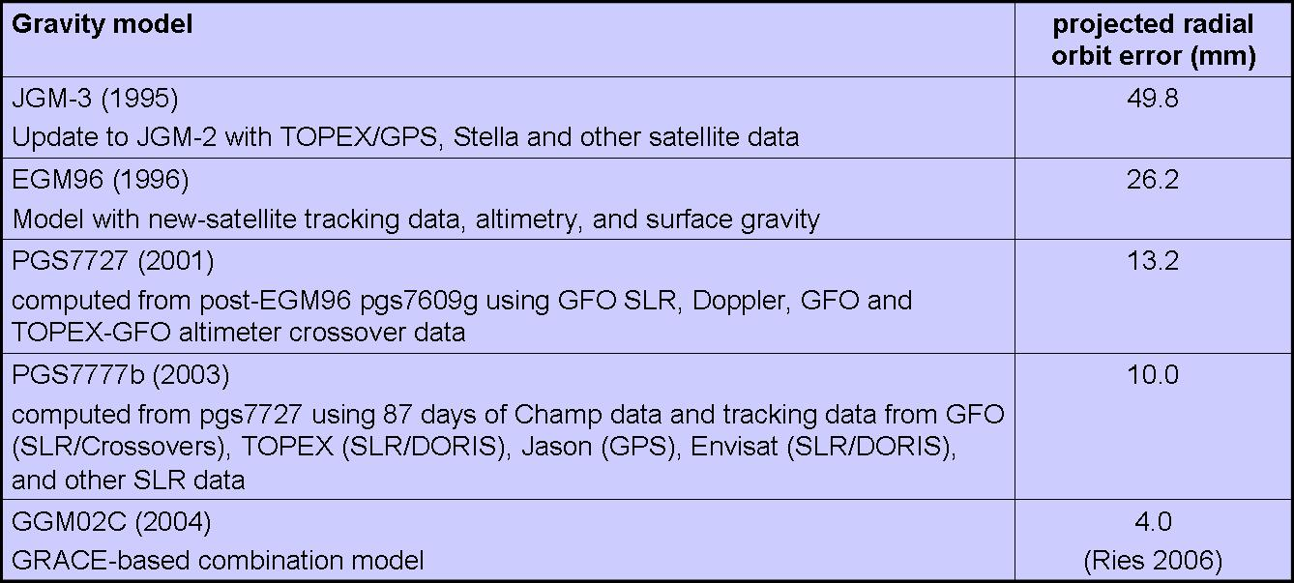
GEOSAT Gravity Model Error

Slide 16
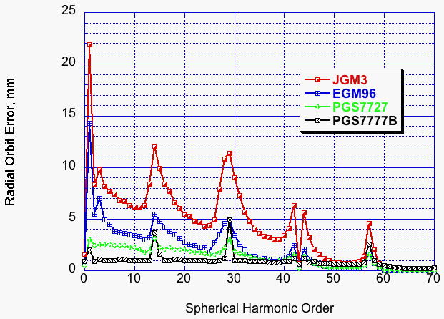
GEOSAT Gravity Model
Radial Orbit Error

Slide 17
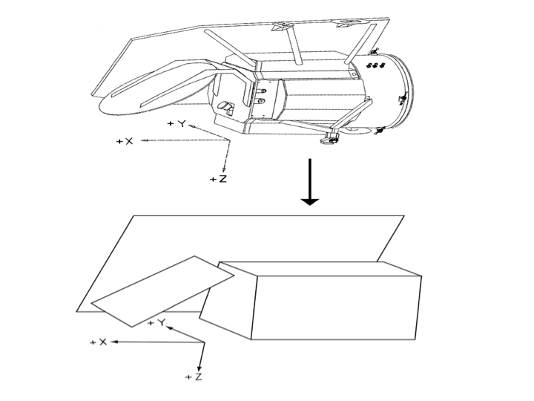
GFO Macromodel
(Nonconservative Force Modelling)
Acceleration due to radiation pressure on a flat plate:
where
Γ = acceleration (m/s²)
Φ = radiation flux from source
Α = surface area of flat plate (m²) *
θ = incidence angle (surface normal to source)
Μ = satellite mass (m)
c = speed of light (m/s)
δ = diffuse reflectivity *
ρ = specular reflectivity *
n = surface normal unit vector
s = source incidence unit vector
* are the adjustable macro model parameters

Slide 18
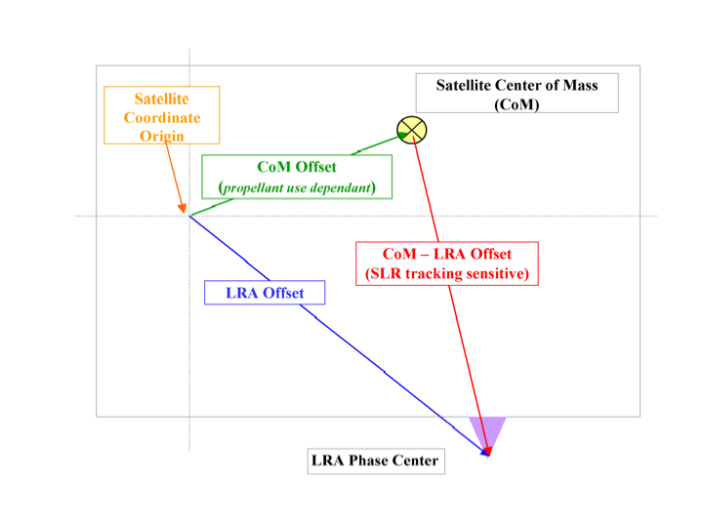
GFO LRA Offset Modelling

Slide 19
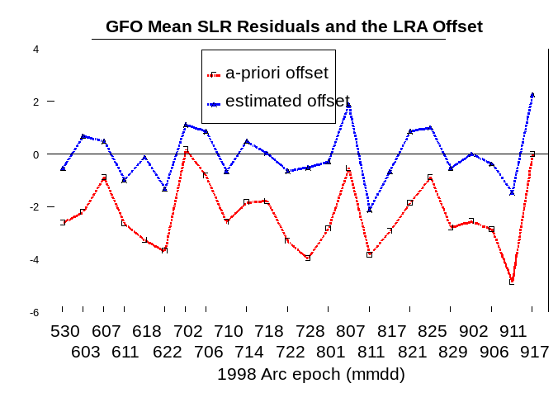
Estimate GFO LRA Offset using June ’98 SLR Data
Description | Spacecraft body-fixed coordinates (cm) |  |  | SLR residuals (cm)
 | X | Y | Z | Mean | RMS
A priori CoM | 89.7 | 0.8 | -6.6
A priori LRA offset | 114.2 | 77.2 | 42.7 | 2.5 | 10.7
Estimated LRA offset | 107.9 | 76.1 | 53.3 | -0.1 | 10.0

Slide 20
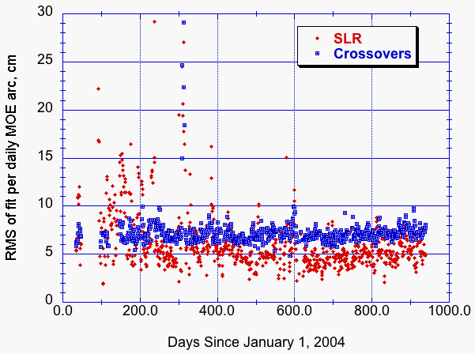
GFO MOE RMS of Fit
Due to latency issues, MOE arcs, have altimeter crossovers for first three days of each arc only.
SLR avg. RMS = 6.1 cm
Crossover avg. RMS = 7.3 cm

Slide 21
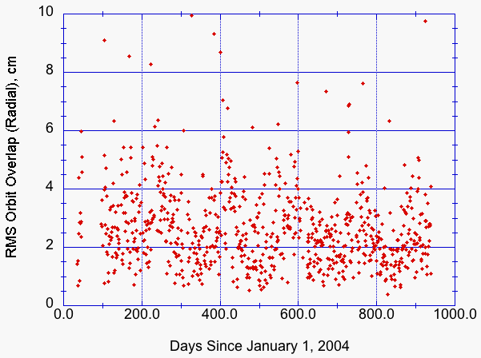
GFO MOE Orbit Overlaps
Radial
MOE Orbit Statistics (cm) (Avg. RMS Overlaps)
Radial | 5.11
Cross-track | 11.89
Along-track | 23.82
(Only show statistics since we started routinely including crossovers in MOE orbits in February 2004)

Slide 22
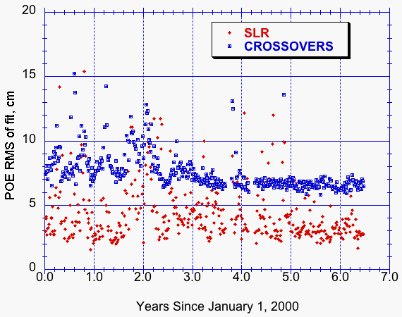
GFO POE RMS of Fit
SLR avg. RMS = 4.37 cm
Crossover avg. RMS = 7.51 cm

Slide 23
GFO POE RMS of Fit Summary
Year | No. of Arcs | SLR (cm) | Crossovers (cm) | Doppler (cm/s)
2000 | 67 | 4.68 | 8.41 | 1.74
2001 | 60 | 4.70 | 8.64 | 1.93
2002 | 66 | 5.39 | 8.12 | 2.10
2003 | 63 | 4.45 | 7.12 | 1.93
2004 | 62 | 4.49 | 6.80 | 1.75
2005 | 71 | 3.26 | 6.57 | 1.90
2006 | 34 | 3.18 | 6.58 | 1.54
ALL | 423 | 4.37 | 7.51 | 1.89

Slide 24
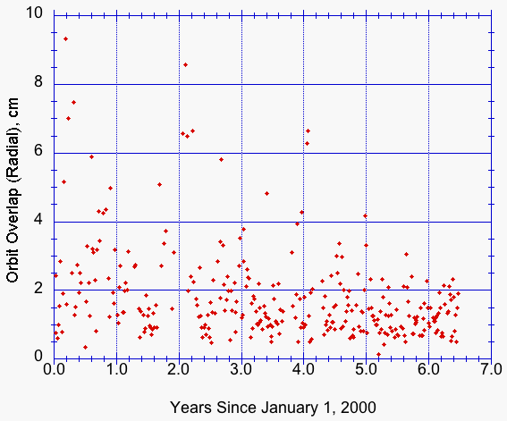
GFO POE Orbit Overlaps
Radial
POE Orbit Statistics (cm) (Avg. RMS Overlaps)
Radial | 1.84
Cross-track | 11.56
Along-track | 13.50

Slide 25
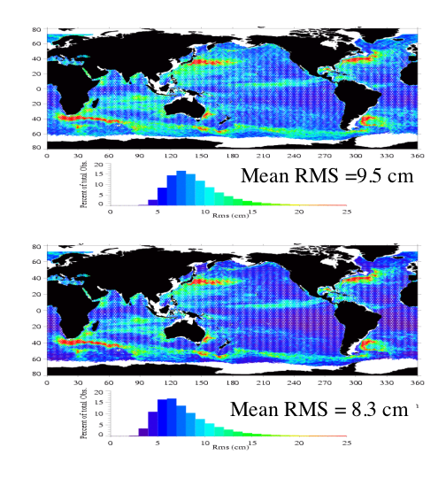
GFO Orbit Error Assessment from analysis of mean of the GFO sea surface variability
Before
Empirical Correction
After
Empirical Correction with Topex/POSEIDON
Orbit Error (relative to Topex) from RSS difference = 4.62 cm.
Including Topex error (2.5 cm) => GFO orbit error = 5.25 cm.
This assessment done with PGS7727 orbits early in mission.

Slide 26
Summary
• The GFO mission was rescued by the laser retroreflector and the demonstration of near-real-time POD using SLR, Doppler, and altimeter crossover data.
• MOE (medium precision) orbits are exported daily, with a probable radial accuracy of 15 to 20 cm.
• POE (precise) orbits are exported with a ~3-week latency with a radial precision of about 5 cm.
• GFO altimeter data have many scientific applications, especially in combination with data from other missions such as Jason-1, Envisat, ERS: mapping of eddies; near-real-time monitoring for hurricane forecasts; inland lake monitoring; detection (ex post facto) of Indian Ocean tsunami.
• Further orbit modelling improvements are planned using GRACE gravity models, better CG modelling, improved drag and radiation pressure modelling.

