Slide 1




Considerations in Collection of Anomalous Data
Bob Sweet
Bill Furey

Slide 2
What on earth does “anomalous” mean?
English: “Not conformed to rule or system; deviating from normal”
Diffraction: Anomalous Scattering is not simply dependent on a free-electron model for the atom. Instead photons that have an energy that is near that of a transition of an atom will experience a phase and amplitude shift during scattering.

Slide 3
How do we solve structures? We must somehow estimate phases so we can perform the inverse Fourier transform, the Fourier synthesis.
Isomorphous Replacement with heavy atoms
MAD/SAD, a variant of IR
Molecular replacement if we have a decent model.

Slide 4
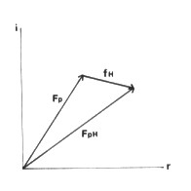
Perutz’s Fundamental Idea: Isomorphous Replacement
F_{P} = Σ F_{atoms}
F_{PH} = F_{P} + F_{H}
F_{H}
We find that, for some things, we can approximate |F_{H}| with |F_{PH}| - |F_{P}|. This often suffices for us to solve for the positions of the heavy atom as if it were a small-molecule structure.

Slide 5
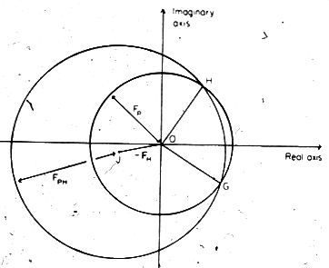
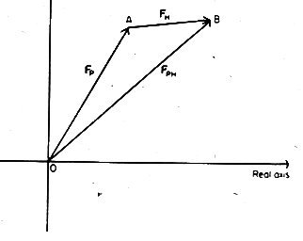
So for some particular reflection and a particular heavy atom, we can begin to find the phase:
Knowing the position of the heavy atom allows us to calculate F_{H}. Then we use F_{P} = F_{PH} + (-)F_{H} to show that the phase triangles close with a two-fold ambiguity, at G and at H. There are several ways to resolve the ambiguity.

Slide 6
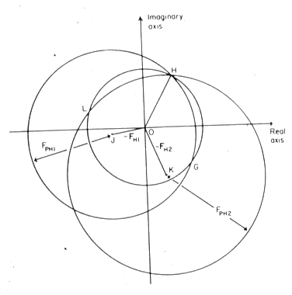
One way to resolve the ambiguity is to use a second isomorphous heavy-atom derivative.

Slide 7
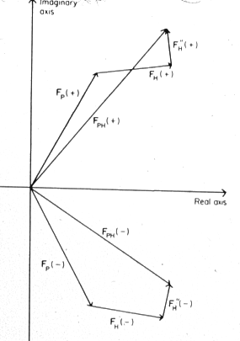
A second technique involves use of anomalous (resonant) scattering from a heavy atom.
In this case, when the photon energy is at a transition energy of a heavy atom, the resonance between the electrons on the heavy atom and the x-rays cause a phase and amplitude shift. The symmetry of diffraction (from the front vs back of the Bragg planes) is broken. Friedel’s Law is broken! This can be measured and used.

Slide 8
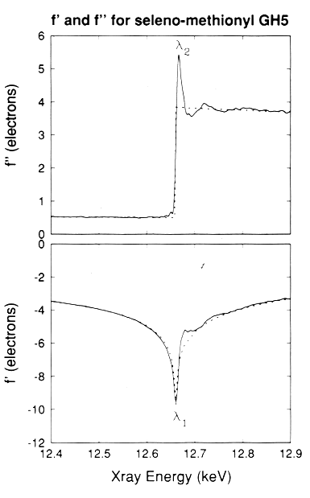
Scattering Power
f º
f ’
imaginary
f ”
real
Excitation Scans
We can observe the Δf” by measuring the absorption of the x-rays by the atom. Often we us the fluorescence of the absorbing atom as a measure of absorptivity. That is, we measure an “excitation” spectrum.
One way to represent this resonance is plots of the shifts in the real part (f ’) and imaginary part (f ”) of the scattering of x-rays as a function of the photon energy.
From Ramakrishnan’s study of GH5

Slide 9
Scattering Power
fº
f’
f’
imaginary
f”
How to get Δf ’?
The real, “dispersive” component is calculated from Δf” by the Kramers-Kronig relationship. Very roughly, Δf’ is the negative first derivative of Δf”.
real
One way to represent this resonance is plots of the shifts in the real part (f’) and imaginary part (f”) of the scattering of x-rays as a function of the photon energy.
From Ramakrishnan’s study of GH5

Slide 10
Scattering Power
fº
f’
imaginary
f”
real
One way to represent this resonance is plots of the shifts in the real part (f’) and imaginary part (f”) of the scattering of x-rays as a function of the photon energy.
From Ramakrishnan’s study of GH5

Slide 11
Excitation Scans
We can observe the Δf” by measuring the absorption of the x-rays by the atom. Often we us the fluorescence of the absorbing atom as a measure of absorptivity. That is, we measure an “excitation” spectrum.
How to get f ’?
The “real,” dispersive component is calculated from f” by the Kramers-Kronig relationship. Very roughly, it’s the negative first derivative of f”.

Slide 12
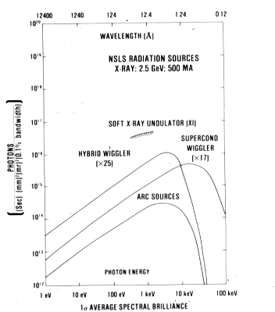
The tunability of the synchrotron source allows us to choose precisely the energy (wavelength) we need.

Slide 13
Or the use of very low energy (Cr anode at 2.3Å) enhances the natural anomalous signal for measurement of anomalous data without a synchrotron.

Slide 14
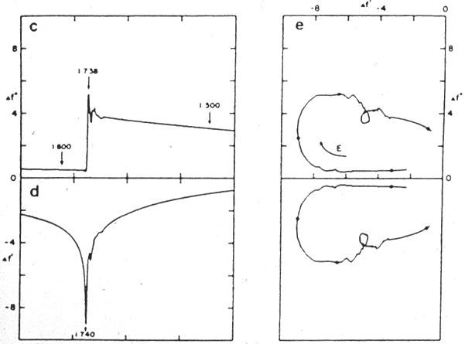
One can see how to choose wavelengths to get large phase contrast for MAD phasing
*
*
*
*
*
*
*
*
Maximum Real Signal
*
Maximum Imaginary Signal
*
*
*
Spectrum from Phizackerly, Hendrickson, et al. Study of Lamprey Haemoglobin.

Slide 15
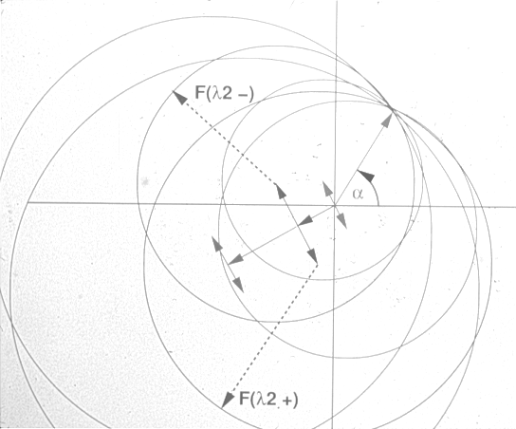
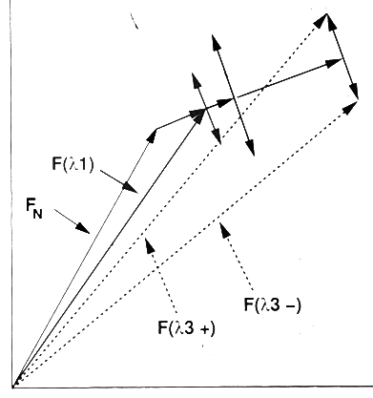
This Multiwavelength Anomalous Diffraction method often gives very strong phase information and is the source of many new structures.

Slide 16
What about Single-wavelength Anomalous Diffraction phasing – SAD?
There’s aleady a lot of phasing information in a strong Anomalous signal.
It’s essentially like Single Isomorphous Replacement – one must resolve the phase ambiguity somehow.
  One can resolve it with other phasing information, like solvent flattening or non-crystallographic symmetry.
This works only with VERY accurate data.
How do we measure accurate data for either MAD or SAD?

Slide 17
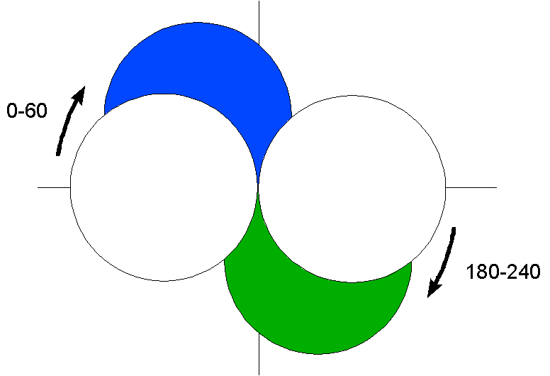
Measuring accurate Anomalous Diffraction Data
Think about how you’ll measure the F_{h} and F_{-h} data:
  Use the Friedel Flip: take one sweep, say 0-60, then flip by 180 deg and do it again, 180-240. (Some call this the “inverse beam.”)
  The 0-1 image is identical to the 180-181 image, except they’re reversed by a mirror perpendicular to the rotation axis.

Slide 18
  Align the crystal so a mirror plane in the diffraction pattern is perpendicular to the rotation axis. The reflections across the mirror will be equivalent to F_{h} and F_{-h} although they’re not precisely that (maybe h k l and h –k l).
Pay special attention to avoiding systematic errors:
  Damage – don’t take data from dead crystals; change the crystal.
  Absorption – (especially for long wavelengths!!) keep the crystal mount small; use the physical symmetry of the crystal to make absorption similar for F_{h} and F_{-h}
  Different crystal volumes exposed – make sure that the part of the crystal in the beam is the same for F_{h} and F_{-h}

Slide 19
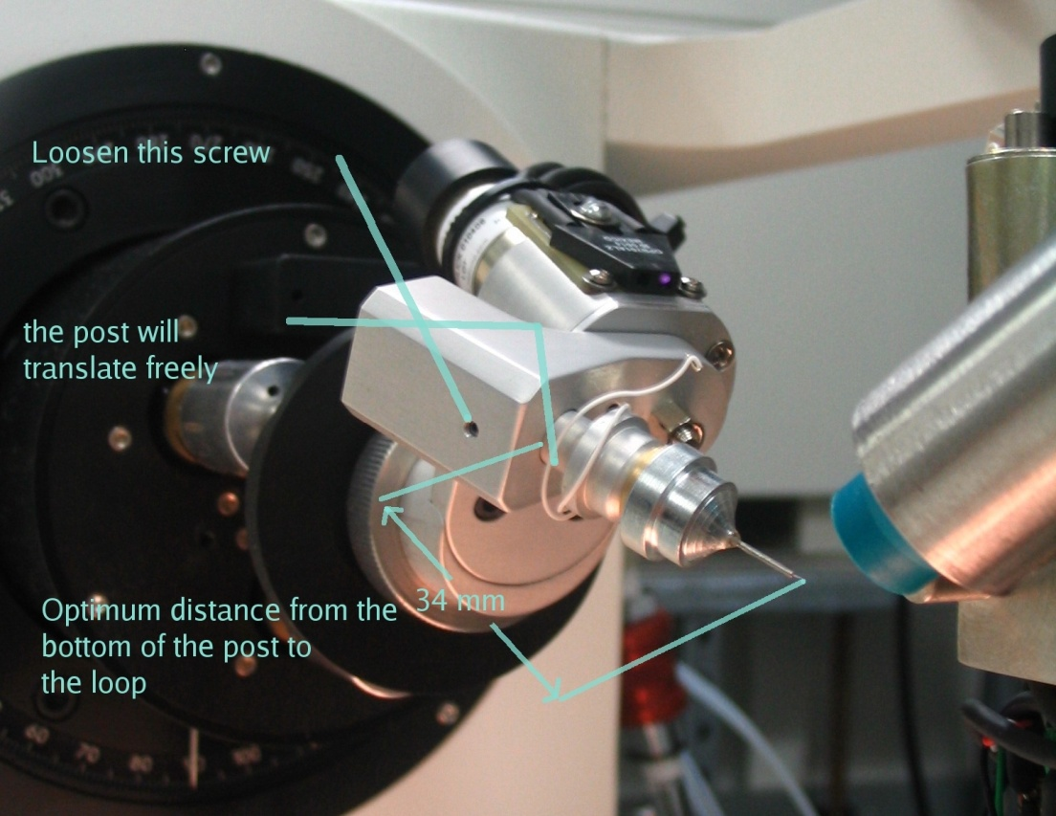
“Correcting” systematic errors
The best way is to measure the same data again in some symmetrically equivalent way – measure “redundant” data.
The first thing is to take a full 360° rotation of data.
The next thing to do is to realign the x-tal to rotate about a different axis.
  Bend the loop
  Use a mini-kappa orienter
  Much more useful than taking more than 360 degrees!

Slide 20
The reason SAD phasing works
The sources, detectors, and diffractometers are extremely good – giving accurate as well as precise data.
The software is very mature.
  Data reduction programs are excellent, making the most of weak data.
  Methods to find and refine heavy atoms make the best of weak signals.
  The phase-correction methods embedded in solvent flattening and non-crystallographic symmetry averaging are amazingly effective.

