Slide 1

Monitoring and Analytical Issues For BMP Performance Evaluation
Hong Lin, Ph.D.
Gary Lippner, P.E.
CDS Technologies
May 9, 2006
NWQMC San Jose, CA
Notes:
CDS is an Australian Company (Public Company – Buy Stock)
The Australians have brought an “Enhanced Vortexing” solid separator to the US in 1996. This Enhanced Vortexing unit is unique in that it has a balanced set of hydraulics within the separation chamber to produce a non-blocking screen as well.
As of Right Now, Just this Month, We now offer a filter media cartridge in addition to our
I’m going to first discuss the CDS Enhanced Vortexing system and than discuss the Cartridge filtration system.

Slide 2
Urban Rainfall-runoff and its pollution
Rainfall
Vehicular discharge and abrasion
Urban activities
Pavement abrasion
Contaminants
Urban pavement surface
Rainfall-runoff
Trash and Debris (Gross Pollutants) :
Esthetic impact, threats to human health, fishes, wildlife
Particles and sediments :
Clog fish gills, choke other organisms; Prevent sunlight from reaching aquatic plants
Metal elements : toxic to aquatic life and potentially contaminant ground water
Fertilizers (N, P, K) : eutrophication Pathogens : threat to human health

Slide 3
BMP Regulations
National Pollutant Discharge Elimination System (NPDES)
  Phase I – Medium & Large MS4; 11 Categories of Industrial activities
  Phase II – Small MS4
Total Maximum Daily Load (TMDL)
  Waste load allocations from point sources
  Load allocations from non-point sources and natural background conditions.
  Margin factor

Slide 4
BMP Monitoring Protocols
EPA/ASCE Urban Stormwater BMP Performance Monitoring (April 2002)
The Technology Acceptance Reciprocity Partnership Protocol for Stormwater Best Management Practice Demonstration (TARP) - CA, MA, MD, NJ, PA and VA (July 2003)
Guidance for Evaluating Emerging Stormwater Treatment Technologies, Technology Assessment Protocol - Ecology (TAPE) Washington Department of Ecology (June 2004)

Slide 5
BMP Field Monitoring Goals
Treatment efficiency for targeted pollutants (Reduction Percent and Effluent Quality)
Hydraulic performance (Treatment flow, Bypass)
Operation and performance under various flow conditions
Maintenance requirements

Slide 6
BMP Monitoring Component
Rainfall (depth & intensity)
Runoff flow (water quality flow)
Sampling (Automatic vs. manual)
Sample Management
Analytical parameters & methods
Data evaluation and validation
Quality Analysis/Quality Control (QA/QC)
BMP performance evaluation

Slide 7
“Storm Criteria - Qualified Events”
Total Rainfall Depth (inch)
Rainfall intensity (in/hr)
Antecedent dry period
Storm coverage (First Flush coverage)
Number of events
Influent TSS/SSC Concentration
Particle Size Distribution

Slide 8
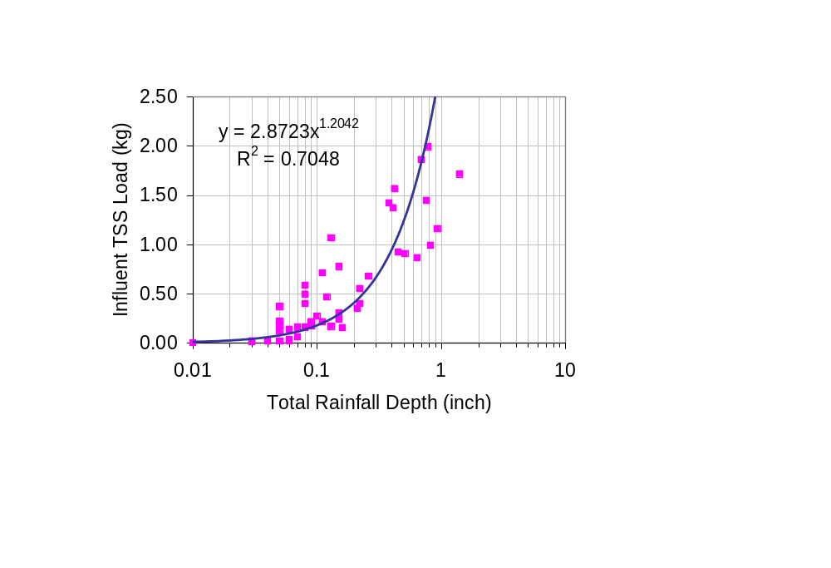
Total Rainfall Depth & Influent Pollutant Load
Solids loading appears to be a power law function of the total rainfall depth at a CDS MFS monitoring site.

Slide 9
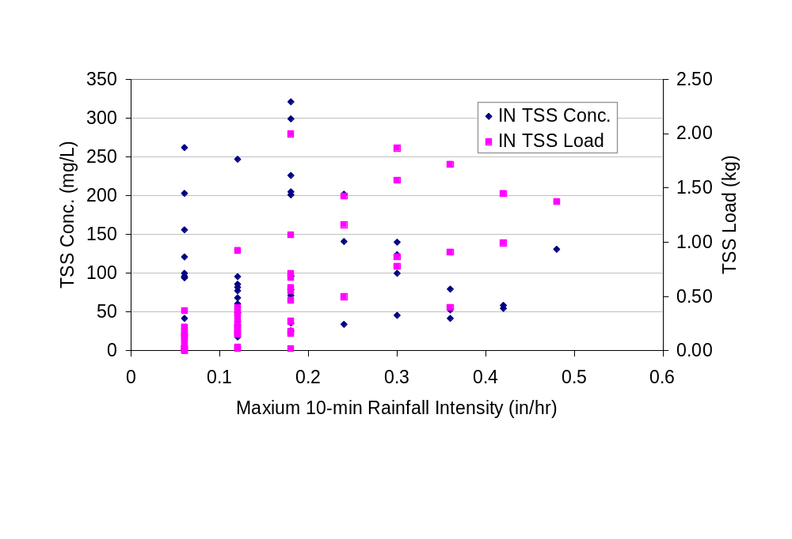
Rainfall Intensity vs. TSS/SSC
There is no apparent relationship between rainfall intensity and solids concentration & loadings at a CDS MFS monitoring site.

Slide 10
Storm Coverage
Composite samples (flow-weighted)
  covering a minimum of 70% of the total storm runoff flow
Low intensity (flow-limited)
  Pollutant mass delivery proportion to the hydrograph
High intensity (mass-limited)
  Disproportionate “first flush” of pollutant mass

Slide 11
Particle Size Distribution (PSD)
Granulometric characteristics of pollutants
PSD - d₅₀, d₁₀ and d₉₀
Determining factor of performance for physical separation

Slide 12
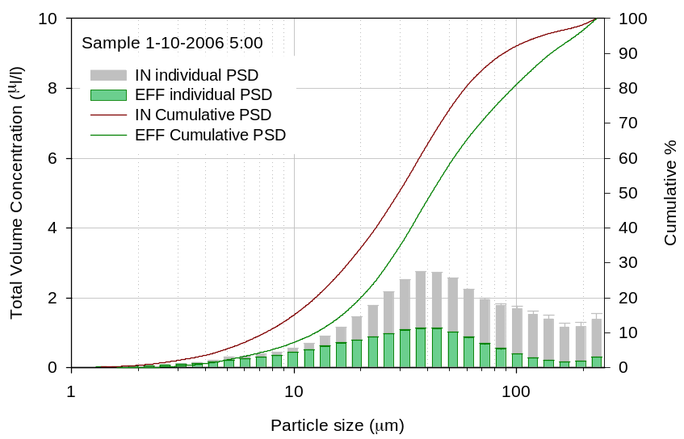
Particle Size Analysis
PSD Analysis using Laser Diffraction Instrument – Monitoring of CDS MFS

Slide 13
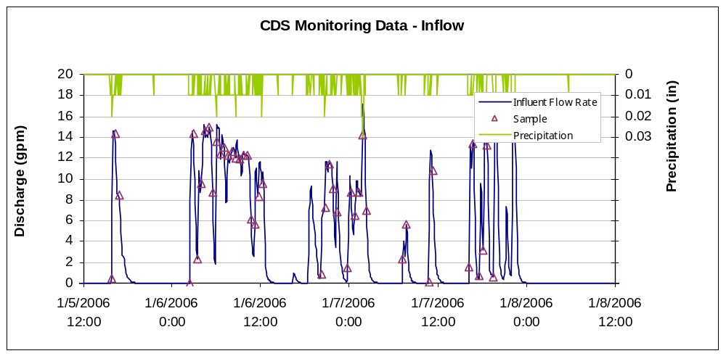
Sampling Structure
time-based sampling triggered by flow – CDS MFS Monitoring

Slide 14
Flow Measurement
Primary Measuring Device
  Flumes
  Weirs
Secondary Measuring Device
  Area velocity flow meter
  Velocity sensors w/depth sensors
Installation & Calibration

Slide 15
Sample Collection
Automatic Sampler
  Sampling location
  Sampling structure (time-based vs. flow-based)
  Limited application in the sediment-laden runoff
  Convenient and less labor intensive
Manual Sampling
  Full-cross sectional manual sampling - representative samples
  Time consuming & Labor intensive
  Can be applicable for some field installations

Slide 16
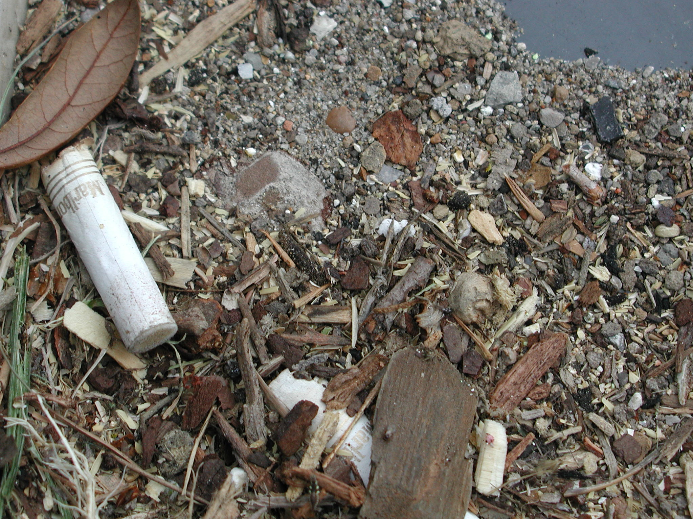
Sediment and Floatable Fractions in Urban Storm Water Runoff
Heterogeneous mixture of particulate materials from a variety of anthropogenic and natural sources
> 75 μm
Variable ρ_{s}
Separated at #200 sieve (75-μm)

Slide 17
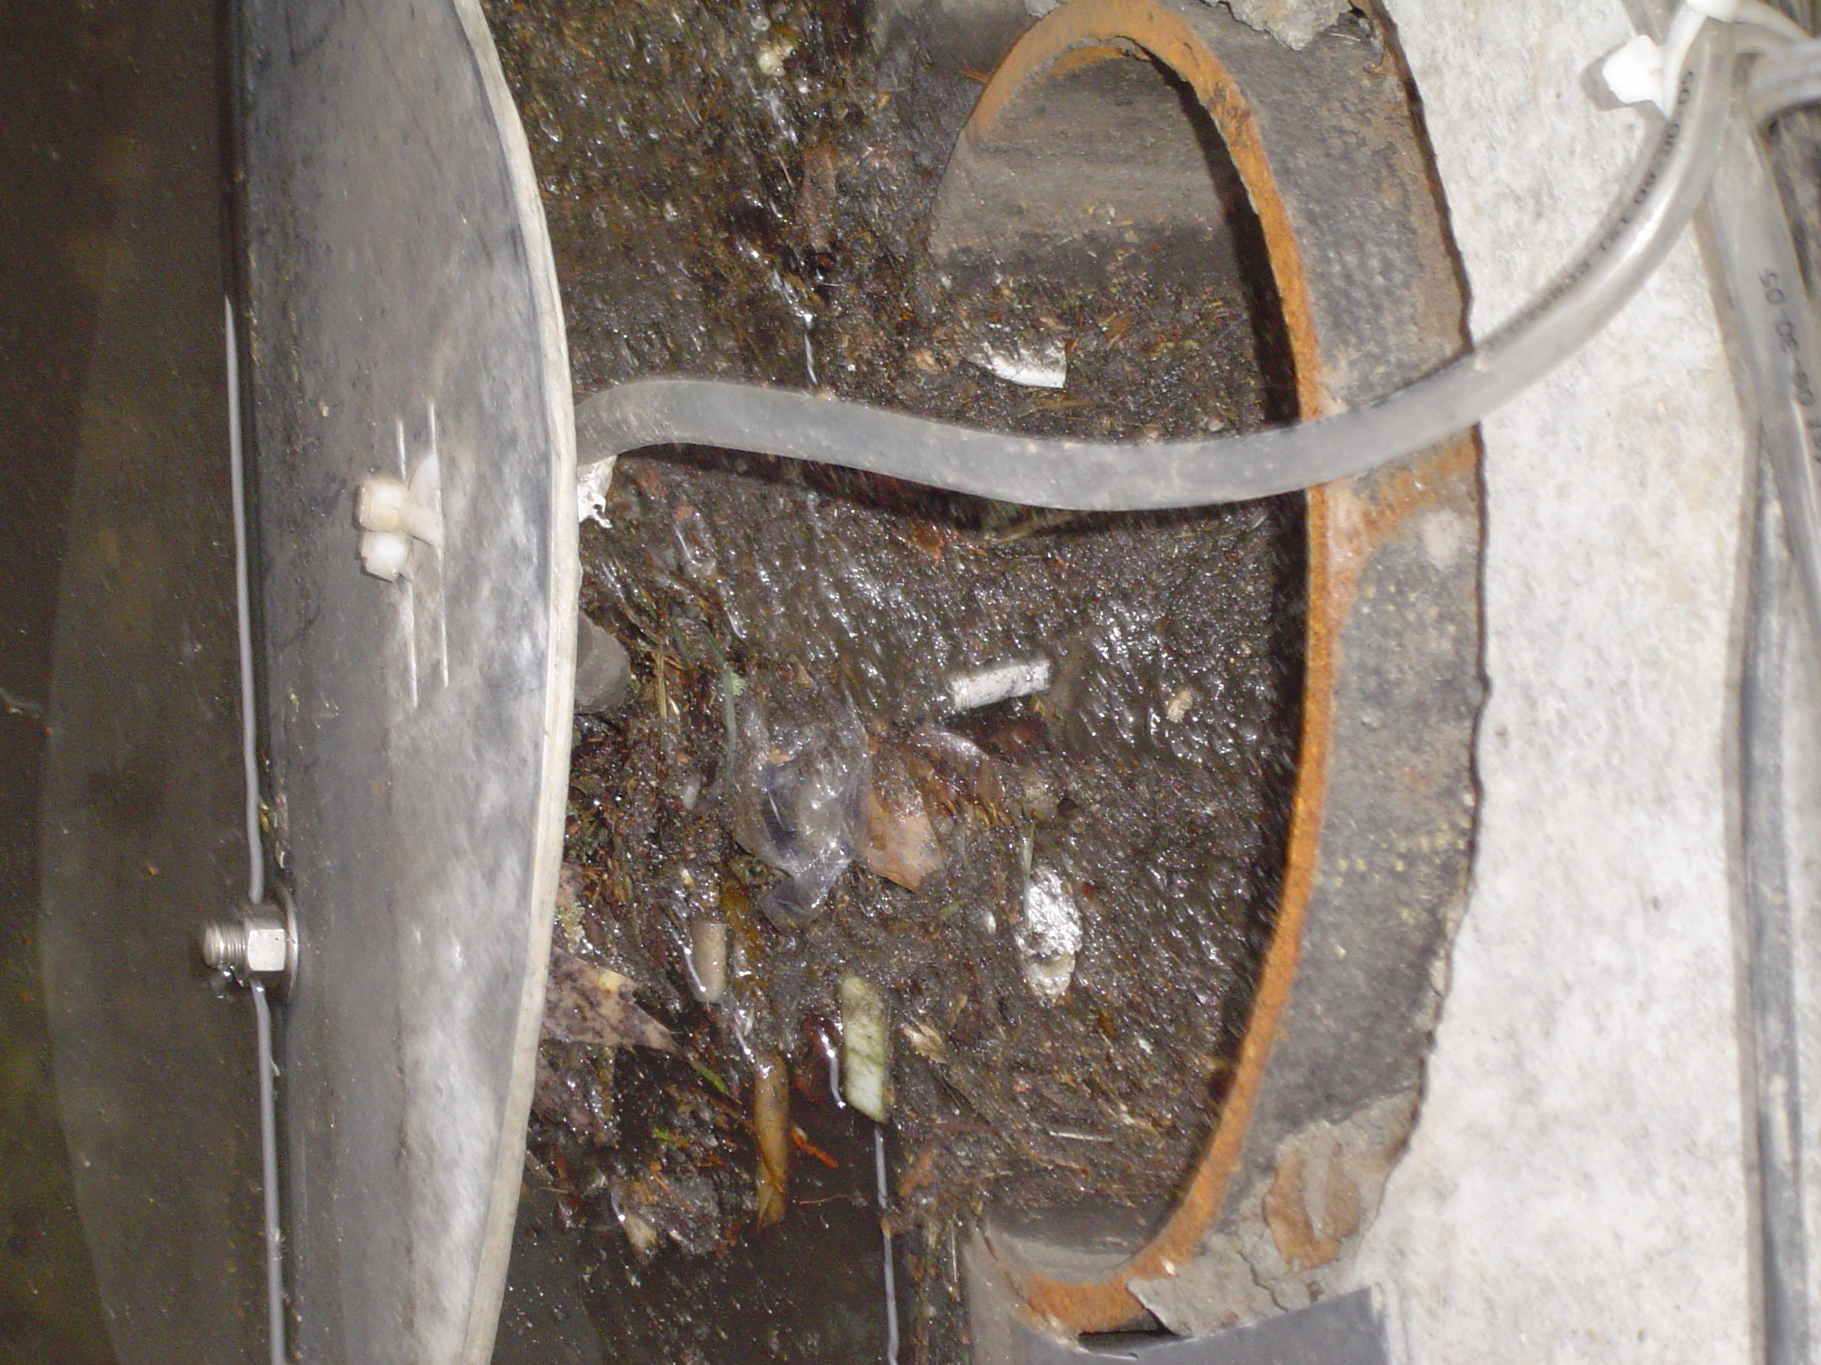
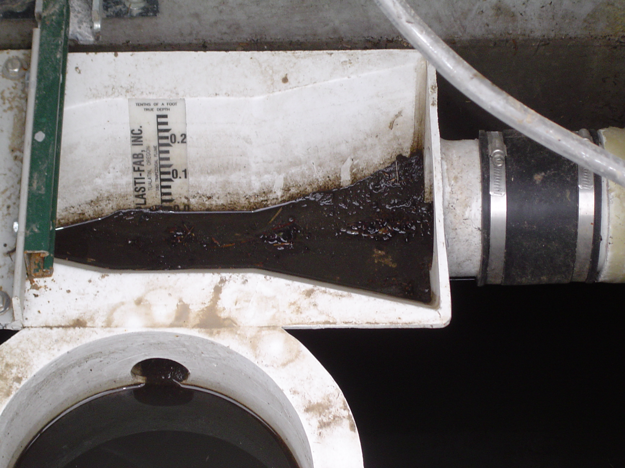
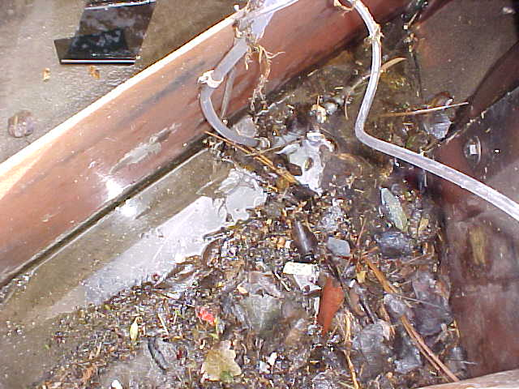
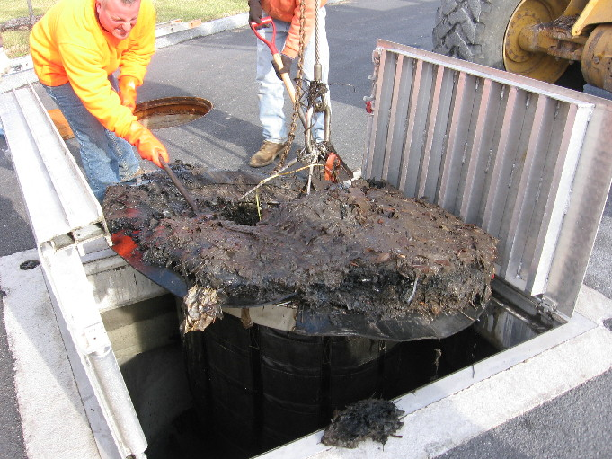
Automatic Sampling
Trapezoidal
Flume
CDS Sump Materials

Slide 18
Mass Balance Approach
True Influent Load = Captured Pollutant Load in BMP + Effluent Load (Auto sampler) + Bypass Load

Slide 19
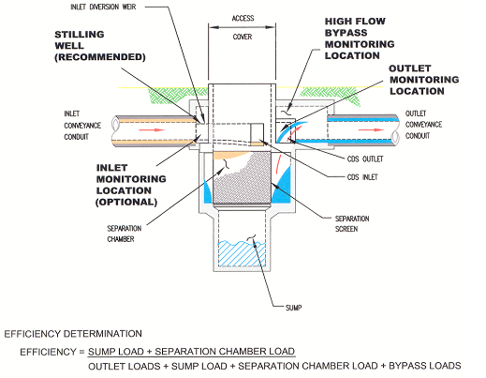
Mass Balance Approach Methodology

Slide 20
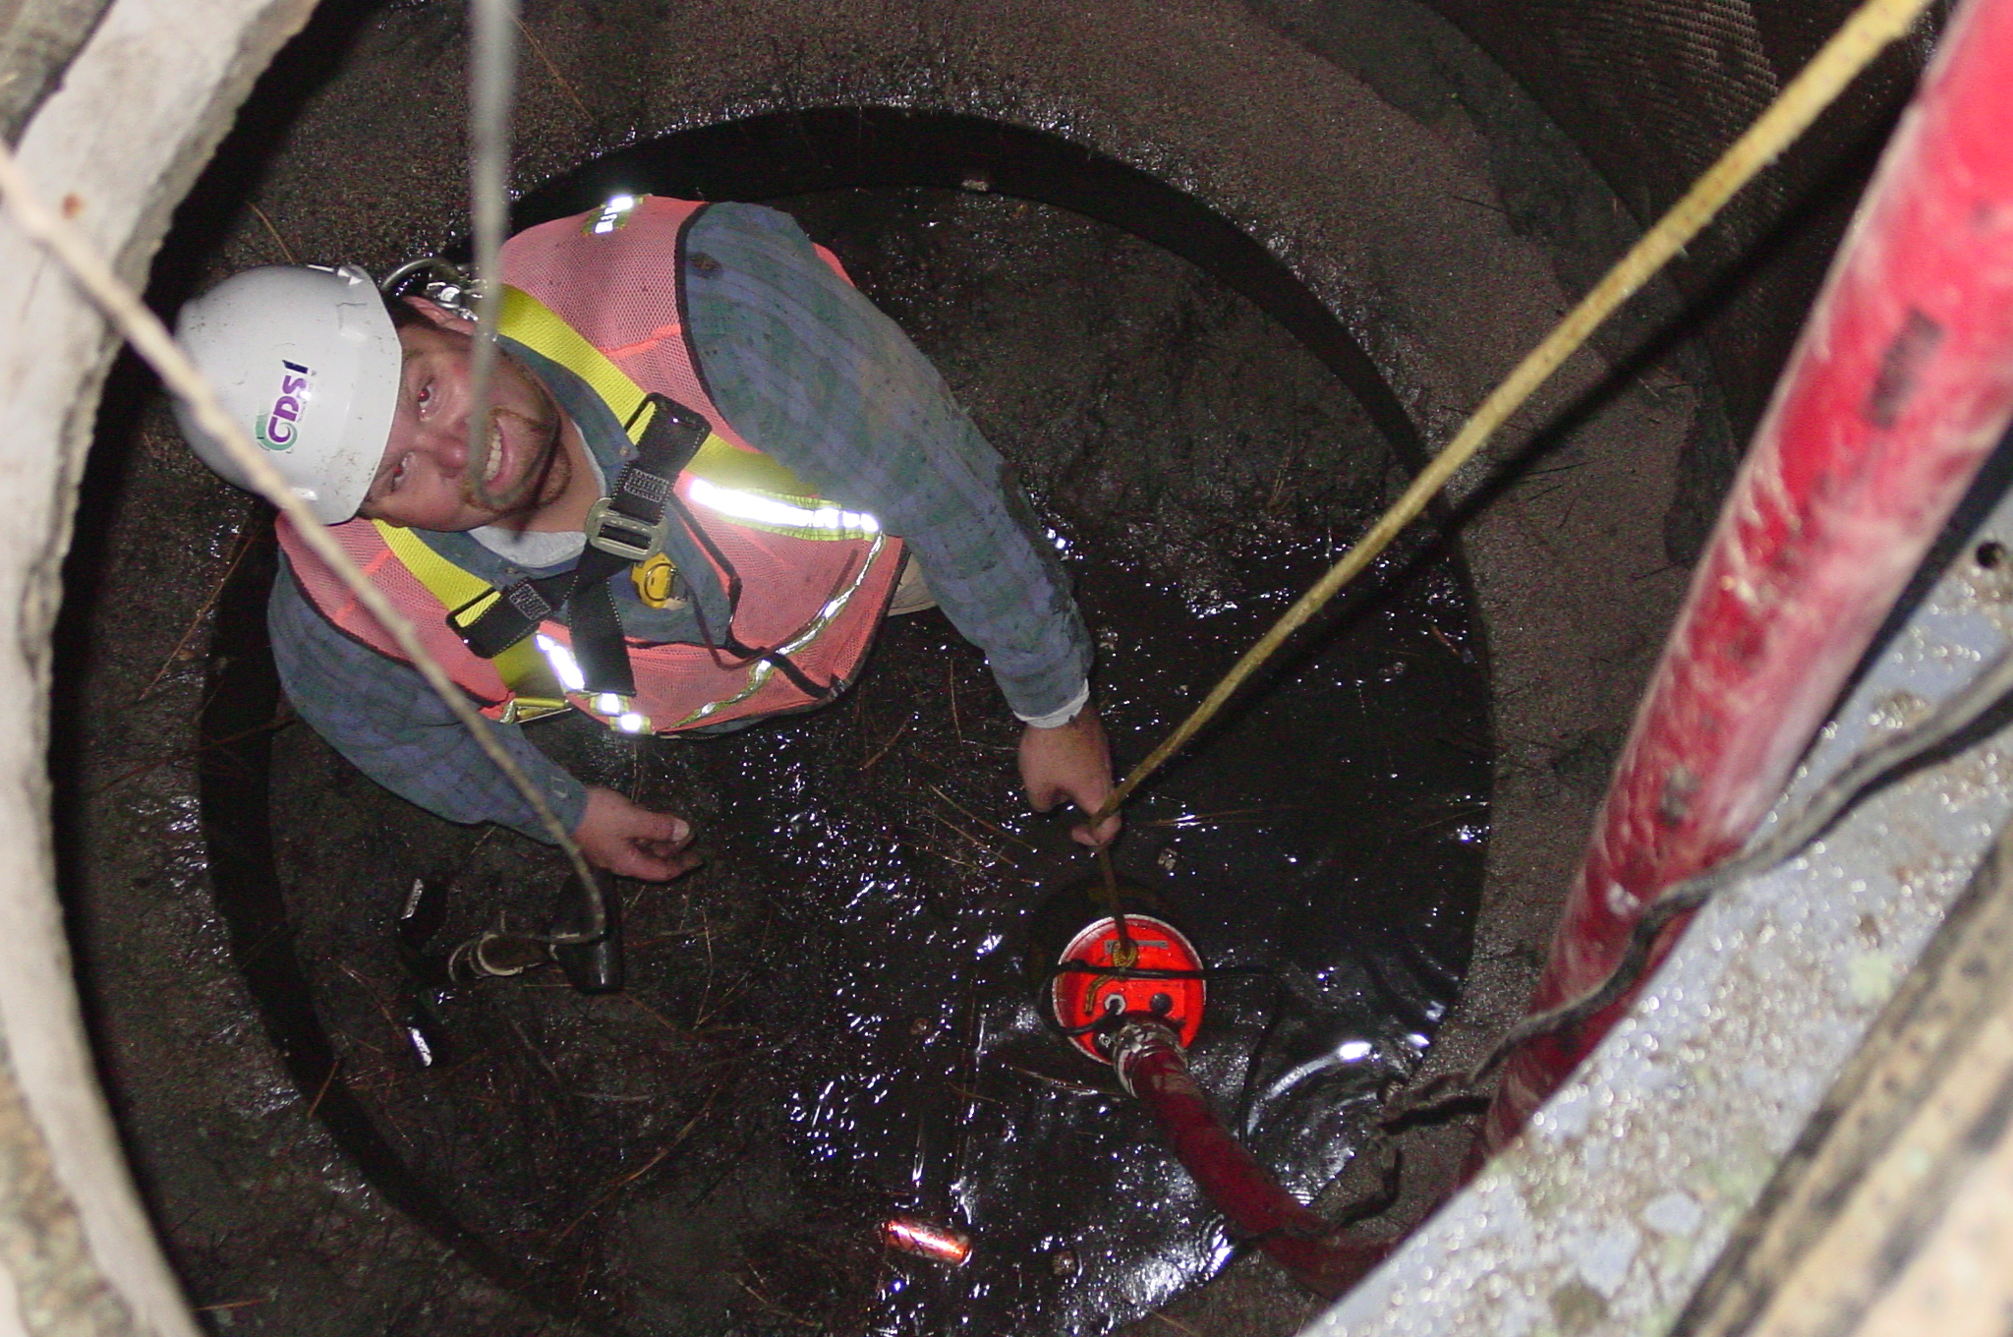
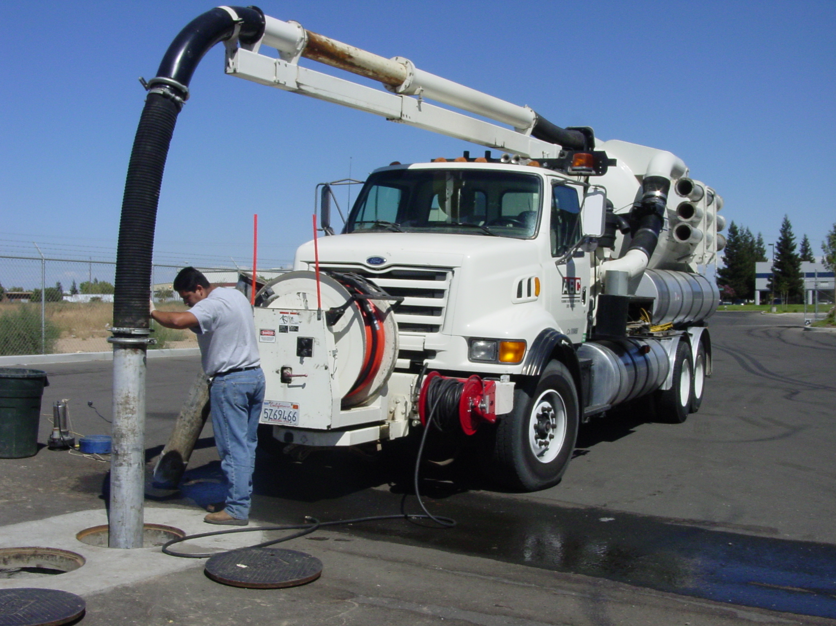
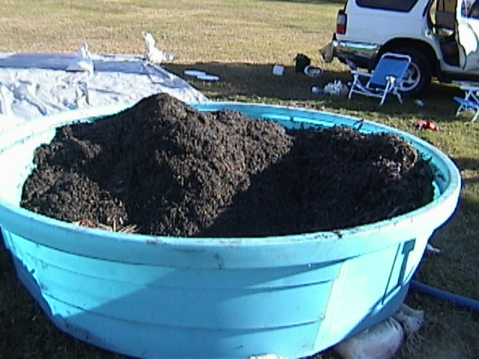
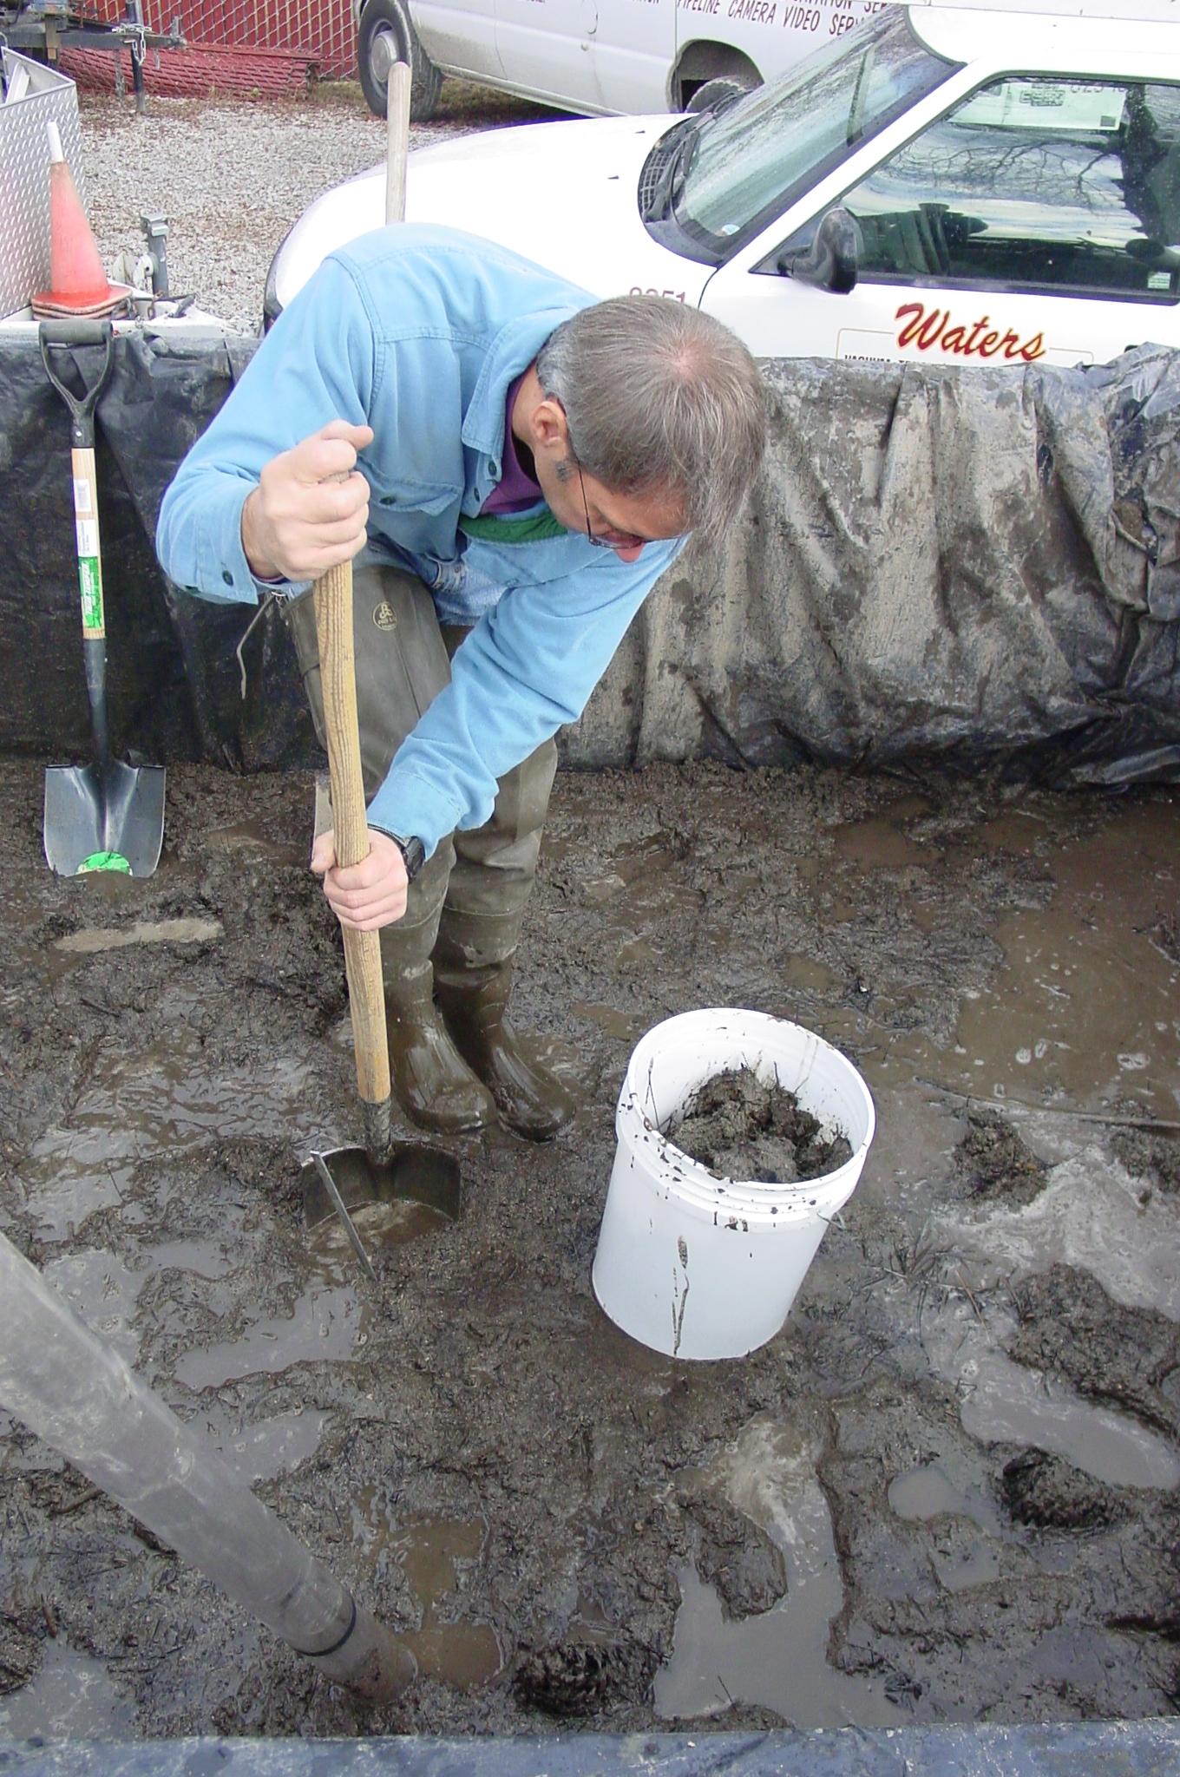
CDS Sump Solids
Characterization
(Mass Balance Approach)
Remove solids using vacuum truck or manually
Place in phase separator or storage tank
Decant water, air dry solids and measure volume
Sub-sample entire volume or use successive quartering techniques for large quantities
Analysis - Total Solids, Total Volatile Solids, Grain size distribution (PSD), S.G.

Slide 21
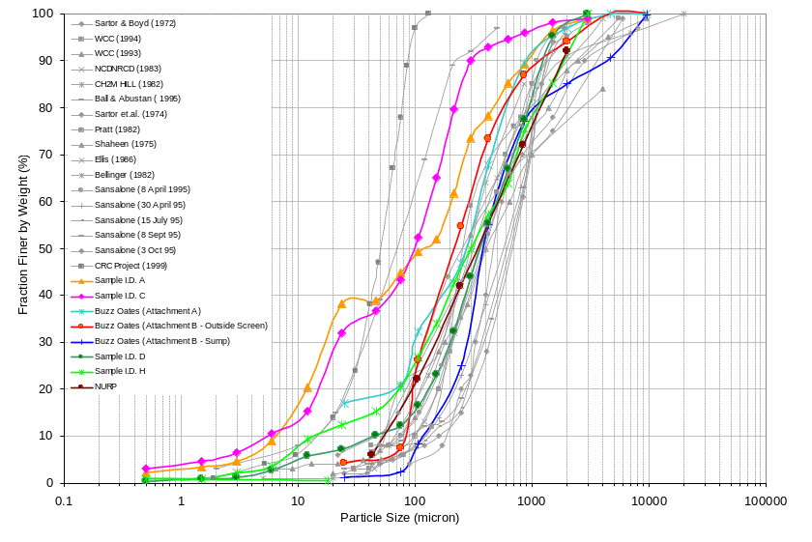
CDS Sump Material PSD vs. Other Studies
CDS Sump Material
at Various Sites
* NURP - National Urban Runoff Program (1982)

Slide 22
Analytical Procedure
Composite and Sub-sampling
  Flow weighted composite samples
  Cone Splitter for sub-sampling
Total Suspended Solids (TSS) vs. Suspended Sediment Concentration (SSC)
  APHA Method 2540D
  ASTM Method D3977-97
Maximum Detection Limit
Partitioning of Phosphorous and Metals – Fractionation immediately after sampling

Slide 23
Data Evaluation
Individual Storm Event – Pollutant Reduction
  Concentration (mg/L)
  Mass Loading (g)
Accumulated Pollutant Load Reduction – Mass Balance Approach
Removal percentage and Effluent quality
Statistical goals – cov, C.I.

Slide 24
Statistical Goals
Number of Events
Coefficient of variance
Confidence Internal
Treatment level | Standard | COV | Min # of Sample Pairs
 |  |  | C.I. 95 | C.I. 90
Basic | 80% SSC | 0.55 | 6 | 5
TP | 50% TP | 0.75 | 28 | 20
Washington Ecology - TAPE protocol

Slide 25
BMP Performance Evaluation
Treatment Performance
  Solid (TSS/SSC) removal
  Total metals, Total Phosphorous
  Dissolved pollutants
Hydraulic performance
  Treatment flow vs. Bypass flow
  Headloss
Operation & Maintenance
  Frequency
  Procedure

Slide 26
Summary
Accurate flow measurement is critical for the BMP monitoring in order to determine system hydraulic performance and pollutant load.
Particle size analysis is critical for comparing system performance. d₅₀, d₁₀ and d₉₀ are necessary to define a PSD.
A mass balance approach by characterizing the pollutant load captured in the BMP can correct the inaccuracy of auto sampling for sediment-laden (>63-μm) urban runoff flow.

Slide 27
Summary - Cont.
SSC analytical method provides accurate pollutant loading analyses for the urban runoff flow.
Compositing and Sub-sampling using cone-splitter is efficient for analyses of particles less than 500-μm.
Load reduction and effluent quality should be the ultimate performance evaluation criteria for BMPs.

Slide 28
BMP Monitoring & Evaluation
Site Selection
Rainfall
Data Acquisition
Runoff
Flow
Sample
Water Quality Analyses
Mass Loading Reduction
BMP Evaluation
Percent Removal
Treatment Performance
Effluent Quality
Hydraulic Performance
Operation & Maintenance

