Slide 1
Madden/Julian Oscillation: Recent Evolution, Current Status and Forecasts
Update prepared by
Climate Prediction Center / NCEP
November 28, 2005

Slide 2
Outline
Overview
Recent Evolution and Current Conditions
Madden Julian Oscillation Forecast
Summary

Slide 3
Overview
The MJO was active at weak to moderate levels during the last few months.
The MJO remains weak with signals across the global tropics more regional in nature and associated with more localized forcing such as that from SSTs and linkages with the extratropical circulation. Since the last update regions of enhanced convection over the eastern Indian Ocean and suppressed convection over the Pacific have shifted slightly eastward. Easterly wind anomalies in the tropical western Pacific Ocean have expanded and strengthened.
Based on the latest observational evidence and statistical and dynamical forecasts, the MJO is expected to remain weak during the upcoming period with a quasi-persistent pattern continuing.
Although the MJO remains weak, there are potential benefits/hazards in the global tropics during the forecast period. During week 1, extratropical storm Delta will move eastward leading to increased rainfall in Morocco while a tropical cyclone in the Bay of Bengal will increase the risk of precipitation for southern parts of India. In addition, a low pressure area east of Bermuda needs to be monitored for subtropical or tropical development. We also expect an increased chance of above average rainfall across Indonesia associated with above average SSTs and continuation of the persistent pattern cited above. We expect reduced rainfall over northern South America and southern Central America.
During week 2, we expect an increased chance of above average rainfall over the Bay of Bengal, India, and the Maritime Continent to continue as a result of a quasi-persistent pattern mainly associated with above average SSTs and other intraseasonal tropical variability.
As a result of the continued enhanced convection across the eastern Indian Ocean and Indonesia and the associated westerly wind anomalies, the Southern Indian Ocean and the Bay of Bengal will need to be monitored for additional tropical cyclogenesis throughout the forecast period.

Slide 4
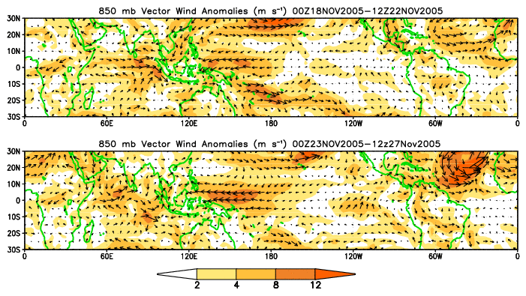
850-hPa Vector Wind Anomalies (m s⁻¹)
Note that shading denotes the magnitude of the anomalous wind vectors.
Westerly anomalies in the Indian Ocean have weakened
Easterly wind anomalies in the tropical Pacific Ocean have strengthened and extend further east

Slide 5
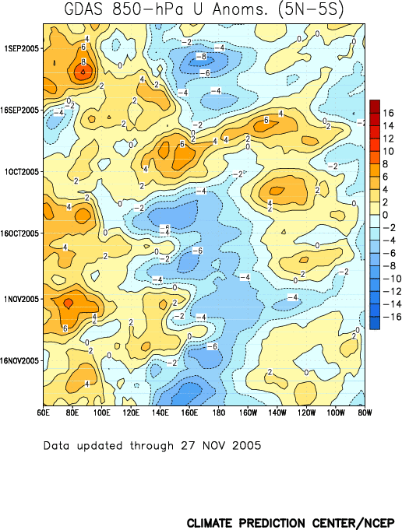
Low-level (850-hPa) Zonal (east-west) Wind Anomalies (m s⁻¹)
Weaker-than-average easterlies or westerlies (orange/red shading).
Stronger-than-average easterlies (blue shading).
Anomalies associated with the MJO in the eastern Indian Ocean, Indonesia, and Pacific Ocean propagated eastward during the first half of September
Time
Equatorial easterly and westerly anomalies have shifted eastward
Longitude

Slide 6
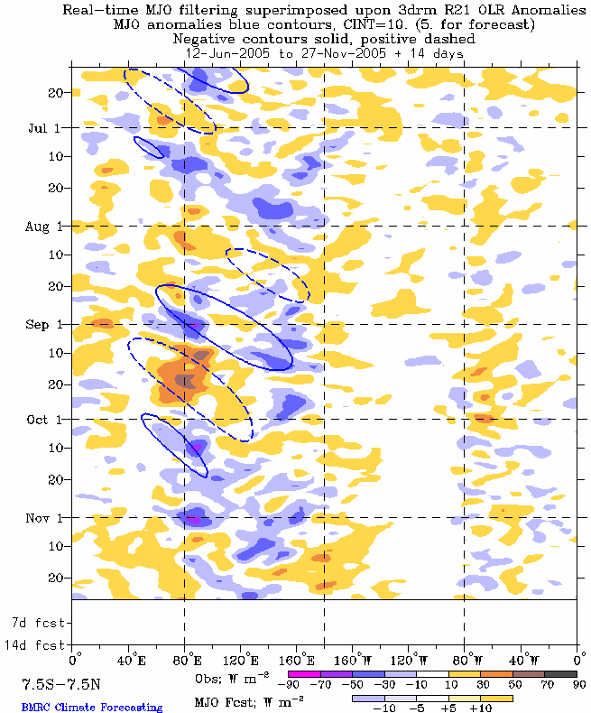
Outgoing Longwave Radiation (OLR) Anomalies (7.5°S-7.5°N)
Drier-than-average conditions (/red shading)
Wetter-than-average conditions (blue shading)
The MJO was generally weak from June through August
Time
Convection that developed near the beginning of September in the Indian Ocean propagated eastward during early September
Suppressed convection in the western equatorial Pacific Ocean and enhanced convection in the Indian Ocean shifted slightly eastward during the past week.
Longitude

Slide 7
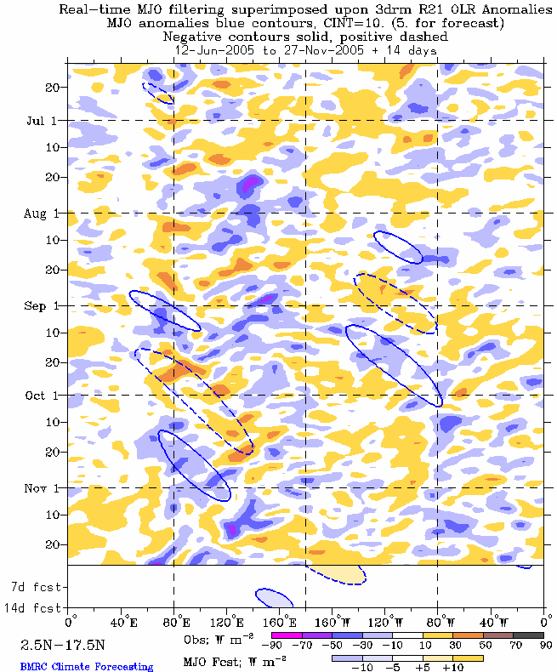
Outgoing Longwave Radiation (OLR) Anomalies (2.5°N-17.5°N)
Drier-than-average conditions (orange/red shading)
Wetter-than-average conditions (blue shading)
Time
Enhanced convection north of the equator shifted eastward during the second half of October
During the past week, regions of enhanced/suppressed convection shifted slightly eastward.
Longitude

Slide 8
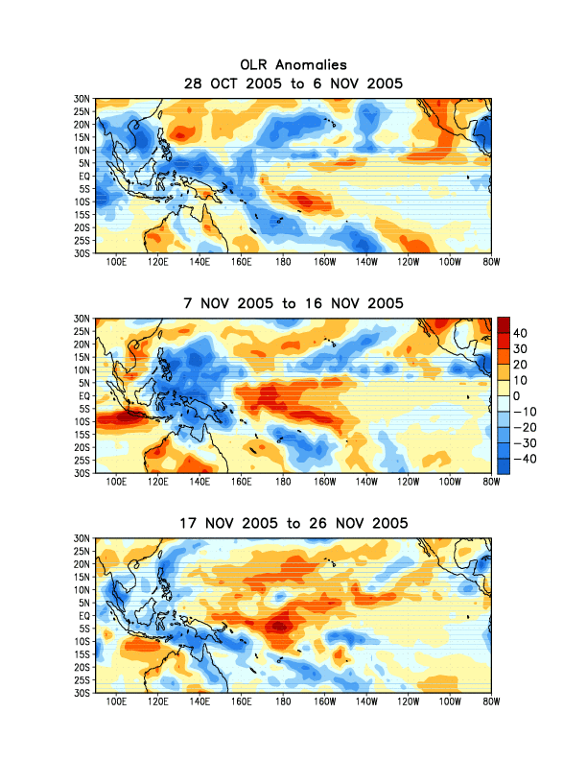
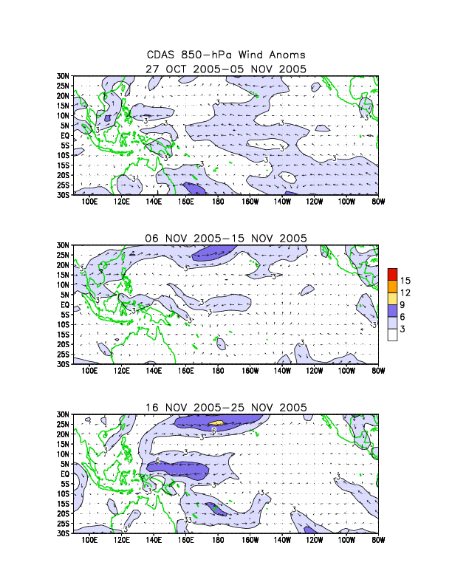
Anomalous OLR and 850-hPa Wind: Last 30 days
During the past 30 days, enhanced convection has been evident across the eastern Indian ocean and Indonesia. During the most recent period, convection has diminished across the Maritime Continent.
Easterly anomalies have strengthened in the western Pacific

Slide 9
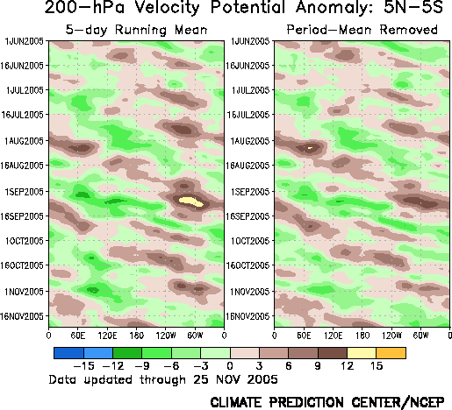
200-hPa Velocity Potential Anomalies (5°S-5°N)
Positive anomalies (brown shading) indicate unfavorable conditions for precipitation.
Negative anomalies (green shading) indicate favorable conditions for precipitation.
Weak to moderate MJO activity has been observed from July into October as upper-level convergence (brown areas) and upper-level divergence (green areas) have propagated eastward across the global tropics.
During the past week, regions of upper-level divergence and convergence have shifted eastward.
Time
Longitude

Slide 10
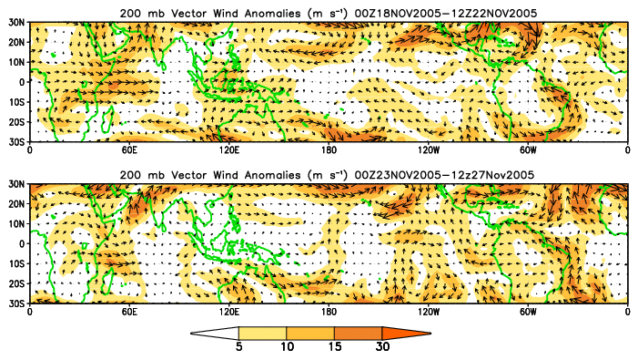
200-hPa Vector Winds and Anomalies (m s⁻¹)
Note that shading denotes the magnitude of the anomalous wind vectors.

Slide 11
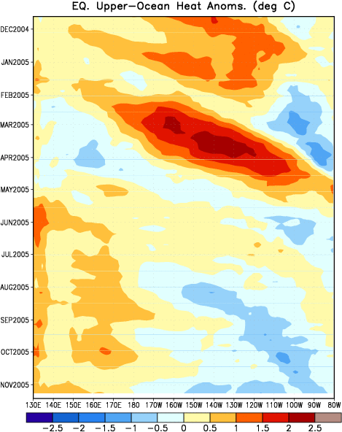
Heat Content Evolution in the Eq. Pacific
Through 2004 and 2005 there were several cases of eastward-propagating oceanic Kelvin waves (indicated by dashed black lines in the figure).
Each Kelvin wave was initiated when the easterlies weakened over the equatorial Pacific in association with Madden-Julian Oscillation (MJO) activity.
During February 2005, a strong Kelvin wave (initiated by persistent westerly anomalies near the date line unrelated to the MJO) developed and continued to strengthen during March and reached the South American coast during early April. Heat content has become above average in the western Pacific during July, August, September, and October while cooler water has been observed across the eastern Pacific.
Time
Longitude

Slide 12
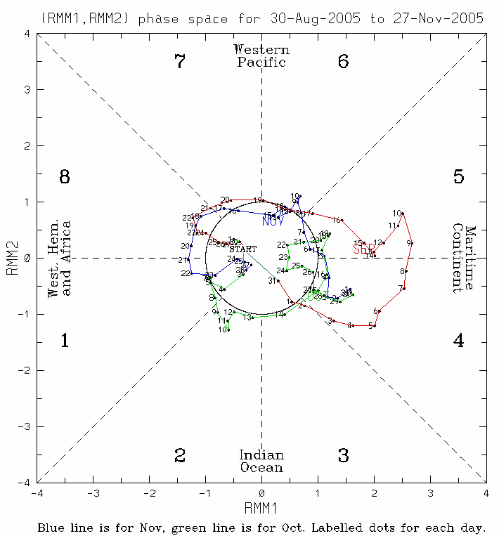
MJO Index (Magnitude and Phase)
The current state of the MJO as determined by an index based on Empirical Orthogonal Function (EOF) analysis using combined fields of near-equatorially-averaged 850 hPa zonal wind, 200 hPa zonal wind, and satellite-observed outgoing longwave radiation (OLR) (Wheeler and Hendon, 2004).
The axes represent the time series of the two leading modes of variability and are used to measure the amplitude while the triangular areas indicate the phase or location of the enhanced phase of the MJO. The farther away from the center of the circle the stronger the MJO. Different color lines indicate different months.
The MJO strengthened in early September with enhanced convection propagating eastward into the month of October at weak to moderate levels
During the past week, the MJO remained weak with little projection.

Slide 13
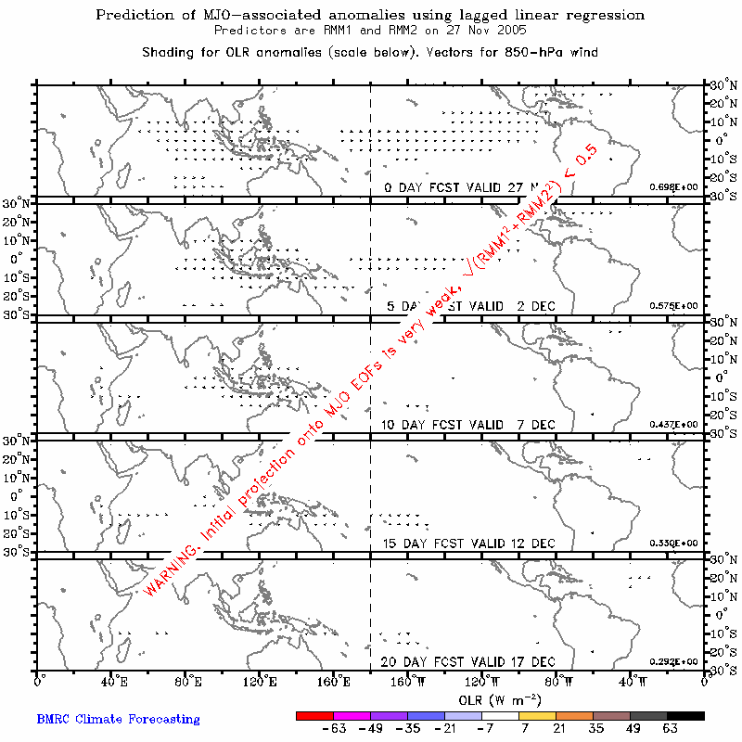
Statistical OLR MJO Forecast
The MJO is forecast to remain weak during the next 6-10 days

Slide 14
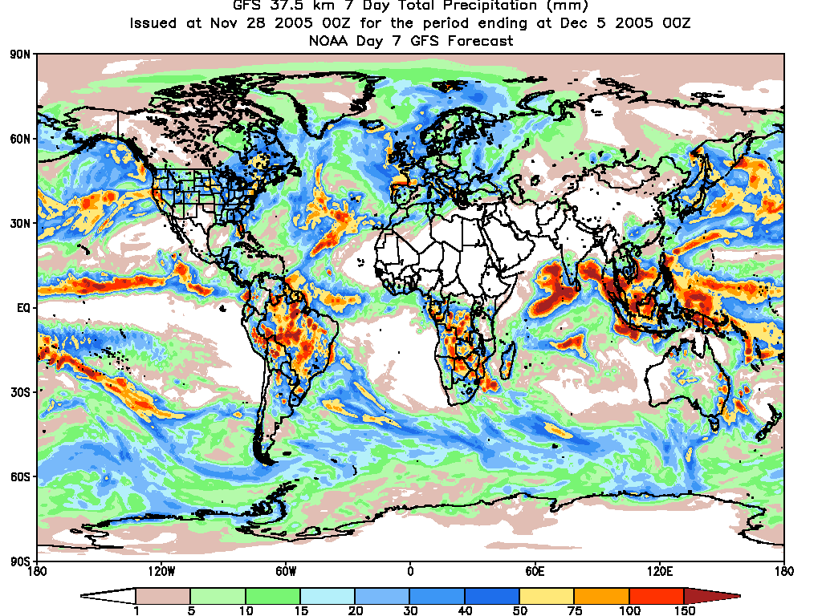
Global Forecast System Precipitation Forecast

Slide 15
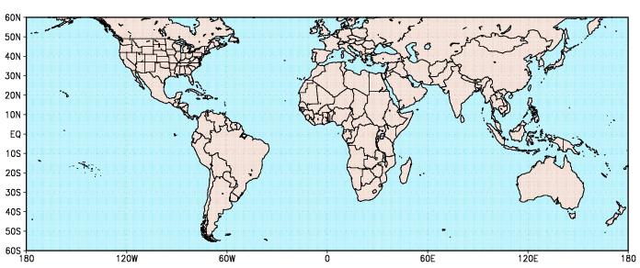
Potential Benefits/Hazards – Week 1
1
4
3
2
1. Extratropical Storm Delta will influence Morocco with heavy rain and strong winds
2. An increased chance of above average rainfall across southern India, Bay of Bengal, the Maritime Continent (i.e., Indonesia), and northern Australia.
3. Tropical cyclone 5B will influence the Bay of Bengal and the Indian continent.
4. An increased chance of below average rainfall across southern Central America and extreme northern South America.

Slide 16
Potential Benefits/Hazards –Week 2
1
1. An increased chance of above average rainfall across southern India, Bay of Bengal, the Maritime Continent (i.e., Indonesia), and northern Australia

Slide 17
Summary
The MJO was active at weak to moderate levels during the last few months.
The MJO remains weak with signals across the global tropics more regional in nature and associated with more localized forcing such as that from SSTs and linkages with the extratropical circulation. Since the last update regions of enhanced convection over the eastern Indian Ocean and suppressed convection over the Pacific have shifted slightly eastward. Easterly wind anomalies in the tropical western Pacific Ocean have expanded and strengthened.
Based on the latest observational evidence and statistical and dynamical forecasts, the MJO is expected to remain weak during the upcoming period with a quasi-persistent pattern continuing.
Although the MJO remains weak, there are potential benefits/hazards in the global tropics during the forecast period. During week 1, extratropical storm Delta will move eastward leading to increased rainfall in Morocco while a tropical cyclone in the Bay of Bengal will increase the risk of precipitation for southern parts of India. In addition, a low pressure area east of Bermuda needs to be monitored for subtropical or tropical development. We also expect an increased chance of above average rainfall across Indonesia associated with above average SSTs and continuation of the persistent pattern cited above. We expect reduced rainfall over northern South America and southern Central America.
During week 2, we expect an increased chance of above average rainfall over the Bay of Bengal, India, and the Maritime Continent to continue as a result of a quasi-persistent pattern mainly associated with above average SSTs and other intraseasonal tropical variability.
As a result of the continued enhanced convection across the eastern Indian Ocean and Indonesia and the associated westerly wind anomalies, the Southern Indian Ocean and the Bay of Bengal will need to be monitored for additional tropical cyclogenesis throughout the forecast period.

