Slide 1
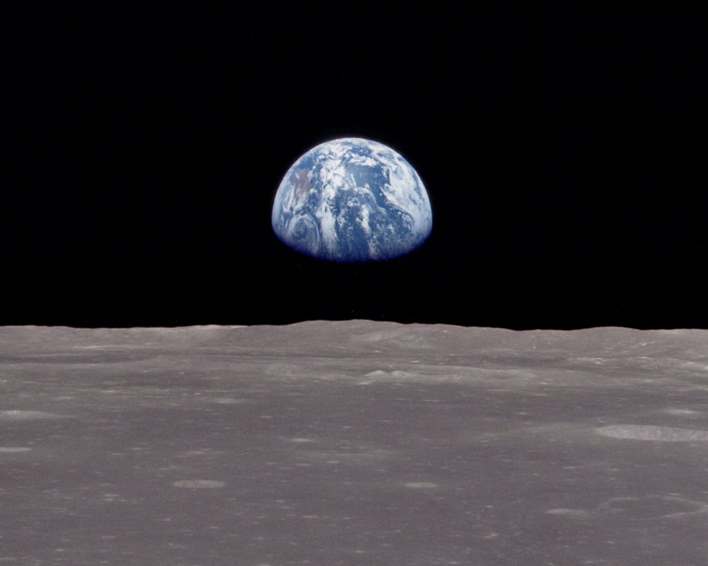
Lunar Surface Charging: Observations from Lunar Prospector

Slide 2
Horizontal and/or
Vertical Dust Transport
Plasma
Electrons
Solar Illumination
Sheath
Boundary
Secondary
Electrons
Wake
Boundary
Photoelectrons
_
_
_
_
_
_
_
_
+
+
Terminator Region
_
+
+
+
_
+
Photon Driven
Positive Charging
_
+
Electron Driven
Negative Charging
+
_
+
_
+
+
Lunar Surface Charging And Electric Fields
_
Positive photon charging on day side
Negative electron charging on night side
Implications for dust charging and transport, especially near terminator

Slide 3
LP Electron Reflectometer
The Electron Reflectometer is a top-hat electrostatic analyzer that measures the 3-d electron distribution from ~10 eV to 20 keV
Magnetic and electric fields reflect electrons adiabatically – with reflection depending on initial pitch angle
Measurements of angular distributions therefore give information on both electric and magnetic fields below the spacecraft

Slide 4
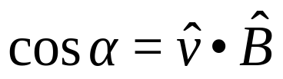
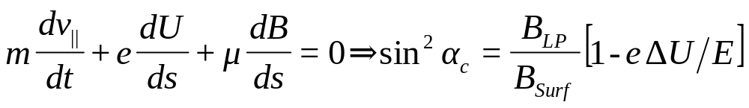
Electron Trajectory
Converging
Magnetic Fields
Downward
Electric Field
Negative Surface
Charge Layer
-
-
-
-
-
-
-
-
-

Slide 5
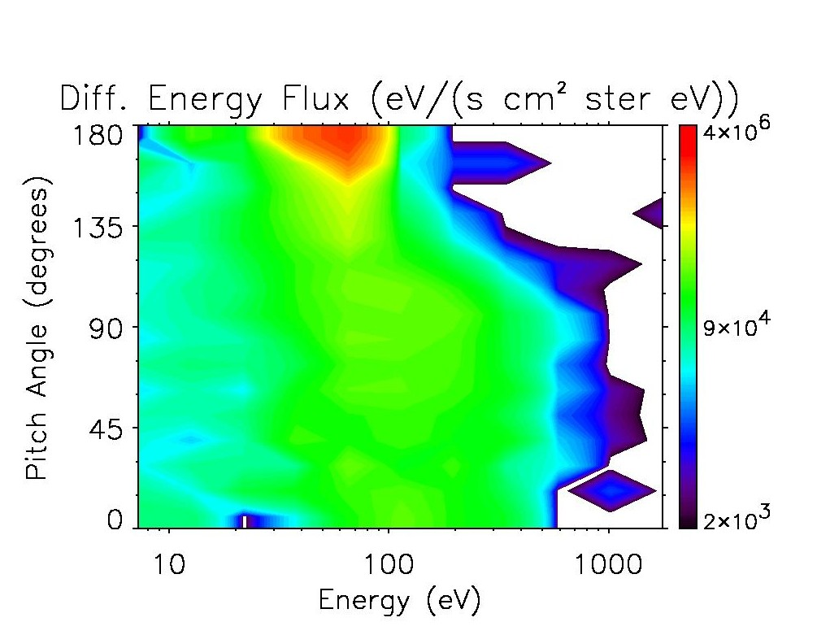
Typical Night Side Observation
Energy-dependent loss cone from ~100-1000 eV implies electric fields
Beam of upward-going secondary electrons at ~50 eV implies electric fields

Slide 6
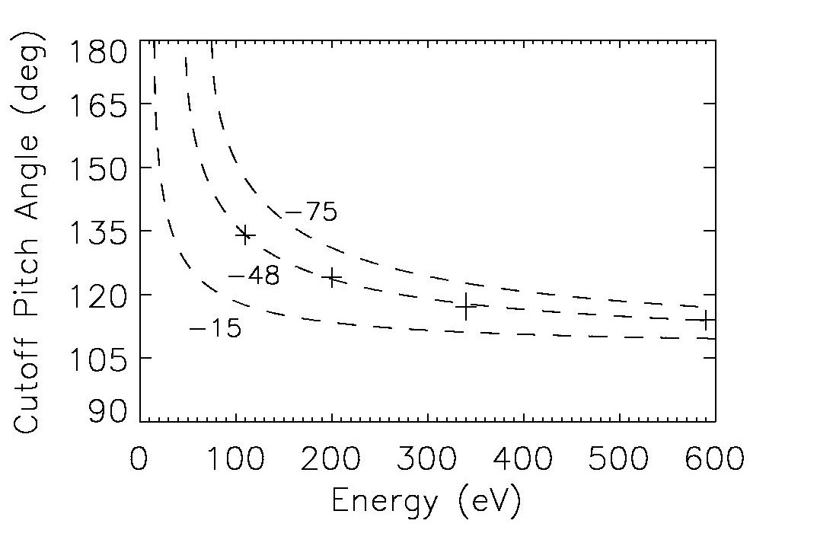
Energy-Dependent Loss Cone
Fitting loss cone gives potential drop of ~48 V
Consistent with energy of beam of accelerated secondary electrons from the surface.

Slide 7
Electric Field Scale Height
A critical parameter is the scale height – or sheath thickness
If the sheath thickness is comparable to the electron gyroradius, we can use this to estimate the sheath thickness by comparing measurements for different magnetic field tip angles with respect to the surface normal
We find a night side sheath thickness of ~1 km

Slide 8
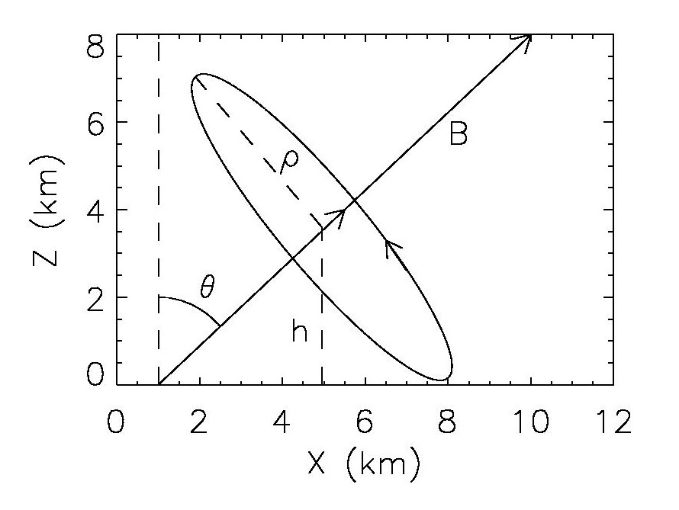
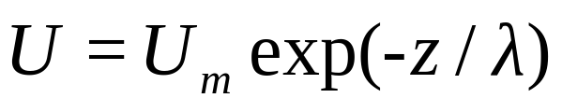

Lunar Potential
Altitude Variation:
Electron Orbit
Magnetic Field: B
Tip-Angle: θ
Electron Gyro-Radius: ρ
Minimum Gyro-Center
Altitude:
Quasi-Adiabatic Prediction for Maximum
Gyro-Averaged Potential Seen by Electron:

Slide 9
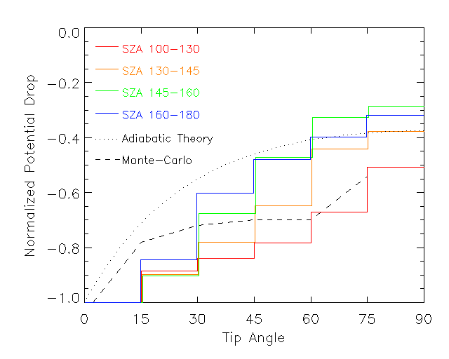
Predictions vs. Data

Slide 10
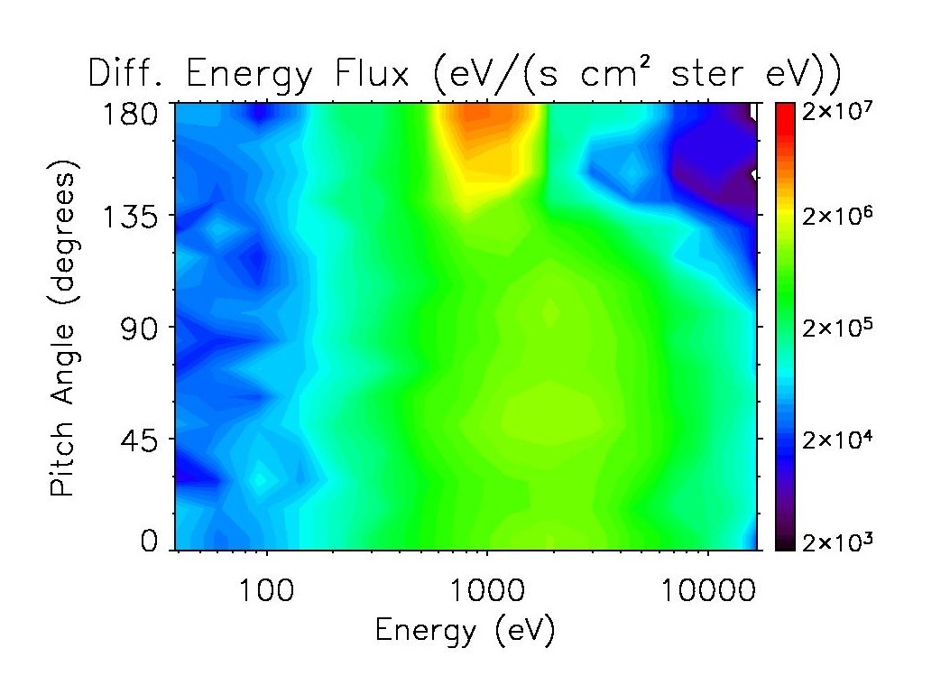
Extreme Environments
In the plasmasheet electron temperatures are much higher
Here we find evidence for negative surface potentials as large as ~ -2 kV

Slide 11
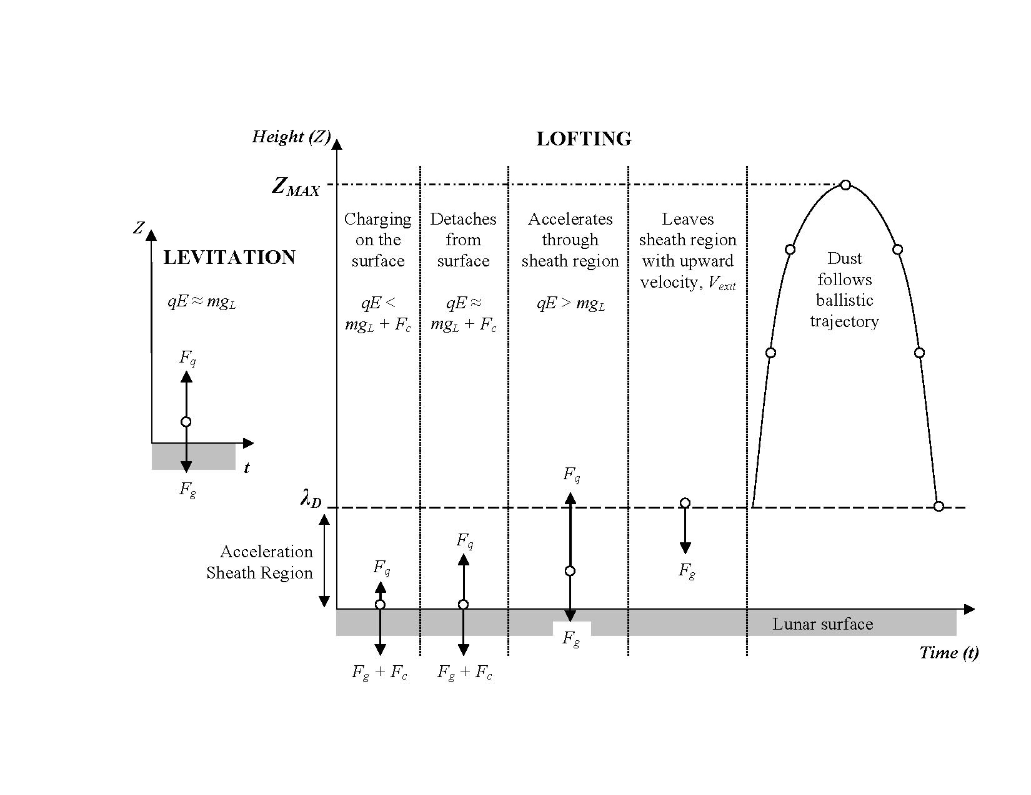
Implications for Dust Transport
Courtesy of Tim Stubbs

