Slide 1
Model Uncertainty in Ensemble Design:
I: Time-Step Truncation Error
II: Stochastic Parameterizations
João Teixeira^{(1,2)}, Carolyn A. Reynolds⁽¹⁾ , Kevin Judd^{(1,3)} and Craig Bishop⁽¹⁾
Naval Research Laboratory, Monterey, CA, USA
NATO Undersea Research Centre, La Spezia, Italy
University of Western Australia, Perth, Australia

Slide 2
I:Truncation error: introduction – 3 questions
Extreme sensitivity of models to initial conditions
major source of uncertainty in weather and climate prediction
What is the sensitivity of chaotic systems to truncation error?
3 models of different levels of complexity to answer the questions:
1) What are the consequences in terms of numerical convergence of using different time-steps in chaotic models such as Lorenz63? (not discussed here).
2) What are the differences between truncation error (time-step) and initial-condition error in models such as the QG model?
3) What is the impact of the truncation error in terms of the predictability of an operational system such as NOGAPS?

Slide 3
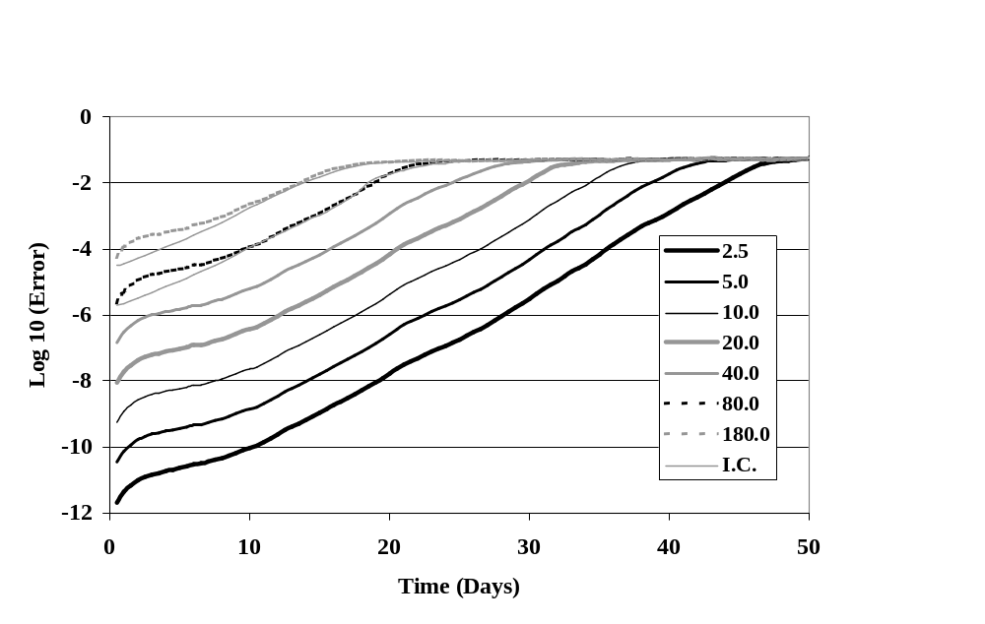
QG model- Truncation error growth
Quasi-geostrophic (QG) potential vorticity (PV) model (Marshall and Molteni, 1993)
T21 horizontal resolution – 3 vertical levels (800, 500 and 200 hPa).
Forcing - Source terms of PV, varying in space but not in time, NH winter climatology
Truncation (Δt) error
Initial condition error
Different growth properties between truncation and initial-condition error
Log10 of L2 norm error in non-dimensional stream function state vector: different time-steps versus control time-step of 1.25 min.
Regular decoupling – Log relation

Slide 4
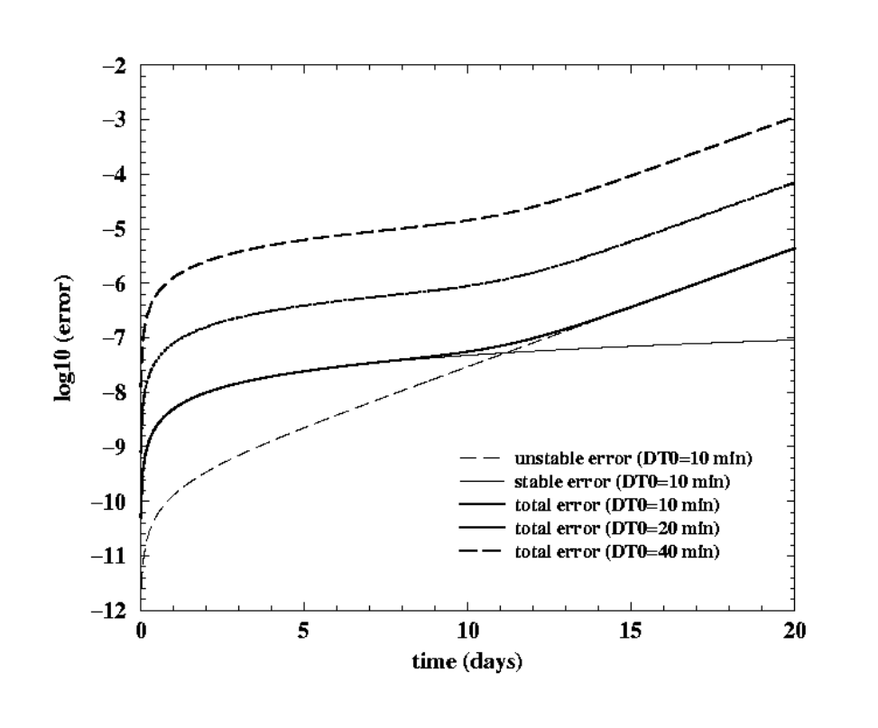
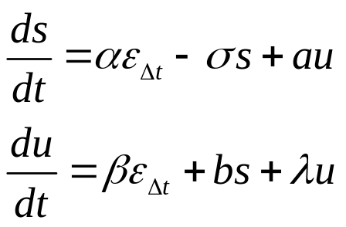

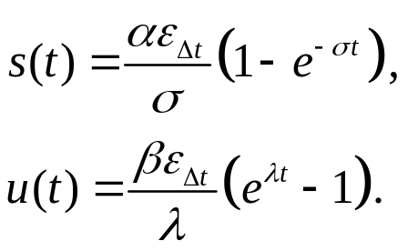
Simple model of truncation error growth in chaotic systems
Simple model of error growth is constructed, by considering relative error growth rates in the stable and unstable directions:
σ - rate of decay of stable modes
λ - sensitivity to initial conditions
ε_{Δt} - typical one-step truncation error
Assuming we obtain:
Truncation error in non-linear systems is a simple combination of:
Stable linear error
Unstable exponential error

Slide 5
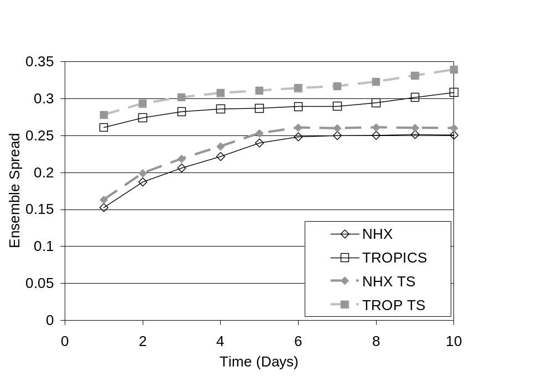
NOGAPS Ensemble – the impact of time-step
Ensemble spread of 12-h accumulated precipitation (mm) - May 2005 32 member ensemble, T119L30 resolution
Solid lines - ensemble with varying initial conditions (IC) but same time-step of 900 s. Dashed lines - ensemble with varying IC and two different time-steps: 900 s and 450 s.
Tropics (TROP) NH extratopics (NHX) SH extratropics (SHX)
Spread increases with different time-steps
Different time-steps may be a simple way of introducing model error in ensemble design

Slide 6
Truncation error: Summary
Solutions with different time-steps decouple from each other (time of decoupling depends on log of time-step)
Numerical convergence in chaotic models is not forever
3 stages of truncation error growth in chaotic systems (QG): 1) rapid growth, 2) saturation, 3) exponential growth
Truncation_error=stable error + unstable error (simple model)
NOGAPS: truncation error is substantial part of total error
Using different time-steps is a simple and potentially useful way of introducing model (truncation) error into ensembles
Notes:
For NOGAPS different time step ensemble experiments. There is considerably less sensitivity at the resolution of T119 then at the resolution of T79. Not sure if we should mention this.

Slide 7
II: Stochastic nature of physical parameterizations in ensemble prediction
For parameterizations: Ensemble prediction is fundamentally different from deterministic prediction
In ensemble prediction systems:
Physical parameterizations should be viewed/used as stochastic (rather than deterministic as usually done)
This can be done within the context of current parameterizations (without imposing artificial stochastic terms)
Parameterizations:
Typically used to predict the evolution of grid-mean quantities (due to unresolved sub-grid scale processes)
Can also provide estimates of higher moments (which can be used to constrain the random determination of a variable)

Slide 8
Stochastic nature of physical parameterizations in ensemble prediction
Parameterizations in ensemble prediction systems:
No a priori reason for parameterizations to produce evolution of grid-mean
Each ensemble member should provide a probable value of a variable
Random values should be constrained by parameterization PDFs (e.g. variance given by parameterization)
Introducing additional stochastic terms may not be necessary
Parameterizations in ensemble prediction should be used in a stochastic manner, based on PDFs produced by the parameterizations themselves

Slide 9

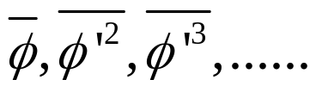
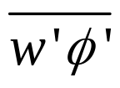
Parameterization problem in weather models
Climate and weather prediction models: Δx=Δy~100 km
Δx
Δy
probability
latitude
Temperature (K)
pdf of temperature in the grid-square
longitude
The problem of parameterization
How to better estimate:
1) the pdf of each variable 2) the subgrid flux
=> estimating

Slide 10
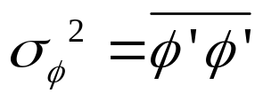
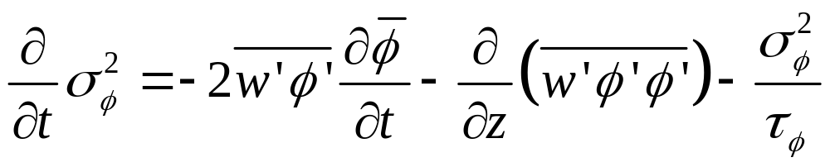
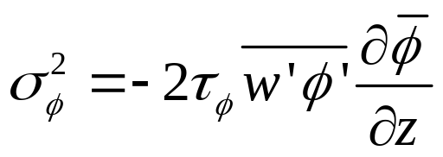
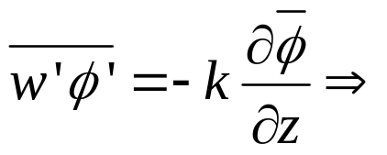
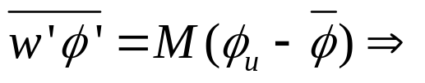
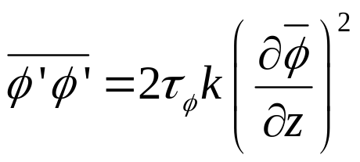
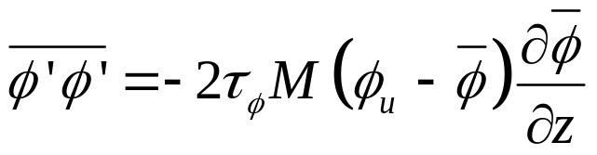
Variance/standard-deviation equations
How to determine the standard deviation
1) Prognostic equation:
2) Diagnostic equation:
Eddy-diffusivity (PBL)
Mass-flux (convection)

Slide 11
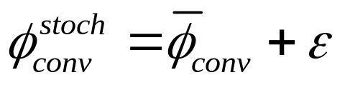






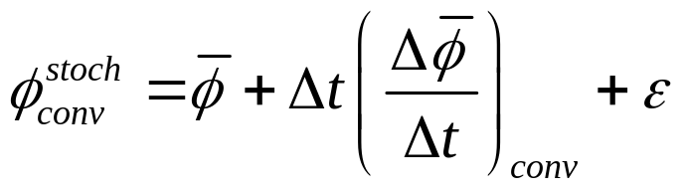

Stochastic parameterizations: methodology
Methodology for stochastic parameterizations based on the variance
A variable after being updated by a parameterization (e.g. moist convection) can be written as:
- mean value of the variable after convection
- stochastic value after convection
- normally distributed stochastic variable with
mean
standard deviation
- standard deviation due to moist convective processes
After discretizing the first term on the rhs, the following equation is obtained
- mean value before the moist convection parameterization

Slide 12
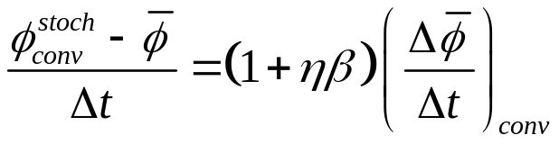




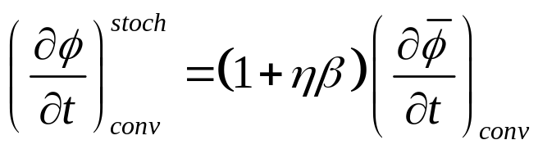

Stochastic convection: simple approach
Assuming standard deviation proportional to convection tendency leads to:
- constant of proportionality
- normally distributed stochastic variable with mean
and standard deviation
leads to
Simple vertical correlation: single random number per column
No horizontal or temporal correlations:
Simpler
Perturbations assumed much smaller than grid-size/time-step
Parameterization variance already possesses a certain degree of correlation
Physically unclear how to construct correlations

Slide 13
Stochastic convection in NOGAPS
Proposed methodology compared to Buizza et al. (1999):
Based on using formalism of convection parameterization (i.e. variance given by convection parameterization)
Stochastic approach only for moist convection parameterization
Assumes that PDF is well approximated by a Normal distribution
NOGAPS: Navy Operational Global Atmospheric Prediction System - global spectral model in horizontal and energy conserving finite difference in vertical
NAVDAS: NRL Atmospheric Variational Data Assimilation System
NOGAPS ensemble system:
32-members, 10 day forecasts, T119L30 resolution
Twp types of experiments:
Stochastic convection only
Initial condition perturbations only (based on randomly sampling NAVDAS analysis error variance estimate)

Slide 14
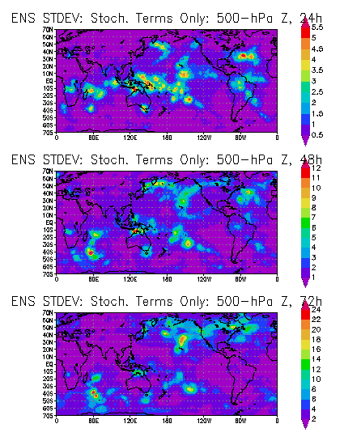
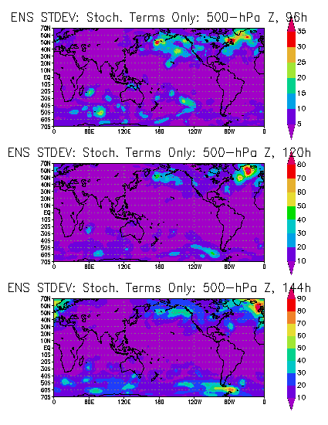
Ensemble spread due to stochastic convection only: 500 hPa Z
Perturbations grow in time
At 24 h: mostly in Tropics/Sub-tropics – At 144 h: mostly in Mid-latitudes
Similar for U at 250 and 850 hPa, T at 850 hPa
Notes:
Square root of ensemble variance for 1 case, 32-member ensemble, for 2005050100 (results are typical of other days). For different forecasts times from 24 hours to 144 hours.

Slide 15
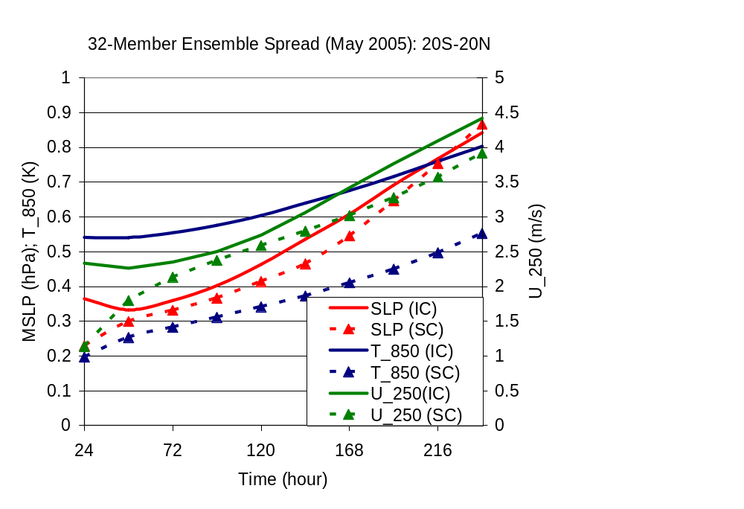
Stochastic convection: ensemble spread
Two different ensemble experiments are analyzed:
Only initial condition perturbations
Only stochastic convection perturbations
32-Member ensembles, T119l30, May ‘05
TROPICS
Ensemble spread in Tropics:
Mean-sea-level pressure (hPa)
Temperature at 850 hPa (K)
Wind at 250 hPa (m/s)
Initial condition (IC) ensembles: initial decay or slow growth.
Stochastic convection (SC) ensembles: spread increases substantially from start - comparable to initial condition spread for 250 U and SLP

Slide 16
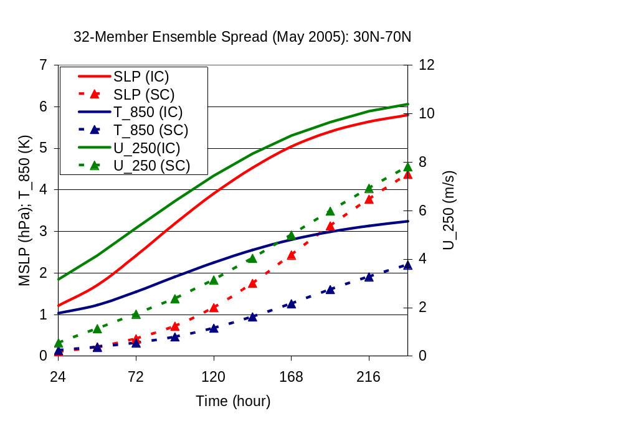
Stochastic convection: ensemble spread
Two different ensemble experiments are analyzed:
Only initial condition perturbations
Only stochastic convection perturbations
32-Member ensembles, T119l30, May ‘05
EXTRA-TROPICS
Ensemble spread in 30-90N:
Mean-sea-level pressure (hPa)
Temperature at 850 hPa (K)
Wind at 250 hPa (m/s)
Initial condition (IC) ensembles: Some saturation after 10 days
Stochastic convection (SC): Still significant impact in extra-tropics Less saturation at 10 day forecast range

Slide 17
Stochastic parameterization in ensemble systems
Stochastic nature of parameterizations in ensemble systems:
Parameterizations in ensemble prediction should be stochastic
Stochasticity constrained by parameterization PDF
A simple stochastic convection approach:
Standard deviation proportional to convection tendency
Perturbations grow in time + ‘migrate’ (tropics to extra-tropics)
Tropics: stochastic convection spread ~ init. cond. spread
NEAR FUTURE…
Stochastic convection + Initial-condition perturbations
Feasibility of this type of approach at NCEP

Slide 18
Extra Slides
Preliminary Results:
Stochastic convection + initial condition perturbations.
May 2005, T119L30, 32-member ensembles.

Slide 19
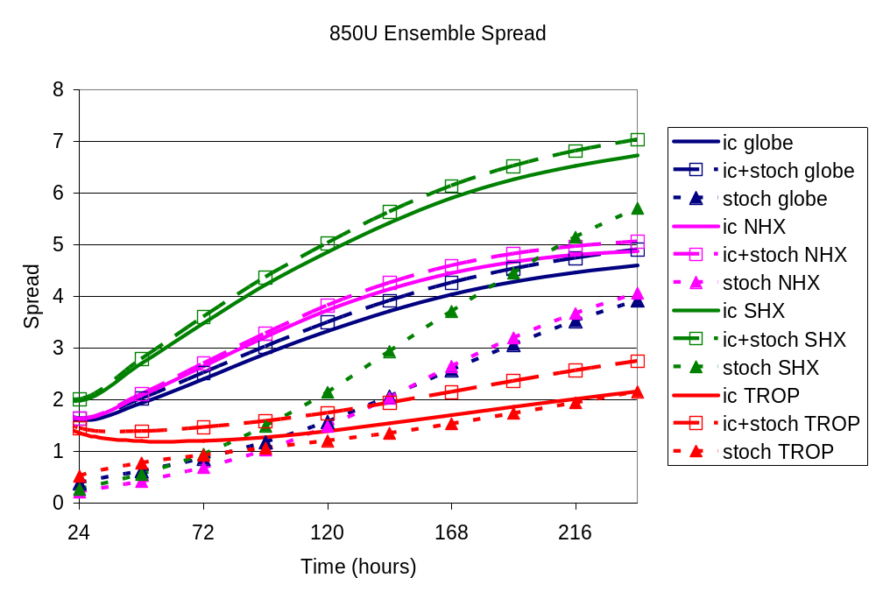
STOCHASTIC PARAMETERIZATION OF DEEP CONVECTION
Stochastic physics enhances ensemble spread, particularly in the tropics.

Slide 20
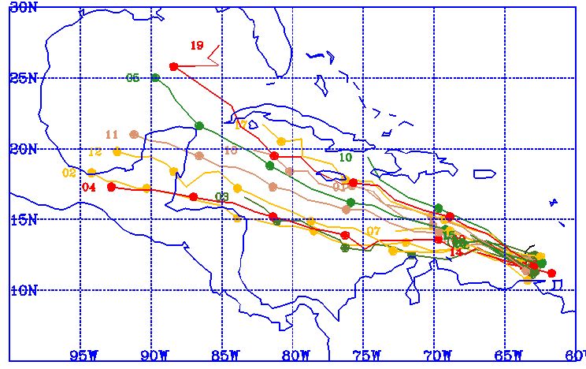
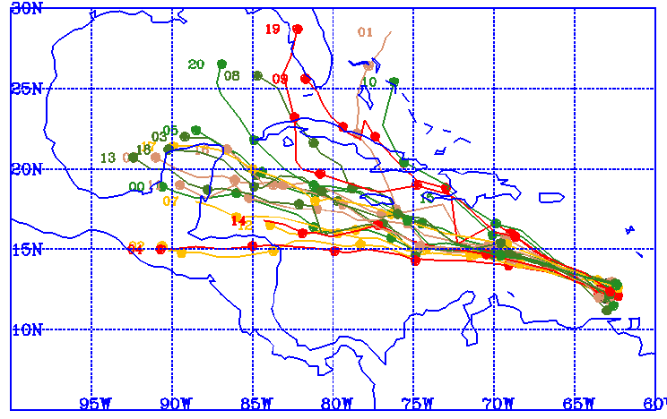
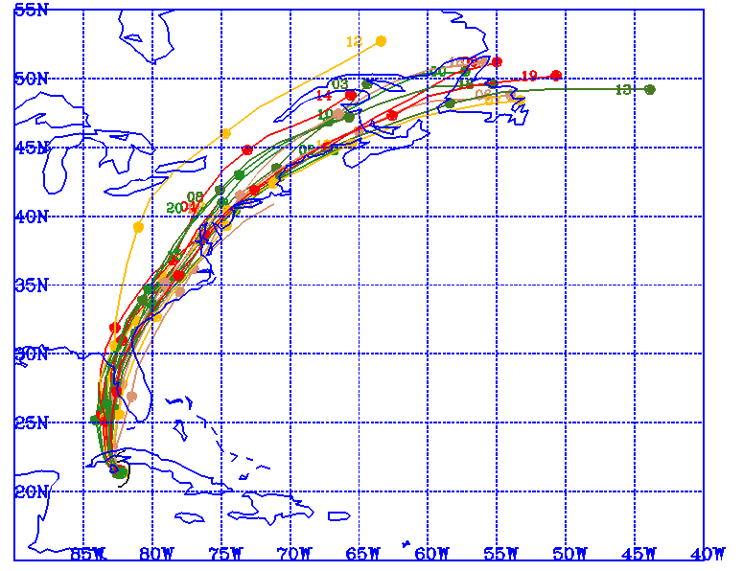
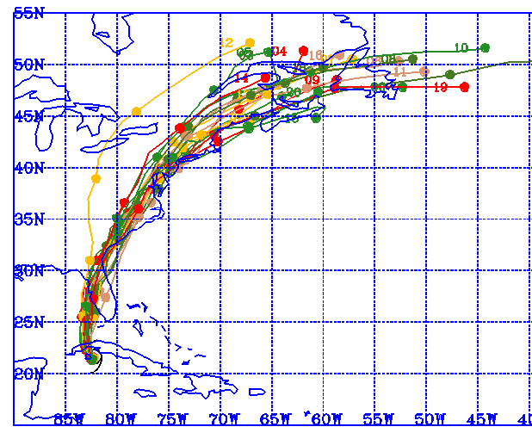
20-member Ensemble Tropical Cyclone Tracks: 20040810 (top) and 20040813 (bottom)
Control (initial perturbations only) Initial + Stochastic Perturbations
On average, stochastic perturbations increase spread in track by 15-20%. Appear to have less of an impact during recurvature.

Slide 21
Extra Slides

Slide 22
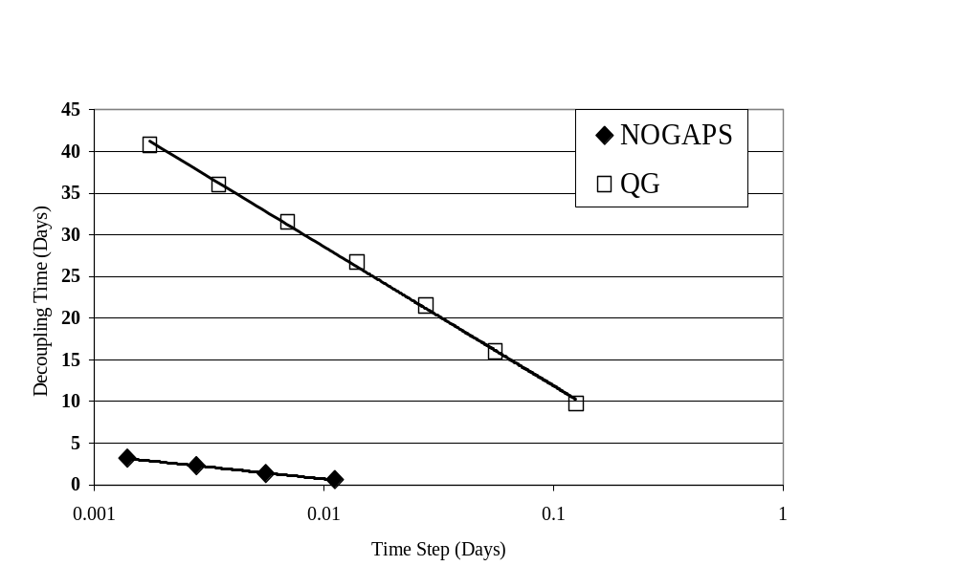
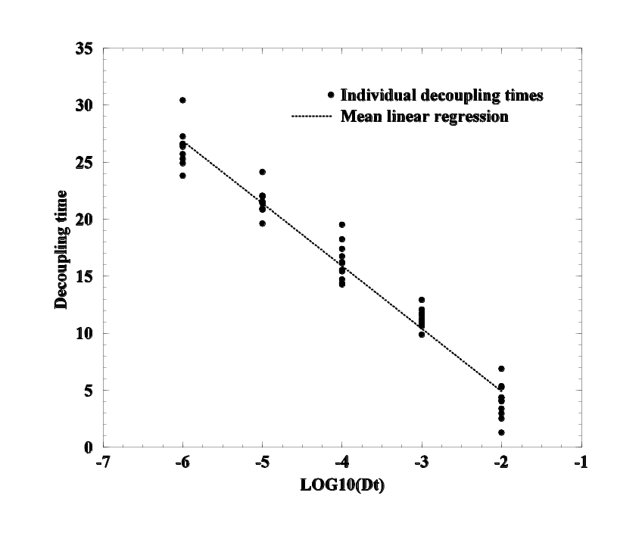
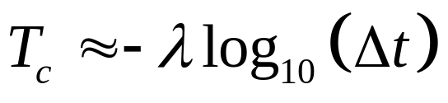
Non-linear models – Decoupling Log-relation
Critical time of decoupling T_{C}: when error for a certain Δt is above a fixed threshold
Decoupling time as a function of time-step for 3 models:L63, QG, NOGAPS
Lorenz63
slope (QG):-16.7
slope (NOGAPS):-2.9

Slide 23
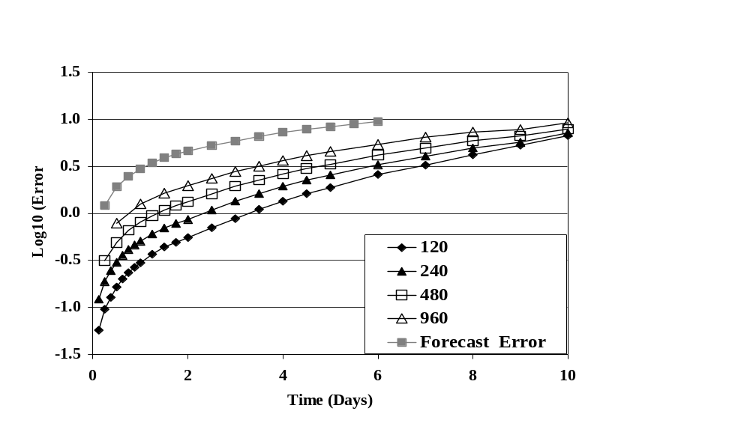
NOGAPS – Truncation error growth
NOGAPS - Navy Operational Global Atmospheric Prediction System
Global spectral model – resolution: T79L30
Parameterizations: boundary layer turbulence, moist convection, clouds, subgrid orography, land-surface, solar and longwave radiation.
Different from QG model: initial fast growth towards saturation
Parameterizations constrain accuracy to first-order
Truncation error can be a substantial part (40-60%) of total forecast error
Log₁₀ of L2 norm error in global dry total energy: different time-steps versus control time-step of 60 s. Also shown: operational (T239, 300 s) error (forecast-analysis)

Slide 24
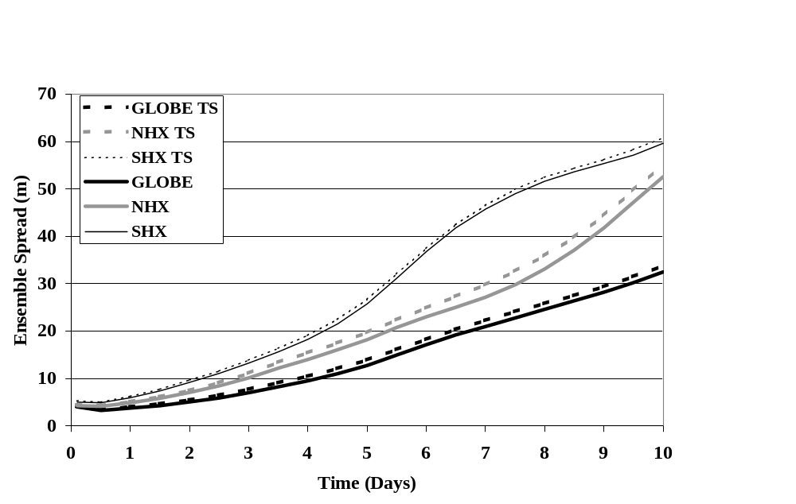
NOGAPS Ensemble – the impact of time-step
Ensemble spread of 500 hPa geopotential height (m) - T79L30 NOGAPS 20-members.
Solid lines - ensemble with varying initial conditions (IC) but same time-step of 900 s. Dashed lines - ensemble with varying IC and two different time-steps: 900 s and 450 s.
Globe NH extratopics (NHX) SH extratropics (SHX)
Spread increases with different time-steps
Different time-steps may be a simple way of introducing model error in ensemble design

Slide 25
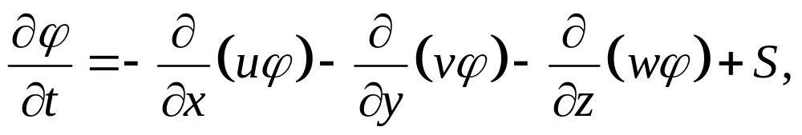
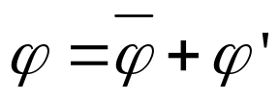
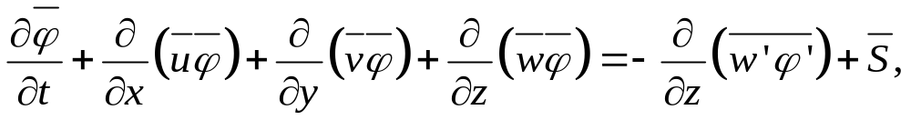
Parameterization problem in weather and climate prediction models
Atmospheric/oceanic model equation for a generic variable can be written as:
Using Reynolds decomposition and averaging
to get an equation for the mean:
vertical sub-grid flux needs to be parameterized
Where it is assumed that S is linear and the horizontal divergence terms of the sub-grid fluxes can be neglected

Slide 26
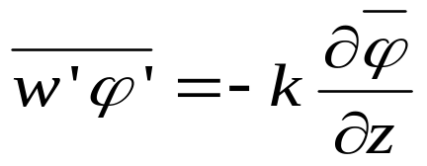
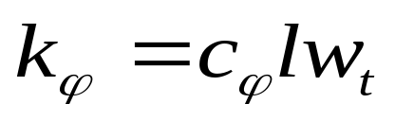



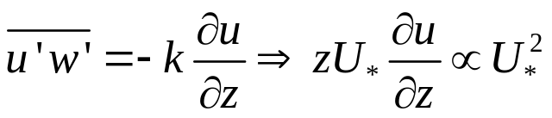
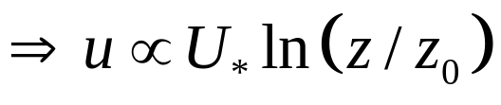
Eddy-diffusivity (ED) approach
In ED closure the sub-grid flux is parameterized as
where k is the diffusivity coefficient. The mixing length approach (e.g. Taylor, Prandtl) is
where w_{t} is a turbulent velocity and l is a mixing length.
ED is successful in representing:
Surface layer (MO theory), momentum mixing
Neutral/stable boundary layers => Logarithmic-law:
Surface layer (constant flux):
and
leads to

Slide 27
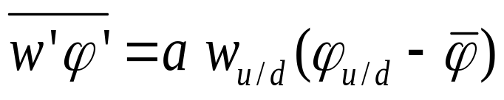
Mass-flux (MF) approach
MF closure is based on parcel ideas (e.g. Stommel 1947) and tries to represent strong upward/downward convection:
a - updraft/downdraft area w_{u/d} - upward/downward vertical velocity in a φ_{u/d} - variable value in a.
MF is typically used for parameterization of deep convection
free atmosphere inversion
capping inversion
Mass-flux (MF) represents large-scale eddies
cloud layer
Eddy-diffusivity (ED) represents small-scale eddies
LCL
mixed
subcloud layer

Slide 28
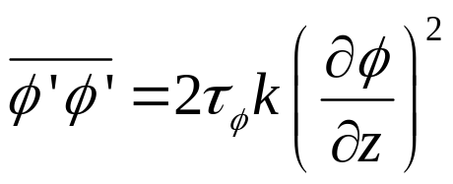
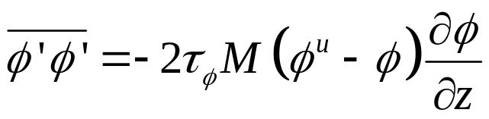
Variance/standard-deviation equations
How to determine the standard deviation
1) Prognostic equation:
2) Diagnostic equation:
Eddy-diffusivity
Mass-flux

Slide 29
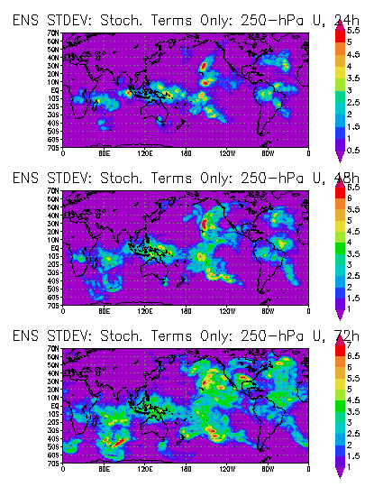
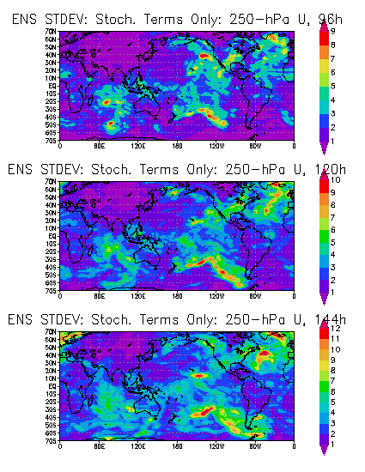
Ensemble spread due to stochastic physics only: 250-hPa U

Slide 30
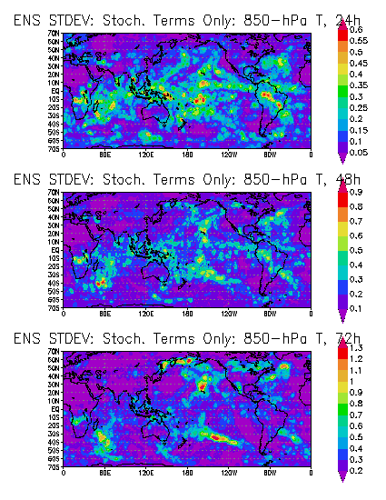
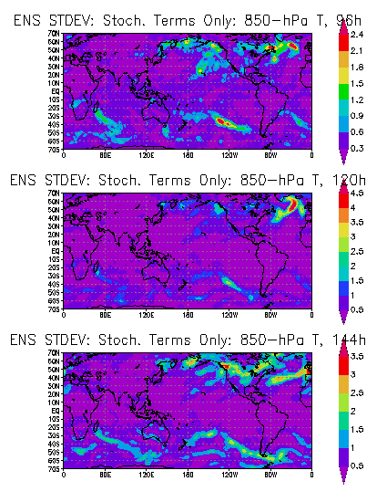
Ensemble spread due to stochastic physics only: 850 hPa T

Slide 31
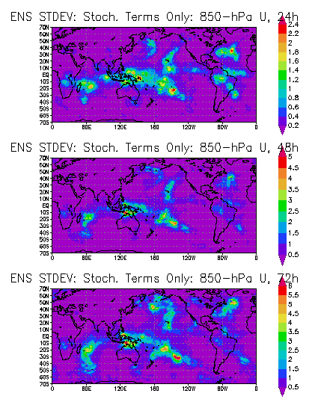
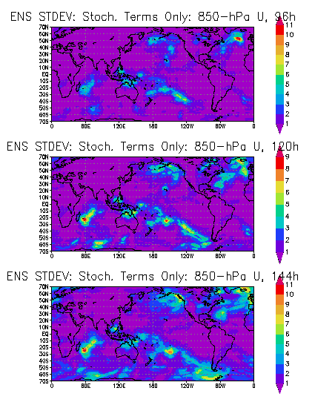
Ensemble spread due to stochastic physics only: 850 hPa U

Slide 32
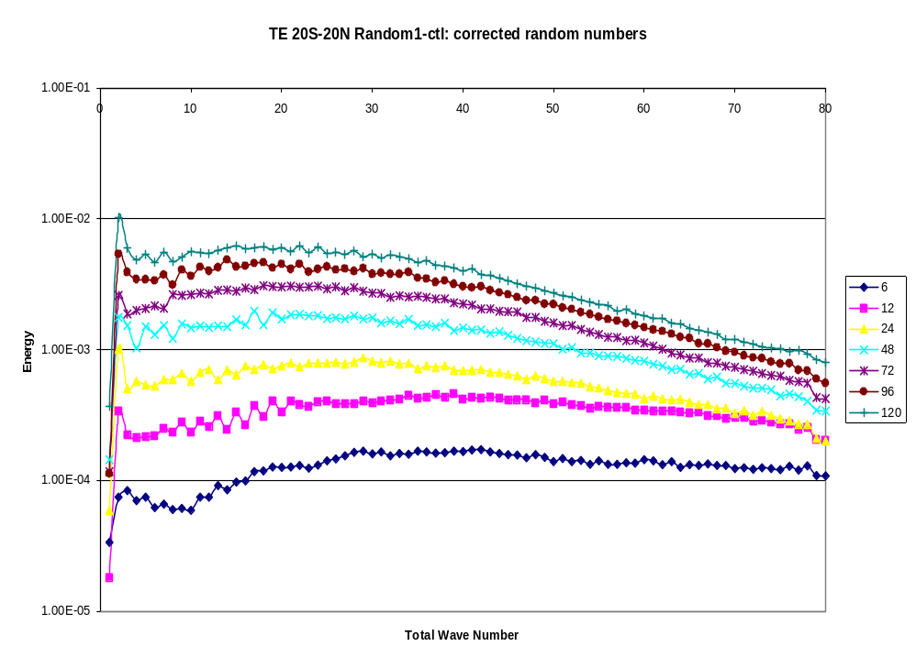
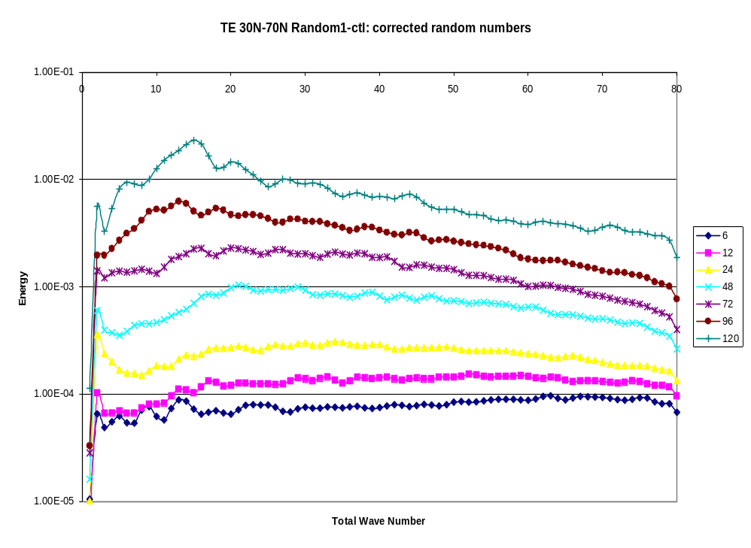
Stochastic convection: Tropics versus Extra-tropics
Total Energy difference: one ensemble member - control
Tropics
NH Extra-tropics
1 Total Wave Number 80
1 Total Wave Number 80
NOGAPS stochastic convection after 5 days:
Starts to saturate in Tropics
Starts to exhibit synoptic (sub-synoptic) peak in NH Extra-tropics
Notes:
Key gives corresponding forecast hour for each color. Lowest curve is for 6 hours, then 12, 24, 48,72,96, and 120 h for curves of increasing magnitude. Note the in contrast to the tropics, the NH extratropics has (1) significant synoptic/subsynoptic scale peak and 2) still has substantial perturbation growth between 96 and 120h.

Slide 33

STOCHASTIC PARAMETERIZATION OF DEEP CONVECTION
Ensemble mean error is comparable or slightly larger when stochastic physics included. Significantly larger for stochastic physics only. (Results for April 2005)

Slide 34

STOCHASTIC PARAMETERIZATION OF DEEP CONVECTION
Number of outliers is decreased by inclusion of stochastic physics, particularly in the tropics (although the number of outliers is still too large).

Slide 35

STOCHASTIC PARAMETERIZATION OF DEEP CONVECTION
In the tropics, addition of stochastic physics improves the spread-skill relationship (minimal impact in the mid-latitudes, not shown).

