Slide 1
Relation between color deconfinement and chiral restoration
Kenji Fukushima (MIT / U.Tokyo)
References: K. Fukushima Phys. Lett. B553, 38 (2003)
K. Fukushima Phys. Rev. D68, 045004 (2003)
K. Fukushima hep-ph/0310121
Y. Hatta and K. F. hep-ph/0307068, hep-ph/0311267

Slide 2
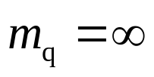
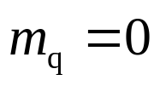
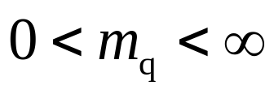
Question and Conclusion
Question
  What is the QCD phase transition like?
  Deconfinement or Chiral restoration
  What happens for ?
Conclusion
  There is only one phenomenon for any m_{q}.
Well-defined at
Well-defined at
Simultaneous transitions are really simultaneous.

Slide 3


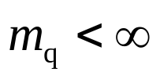








Some Basics
“Confinement” cannot be recognized.
Chiral restoration is approximately realized.
One might think…
There is only one phenomenon, i.e., chiral restoration.
l reflects the singularity of due to mixing effects.

Slide 4
That means…
The deconfinement phase transition is so smeared that we cannot see its remnant.
Then…the QCD phase transition is nothing more than a chiral phase transition?
Even though we have no rigorous definition, the notion of “deconfinement” is indispensable to understand the QCD phase transition.
  Thermodynamic quantities (e.g. entropy)
However…

Slide 5
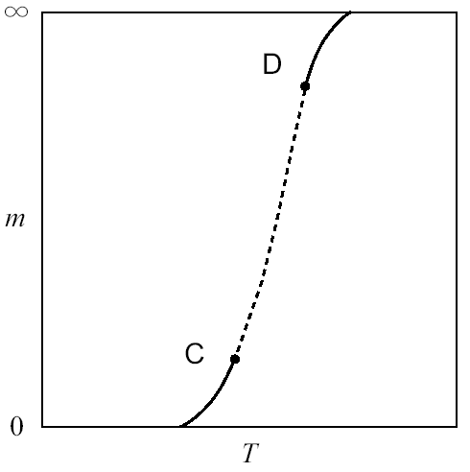
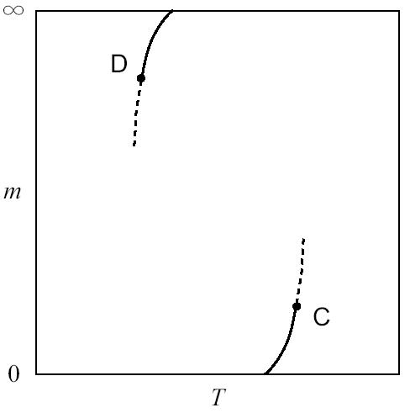
Linking deconfinement and chiral phase transitions
Two true phase transitions are connected.
    (This is the fact observed in the lattice QCD simulation.)
Not disconnected like

Slide 6
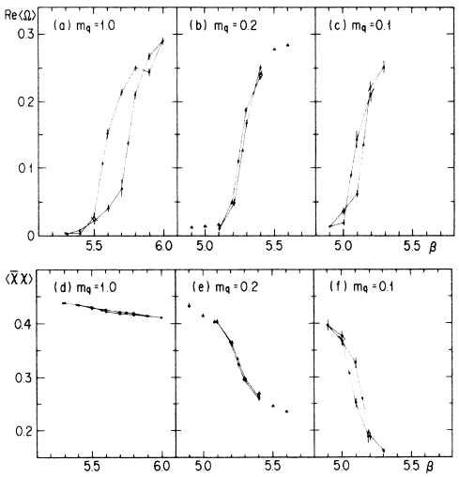
Evidence
Fukugita, Ukawa
PRL57, 503 (1986)
Notes:
After that, Fukugita and Ukawa investigated in full QCD simulation for various quark masses. The upper figures show the Polyakov loop and the lower figures show the chiral condensate.

Slide 7
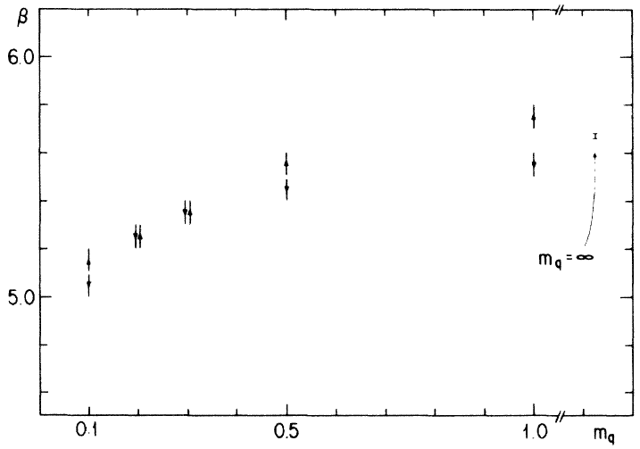
Evidence
Fukugita, Ukawa
PRL57, 503 (1986)
“The deconfining and chiral transitions occur at the same temperature.
The strength of transition weakens initially as the quark mass decreases
from infinity, but at small quark masses it strengthens again …”
Notes:
This is the quotation from the abstract of their paper. They concluded “The deconfining and chiral transitions occur at the same temperature.” And moreover, they added an important observation. “The strength of transition weakens initially as the quark mass decreases from infinity, but at small quark masses it strengthens again.” What they say is, in the temperature-quark mass plane, there is one simultaneous transition and, on this transition line, the transition is strong at small and large quark masses. This is quite natural because at small quark mass we can expect a chiral phase transition and at large quark mass the deconfinement phase transition is manifested.

Slide 8
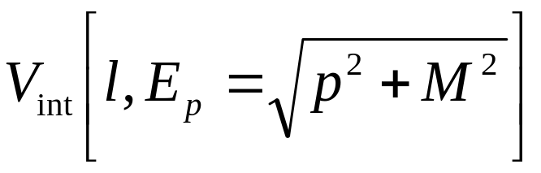
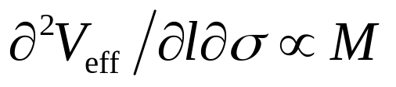
Effective Potential
Around C, l sees the singularity of σ in V_{chiral} through V_{int}
Around D, σ sees the singularity of l in V_{glue} through V_{int}
To link C and D, V_{int} must have special properties.
Polyakov loop, l, couples with σ through quasi-quark excitations.
then the mixing
A simple mixing argument is challenged.

Slide 9
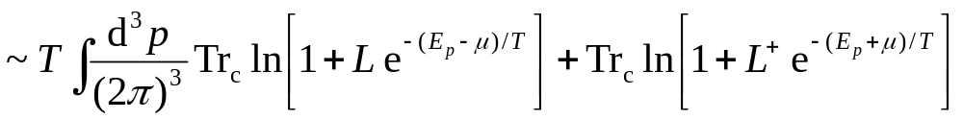
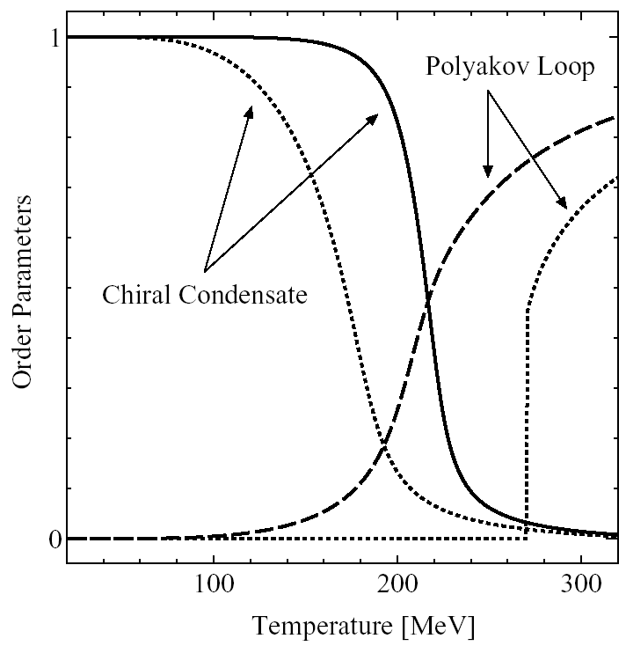
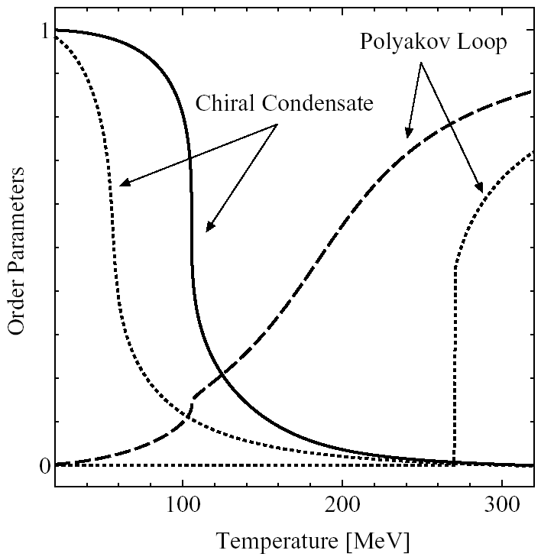


Model

Slide 10
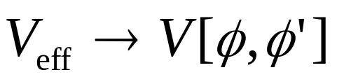
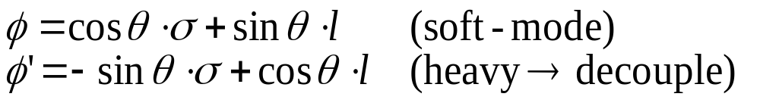
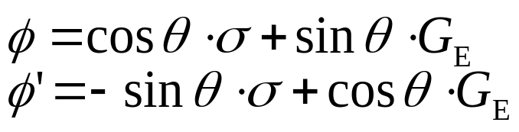
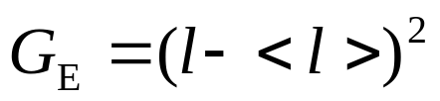
Soft Mode
l does not correspond to physical excitations.
Electric glueballs, G_{E}, couple to l to be a soft-mode.
Alternatively we can define
where
should be distinguished from G_{M}
It is proven that G_{E} becomes massless at D.

Slide 11
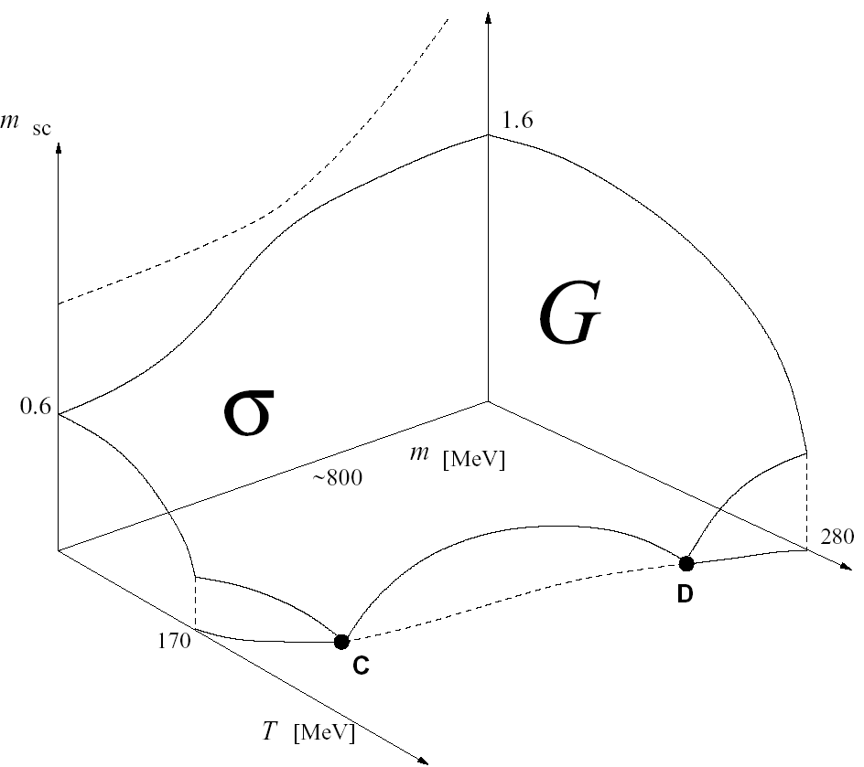
Level Repulsion
Schematic picture of soft φ mode
If level repulsion between
φ and φ’ is strong enough,
only φ becomes a soft-mode
and φ’ remains heavy.

Slide 12
Conclusion again
Chiral and Deconfinement phase transitions are extreme manifestations of one phenomenon characterized by one soft-mode.
Deconfinement transition
2nd
Simultaneous transitions indicate not only mixing effects but also true simultaneous realization of remnants of two transitions.
2nd
Chiral phase transition

