Slide 1
Pixel Efficiency in Overlap Region
Hemma Mistry
Kevin Lung, Ana Ovcharova, Boyan Tabakov
Weiming Yao, Jim Siegrist
URAP Project: Atlas Pixel Commissioning
Goal: Study pixel detector performances using pixel endcapA cosmic data and compare with Monte Carlo predictions in terms of pixel clustering, noise, resolution, and hit efficiencies as an undergraduate research project

Slide 2
Current Work
Check cluster width vs. Incident Angle
Check total cluster charge vs. Incident angle
Compare Data and Monte Carlo
Check hit efficiency in overlap region

Slide 3
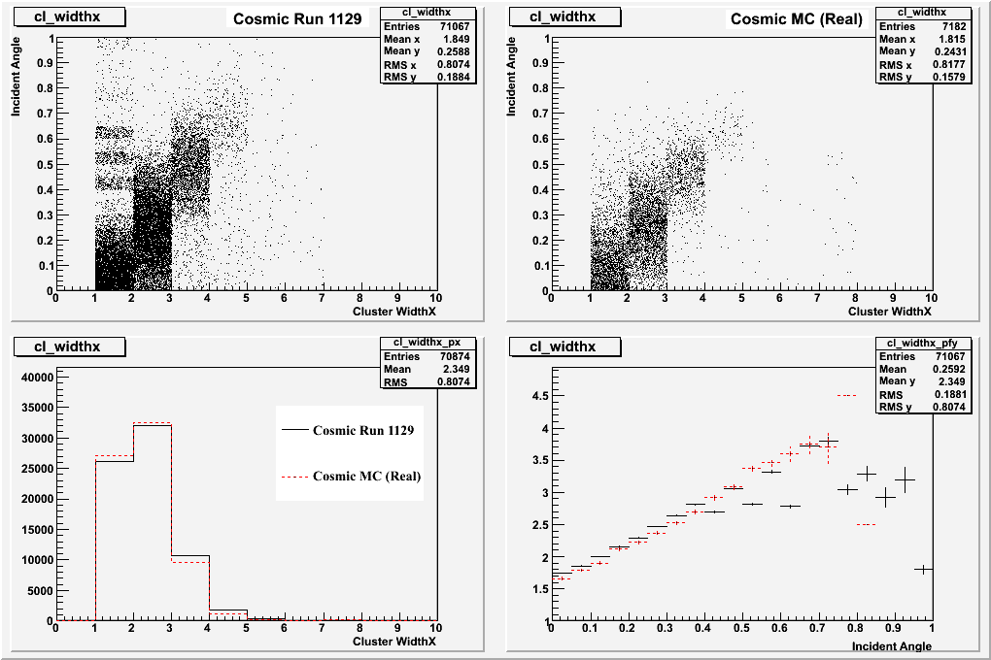
Cluster Width X vs. Incident Angle
Cluster width in local x vs. incident angle of track passing through disk
Data agrees well with Monte Carlo
noise
X Projection
Y Profile

Slide 4
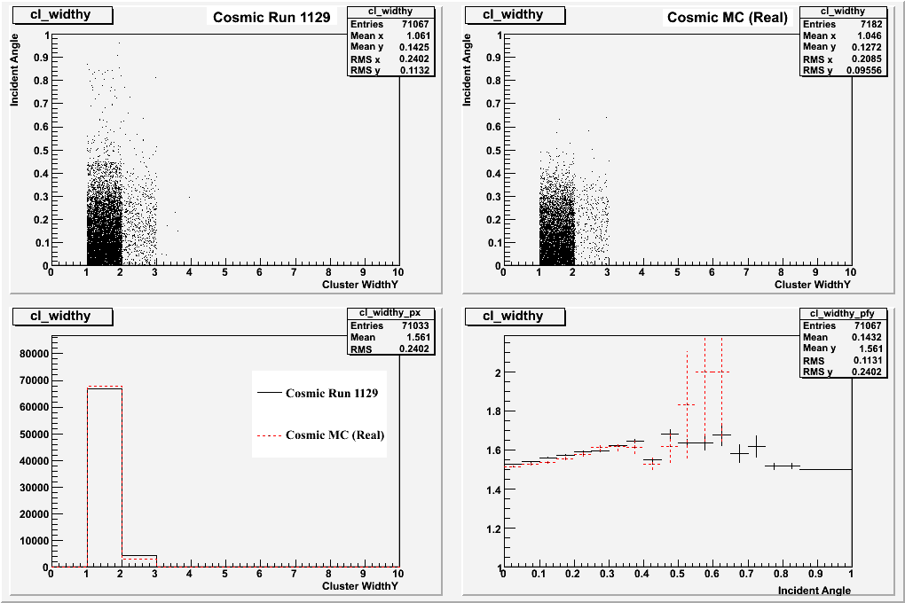
Cluster Width Y vs. Incident Angle
Cluster width in local y vs. incident angle of track passing through disk
Data agrees well with Monte Carlo
X Projection
Y Profile

Slide 5
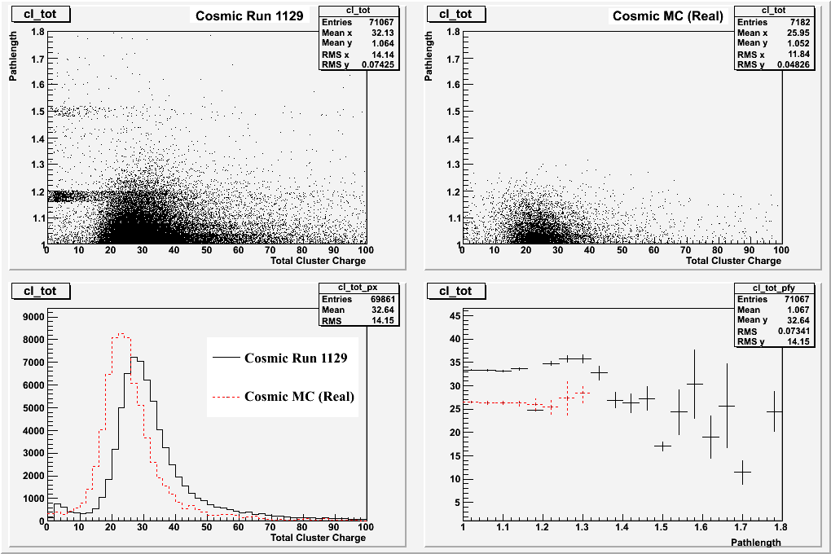
Cluster Charge vs. Incident Angle
Total cluster charge (ToT) vs. incident angle of track passing though disk
Shift between Data and Monte Carlo
noise
X Projection
Y Profile

Slide 6
Checking Efficiency
Check hit efficiency in overlap regions
Plot local x vs. local y of active overlap region
Take hit on front of disk and extrapolate to back of disk to find expected hit
Check if expected hit is within overlap region
Check minimum distance between expected hit and real hit on module

Slide 7
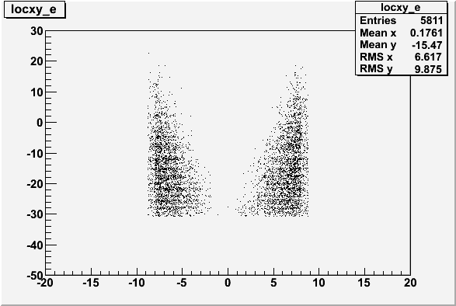
Local X vs. Local Y
Overlap Region - Even Modules
Local y
Local x

Slide 8
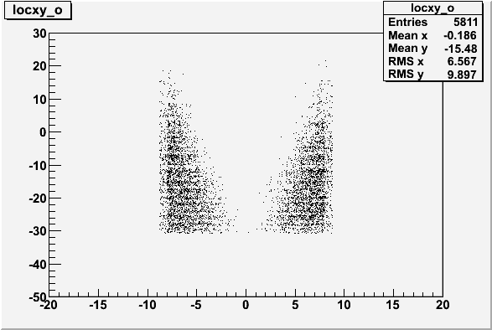
Local X vs. Local Y
Overlap Region - Odd Modules
Local y
Local x

Slide 9
Local X vs. Local Y
Overlap Region - Odd Modules
Local y
Local x

Slide 10
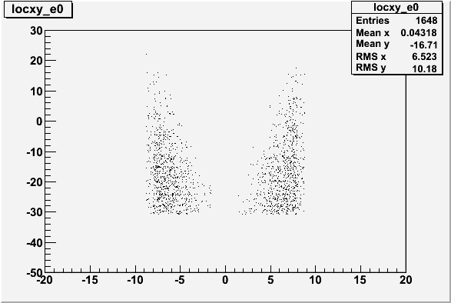
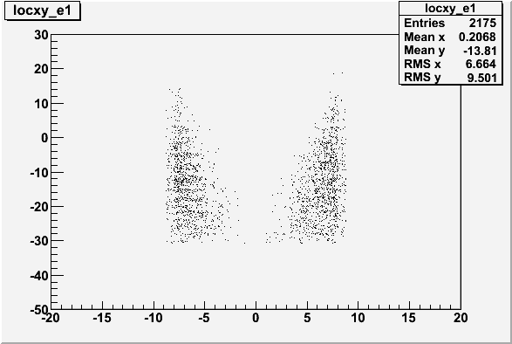
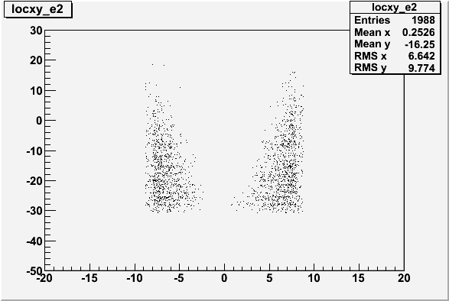
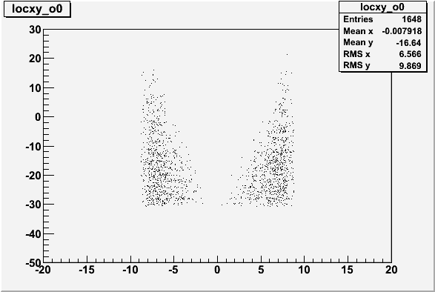


Local X vs. Local Y For Each Disk
Even Modules -Disk 0
Even Modules -Disk 1
Even Modules -Disk 2
Odd Modules -Disk 0
Odd Modules -Disk 1
Odd Modules -Disk 2

Slide 11
Extrapolate Hit on Front of Disk to Back of Disk
Disk 0
Disk 1
Disk 2
For each hit on the front of second disk, calculate expected coordinates on back of disk
Check if within overlap region

Slide 12
Find Expected Hit on Back of Disk
y
Y_{B}
y
dz
(X_{A}, Y_{A})
(X_{B}, Y_{B})
φ
θ
Y_{A}
x
z
X_{A}
X_{B}
X_{A}, Y_{A} is the hit on the front of the disk
X_{B}, Y_{B} is the expected hit on the back of the disk
X_{B} = X_{A} + dz * tan(θ) * cos(φ)
Y_{B} = Y_{A} + dz * tan(θ) * sin(φ)

Slide 13
Convert X_{B}, Y_{B} to Local Coordinates
7.5 degrees between each module
angle = (3.75+7.5*module) * π/180
center of module:
  X₀ = 119.17 * cos(angle)
  Y₀ = 119.17 * sin(angle)
Local x = (X_{B} – X₀) * cos(angle + π/2) +(Y_{B} – Y₀) * sin(angle + π/2)
Local y = (X_{B} – X₀) * sin(angle + π/2) -(Y_{B} – Y₀) * cos(angle + π/2)

Slide 14
Local X vs. Local Y
Overlap Region - Even Modules
Local y
y < (-16/5)x – 35.6
y > -26
x < 8
y > -26
x < 8
y < 8x – 50
Local x

Slide 15
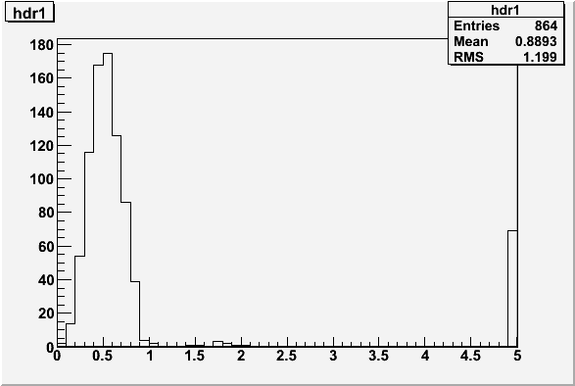
Efficiency in Overlap Region
Disk 1
dr = minimum distance between expected hit and actual pixel hit
dr = (Δx² + Δy²)^{½}
dr

Slide 16
Efficiency
Hits with dr < 1mm: 784
Total hits: 864
784
= .9074 +/- .01
864
90.74% dr < 1mm
dr

Slide 17
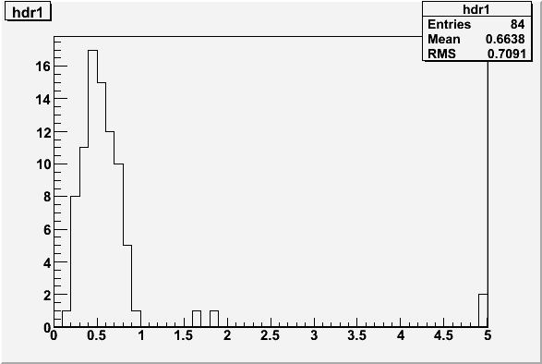
Data
Efficiency for
Second Disk
Compare with Monte Carlo
Data agrees with Monte Carlo
Redefine fiducial region to see better efficiency
dr
Monte Carlo
80
= .9524 +/- .023
84
95.24 % dr < 1mm
dr

Slide 18
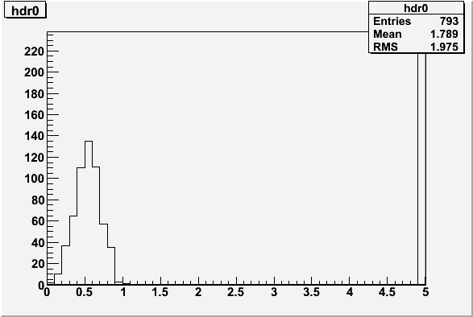
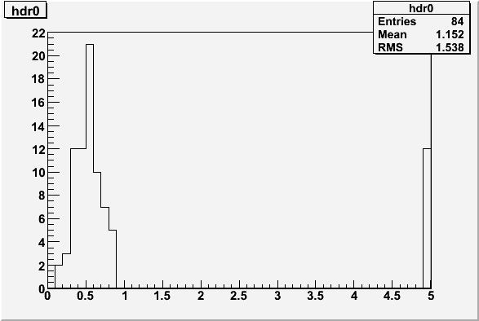
Efficiency for Disk 0
Data
565
= .7125 +/- .016
793
71.25 % dr < 1mm
dr
Monte Carlo
72
= .8571 +/- .038
84
85.71 % dr < 1mm
dr

Slide 19
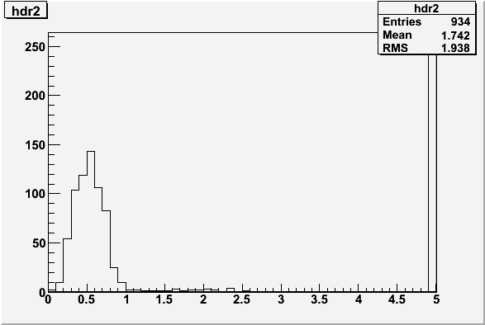
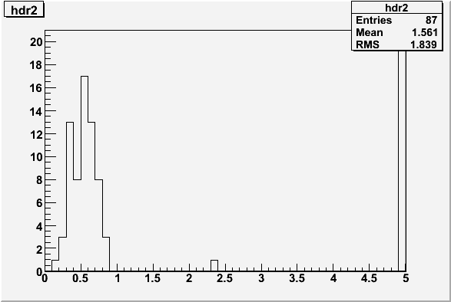
Efficiency for Disk 2
Data
656
= .7024 +/- .015
934
70.25 % dr < 1mm
dr
Monte Carlo
66
= .7586 +/- .046
87
75.86 % dr < 1mm
dr

Slide 20
To Do
Tighten fiducial region to see if efficiency remains the same
Check overlap efficiency as a function of the module in the disk
Check overlap resolutions as a function of the size of pixel clusters to make sure both clusters contain same number of pixels
Check global position of middle disk between other two disks

