Slide 1
Pixel Efficiency in Overlap Region
Hemma Mistry
Kevin Lung, Ana Ovcharova, Boyan Tabakov
Weiming Yao, Jim Siegrist
6/12/2007
URAP Project: Atlas Pixel Commissioning
Goal: Study pixel detector performances using pixel endcapA cosmic data and compare with Monte Carlo predictions in terms of pixel clustering, noise, resolution, and hit efficiencies as an undergraduate research project

Slide 2
Current Work
Check cluster width vs. Incident Angle
Check total cluster charge vs. Incident angle
Compare Data and Monte Carlo
Check hit efficiency in overlap region
What's new since last presentation (4/24/2007)
Removing noise/disable modules, bug fixes...

Slide 3
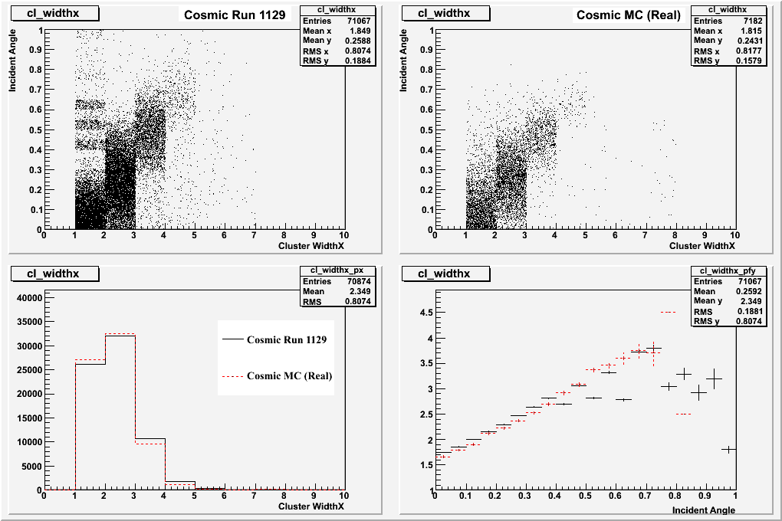
Cluster Width X vs. Incident Angle
Cluster width in local x vs. incident angle of track passing through disk
Data agrees well with Monte Carlo
noise
X Projection
Y Profile

Slide 4
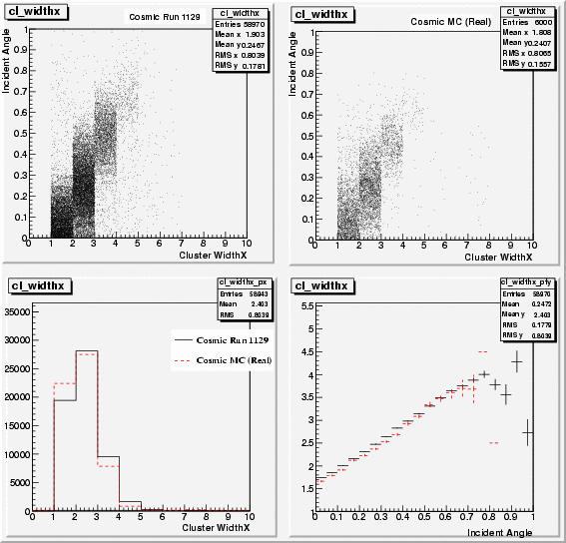
Cluster Width X vs Incident Angle after Cleanup
Noise modules are identified: 0/15,0/34,1/39,2/42
Removing 17% of tracks after cleanup
Data agree well with Monte Carlo

Slide 5
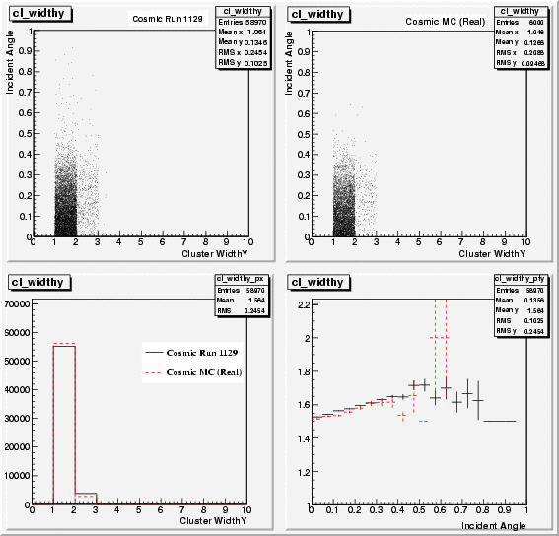
Cluster Width Y vs. Incident Angle
Cluster width in local y vs. incident angle of track passing through disk
Data agrees well with Monte Carlo after cleanup

Slide 6
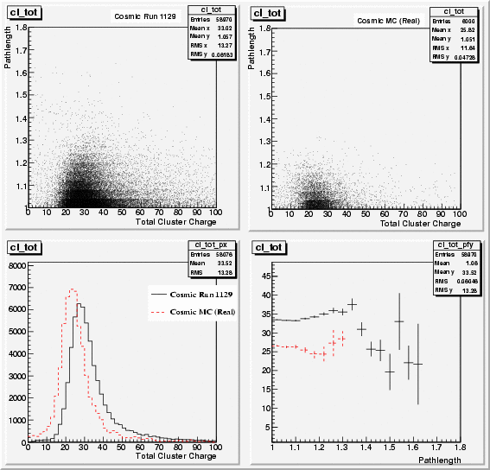
Cluster Charge vs. Incident Angle
Total cluster charge (ToT) vs. incident angle of track passing though disk
Good agreement except peak shifted due to wrong calibration used in MC

Slide 7
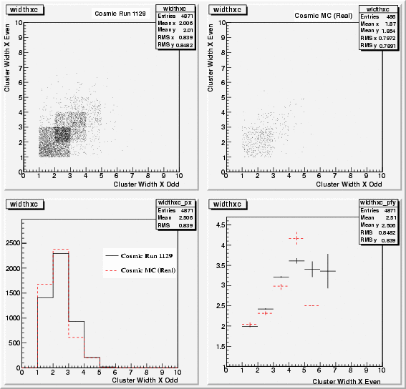
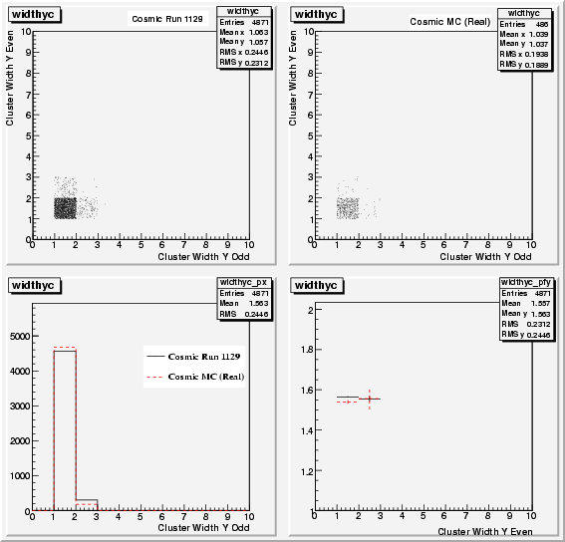
Cluster Correlation between Overlap Hits
Cluster Width X Odd vs Even (Left) Cluster Width Y Odd vs Even (Right)

Slide 8
Checking Efficiency
Check hit efficiency in overlap regions
Plot local x vs. local y of active overlap region
Take hit on front of disk and extrapolate to back of disk to find expected hit
Check if expected hit is within overlap region
Check minimum distance between expected hit and real hit on module

Slide 9
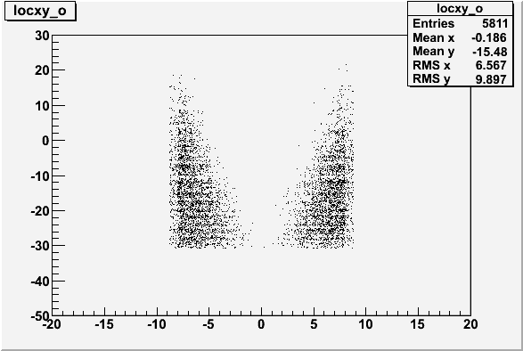
Local X vs. Local Y
Overlap Region - Odd Modules
Local y
Local x

Slide 10
Extrapolate Hit on Front of Disk to Back of Disk
Disk 0
Disk 1
Disk 2
For each hit on the front of second disk, calculate expected coordinates on back of disk
Check if within overlap region

Slide 11
Find Expected Hit on Back of Disk
y
Y_{B}
y
dz
(X_{A}, Y_{A})
(X_{B}, Y_{B})
φ
θ
Y_{A}
x
z
X_{A}
X_{B}
X_{A}, Y_{A} is the hit on the front of the disk
X_{B}, Y_{B} is the expected hit on the back of the disk
X_{B} = X_{A} + dz * tan(θ) * cos(φ)
Y_{B} = Y_{A} + dz * tan(θ) * sin(φ)

Slide 12
Convert X_{B}, Y_{B} to Local Coordinates
7.5 degrees between each module
angle = (3.75+7.5*module) * π/180
center of module:
  X₀ = 119.17 * cos(angle)
  Y₀ = 119.17 * sin(angle)
Local x = (X_{B} – X₀) * cos(angle + π/2) +(Y_{B} – Y₀) * sin(angle + π/2)
Local y = (X_{B} – X₀) * sin(angle + π/2) -(Y_{B} – Y₀) * cos(angle + π/2)

Slide 13
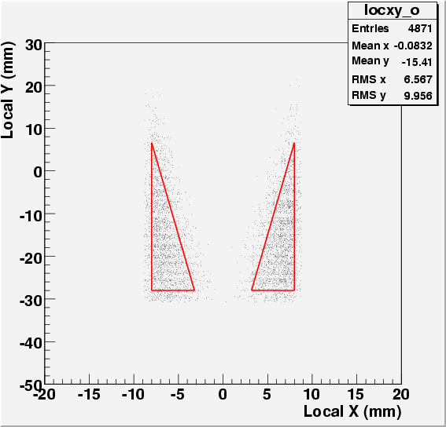
Local X vs. Local Y
Overlap Region - Even Modules

Slide 14
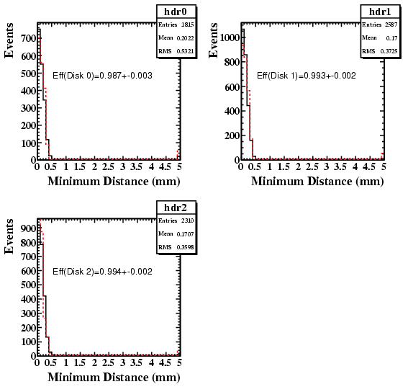
Efficiency in Overlap Regio
dr = (Δx² + Δy²)^{½}
:minimum distance between expected hit and actual pixel hit
eff = N(dr<1)/Ntotal

Slide 15
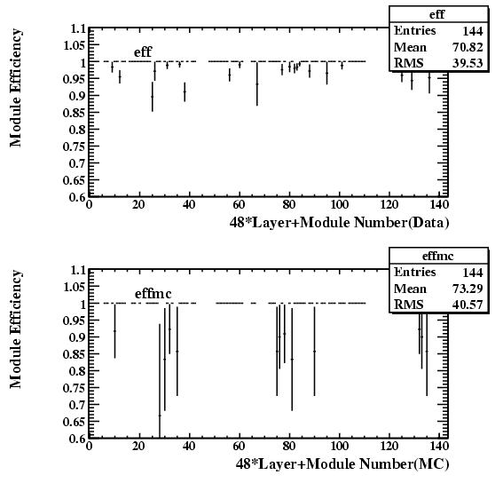
Efficiency vs Module

Slide 16
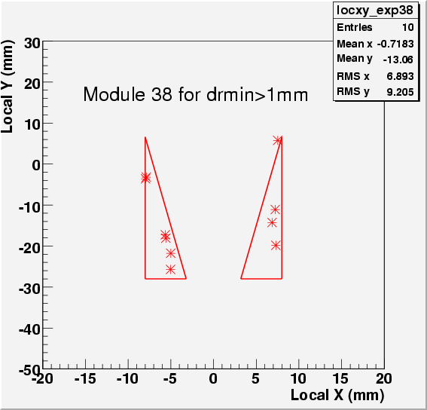
Efficiency (0.89+-0.03) seems low for Disk 0 Module 38
Check the expected local x, y for failing drmin cut, some of them near the side of fiducial region.

Slide 17
Conclusion
Cluster data are in good agreement with MC simulation.
The pixel efficiencies have been measured to be close to 99% using overlap hits
The cleanup removes 17% of tracks due to noise modules
Overlap efficiency seems flat as function of module
Residual distance (drmin) seems consistent between data and Monte Carlo.
Check global position of middle disk between other two disks still on going.

