Slide 1
Exploring the Structure and Dynamics of Inter-Site Network Scanning
Scott Campbell
NERSC/LBNL

Slide 2
Outline
Abstract
Background.
How are we doing it?
Looking for scanning structure.
Measuring differences between structure and non-structure address groups.

Slide 3
Abstract
We are looking at scanning from the perspective of multiple sites. Using site agnostic tools, track the movement of individual scanners as they cross different address ranges.
By looking at which sites are being scanned by the same addresses, we can infer groupings of networks which seem to attract similar attackers.
Take measurements to see if sites within these scanning groups can be differentiated by behavior that they exhibit.

Slide 4
Background
Passive network analysis can be broken out into three basic types:
  Radiation
  Telescope
  Scanning analysis
Typically look at aggregate behavior over some time and address range.
We look for groupings of attack addresses across as large a spread of network ranges as we can find.

Slide 5
More Background
Initial work was done in:
Collaborating Against Common Enemies, Sachin Katti, Balachander Krishnamurthy, Dina Katabi, Proc. of ACM SIGCOMM IMC 2005.

Slide 6
Send More Data
Need scanning data!
Problems: political and technical
Political – address privacy issues for non-DOE labs.
Technical - Need platform agnostic method which can operate independently of local site policy.

Slide 7
Data Gathering
Use perl script to crunch connection logs. All analysis will then be consistent and should work on non bro records as well.
Always filter local addresses and, if required, hash the scanners IP to provide loose anonymity.
Treat sites with multiple networks – like LBNL – as several discrete and unrelated networks.

Slide 8
Sample Record
1181828234.934813 TRW 190.47.179.63 1 445 6.62012410163879
1181828236.141497 TRW 190.46.88.178 1 445 3.85341191291809
1181828236.558456 TRW 201.239.28.35 1 445 5.18057298660278
SCAN_TIMING 1 221.192.143.198 port:10020 time: 1181828237.807849 dt:8.53110194206238
1181828239.657777 TRW 200.104.187.83 1 445 8.33125901222229
1181828241.176143 TRW 201.215.177.141 1 445 10.296108007431
SCAN_TIMING 1 82.67.3.176 port:139 time: 1181828253.190993 dt:23.9289910793304
SCAN_TIMING 1 60.191.233.20 port:64025 time: 1181828261.923445 dt:32.7112550735474
Nice example of what not to do …

Slide 9
Initial Structure Detection
Three tests are conducted in looking at initial structure detection:
  Network Overlap
  Temporal Locality
  Total Address Overlap

Slide 10
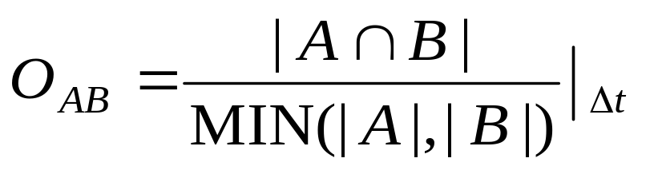
Network Overlap
Overlap follows your intuition.
It is measured against the smallest of the two sets since the magnitude of the overlap can be no bigger than the smallest area.
A
B
A ∩ B : Green Area

Slide 11
Network Overlap Example
N₁ | -----
N₂ | O(N₂, N₁ ) | -----
N₃ | O(N₃, N₁ ) | O(N₂, N₂ ) | -----
N_{n} | O(N_{n}, N₁ ) | O(N_{n}, N₂ ) | O(N_{n}, N₃) | -----
 | N₁ | N₂ | N₃ | N_{n}
For the overall calculations, just do a “mileage map” style representation. In the paper, the final overlap was calculated as a series of 24 hour periods and averaged.

Slide 12
Network Overlap Data
1
Index number indicates network
> 10 %
> 5 – 10 %
> 0 – 5 %
0 %
21
1
21

Slide 13
Temporal Locality
Take a series of time windows and see which groups of networks consistently identified the same scanner address.
In this example, for time window 3, IP address ‘a’ was seen by networks 1,2, and 5.
1
2
5
7
Δt₃
Time
1
2
5
1
3
5
Δt₂
1
5
9
Δt₁
a
b
IP Address

Slide 14
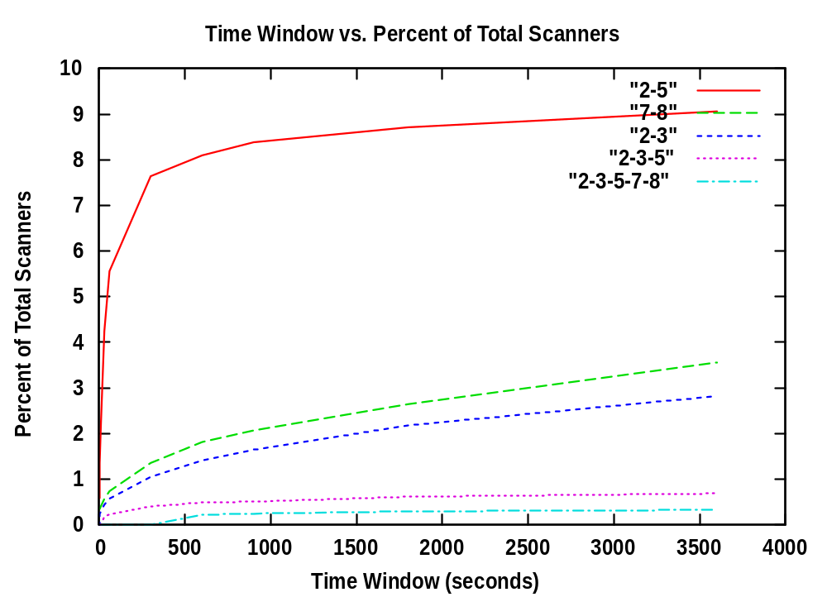
Temporal Locality Results

Slide 15
Total Address Overlap
Here we have the same mechanism as the ‘Network Overlap’ section, except that there is no time window used.
We expect different results since any overlap will be magnified, abet at the cost of reduced resolution.

Slide 16
Total Overlap
1
Index number indicates network
> 10 %
> 5 – 10 %
> 0 – 5 %
0 %
21
1
21

Slide 17
Results of Structure Search
Of the three methods looked at, all agreed on a set of networks which tended to see the same set of attackers:
{2,3}, {2,5}, {7,8}, {2,3,5}, {2,3,5,7,8}
Note this is out of a total of 21 discrete networks.

Slide 18
So What?
If you know who is most likely to be scanned together, you can share information more quickly.
Given that there is such a structure, what can we measure about it …

Slide 19
What to Measure?
There are a number of things that we measured:
Direction bias.
Scanning velocity.
Directed vs. Radiation like scanning.

Slide 20
Direction Bias
Simple initial question: are scanners on the whole right or left handed?
Sort timestamps for identified scanners by the networks IP address: you end up with something like:
<t₁ , t₂ , t₃ , t₄ , t₅ , t₆>
Just move along the sorted list – if the next numbers value is greater than the current, the scanner is moving toward the right.

Slide 21
Results
Bias in Structure
Left | Right
179858 (.464) | 207263 (.536)
Bias in Control
If an address is in the structure list it is not allowed in the control group
Minimum Instances | Left | Right
6 | 118 (.480) | 128 (.520)
5 | 194 (.430) | 257 (.570)
4 | 357 (.430) | 473 (.570)
3 | 839 (.626) | 502 (.374)

Slide 22
Scanning Velocity
The measurements look at both internet and intranet velocities.
Internet velocity is approximated by taking the distance between the first addresses in each of the networks and dividing by the difference in the initial contact time.
Intranet velocity is approximated by taking the total number of hosts that a scanner touches and dividing by the time between the first and last connections.

Slide 23
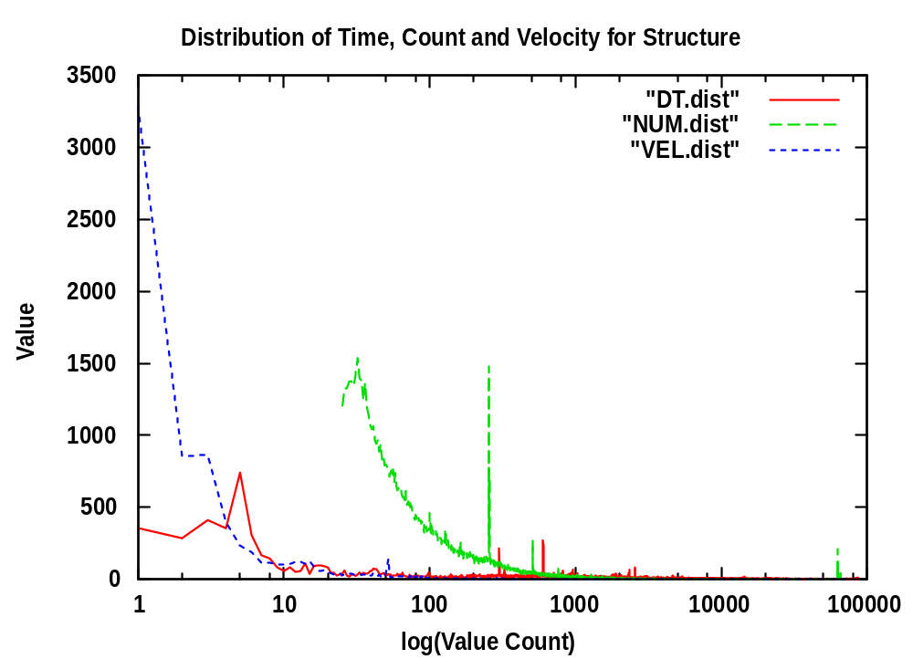
Internet Velocity
Velocity units: hosts/sec
The spike for NUM is at 254 which is extremely common.
Numbers are lower than initially expected, but consistent with other observers values

Slide 24
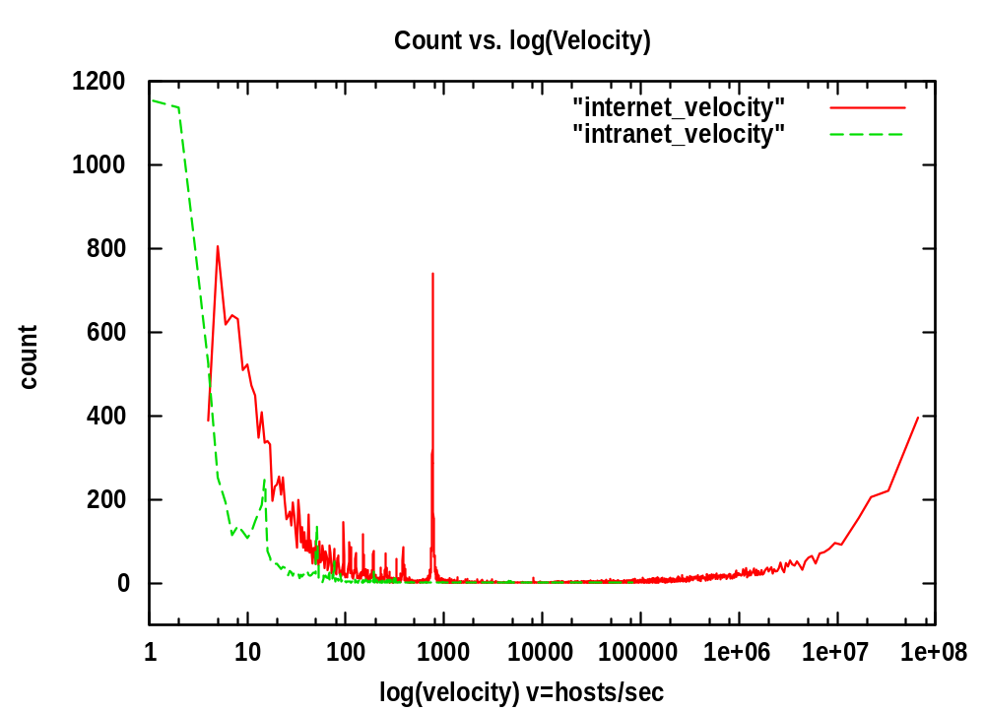
Inter vs Intranet Velocity
Velocity calculated for a single pair of class B networks: NET2 and NET3 (LBNL address space)
Climbing internet velocity a byproduct of small delta t values dominating behavior.
Spike lands exactly where distance between nets divided by 24 hours. Represents continuously scanning systems or period > 24 hours.

Slide 25
Velocity Assumptions
Interesting problem: It is not always clear when an address’ scanning begins and ends.
We assume the closest possible time is a match so if an address is scanning networks A and B at times T_{A1}, T_{A2} and T_{B1}, the time difference would be |T_{B1} – T_{A2}|.
This may introduce a systematic error.

Slide 26
Directed vs. Radiation Scanning
Scanning Count
Directed Scanning
Scan Threshold
Radiation Scanning
TRW Threshold
Radiation destination is randomly derived. Directed scanning focuses on a specific network. Radiation candidates count as TRW but not scanners.

Slide 27
Data Representation
Data is complex, but by plotting ratio of radiation/directed over time.
Structures which are stable will continue over time.
Networks 2, 3 and 5 (mislabeled 4!) are part of the observed structure.
Networks 7 and 8 do not have TRW data associated with them so they are not included.

Slide 28
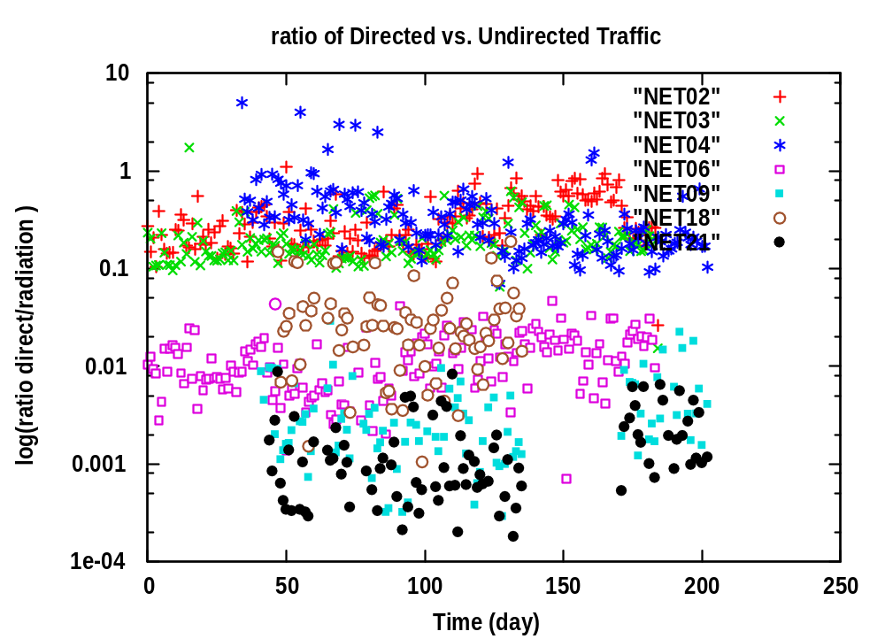
Radiation vs. Direct Scanning

Slide 29
Future Work
Expand scope of analysis to a more diverse collection of networks.
Re-evaluate analysis based on feedback from this run.
Better communication and organization of data and results.
Sharing of data with other researchers.

