Slide 1
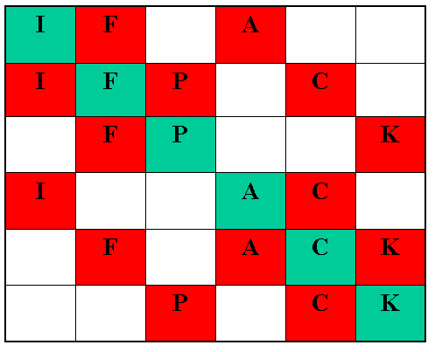
IFPACK:
Robust Algebraic
Preconditioning
Package
Trilinos Users Group Meeting
November ’04
Marzio Sala, Mike Heroux

Slide 2
Overview
IFPACK algebriac preconditioners for sparse distributed matrices
  Epetra_RowMatrix derived classes
  Preconditioner is defined using matrix structure and values only
  Can be applied in parallel
    Use local matrix rows, plus (if required) some neighboring rows
IFPACK contains (among others) Aztec-like preconditioners
  New relaxation methods
  Different ILU factorizations
  Improved handling of overlapping regions

Slide 3
Matrix-vector product: Data layout
A_{i}
z_{i}
r_{i}
Processor i ->
=
r_{i}, z_{i} local vectors Local rows Neighboring (overlapping) rows ➔ Need a preconditioner (action of the inverse of A)
Importing data

Slide 4
IFPACK preconditioners
IFPACK implements one-level additive Schwarz preconditioners (overlapping domain decomposition)
“Subdomain” i is identified by the rows assigned to a processor i
Minimal overlap:
Variable overlap:
Importing data
Exporting data
External rows

Slide 5
Preconditioning: Data layout
A_{i}
z_{i}
r_{i}
Processor i ->
=
Exporting data
Apply inverse
Importing data
r_{i}, z_{i} local vectors Local rows Neighboring (overlapping) rows Square local matrix
Preconditioner has two components:
handling of overlap (matrix, vecs)
solution with local matrix

Slide 6
IFPACK preconditioners (2)
Class Ifpack_AdditiveSchwarz<T> defines the IFPACK preconditioner
Overlap is handled by class Ifpack_AdditiveSchwarz
  If overlap > 0, overlapping matrix allocated rows for overlapping region only
This class is templated with the local solver T:
  Defines A_{i}⁻¹
  Must be an Ifpack_Preconditioner derived class

Slide 7
Available Local Solvers
Effectiveness
Memory
requirements
Simple point relaxation methods:
  Jacobi, Gauss-Seidel, SOR, SSOR
Block relaxation methods:
  Blocks defined by METIS or a simple greedy algorithm
  Blocks of any size, inverse of each block applied using LAPACK of any IFPACK preconditioner
  Jacobi, Gauss-Seidel, symmetric Gauss-Seidel
Incomplete factorizations:
  Dropping based on graph
  Dropping based on value
Any Amesos LU factorization
  Replace Y12M
−
+

Slide 8
How to use an IFPACK preconditioner
Create
  Epetra_RowMatrix A
  Ifpack_Preconditioner P(A,OverlapLevel)
Set parameters of P using SetParameters(List)
Compute elements of P using sparsity of A by calling Initialize()
Compute the elements of P using values of A by calling Compute()
If estimated condition number if ok, proceed
Apply the preconditioner using ApplyInverse()

Slide 9
Example of Code
#include “Teuchos_ParameterList.hpp”
#include “Ifpack_AdditiveSchwarz.h”
#include “Ifpack_vIct.h”
…
Teuchos::ParameterList List;
int Overlap = 2;
Ifpack_AdditiveSchwarz<Ifpack_vIct> Prec(A,Overlap);
List.set("fact: level-of-fill", 5);
IFPACK_CHK_ERR(Prec.SetParameters(List));
IFPACK_CHK_ERR(Prec.Initialize());
IFPACK_CHK_ERR(Prec.Compute());
AztecOOSolver.SetPrecOperator(&Prec);
Or any IFPACK
preconditioner

Slide 10
Estimating The Condition Number
The quality of a preconditioner is assessed by the corresponding condition number
  cond(A) = || A || * || A⁻¹ ||
Method Condest() returns a cheap estimate of the condition number
  If Condest() returns a “big” number, it may be preferable to re-build a new preconditioner with different parameters (for example, a different threshold)
Condest(Ifpack_CG) and Condest(Ifpack_GMRES) use AztecOO’s Krylov solvers to accurately estimate the condition number

Slide 11
Estimating The Condition Number (2)
Ifpack_AdditiveSchwarz<Ifpack_BlockJacobi
<Ifpack_DenseContainer> > Prec(A,Overlap);
List.set(”partitioner: local parts", 64);
IFPACK_CHK_ERR(Prec.SetParameters(List));
IFPACK_CHK_ERR(Prec.Initialize());
IFPACK_CHK_ERR(Prec.Compute());
// cheap estimate of the condition number
double Condest = Prec.Condest();
// if necessary,change parameters and call Compute()
// alternatively, one can use:
double Condest2 = Prec.Condest(Ifpack_CG);
double Condest3 = Prec.Condest(Ifpack_GMRES);

Slide 12
Factory class
“point relaxation” “block relaxation” “vIct”, “gIct” “gRiluk”, “vRiluk” …
#include “Ifpack_Preconditioner.h”
#include “Ifpack.h”
Ifpack Factory;
Ifpack_Preconditioner* Prec =
Factory.Create(“Amesos”, A, OverlapLevel);
assert(Prec != 0);
List.set(”amesos: local solver", “KLU”);
IFPACK_CHK_ERR(Prec->SetParameters(List));
IFPACK_CHK_ERR(Prec->Initialize());
IFPACK_CHK_ERR(Prec->Compute());
// use Prec, e.g. w/ AztecOO
delete Prec;

Slide 13
Concluding Remarks
IFPACK preconditioners accept any Epetra_RowMatrix object
If overlap > 0, we do not replicate the local rows in the overlapping matrix
  Additional memory is required for rows corresponding to overlapping rows only
Reordering of local matrix:
  Reverse Chuthill-McKee
  METIS reordering
Local matrix can be “filtered” before performing the factorization
  Dropping “small” elements
  Limit the number of elements per row
  Add value to diagonals
User’s guide in preparation, Doxygen documentation
End of development: January 2005 (??)

