Slide 1
Domestic Mergers and Acquisitions

Slide 2
Agenda
Government’s role and activity status
Overview
  Transactions
  Rationale
Analysis
  Network Competition
  Concentration: National; Regional; City; City-Pair
Remedies

Slide 3


Government’s Role
Airline mergers subject to Clayton Act
Transportation Department
  Economic and safety fitness
  Transfer of international route authority
  Advise DOJ on competitive impacts
  Decide whether to use 411 authority
Justice Department
  Assess competitive impact of acquisition and proposed conditions
  Challenge transaction in federal court when necessary
Department of Justice Review Status
  Bankruptcy Judge to decide TWA transaction by March 9
  DOJ’s target for deciding UA/US/AA is April 3
Notes:
The Government’s Review of the Transaction
As a result of the deregulation of the airline industry, airline mergers and acquisitions are subject to the antitrust laws. The Justice Department is responsible for determining whether a transaction should be challenged on competitive grounds. This Department usually analyzes such transactions and presents its views on a transaction’s competitive impact privately to the Justice Department. This Department’s staff are reviewing various acquisitions. The statute now governing airline mergers, section 7 of the Clayton Act, prohibits mergers and acquisitions that may substantially lessen competition in any relevant market or tend to create a monopoly.
This Department’s approval is necessary for parts of the transactions:
The Department will be responsible for determining whether DC Air meets the fitness standards applicable to airlines under this Department’s governing statute. The Department will determine whether the firm is "fit, willing, and able" to perform air transportation and comply with applicable legal requirements. In making fitness determinations, we review an airline’s financial resources, managerial capabilities, and compliance disposition.
The FAA, under its safety authority, conducts a separate, comprehensive safety fitness analysis of the new carrier before issuing the Air Carrier Certificate and Operations Specifications.
The Department must approve the transfer of US Airways’ international route authority to United. Approving the transfer of the route authority requires assessing the transfers’ impact on the airlines’ viability, competition in domestic markets, and the United States’ trade position.
The Justice Department reviews the acquisition under the Hart-Scott-Rodino Act, which requires parties to a major transaction to submit relevant information and documents to the Justice Department and gives that Department time to review the possible competitive impact before the transaction may go ahead. When the Justice Department challenges a transaction, it files suit against the parties in federal court, as it has done with Northwest’s acquisition of the controlling block of Continental’s stock (in most cases the Justice Department would also seek an injunction to block the transaction pending trial).
If the Justice Department believes that a transaction will violate the Clayton Act, the parties may propose conditions such as divestitures that would eliminate the loss of competition. The Justice Department reviews divestitures to see whether the firm acquiring the assets or business being divested is likely to be an effective competitor and operate independently of the merging firms.
DOT has limited its role to providing its own analysis to DOJ, DOT has broader authority under 411 should it choose a more active role.

Slide 4
Background
The Transactions
  UA/US: UA initially acquires US for $4.3 billion/US divests DCA assets to DCAir
  UA/AA/US: UA/US transaction modified to include AA purchase of US assets and 49% share of DCAir
  AA/TW: AA acquires failing TWA for $3.5 billion
  CO/DL: CO acquires DL
Notes:
BACKGROUND
United initially proposed to acquire US Airways for $4.3 billion in cash; and to assume $1.5 billion in net debt and $5.8 billion in aircraft operating leases.
United would divest assets, including many slots at Reagan National Airport, to Mr. Johnson, who will form a new airline, DC Air, operating out of that airport.
In response to DOJ concerns about United’s acquisition of US Airways, and whether DCAir would be a viable competitor at DCA, American, United and DCAir agreed to two separate, but related transactions.
For $1.2 billion in cash and the assumption of $300 million in aircraft operating leases, American would acquire from US Airways 86 aircraft (66 owned and 20 leased) 36 slots at LGA (22 jet and 14 commuter), and 14 gates (LGA-5, DCA-3, BOS-3, and EUR/PHL/ATL 1 each)
American and United also proposed a joint venture for the BOS-DCA-LGA shuttle, with American leasing enough gates and slots to operate 50% of the service.
As a further condition to the deal, American has agreed to ensure service on certain United or US Airways routs with a minimum of two frequencies per day for 10 years; ORD-CLT, LAX-PHL, SJC-PHL, and DCA-PIT. American would also fly in the PHL-DEN market.
The purchase of the US Airways assets and the 49% stock in DCAir are contingent on United’s success in the acquisition of USAirways.
The Department of Justice’s review of United’s acquisition of US Airways is targeted for completion by April 3.
Regarding the American/TWA transaction, American would purchase virtually all TWA assets for about $3.5 billion, $500 million in cash, $3.0 billion in lease assumptions, and $200 million in DIP financing. This includes:
Up to 190 aircraft
173 slots—JFK-84, LGA-51, DCA-33, SNJ-3, ORD-2.
175 gates—STL-57, JFK-17, plus 101 gates in small numbers at numerous cities.
Maintenance and hangar facilities, and reservations centers at Kansas City, Los Angeles and St. Louis.

Slide 5
The UA/US Transaction
$4.3 billion
Divests
DCA
Assets
DC Air

Slide 6
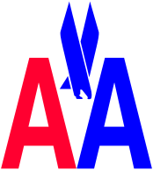
The UA/US Modified Transaction to Include AA
80%
+
20%
AA purchases US assets
DC Air
AA purchases 49% of DC Air

Slide 7


Other Transactions
$3.5 billion
Continental

Slide 8
Background (continued)
DCAir
Proposal acquisition contingent on DCAir arrangements
Notes:
DCAir
According to information United and US Airways provided the Department, DCAir will acquire all of US Airway’s opearations and routes at Reagan National Airport.
United will keep US Airways’ shuttle service to New York and Boston and enough slots to operate flights from Reagan national to Pittsburgh, Charlotte, and Philadelphia.
DCAir would acquire 222 slots at DCA (119 jet slots and 103 commuter slots); gates at DCA and other airports: support facilities and assets, and a line maintenance hanger.
DCAir plans to replace jet service with regional jet service in many US Airways markets. The number of seats in those markets will decline.
DCAir would use these assets to serve 44 cities out of DCA.

Slide 9

DCAir: Based on Initial UA/US Acquisition
DCA
Slots
222
Line Maintenance Hangar
DCA & Other
Airport Gates
DC Air
  Exceptions: Shuttle service and sufficient slots to and from current US hubs
Support Facilities

Slide 10
Proposal Acquisition: Contingent on DCAir Arrangements
DC Air
49% share to AA
DCA
Serve 44 cities
Out of DCA
Acquire 49%
voting & equity
interests for
$82.4 m
20 year
marketing
alliance
Provide
DCAir a
portion of
jet service
Right of 1st refusal of sale of
DCAir equity & assets
At least
11-14
F-100

Slide 11
General Comments Regarding Competition
Competition has Worked Well
  Overlapping network systems (See Chart 1)
  Low-fare competition
Airline Industry is Network Industry
  Networks have resulted in better more competitive service
  Bigger networks are more effective than smaller networks
  Increasing network size, therefore, can benefit consumers
  Reasons for consolidation
    Efficient way to expand networks
    Increases flow traffic through existing network
    Larger networks have competitive advantage

Slide 12
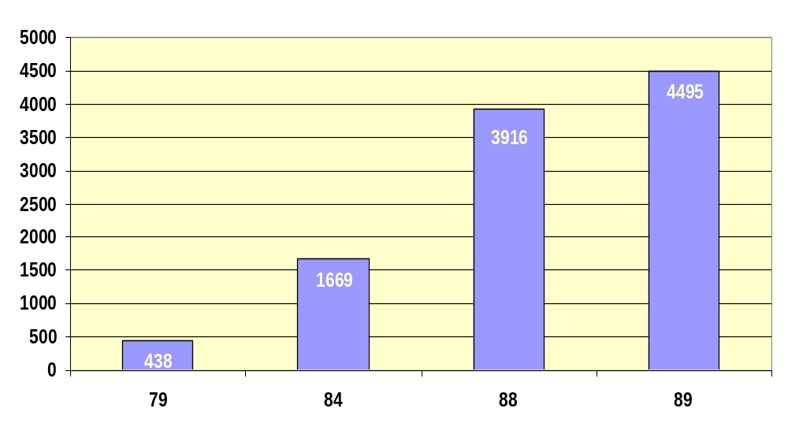
Markets with 3 or More Carriers
Chart 1
Number of City-Pair Markets with 3 or More Carriers

Slide 13
General Comments Regarding Competition (Continued)
Airline Industry is Network Industry
  Expanding network through consolidation raises concerns
    Loss of competition in overlap markets
    Larger, more powerful airlines make new entry more difficult
  Reduces competitive alternatives at capacity limited airports
    Increased hub dominance
    Pressure for others to follow

Slide 14
General Comments Regarding Competition (continued)
How many competitors are enough?
  Number not as important as type, especially in nonstop markets
  Low-fare competition is key
  Less competition allows greater capacity and pricing control by individual carriers
Domestic competitive structure
  Domestic yield (see Chart 2)
  Domestic passengers distribution by number of competitors using a 10% standard (see Chart 3)
Notes:
GENERAL COMMENTS REGARDING COMPETITION
How many competitors are enough?
In shorter-distance markets where connecting services are not effective service alternatives the number of competitors is not as important as who the competitors are.
Thus, when examining overlap markets one thing we want to know is whether or not low-fare competition is present.
Does this mean that if the number of national networks is reduced to 3 or 4 that we will not have effective competition?
We have 6 national network competitors, plus TWA and America West. We generally do not see more than 3 or 4 competitors in city-pair markets.
Yet in connecting markets, we have not seen evidence that 3 or 4 connecting competitors has resulted in high fares as has occurred in shorter distance nonstop markets.
This suggests that it is easier for competitors to accommodate one another in city-pair markets where they compete with each other as a nonstop basis than it is to accommodate each other where their networks compete.
We are aware of reasons why this makes sense, but we really do not know whether reducing the number of industry competitors will change this dynamic.
For example, one less network competitor makes it both less likely that a carrier will resist other carriers’ efforts for general price increases and less likely that an existing competitor will stimulate price competition by instituting a promotional fare increase.
And beyond how fewer competitors will affect competition, fewer competitors would be better able to control industry capacity which, irrespective to the level of competition in the industry, would likely result in higher prices.

Slide 15
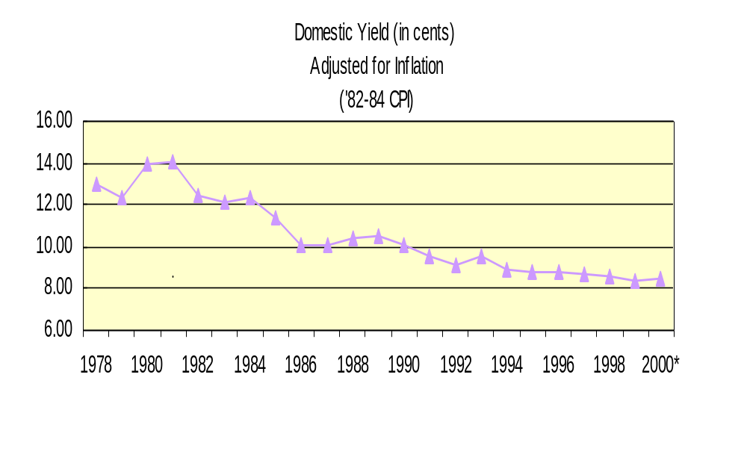
Domestic Yield
Chart 2
Real Change
(in cents)
1980 - 1985 (2.58)
1985 - 1990 (1.27)
1990 - 1995 (1.25)
1995 - 2000 (0.40)
1980 - 2000 (5.50)
Percent Change
1980 - 2000 ( 39.4%)
Domestic Yields (in cents)
Adjusted for inflation using 82-84 CPI)
Data are for the year ended Sept. 30, 2000 (preliminary)

Slide 16
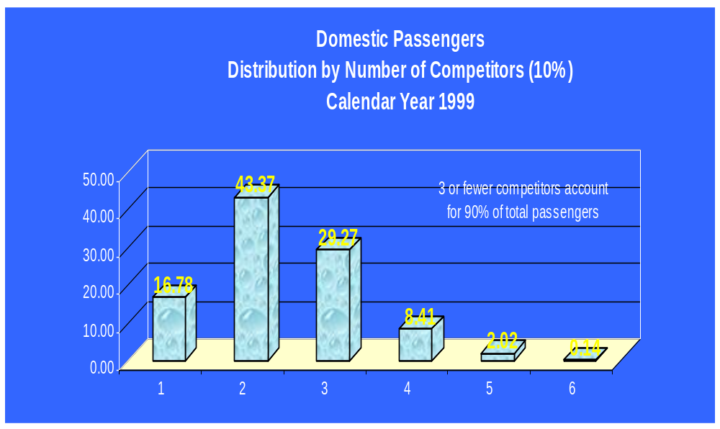
Using a 10% Standard
Industry by # of Competitors
Chart 3
%
s
h
a
r
e
# of Competitors
Notes:
Chart 2 shows domestic passengers distribution by number of competitors using a 10% standard. The three largest airlines account for 90% of total passengers.

Slide 17
Domestic Mergers vs. Int’l Alliances
Degree of overlap
  International alliances pair-up carriers with no network overlap, creating new online service
  Merger of two domestic carriers will result in extensive competitive overlap
Legal constraints
  No legal impediments to growth in domestic markets
  International alliances allow expansion into legally constrained markets
Notes:
DOMESTIC MERGERS VS INTERNATIONAL ALLIANCES
It is important to distinguish between mergers of U.S. airlines and quasi mergers created by the formation of immunized alliances between U.S. and foreign airlines.
One important difference is the degree of overlap.
The international alliances for which the Department has granted antitrust immunity have involved very little overlap, and, at the same time, have enabled new online services in many city-pair markets. For example, both the Northwest/KLM and United/Lufthansa alliances had overlap between the partners in only two city-pair markets, but each has resulted in creating new online service in more than 4,000 city-pair markets.
Any merger between two U.S. airlines with geographically broad networks will involve much more overlap.
Another important difference is that domestic airlines do not have legal constraints to expanding their networks to different parts of the country or even creating new networks in differing parts of the country.
U.S. airlines have very limited ability to unilaterally extend the reach of their domestic networks to foreign cities other than gateway cities.
In the deregulated U.S. market, United and US Airways each has full legal authority to expand services to additional markets.
United is now expanding in the east, where US Airways is very strong, with a rapid buildup of its Dulles hub. Indeed, this buildup at least in part is in response to US Airways own expansion at Dulles.
US Airways is expanding its transcontinental service, where United is a strong competitor.

Slide 18
Focus of Merger Analysis
Concentration at national, regional, point and city-pair levels
Competition effects in relevant markets
  New online connections—improved service/more competition
  New non-stop service
  Lost competition due to network overlap
  Price and service degradation
  Potential new competitors as disciplinary force
Market dominance is primary concern
  Discourages new entry
  May render former 3rd-party competitors ineffective
Notes:
MERGER ANALYSIS
The Justice Department’s merger analysis focuses on whether the combined firms will have the power to charge prices above competitive levels and to reduce service below competitive levels in relevant markets. If the combined firm’s market share will be large, it is likely that that firm will have some power to ignore consumer demands in setting pries and service levels. A large market share will not be troublesome if other firms can easily enter the market if prices exceed competitive levels.
In airline cases the relevant markets are usually city pairs. Airport pairs (Reagan national to LaGuardia, for example) are relevant markets if a significant number of travelers are unlikely to use alternative airports unless fares in that airport pair are quite high.
Market share in individual cities is relevant, because an airline’s possession of a large market share in a city may well make it difficult for other airlines to compete on routes that begin or end at that city.
Competition analysis is forward-looking
For example, based on historical data it is easy to determine where merger partners’ services overlap, but the historical perspective is just the starting point.
To illustrate, if three carriers operate in a city-pair market, each with a 1/3rd share, will the merger of two of the carriers result in two competitors, or is it likely that the merged carrier, starting with a 2/3rd’s market share and the advantages that brings, will eventually cause the other carrier to exit, or at least be an ineffective competitor?
An equally important consideration is that the prospects of new entry are less in a highly dominated market. The creation of market dominance therefore has prospective anticompetitive implications.

Slide 19
Mergers: National Concentration
Size is important indicator of network strength
Current domestic operating revenues by market share (see chart 4)
    United, American and Delta now account for 49.9% combined
Notes:
NATIONAL CONCENTRATION
National concentration important measure of network strength.

Slide 20
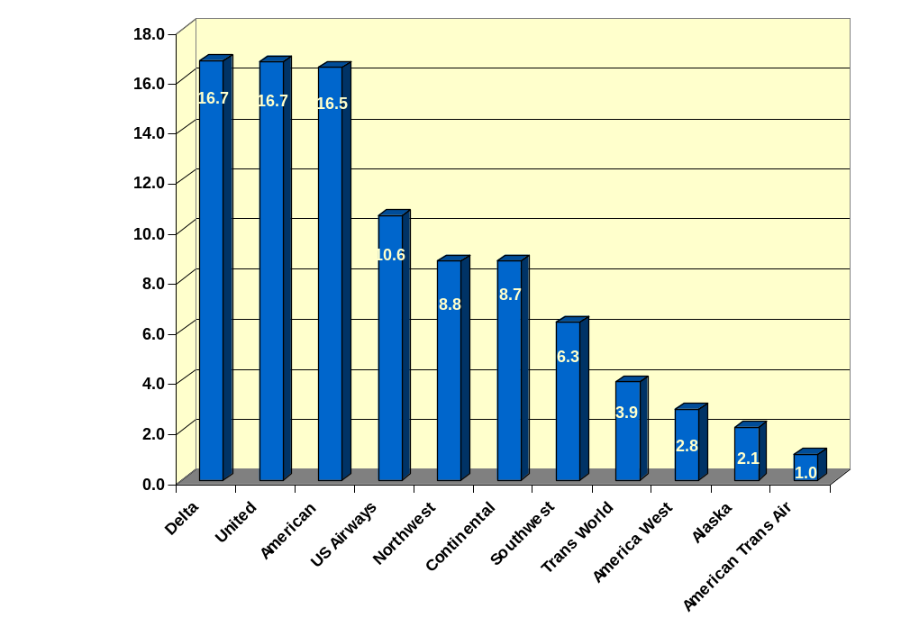
Domestic Operating Revenue
Market Share
Chart 4
Year Ended 1999
Top 3 = 49.9%
Percent
Carrier
Notes:
Chart 4 shows the pre-merger market share of domestic operating revenue for the largest domestic airlines. The three largest airlines account for about 50 percent of total revenue. US Airways is the largest of the next group of carriers, the three of which account for almost 30 percent of operating revenue. The top six account for 78 percent of operating revenue

Slide 21
Mergers: National Concentration (Continued)
Post-merger domestic operating revenues
    UA/US (see Chart 5)
    UA/AA/US and AA/TW (see Chart 6)
    AA/TW (see Chart 7)
    UA/AA/US, AA/TW and CO/DL (see Chart 8)
DOJ’s HHI merger guidelines concerning market concentration (see Chart 9)
    HHI of 1,000 moderately concentrated/1,800 highly concentrated
    100 point/50 point increase, respectively cause concern
Notes:
Chart 5 is revised to show the same information assuming the combination of United and US Airways. The combined carrier would be substantially larger than either American or Delta, and the top three airlines would account for just over 60 percent of revenue.
Chart 6 is adjusted to reflect American asset purchase, so that US Airways is divided between AA (20%) and UA (80%).
Chart 7 shows the percent market share adjusted to reflect only AA’s acquisition of TWA.
One of the concerns expressed about United’s acquisition of US Airways is the so-called downstream effect. Chart 8 is revised to assume three mergers UA/AA/US, AA/TW and CO/DL.
The use of other measures—system revenue, departures, O&D passengers, enplanements—all show essentially the same patterns of market share.
A component of DOJ’s merger guidelines consists of applying the Herfindahl-Hirschman Index (HHI) as a measure of concentration.
This index considers HHI’s of 1,000 to represent a moderately concentrated market and 1,800 to represent a highly concentrated market.
DOJ becomes concerned about a transaction that causes a 100-point increase in a moderately concentrated market and a 50- point increase in a concentrated market.
Chart 9. Based on domestic revenues, the domestic industry HHI for Calendar Year 1999 was 1,167, or was moderately concentrated.
United’s acquisition of US Airways would increase the HHI by 412 points, to 1,519.
If the top six carriers all merged, the HHI would increase to 2,100, an increase of almost 1,000 points.
Attachment 4 shows the domestic industry HHI (based on operating revenues) for Calendar Year 1999, pre-merger, assuming United acquired US Airways, and assuming that all six large network carriers merge into three carriers.
It should be pointed out that an increase in HHI is not evidence that a merger is anticompetitive. For example, an end-to-end merger would increase the HHI, but economists generally agree that such mergers are likely to be pro-competitive. Increases in HHI that “fail” DOJ’s merger guidelines, however, are evidence that a transaction could have anticompetitive implications and requires further investigation.

Slide 22
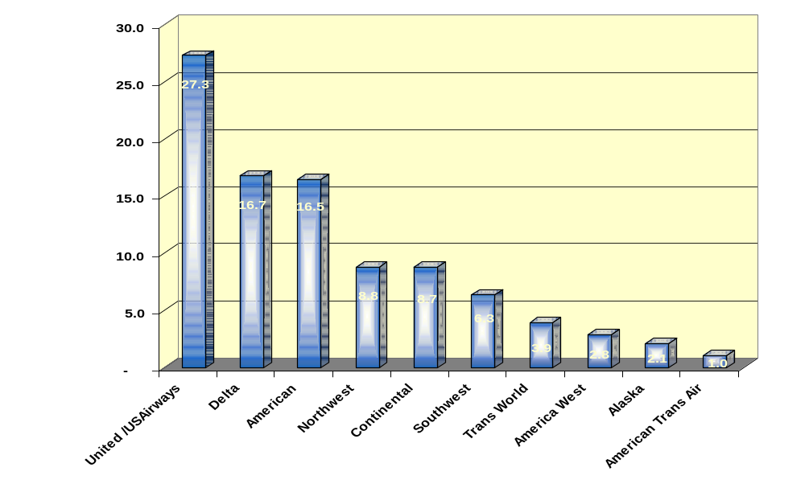
Domestic Operating Revenue Market Share: Assuming UA/US Merger
Chart 5
Year Ended 1999
Top 3 = 60.5%
Percent
Carrier

Slide 23
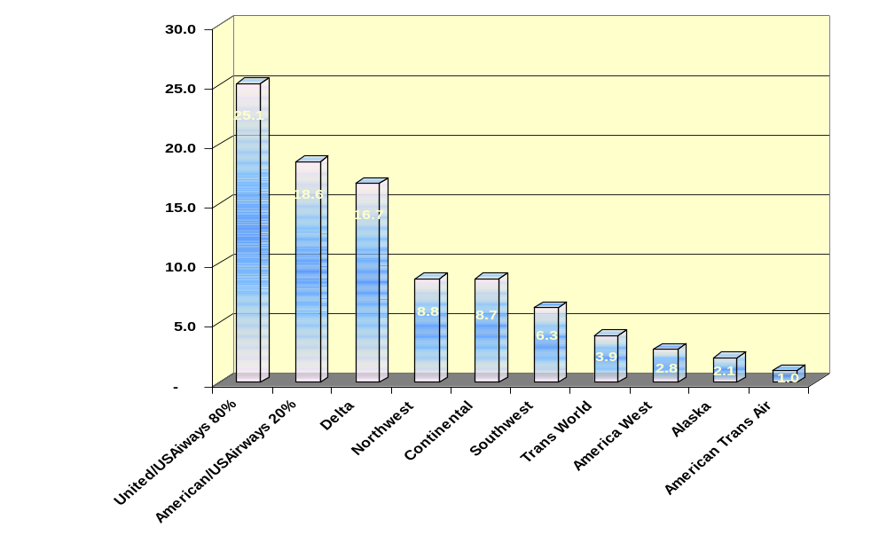
Domestic Operating Revenue Market Share: Assuming UA/AA/US and AA/TW Merger
Chart 6
Year Ended 1999
Top 3 = 60.5%
Percent
Carrier

Slide 24
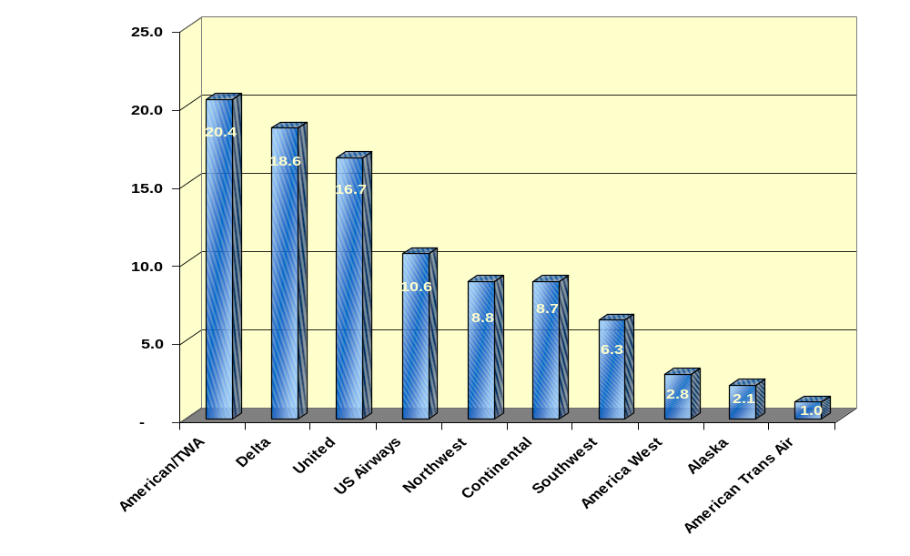
Domestic Operating Revenue Market Share: Assuming AA/TW Merger
Chart 7
Year Ended 1999
Top 3 = 55.7%
Percent
Carrier

Slide 25
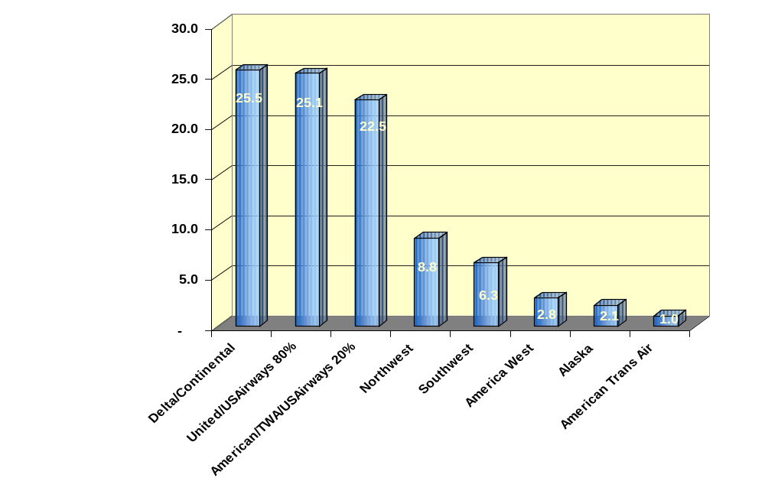
Domestic Operating Revenue Market Share: Assuming UA/AA/US, AA/TW, and CO/DL Merger
Chart 8
Year Ended 1999
Top 3 = 73.1%
Percent
Carrier

Slide 26
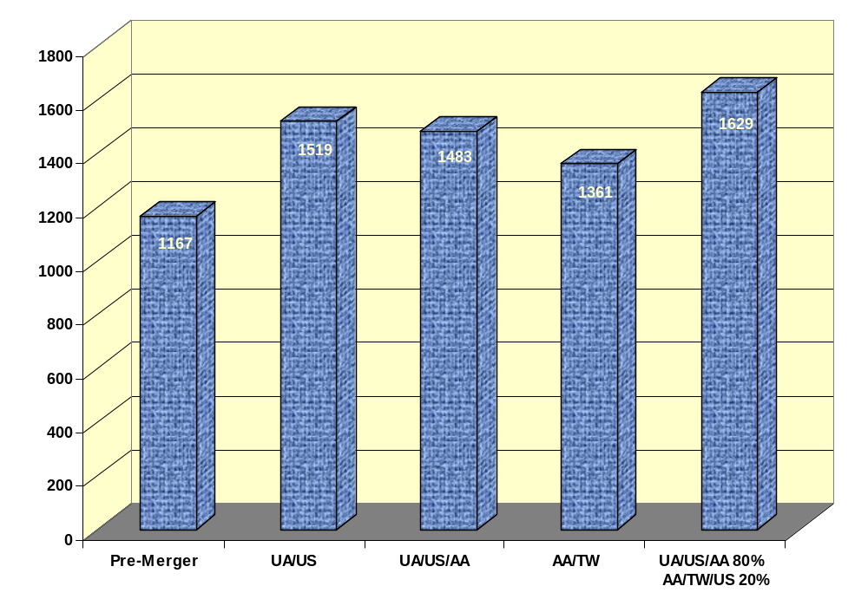
Domestic Airline Operating Revenue HHI
Chart 9
Year Ended 1999
HHI
Alliances

Slide 27
Preliminary Analysis:UA/US Acquisition
Benefits
Concerns
  New online connectors
  UA presence in East
  Loss of network competition
  Increased dominance at several airports
Notes:
PRELIMINARY ANALYSIS OF THE TRANSACTION
Our efforts so far have focused on identifying where overlap exists and some initial efforts to evaluate the competitive consequences of such overlap.
We have also gained access to get the material the carriers will supply in response to the Department of Justice’s second request. This information is quite voluminous, but is an important part of the review process that can be expected to be very informative.
To illustrate this, at the conclusion of this power point presentation we will discuss some of the documents the carriers provided in response the DOJ’s first information request.

Slide 28
UA/US Merger: Regional Concentration
US carries over 50% of passengers in the east (North Carolina to Maine)
Delta is closest competitor with 10% market share
Notes:
REGIONAL CONCENTRATION
US Airways strong presence in the east.
US Airways carries over 50 percent of the passengers traveling between city pairs within the eastern region from North Carolina to Maine. The closest competitor in this area is Delta with a 10 percent market share.
This is important to United because of its small presence in this area, and the instant traffic feed this will provide United to other areas, both within the U.S. and to other entities.

Slide 29
Preliminary Analysis: UA/AA/US Acquisition
Benefits
Concerns
  Reduces eastern dominance of UA/US
  Stronger DCA competition
  New hub-to-hub competition
  UA/AA account for ½ domestic system
  UA/AA large shares of capacity limited large cities
  TWA and US assets for AA very dominant position in NYC

Slide 30
Preliminary Analysis: AA/TWA Acquisition
Benefits
Concerns
  Rescue failing carrier
  Hub-to-hub presence
  New York presence
  Network overlap

Slide 31
Preliminary Analysis: CO/DL Acquisition
Benefits
Concerns
  Network mass for competition with UA/AA
  East coast position
  Network overlap

Slide 32
Mergers: City Concentration
UA and US serve 100 common airports
  UA dominates 13 airports, US dominates 31
  Post-merger: 51 airports dominated (see Chart 10)
Market share gap for UA/US airlines
  Merger will change competitive dynamic in formerly competitive cities (see Chart 11)
  Current average share gap advantage: 24.5%
  Post-merger average share gap advantage: 41%
Notes:
City/Point Concentration
United and US Airways provide service at 100 common airports.
United’s acquisition of US Airways would result in a significant increase in point concentration. In terms of seat shares, United or US Airways is the dominant carrier at 13 and 31 airports, respectively. Merged, they would be the dominant carrier at 51 airports, mostly in the eastern part of the country.
Attachment 5 is a map that illustrates airports where each airline had the largest seat share in 1999, and those new airports where their post-merger shares would be the largest.
Another important competition concept is “share gap”, which is the difference between the market shares of “competing” carriers, and in particular the market share gap between the dominant and next dominant carrier. For example, a market with two competitors, one having a 90 percent share and the other a 10 percent share will likely be less competitive than another market with two competitors, one having a 50 percent share and the other a 45 percent share.
Before the merger, the average share gap advantage of United or US Airways over its closest competitor was 24.5 percent. After the merger this increased to 41.1 percent.
Before the merger, in 12 of the 31 cities dominated by US Airways its share gap advantage was less than 10 points. After the merger only one US Airways dominated city has a share gap of less than 10 percent, and 15 of the 31 cities have a share gap of more than 30 percent.
We will show you that United and US Airways both believe that this has very important implications to their ability to increase revenue after the merger.
Attachment 6 is an example of how the combination of United and US Airways can change the competitive dynamic at a city.
At Allentown, PA, pre-merger seat availability shows 4 competitors, with US Airways the dominant airline with a 9.2-point share gap advantage over its closest competitor, Delta. United also has a competitive share.
Post merger, the combination of US Airways and United results in a commanding share gap advantage of 30 points over Delta.
Conventional wisdom is that with such a service advantage United and US Airways combined will increase their competitive edge over Delta and the other competitor in the market, Northwest

Slide 33
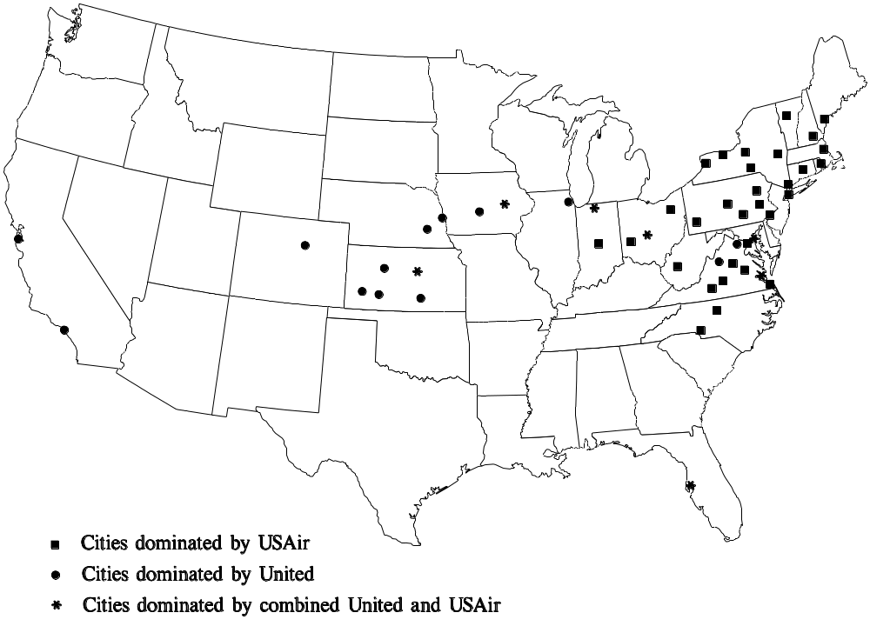
Cities Dominated by UA and/or US Air
Chart 10

Slide 34
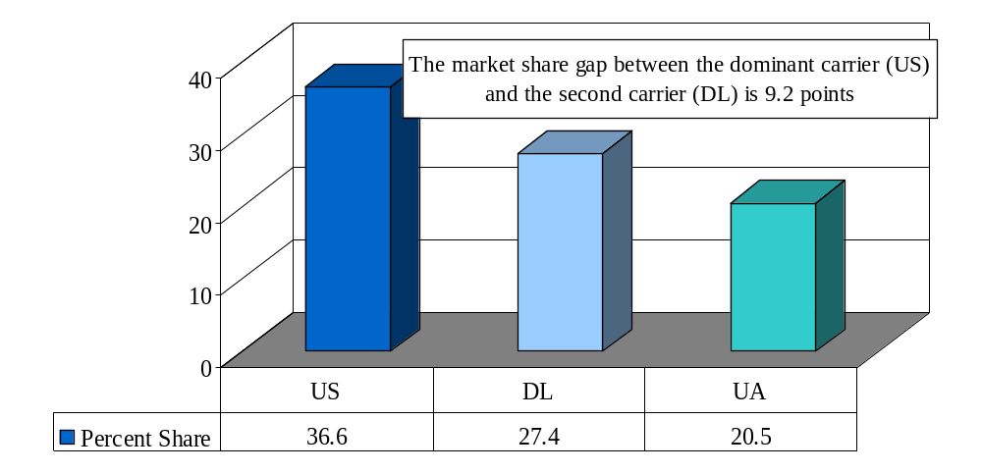
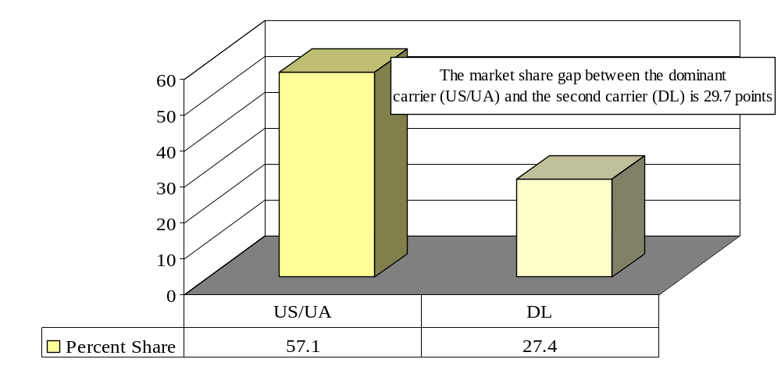
Passenger Market Share in Allentown, PA by Carrier
Chart 11
Current
Post-Merger

Slide 35
Mergers: City-Pair Concentration
Concern with loss of one competitor?
  17% of domestic passengers travel in monopoly markets
  43% travel in markets with two competitors
  Nearly 90% travel in markets with three or fewer competitors
Merger between any of the six largest carriers would reduce competition in numerous city-pairs
Hub-to-hub markets also affected
Notes:
CITY-PAIR CONCENTRATION
We will preface this section with a brief discussion about the domestic competitive structure. Two comments frequently heard at the recent congressional hearings were (1) with 6 national network competitors should we be concerned about the loss of one competitor, and (2) would allowing this merger result in additional mergers, the so called downstream effect.
We believe that the correct position is to weigh the United/US Airways transaction on its merits, and beyond that consider whether allowing the merger would result in a competitive need for others to respond by acquiring other carriers rather than just wanting to do so in order to gain competitive advantage.
Attachment 7 illustrates the number of competitors in domestic markets, counting a market share of 10% or greater as a competitor. It identifies the number of markets and number of passengers with 1 through 6 or more competitors.
• 17 percent of domestic passengers travel in monopoly markets.
• Another 43 percent travel in markets with only 2 competitors.
• Nearly 90 percent of domestic passengers travel in markets with three or fewer competitors.
• Only 10 percent of passengers travel in markets with 4 or more competitors.
• One tenth of one percent of passengers travel in markets with 6 competitors.
We will later show what one would expect—that a merger between any two of the 6 largest network airlines would involve considerable overlap in a city-pair basis. And given that most passengers travel in markets that have 3 or fewer competitors this means that in many instances the number of competitors is being reduced from 3 to 2, or 2 to 1.
There are several city-pair routes involving a United hub and a US Airways hub, such as Philadelphia-Los Angeles/San Francisco and Denver-Pittsburgh, where the merger will eliminate all nonstop competition. Since no other airline has a hub at either endpoint, no airline is likely to enter these nonstop markets, although United may be willing to propose conditions that allegedly would make entry possible (for example, allowing the entrant to participate in United’s frequent flyer program for travelers in the affected cities).
The Justice Department sued to keep Northwest from acquiring the major block of stock in Continental largely on the ground that Northwest’s control of Continental would eliminate competition on routes between a Continental hub and a Northwest

Slide 36
UA/US Overlap
UA and US overlap in 623 city-pairs (10% standard)
  Combined market share: 57% (10.8 million passengers)
  Most overlap occurs in connecting markets where their networks compete
  Excluding DCA reduces the overlap to 603 city-pairs
Notes:
United and US Airways overlap
These carriers overlap in 623 city-pair markets. During 1999, United and US Airways carried 10.8 million O&D passengers in these markets, or 57% of the total O&D of 18.9 million passengers.
The overlap markets include 35 nonstop airport-to-airport markets; 23 that involve the hub of one of the merger partners, 6 that involve hub-to-hub overlap markets, and 6 that do not involve a hub of either carrier.
The carriers also compete nonstop in d additional city pairs with each carrier serving different local airports, such as Baltimore Chicago, with United Serving O’Hare and US Airways service Midway airport.
The overlap markets also include 86 markets that are served nonstop by one carrier and on a connecting basis by the other carrier.
Most overlap markets involve connecting markets, or markets where the carriers compete purely on a network basis.
If we treat US Airways Ronald Reagan National Airport service as a separate competitor, the number of overlap markets with a United/US Airways merger would reduce from 623 to 603.

Slide 37
UA/US Overlap (cont.)
Consumer effects (see Chart 12)
  177 markets would become monopoly markets, affecting 4.8 million passengers
  253 markets with 6.6 million passengers would drop from three to two competitors
Impact on other competitors (see Chart 13)
  High combined market shares result in competitive advantage for UA/US
  $1.5 billion in combined revenue of other carriers jeopardized
Notes:
UA/US Overlap continued
Attachment 8 illustrates the number of United/US Airways overlap markets by number of competitors, based on a 10 percent competitive share.
177 markets with 4.8 million passengers annually have only two competitors, United and US Airways, and after the merger would have monopoly service.
Another 253 markets with 6.6 million passengers annually have only three competitors, and with a United/US Airways merger, the combined carrier would often have a very large share gap advantage over the remaining competitor in the market.
Attachment 9 illustrates detail information about the overlap markets segregated by distance and density. The distance intervals are shown across the top of the table and the density intervals expressed in terms of passengers per day are shown down the side. For each distance and density cell block the table shows data separately for the merger partners and all carriers in the markets, and the market share for the merger partners.
For example, in the first distance/density cell block, for 0 to 250 miles and 0-20 passengers per day, United and US Airways overlap in 11 city-pair markets and carried 17,840 of the 18,40 passengers in those markets for a 97 percent combined share. The combined share provides a good indicator of the extent of other competition in the market.
We also have detailed information about these overlap markets. For example, as the 97 percent combined share in these 11 markets we would not expect much other competition.
Our detailed backup information shows that in 10 of the 11 markets United and US Airways are the only competitors.
The detailed information also shows us that in most of these 11 markets both carriers tend not to have marginally competitive shares, but substantial market shares. The merger, therefore, results in a meaningful reduction in effective competition.
We do not expect you to focus on the details of this attachment, but we have highlighted the combined market share to illustrate that in many instances the merged carriers would have a very large percentage of traffic in the markets, and, accordingly a competitive advantage over other carriers.
One other thing we would call your attention to is other carriers’ revenue of $1.5 billion in these overlap markets. This is important because the increased dominance of United and US Airways combined operations in these markets suggests that these carriers will be in a position to attract a significant part of that revenue from other carriers unless they find a way to compensate.
In documents prepared by United regarding its acquisition of US Airways United acknowledges that the only way to expand its systems to dramatically in the near term is to consolidate.

Slide 38
UA/US Merger
Chart 12
United/US Airways Overlap Markets
Calendar Year 1999
Competition | Markets | Passengers
2 | 177 | 4,856,720
3 | 253 | 6,579,310
4 | 147 | 5,336,740
5 | 43 | 1,896,640
6 | 3 | 219,110
Total | 623 | 18,888,520

Slide 39
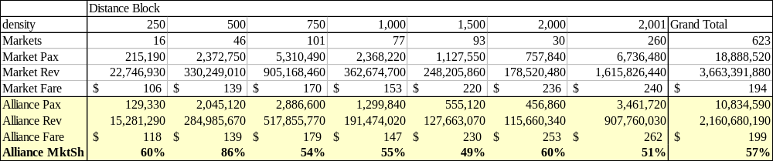
Impact on other carriers
Chart 13

Slide 40
AA/TWA Overlap
AA and TW overlap in 650 city pairs (10% standard)
  Combined market share: 47% (4.8 million passengers)
  Most overlap occur in connecting markets
Consumer Effects
  97 markets would become monopoly markets affecting 0.4 million passengers
  274 markets with 3.0 million passengers would drop from these to two competitors
Impact on Other Competitors
  High combined market shares result in competitive advantage for AA/TW
  $1.1 billion in combined revenue of other carrier jeopardized

Slide 41
CO/DL Overlap
CO and DL overlap in 862 city pairs (10% standard)
  Combined market share: 57% (19.3 Million passengers)
  Most overlap in connecting markets
Consumer Effects
  198 market would become monopoly markets, affecting 5.3 million passengers
  425 markets with 16.1 million passengers would drop from these to two competitors
Impact on Other Competitors
  High combined market shares result in competitive advantage for CO/DL
  $2.7 billion in combined revenue of other carrier jeopardized

Slide 42
Further Consolidation
Impact on competitors in UA/US merger markets (see Chart 14 & 15)
  American: 46% fewer dominant markets
  Delta: 29% fewer dominant markets
Magnitude varies, but any combination would increase dominance (see Chart 16)
Notes:
United’s acquisition of US Airways will make United substantially larger than either American or Delta; and those airlines may feel compelled to respond by acquiring someone themselves.
To evaluate this, we examined the United-US Airways overlap markets to determine it their combined presence resulted in significantly increased share gap advantages over American or Delta in those same markets. This is illustrated in Attachments 10 and 11, which show that large numbers of passengers for both American and Delta would be exposed to United due to an increased share gap disadvantage.
American competes in 364 of United and US Airways overlap markets accounting for 12.6 million passengers.
Pre merger, American has a share gap advantage in 99 markets that account for 2.9 million passengers. Post merger American’s share gap advantage shrinks to 53 markets and 1.6 million passengers.
Pre merger, American has a share gap disadvantage of more than 20 points in 112 markets that account for 4.2 million passengers. Post merger American’s share gap disadvantage of 20 or more points extends to 202 markets and 7.6 million passengers. An additional 3.4 million passengers are in markets where American’s share gap disadvantage will hurt its ability to successfully compete.
Delta competes in over 600 of United and US Airways overlap markets accounting for 20.0 million passengers.
Pre merger, Delta has a share gap advantage in 190 of these markets that account for 7.6 million passengers. Post merger Delta’s share gap advantage shrinks to 135 markets and 5.7 million passengers.
Pre merger Delta has a share gap disadvantage of more than 20 points in 261 markets that account for6.9 million passengers. Post merger Delta’s share gap disadvantage of 20 or more points extends to 369 markets and 10.0 million passengers. An additional 3.1 million passengers are in markets where Delta’s share gap disadvantage will hurt its ability to successfully compete.
It is evident that both American and Delta would face competitive harm by a United/US Airways merger. Both would be competitively disadvantaged in large numbers of city-pair markets that account for millions of passengers. This is consistent with the fact that both compete at several cities where the dominance of either United or US Airways would increase.
We suspect that one of the concerns these and other carriers may have is the possibility that the United/US Airways transaction could be approved, but with that degree of domestic consolidation further large-scale consolidation would be denied.
We next tested the consequences of further consolidation. We have performed the United/US Airways analysis discussed above on hypothetical mergers of American and Northwest merger and of Delta-Continental. For comparative purposes we also performed this analysis for mergers by US Airways with American, Delta, Continental, and Northwest. (Attachment 12)
While the orders of magnitude are different any such mergers would affect large numbers of markets and passengers, and provide the merger partners very considerable presence in their overlap markets.
Further Consolidation
One of the most asked questions is will United’s acquisition of US Airways cause other carriers to respond through their own efforts to consolidate. Two possibilities that are frequently mentioned are mergers between American and Northwest and between Delta and Continental.
An airline’s relative size in a market affects its ability to obtain revenue. The competitor with the biggest network has the advantages of powerful frequent flyer programs, widespread service, and override commission programs, all of which attract a disproportionately high percentage of corporate and business travelers.

Slide 43
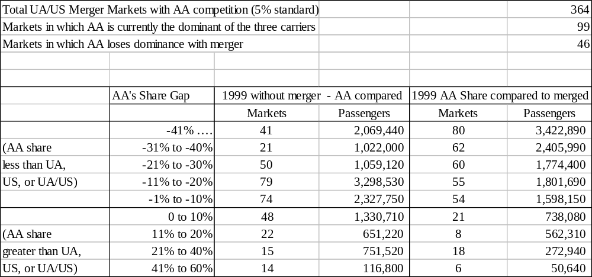
Impact on Competitors in UA/US Markets
Chart 14

Slide 44
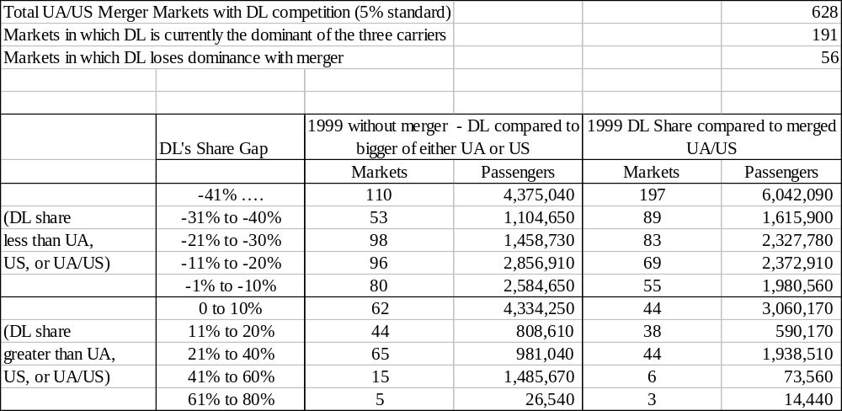
Impact on Competitors in UA/US Markets
Chart 15

Slide 45
Potential Merger Combinations
Chart 16
Merger Combinations
UA/US
AA/NW
CO/DL
US/AA
US/DL
US/CO
US/NW
Markets
623
1,239
923
349
2,102
407
784
Market Pax
(Millions)
18.9
14.4
35.5
11.9
49
24.8
7.8
Merger carrier Pax
(Millions)
10.8
7.3
19.9
5.9
33.4
14
14
Merger
Partner’s
Percentage
57%
51%
56%
49%
68%
56%
57%

Slide 46
International Implications
Network feed
  US Airways well positioned to feed UA’s transatlantic or transcontinental network
  Raises concern in regions already dominated by UA (all but Latin/South America)
Significant UA/US overlap already exists in transatlantic, especially to Germany
Notes:
INTERNATIONAL IMPLICATIONS
There are three areas of focus:
The US Airways feed potential for United’s domestic and international networks, and how this may affect competition.
To what extent do the carriers now overlap in international markets?
Ongoing changes that may influence how they compete in the future.
US Airways feed potential is enormous. It is clearly the dominant carrier in the heavily populated northeast region of the U.S. We have previously examined the feed potential of U.S. carriers across the Atlantic, and US Airways’, with its principal hubs situated in the east, has access to more transatlantic passengers than any other carrier other than Delta. And while US Airways’ system is ideally situated to feed traffic across the Atlantic, it is also well situated to flow passengers through United’s system in transcontinental U.S. markets, and all of United’s international operations. This causes concern in areas where United already has a strong presence, which is virtually everywhere but south, to the Latin American market where American now has a dominant presence.
One international area where United and US Airways now overlap significantly is the transatlantic market. US Airways has been building its presence in this market, and continued growth is part of its long-term plan. But even today US Airways competes with United in a large number of transatlantic markets, particularly to Germany.

Slide 47
Remedies
UA/AA/US/DCAir
  Access to key airports (JFK, DCA) for competitors
  New low-cost hub
  Access to dominated hubs
AA/TW
  Access to key airports (JFK, DCA) for competitors
  Access to STL for Southwest and others
CO/DL
  Access to key airports (EWR, DCA) for competitors
  Access to ATL for Air Tran

Slide 48

Questions

