Slide 1
Evaluation of High-Performance Networks as Compilation Targets for Global Address Space Languages
Mike Welcome
In conjunction with the joint UCB and NERSC/LBL
UPC compiler development project
http://upc.nersc.gov

Slide 2
GAS Languages
Access to remote memory is performed by de-referencing a variable
  Cost of small (single word) messages is important
Desirable Qualities of Target Architectures
  Ability to perform one-sided communication
  Low latency performance for remote accesses
  Ability to hide network latency by overlapping communication with computation or other communication
  Support for collective communication and synchronization operations

Slide 3
Purpose of this Study
Measure the performance characteristics of various UPC/GAS target architectures.
  We use micro-benchmarks to measure network parameters, including those defined in the LogP model.
Given the characteristics of the communication subsystem, should we…
  Overlap communication with computation?
  Group communication operations together?
  Aggregate (pack/unpack) small messages?
Notes:
We will highlight the “starred” systems: SP, Quadrics and Myrinet.

Slide 4
Target Architectures
Cray T3E
  3D Torus Interconnect
  Directly read/write E-registers
IBM SP
Quadrics/Alpha Quadrics/Intel
Myrinet/Intel
Dolphin/Intel
  Torus Interconnect
  NIC on PCI bus
Giganet/Intel (old, but could foreshadow InfiniBand)
  Virtual Interface Architecture
  NIC on PCI bus

Slide 5
IBM SP
Hardware: NERSC SP – Seaborg
  208 - 16 processor Power 3+ SMP nodes running AIX
Switch Adapters
  2 Colony (switch2) adapters per node connected to a 2GB/sec 6XX memory bus (not PCI).
  No RDMA, reliable delivery or hardware assist in protocol processing
Software
  “user space” protocol for kernel bypass
  2 MPI libraries – single threaded & thread-safe
  LAPI
    Non-blocking one-sided remote memory copy ops
    Active messages
    Synchronization via counters and fence (barrier) ops
    Polling or Interrupt mode
Notes:
MB = 10^6 bytes
740 PowerPC processor provides:
Microcode control for adapter components
format and decode packet headers
build packet routing info
handle error conditions
pass control info back to node bus.
NOTE: doc says it operates at 486 MHz internal and 72 MHz external. I take this to mean 78 MHz compared to the 375 MHz Power 3+ processor. Given there are 16 of these per node, it might not be wise to have adapters do much comm work.

Slide 6
Quadrics
Hardware: Oak Ridge —”Falcon” cluster
  64 4-way Alpha 667 MHz SMP nodes running Tru64
Low latency network
  Onboard 100 MHz processor with 32 MB memory
  NIC processor can duplicate up to 4 GB of page tables
    Uses virtual addresses, can handle page faults
  RDMA allows async, one-sided communication w/o interrupting remote processor.
  Runs over 66 MHz, 64 bit PCI bus
  Single switch can handle 128 nodes: federated switches can go up to 1024 nodes
Software:
  Supports MPI, T3E’s shmem, and ‘elan’ messaging APIs
  Kernel bypass provided by elan layer

Slide 7
Myrinet 2000
Hardware: UCB Millennium cluster
  4-way Intel SMP, 550 MHz with 4GB/node
    33 MHz 32 bit PCI bus
  Myricom NIC: PCI64B
    2MB onboard ram
    133 MHz LANai 9.0 onboard processor
Software: MPI & GM
  GM provides:
    Low-level API to control NIC sends/recvs/polls
    User space API with kernel bypass
    Support for zero-copy DMA directly to/from user address space
      Uses physical addresses, requires memory pinning

Slide 8
The Network Parameters
EEL – End to end latency or time spent sending a short message between two processes.
BW – Large message network bandwidth
Parameters of the LogP Model
  L – “Latency”or time spent on the network
    During this time, processor can be doing other work
  O – “Overhead” or processor busy time on the sending or receiving side.
    During this time, processor cannot be doing other work
    We distinguish between “send” and “recv” overhead
  G – “gap” the rate at which messages can be pushed onto the network.
  P – the number of processors
Notes:
Developed by Culler et. Al. at UCB as a better model for the analysis of parallel algorithms.
Our analysis is limited to small messages. The model would be modified for large messages.

Slide 9
LogP Parameters: Overhead & Latency
Non-overlapping overhead
Send and recv overhead can overlap
P0
o_{send}
P0
o_{send}
L
o_{recv}
o_{recv}
P1
P1
EEL = o_{send} + L + o_{recv}
EEL = f(o_{send}, L, o_{recv})
Notes:
Although it is tempting to think that a message in transit from P0 to P1 will progress through the separate stages of Osend, L and Orecv in sequence, this may not be the case for some networks.
Part of the send overhead may occur after the message has been sent. This may involve reaping send descriptors and reclaiming buffer memory.
Part of the receive overhead may occur before the message is sent. This may involve allocating receive buffers and posting receive descriptors.
We will generally assume the diagram on the left, but will note when evidence indicates otherwise, such as the appearance of negative wire latencies.

Slide 10
LogP Parameters: gap
The Gap is the delay between sending messages
Gap could be larger than send ovhd
  NIC may be busy finishing the processing of last message and cannot accept a new one.
  Flow control or backpressure on the network may prevent the NIC from accepting the next message to send.
The gap represents the inverse bandwidth of the network for small message sends.
P0
o_{send}
gap
gap
P1

Slide 11
LogP Parameters and Optimizations
If gap > o_{send}
  Arrange code to overlap computation with communication
The gap value can change if we queue multiple communication operations back-to-back
  If the gap decreases with increased queue-depth
    Arrange the code to overlap communication with communication (back-to-back).
If EEL is invariant of message size, at least for a range of message sizes
  Aggregate (pack/unpack) short message if possible

Slide 12
Benchmarks
Designed to measure the network parameters for each target network.
  Also provide: gap as function of queue depth
Implemented once in MPI
  For portability and comparison to target specific layer
Implemented again in target specific communication layer:
  LAPI
  ELAN
  GM
  SHMEM
  VIPL

Slide 13
Benchmark: Ping-Pong
Measure the round trip time (RTT) for messages of various size
Report the average RTT of a large number (10000) of message sends.
EEL = RTT/2 = f(L, o_{send}, o_{recv})
Approximate:
  f(L, o_{send}, o_{recv}) = L + o_{send} + o_{recv}
Also provides large message bandwidth measurement
o_{send}
L
RTT
o_{recv}
Notes:
If send and recv overhead overlap in time, as on some networks, L will appear negative.

Slide 14
Benchmark: Flood Test
Calculate the rate at which messages can be injected into the network.
Issue N=10000 non-blocking send messages and wait for final ack from receiver.
  Next send is issued as soon as previous send is complete at sender.
F = 2o + L + N*max(o_{send},g)
F_{avg} = F/N ~ max(o_{send},g)
  For large N
Can run: Q_Depth >= 1
P0
o_{send}
gap
F
ack
P1
Notes:
Figure shows gap larger than send overhead. If this is true, the flood test will give us the gap time. If not, it will give us the send overhead time. With this test alone, we are not sure which we are measuring.

Slide 15
Benchmark: Overlap Test
In the overlap test, we interleave send and receive communication calls with a cpu loop of known duration
Allows measurement of send and receive overhead.
Similar to the Flood Test, we can measure the average value of T.
We vary the “cpu” time until T begins to increase, at T*
  o_{send} = T* – cpu
By moving the cpu loop to recv side we measure o_{recv}
P0
o_{send}
gap
cpu
P0
o_{send}
gap
T
cpu
Notes:
Upper diagram shows small cpu overlap loop. Lower case shows larger cpu overlap loop.
T is the measurable quantity.

Slide 16
Putting it all together…
From Overlap Test, we get:
  o_{send}
  o_{recv}
From Ping-Pong Test:
  EEL
  BW
  If no overlap of send and receive processing:
    L = EEL – o_{send} – o_{recv}
From Flood Test:
  F_{avg} = max(o_{send}, g)
  If (F_{avg} > o_{send}) then
    g = F_{avg}
  Otherwise
    cannot measure gap, but its not important

Slide 17
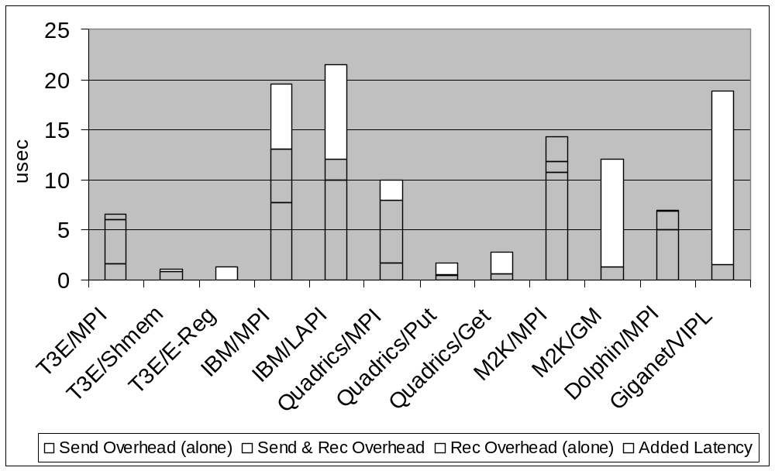
Results: EEL and Overhead
Notes:
The height of bars = end-to-end one-way latency.
Red is send overhead alone
Blue is recv overhead alone
Purple shows overlap of send and receive overhead
White is wire latency, or the part of the end-to-end latency that is not explained by send and receive overhead in the CPU. This will include latency incurred on the network as well as by the NICs on both nodes.
Note that many of the high performance systems have no measurable receive overhead. On the T3E, the data is placed directly in the remote processors E-registers so there is noting to that processor to do. For quadrics, myrinet and Giganet, the NIC performs DMA to the application host memory so receive overhead is low. Note that all MPI implementation have receive overhead because, at a minimum, send/recv matching operations must be performed.
Note also the latency hiding effects of communication networks in which send and receive overhead overlap in time.

Slide 18
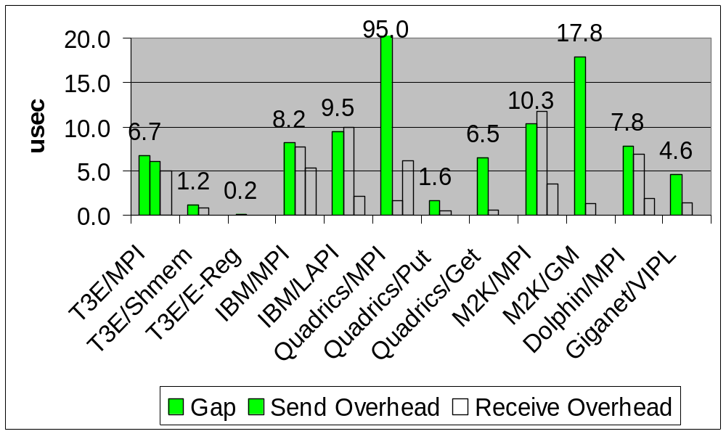
Results: Gap and Overhead
Notes:
This chart shows the results of the Flood test to compute GAP, with the send and receive overhead in juxtaposition.
Indicates degree to which overlapping computation with communication will be beneficial.
Quadrics, Myrinet/GM, Giganet/VIPL

Slide 19
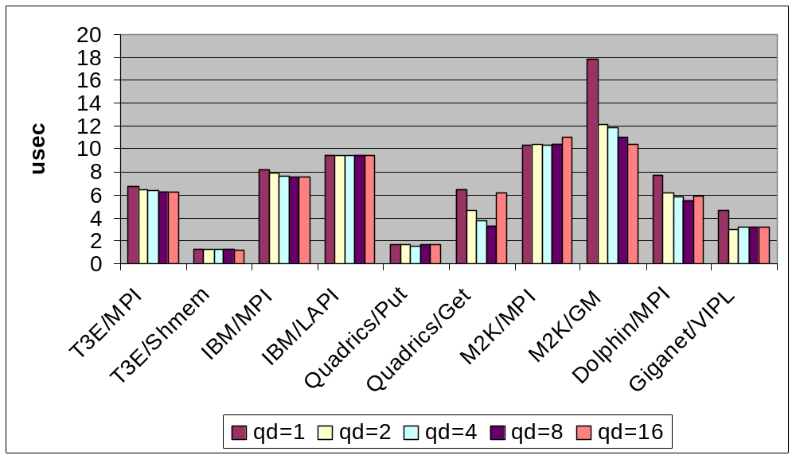
Flood Test: Overlapping Communication
Notes:
This graph shows the results of a modification of the flood test in which multiple (qd) communication calls are queued at all times.
If the gap values decrease with qd, as they do with on several systems, in particular Quadrics Get and Myrinet GM, re-arranging the code so that communication calls are back-to-back will improve latency.
Note that most MPI implementation exhibit this behavior. Most MPI implementations make progress on outstanding communication calls when the user program makes a call into the MPI library. Most calls enter the “progress engine”, which checks for new incoming packets that compose a receive message or send additional data on outstanding sends as remote buffer space becomes available (flow control). With more work in the queue, the progress engine has the opportunity to process the requests more efficiently.

Slide 20
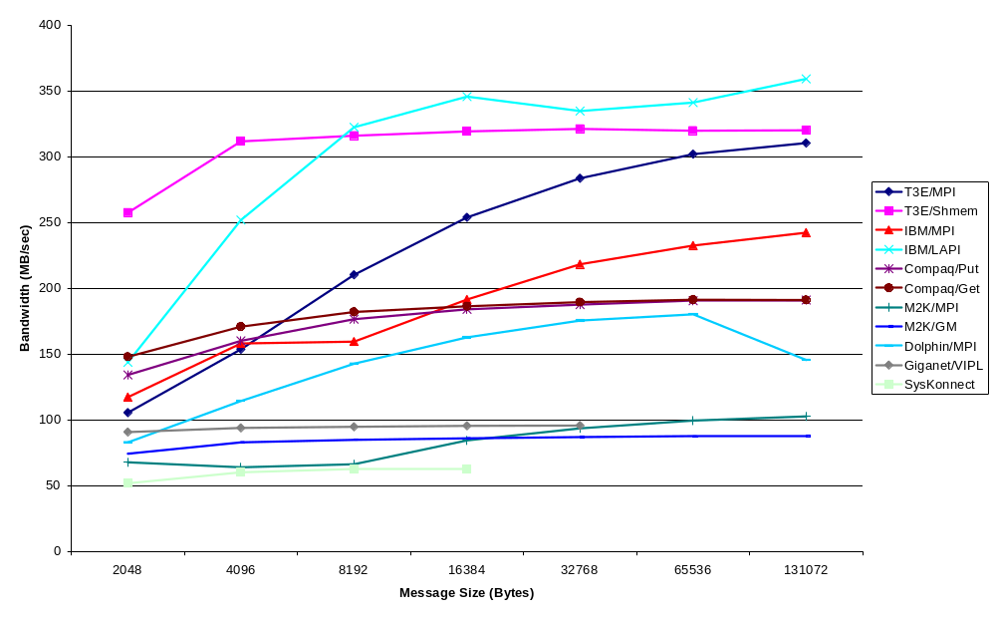
Bandwidth Chart
Notes:
Although we emphasize latency in this talk, there are occasions in GAS languages where large-message bandwidth is important. This graph
Displays the characteristics of the various networks.
Note that the IBM finally shines, but only if you use LAPI. The difference between MPI and LAPI is probably an additional data copy.
The T3E shmem performance nearly peaks out the torus bandwidth even for 4k messages.
The quadrics and Dolphin bandwidth are probably limited by the PCI bus
As well as Giganet (for older, 32 bit, 33Mhz PCI bus).
Why is Myrinet so slow?

Slide 21
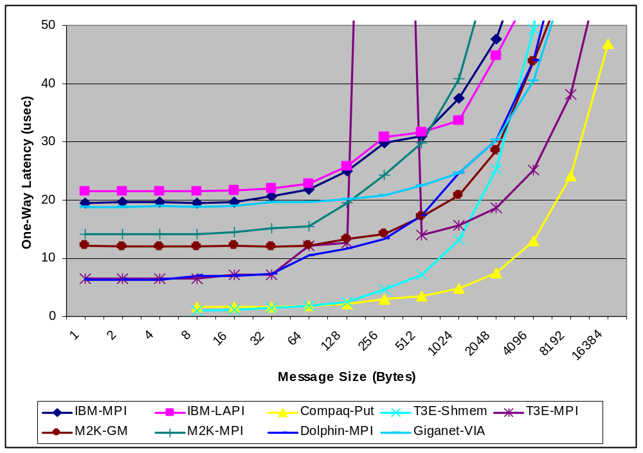
EEL vs. Message Size
Notes:
Packing small messages is always a win from the perspective of latency.
For Example, using IBM-LAPI you can pack 16 64-byte messages in one 1024 byte message
For a latency cost of 34 usec. 16 64-byte messages would cost 368 usec. A factor of 10.
Note: this does not include the cost of packing and unpacking.

Slide 22
Benchmark Results: IBM
IBM Performance | O_{send} usec | Gap usec | O_{recv} usec | EEL usec | L usec | BW MB/s
IBM Published | N/A | N/A | N/A | 17.9 | 2.5* | 500*
MPI | 7.8 | 7.6 | 5.4 | 19.5 | 6.3 | 242
LAPI | 9.9 | 9.5 | 2.4 | 21.5 | 9.4 | 360
* Theoretical Peak
High Latency, High Software Overhead
Gap ~ O_{send}
  No overlap of computation with communication
Gap does not vary with number of queued ops
  No overlap of communication with communication
LAPI Cost to send 1 byte ~ cost to send 1KB
  Short message packing is best option

Slide 23
Benchmark Results: Myrinet 2000
Myrinet Performance | O_{send} usec | Gap usec | O_{recv} usec | EEL usec | L usec | BW MB/s
Myricom Published | 0.3 | N/A | N/A | N/A | 9 | 100-130
GM (measured) | 1.3 | 17.8 | ~0 | 12.0 | 10.7 | 88
Small o_{send} and large gap: g - o_{send} = 16.5 usec
  Overlap of computation with communication a big win
Big reduction in Gap with queue depth > 1 (5-7 usec)
  Overlap of communication with communication is useful
RDMA capability allows for minimal o_{recv}
Bandwidth limited by 33MHz 32bit PCI bus. Should improve with better bus.

Slide 24
Benchmark Results: Quadrics
Quadrics Performance | O_{send} usec | Gap usec | O_{recv} usec | EEL usec | L usec | BW MB/s
Quadrics Published | N/A | N/A | N/A | 2 | N/A | N/A
MPI (measured) | 1.7 | 95.0* | 6.2 | 9.9 | 2.0 | 470*
Quadrics Put | 0.5 | 1.6 | ~0 | 1.7 | 1.2 | 180
* MPI Bugs?
Observed one-way msg time slightly better than advertised!
Using shmem/elan is big savings over MPI for latency and CPU overhead.
No CPU overhead on remote processor w/shmem
Some computation overlap is possible
MPI implementation a bit flaky…

Slide 25
General Conclusions
Overlap of Computation with Communication
  A win on systems with HW support for protocol processing
    Myrinet, Quadrics, Giganet
  MPI o_{send} ~ gap on most systems: no overlap.
Overlap of Communication with Communication
  Win on Myrinet, Quadrics, Giganet
  Most MPI implementation exhibit this to a minor extent
Aggregation of small messages (pack/unpack)
  A win on all systems

Slide 26
Old/Extra Slides

Slide 27
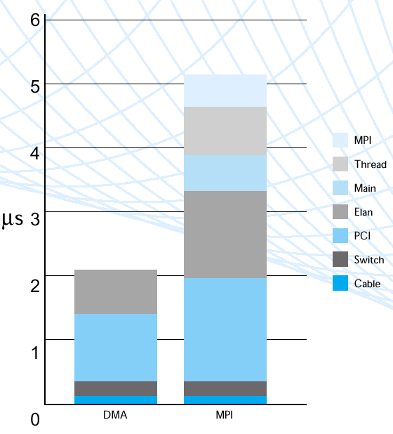
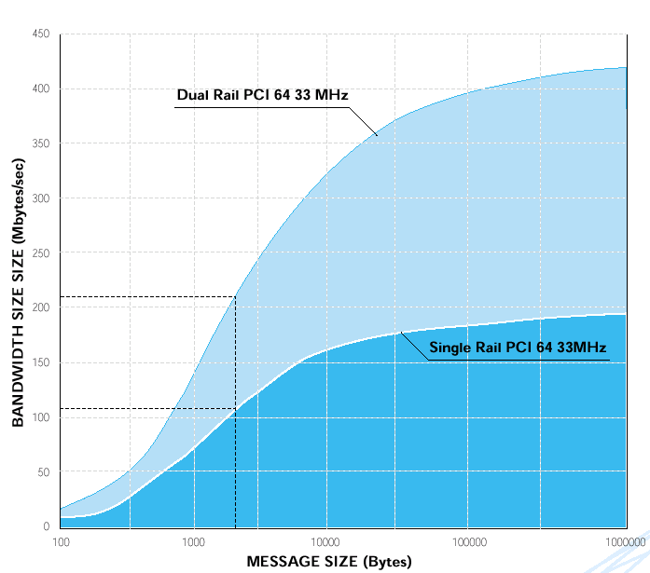
Quadrics
Advertised Bandwidth/latency, with PCI bottleneck shown

Slide 28
IBM SP – Hardware Used
NERSC SP – Seaborg
  208 - 16 processor Power 3+ SMP nodes
  16 – 64 GB memory per node
Switch Adapters
  2 Colony (switch2) adapters per node connected to a 2GB/sec 6XX memory bus (not PCI).
  Csss “bonding” driver will multiplex through both adapters
  On-board 740 PowerPC processor
  On-board firmware and RamBus memory for segmentation and re-assembly of user packets to and from 1KB switch packets.
  No RDMA, reliable delivery or hardware assist in protocol processing
Notes:
MB = 10^6 bytes
740 PowerPC processor provides:
Microcode control for adapter components
format and decode packet headers
build packet routing info
handle error conditions
pass control info back to node bus.
NOTE: doc says it operates at 486 MHz internal and 72 MHz external. I take this to mean 78 MHz compared to the 375 MHz Power 3+ processor. Given there are 16 of these per node, it might not be wise to have adapters do much comm work.

Slide 29
IBM SP - Software
AIX “user space” protocol for kernel bypass access to switch adapter
2 MPI libraries – single threaded and thread-safe
  Thread-safe version increases RTT latency by 10-15 usec
LAPI – Lowest level comm API exported to user
  Non-blocking one-sided remote memory copy ops
  Active messages
  Synchronization via counters and fence (barrier) ops
  Thread-safe (locking overhead)
  Mulit-threaded implementation:
    Notification thread (progress engine)
    Completion handler thread for active messages
  Polling or Interrupt mode
  Software based flow-control and reliable delivery (overhead)

Slide 30
Quadrics
Low latency network, w/100 MHz processor on NIC
  RDMA allows async, one-sided communication w/o interrupting remote processor.
  Supports MPI, T3E’s shmem, and ‘elan’ messaging APIs.
  Advertised one way latency as low as 2 us (5 us for MPI).
  Single switch can handle 128 nodes: federated switches can go up to 1024 nodes (Pittsburgh running 750 nodes).
  NIC processor can duplicate up to 4 GB of page tables—good for global address space languages.
  Runs over PCI bus—limits both latency & bandwidth
64 node cluster at Oak Ridge Nat’l Lab—”Falcon”
  64 4-way Alpha 667 MHz SMP nodes running Tru64
  66 MHz, 64 bit PCI bus
  Future work: look at Intel/Linux Quadrics cluster at LLNL

Slide 31
Myrinet 2000
Hardware: UCB Millennium cluster
  4-way Intel SMP, 550 MHz with 4GB/node
    33 MHz 32 bit PCI bus
  Myricom NIC: PCI64B
    2MB onboard ram
    133 MHz LANai 9.0 onboard processor
Software: GM
  Low-level API to control NIC sends/recvs/polls
  User space API with kernel bypass
  Support for zero-copy DMA directly to/from user address space

