Slide 1
Identification of Potential Strategic Partners using VxInsight
Kevin Boyack
Sandia National Laboratories

Slide 2
Process Steps
Select appropriate data set (queries to ISI physical science citation database of 4.7 million papers)
Calculate x-y position for each paper (ordination)
Query database to acquire list of organizations or individuals to focus on (relationship to Sandia)
Use VxInsight to explore overlap and relationships between Sandia and other organizations
Organizations that overlap Sandia in multiple areas are potential strategic partners

Slide 3
First Generation SAND92 set Specifics
Initial query on Sandia since 1992 yielded 3451 papers
Cited/citing pairs on Sandia papers
gave 31623 unique papers
Similarity measure between pairs of papers calculated using cocitation analysis
Ordination: x-y position calculated for the 31623 papers using the similarity matrix above
Landscape constructed using VxInsight
S

Slide 4
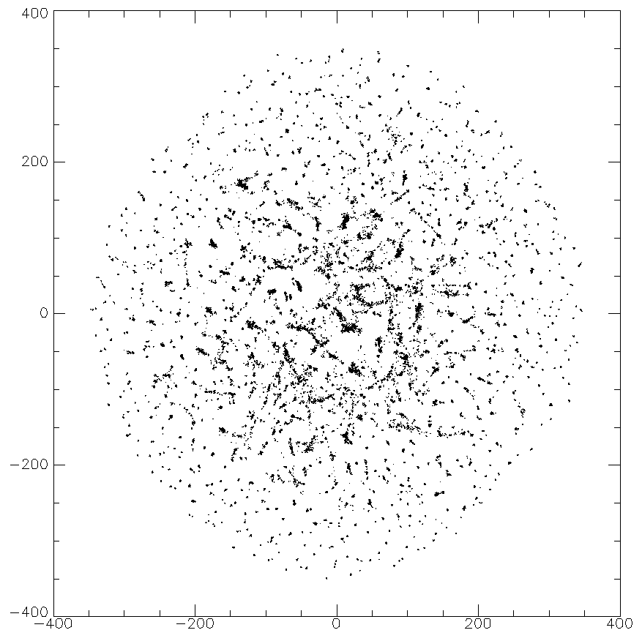
X-Y Scatterplot of Ordination (shows clustering)

Slide 5
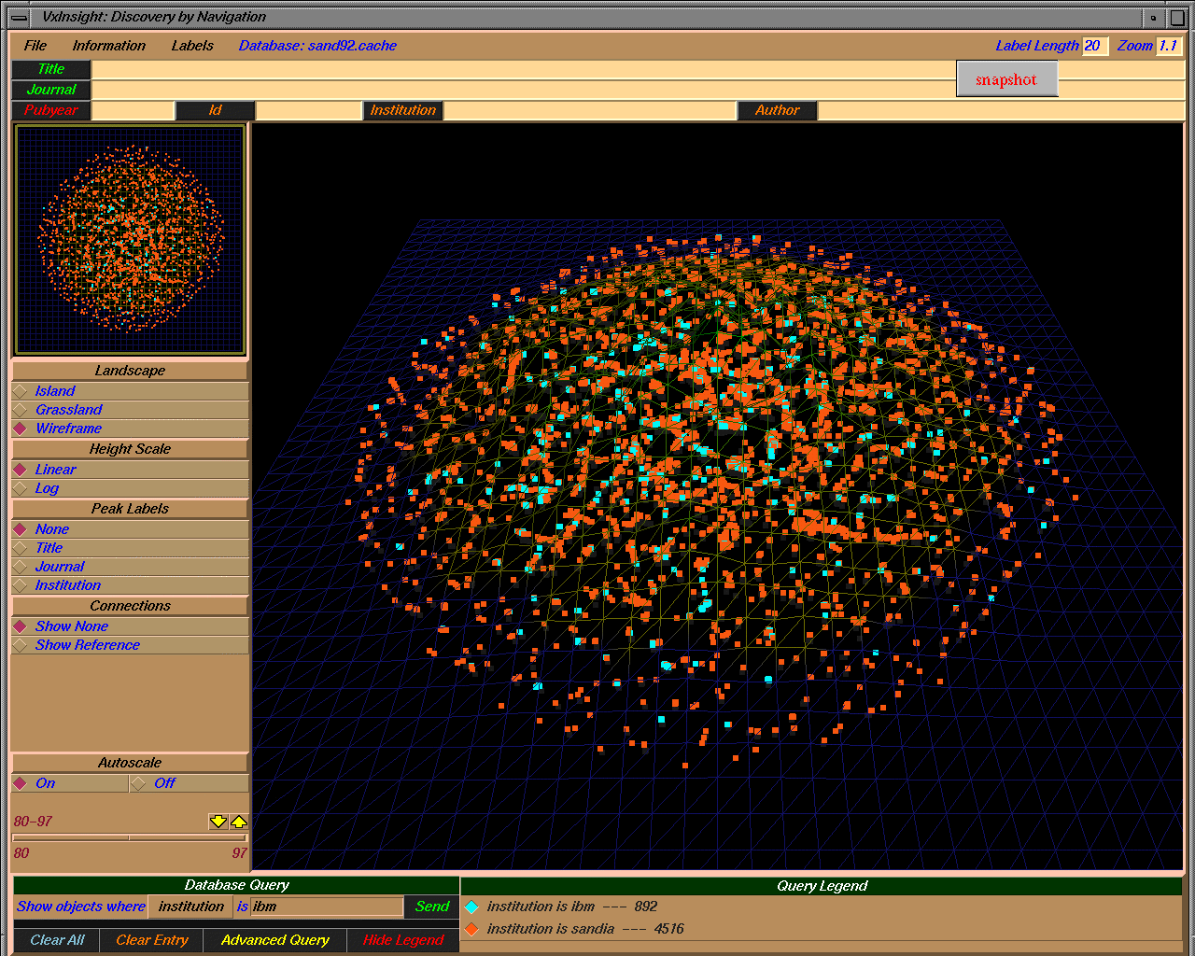
Top Level View of SAND92 Landscape (overlap with IBM)

Slide 6
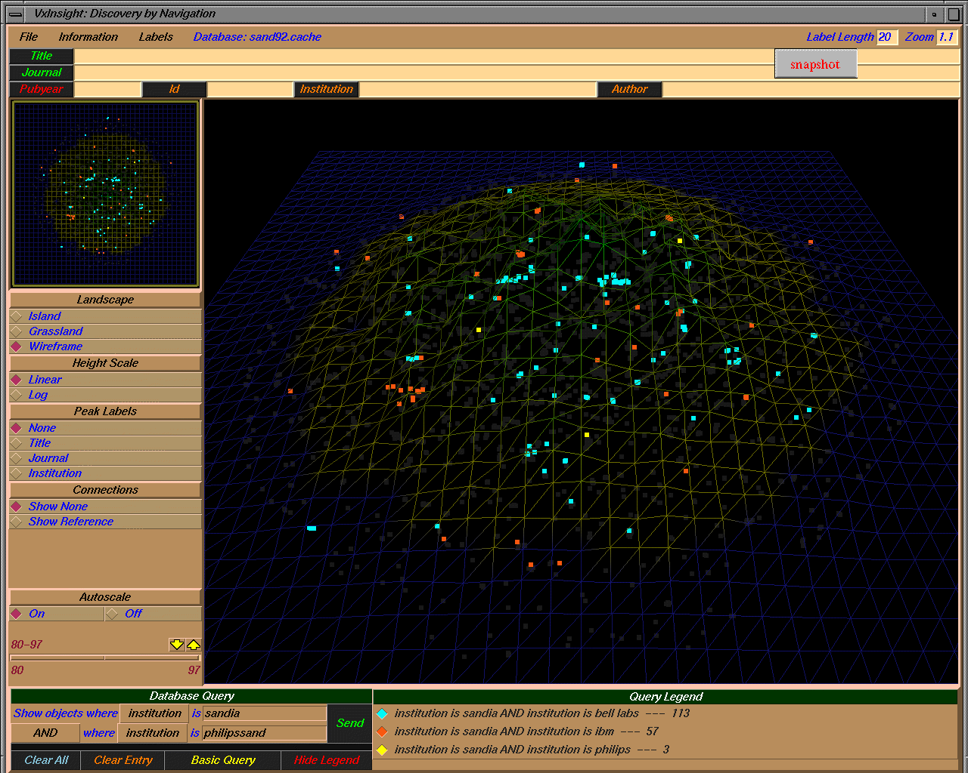
Joint Citations With IBM, Bell Labs, and Philips

Slide 7
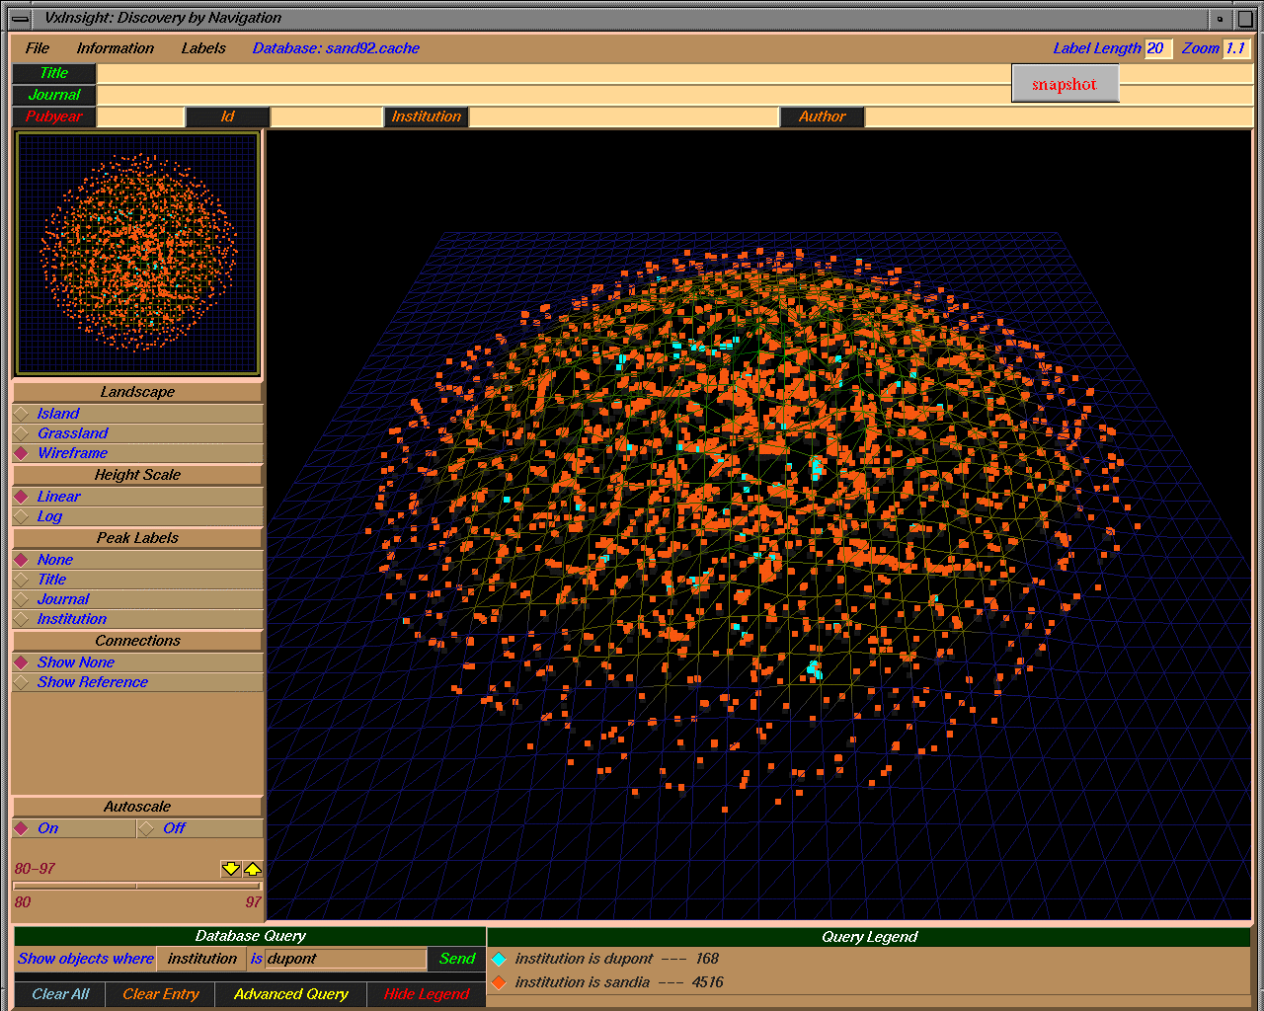
Top Level View of Landscape (overlap with DuPont)

Slide 8
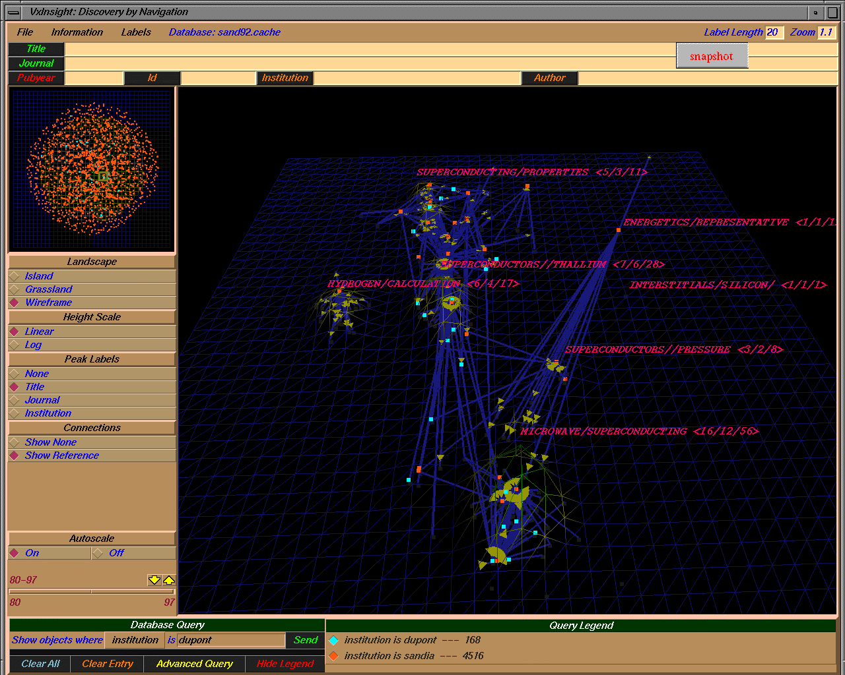
Detailed View (overlap with Dupont in Superconducting)
Area of detail

Slide 9
Second Generation SAND92 set
First generation Second generation
Second generation set has 514k articles with 1.42M citation pairs (ordination not done yet)
Second generation will reveal more potential partners (35.5k vs. 5.2k distinct addresses)
S
S

