Slide 1
MITRE TDT-2000
Segmentation System
Warren R. Greiff
Alex Morgan
Randall Fish
Marc Richards
Amlan Kundu
November, 2000

Slide 2
MITRE Segmentation Systems
TDT-3
  Naïve Bayes classifier
  independent boundary/no-boundary decisions at each word
  features:
    overlap
    x-duration
    triggers
    audio cues
TDT-2000
  fine-grained Hidden Markov Model
    story-length modeling
    story-position features
    single coherent segmentation

Slide 3
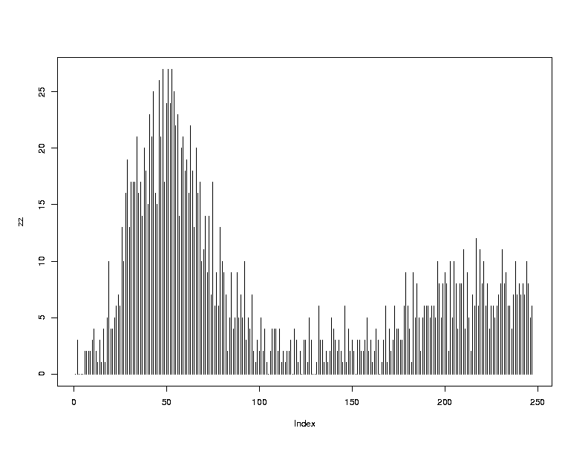
Story length profiles
Each source has it’s own typical profile
ABC_WNT:

Slide 4
HMM: initial topology
end of story (250 states)
start of story (250 states)
...
...
feature value
probability
distributions
middle of story
estimated from training data

Slide 5
Features - TDT-3
overlap:
  amount of overlap
  weighted by rarity
delta-overlap:
  change in overlap
pre-trigger cues:
  words that tend to occur at end of story
post-triggers:
  words that tend to occur at start of story
X-duration cue:
  duration of untranscribable input

Slide 6
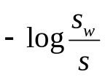
TDT-2000: Coherence Features
window:
50 words immediately prior to current word
value:
  if not in window:
  if occurs in window:
low values should be common at beginning of story
high values more common 50 words or more into story
COHER-1
0
s_{w}: # of stories in which w occurs
s: total # of stories

Slide 7
Features - coherence
motivation
  indication of how deep we are into story
  e.g.: high value of COHER-3:
    unlikely prior to word 100 of story
    most likely after word 150 of story
    increasing probability from 100 - 150
COHER-1
COHER-2
COHER-3
COHER-4

Slide 8
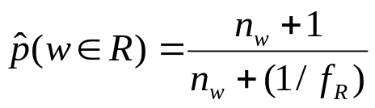
Trigger Features
Exploit:
  words more likely to appear in specified regions (near boundary)
  value of feature for region R:
    Bayesian estimator
    beta prior equiv to:
      uniform prior + 1 observation in R out of 1/f_{R} observation of word
    chosen because:
      prior = frequency of randomly selected word
      prior not greatly affected for low freq. words not occurring in R
      pushed strongly towards empirical freq. for words occurring in R
-5 -4 -3 -2 -1 1 2 3

Slide 9
Trigger Features (cont.)
Submission run:
  . 1st
  . 2nd
  . last
  . next-to-last
initial experimentation with other regions:
  unfruitful, so far
word of story

Slide 10
HMM: reduced end-of-story states
Problem with previous model
  confusion: end of short story / end of long story
  reduces value of coherence features
10 end states preserved for: end-of-story trigger cue
end of story (10 states)
start of story (250 states)
...
...
middle of story

Slide 11
HMM - current version: no end-of-story states
Problem with previous model
  confusion still degrades performance
  reduces value of coherence features
end-of-story triggers:
  delay observation for 10 counts:
    e.g: {-4,-3,-2} region:
    high values can be interpreted as:
      “a word showing preference for occuring 2-4 word
      prior to end of story, ocurred 10 words ago”
    high values most likely in states 6,7,8
250 states
...

Slide 12
Probability estimation problem:
probabilities must be
transition probabilities for each state
observation probabilities
  for each feature
    for each possible value of observation
    in each state
250 states
...
feature value
probability
distributions
estimated from training data

Slide 13
Probability estimation - smoothing:
assumptions:
  transition probabilities don’t vary much
    from state to state
  for a given feature,
  observation probabilities should be similar:
    for neighboring values
    in neighboring states
250 states
...
feature value
probability
distributions

Slide 14
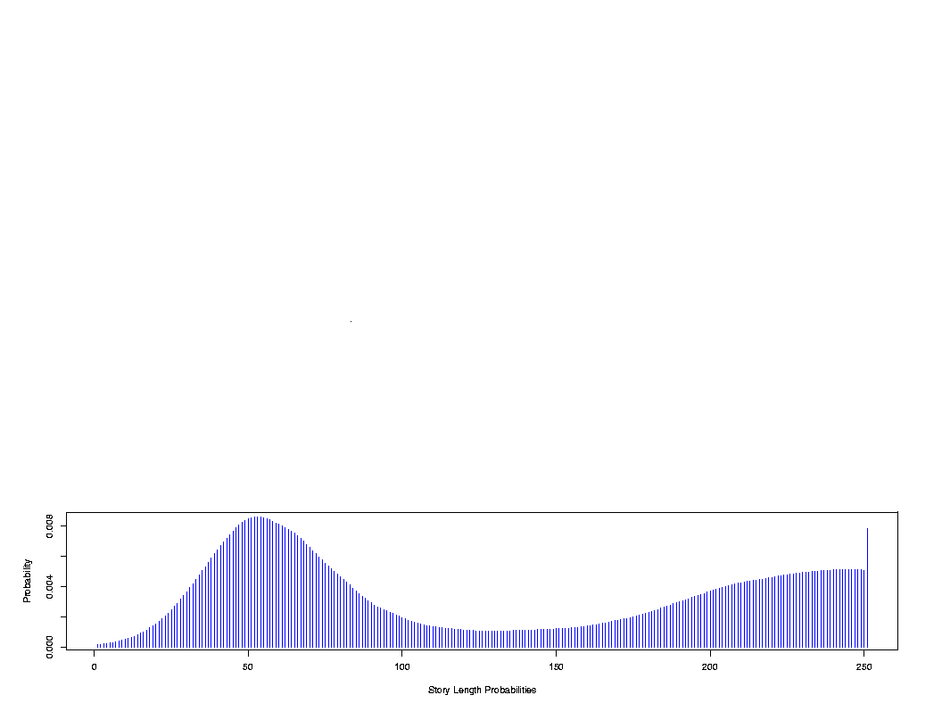
Parameter estimation - transition probabilities
Raw histogram: ABC_WNT
Smoothed density estimation
  in place of raw histogram
from this, cond. probs: p(S_{t+1} = 0| S_{t} = s) derived directly

Slide 15
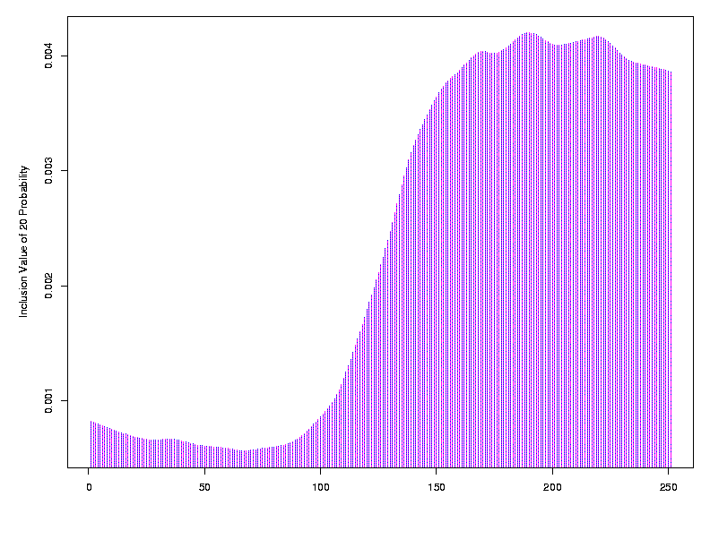
Non-parametric estimation: observation probs
values are binned
for each binned feature value, fv:
  non-parametric regression: fv-count vs. state
  normalize smoothed counts => p(fv | s)
  p(fv | s) * p(s) => p(fv, s)
for each state, s:
  normalize p(fv, s) across values => p(fv | s)
COHER = 20

Slide 16
Segmentation
Viterbi algorithm: Maximum Likelihood state sequence
output boundary each time word generated from state=1
boundary state “penalty”:
  tuning for evaluation metric
...
additional cost
...

Slide 17
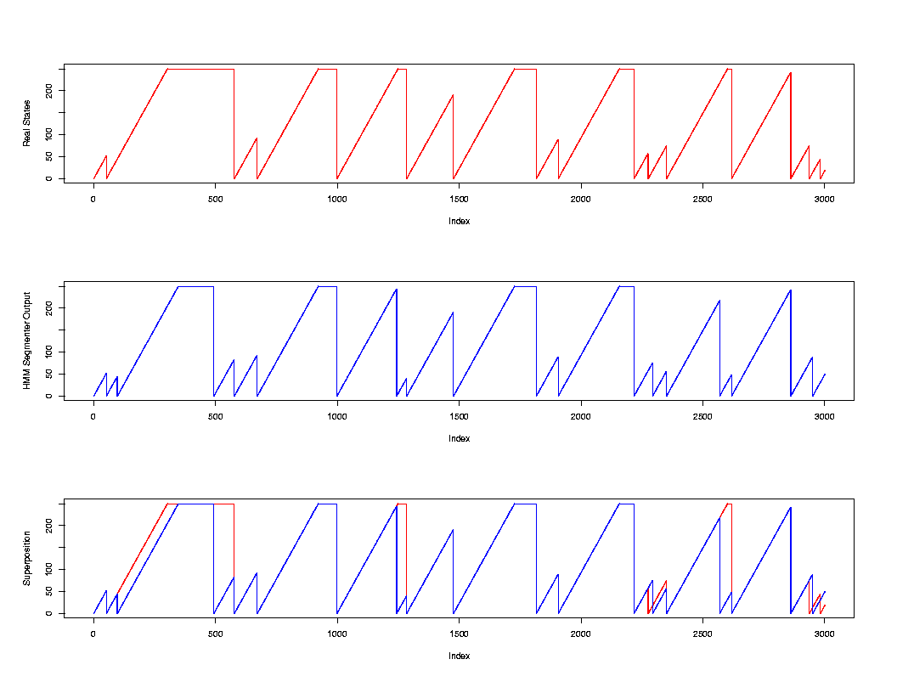
segmentation performance (ABC_WNT)
true states:
true states:
true states:
segmentation
output:
segmentation
output:
segmentation
output:

Slide 18
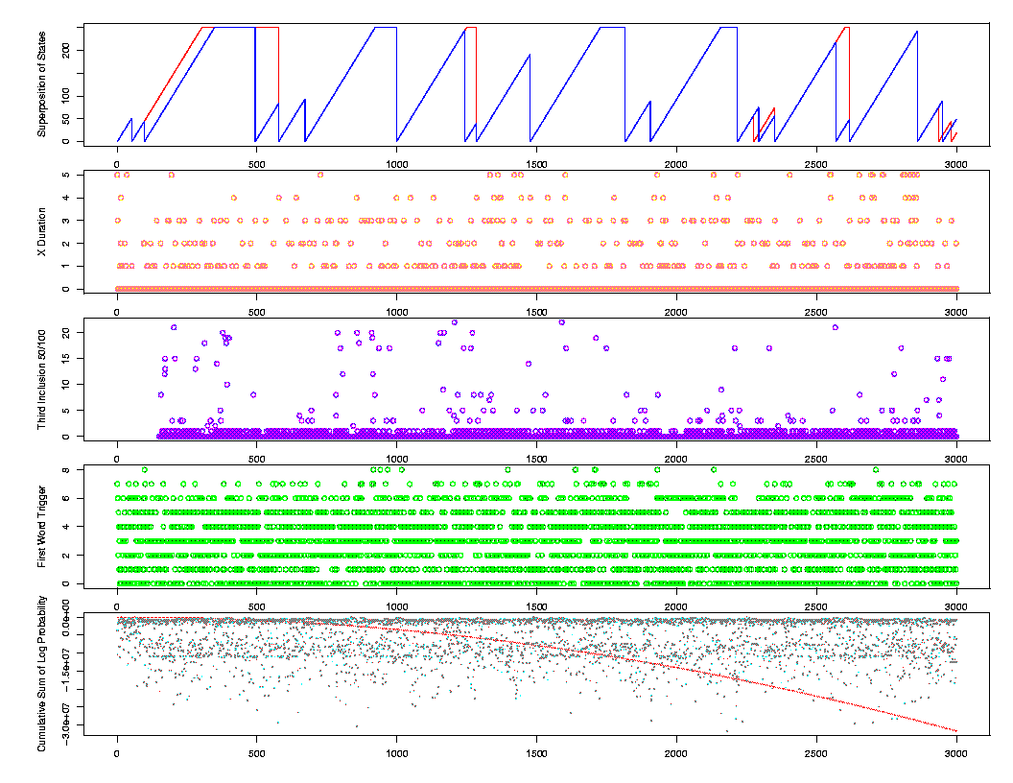
Visualization: effect of observation values on segmentation
X-DURATION
COHER-3
first word
trigger

Slide 19
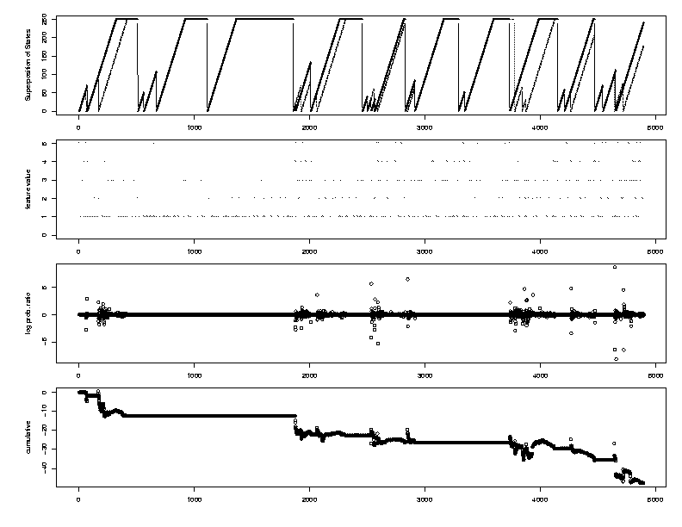
Visualization: effect of X-DURATION

Slide 20
Results
ABC_WNT:
  encouraging
  train on all but 15 files
  test of remaining 15
  .31 (TDT-3: IBM=.31; CMU=.33)
approach needs to be applied to other sources

Slide 21
Future work
Extension to other sources
Theoretically motivated methods for evaluating
  feature potential
  impact on segmentation performance over multiple files
Smoothing
  degree of polynomial, kernel function, bandwidth
  goodness-of-fit
Features:
  textual
  audio signal

