Slide 1

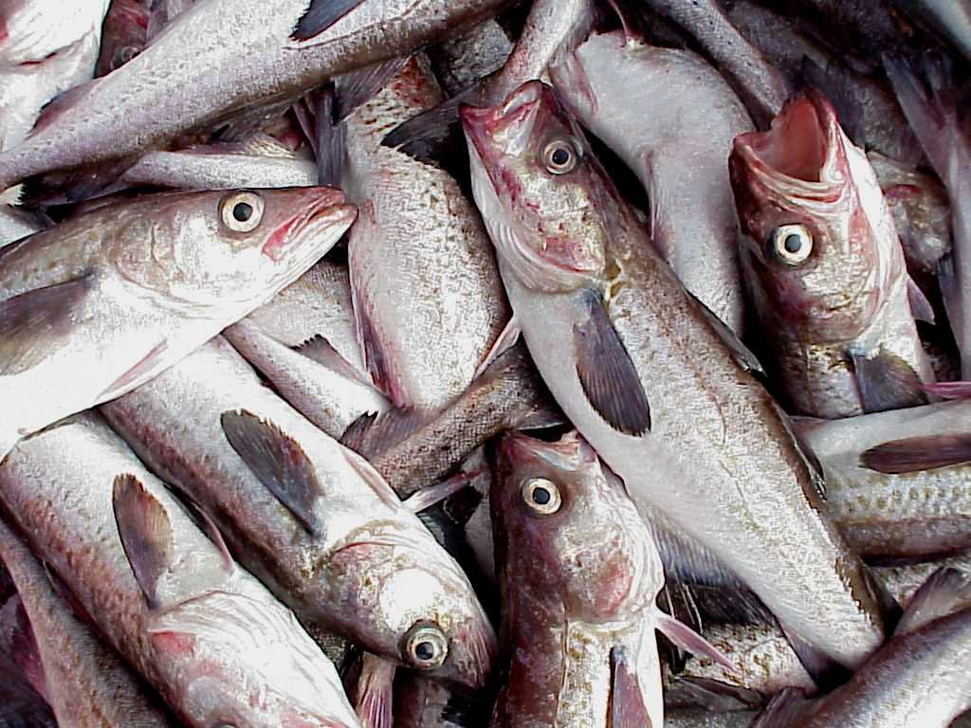

Spatial distribution and ontogenetic movement of walleye pollock in the eastern Bering Sea
Presenters:
Troy Buckley, Angie Greig,
James Ianelli, Patricia Livingston,
and Gary Walters

Slide 2
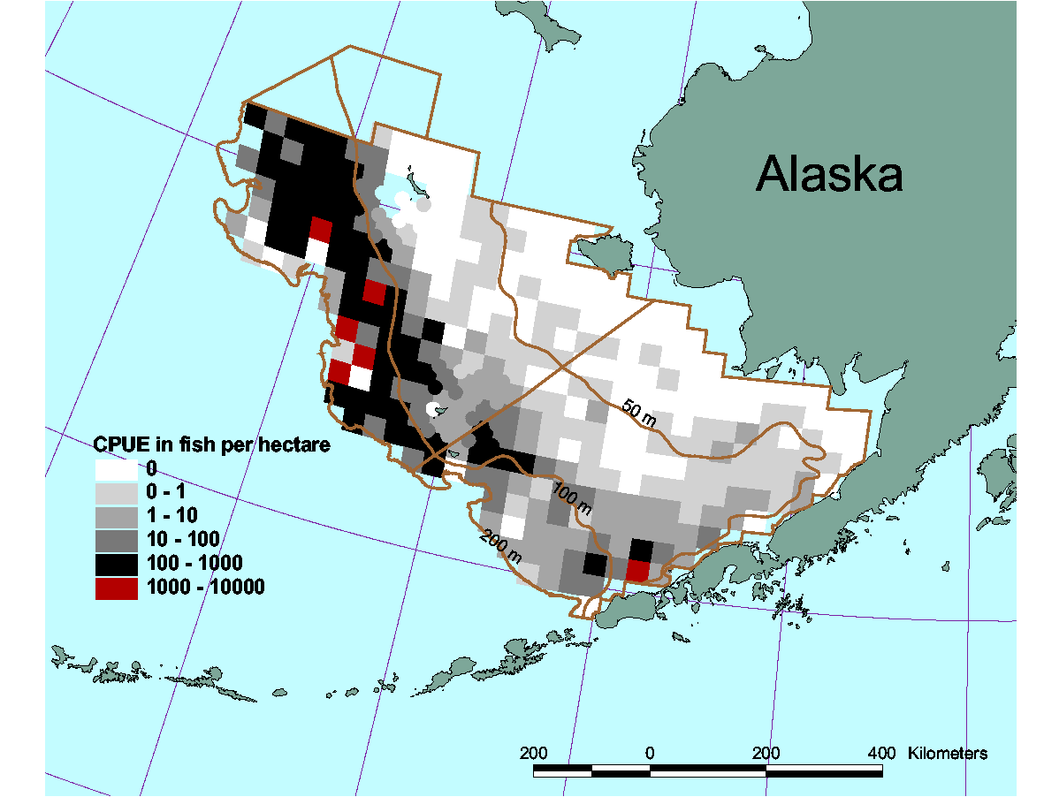
Bottom trawl survey area

Slide 3
Considerations:
- These are bottom trawl data for a semi-pelagic species.
- Walleye pollock becomes increasingly demersal with age,
so older fish are sampled better by the bottom trawl.
- But length to age conversion is better for younger walleye
pollock (there is less overlap of length ranges).
- Border effects may influence apparent patterns if large
numbers of fish move into, or out of, the survey area.
- Twenty consecutive years of standardized data!

Slide 4
Considerations:
- These are bottom trawl data for a semi-pelagic species.
- Walleye pollock becomes increasingly demersal with age,
so older fish are sampled better by the bottom trawl.
- But length to age conversion is better for younger walleye
pollock (there is less overlap of length ranges).
- Border effects may influence apparent patterns if large
numbers of fish move into, or out of, the survey area.
- Twenty consecutive years of standardized data!

Slide 5
Considerations:
- These are bottom trawl data for a semi-pelagic species.
- Walleye pollock becomes increasingly demersal with age,
so older fish are sampled better by the bottom trawl.
- But length to age conversion is better for younger walleye
pollock (there is less overlap of length ranges).
- Border effects may influence apparent patterns if large
numbers of fish move into, or out of, the survey area.
- Twenty consecutive years of standardized data!

Slide 6
Considerations:
- These are bottom trawl data for a semi-pelagic species.
- Walleye pollock becomes increasingly demersal with age,
so older fish are sampled better by the bottom trawl.
- But length to age conversion is better for younger walleye
pollock (there is less overlap of length ranges).
- Border effects may influence apparent patterns if large
numbers of fish move into, or out of, the survey area.
- Twenty consecutive years of standardized data!

Slide 7
Considerations:
- These are bottom trawl data for a semi-pelagic species.
- Walleye pollock becomes increasingly demersal with age,
so older fish are sampled better by the bottom trawl.
- But length to age conversion is better for younger walleye
pollock (there is less overlap of length ranges).
- Border effects may influence apparent patterns if large
numbers of fish move into, or out of, the survey area.
- Twenty consecutive years of standardized data!

Slide 8
1990 age-6

Slide 9
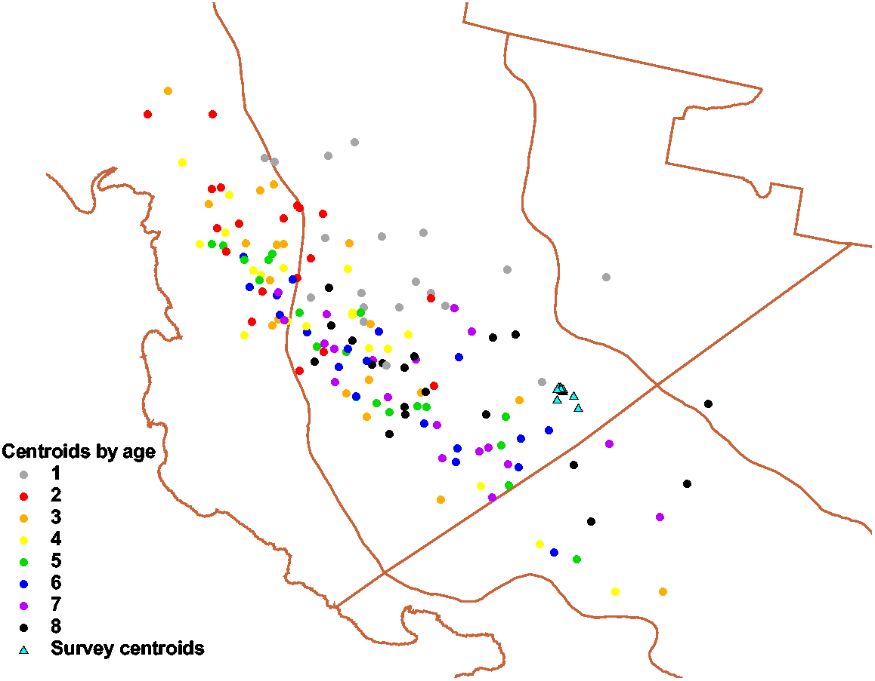

Slide 10
1. Will the centroids reflect previously described spatial
patterns relative to:
- Temperature?
- Ontogeny?
2. What other spatial patterns are apparent?
- Northwest vs. Southeast Yearclasses
- What might cause these patterns?
- What are some implications of this result?

Slide 11
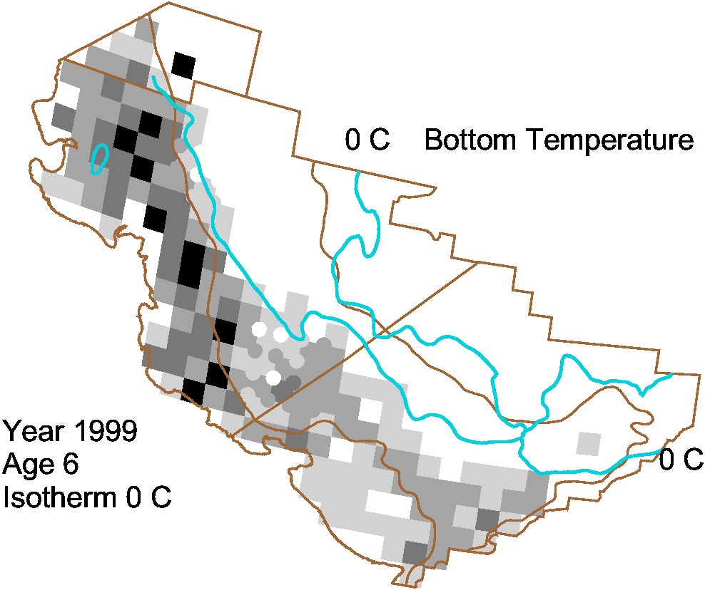

Slide 12
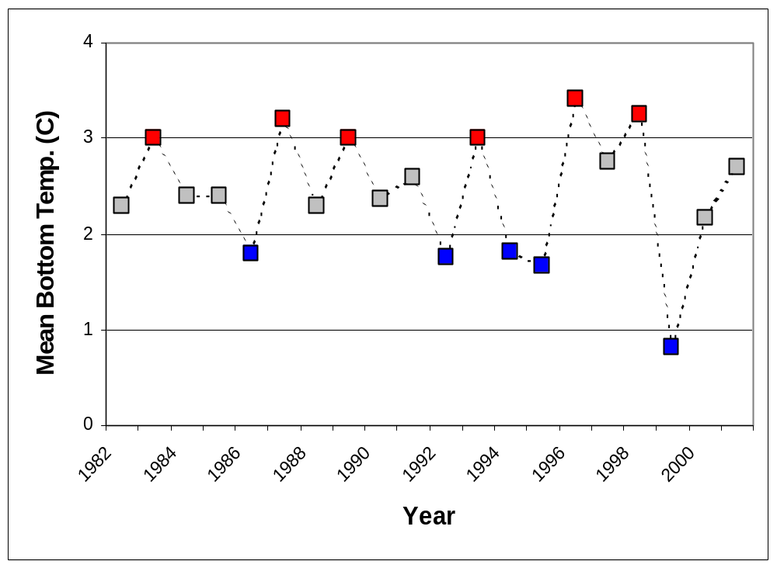

Slide 13
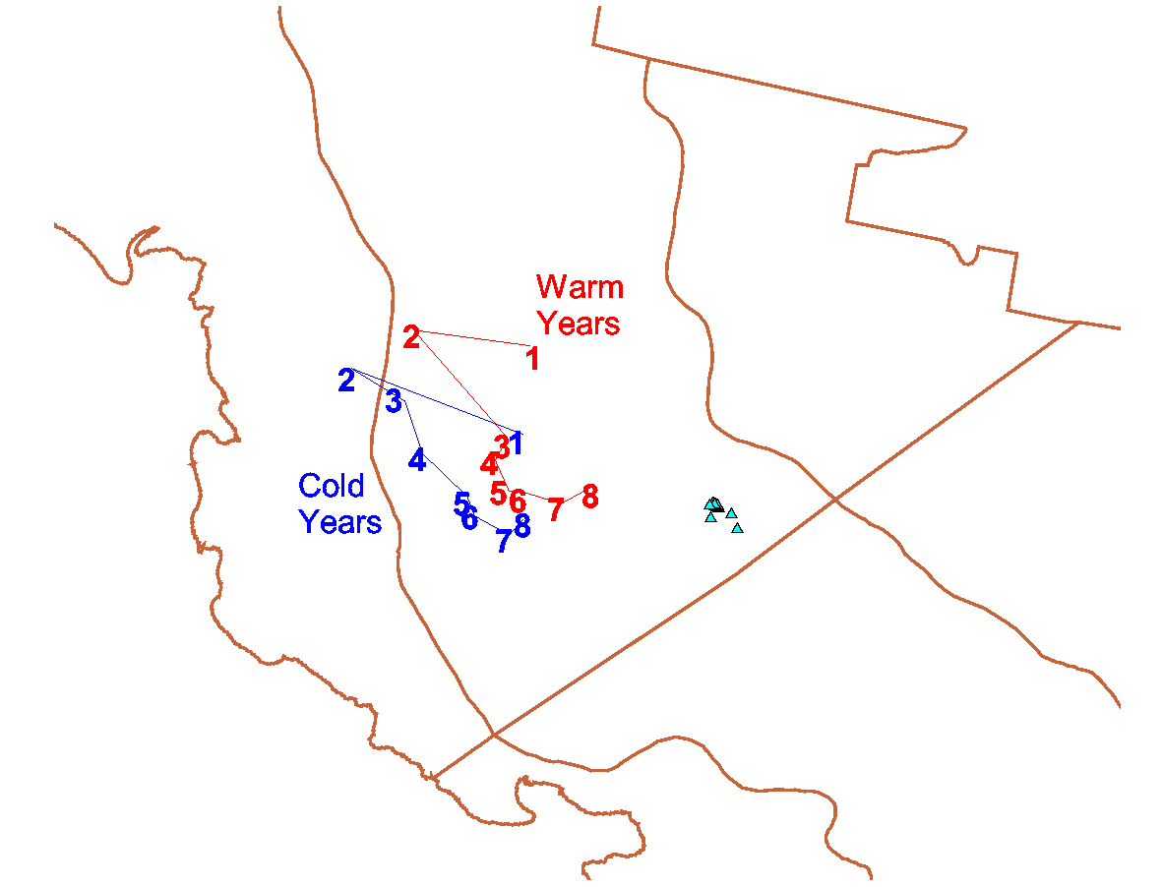

Slide 14
1. Will the centroids reflect previously described spatial
patterns relative to:
- Temperature? Yes
- Ontogeny? Yes
2. What other spatial patterns are apparent?
- Northwest vs. Southeast Yearclasses
- What might cause these patterns?
- What are some implications of this result?

Slide 15
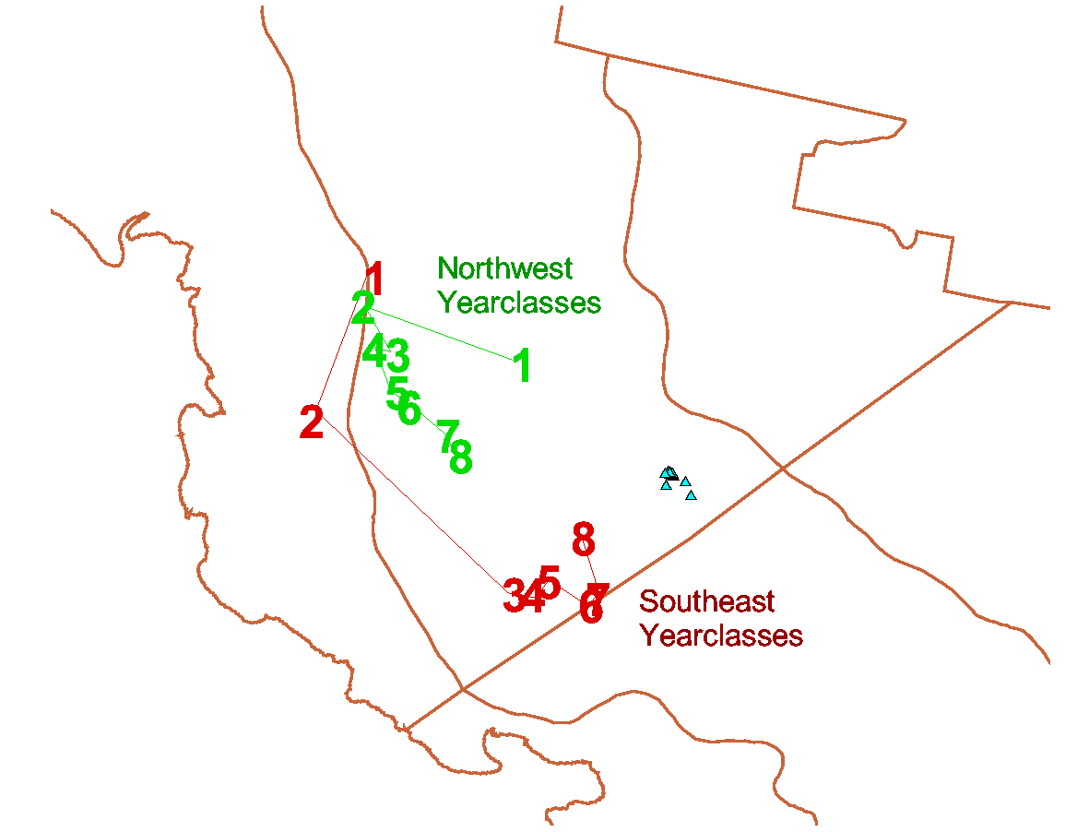

Slide 16
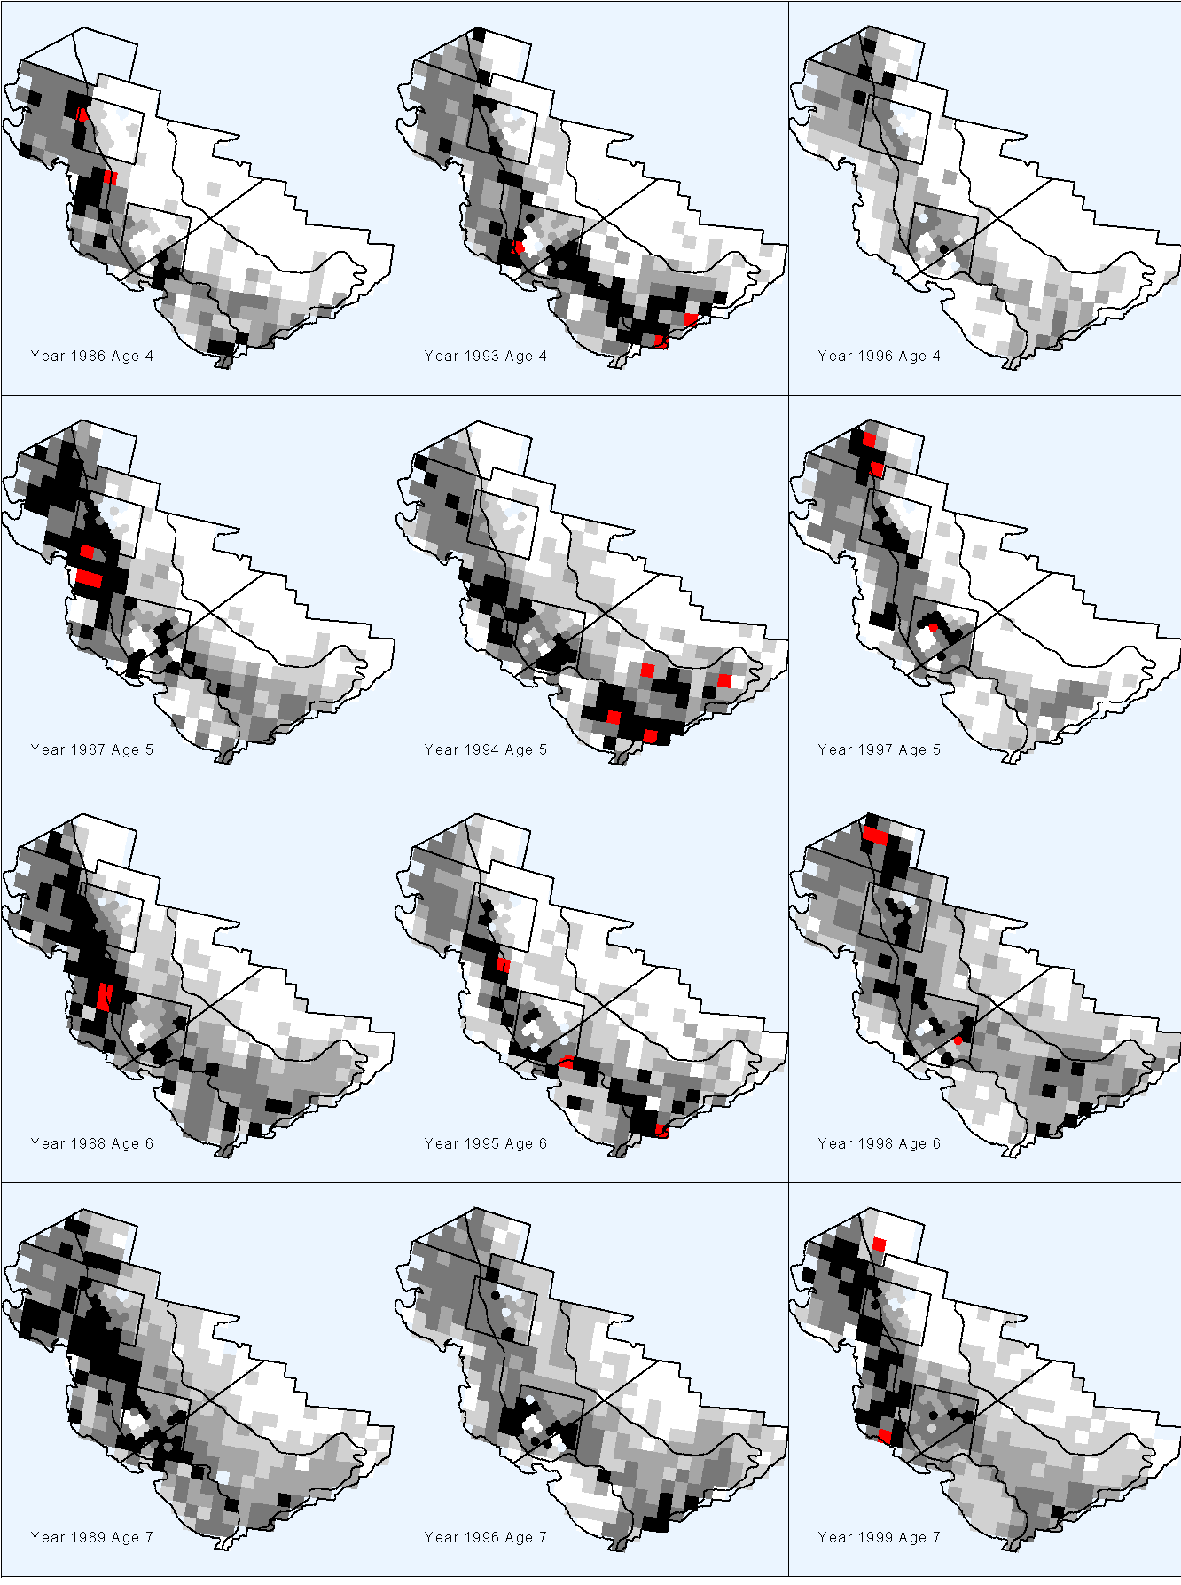
1982 yc
1989 yc
1992 yc

Slide 17
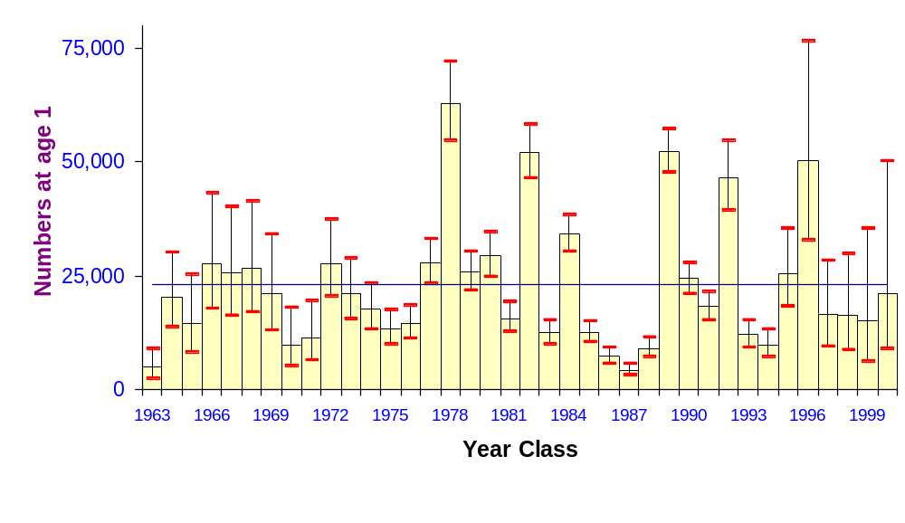
Year-Class Estimates

Slide 18
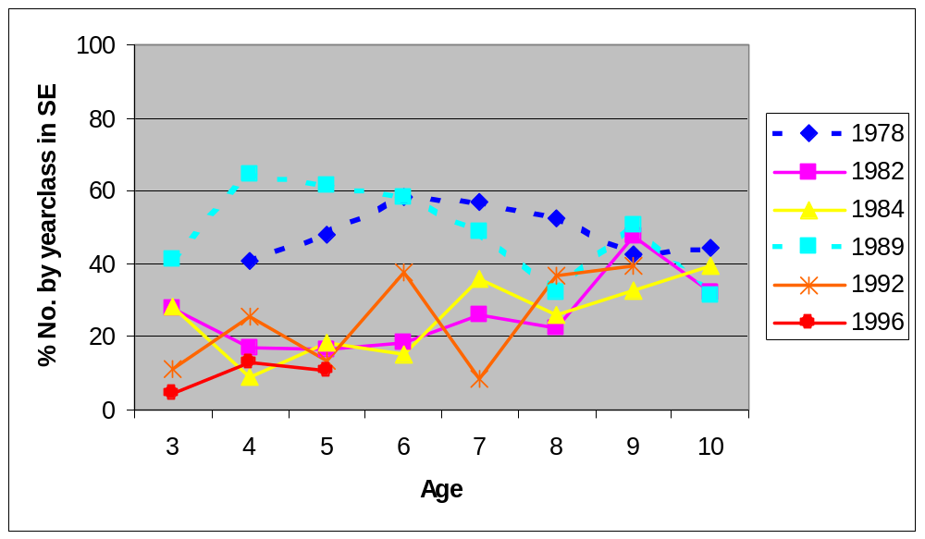
Yearclass

Slide 19
1. Will the centroids reflect previously described spatial
patterns relative to:
- Temperature?
- Ontogeny?
2. What other spatial patterns are apparent?
- Northwest vs. Southeast Yearclasses
- What might cause these patterns?
- What are some implications of this result?

Slide 20
1982 yc
1989 yc
1992 yc

Slide 21
- What might cause these patterns?
A) Successful reproduction only in the SE with eggs
and larvae being transported to the NW or the SE
areas where the majority remain.
OR
B) Successful reproduction in the SE and NW areas
with the majority of juveniles returning to their
area of origin.

Slide 22
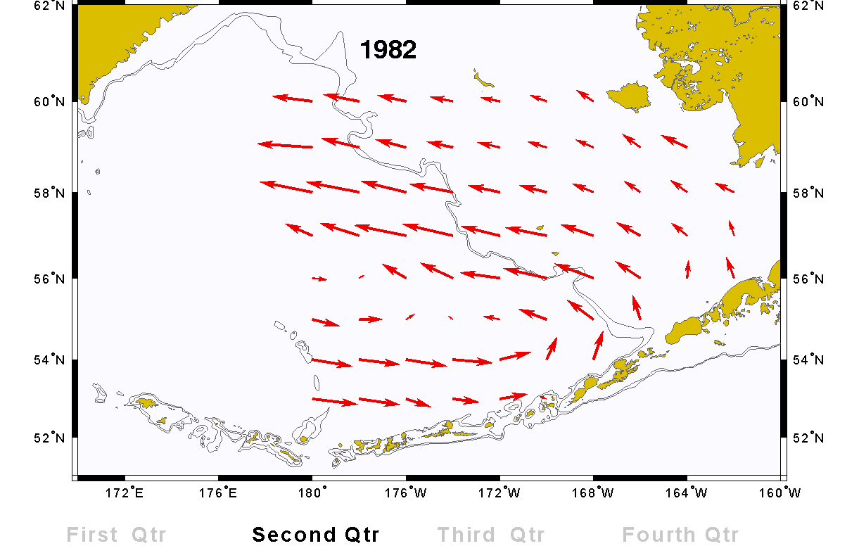
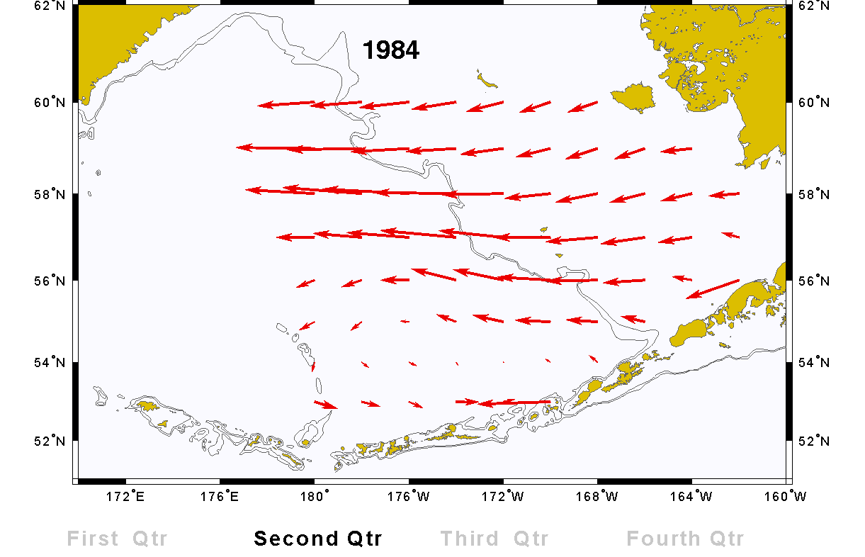
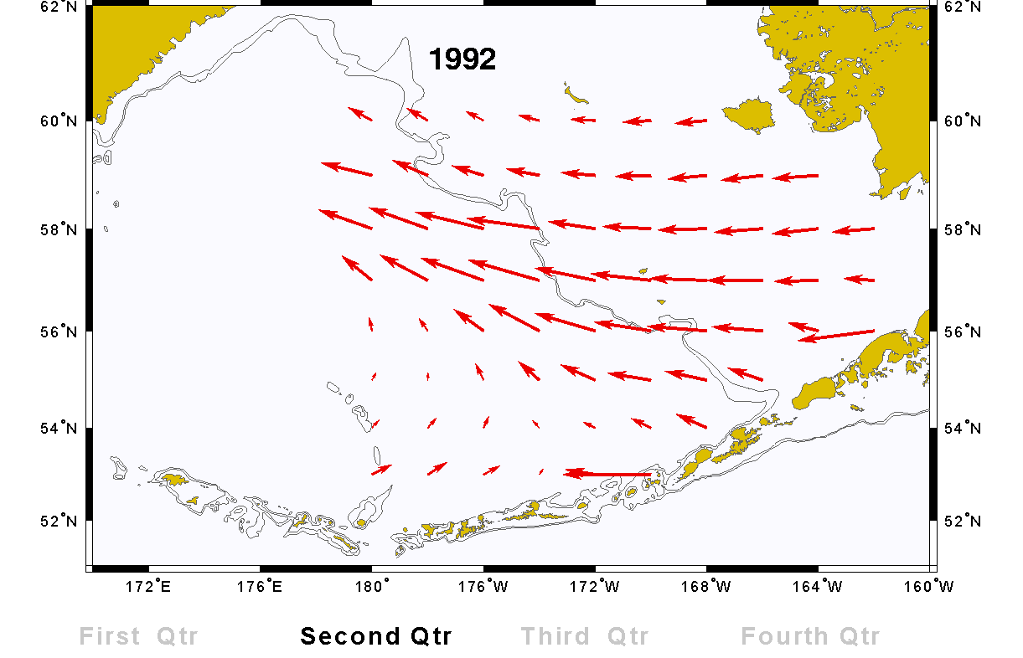
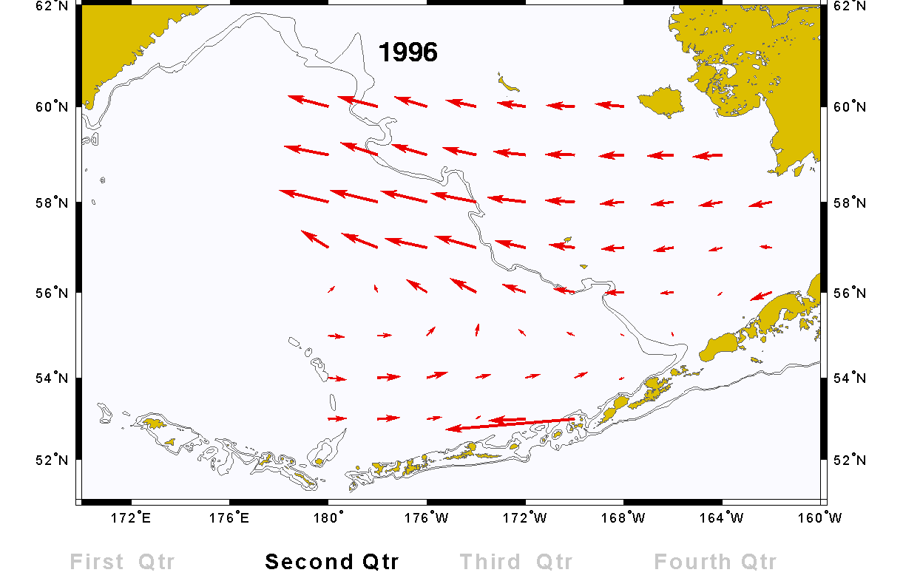

Slide 23
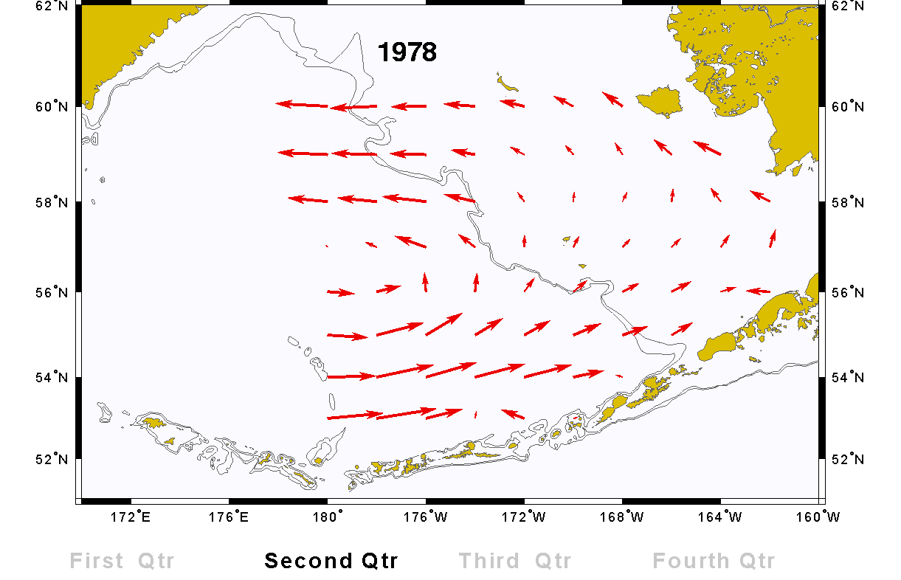
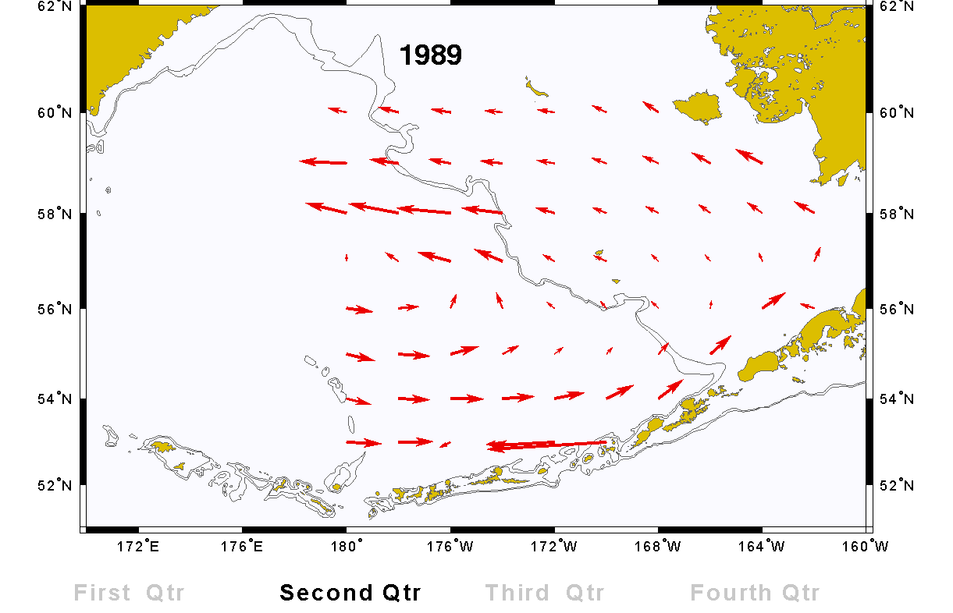

Slide 24
“Strong year classes in 1972 and 1973 appear to have supported
the fishery in the northwest in the early and mid 1970’s…
whereas a strong 1978 year class appears to be supporting the
recent fishery in the southeast…”
Francis, R.C. and K.M. Bailey. 1983. Factors Affecting
Recruitment of Selected Gadoids in the Northeast Pacific
and East Bering Sea. Pages 35-60 in W. Wooster. (ed.)
From Year to Year. Washington Sea Grant, University
of Washington, Seattle.

Slide 25
1. Will the centroids reflect previously described spatial
patterns relative to:
- Temperature?
- Ontogeny?
2. What other spatial patterns are apparent?
- Northwest vs. Southeast Yearclasses
- What might cause these patterns?
- What are some implications of this result?

Slide 26
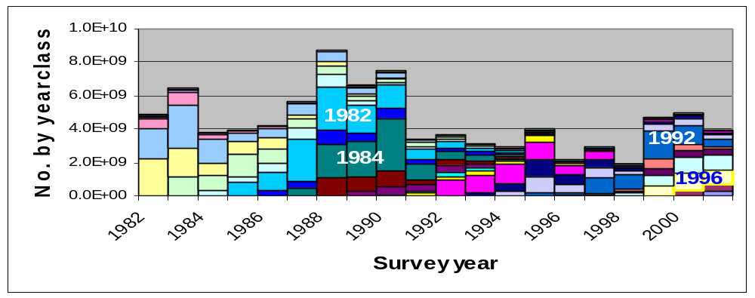
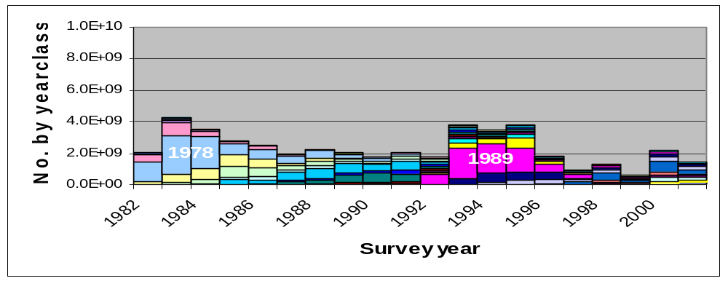

Slide 27
Conclusions:
The age-specific spatial distribution of walleye pollock in the
eastern Bering Sea is highly variable.
Warm years allow walleye pollock to move further on-shelf
during the summer.
The spatial distribution of a yearclass appears to persist for
many years. Few yearclasses appear to contribute many
walleye pollock to the southeast area.
Patterns in surface current simulations appear to correlate
with the recruitment success of large yearclasses and with
the geographic area of the recruitment.

Slide 29
Spatial distribution and ontogenetic movement of walleye pollock in the eastern Bering Sea
Presenters:
Troy Buckley, Angie Greig,
James Ianelli, Patricia Livingston,
and Gary Walters

