Slide 1
Informational Material
On Burnthrough
June 03

Slide 2
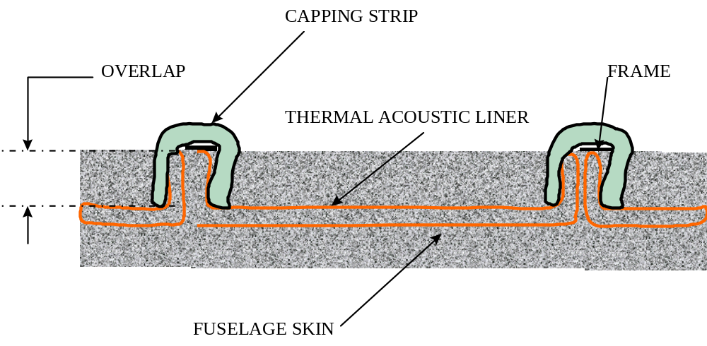
Terms Used

Slide 3
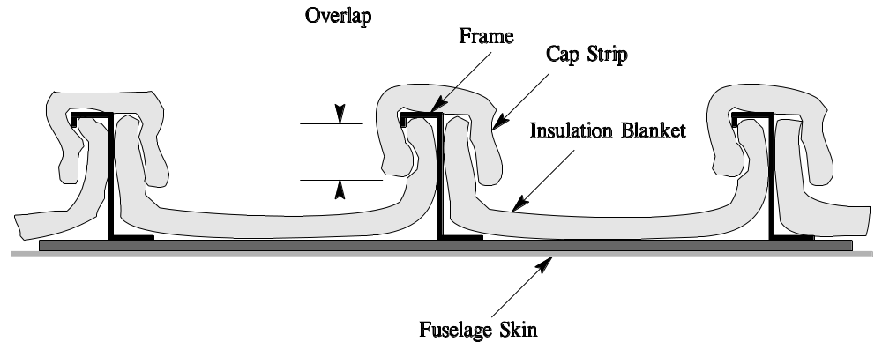
2 inch Minimum Overlap
Use of Cap Strip

Slide 4
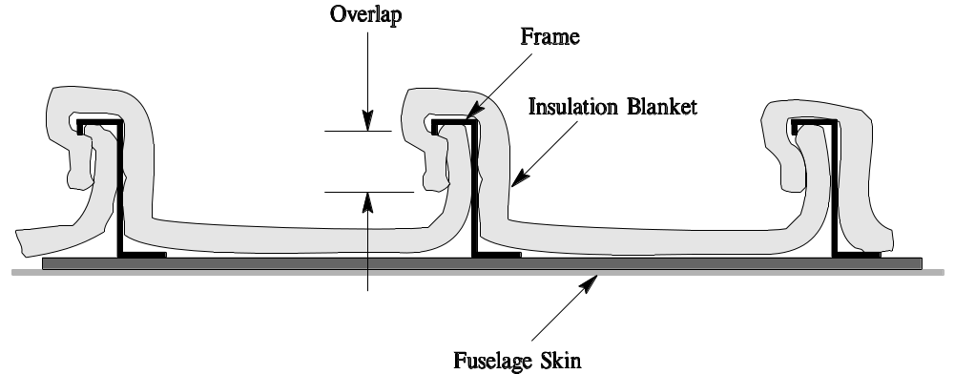
Blanket Overlap

Slide 5
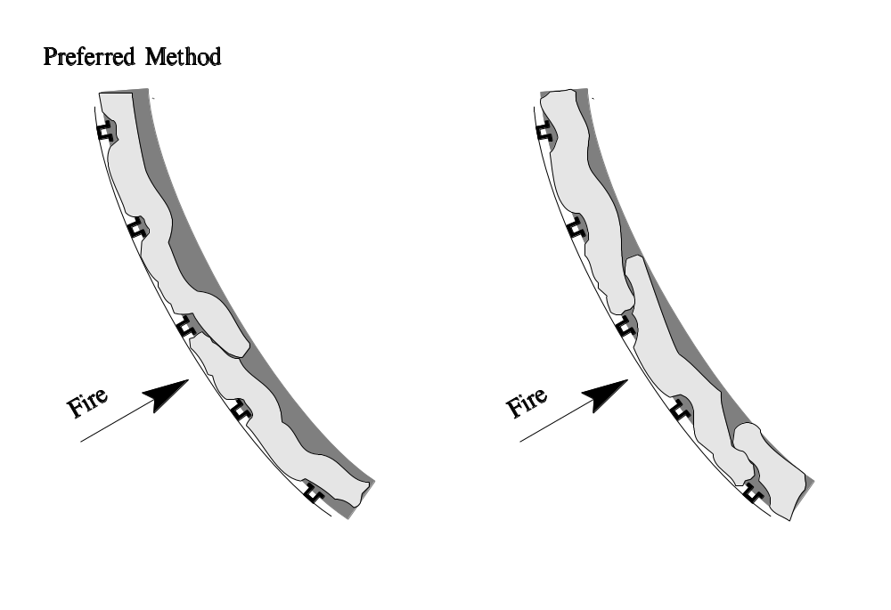
6 inch Minimum sealed with Tape
Horizontal Overlap

Slide 6
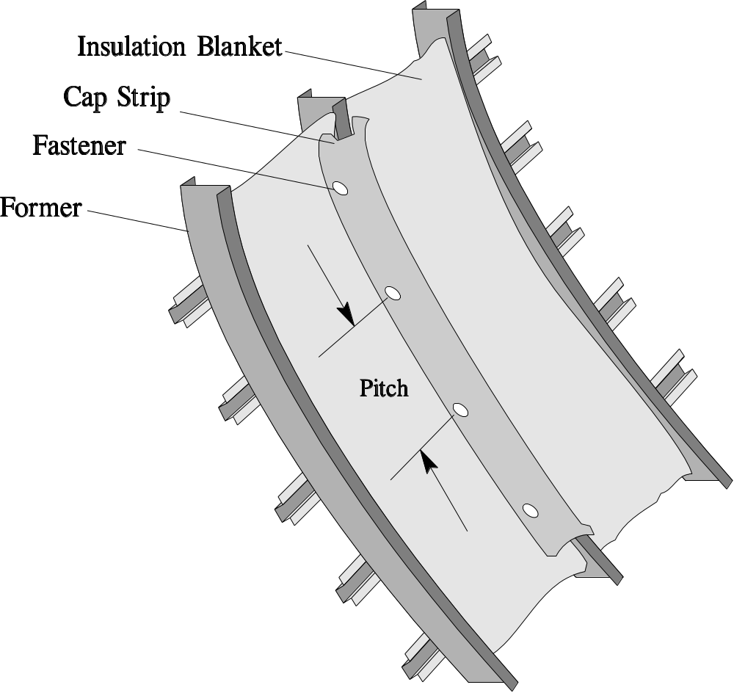
14 inch Maximum Pitch

Slide 7
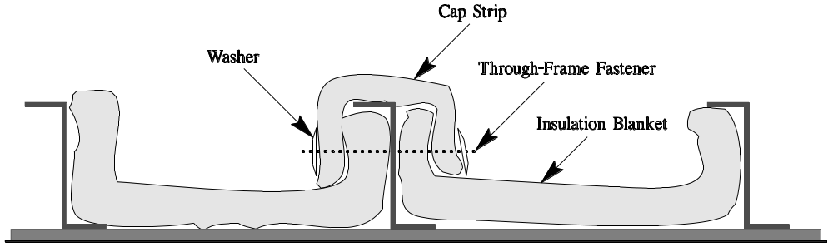
Minimum 1 inch from Skin

Slide 8
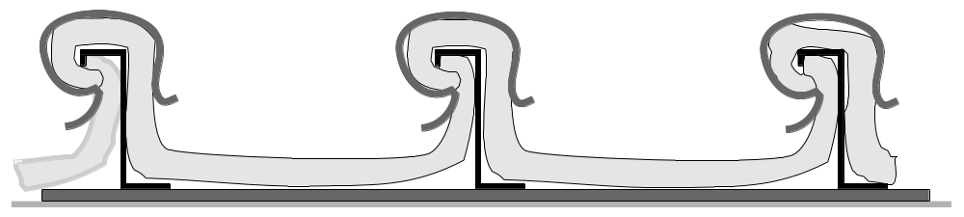
Maximum 14 inches

Slide 9
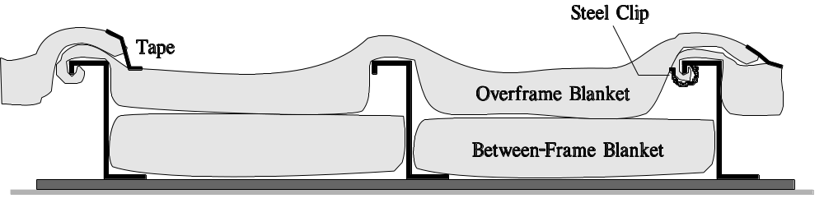
Maximum 14 inches

Slide 10
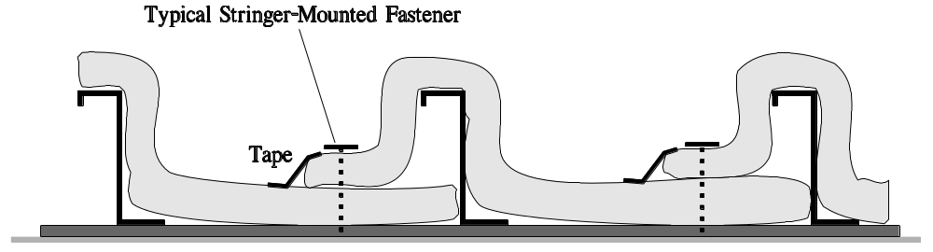
Should be Fire Resistant

Slide 11
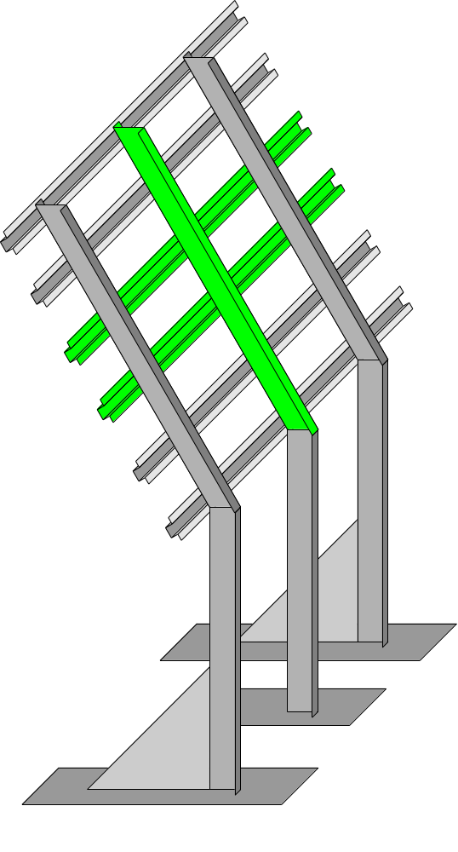
Test Fixture Modification for the Testing of Fixing System

Slide 12
Configurations that Meet
the Requirement

Slide 13
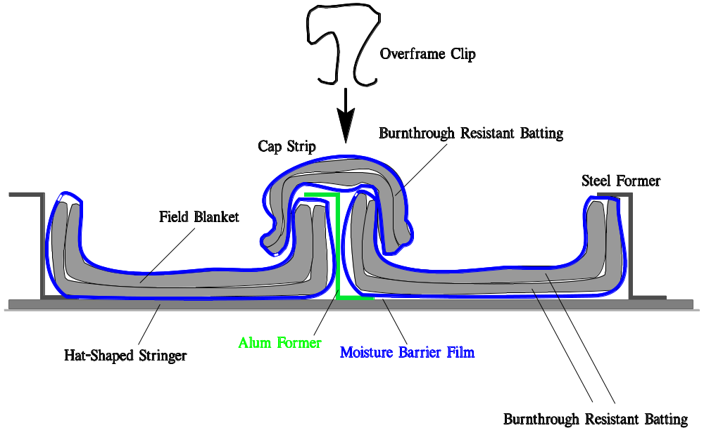

Slide 14
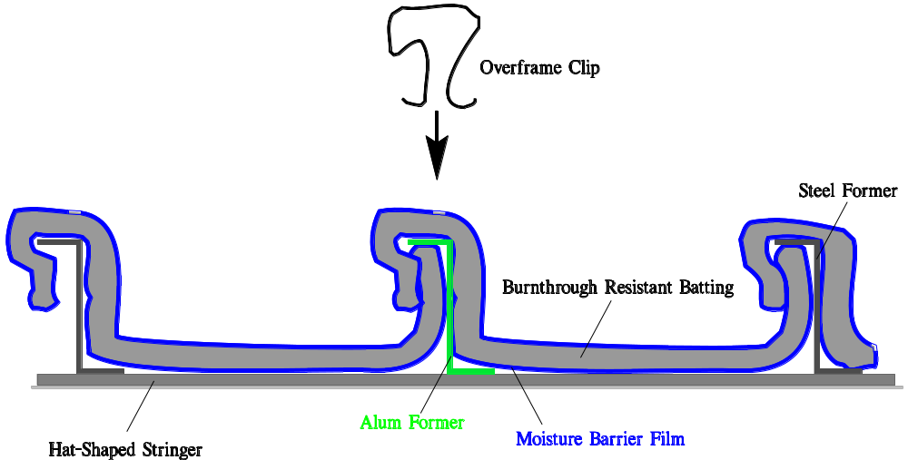

Slide 15
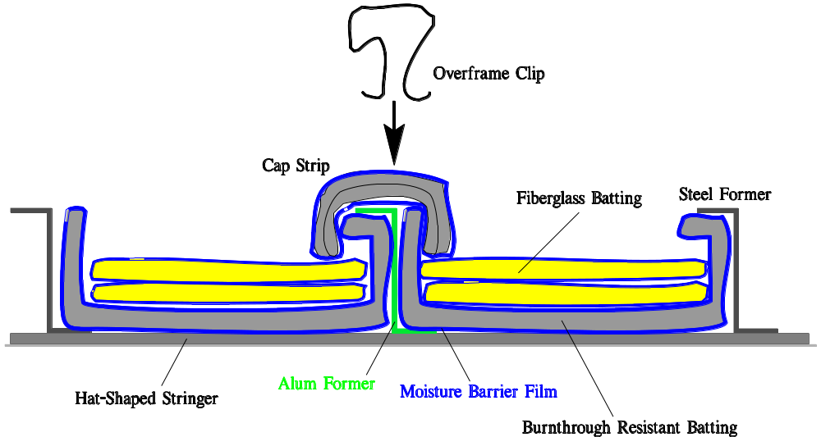

Slide 16
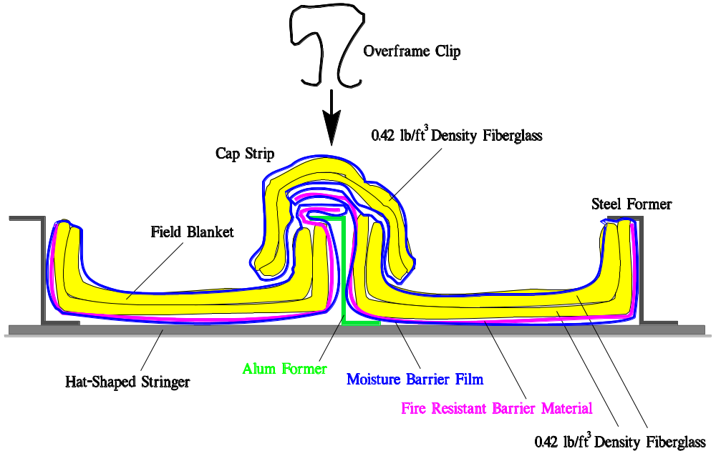

Slide 17
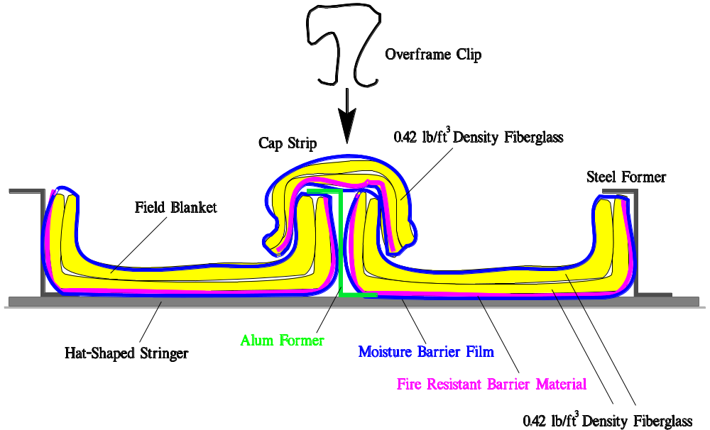

Slide 18
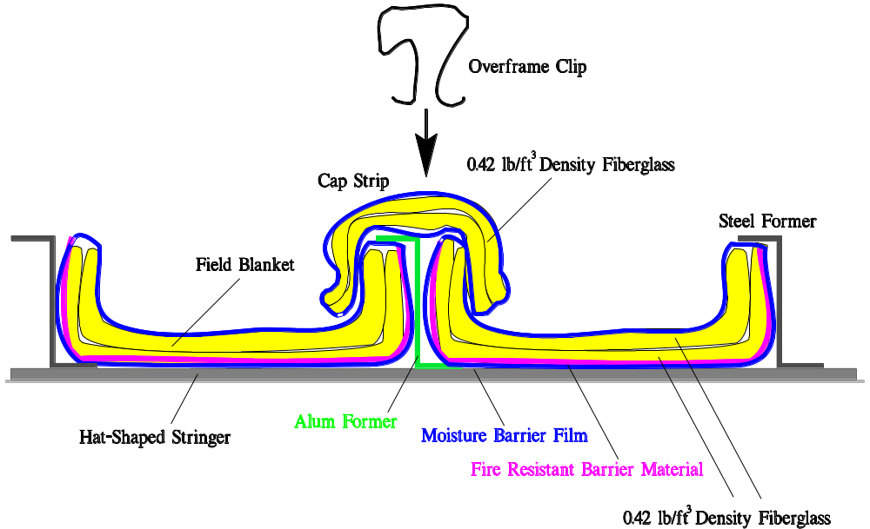

Slide 19
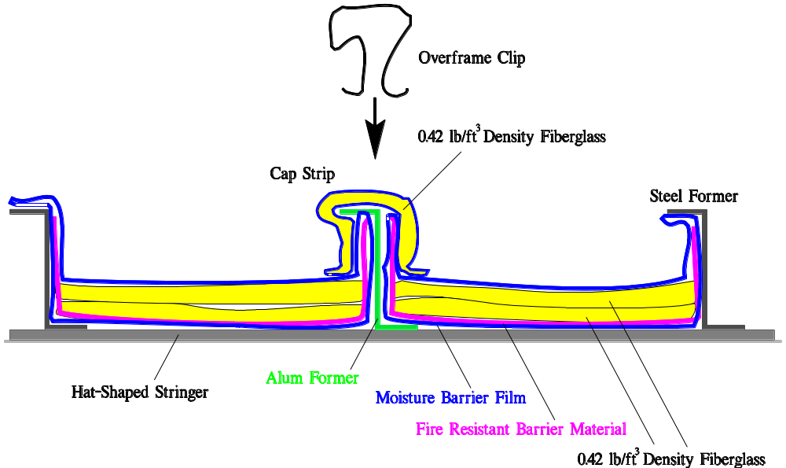

Slide 20
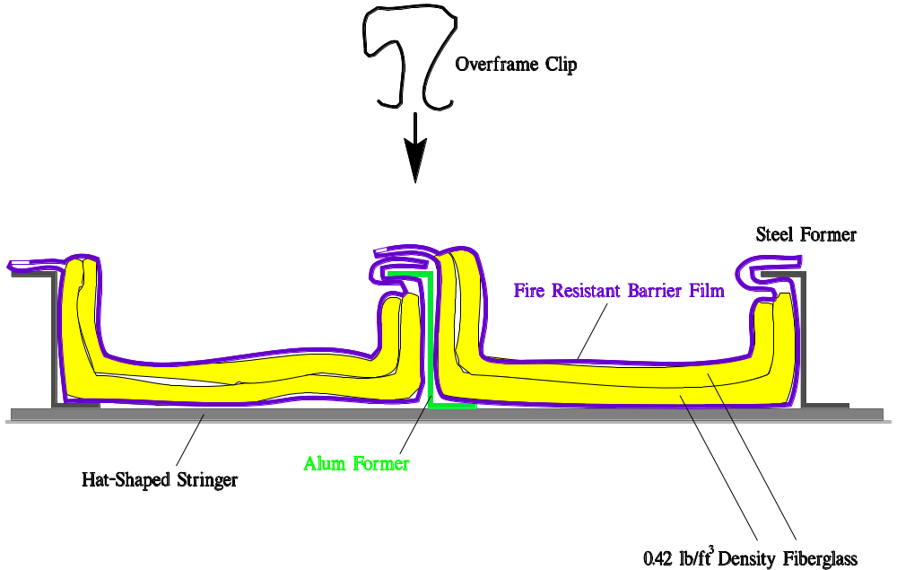

Slide 21
