Slide 1
Optimizing Bandwidth Limited Problems Using One-Sided Communication and Overlap
Christian Bell^{1,2}, Dan Bonachea¹,
Rajesh Nishtala¹, and Katherine Yelick^{1,2}
¹UC Berkeley, Computer Science Division
²Lawrence Berkeley National Laboratory

Slide 2
Conventional Wisdom
Send few, large messages
  Allows the network to deliver the most effective bandwidth
Isolate computation and communication phases
  Uses bulk-synchronous programming
  Allows for packing to maximize message size
Message passing is preferred paradigm for clusters
Global Address Space (GAS) Languages are primarily useful for latency sensitive applications
GAS Languages mainly help productivity
  However, not well known for their performance advantages

Slide 3
Our Contributions
Increasingly, cost of HPC machines is in the network
One-sided communication model is a better match to modern networks
  GAS Languages simplify programming for this model
How to use these communication advantages
  Case study with NAS Fourier Transform (FT)
  Algorithms designed to relieve communication bottlenecks
    Overlap communication and computation
    Send messages early and often to maximize overlap

Slide 4
UPC Programming Model
Global address space: any thread/process may directly read/write data allocated by another
Partitioned: data is designated as local (near) or global (possibly far); programmer controls layout
Global arrays:
Allows any processor to directly access data on any other processor
shared
g:
g:
private
g:
l:
l:
l:
Proc 0
Proc 1
Proc n-1
3 of the current languages: UPC, CAF, and Titanium
  Emphasis in this talk on UPC (based on C)
  However programming paradigms presented in this work are not limited to UPC

Slide 5
Advantages of GAS Languages
Productivity
  GAS supports construction of complex shared data structures
  High level constructs simplify parallel programming
  Related work has already focused on these advantages
Performance (the main focus of this talk)
  GAS Languages can be faster than two-sided MPI
  One-sided communication paradigm for GAS languages more natural fit to modern cluster networks
  Enables novel algorithms to leverage the power of these networks
  GASNet, the communication system in the Berkeley UPC Project, is designed to take advantage of this communication paradigm

Slide 6
One-Sided vs Two-Sided
one-sided put (e.g., GASNet)
host
CPU
dest. addr.
data payload
network
interface
two-sided message (e.g., MPI)
memory
message id
data payload
A one-sided put/get can be entirely handled by network interface with RDMA support
  CPU can dedicate more time to computation rather than handling communication
A two-sided message can employ RDMA for only part of the communication
  Each message requires the target to provide the destination address
  Offloaded to network interface in networks like Quadrics
RDMA makes it apparent that MPI has added costs associated with ordering to make it usable as a end-user programming model

Slide 7
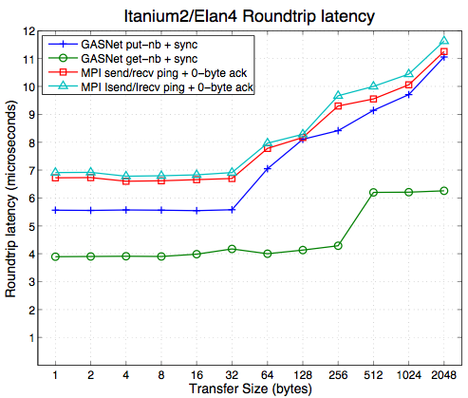
Latency Advantages
Comparison:
  One-sided:
    Initiator can always transmit remote address
    Close semantic match to high bandwidth, zero-copy RDMA
  Two-sided:
    Receiver must provide destination address
Latency measurement correlates to software overhead
  Much of the small-message latency is due to time spent in software/firmware processing
down is good
One-sided implementation consistently outperforms 2-sided counterpart

Slide 8
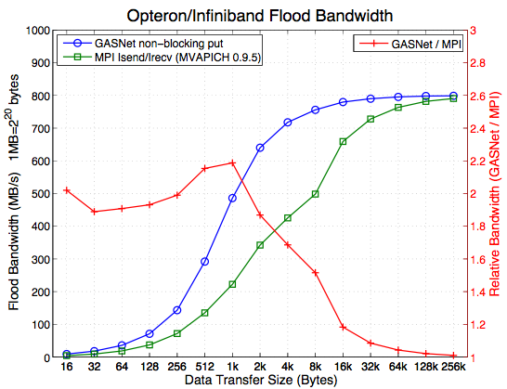
Bandwidth Advantages
One-sided semantics better match to RDMA supported networks
  Relaxing point-to-point ordering constraint can allow for higher performance on some networks
  GASNet saturates to hardware peak at lower message sizes
  Synchronization decoupled from data transfer
MPI semantics designed for end user
  Comparison against good MPI implementation
  Semantic requirements hinder MPI performance
  Synchronization and data transferred coupled together in message passing
up is good
Over a factor of 2 improvement
for 1kB messages

Slide 9
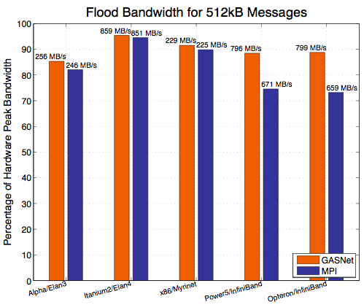
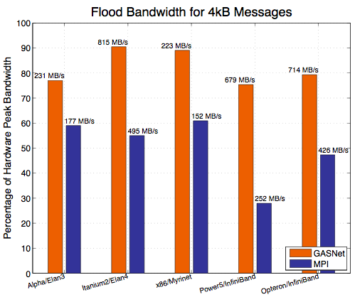
Bandwidth Advantages (cont)
GASNet and MPI saturate to roughly the same bandwidth for “large” messages
GASNet consistently outperforms MPI for “mid-range” message sizes
up is good

Slide 10
A Case Study: NAS FT
How to use the potential that the microbenchmarks reveal?
Perform a large 3 dimensional Fourier Transform
  Used in many areas of computational sciences
    Molecular dynamics, computational fluid dynamics, image processing, signal processing, nanoscience, astrophysics, etc.
Representative of a class of communication intensive algorithms
  Sorting algorithms rely on a similar intensive communication pattern
  Requires every processor to communicate with every other processor
  Limited by bandwidth

Slide 11
Performing a 3D FFT
NX x NY x NZ elements spread across P processors
Will Use 1-Dimensional Layout in Z dimension
  Each processor gets NZ / P “planes” of NX x NY elements per plane
Example: P = 4
NZ
1D Partition
NZ/P
NX
p3
p2
NY
p1
p0

Slide 12
Performing a 3D FFT (part 2)
Perform an FFT in all three dimensions
With 1D layout, 2 out of the 3 dimensions are local while the last Z dimension is distributed
Step 1: FFTs on the columns
(all elements local)
Step 2: FFTs on the rows
(all elements local)
Step 3: FFTs in the Z-dimension
(requires communication)

Slide 13
Performing the 3D FFT (part 3)
Can perform Steps 1 and 2 since all the data is available without communication
Perform a Global Transpose of the cube
  Allows step 3 to continue
Transpose

Slide 14
The Transpose
Each processor has to scatter input domain to other processors
  Every processor divides its portion of the domain into P pieces
  Send each of the P pieces to a different processor
Three different ways to break it up the messages
  Packed Slabs (i.e. single packed “Alltoall” in MPI parlance)
  Slabs
  Pencils
An order of magnitude increase in the number of messages
An order of magnitude decrease in the size of each message
“Slabs” and “Pencils” allow overlapping communication and computation and leverage RDMA support in modern networks

Slide 15
Algorithm 1: Packed Slabs
Example with P=4, NX=NY=NZ=16
Perform all row and column FFTs
Perform local transpose
  data destined to a remote processor are grouped together
Perform P puts of the data
put to proc 0
put to proc 1
put to proc 2
put to proc 3
Local transpose
For 512³ grid across 64 processors
  Send 64 messages of 512kB each

Slide 16
Bandwidth Utilization
NAS FT (Class D) with 256 processors on Opteron/InfiniBand
  Each processor sends 256 messages of 512kBytes
  Global Transpose (i.e. all to all exchange) only achieves 67% of peak point-to-point bidirectional bandwidth
  Many factors could cause this slowdown
    Network contention
    Number of processors that each processor communicates with
Can we do better?

Slide 17
Algorithm 2: Slabs
Waiting to send all data in one phase bunches up communication events
Algorithm Sketch
  for each of the NZ/P planes
    Perform all column FFTs
    for each of the P “slabs”
    (a slab is NX/P rows)
      Perform FFTs on the rows in the slab
      Initiate 1-sided put of the slab
  Wait for all puts to finish
  Barrier
Non-blocking RDMA puts allow data movement to be overlapped with computation.
Puts are spaced apart by the amount of time to perform FFTs on NX/P rows
plane 0
put to proc 0
put to proc 1
put to proc 2
put to proc 3
Start computation
for next plane
For 512³ grid across 64 processors
  Send 512 messages of 64kB each

Slide 18
Algorithm 3: Pencils
Further reduce the granularity of communication
  Send a row (pencil) as soon as it is ready
Algorithm Sketch
  For each of the NZ/P planes
    Perform all 16 column FFTs
    For r=0; r<NX/P; r++
      For each slab s in the plane
        Perform FFT on row r of slab s
        Initiate 1-sided put of row r
  Wait for all puts to finish
  Barrier
Large increase in message count
Communication events finely diffused through computation
  Maximum amount of overlap
  Communication starts early
plane 0
0
0
0
0
1
1
1
1
2
2
2
2
3
3
3
3
Start computation
for next plane
For 512³ grid across 64 processors
  Send 4096 messages of 8kB each

Slide 19
Communication Requirements
512³ across 64 processors
  Alg 1: Packed Slabs
    Send 64 messages of 512kB
  Alg 2: Slabs
    Send 512 messages of 64kB
  Alg 3: Pencils_x0010_
    Send 4096 messages of 8kB
With Slabs GASNet is slightly faster than MPI
GASNet achieves close to peak bandwidth with Pencils but MPI is about 50% less efficient at 8k
With the message sizes in Packed Slabs both comm systems reach the same peak bandwidth

Slide 20
Platforms
Name | Processor | Network | Software
Opteron/Infiniband “Jacquard” @ NERSC | Dual 2.2 GHz Opteron (320 nodes @ 4GB/node) | Mellanox Cougar InfiniBand 4x HCA | Linux 2.6.5, Mellanox VAPI, MVAPICH 0.9.5, Pathscale CC/F77 2.0
Alpha/Elan3 “Lemieux” @ PSC | Quad 1 GHz Alpha 21264 (750 nodes @ 4GB/node) | Quadrics QsNet1 Elan3 /w dual rail (one rail used) | Tru64 v5.1, Elan3 libelan 1.4.20, Compaq C V6.5-303, HP Fortra Compiler X5.5A-4085-48E1K
Itanium2/Elan4 “Thunder” @ LLNL | Quad 1.4 Ghz Itanium2 (1024 nodes @ 8GB/node) | Quadrics QsNet2 Elan4 | Linux 2.4.21-chaos, Elan4 libelan 1.8.14, Intel ifort 8.1.025, icc 8. 1.029
P4/Myrinet “FSN” @ UC Berkeley Millennium Cluster | Dual 3.0 Ghz Pentium 4 Xeon (64 nodes @ 3GB/node) | Myricom Myrinet 2000 M3S-PCI64B | Linux 2.6.13, GM 2.0.19, Intel ifort 8.1-20050207Z, icc 8.1-20050207Z

Slide 21
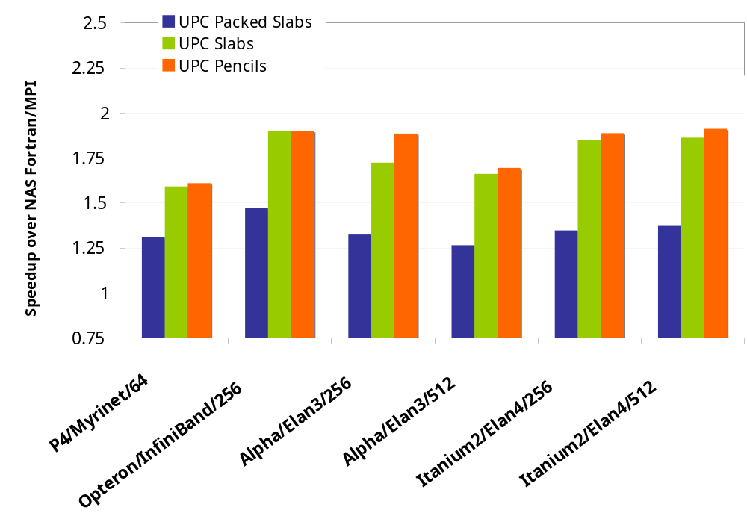
Comparison of Algorithms
Compare 3 algorithms against original NAS FT
  All versions including Fortran use FFTW for local 1D FFTs
  Largest class that fit in the memory (usually class D)
All UPC flavors outperform original Fortran/MPI implantation by at least 20%
  One-sided semantics allow even exchange based implementations to improve over MPI implementations
  Overlap algorithms spread the messages out, easing the bottlenecks
  ~1.9x speedup in the best case
up is good

Slide 22
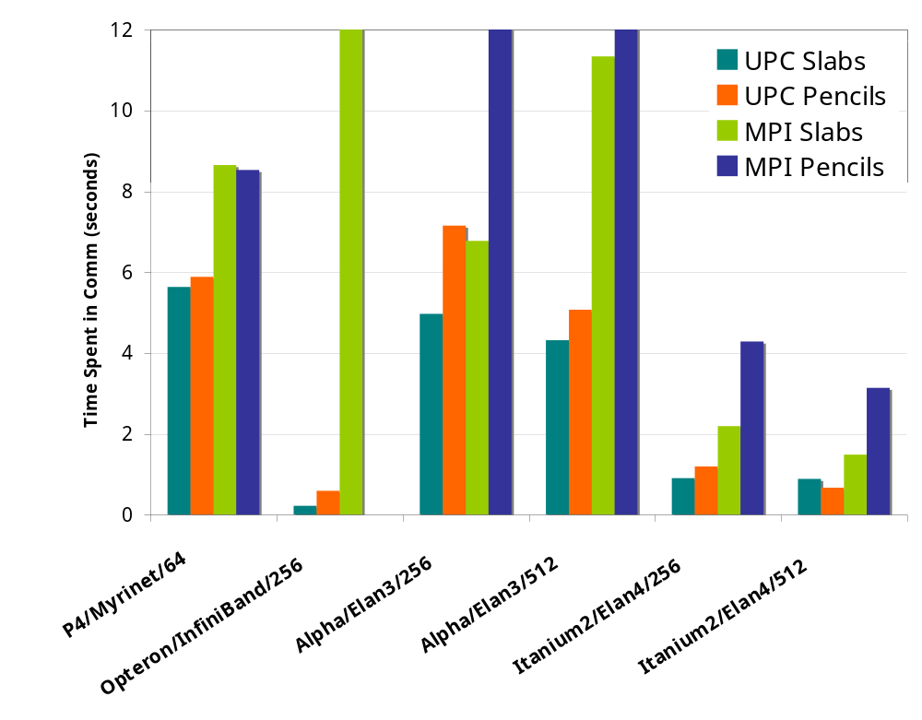
Time Spent in Communication
Implemented the 3 algorithms in MPI using Irecvs and Isends
Compare time spent initiating or waiting for communication to finish
  UPC consistently spends less time in communication than its MPI counterpart
  MPI unable to handle pencils algorithm in some cases
312.8
34.1
28.6
MPI Crash (Pencils)
down is good

Slide 23
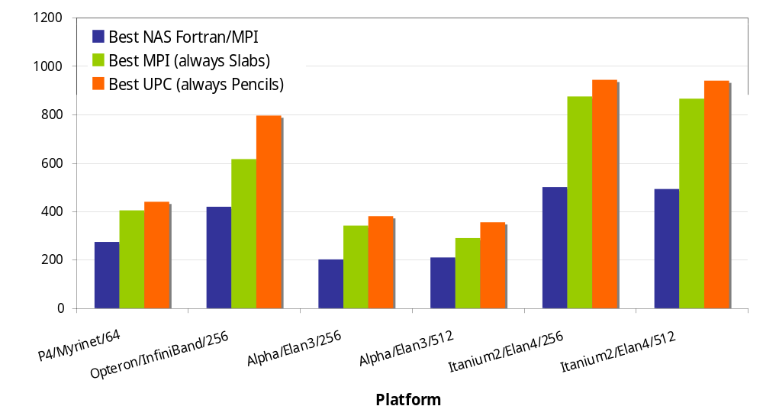
Performance Summary
MFLOPS / Proc
up is good

Slide 24
Conclusions
One-sided semantics used in GAS languages, such as UPC, provide a more natural fit to modern networks
  Benchmarks demonstrate these advantages
Use these advantages to alleviate communication bottlenecks in bandwidth limited applications
  Paradoxically it helps to send more, smaller messages
Both two-sided and one-sided implementations can see advantages of overlap
  One-sided implementations consistently outperform two-sided counterparts because comm model more natural fit
Send early and often to avoid communication bottlenecks

Slide 25
Try It!
Berkeley UPC is open source
  Download it from http://upc.lbl.gov
  Install it with CDs that we have here

Slide 26
Contact Us
Associated Paper: IPDPS ‘06 Proceedings
Berkeley UPC Website: http://upc.lbl.gov
GASNet Website: http://gasnet.cs.berkeley.edu
Authors
  Christian Bell
  Dan Bonachea
  Rajesh Nishtala
  Katherine A. Yelick
  Email us:
    upc@lbl.gov
  Special thanks to the fellow members of the Berkeley UPC Group
    Wei Chen
    Jason Duell
    Paul Hargrove
    Parry Husbands
    Costin Iancu
    Mike Welcome

