Slide 1
The Photometric Calibration of the DES
Douglas L. Tucker
(FNAL)
Joint DOE/NSF Review of DES
29-31 January 2008

Slide 2
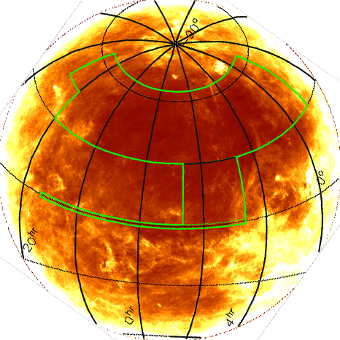
Basic Observing Strategy
Survey Area
Overlap with
South Pole
Telescope
Survey
(4000 sq deg)
Observing Strategy
100 sec exposures
2 filters per pointing (typically)
  gr in dark time
  iZ in bright time
  Y filter
Multiple tilings/overlaps to optimize photometric calibrations
2 survey tilings/filter/year
All-sky photometric accuracy
  Requirement: 2%
  Goal: 1%
Connector
region
(800 sq deg)
J. Annis
Overlap with SDSS equatorial
Stripe 82 for calibration (200 sq deg)
Total Area: 5000 sq deg

Slide 3
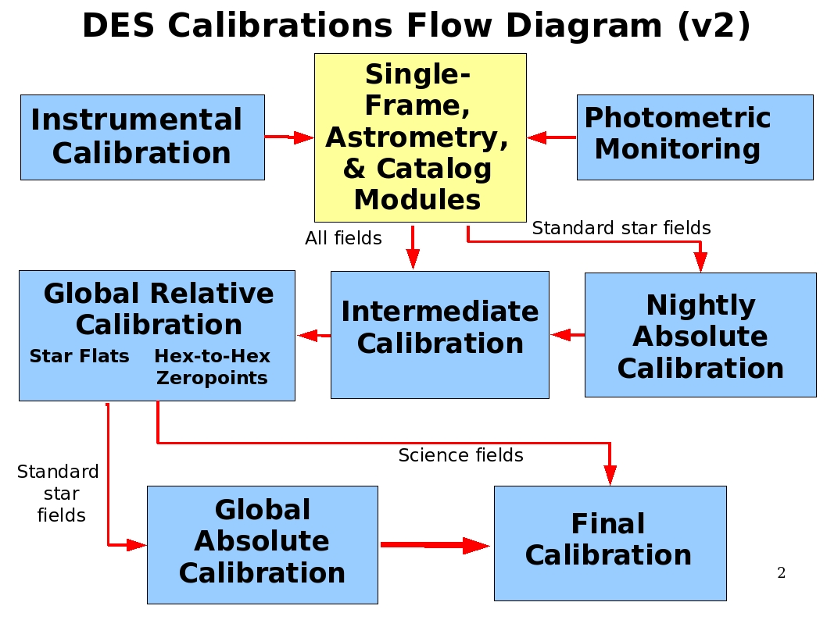
Spectro-
photometric
standard
stars

Slide 4
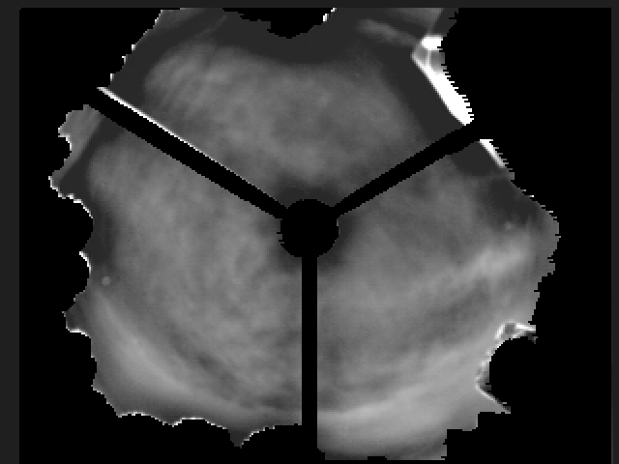
Photometric Monitoring
10 micron All-Sky Camera
Provides real-time estimates of sky conditions for survey strategy
Provides a measure of the photometric quality of an image for off-line processing
Detects even light cirrus under a full range of moon phases (no moon to full moon)
For more details, see the presentation on the Sky Camera during the SISPI Breakout Session.
APO 10 micron all-sky camera

Slide 5
Nightly Absolute Calibration
(Evolving) Standard Star Observation Strategy:
Observe 3 standard star fields, each at a different airmass (X=1-2), between nautical (12°) and astronomical (18°) twilight (evening and morning).
Observe up to 3 more standard fields (at various airmasses) throughout the night
Also can observe standard star fields when sky is photometric but seeing is too poor for science imaging (seeing > 1.1 arcsec)
Use fields with multiple standard stars
Keep an eye on the photometricity monitors
Nightly Absolute Calibration Strategy:
Calibrate to the DES griZY “natural” system
  In theory, no system response color terms in the photometric equations
  In practice, there may be small (1-2%) color terms over the focal plane and over time
  Avoids coupling science images obtained in different filters (to first order)
Use u’g’r’i’z’ and ugriz standards transformed to the DES griZ “natural” system
  SDSS g’r’i’(z’) and gri(z) are similar to DES griZ, so transformations should be well behaved
Use or create Y band standards
  UKIDSS observations in SDSS Stripe 82? VHS Y-band standards?
  Synthetic magnitudes of hot white dwarfs in SDSS Stripe 82?

Slide 6
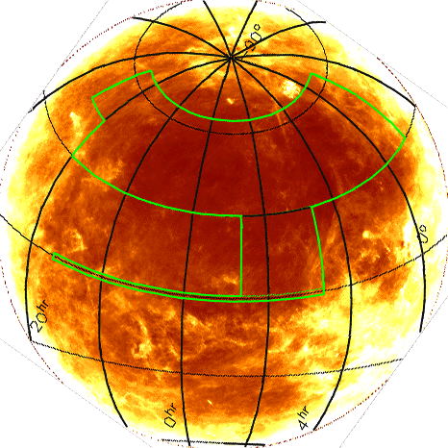
Nightly Absolute Calibration:
SDSS Stripe 82 ugriz Standards
Already part of the DES survey strategy.
Readily observable at a range of airmasses throughout most nights during the DES program.
2.5° wide (compares favorably with DECam's FOV (≈2.2°).
Value-added catalogue of tertiary standards is being made
  Area of Stripe 82 has been observed by SDSS > 10x under photometric conditions
  ~ 1 million tertiary SDSS ugriz standards (r = 14.5 - 21)!
  ~ 4000 per sq deg (on average)
  See Ivezić et al. (2007)

Slide 7
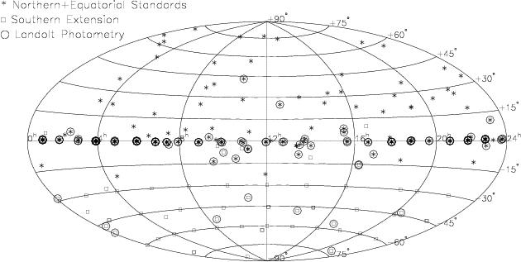
Nightly Absolute Calibration:
Southern u’g’r’i’z’ Standards
Smith, Allam, Tucker, Stute, Rodgers, Stoughton
13.5' x 13.5' fields, typically tens of stds. per field
r = 9 - 18, ~60 fields, ~16,000 standards
stars as bright as r≈13 can likely be observed by DECam with 5+ second exposures under conditions of poor seeing or with de-focusing (FWHM=1.5”).
http://www-star.fnal.gov/Southern_ugriz/
(Others: SkyMapper standards? VST OmegaCam standards? Stars from PanSTARRS-1 3π survey?)

Slide 8
Nightly Absolute Calibration:
The Photometric Standards Module (PSM)
The PSM is basically a big least squares solver, fitting the observed magnitudes of a set of standard stars to their “true” magnitudes via a simple model (photometric equation); e.g.:
  m_{inst} - m_{std} = a_{n} + kX (1)
    m_{inst} is the instrumental magnitude, m_{inst} = -2.5log(counts/sec) (input)
    m_{std} is the standard (“true”) magnitude of the standard star (input)
    a_{n} is the photometric zeropoint for CCD n (n = 1-62) (output)
    k is the first-order extinction (input/output)
    X is the airmass (input)
A refinement: add an instrumental color term for each CCD to account for small differences between the standard star system and the natural system of that CCD:
  m_{inst} - m_{std} = a_{n} + b_{n} x (stdColor ‒ stdColor₀) + kX (2)
    b_{n} is the instrumental color term coefficient for CCD n (n = 1-62) (input/output)
    stdColor is a color index, e.g., (g-r) (input)
    stdColor₀ is a constant (a fixed reference value for that passband) (input)
    DES calibrations will be in the DECam natural system
      Even if SDSS Stripe 82 ugriz and Smith et al. Southern u’g’r’i’z’ standards are “pre-transformed” to the DES system, eq. 2 is still useful for track changes in DECam instrumental response across the focal plane and over time

Slide 9
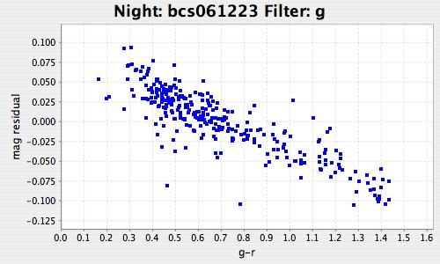
Blanco Cosmology Survey, Fixing b’s to 0
(rms=0.041 mag, χ²/ν=4.24)

Slide 10
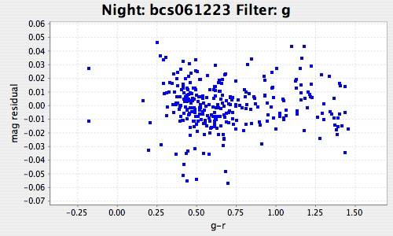
Blanco Cosmology Survey, Solving for b’s
(rms=0.017 mag, χ²/ν=0.74)

Slide 11
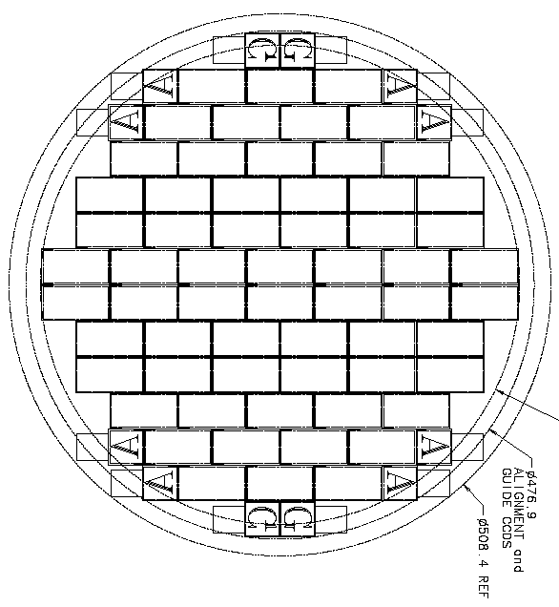
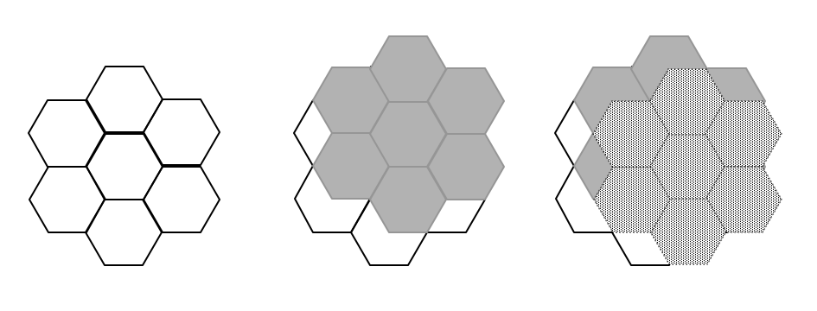
Global Relative Calibrations:
Hex-to-Hex Zeropoint Offsets
We cover the sky twice per year per filter. This is called tiling.
It takes ~1700 hexes to tile the whole survey area.
Recipe:
Tile the plane
Then, tile the plane with hex offset half hex over and up
This gives 30% overlap with three hexagons
Repeat, with different offsets
■ Large overlaps provide very robust hex-to-hex relative calibrations
■ Similar to PanStarrs strategy
DECam Focal Plane:
“The Hex”
1 tiling
2 tilings
3 tilings
Jim Annis
DES Collaboration Meeting,
May 5-7, 2005

Slide 12
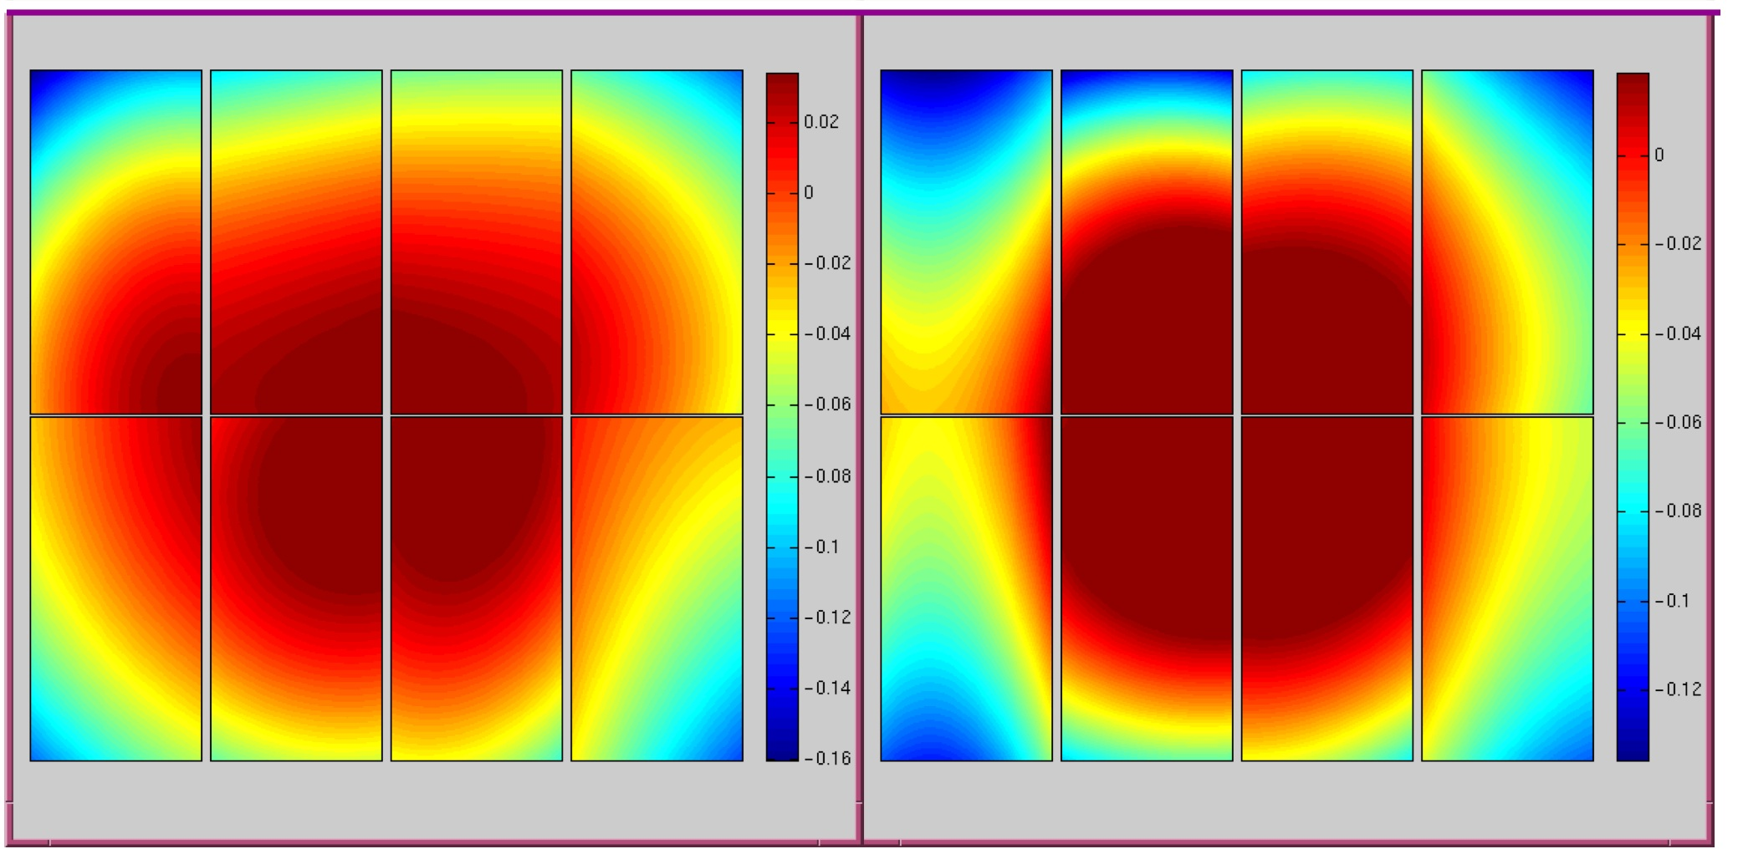
Global Relative Calibrations:
Star Flats
Due to vignetting and stray light, a detector’s response function differs for point sources and extended sources
Standard flat fields (domes, twilights, skies) may flatten an image sky background well, but not the stellar photometry
The solution: star flats (Manfroid 1995)
  offset a field (like an open cluster) multiple times and fit a spatial function to the magnitude differences for matched stars from the different exposures
  can also just observe a well-calibrated field once (Manfroid 1996)
R
V
Koch et al. 2004, ESO WFI star flats based on SDSS Stripe 82 observations (2nd order polynomial fits)
Δmag = -0.16 → +0.03
Δmag = -0.14 → +0.02

Slide 13
Global Relative Calibrations:
The Global Calibrations Module (GCM)
GCM Zeropoint Solver Code
Uses matrix inversion algorithm developed by Glazebrook et al. (1994) and used by MacDonald et al (2004).
Written in Java
Uses cern.colt.matrix
Input: An ASCII table of all unique star matches in the overlap regions
Output: The ZP offsets to be applied to each field, the rms of the solution, and QA plots
GCM Star Flat Code
Basic prototype code developed in the SDSS software environment (Tcl/C)
Future version in Java
Currently assumes the star flat correction is a purely radial, 3rd order polynomial
For more details, see the talk on
Global Photometric Calibration
during the Wednesday morning
Data Management Breakout Session

Slide 14
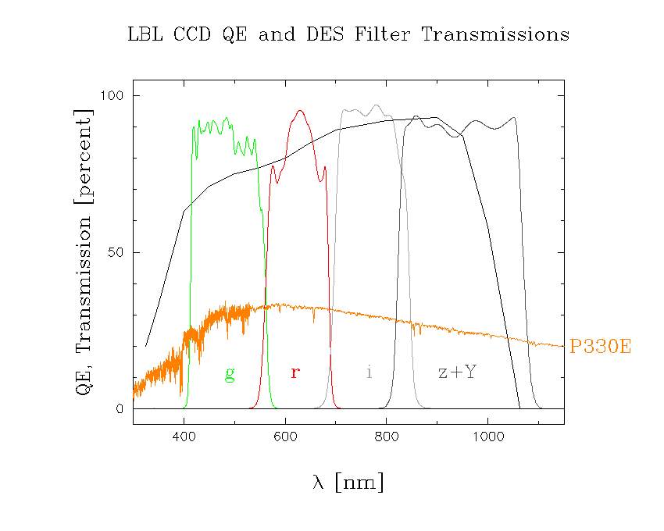
Global Absolute Calibration and
Final Calibration
Global Absolute Calibration
Compare the synthetic magnitudes to the measured magnitudes of one or more spectrophotometric standard stars observed by the DECam.
The differences are the zeropoint offsets needed to tie the DES mags to an absolute flux in physical units (e.g., ergs s⁻¹ cm⁻² Å⁻¹).
Absolute calibration requires accurately measured total system response for each filter passband as well as one or more well calibrated spectrophotometric standard stars.
Final Calibration
Apply the magnitude zeropoint offsets to all the catalog data.

Slide 15
Spectro-
photometric
standard
stars

Slide 16
Extra Slides

Slide 17
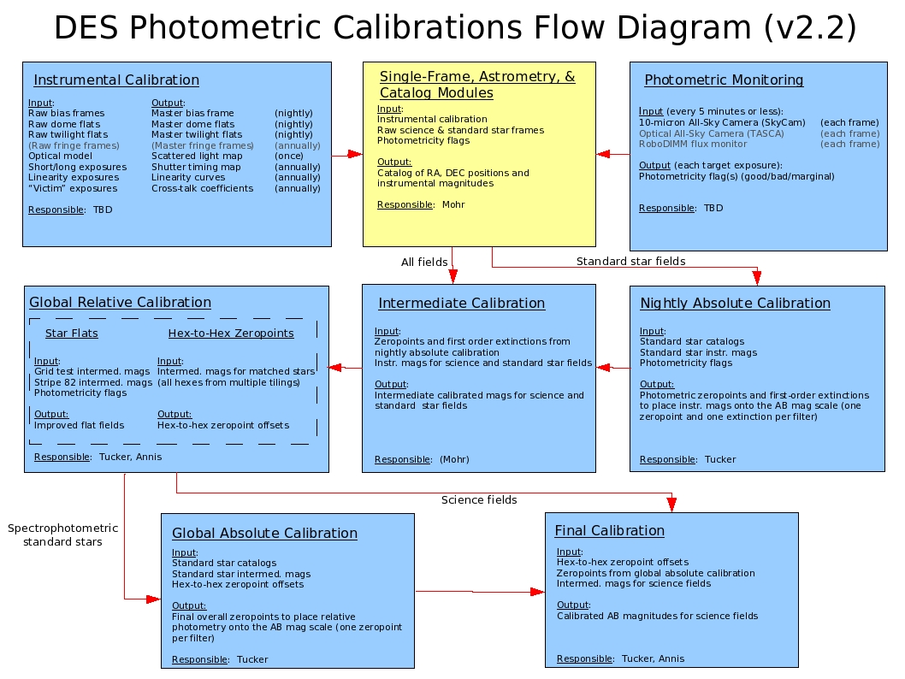

Slide 18
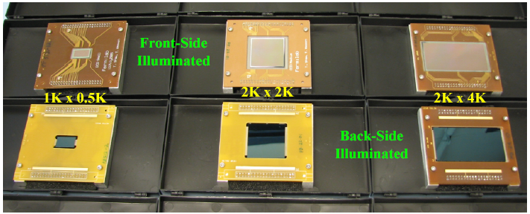
2008A NOAO Proposal
Title: Engineering Tests and Initial Calibration of DECam CCDs
PI: Darren DePoy, CoIs: Ricardo Schmidt, Douglas Tucker, Brenna Flaugher
Telescope: CTIO SMARTS 1m telescope
Instrument: DECam 2kx2k CCD
Filters: DES g, r, i, z, Z, Y, and a 0.93-0.96μ H₂0 absorption feature filter
Goals: on-sky tests and calibration of the DECam CCDs and DES filters, refine definition of DES z/Z and Y filter, initial search and calibration of DES z/Z and Y-band standards
Dates: 9-15 April 2008

Slide 19
Nightly Absolute Calibration:
The Photometric Standards Module
Written in Java
Uses the cern.colt.matrix Java classes
Interacts directly with the database:
    Queries stars in standard star fields to match with photometric standards
    Ingests solutions back to database
Solves for photometric zeropoints (“a_{n}”) and instrumental color term (“b_{n}”) coefficients for all n CCDs simultaneously:
m_{inst} - m_{std} = a₁ + … + a₆₂ + b₁×(color-color₀) + … + b₆₂× (color-color₀) + kX
    Option to set k to a fixed value rather than to solve for it
    Option to set all b_{n}’s to a single fixed value rather than to solve for them
Outputs QA plots of the fits to the photometric solution.
Tested in Data Challenges 1, 2, and 3
Is a nearly finished product
    Still need to implement the option ability to fix individual photometric zeropoints (“a_{n}”) and/or individual instrumental color term (“b_{n}”) coefficients

Slide 20
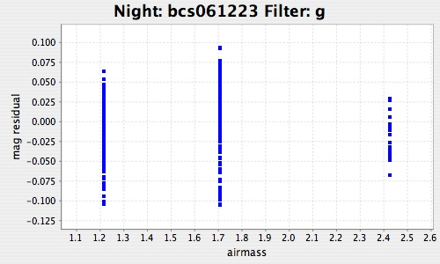
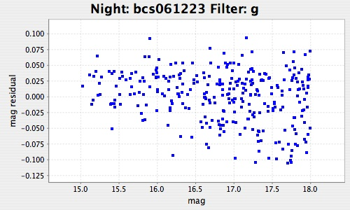
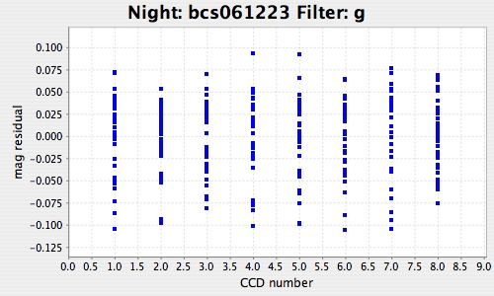
Blanco Cosmology Survey, Fixing b’s to 0
(rms=0.041 mag, χ²/ν=4.24)

Slide 21
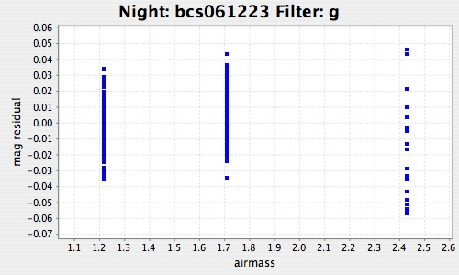
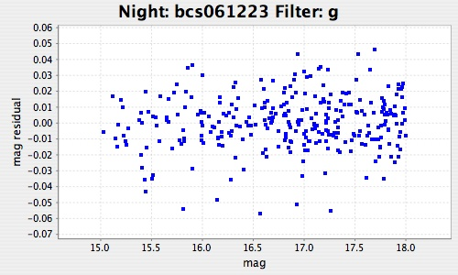
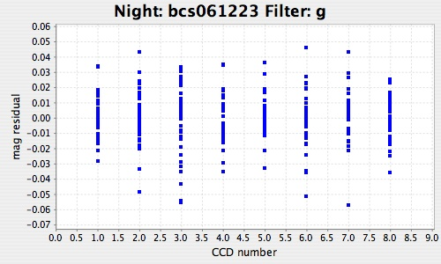
Blanco Cosmology Survey, Solving for b’s
(rms=0.017 mag, χ²/ν=0.74)

Slide 22
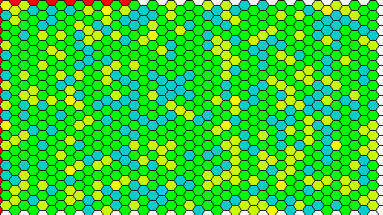
Global Relative Calibrations:
Simulation
INSTRUMENT MODEL:
A multiplicative flat field gradient of amplitude 3% from east to west
An additive scattered light pattern with a amplitude from the optical axis, 3% at the edge of the camera
An additive 3% rms scattered light per CCD
Solution:
Simultaneous least squares solution to the underlying relative photometry given the observations
scaling bar is –0.20 mags to +0.20 mags
Relative Calibration
Tiling
σ (rms of hex ZPs)
1
0.035
2
0.018
Jim Annis
DES Collaboration Meeting,
May 5-7, 2005
5
0.010

Slide 23
Global Calibration Module :
Global Relative Calibrations
Method used by Oxford-Dartmouth Thirty Degree Survey (MacDonald et al. 2004)
Developed by Glazebrook et al. (1994) for an imaging K-band survey
1
4
3
2
6
5
Example:
Frames 5 & 6 are calibrated.
The others are uncalibrated.
Consider n frames, of which (1, …, m) are calibrated and (m+1,…,n) are uncalibrated.
Let Δ_{ij} = <mag_{i} - mag_{j}>_{pairs} (note Δ_{ij} = - Δ_{ji}).
Let ZP_{i} be the floating zero-point of frame i, with ZP_{i} = 0 if i > m.
Let θ_{ij} = 1 if frames i and j overlap or if i = j; otherwise let θ_{ij} = 0.
Minimize S = ΣΣ θ_{ij} (Δ_{ij} + ZP_{i} - ZP_{j} )²

Slide 24
Global Calibration Module :
Global Relative Calibrations
1
4
Example:
Frames 5 & 6 are calibrated.
The others are uncalibrated.
(From Glazebrook et al. 1994)
3
2
6
5
-2 | 1 | 0 | 0 | 0 | 1
1 | -2 | 0 | 0 | 0 | 1
0 | 0 | -1 | 1 | 0 | 0
0 | 0 | 1 | -2 | 1 | 0
0 | 0 | 0 | 0 | 1 | 0
0 | 0 | 0 | 0 | 0 | 1
ZP1
ZP2
ZP3
ZP4
ZP5
ZP6
Δ₁₂ + Δ₁₆
Δ₂₁ + Δ₂₆
Δ₃₄
Δ₄₃ + Δ₄₅
0
0
x
=

Slide 25
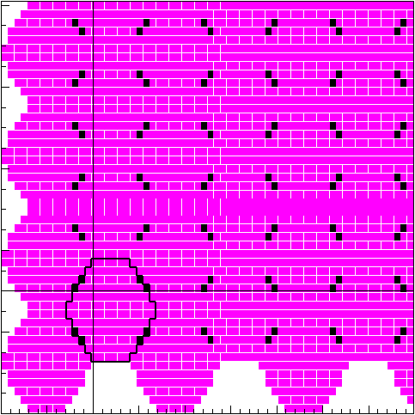
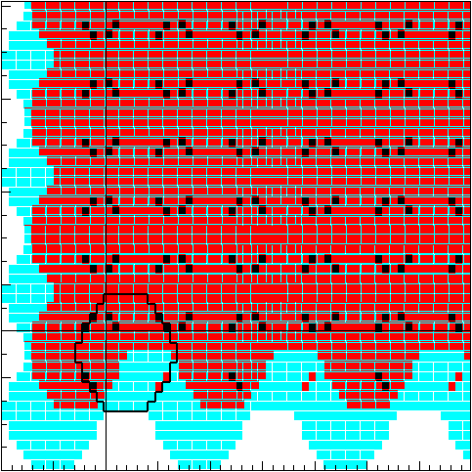
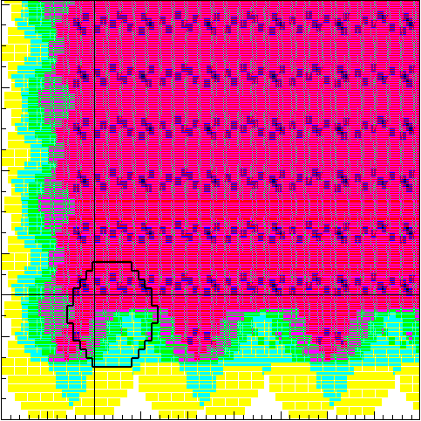
Global Calibration Module :
Global Relative Calibrations
GCM Zeropoint Solver Code
Uses matrix inversion algorithm developed by Glazebrook et al. (1994) and used by MacDonald et al (2004).
Written in Java
Uses cern.colt.matrix
Input: An ASCII table of all unique star matches in the overlap regions
Output: The ZP offsets to be applied to each field, the rms of the solution, and QA plots
For more details, see the talk on Global Photometric Calibration during the Wednesday morning Data Management Breakout Session
1 tiling
2 tilings
3 tilings

Slide 26
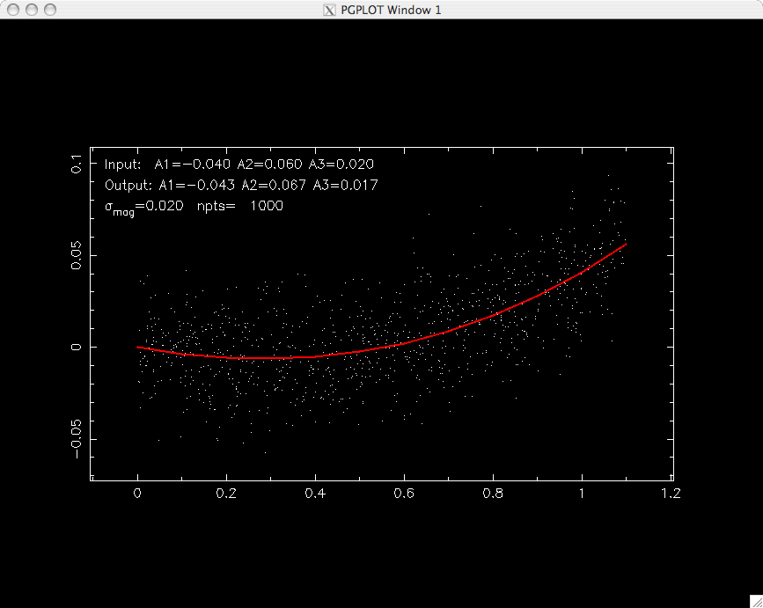
Global Relative Calibrations:
Prototype Star Flat Code
GCM Star Flat Code
Basic prototype code developed in the SDSS software environment (Tcl/C)
Future version in Java
Currently assumes the star flat correction is a purely radial, 3rd order polynomial
Input: Δmag = -0.040r + 0.060r² + 0.020r³
Data Points: σ = 0.020 mag, n_{pts} = 1000
+0.10
Δmag
-0.05
0.0
1.2
Radial distance from center of focal plane, r [deg]
Output: Δmag = -0.043r + 0.067r² + 0.017r³

Slide 27
Global Absolute Calibration
Need:
  one or more spectrophotometric standard stars which have been calibrated (directly or indirectly) to a NIST standard source
  an accurately measured total system response for each filter passband for at least one CCD
    filter transmissions, CCD QE, optical throughput, atmospheric transmission
Calculate the expected photon flux F_{exp} for each std star in each filter passband (synthetic photometry)
Measure the magnitude for each standard star in each filter passband with the Blanco+DECam
Calculate the zeropoint zp via the relation,
  10**[-0.4*(mag – zp)] = F_{exp}

Slide 28
Global Absolute Calibration:
Spectrophotomeric Standards
~100 Hot White Dwarfs (DA) in SDSS Stripe 82 (r=16-21)
  Need to know temperature and log g for “true” SED (models)
  Need high-resolution spectroscopy (ground-based) + modelling?
  These set an absolute color scale
LDS 749B (DES Fundamental Calibrator?)
  In SDSS Stripe 82 (RA=21:32:16.24, DEC=+00:15:14.7; r=14.8)
  In HST CalSpec database (STIS observations + model)
  Sets the absolute flux scale relative to Vega (i.e., Vega taken as “truth”)
Others
  E.g, G158-100, GD50, GD 71, G162-66
  All are HST WD spectrophotometric standards
  All are visible from CTIO
  All are V> 13.0 (won’t saturate DECam at an exposure time of 5 sec (FWHM ~ 1.5”)

